Slide 1
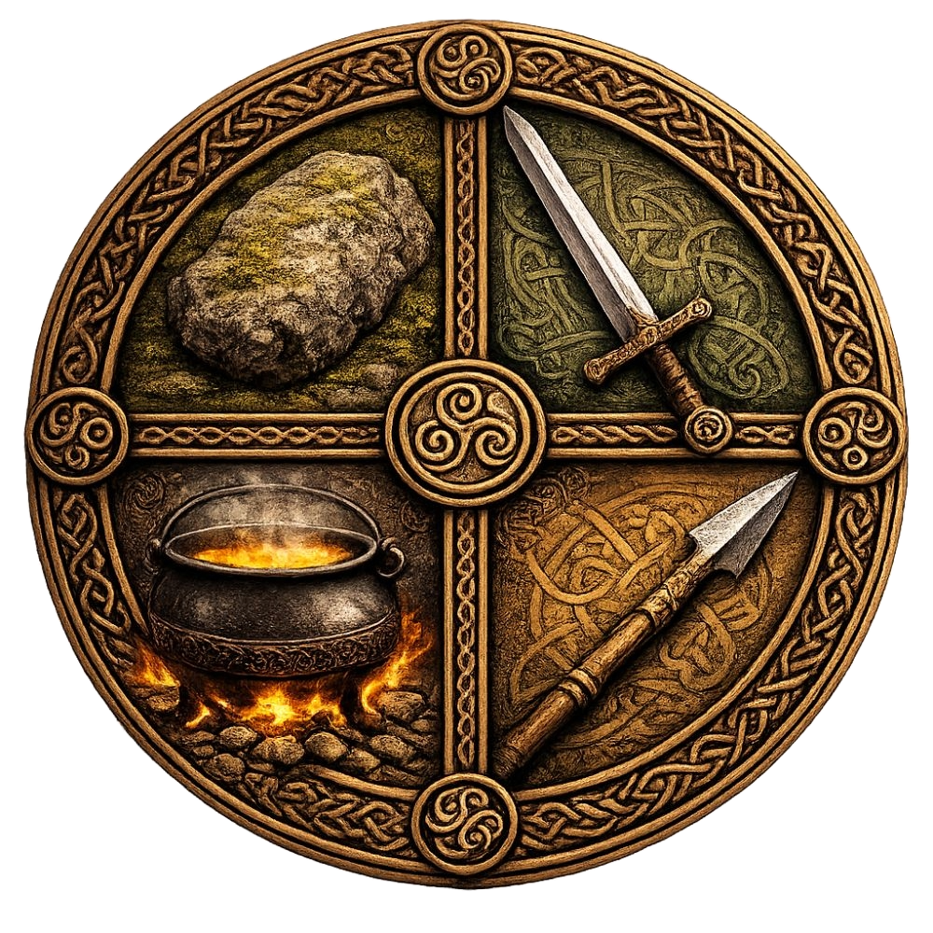
The Four Talismans:
Devotion, Initiation, and Magic
Dr. Robert Patrick

Slide 2
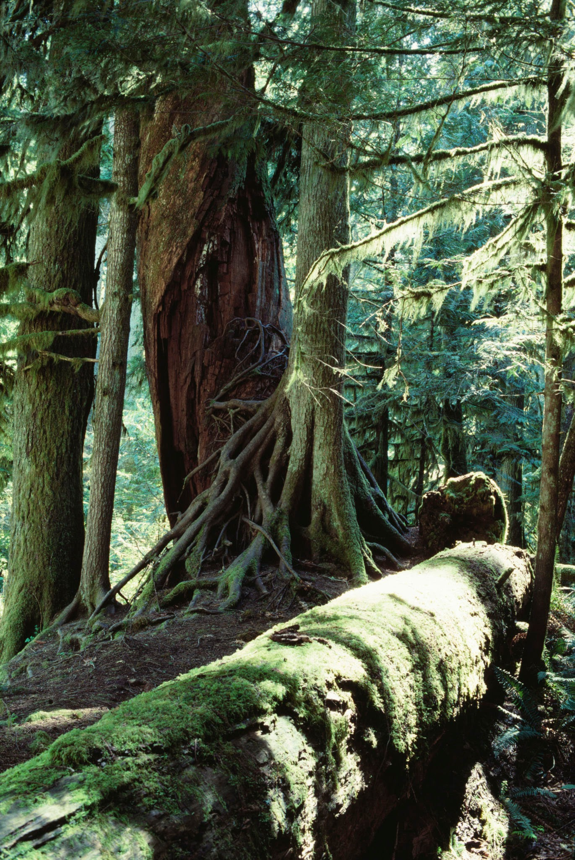
What’s your story?
The stories we participate in
My story
This story: and they sailed to the north to study magic
  Cath Maige Tuired
  Tuatha De Danann
  Magic: an art of change (Aidan Wachter)
Talisman
What if this is a paradigm for working magic in our lives, for the world?
Visit each city, Druid, talisman, story connections, guided meditations, and see what we are invited to work with.

Slide 3
The North
--Falias
--Morfesa
--The Stone of Fal
Fal--hedge, fence, creation of boundaries
Mor--great
fis--knowledge

Slide 4
The East
--Findias (finn,find): white, bright, lustrous, fair-haired
--Semias: transparent, rarified, air
--The Sword of Nuadu: truth, fairness, justice, guardian of the community and values

Slide 5
The South
Gorias: fire, heat, transformative, creative
Esras: outlet, means, opportunity, passage
Spear of Lug: gifts and skills

Slide 6
The West
Murias: (muir) the sea
Uiscias: (uisce) water
The Cauldron of the Dagda:
Abundance, life and death

Slide 7
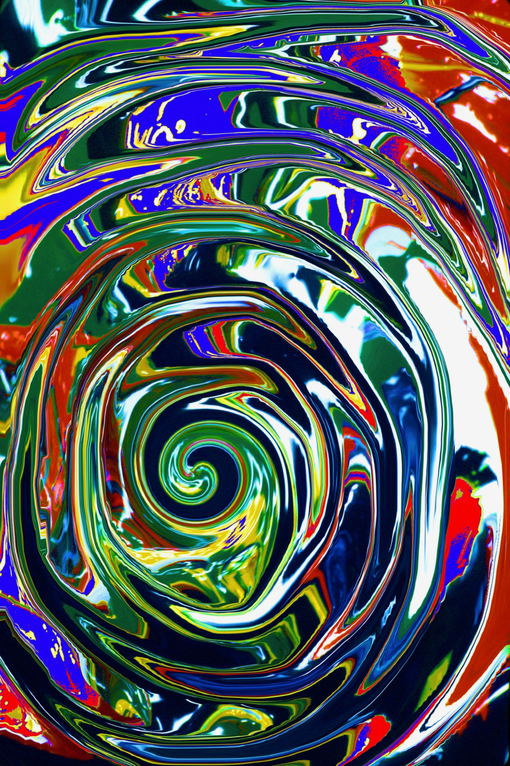
The Center
What are you bringing to your center?
Review your notes
The Stone: what has been given to you as grounding, boundaries, safe space that you can return to?
The Sword: what is light and life giving to you?
The Spear: what are gifts you claim for yourself and those still waiting?
The Cauldron: Can you feel abundance beginning to surround you?

Slide 8
Ways to get it:
The Sojourner book table, 20.00 cash or Venmo
Amazon, 19.99
What’s in the book?
How this became a story for me
Personal stories throughout the book
Each talisman: research, meaning, spiritual exploration
Devotional practice, script, commentary
An initiatory exploration and process
Working magice: a starting place
A mystic’s theology
My version of the story

