Slide 1
Tarot 201
A Further Exploration of
The Practice

Slide 2
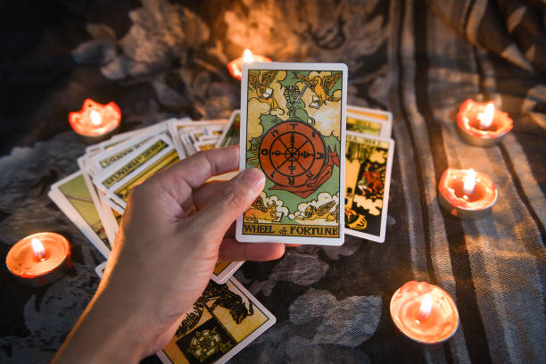
Levelling Up
Read for others more than yourself.
Get your ego out of the way.
Don’t read if you get the ick.
Notes:
You become much better by taking the leap to reading for others early. Much like skills at playing an actual sport or video game improve once you introduce other humans to the experience. This is especially important because of point 2.
Ego in this case refers to your conscious mind and opinions. Keep your experiences and opinions out of the initial reading.
If the question or general demeanor of the querent give you the wiggins, feel free to stop the reading or refuse the question. You are not under any obligation.

Slide 3
Levelling Up
4. Spreads?
5. Reversals?
6. Spit it out but take your time
7. Read all the cards.
8. Check in.
Notes:
4. Spreads? As many or few as necessary to tell the story. Find your method. No need to follow prescribed methodology.
5. Reversals? Whatever you feel. The cards and your abilities will adapt.
6. Say what the cards and your abilities say without too much ego insertion, but wait for it to all come together.
7. If interrupted, go back and complete the reading. Don’t leave out the whole picture.
8. Make sure the querent is all right, understands message, is comfortable continuing, etc.

Slide 4
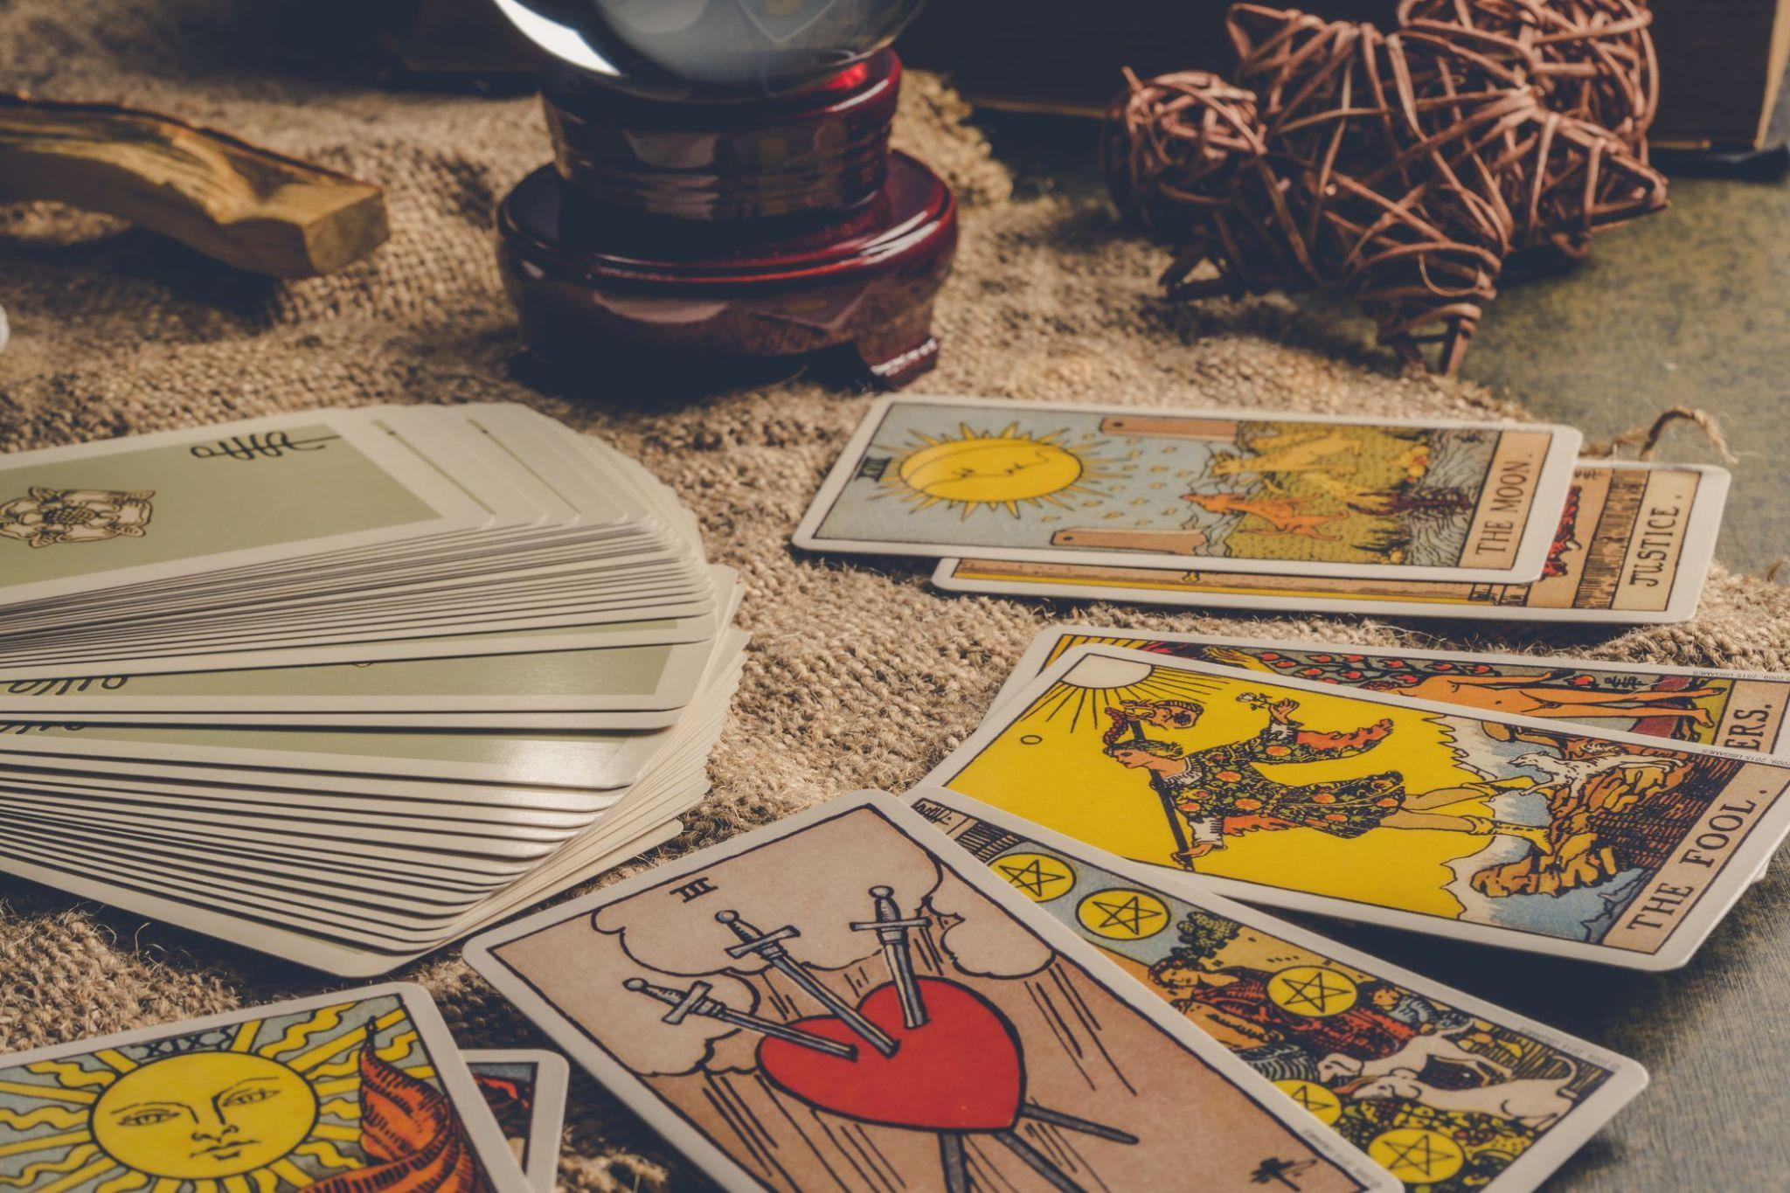
Elements of a Reading
Intellect
Intuition
Psychic
Notes:
Intellect: Knowledge of the card and conscious interpretations of artwork.
Intuition: Subconscious impressions tied to said knowledge.
Psychic: Any extrasensory or supernatural abilities.

Slide 5

The Woo Woo
Wells of power
  Divinity
  Celestial
  Terrestrial
  Personal
Notes:
A: Deities, spitit guides, etc.
B: The planets, moons, and other celestial bodies.
C: Spirits and powers inherent to the Earth, including the querent.
D: The power inherent to your spiritual and material self.

Slide 6
The Woo Woo
Synchronicities
  The mundane
  Timing coincidence
  Card coincidence
Deck vibes
Notes:
2. Birds, the person querent is talking about calls or texts, horn honks when clarity sinks in, multiple deck draws reveal the same card twice, etc.
3. When a specific deck calls to you. Especially one with a particular personality.

Slide 7
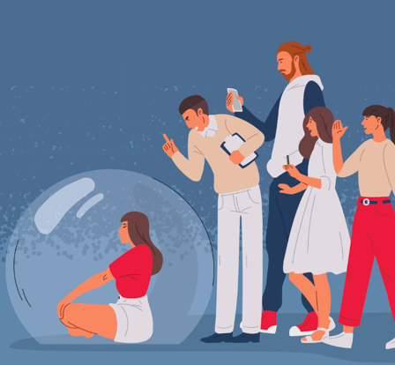
Establish Boundaries
People pleasers
Live to serve?
Oversharing
Topics
No obligation to read
Reading against style
Notes:
You are not responsible for making the querent happy. Some readings are uncomfortable. Also no need to go over time to please them.
The need to serve others is commendable, but a line needs to be drawn. Your responsibility needs to have a limit.
Don’t overshare your perspective. The querent needs to take what they want from the message without too much of your opinion and experiences, though some limited sharing is understandable.
Cover topics you are comfortable with. If a topic triggers you, it will be difficult or even impossible to get the ego out of the way.
You never have to do a reading. You are free to cancel the reading at any time. Your personal agency is important.
Read the way you read not the way they expect you to read.

Slide 8
Establish Boundaries
Read for exposure (for free)
100% accuracy or clarity
Their reaction is not your responsibility.
You are doing the reading
Respect their boundaries
Notes:
7. Exposure does not pay the bills.
8. Readings may have less accuracy with a muddy query or because the answer is in flux. Maybe you are not at the top of your game. Accept that it happens occasionally.
9. Answers that depend on too many variables or unclear queries can be vague. Don’t struggle to clarify. Perhaps make the question clearer.
10. Experienced readers can try to alter your reading with their understanding of the cards. Your reading is your reading. Don’t let them hijack the message.
11. If the querent is uncomfortable and wanted to stop exploring a topic or cease the reading, respect that.

Slide 9
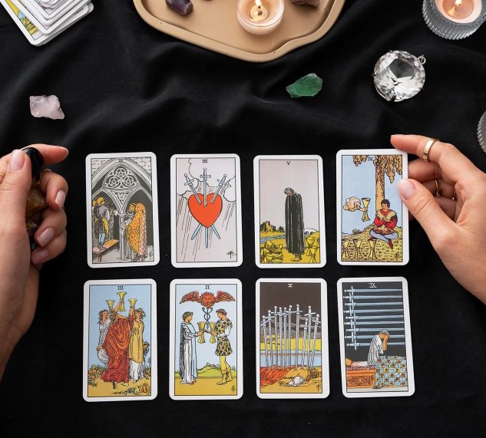
Responses
Ignore the message
Transference - guru, therapist, romantic, authority, friend
Projection - on others and you: The Bruno Effect
Notes:
Querent may dismiss the message altogether.
Querent puts too much responsibility for their well-being on the readerand desire more intimacy than the reader feels comfortable with.
Their problems are caused by anyone but themselves.

Slide 10
Responses
Cognitive misunderstandings
  All Good/Bad
  Overgeneralizing
  Ego Distortion
  Emotional reasoning
  Fairness
Notes:
It’s all good or all bad. No middle ground.
Inability to see clarifying details.
Distorting and altering message through personal biases.
Letting emotions get in the way of logical messages.
Querent upset at the unfairness of the resultant message. Life isn’t always fair.

Slide 11
Responses
Problematic querents
  In self-harm crisis
  Mental health challenges
  Revealing or planning something harmful
Notes:
Responsibility to get help for querent in danger of self harm. Protecting their overall well-being is of paramount importance.
Mental health episodes should be reported if destructive. Proper treatment is more important that a reading. We are not therapists or psychiatrists.
If planning on hurting others, find out any details they will share that you feel safe discussing. Then report to authorities and/or loved ones and those in potential danger. Lives may be in the balance.

Slide 12
Responses
Troublesome querents
  Gotcha querents
  Comparison shoppers
  Talkers
  Not connecting
Notes:
a. Asking a question under false pretenses. “Hah! I asked about a girlfriend, but I’m married. You should have guessed.”
b. Querent goes to many psychics to see if they get similar messages.
c. Querent talks more than they listen. Try to redirect to reading. Sometimes, they just want to pay for a single answer then have someone to talk to. They may just be lonely. If they won’t be redirected, just give them what they think they need: an ear.
d. Querent is shut off or not open to reading.

Slide 13
Responses
Troublesome querents
  Reading is wrong! (Is it really, though?)
  I already knew that!
  Repeated question
  Pushing for more time
Notes:
e. Some querents come seeking confirmation. Others get an answer that they knew the answer to but may not have accepted or understood the importance of. Try to get clarity from further draws or a new draw. If nothing else is forthcoming, they may have not thought about what they know in the right way.
f. Querent expected a different answer. Already had a result in mind. Confused when the answer is not as predicted.
g. Querent gets an answer, may not like the answer, and rephrases the exact same question. They will likely get the same answer. They will likely never be satisfied. Not your responsibility.
h. An hour of questions in a 30 minute reading.

Slide 14
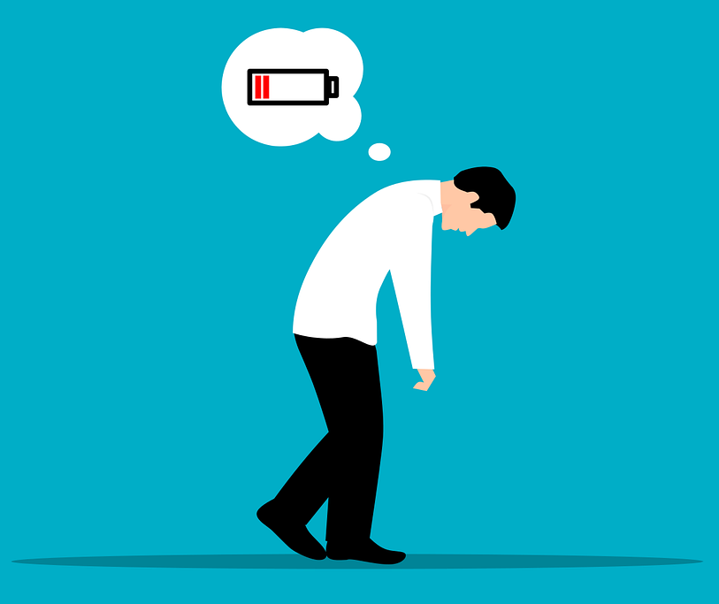
Restoration
Feng Shui
Ergonomics
Healthy habits
Sharing
Nature
Tarot activities
Notes:
Your setting should be conducive to comfort rather than purely aesthetically pleasing.
Ergonomic setup is important. Chair height for leg comfort. Table height to prevent deep bending. Ability to easily reach cards.
Food and water. Physical activity.
If able, journal, talk, etc. with someone neutral.
Go outside and touch grass. Hug a tree. Whatever works.
Look to books or the internet for fun activites with the cards outside of divination. Play a game.

Slide 15
Restoration
Therapy
Socializing
Have fun
Take a mental health break
Retrain synapses
Notes:
7. Talk to a professional. Even therapists need a therapist sometimes. There is no shame in needing a neutral ear.
8. Get out with friends or family. Talk about anything but work unless you need to.
9. Do something you enjoy. Play a board game, go to a theme park, sing karaoke, etc.
10. Take time off reading if necessary. Come back refreshed.
11. Train your brain to recognize the good in situations. Negative aspects are easy to obsess about. Spread good even if you feel bad. Tell someone to have a wonderful day even if you are having a tough time. Such a simple action can reflect back to you in small ways.

