Slide 1

Ancestral Magick for Unbinding the Past,
Healing the Present,
Empowering the Future
Workshop
Dave Gaddy • The Weathered Wiseman

Slide 2

Course Intention
Release inherited burdens
Heal the present
Reclaim ancestral gifts
Become a blessing for the future

Slide 3
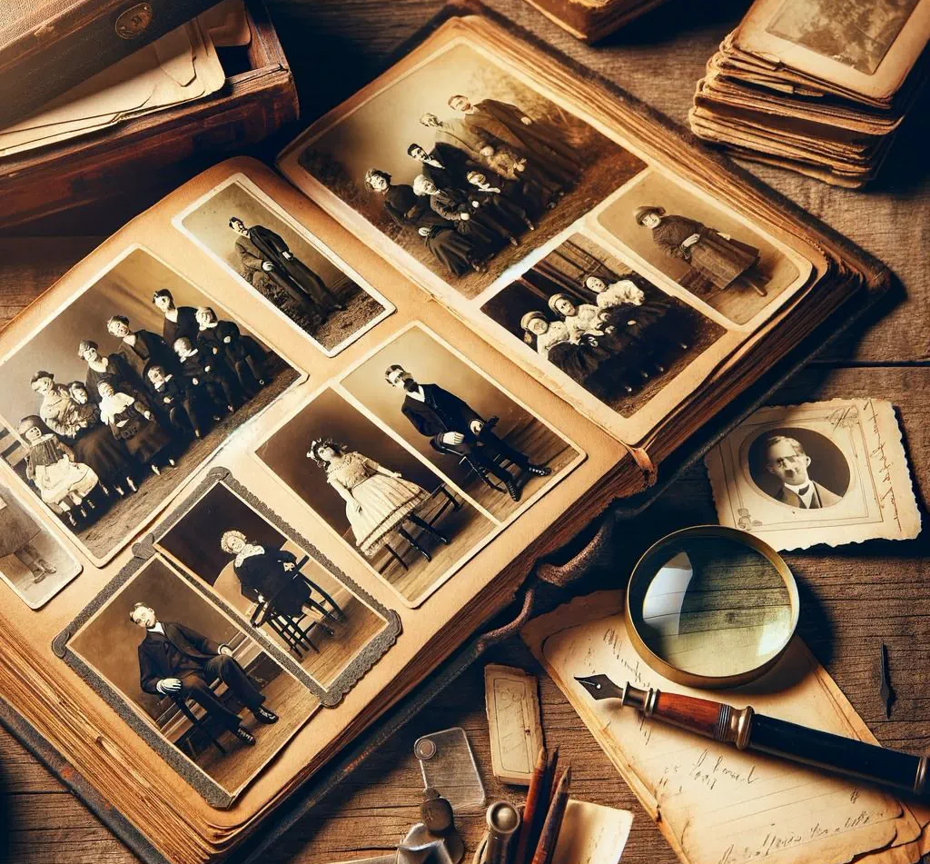
Learning Objectives
Discern lineage patterns
Practice healthy discernment
Transform inherited burdens
Live as a good ancestor

Slide 4
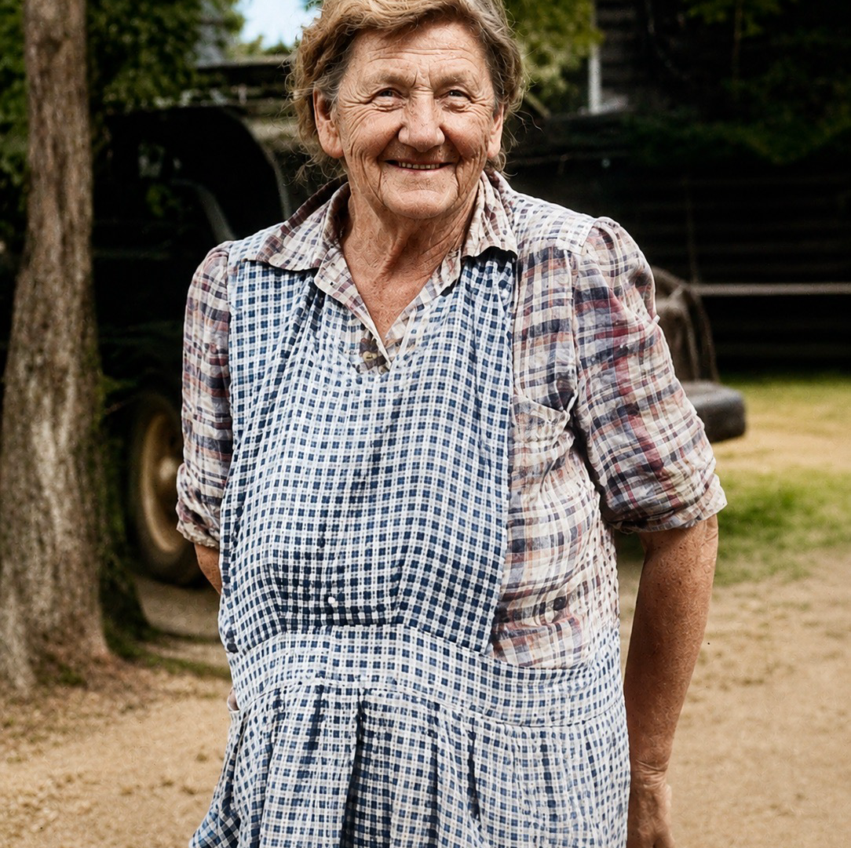
Every Family Leaves an Inheritance
Stories
Strength
Silence
Hope

Slide 5
What Is Ancestral Magick?
Relationship over ritual
Healing over nostalgia
Reciprocity over obligation

Slide 6
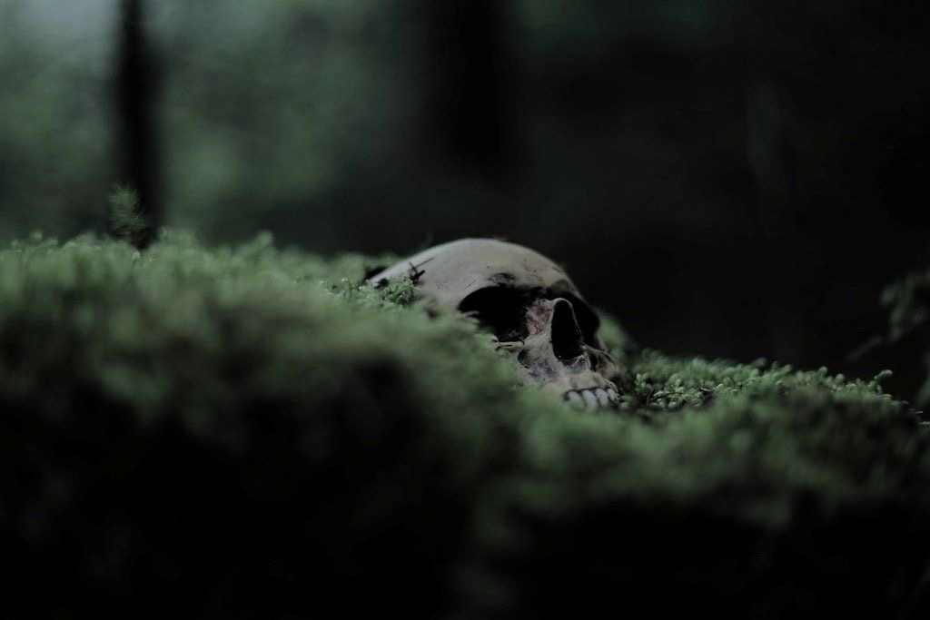
The Bones Remember
Patterns repeat
Awareness creates choice
Choice creates change

Slide 7

Stories Beneath the Stories
What was spoken?
What remained silent?
What continues today?

Slide 8
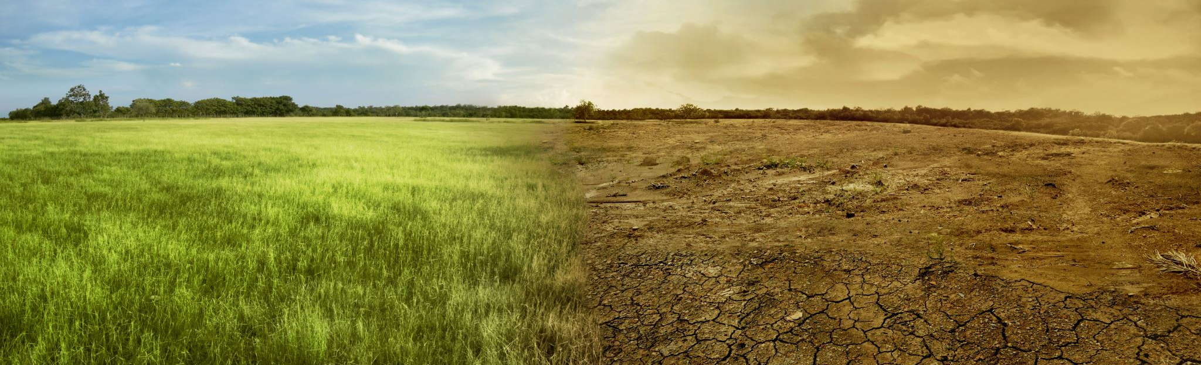
The Land Remembers
Place shapes people
The land is an elder
Belong where you are

Slide 9
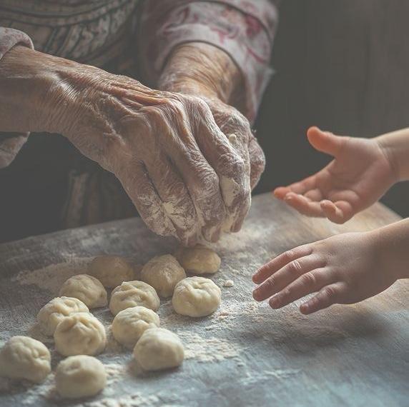
Reflection
What have I inherited?
What do I choose to keep?

Slide 10
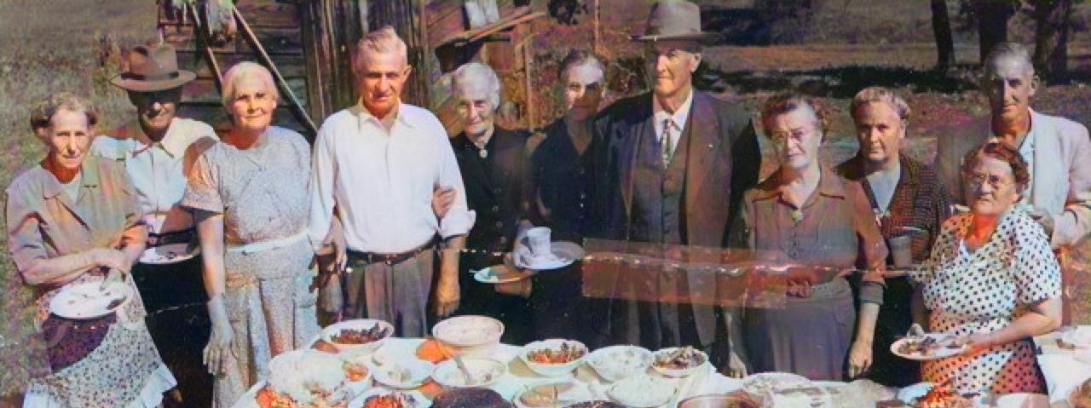
Choosing Your Ancestors
Discernment
Boundaries
Wisdom

Slide 11
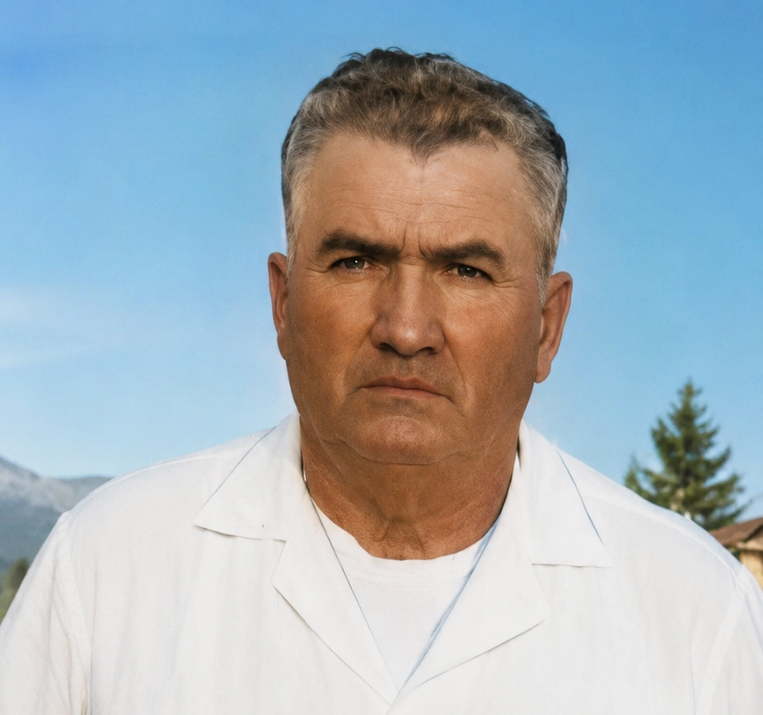
Death Does Not Erase Character
Invite wisely
Relationship requires trust

Slide 12
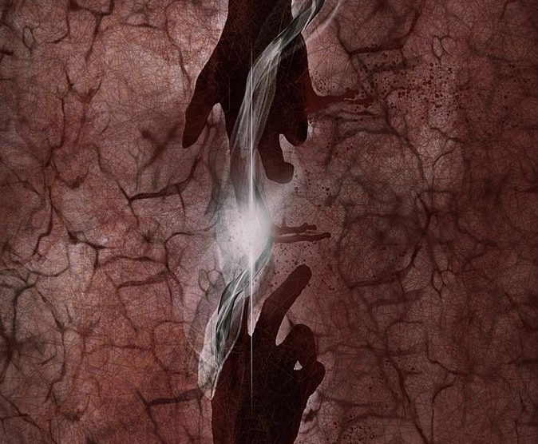
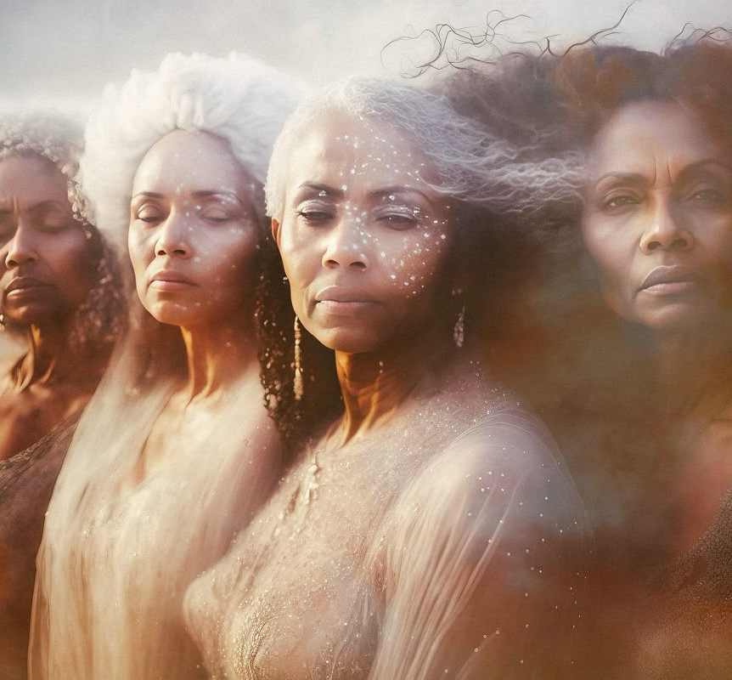
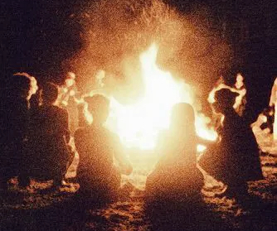
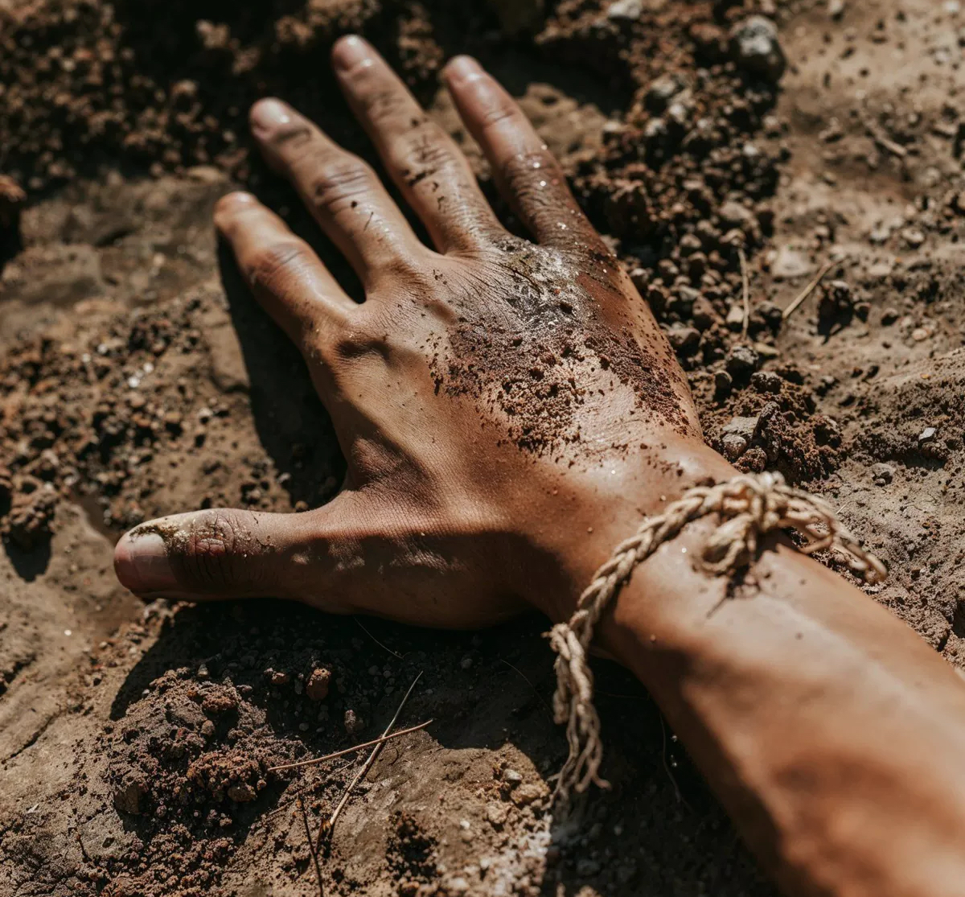
The Four Streams
Blood
Spirit
Tradition
Place

Slide 13
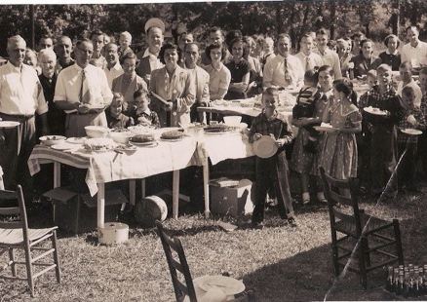
Building Your Ancestral Court
A council of wisdom
Not everyone receives an invitation

Slide 14
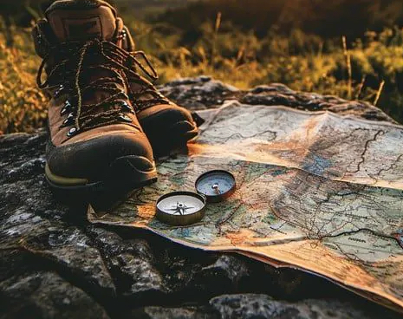
Guided Journey
Meeting the wise ancestor
Receiving guidance

Slide 15
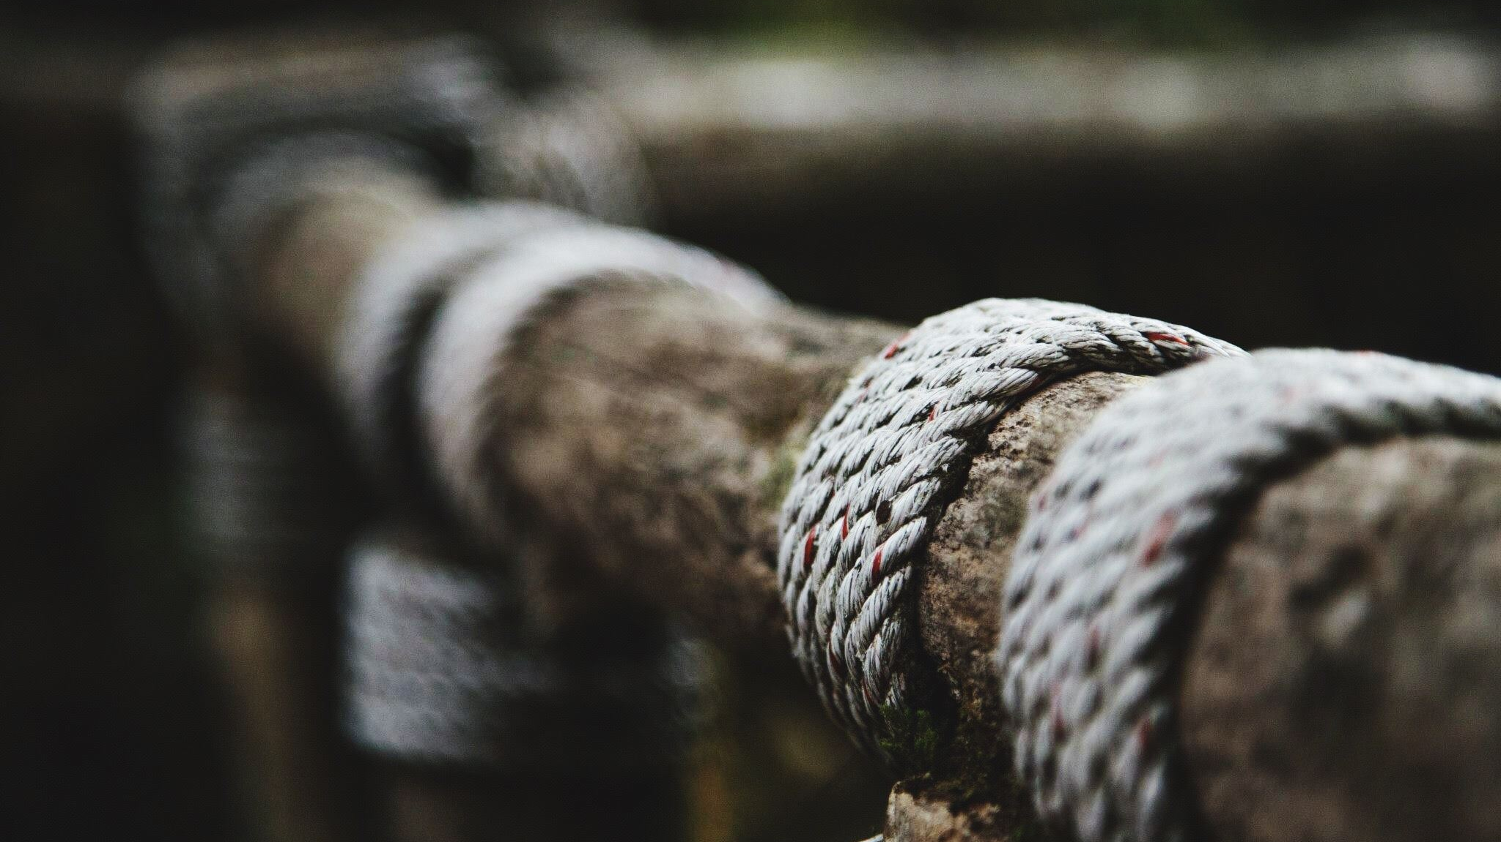
Unbinding the Past
Not everything I carry belongs to me

Slide 16
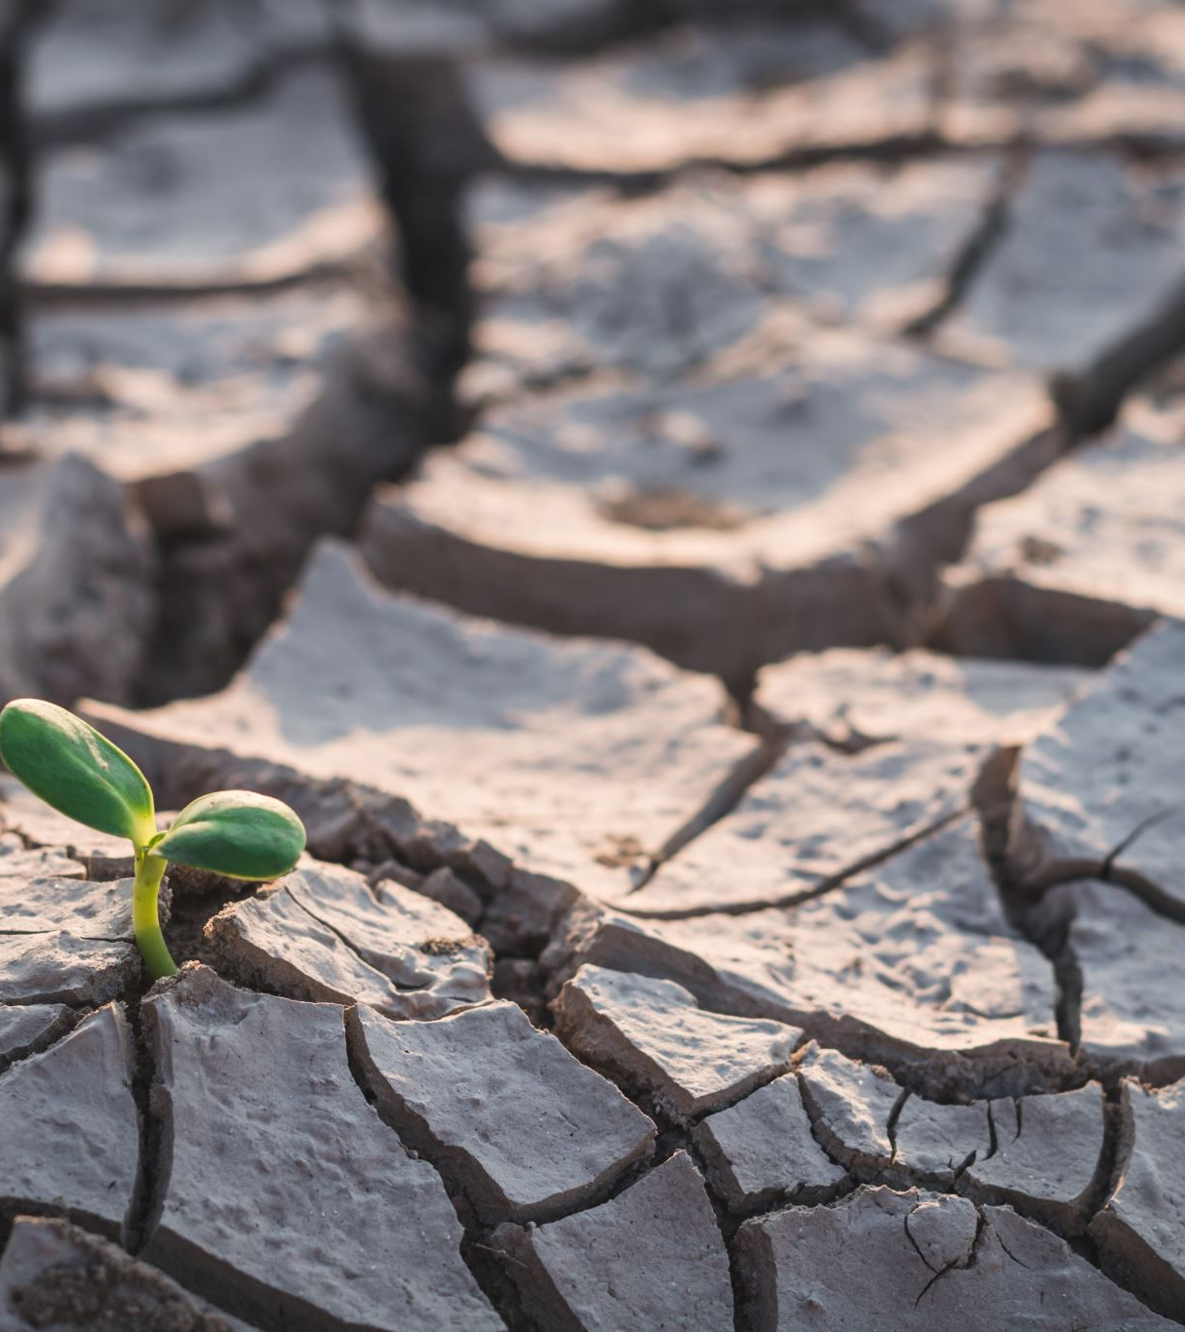
Survival vs. Living
Survival strategies
Freedom to choose

Slide 17
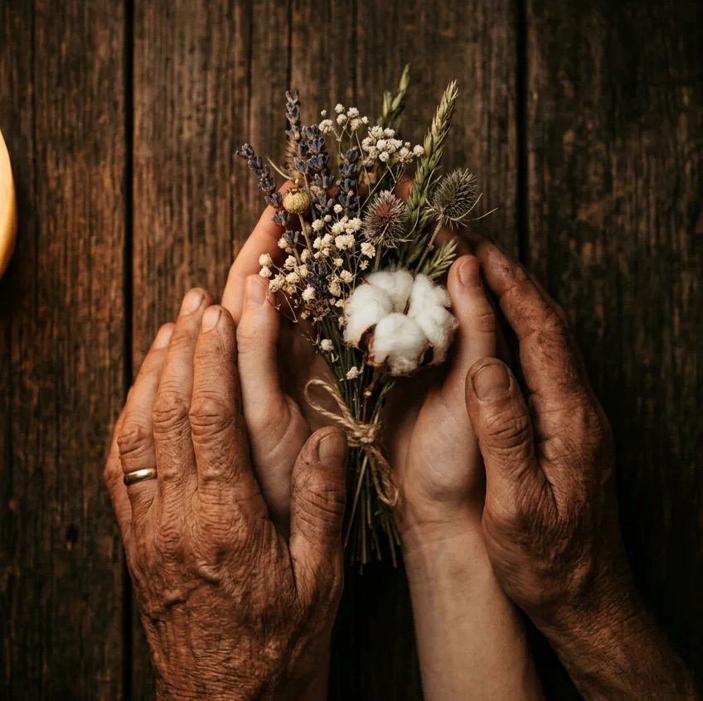
Honor Without Carrying
Honor wisdom
Release burdens

Slide 18
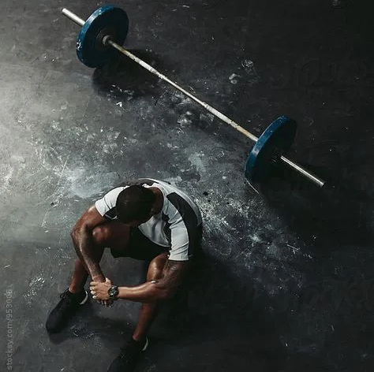
Reflection Exercise
Who carried this before me?
Does it still belong to me?

Slide 19

Healing the Present
Remember the gifts
Remember the joy

Slide 20
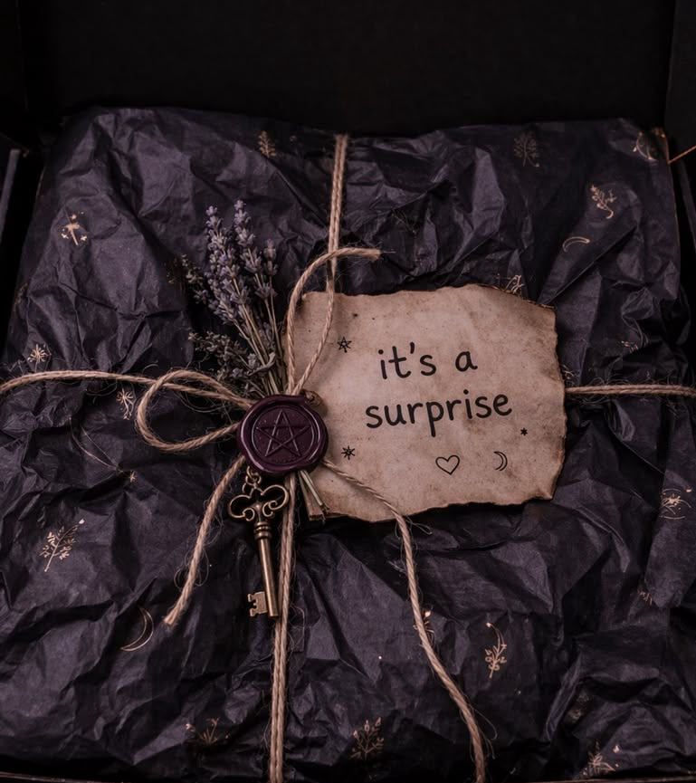
Hidden Gifts
Compassion
Courage
Creativity
Intuition

Slide 21

The Ancestors Dreamed of You
Healing continues through us

Slide 22
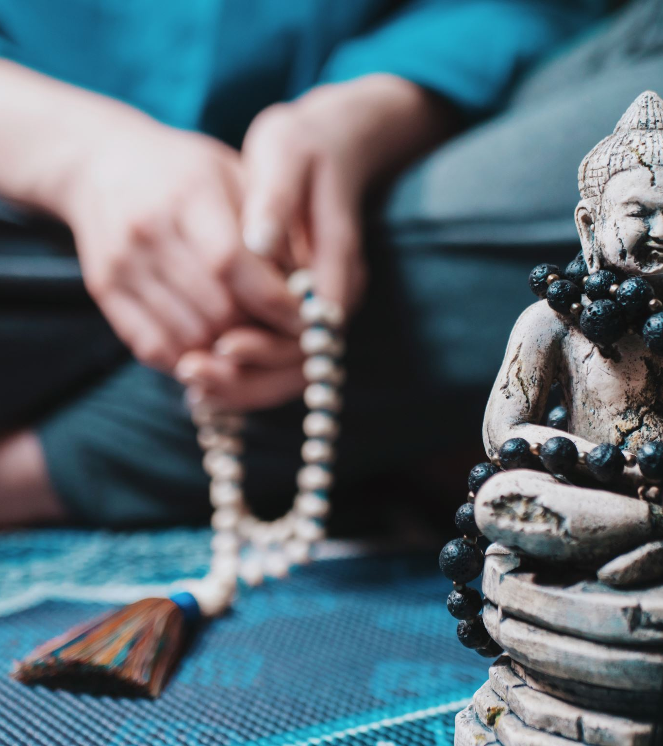
Receiving the Blessing
Guided meditation
Accept the gift

Slide 23
Becoming a Living Blessing
Live intentionally
Lead with kindness

Slide 24
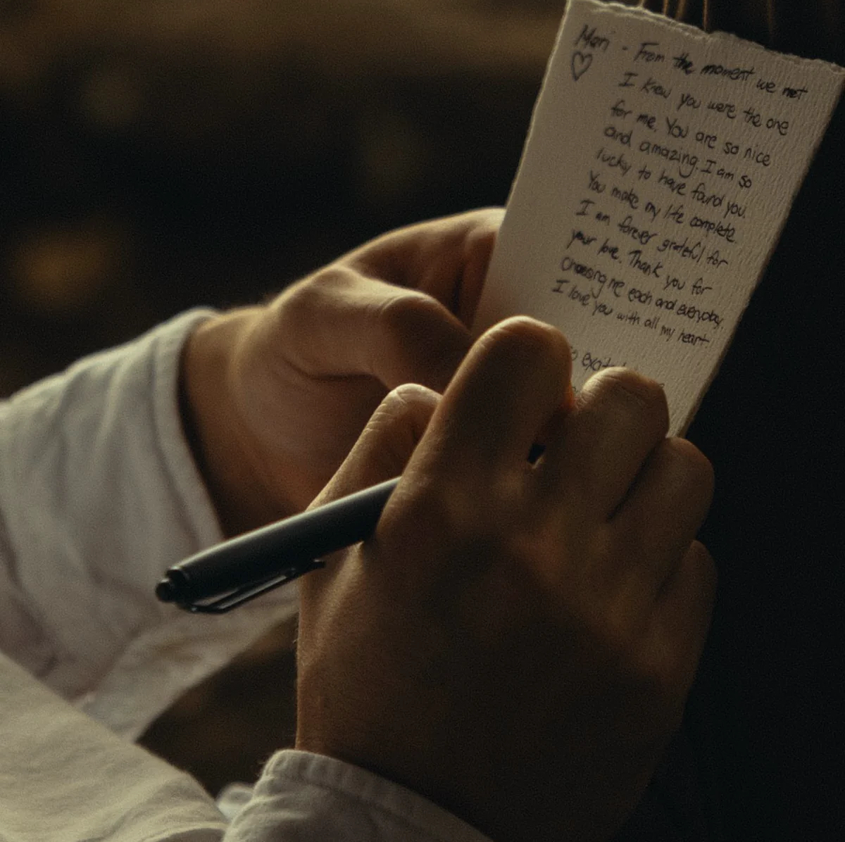
Letter to the Future
'If you're reading this after I'm gone...'

Slide 25
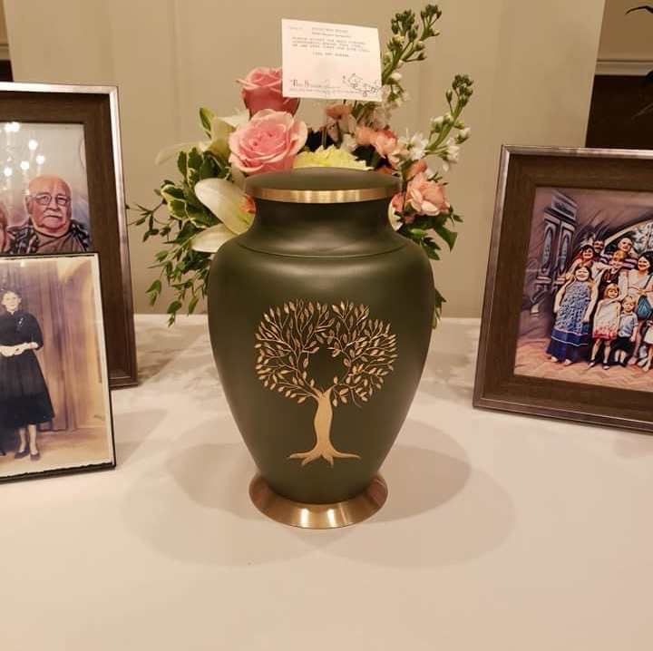
Becoming the Ancestor
Legacy is influence
Leave more blessing than burden

Slide 26
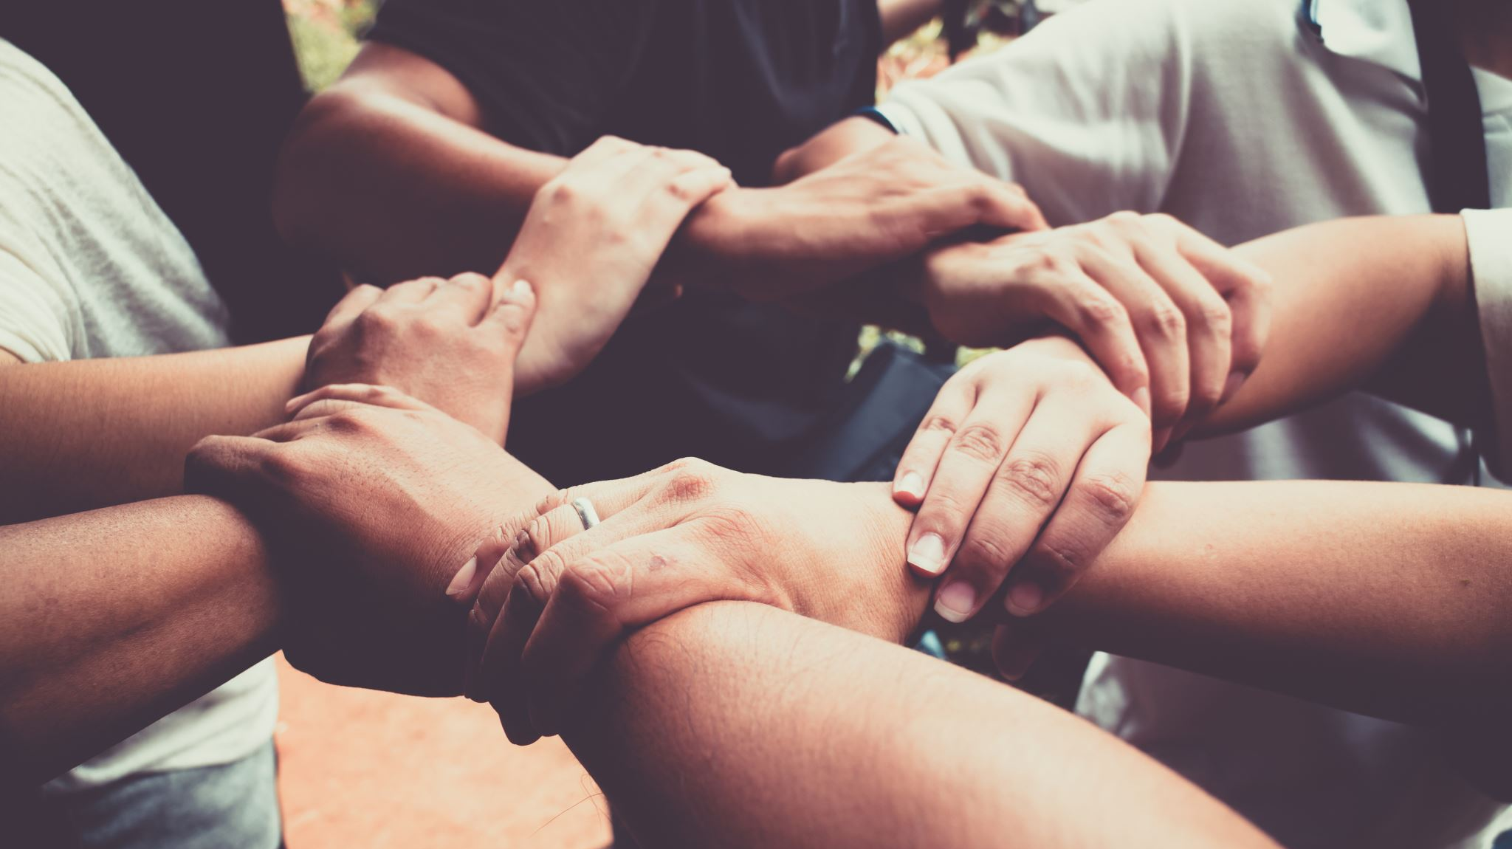
Closing Rite
Honor
Release
Receive
Choose

Slide 27
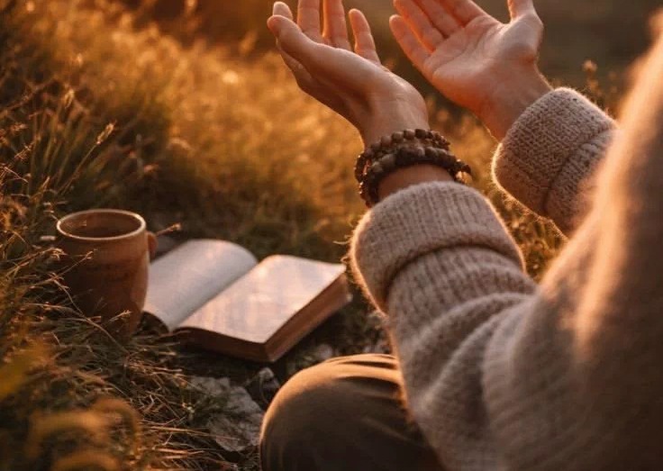
Student Affirmation
I remember.
I release.
I reclaim.
I become.

Slide 28
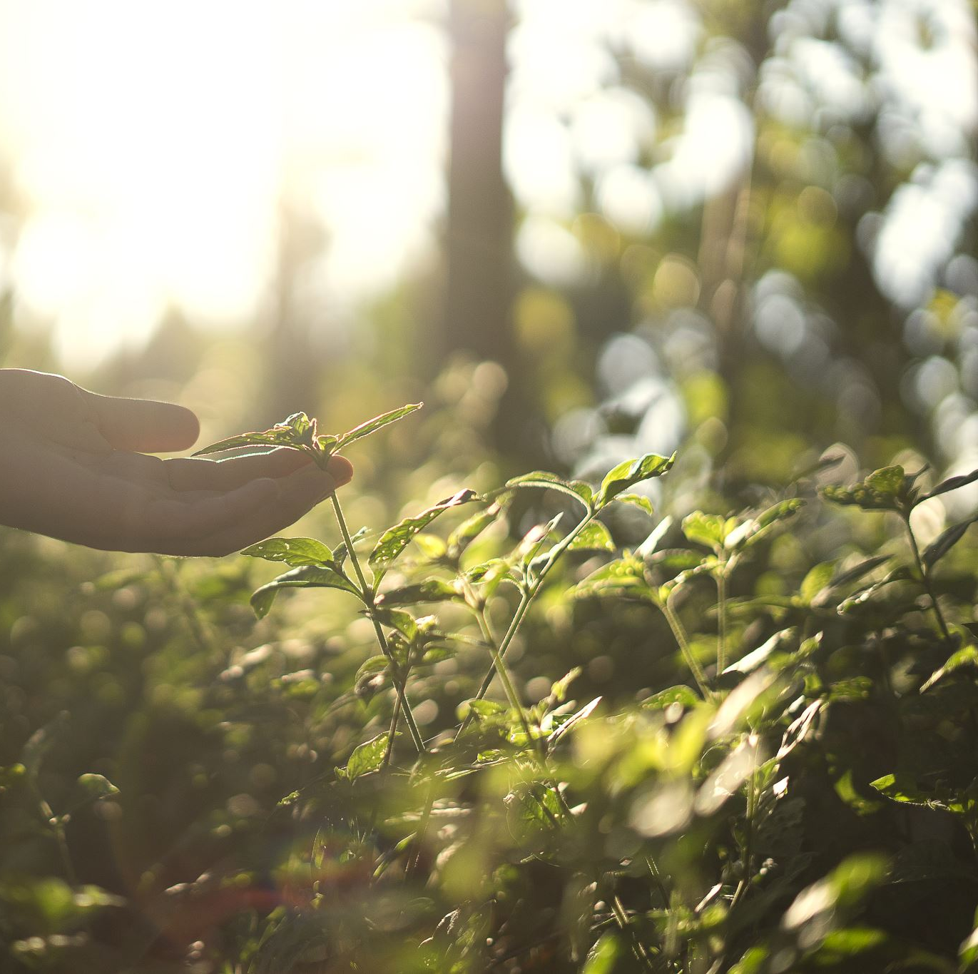
Resources for Continued Practice
Journaling
Nature
Story
Community

Slide 29
Questions & Discussion
Reflection and sharing

Slide 30

Thank You
Walk in wisdom
Walk in compassion
Walk in courage

