Slide 1

How to Build SQL-Based Data Validation Reports
DPI Team will add QR code here
Tamara Dillard, Tim MacArthur
Go Link: go.ncdpi.gov/8gkuw

Slide 2
Acknowledgement of Generative AI Assistance
This content was developed with the support of generative AI tools for ideation, content development, design and research assistance. These technologies supported brainstorming, accelerated content development and assisted with organizing and refining ideas.
All AI-generated content was carefully reviewed and edited by the presenter to ensure accuracy, relevance, alignment with the sessions educational objectives and consistency with the presenter’s voice and style.
Reference
NC Generative AI Implementation Recommendations and Considerations for PK-13 Public Schools,
https://docs.google.com/document/d/1U-AwwwBg7glJ4ZDlcKVzARuFRPWwUWzqRN2rOgT9zlA/

Slide 3
3rd Party Tools Disclaimer
NCBOLD is designed to support educators in the use of digital tools and technology to enhance learning outcomes. NCBOLD strives to model best practices for educators including data privacy and cybersecurity. As such, we want educators to be aware of the importance of following North Carolina’s 3rd Party vendor policy in using tools. As such, educators should follow the district’s policy and consult with their district’s (PSU) technology department prior to signing up students for digital tools.

Slide 4
NCSIS Tool Rights Disclaimer:
Any tool rights mentioned in this presentation are for informational purposes. Tool rights vary by PSU and are not determined by job title or role. Please contact your SIS Coordinator for specific guidance on tool rights within your PSU.

Slide 5
Alignment to New Digital Learning Competencies:
Educators:
Educational Leaders:
Coaching:

Slide 6
Purpose of This Session:
Be the collaboration you want to see
  If we wait until we’re experts before sharing, no one will ever share
  Modeling transparency
If You Can Describe the Problem, You Can Build the Validation.
  SQL
  AI
  Workflow thinking
  Accessibility
  Operational logic

Slide 7
Intended Participant Outcomes:
The goal is not to create SQL developers, but to create professionals who can understand, request, validate, troubleshoot, and safely use SQL-based data validation solutions in Infinite Campus

Slide 8
Build Sustainable Systems
Documented
Understandable
Scalable
Secure
Maintainable

Slide 9
Modern Data Management Is:
Reducing repetitive manual work
Improving data quality
Protecting student information
Supporting staff capacity
Building sustainable workflows
Preserving institutional knowledge

Slide 10
Why Data Validation Matters

Slide 11
Examples of why a SQL:
Student enrolled at two schools simultaneously
Missing end enrollment dates
Invalid grade levels
Enrollment dates outside school calendars
Missing state IDs
Homeroom teacher not assigned
Census vs Enrollment mismatch

Slide 12
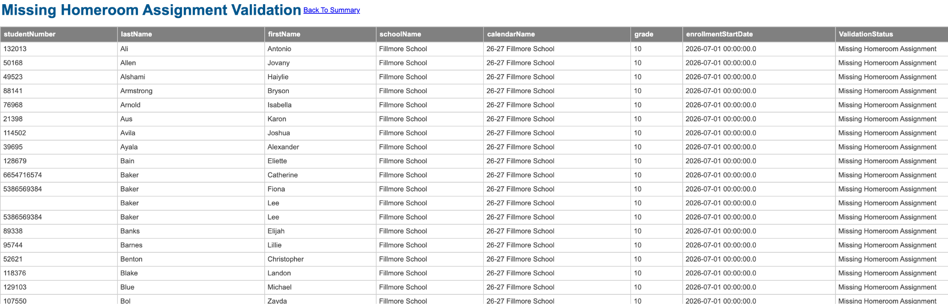
Missing Data
Does everyone have a homeroom teacher assigned?

Slide 13
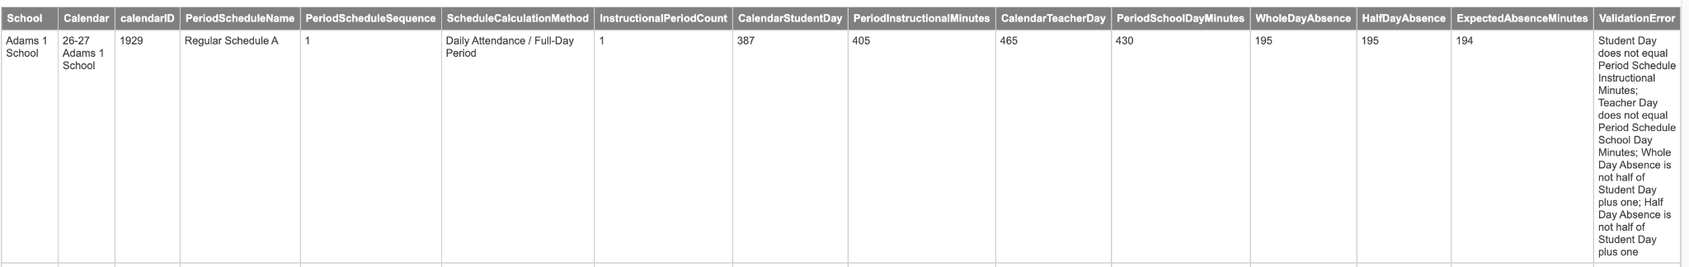
Comparison Data
Calendar Minutes vs Period Setup Minutes

Slide 14
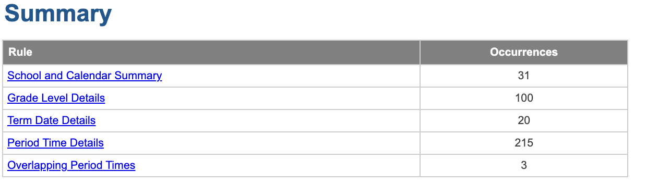
Stacking Data

Slide 15
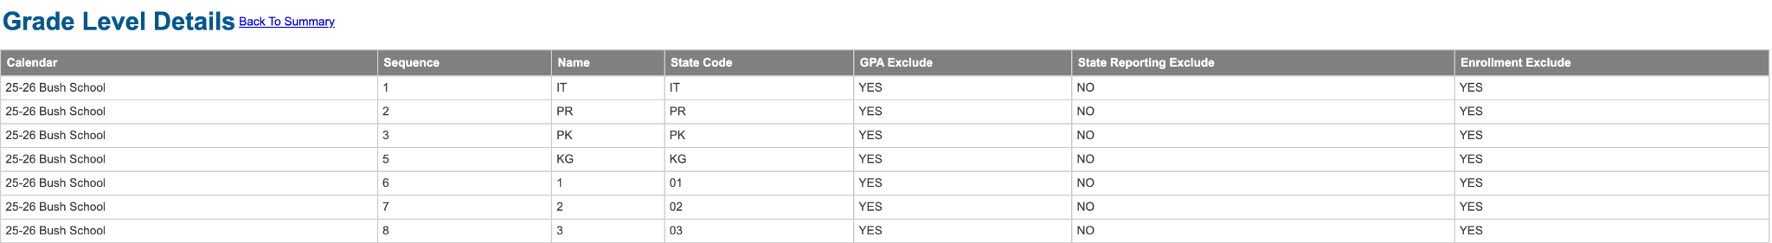
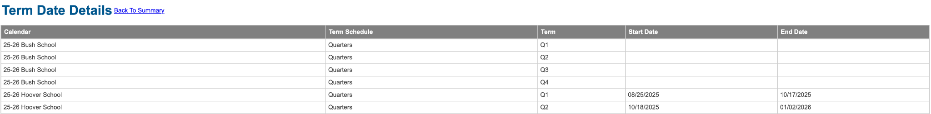
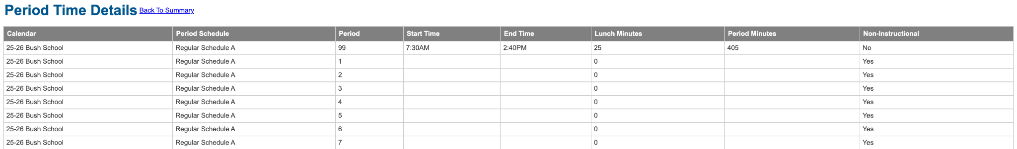
Stacking Data

Slide 16
What SQL Actually Is

Slide 17
Definition and Basic Functions
Structured Query Language
Pronunciation
  “S” “Q” “L”
  Sequel
Data Extraction (SELECT)
Data Insertion (INSERT)
Data Modification (UPDATE)
Data Removal (DELETE)

Slide 18
Organization
Databases are comprised of
  TABLES
    Think tabs of a spreadsheet that are each filled with data related to a single topic or theme
  FIELDS
    Columns of data
    Each table will have 1 unique identifier (usually)
  ROWS
    1 set of information related to each other

Slide 19
Organization (continued)
Tables are built around themes of data
  Person
  Enrollment
  Calendar
  Identity
Views to combine the data together for convenience
  The student view combines data from the Enrollment, Person, Calendar, and Identity tables

Slide 20
Joining Tables Together
JOINs are the way to combine data from various tables together.
Choosing the correct type of JOIN matters
  LEFT JOIN
    Select all rows from the first table, and match it to a 2nd table when a matching condition is met.
    E.G. select all student records and include their AIG records if they have them
    E.G. select all student records and include their guardian contact information
    This can create a lot of repetitive information from the original table
  INNER JOIN
    Select all rows from 2 tables where some condition is matched
    E.G. Select all students who have an AIG record, but exclude any student who does not have an AIG record
    NOTE: This is the logic that Ad-hoc reports use, which is why including some data fields in ad-hoc reports will drastically reduce the number of records.

Slide 21
Querying Data
Occasionally, a view will exist and contain all of the data we want
You will often need to do the specifications yourself
  Select * from student will return all of the data from the student view. For a school district, this will be an incredible amount of data.
  We want to be specific which students we want based on their…
    Name?
    CURRENT school enrollment?
    Historical school enrollment?
    Course roster?
    Grade received in that course?
    Teacher?
    Some combination of all of these things?!

Slide 22
Filtering Queries
You can use a WHERE clause to specify what values you are interested in
  WHERE schoolid = 681305
  WHERE lastName IS NULL
  WHERE firstName like ‘Tim%’ (Returns Tim, Timmy, Timothy, Timbob… or Tim)
Multiple WHERE statements can be applied
  WHERE schoolID = 681305
  AND WHERE lastName IS NULL
  Find all the students at Carrboro HS whose last name is empty

Slide 23
Output
You may wish to rearrange the output of the query
ORDER BY is comparable to sorting on a column(s) in a spreadsheet
The details of the rows may not be what you want to know, but rather aggregated values
COUNT and GROUP BY are comparable to pivot tables in a spreadsheet

Slide 24
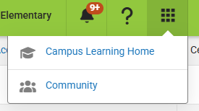
Database Setup
The Database Schema is available through the Campus Community
Log into the Campus Community
Search for Schema Diagrams or load https://kb.infinitecampus.com/help/schema-diagrams

Slide 25
Schema Diagrams
Most Database tables are grouped into themes and their setups are shared through a side menu
The Core - Student menu shows the common student tables
  Person
  Enrollment
  Calendar
  Identity
  Pronoun
  Student (view)
Each column has a field type and description at the bottom of the page. Use search to find the ones you want.
The queries used to build views are included at the bottom as well

Slide 26
SQL= asking the database a question
We are not building the database- we have it
Infinite Campus
Is it hard to know what to ask in SQL?
No, we ask those questions or are asked those questions daily

Slide 27
REMEMBER THIS SENTENCE:
SELECT what you want to see
FROM where it lives
JOIN what else you need
WHERE what is wrong
ORDER BY how you want to review it

Slide 28
SELECT:
What do I want to see?
Example: student number, name, school, grade.

Slide 29
FROM:
Where does the main data live?
Example: enrollment table.

Slide 30
JOIN:
What other data do I need connected?
Example: connect enrollment to student demographics or school.

Slide 31
WHERE:
Which records should show up?
This is the validation rule/filter.

Slide 32
AND / OR:
How do multiple conditions work together?
AND means both must be true.
OR means either one can be true.

Slide 33
NULL:
Blank/missing data.
Very important for validations because many errors are missing values.
Use:
IS NULL
Not:
= NULL

Slide 34
ORDER BY:
How should the results be sorted?
Example: by school, grade, student name.

Slide 35
ORDER BY:
ORDER BY
i.lastName,
i.firstName,
p.studentNumber

Slide 36
Infinite Campus
SQL Mechanisms

Slide 37
SQL Query Mechanisms
Infinite Campus has several mechanisms in which you can utilize SQL queries
The following slides have explanations, examples, and work time to test them

Slide 38
SQL Query Mechanisms: Pass-Through

Slide 39
SQL Query Mechanisms: Pass-Through
Ad-Hoc Pass-through SQL Query Editor
  Very easy to create and share using Ad Hoc Filter Designer Processes
  Limited in terms of what you can select
  Year, Calendar, and Schedule-specific
  Multiple examples available in the KnowledgeBase
  Student Queries like Birth Date from Range, Birthdays by Week, Students without a Current Household, etc

Slide 40
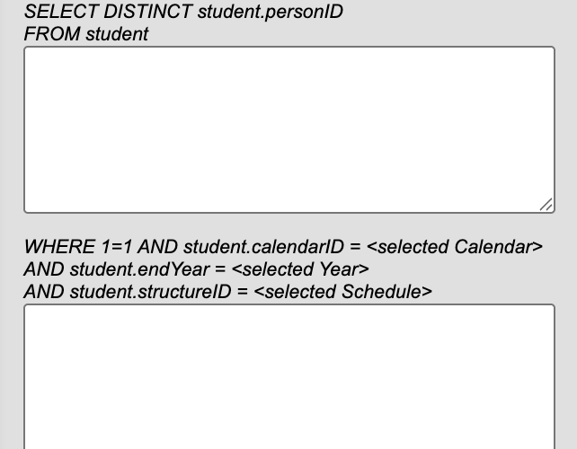
Ad-Hoc Pass-through SQL Query Editor Example
Students without a Current Household
Box A:
LEFT OUTER JOIN HouseholdMember hm ON hm.personID = student.personID
AND (hm.endDate IS NULL OR hm.endDate > getDate())
Box B:
AND hm.personID IS NULL

Slide 41
Ad Hoc Pass-through SQL Query Experiment
Try it out!
Choose a query from the knowledge base
  Census Staff Pass-Through Queries
  Course Section Pass-Through Queries
  Student Pass-Through Queries
Create and test it in Reporting > Ad Hoc Reporting > Filter Designer
Select Pass-through SQL Query
Select Student, Census/Staff, or Course/Section based on the example you chose

Slide 42
SQL Query Mechanisms: Data Extract Utilities

Slide 43
SQL Query Mechanisms: Data Extract Utilities
The Data Extract Utilities tool lives inside the System Settings area
Designed for integrations that accept a file for rostering purposes
  Services that syncs once per day
  SFTP folders can be linked
  Can be scheduled to run daily, weekly, monthly, yearly
Multiple types of extract methods
  AdHoc
  SQL Query
  Prism
Requires Data Extract Utilities access
  Cannot be limited to match calendar rights
  Effectively gives full database view access
  Limit access to those with SIS Coordinator Access or the Integrations Team

Slide 44
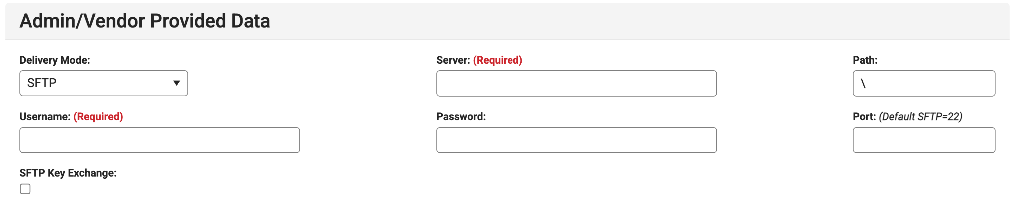
Using Data Extract Utilities: Server Information
The Admin/Vendor Provided Data area is where you would specify server specifications for your 3rd party vendor or PSU
Server and Username are required fields, but you can fill in generic information there if you aren’t intending to export to a server

Slide 45
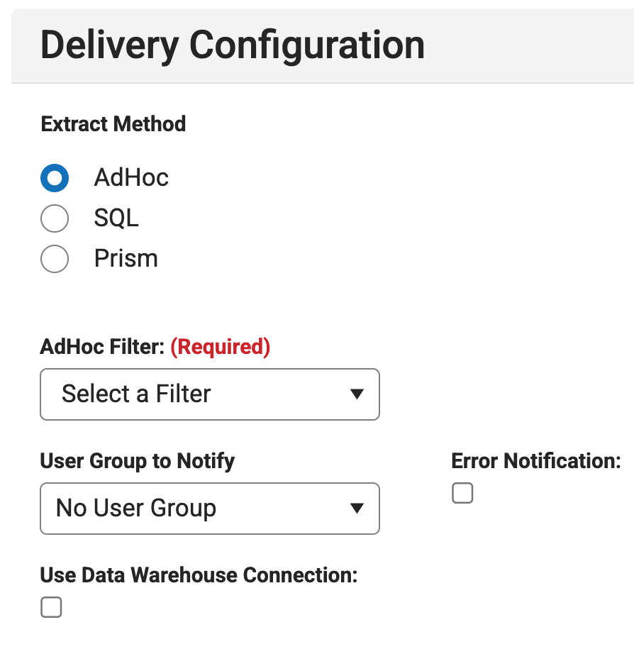
Data Extract Utilities: AdHoc
The Delivery Configuration area is where you specify the extract method
Select AdHoc if you need to schedule an export using an ad hoc filter
Simple 3rd party integrations can be handled using this method

Slide 46
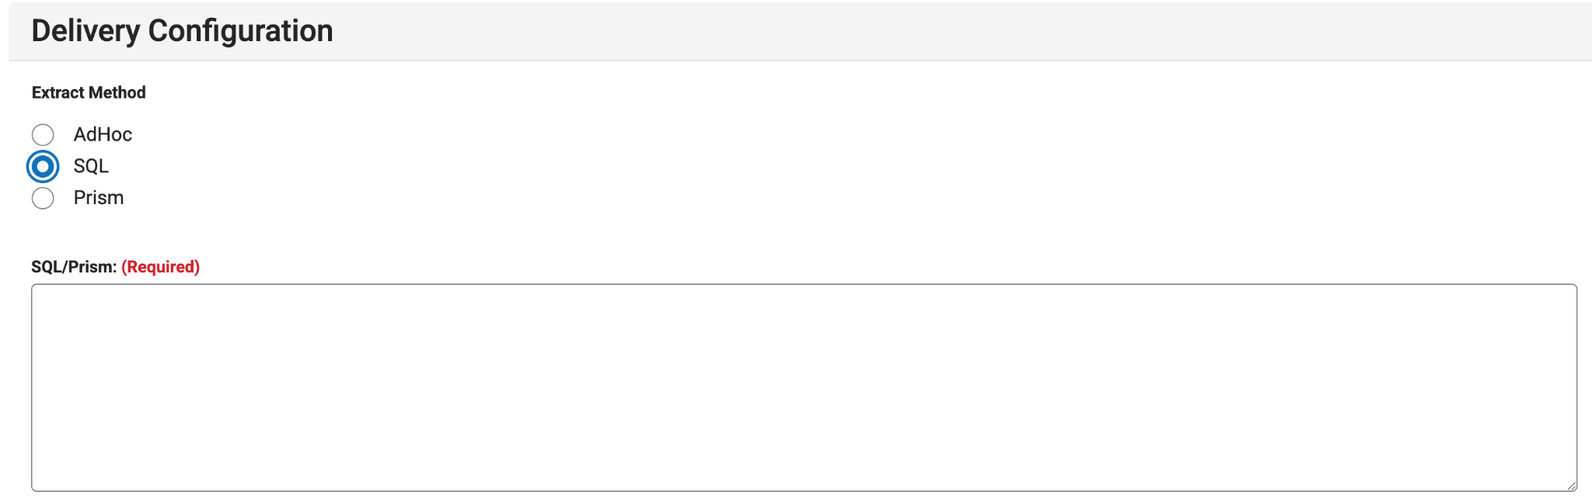
Data Extract Utilities: SQL
Select SQL to use a SQL query to extract data from the database
Write (or paste) the code into the SQL/Prism area.

Slide 47
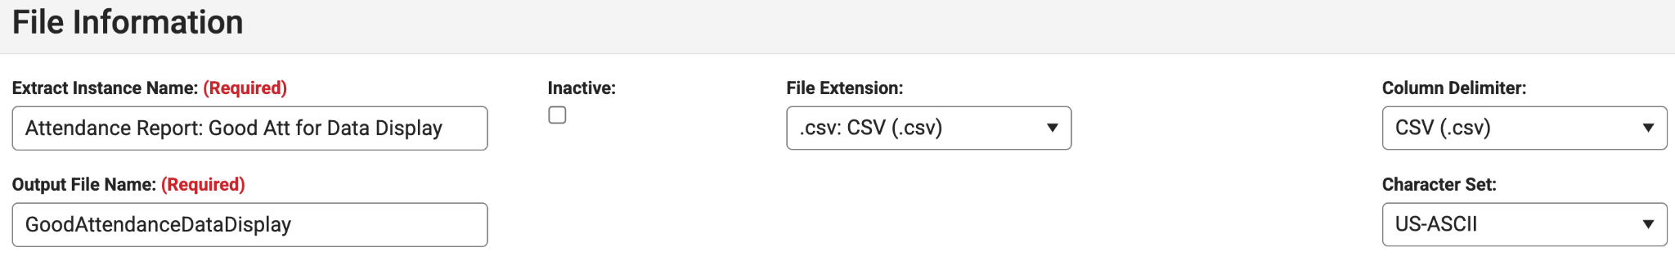
Data Extract Utilities: SQL Export File Information
Extract Instance Name is the name that shows up the list of Data Extracts
Change output file name to match what the vendor expects
Use the Inactive checkbox to disable and hide extracts. This is helpful if v2 of an extract is superior to v1. You can disable instead of deleting it.

Slide 48
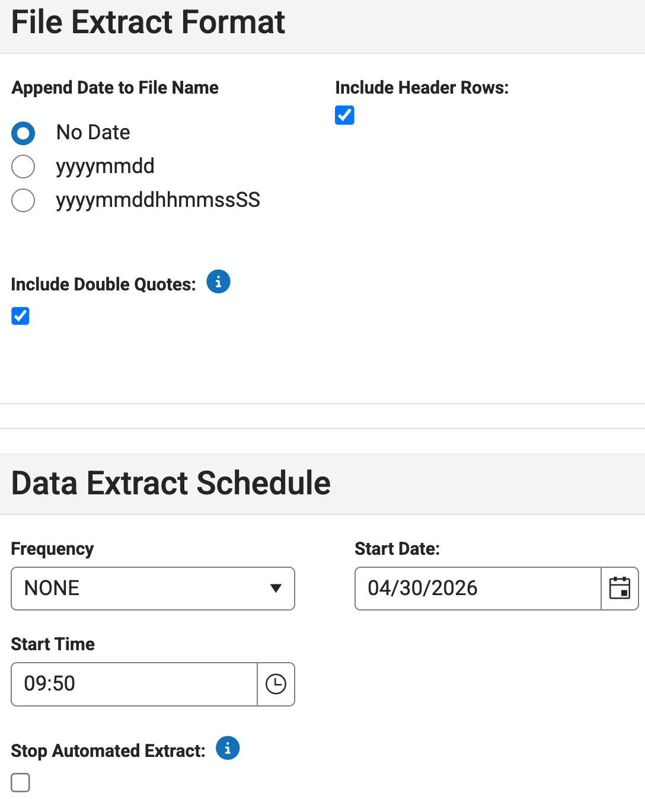
Data Extract Utilities: SQL Schedule and Format
Use the File Extract format menu to append date/time, include headers, and encapsulate values in double quotes
Use the Data Extract schedule menu to schedule the frequency, start date, and export time.
  Stop Automated Extract is helpful during the summer to temporarily stop extracts while student and course information is changing.

Slide 49
Data Extract Utilities: Menu Buttons
Back: return to list of Extracts
Save: Save current edits
Save as New: Create a copy of current extract
Delete: delete current extract
Test Extract: download file locally from SQL
Test Connection: tests connection to server
Run Extract: manually run extract and place resulting file on server
Tip: use test extract and view results

Slide 50
Data Extract Utilities: SQL Limitations
Only SELECT can be used
  UPDATE, DELETE, INSERT are not available
  Only used for querying the database
Select * cannot be used
  Must explicitly name columns
No/limited parameters can be passed to the script
  Scripts do not detect year, school, calendar
  Pro tip: DECARE variables at the top if you intend to edit and and run frequently based on dates, terms, etc

Slide 51
Data Extract Utilities: SQL Data Extraction
Test it out!
SELECT
p.personid,
concat(i.lastName, ', ', i.firstName) as 'fullName',
i.raceEthnicity,
i.raceEthnicityFed,
isnull(c.email, c.secondaryEmail) as 'email'
FROM person p
INNER JOIN [identity] i on i.identityID = p.currentIdentityID
LEFT JOIN contact c on c.personID = p.personID
ORDER BY p.personID

Slide 52
SQL Query Mechanisms: Data Validation Rules

Slide 53
SQL Query Mechanisms: Data Validation Tools
The most useful mechanism for SQL Queries is the combination of Validation Rules, Groups, and Reports
SQL Queries are entered in Validation Rules (Knowledge Base Article)
One or more validation rules are assigned to user groups in the Validation Groups tool
End users access all of their available Data Validations using the Validation Reports
These tools are all found in Reporting > Data Validation

Slide 54
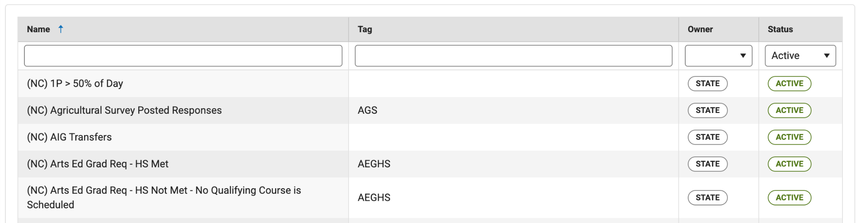
Validation Rules Setup
Reporting > Data Validation > Validation Rules
Validation rules are searchable by Name, Tag, Owner, and Status
Click on any of the rows to load the query. You may only have view access to ones owned by the state or system.

Slide 55
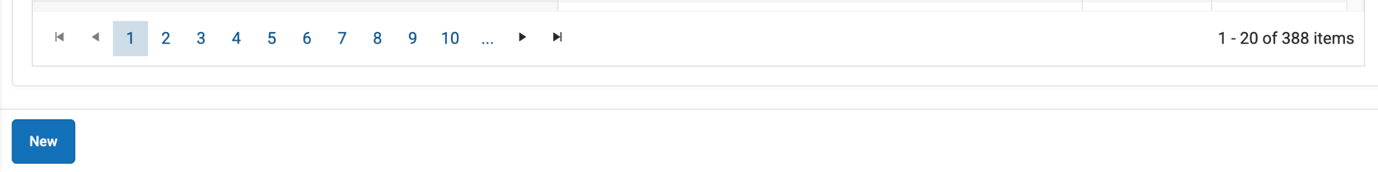
Validation Rules Setup continued
Sort through all available rules using the numbers and arrows at the bottom of the screen
Click on New to open a new Validation Rule

Slide 56
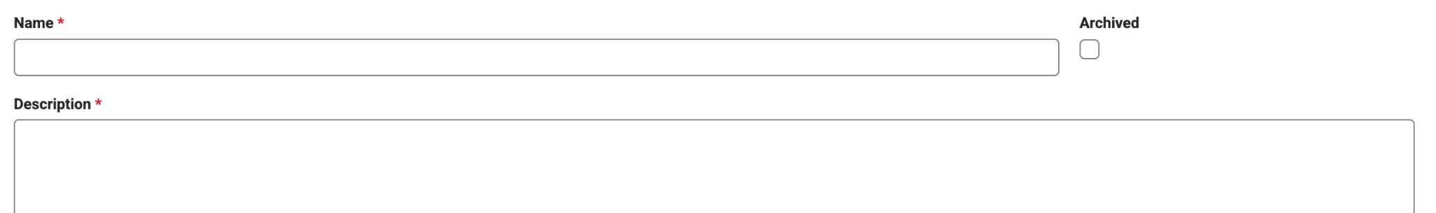
Validation Rules Overview: Name, Archive, Description
Name: The Name of the Validation Rule. Must be unique per owner.
Archived: Use when no longer needed. If archived, cannot be added to a group.
Description: User-defined description. This description displays in the Validation Group Detail editor.

Slide 57
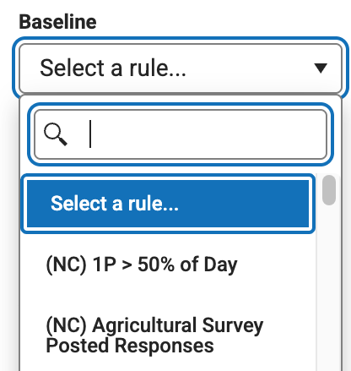
Validation Rules Overview: Baseline
Baseline: Explanation from the Knowledgebase
Allows the user to select an existing Validation Rule to run the current Validation Rule against.
The results of the Baseline Rule will be reported in the Total column of the report; it will also affect the Rate column which is calculated by dividing the current Validation Rule by the Baseline Rule.

Slide 58
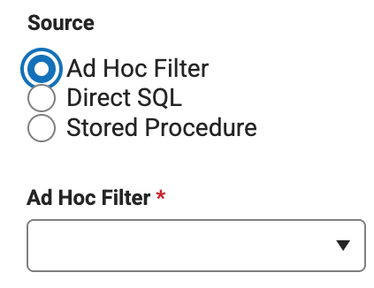
Validation Rules Overview: Ad Hoc Filter
Use the results from an ad-hoc filter for the validation.
Choose the student Ad Hoc FIlter from the drop down menu
Ad hoc must be available in your user account

Slide 59
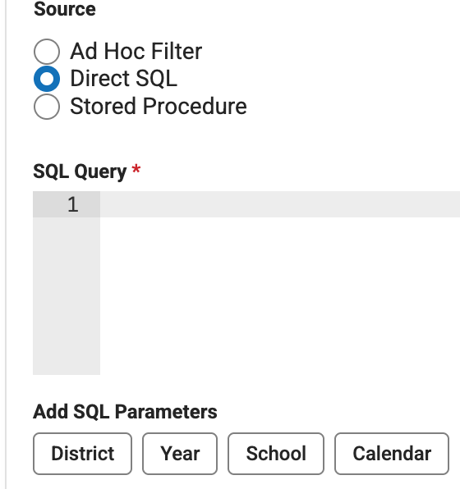
Validation Rules Overview: Direct SQL
Select Direct SQL
Type/paste SQL Query in the box
4 Parameters available to to limit to context:
{selectedDistrict}, {selectedEndYear}, {selectedSchool}, {selectedCalendar}
  Be sure to do this before sharing with user groups
Limited to SELECT statements

Slide 60
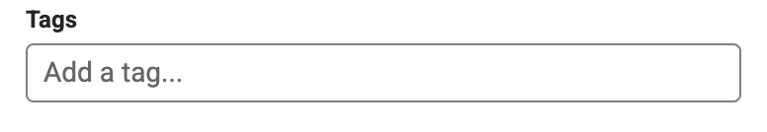
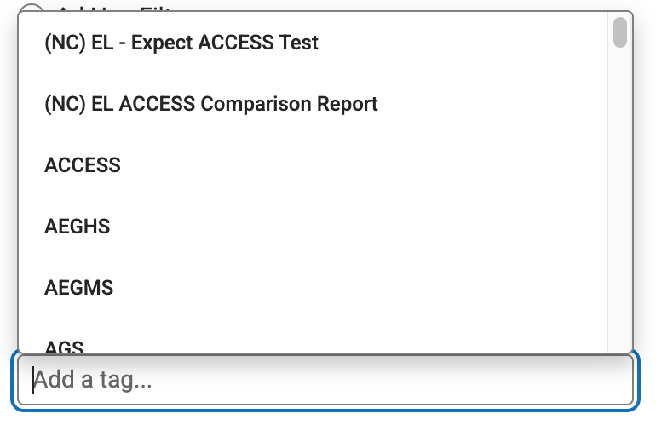
Validation Rules Overview: Tags
Enter tag(s) at the bottom of the page to describe the theme of the rule to find it easier later
You can choose from the list or type your own

Slide 61
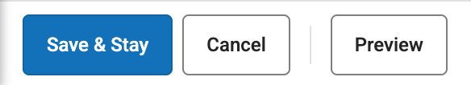
Validation Rules Overview: Saving and Running
Click “Save & Stay” to save your validation rule
  Note: not all well-written SQL will work in Infinite Campus
  Errors will pop up in a red box at the top right of the screen. It must be error-free to save.
Once saved, Preview will load the first 100 results in a pop-up window
Cancel returns you to the list of Validation Rules

Slide 62
Validation Groups

Slide 63
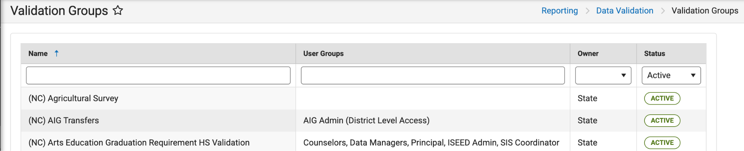
Validation Groups Overview
Use the Validation Groups tool to create a Validation Report, linking it to one or more Validation Rules and granting access to one or more User Groups
Access via Reporting > Data Validation > Validation Groups
Validation Groups can be searched and filtered using the same mechanism as Validation Rules

Slide 64
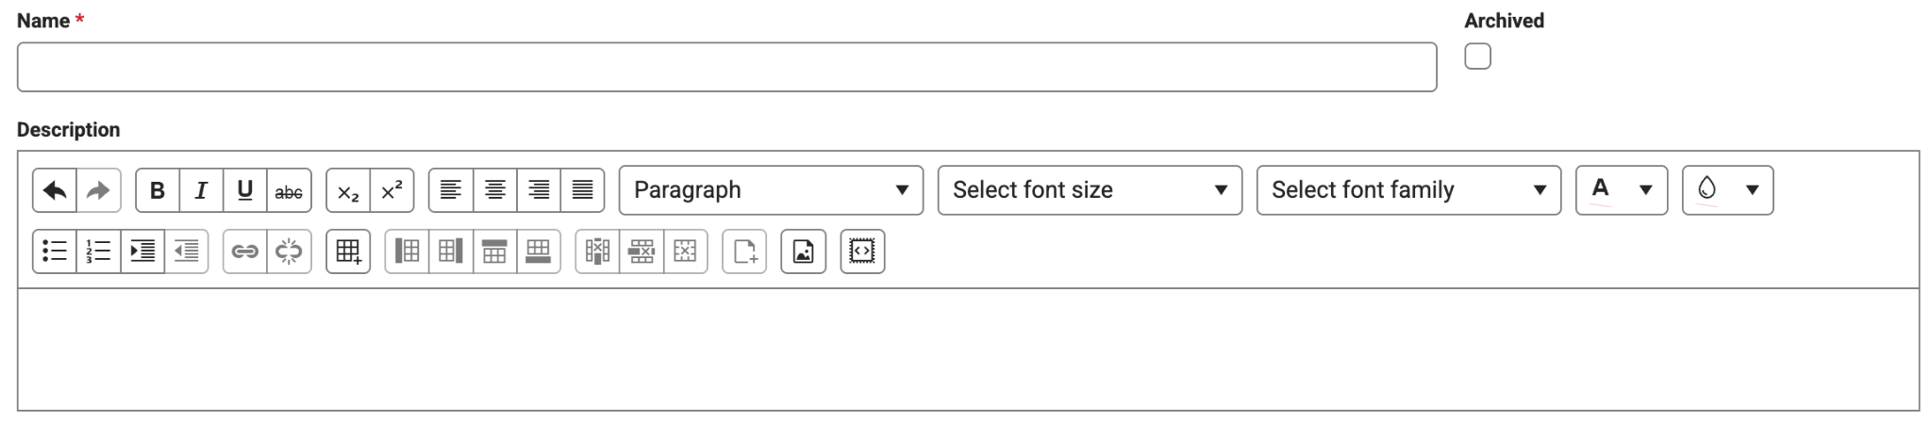
Validation Groups: Create, Name, Describe
The name you select is what will show up in the Validation Reports menu
Use the Archived checkbox to remove the validation group from the Active list
  Note: you can filter to Archived reports on the search menu
The description you choose will show on the validation group editor

Slide 65
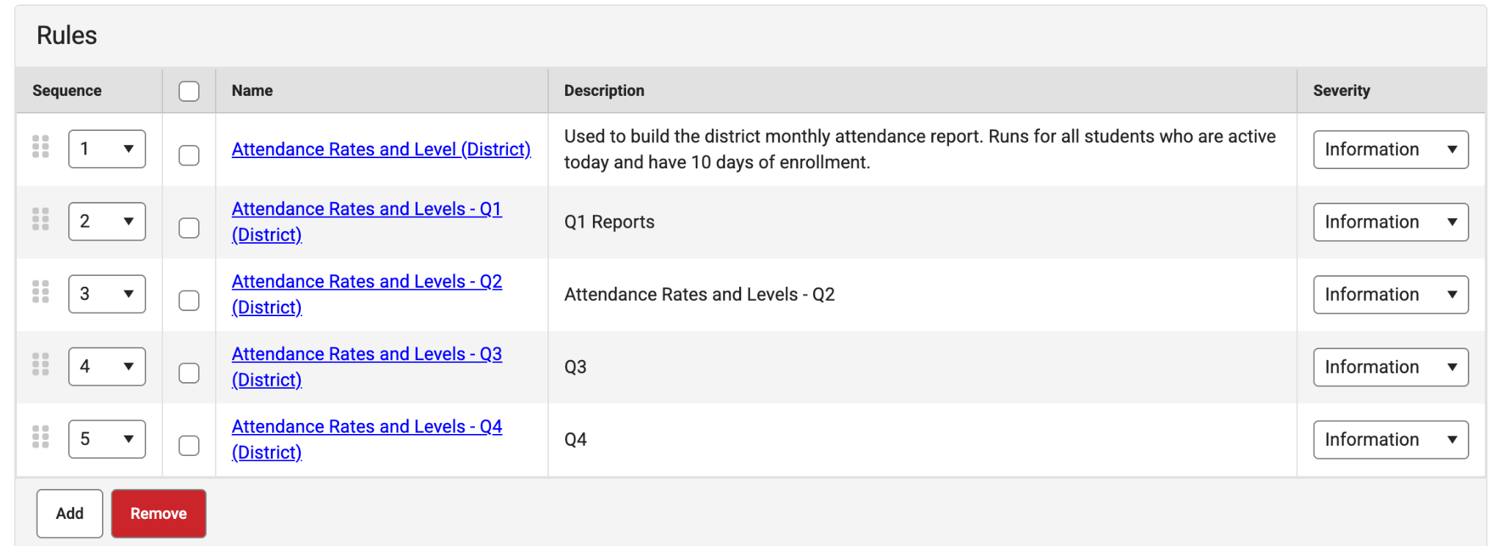
Validation Groups: Link and Order Rules
Link 1+ Rules to the Validation Group
Use the sequence column to set the order of the validation rules in the report
The name and description of the rules are displayed
Severity for validation rules can be set to Information, Warning, Fatal

Slide 66
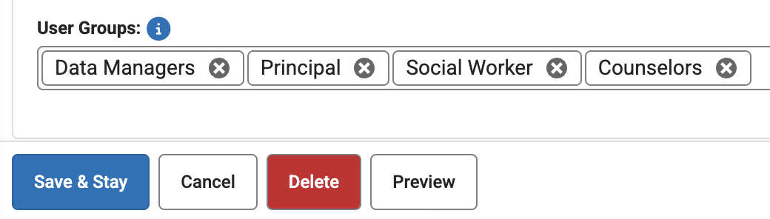
Validation Groups: Assign Groups, Saving
Assign User Groups at the bottom of the page.
  Note: users will only have access to their own Calendar of information, though the data in the report may exceed what they can typically see using their tool rights
Save & Stay to save the report
Cancel returns to the list of report
Preview returns a limited data set in an HTML popup

Slide 67
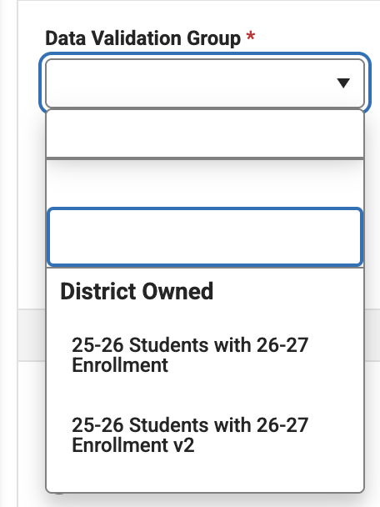
Validation Reports Overview: Selecting Reports
Reporting > Data Validation > Data Validation Report
Choose a desired report from the dropdown menu
Users only see reports granted to their user groups
Those with Student Information System access see all reports

Slide 68
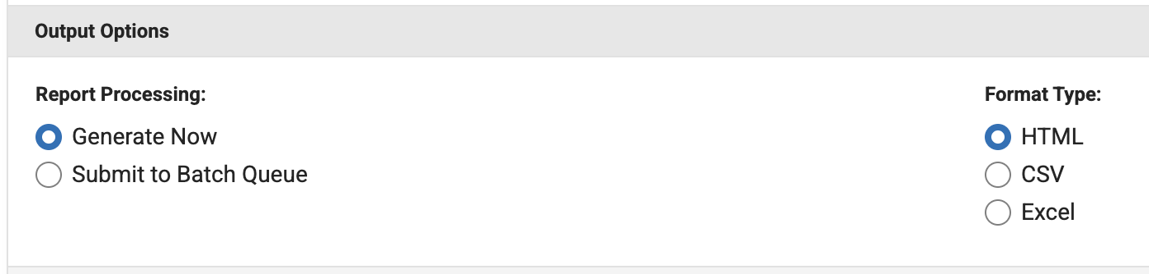
Validation Reports Overview: Output Options
Larger reports may need to be Submitted to Batch Queue
HTML is a popup and is helpful for quick running reports

Slide 69
You try!
Here’s some SQL Code from the Ad Hoc Community you can use your instance
Validation Report: Current Calendar Enrollments (Current & Future) SQL
Create 2 validation rules - be sure to preview
Create Validation Group - be sure to preview
Test through Validation Report

Slide 70
Not Covered:
Task Scheduler
Events & Actions

Slide 71
Task Scheduler

Slide 72
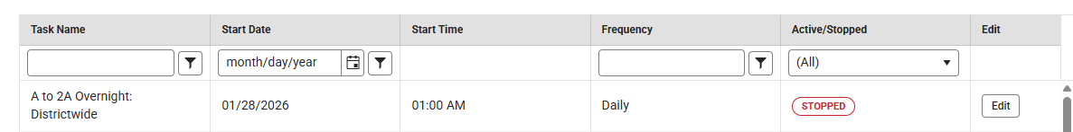
Task Scheduler Overview
The Task Scheduler is a tool to schedule and manage automated tasks
  Example: Convert A to 2A at the end of the day
This is the first tool that has edit/change/destructive ability
  Do not run any script unless you have tested it in your sandbox and are very confident in what it is doing
You can search and filter by Name, Start Date, Frequency, Active status
Click on edit to pull up the SQL being used
This tool can be used to regularly make changes, clear values, etc

Slide 73
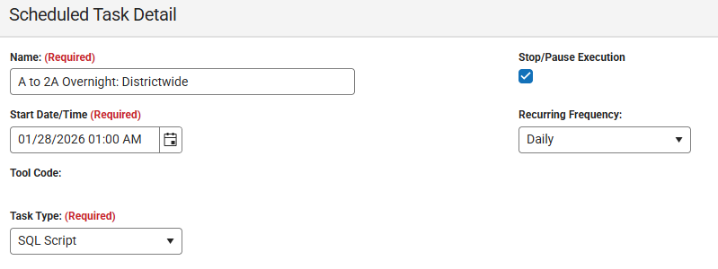
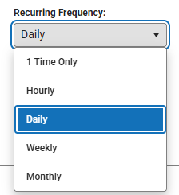
Task Scheduler: Create/Edit
Click edit or new on the Task Scheduler table
Set a name, Start Date/Time, and Recurring Frequency.
Choose SQL Script

Slide 74
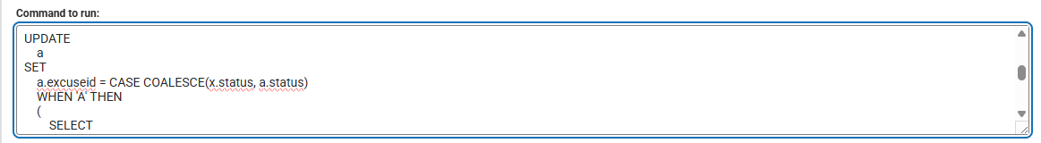

Task Scheduler: Create/Edit
Paste/write any SQL to run into the “command to run” box
Save/Cancel/Delete as appropriate

Slide 75
Data Validation Logic

Slide 76
Missing Data
Missing state ID
Missing counselor
Missing race/ethnicity

Slide 77
Logical Conflicts
End date before start date
Enrollment outside calendar dates
Active enrollment with inactive school

Slide 78
Duplicate/Overlap Conditions
Multiple primary enrollments
Overlapping enrollments
Duplicate student numbers

Slide 79
Compliance Risks
Missing homeless flags
Missing EL dates
Missing immunization status

Slide 80
Using AI Responsibly for SQL

Slide 81
How do I talk to AI?
First - Be Polite (It really matters)
Bad Prompt- Write a SQL for Infinite Campus
Good Prompt- Write a SQL query for Infinite Campus that identifies active enrollments where the student has no homeroom assigned. Include student number, name, grade level, and school name.

Slide 82
What does a Good Prompt do for AI?
Purpose
Conditions
Expected output

Slide 83
Business Rule First → SQL Second
Purpose
Conditions
Expected output

Slide 84
I know I need to find:
Students should not have overlapping active enrollments
  What defines active?
  What defines overlap?
  Which tables contain those fields?

Slide 85
AI Hallucinations & SQL Safety
AI may invent table names
AI may invent fields
AI may use generic SQL not IC schema
AI can create logically dangerous queries
Never run UPDATE/DELETE statements unless fully validated
Always test in non-production first

Slide 86
End Enrollment Focus:
Why end enrollment accuracy matters
Common errors
Validation examples
Reporting impacts
ADM implications
State reporting risks

Slide 87
Missing Data
SELECT
p.studentNumber,
i.lastName,
i.firstName
FROM Person p
JOIN dbo.[Identity] i
ON p.currentIdentityID = i.identityID
WHERE i.homePrimaryLanguage IS NULL
OR i.homePrimaryLanguage = ''
ORDER BY
i.lastName,
i.firstName;
Who is missing a home language?
Notes:
Identify records with missing required information before they impact reporting, communication, or operational processes.

Slide 88
Other Missing Data:
Missing Student Numbers
Missing Parent Email Addresses
Missing Home Language
Missing Race/Ethnicity
Missing Entry Dates
Missing State IDs
Missing Graduation Cohorts

Slide 89
How to ask AI: (Good Prompt)
I am an Infinite Campus SIS Coordinator. Help me write a Infinite Campus Data Validation Reports (Direct SQL) against a SQL Server database. Query to identify active students missing parent email addresses. Include student number, student name, grade level, school name, guardian name, and guardian email. Only include active primary enrollments. Use current identity records and sort by school, grade, and student name. If multiple parent/guardian records exist, return students where all guardian email fields are blank or null.

Slide 90
Formula for Building AI Prompts
What am I looking for?
Missing parent emails
What am I looking for?
Active students
Primary enrollments
What fields do I need?
Student Number
Student Name
Grade
School
Parent Name
Parent Email
What business rules apply?
Current school year
Active enrollments only
Blank or NULL values
How should the results be organized?
Sort by School → Grade → Student

Slide 91
Reusable AI Prompt:
Help me write an Infinite Campus Data Validation Reports (Direct SQL) query to identify [missing data element]. Include [fields needed]. Only include [active students/staff/etc.]. Apply these business rules: [rules]. Sort the results by [sort order]. Explain which tables and joins are being used.

Slide 92
Troubleshooting Failed Queries
At minimum, you can supply the error from your queries to your preferred AI tool
There are a few recurring errors that we have noticed, particularly around filtering to calendar or schools.
  Once you figure out a reliable way to filter this, you can reuse it each time.
Provide the AI tool 1 or more successful SQL queries to pattern after

Slide 93
Best Practices:
Do not supply any student data to AI Tools without a very clear understanding of their data privacy policies
Provide anonymized data or tell it to insert ###### where needed
Know when to quit - if it’s not working after 5-10 prompts, give up, get coffee, and try another approach
Try working with multiple AI tools, have them check each other’s code

Slide 94
Resources → Cheat Sheets→ Q&A
Use the collaborative Ad Hoc Reports community for ideas
SQL for Total Enrollments and Absences by Date
Future Enrollment Validation Reports (SQL)
DRAFT: Stored Grades Reports SQL
Finding 26-27 Course Requests for 25-26 Students (SQL)
NC SIS Users Group (Github)
Infinite Campus Developers User Group (Contact Mark Samberg)

Slide 95
After each session we ask that you please provide feedback in SCHED.

