Slide 1

End Enrollments
DPI Team will add QR code here
Jennifer Chapman, Tamara Dillard, Shantell Hemingway
Go Link: go.ncdpi.gov/2mptw

Slide 2
3rd Party Tools Disclaimer
NCBOLD is designed to support educators in the use of digital tools and technology to enhance learning outcomes. NCBOLD strives to model best practices for educators including data privacy and cybersecurity. As such, we want educators to be aware of the importance of following North Carolina’s 3rd Party vendor policy in using tools. As such, educators should follow the district’s policy and consult with their district’s (PSU) technology department prior to signing up students for digital tools.

Slide 3
NCSIS Tool Rights Disclaimer:
Any tool rights mentioned in this presentation are for informational purposes. Tool rights vary by PSU and are not determined by job title or role. Please contact your SIS Coordinator for specific guidance on tool rights within your PSU.

Slide 4
Acknowledgement of Generative AI Assistance
This content was developed with the support of generative AI tools for ideation, content development, design and research assistance. These technologies supported brainstorming, accelerated content development and assisted with organizing and refining ideas.
All AI-generated content was carefully reviewed and edited by the presenter to ensure accuracy, relevance, alignment with the sessions educational objectives and consistency with the presenter’s voice and style.
Reference
NC Generative AI Implementation Recommendations and Considerations for PK-13 Public Schools,
https://docs.google.com/document/d/1U-AwwwBg7glJ4ZDlcKVzARuFRPWwUWzqRN2rOgT9zlA/

Slide 5
End Enrollment Overview
Transfers - processing withdrawing a student from one school to another.
No Show Process - processing withdrawing a student who has not attended your school for the calendar year.
Dropout - properly marking a student that leaves early/no shows 10+ days
Graduation - graduating students and ending their enrollments

Slide 6
End Enrollments Helpful Links
Student End Enrollment Checklist
NC No Show Process
Summer Graduates
End of Year Closeout Checklist
End Enrollments at EOY

Slide 7
Withdrawals and Accountability
The state requires a Cohort Graduation Rate (CGR) file to be completed to determine a school’s graduation rate. Any student who leaves a PSU must have the appropriate documentation in order to not count against a school’s graduation rate.
Check with your NCSIS coordinator or your accountability department to get a list of required documents for withdrawal.
Example: Homeschool documents with parent signature, school records requests, etc.

Slide 8
Check before you exit:
Attendance: Verify all attendance entries (including suspensions) for the student have been entered and assigned the appropriate attendance code.
Grades: Verify with all of the student's teachers that all grades have been entered prior to ending the enrollment for the student.
Discipline: Verify all incidents have been entered for the student prior to ending the enrollment for the student.
Programs: Verify that student programs are accurate prior to ending enrollment for the student.
Testing/Accommodations: Verify the student EC data is accurate prior to ending the enrollment of the student.
Immunizations: Verify the immunization record is entered and up-to-date if your PSU enters immunizations into Infinite Campus.
Emergency Contacts: Verify that emergency contacts are up-to-date prior to ending the enrollment for the student.

Slide 9
Withdrawals and Accountability
The state requires a Cohort Graduation Rate (CGR) file to be completed to determine a school’s graduation rate. Any student who leaves a PSU must have the appropriate documentation in order to not count against a school’s graduation rate.
Check with your NCSIS coordinator or your accountability department to get a list of required documents for withdrawal.
Example: Homeschool documents with parent signature, school records requests, etc.

Slide 10
Print before you end:
Schedule (if printed after withdrawal you will need to change the date of the schedule for printing)
Transcript (if courses are in progress you will lose them on transcript if this is printed after exit)
Any other documents you need to send based on your school.
Attendance and Discipline can be printed prior to exiting, but you will need to pay attention to exit dates.

Slide 11
Ending an Enrollment: What to Remember
Student’s End Date will be the last day they attended school
Students who are suspended should have an end date of their last day of suspension
Process requests within 48 hours - if not duplicate documents could be imported
Confirm that the student's End Date has been accurately entered
Ensure all records are complete before releasing them to the next school

Slide 12
Transfer Out

Slide 13
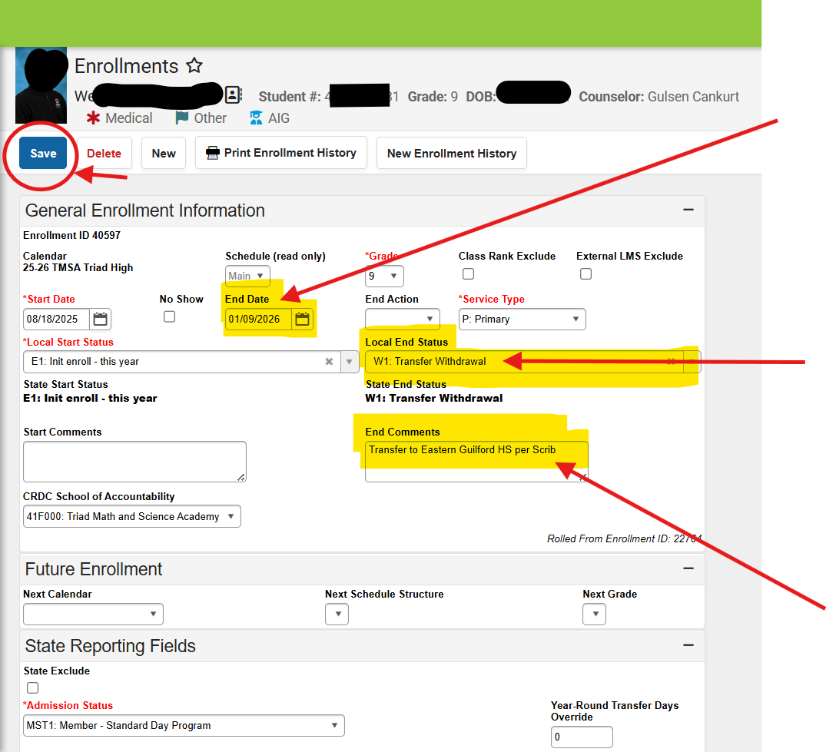
End Enrollment Student Information>General>Enrollments
Census>People>Enrollments
Select the last present/active date
Select the correct end status
Enter end comments - Suggested for CGR to indicate how req was received.

Slide 14
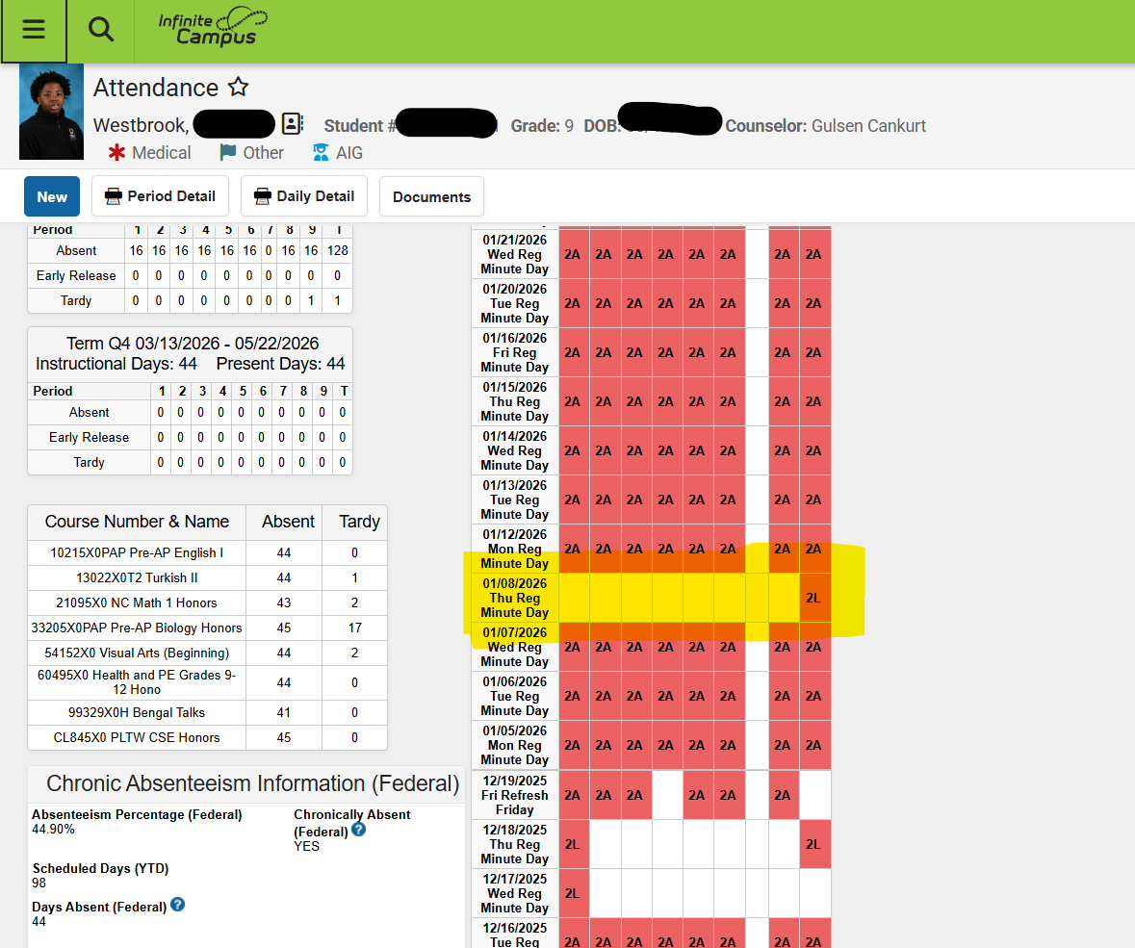
Last Present day was Friday, January 9th. Exit date is January 9th.
*If the last day present does not seem correct, check with teachers about attendance.
For a suspension - exit date is last date of suspension.

Slide 15
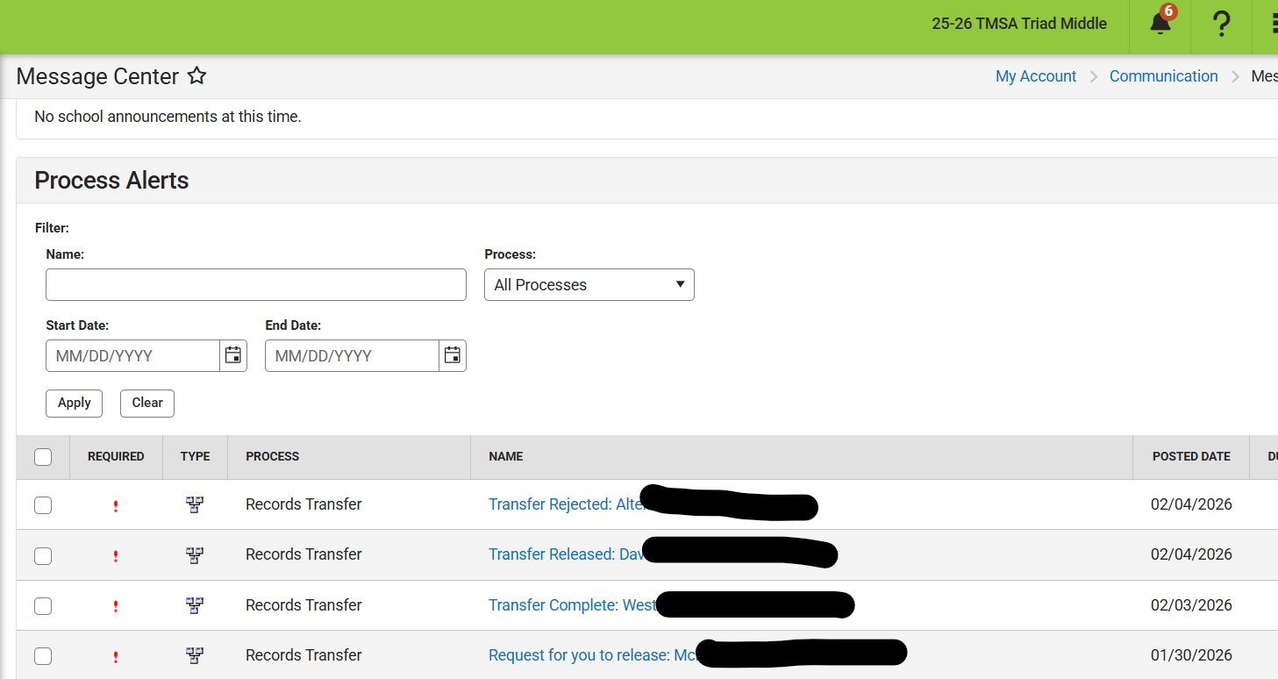
Message Center Info
Transfer rejected: either you or the other school rejected the transfer.
Transfer Released: the prior school released records to you.
Transfer complete: You released the IC files to the new school.
Request to release: New school is requesting transfer of records.

Slide 16
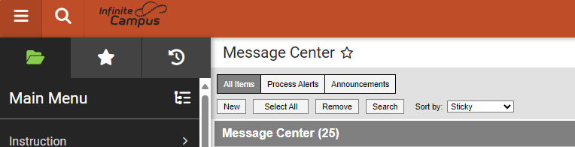
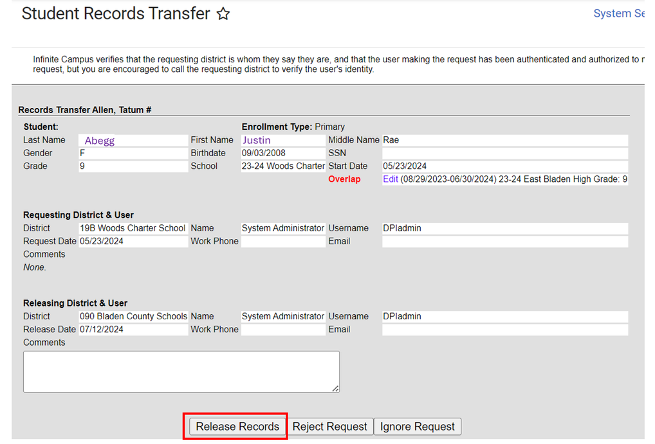
Navigation: My Account > Communications > Message Center > Release Request Message
Navigation: My Account > Communications > Message Center > Release Request Message
End Enrollment
Requests will be listed for out of district transfers
Find the Release Request notification in the Message Center and click on it to open the Student Records Transfer Screen.
Select the Release Records button.

Slide 17
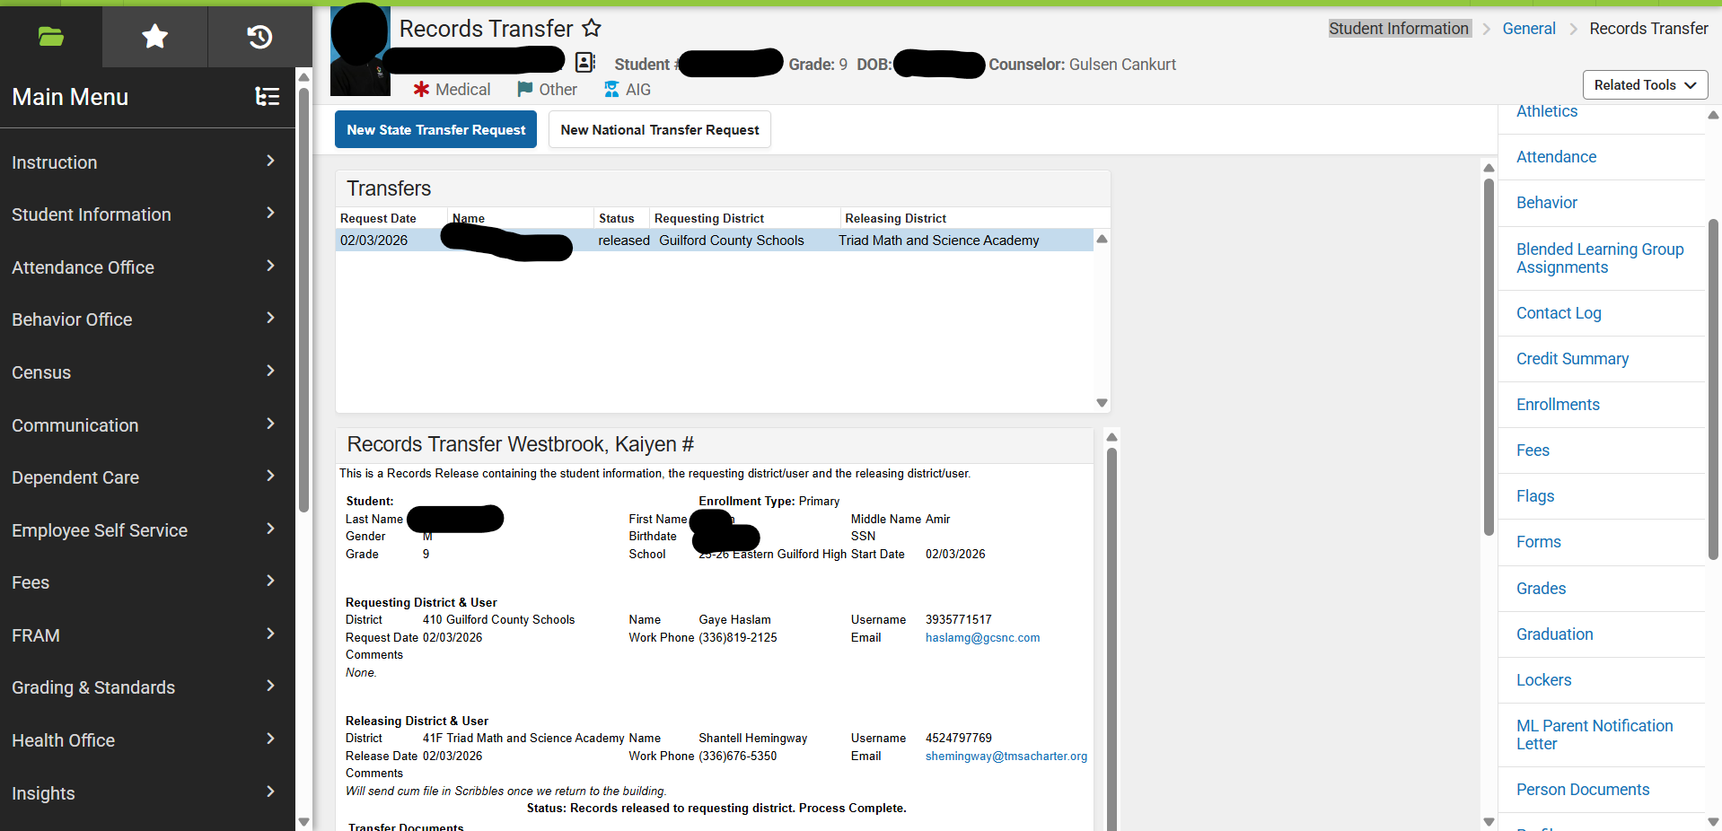
Release Request
Status will be released, rejected, or ignore
Comments are seen by new school.

Slide 18
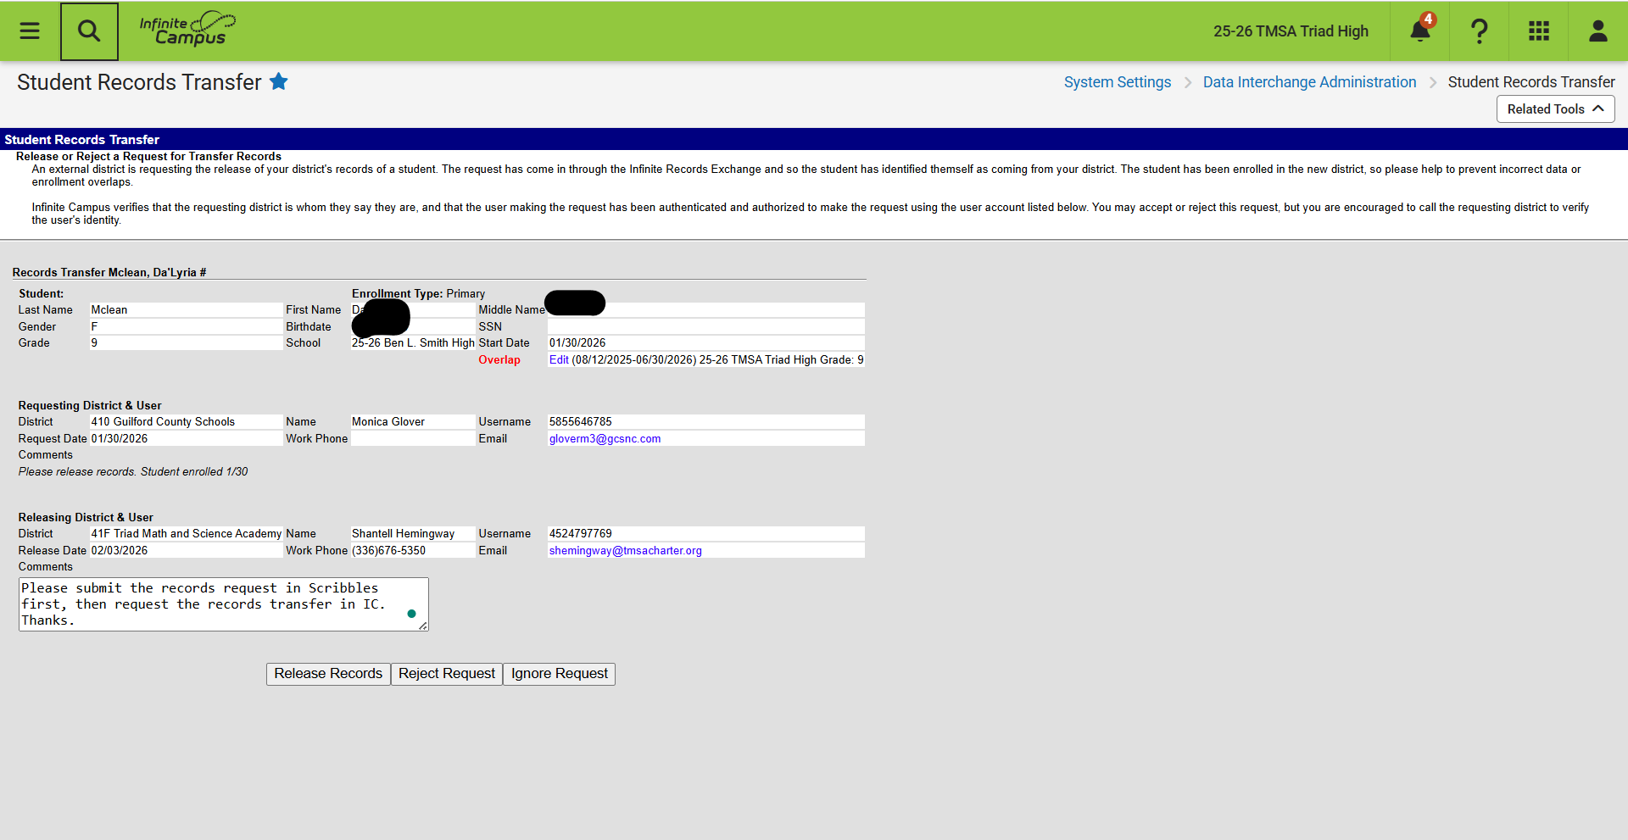
Reject Request
Infinite Campus records transfer requests are not requesting records/cumulative files. It is best practice to have an official records request before releasing a student. However, it is up to your school.
Best practice: If you have not received an official records request from the school, leave a comment and reject the request. DO NOT Ignore requests.

Slide 19
No Show/Summer End Enrollment

Slide 20
No Show/Summer End
Start Date 7/1/XXXX
Leave "Local Start Status"
Select the No Show Checkbox
End Date 7/1/XXXX
Input a "Local End Status" (ref. SASA manual for End Status codes)
  Leave blank during 1st 10 Days for auditing purposes
  Enter W1 - Transfer Withdrawal
  Enter other appropriate End Status code
Optional: Enter "End Comments"
Click Save
A Summer End Enrollment is when the student never attended your school and you have a records request.
A student is a No Show if they are absent for more than half the instructional day on their scheduled first day of school during the current school year. No show students were expected to attend but did not show up.

Slide 21
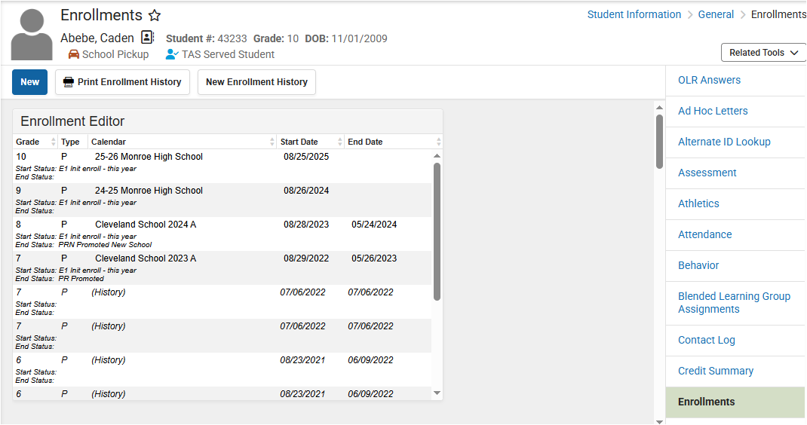
Select Student > Related Tools > Enrollments > Current Year enrollment record
No Show/Summer End Enrollment
Select the current enrollment record

Slide 22
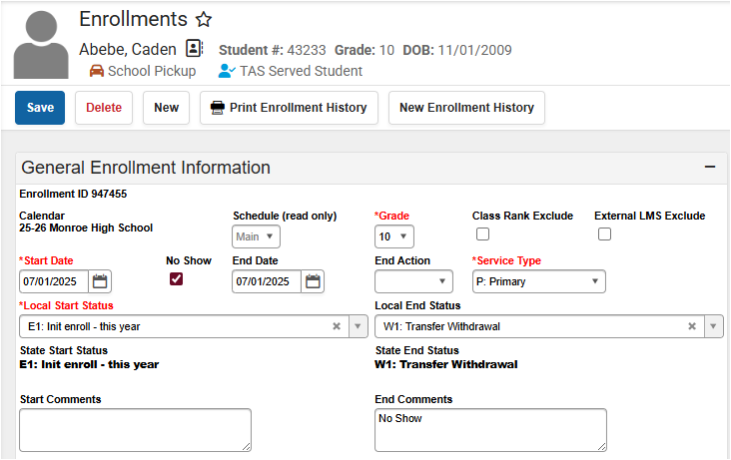
No Show/Summer End Enrollment
Navigation: Student Information > General > Enrollments
Check the No Show box
Populate the Start & End Date (7/1/xxxx)
Populate the Local End Status and End Comments

Slide 23
Drop Out

Slide 24
Definition of a Dropout
Definition of a Dropout All Public School Units (PSU) and schools in North Carolina are to use the following definition for a dropout. To ensure accuracy and consistency in reporting dropouts, dropout data coordinators should become thoroughly familiar with the definition and its interpretations based on state laws and policies.
A "dropout" is an individual who:
• was enrolled in school at some time during the reporting year;
• was not enrolled on day 20 of the current year;
• has not graduated from high school or completed a state or district approved educational program; and does not meet any of the following reporting exclusions:
1) transferred to another public school district, private school registered with the NC Department of Non-Public Education, home school registered with the NC Department of Non-Public Education, or state/district approved educational program (not including programs at community colleges),
2) temporarily absent due to suspension or school approved illness, or
3) death.

Slide 25
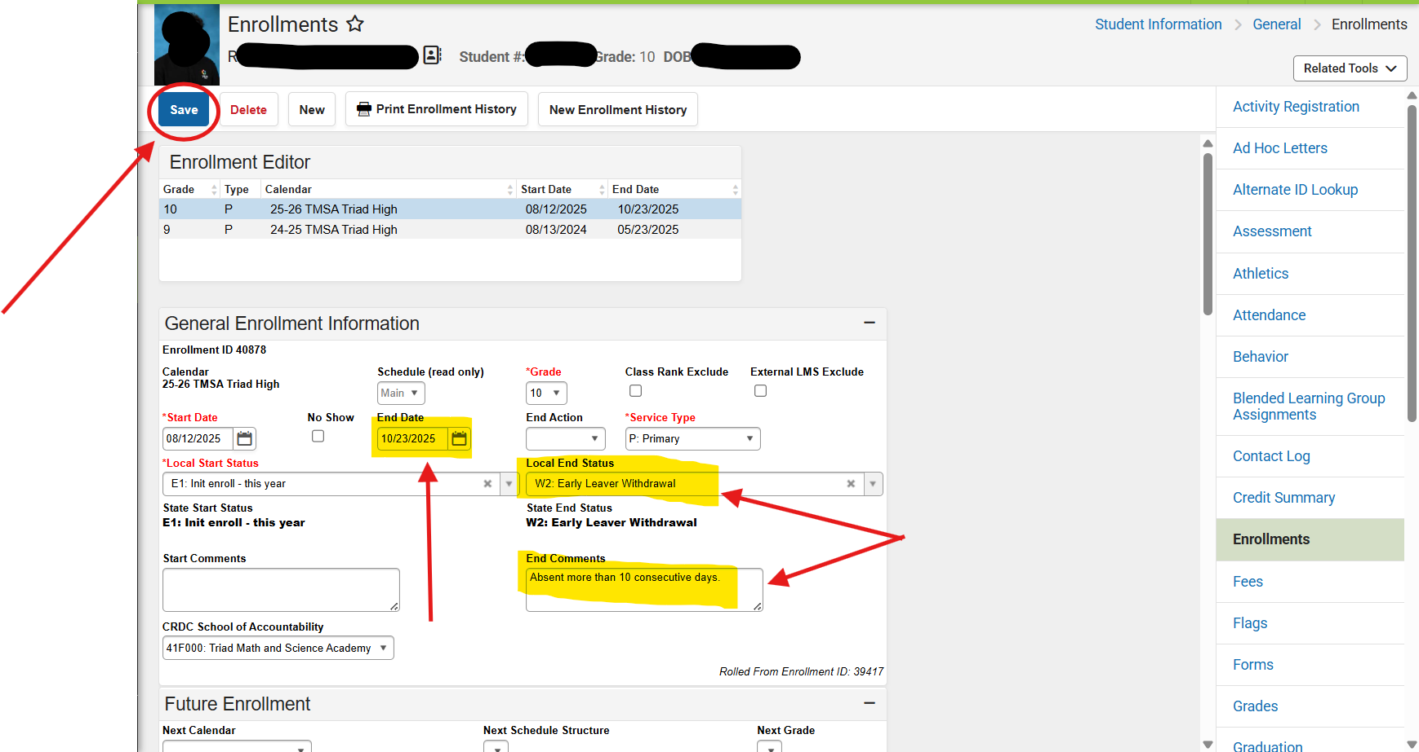
End Enrollment for Dropout
How to Add a Dropout Record - NC Infinite Campus
Always Save
Fill these in
Last Day in class

Slide 26
End Enrollment for Dropout
How to Add a Dropout Record - NC Infinite Campus
Always Save
Fill these in
Last Day in class

Slide 27
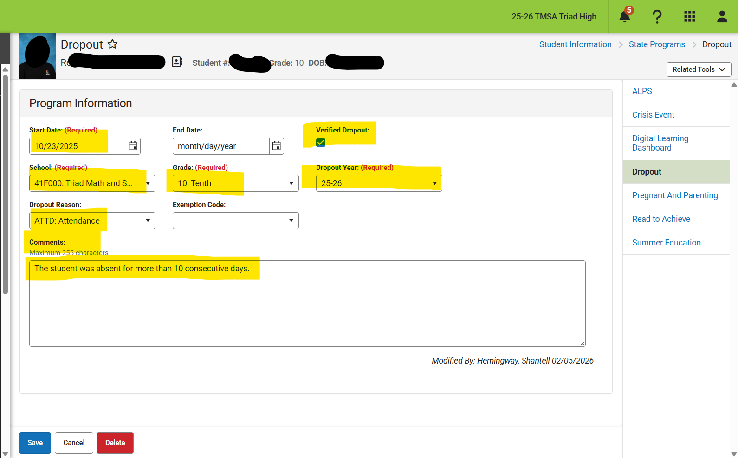
Navigation: Student Information > State Programs > Dropout
End Enrollment for Dropout
Program Start Date is exit date.
Check the Verified Dropout box.
Enter the School, Grade, Dropout year, Dropout reason.
Comments are suggested.
Then Save.

Slide 28
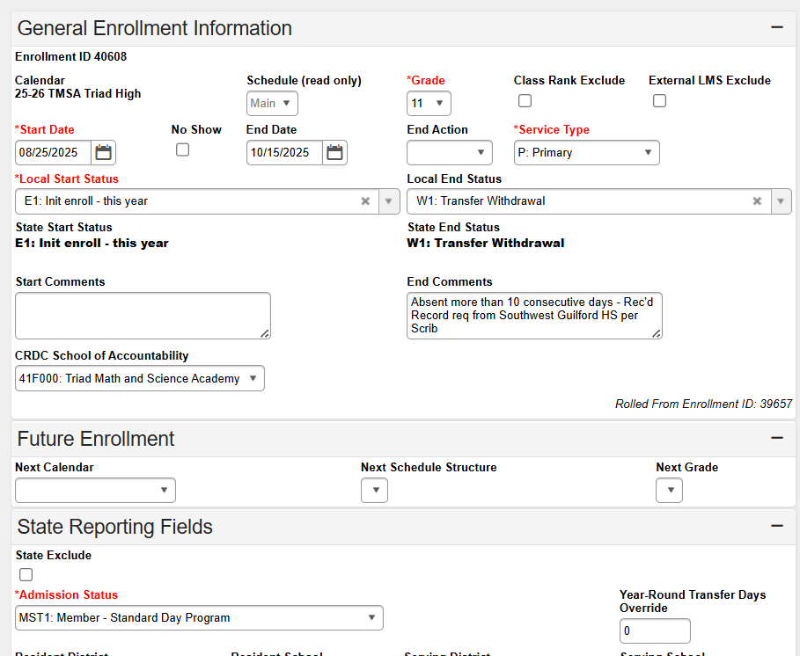
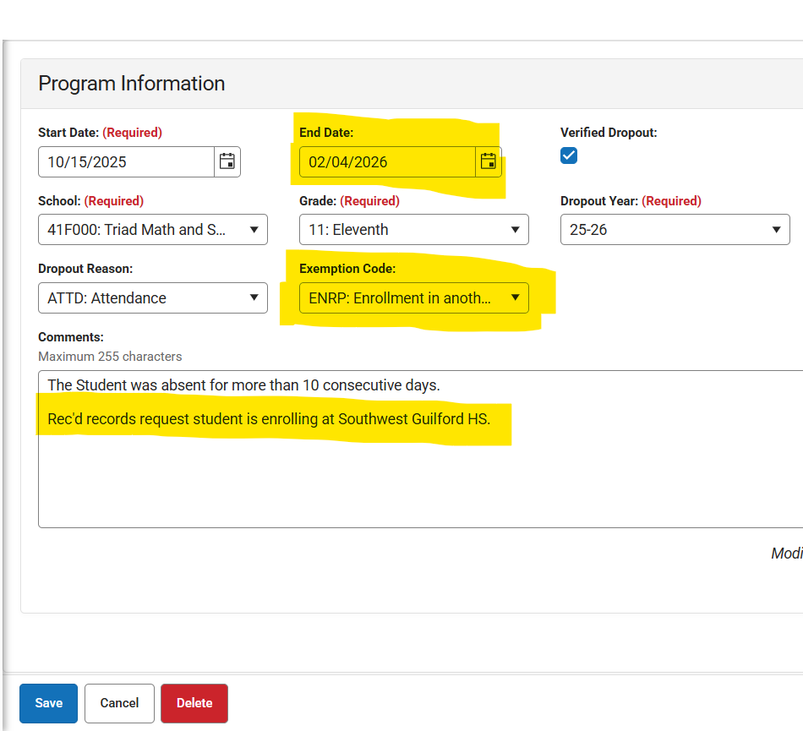
Removing Dropout
Navigation: Student Information > State Programs > Dropout
Program End date if you have verification of new start date
Enter Exemption Code
Edit or add a comment
Then Save
Change the W2 enrollment code to W1 and note the request

Slide 29
Graduation and End of Year

Slide 30
End Enrollment for Graduation
Individual Student Graduates
Post Grades to Transcript
Menu > Student Information > General Student Administration > Transcript Post Wizard
Transcript Post Wizard | Infinite Campus
Verify Graduation Program is assigned
Menu > Student Information > Academic Planning > Programs
Graduation Program Assignment | Infinite Campus
Verify CTE Programs are assigned (if applicable)
Menu > Student Information > Academic Planning > Programs
CTE Program Assignment | Infinite Campus
Calculate Graduation Plan On-Track Status
Menu > Student Information > Program Administration > Course plan Administration
Course Plan Administration | Infinite Campus
This process will also calculate CTE Concentrator Status for those assigned to a CTE Program. This will run for all students. This process is taxing on the system, and it is recommended to be run after regular business hours.

Slide 31
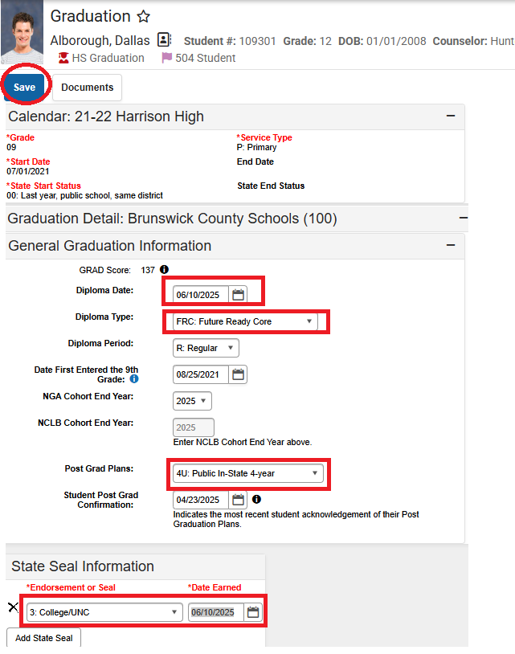
Navigation: Student Information > General > Graduation
End Enrollment for Graduation
Populate the Diploma Type
Before you leave this page, select the Save button
Populate Post Grad plans
Populate the Diploma Date (student’s last day of instruction)
Add Seals (Endorsements)

Slide 32
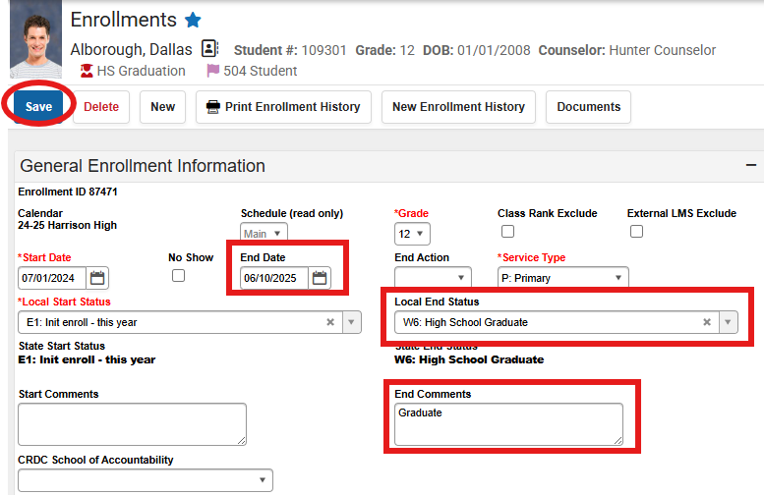
End Enrollment for Graduation
Navigation: Student Information > General > Graduation
Before you leave this page, select the Save button
Populate the End Date (the last day the student sat in a class)
Populate the Local End Status and End Comments

Slide 33
End Enrollment EOY
When ending enrollments graduates end date is the last day of instruction - not their graduation date. If graduation is before last day the students should be marked 2A for last days of instruction.
It is best practice to end graduates, then end retentions, and do everyone else last.
Enrollment Roll Forward Wizard 1st - DO NOT Roll forward your Seniors!
Once you have rolled forward your enrollments then go to the Enrollment End Batch Wizard.

Slide 34

What works for me:
Keep a spreadsheet or withdraw tracker
Take action quickly
Use a checklist
Connect with all parties (EC, 504, ML, etc.)
Monitor the message center for send and receive requests

Slide 35

End Enrollments
Click here to ask your questions

Slide 36
After each session we ask that you please provide feedback in SCHED.

