Slide 1
COOKING WITH CONSEQUENCES
Teaching Allergens, Restrictions, and Student Accountability

Slide 2






INTRODUCTION
Dominic Hawkes M.C.G.B.
Culinary Arts | Lancaster Career Center, SC
Ed. Consultant | Author
ACTE | ProStart | NRAEF | MCGB | CMAA | ACF EFAC

Slide 3
Is our program as dangerous as other CTE workshops?
Students must:
Understand the dangers of the kitchen – hot & sharp
Understand the dangers I can be to others
Understand the danger I can be to those who enjoy my food!

Slide 4
—Calvin Coolidge
30th US President
PERSISTENCE
“Nothing in the world can take the place of Persistence. Talent will not; nothing is more common than unsuccessful men with talent. Genius will not; unrewarded genius is almost a proverb. Education will not; the world is full of educated derelicts. Persistence and Determination alone are omnipotent. The slogan “Press On” has solved and will always solve the problems of the human race.”

Slide 5
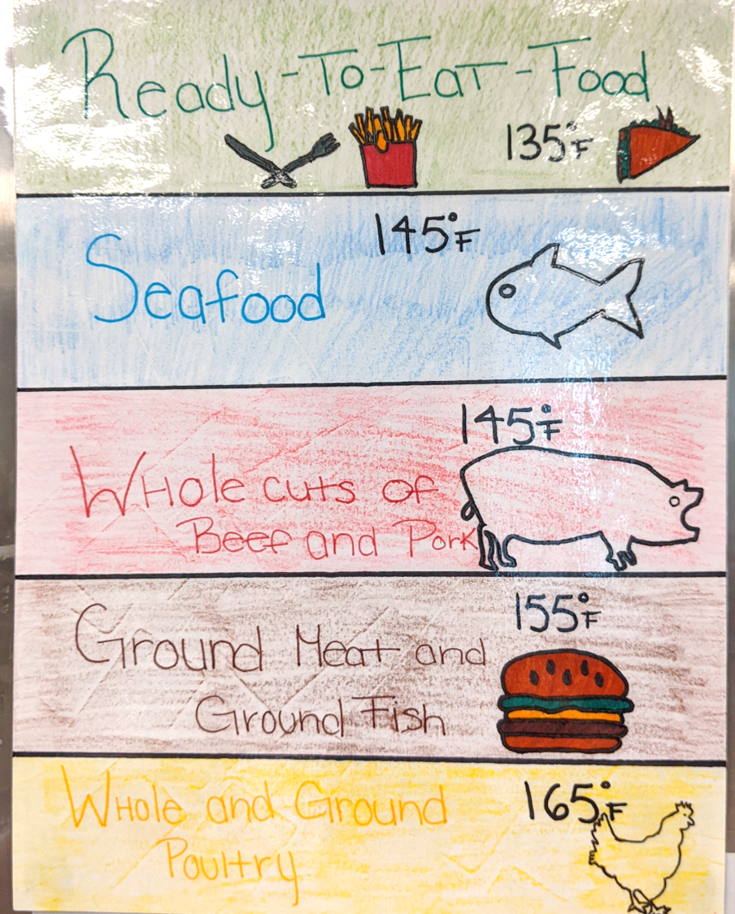
FOOD SANITATION
Create Games
Visuals
Practical Applications
Audio Reviews
Practice Tests
Build it into your program.
Reinforce every day, with every activity to make it habit.

Slide 6
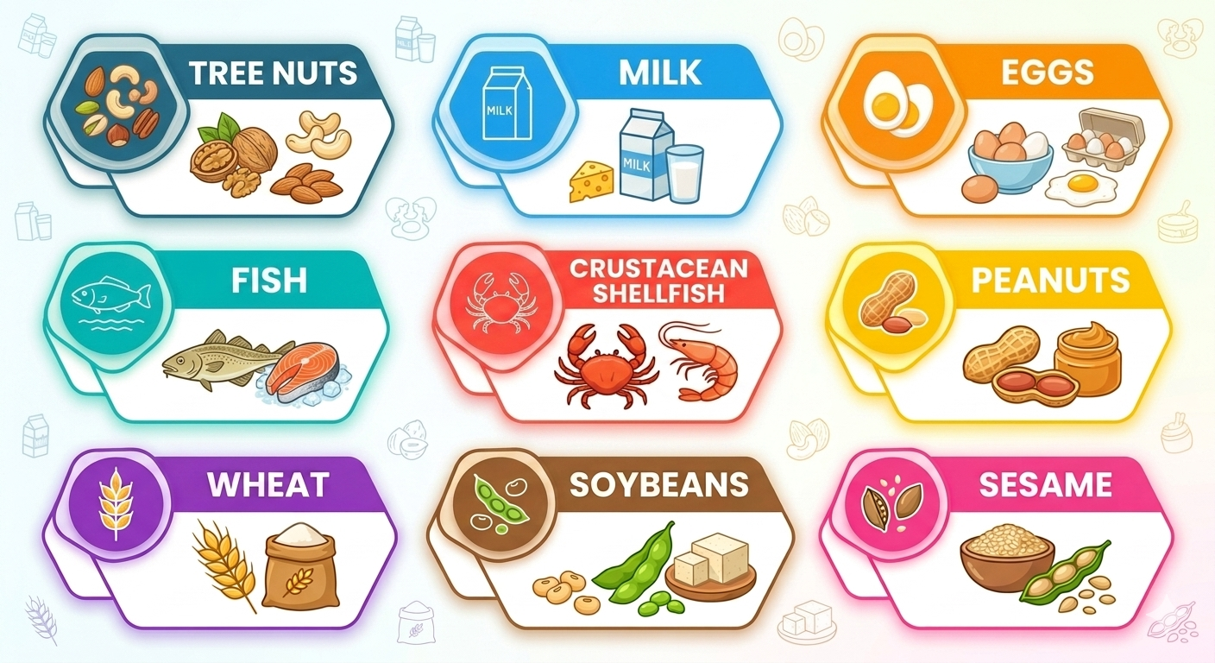
FOOD ALLERGIES: THE BIG 9
Awareness and Training:
Employees must complete training on the nine major food allergens, their risks, and how to recognize the symptoms of an allergic reaction.
*
*New to the 2022 FDA Food Code

Slide 7
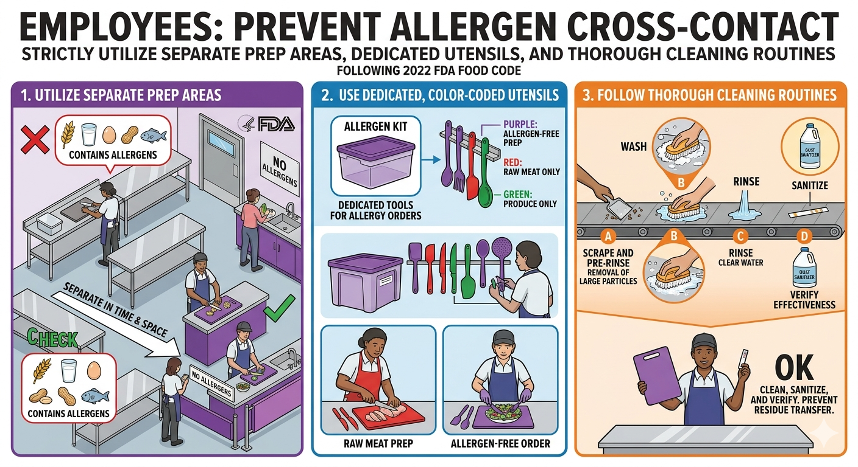
FOOD ALLERGEN TRAINING
Cross-Contact Prevention:
Staff must prevent allergen cross-contact by strictly utilizing separate prep areas, dedicated utensils, and thorough cleaning routines.

Slide 8
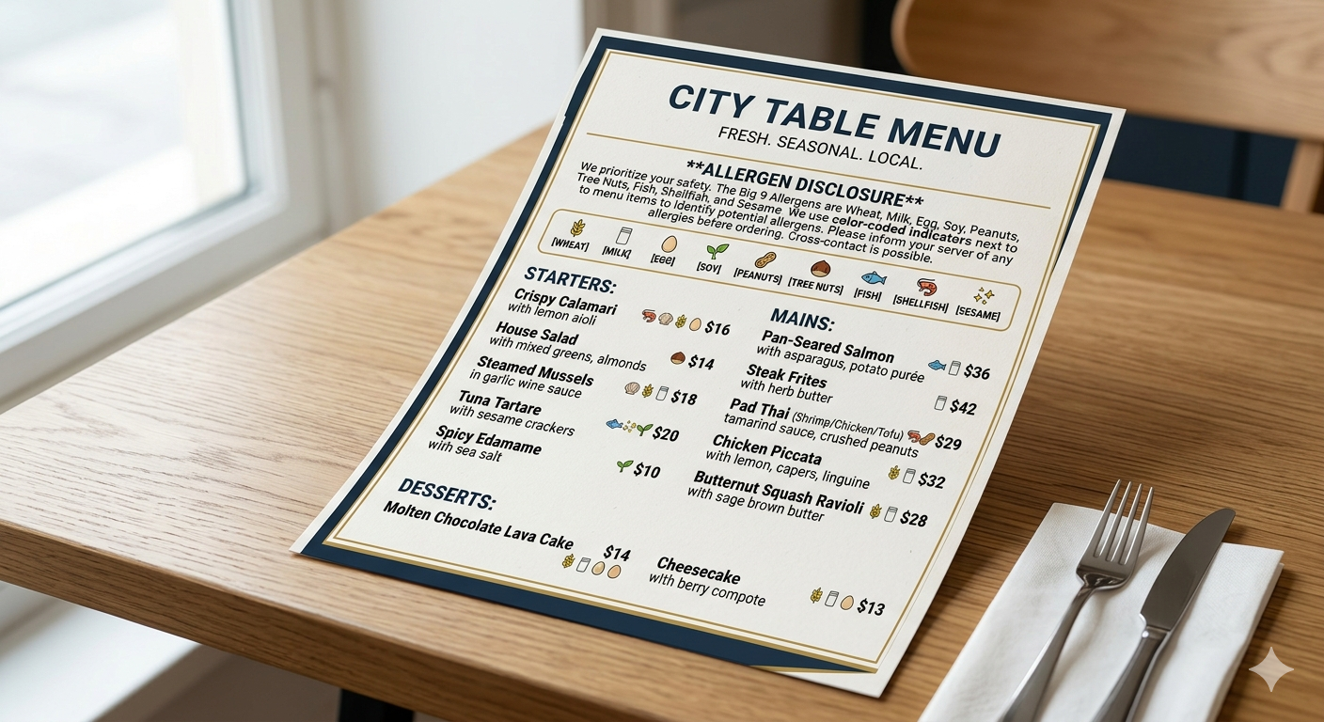
FOOD ALLERGEN TRAINING
Accurate Disclosures: Employees must correctly communicate allergen contents to guests and help the establishment maintain mandatory written notifications for unpackaged foods and bulk displays.

Slide 9
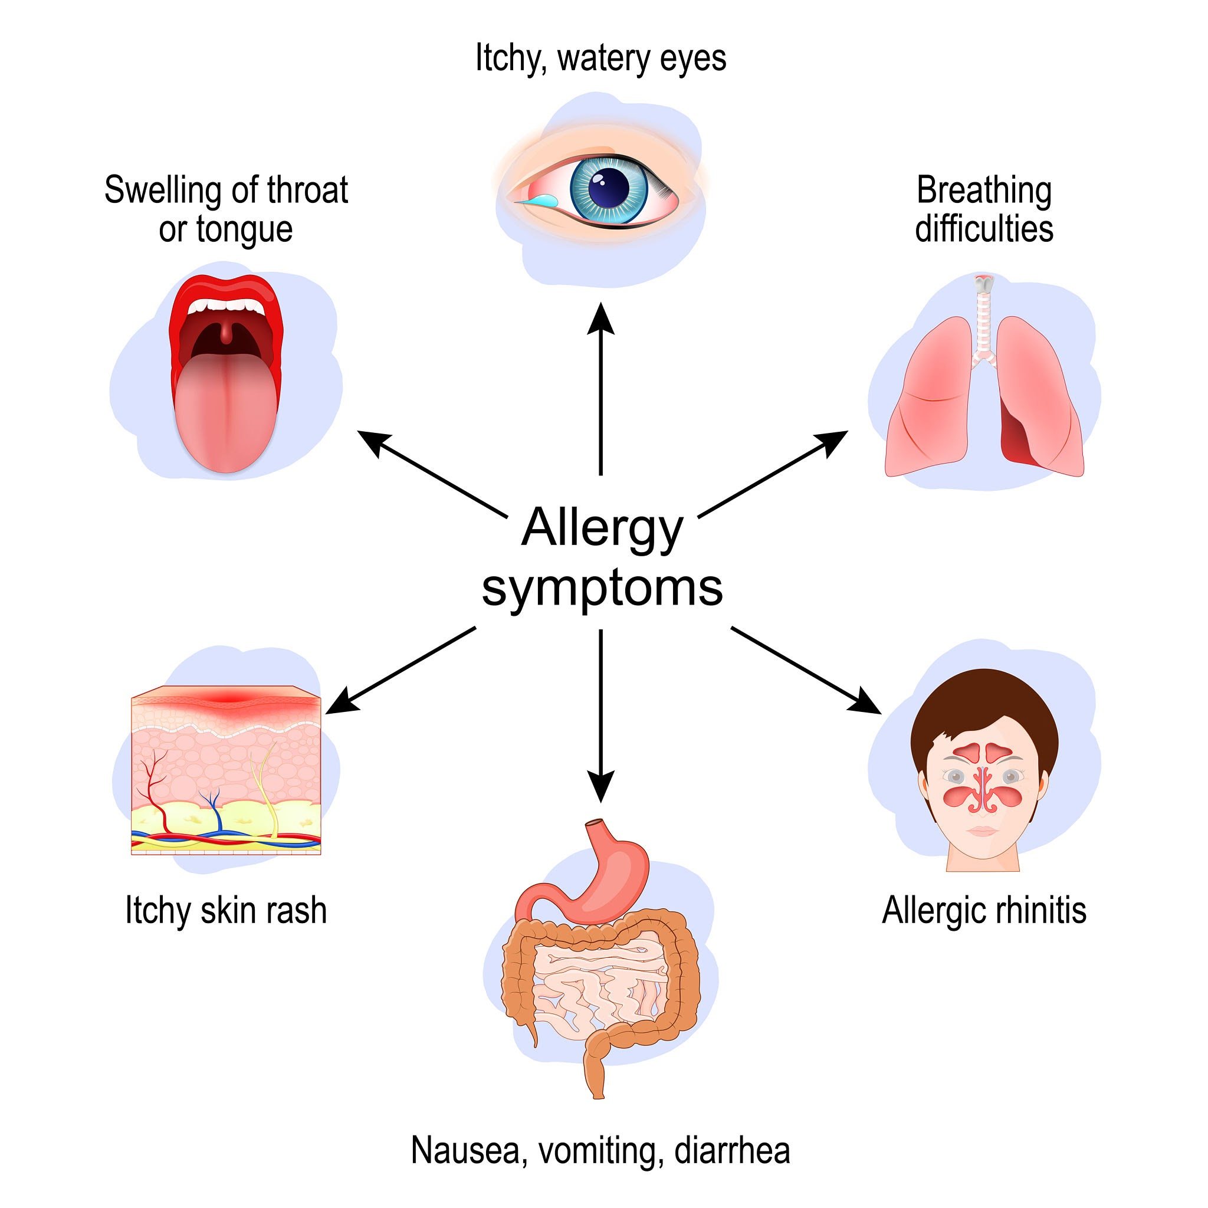
FOOD ALLERGEN TRAINING
Emergency Recognition: Employees are expected to recognize if a customer is showing signs of an allergic reaction so they can rapidly respond and summon medical assistance.

Slide 10

Share a best practice, activity, game, cooking lab.
Teaching the understanding of allergens:

Slide 11
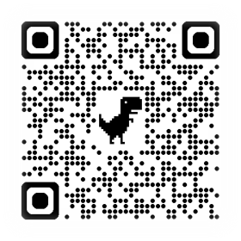
Let's serve up some Chicken Alfredo!

Slide 12

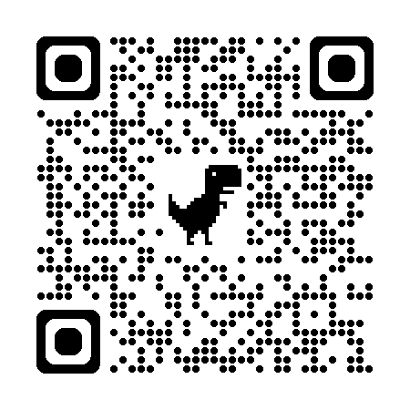

Thank
You!
Feel free to reach out if you have any questions!
Dominic Hawkes MCGB
dominic.hawkes@lcsd.k12.sc.us
NCE Conference Series Session 3 of 5
Next session coming up tomorrow!

