Slide 1





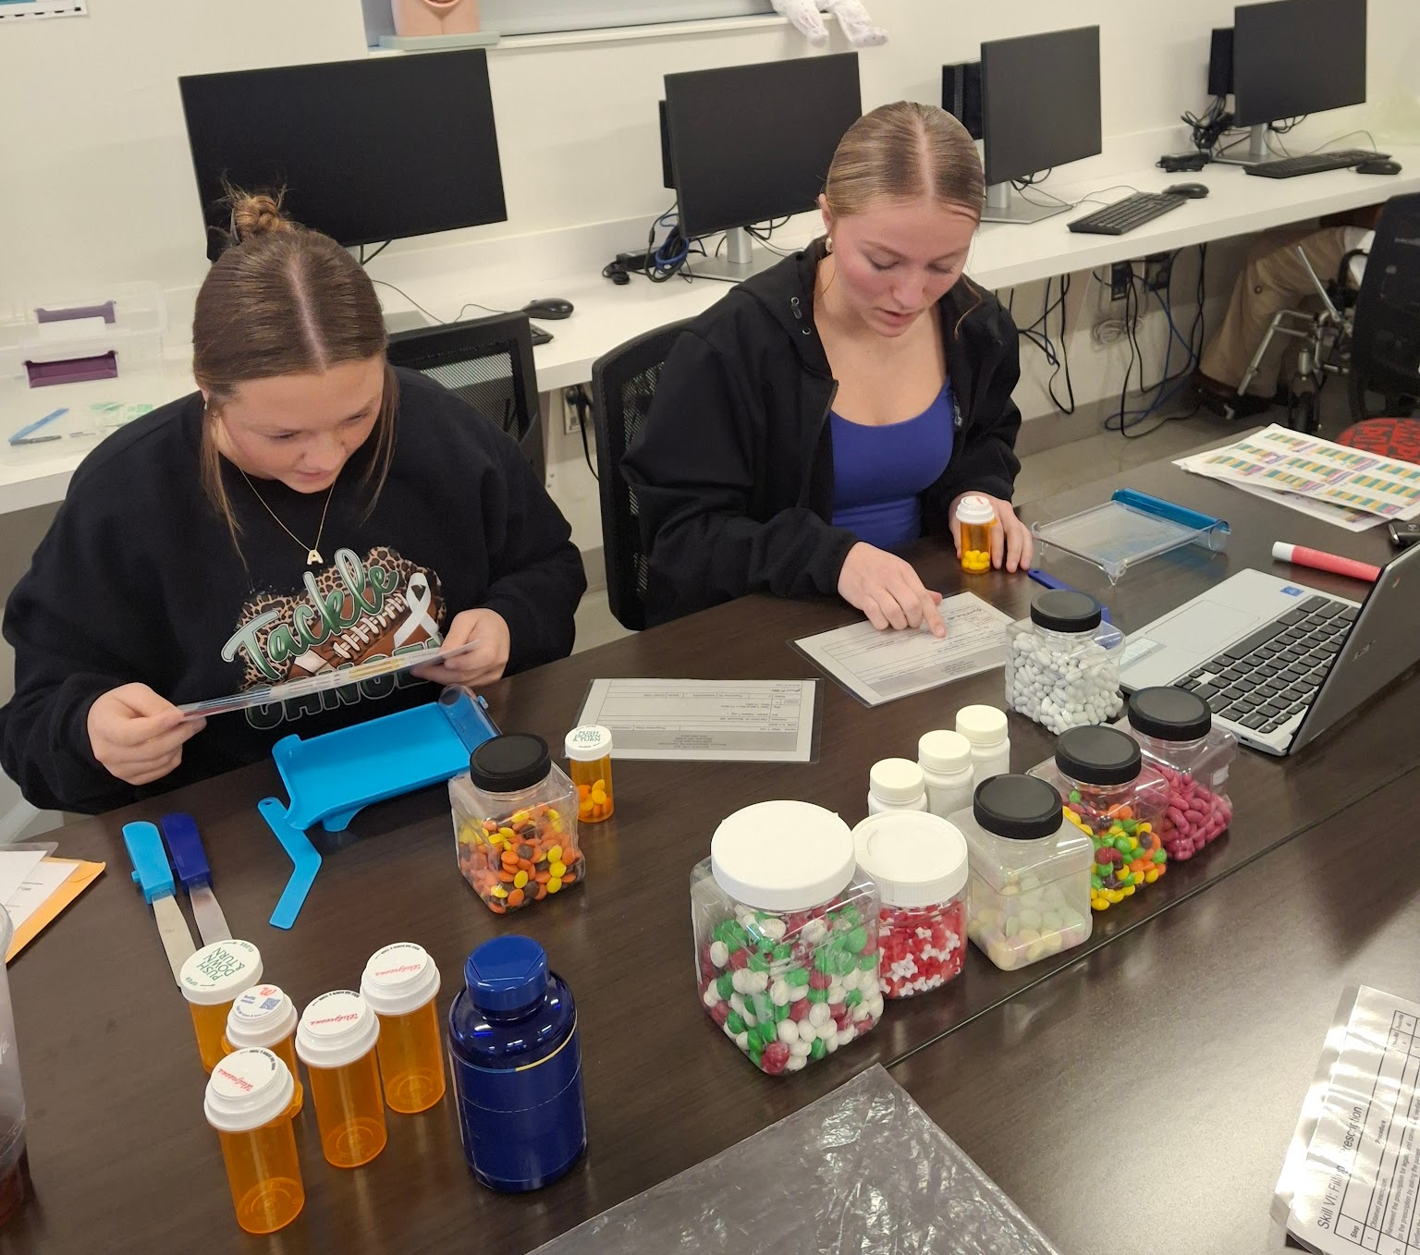

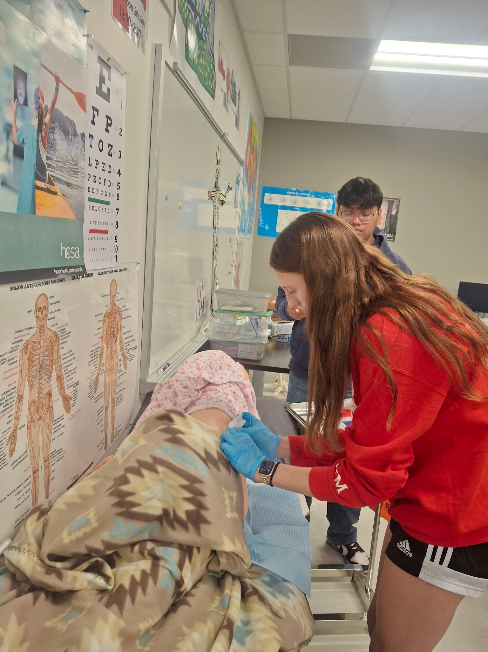
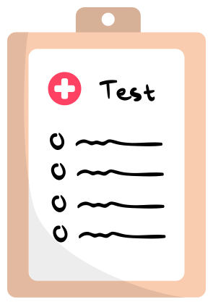
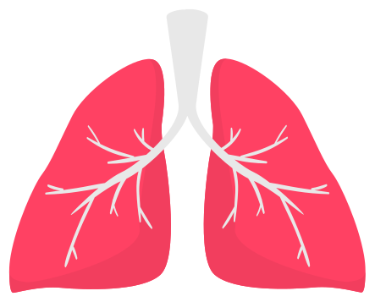
From Rubrics to Reality
Using HOSA Health Professional Events as Daily Instruction
Session 1 & 2
Dale Mundil - Pathways 2 Tomorrow
Link to all
documents

Slide 2
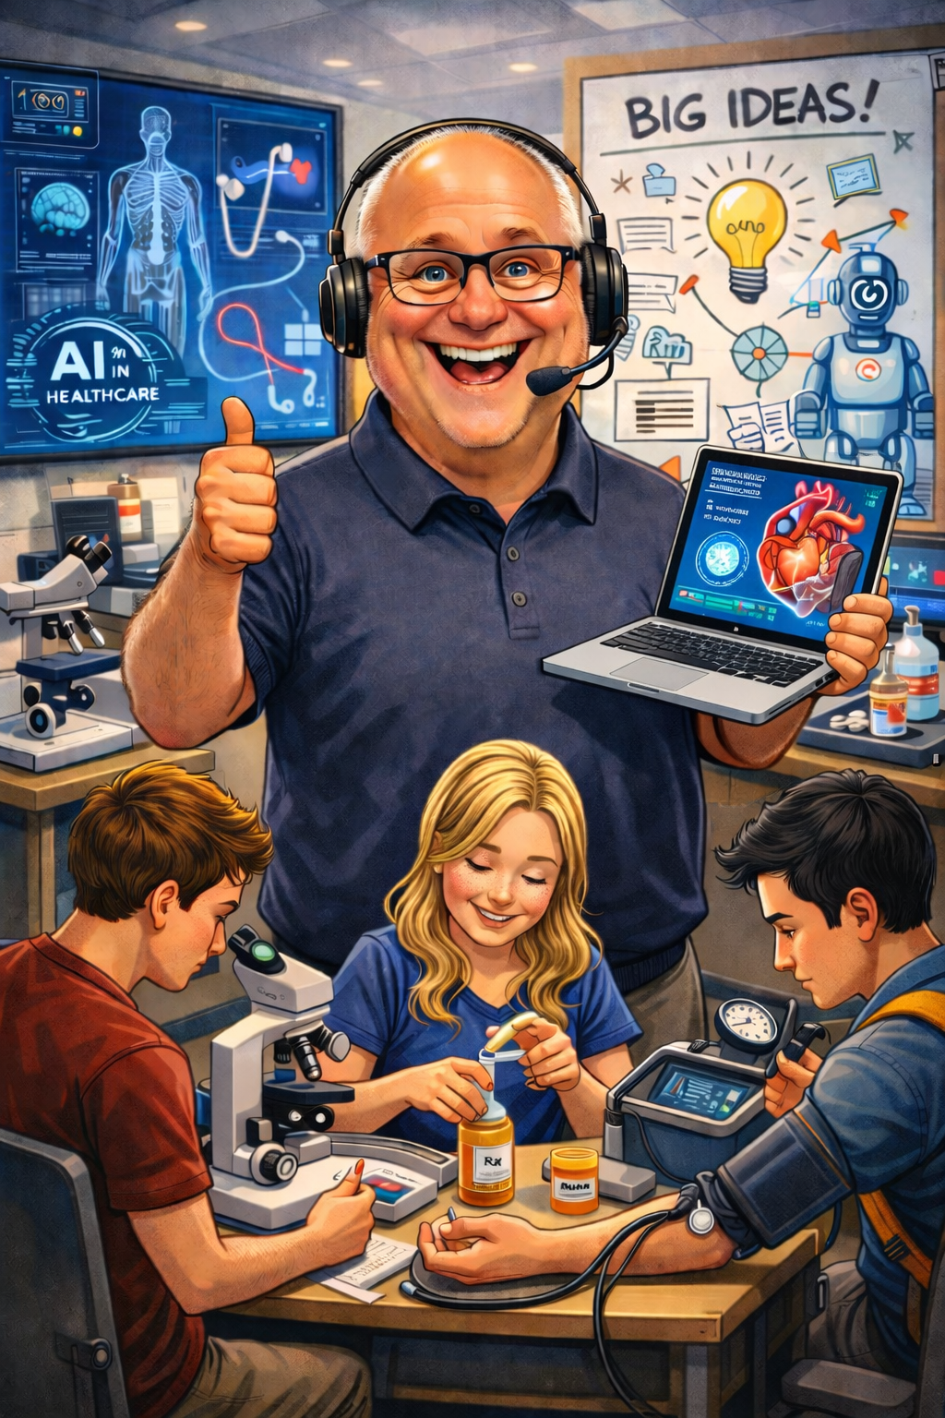
Who am I ?
Biology teacher for most of my career
No healthcare background
Asked to build a Health Science pathway
Many health science teachers face the same challenge

Slide 3
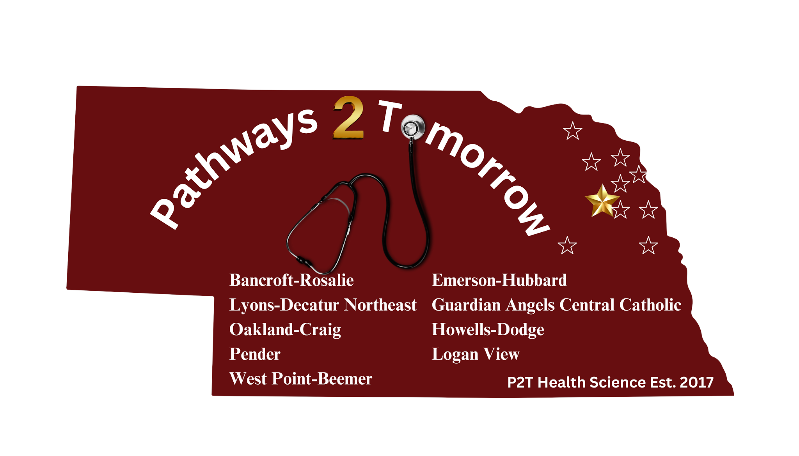
What is Pathways 2 Tomorrow?
Health Science Academy model
Multiple partner schools & ESU 2
Northeast Community College partnership
Wayne State partnership
Franciscan Healthcare and Pender
Community Hospital partnership
Job shadows throughout the region
P2T also includes pathways in…Welding, Building Trades, Education, Computer Science, Commercial Driver's License (CDL) and Exploring Agriculture as a Future Pathway

Slide 4
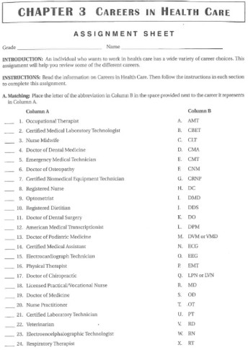
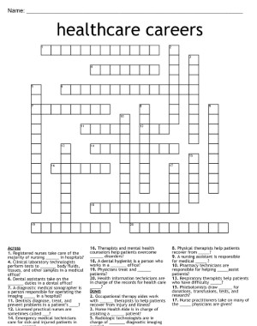
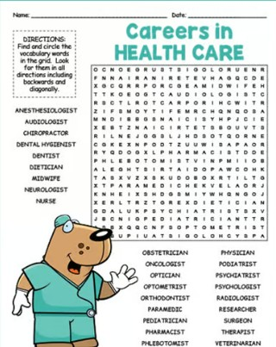
The Problem
"I drove home thinking, I don't want our program to look like that."

Slide 5
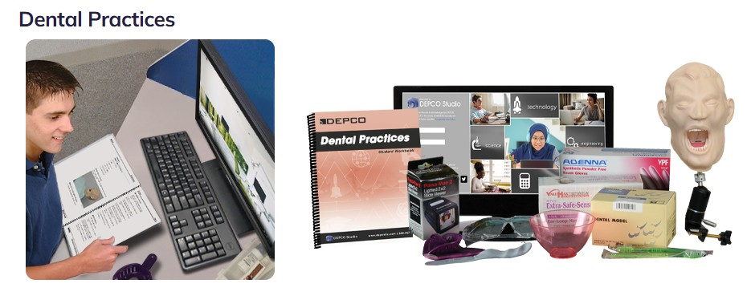
The Problem

Slide 6
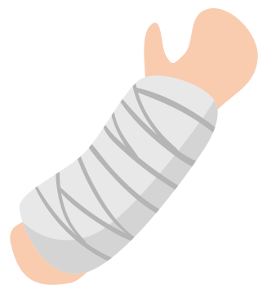
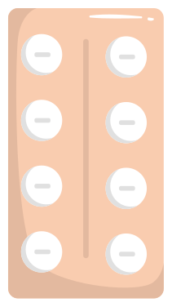
What I Wanted
Hands-on
Affordable
Career exploration
Self-paced
Reusable
Easy to manage

Slide 7
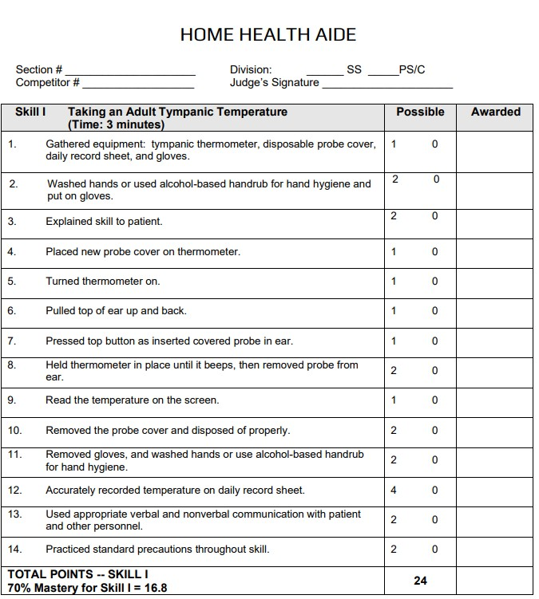
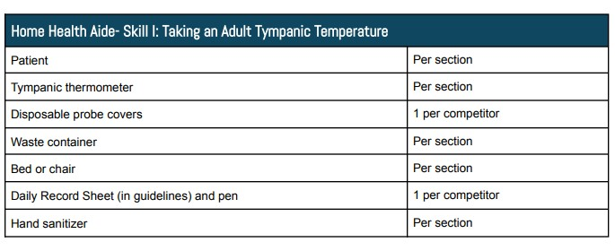

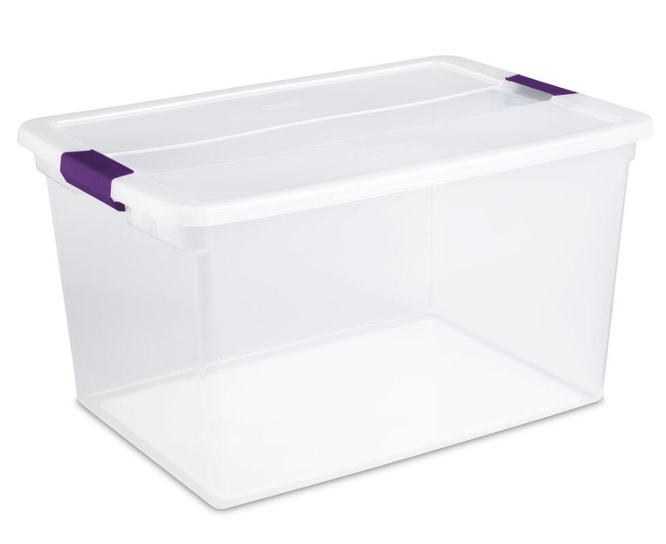
The Breakthrough
HOSA Rubric
HOSA Equipment List
Hands-On Career Exploration

Slide 8


I Didn't Create the Curriculum
HOSA provided the skills
HOSA provided the standards
HOSA provided equipment lists
YouTube provided demonstrations
Canvas provided organization
My job was putting the pieces together.

Slide 9
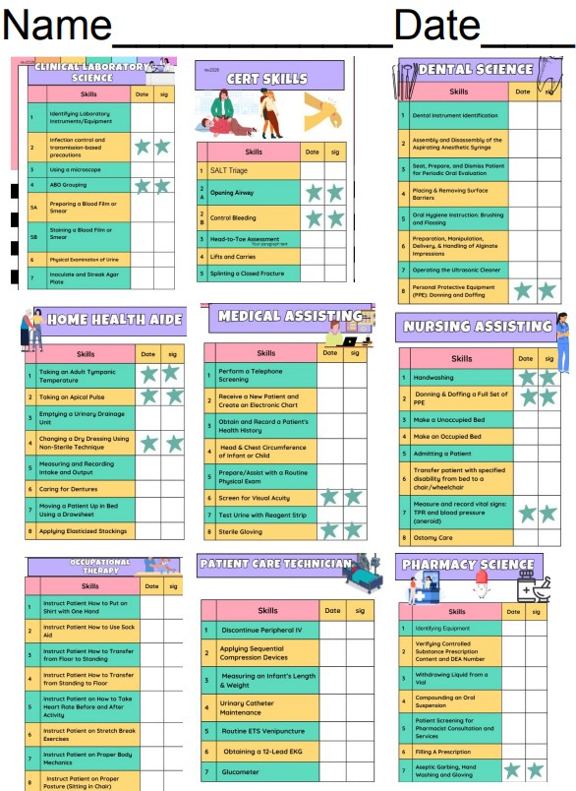
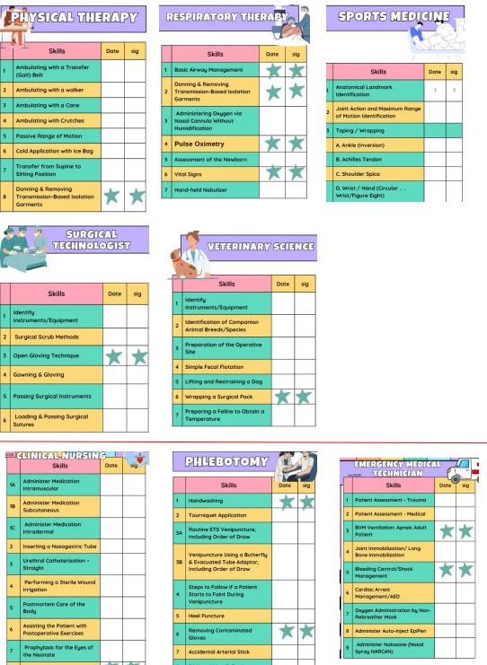
What Career Exploration Looks Like
Students don't read about careers.
Students perform skills from careers.

Slide 10
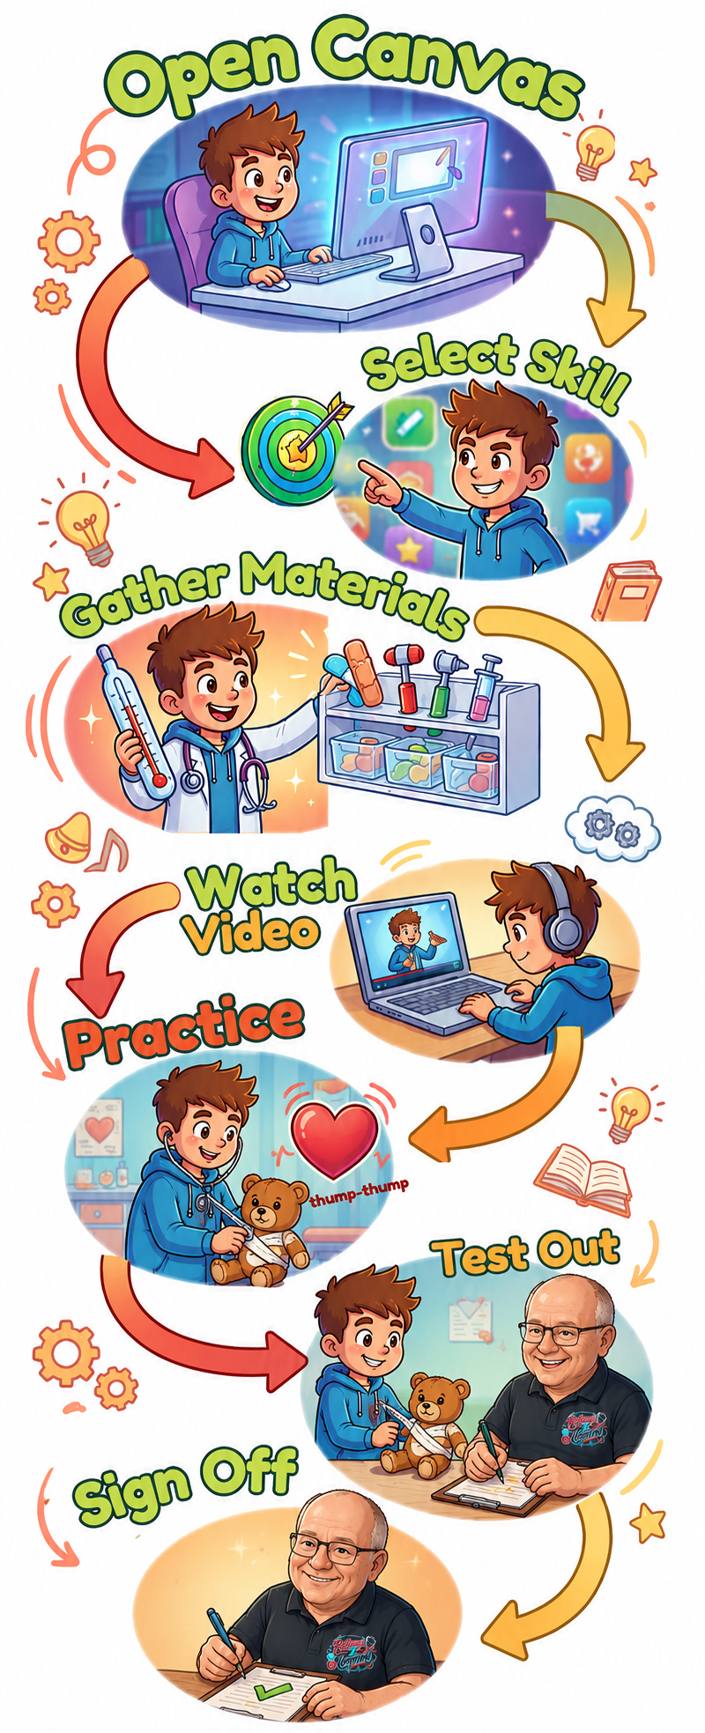

The Student Learning Process
Choose
Career ….

Slide 11

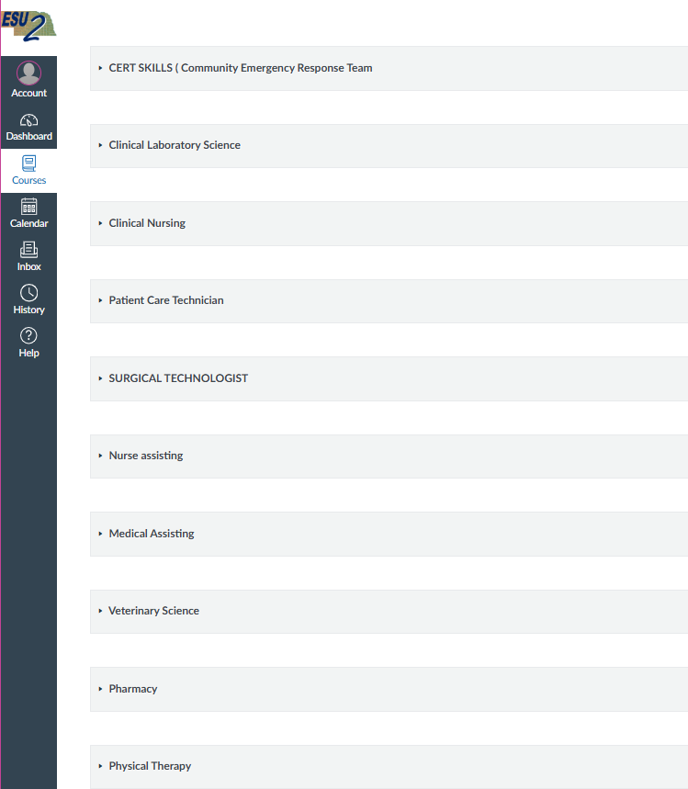

Canvas Organization

Slide 12
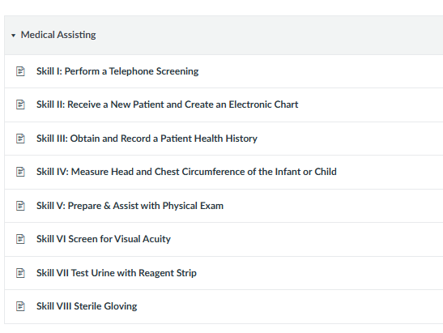
Canvas Organization

Slide 13
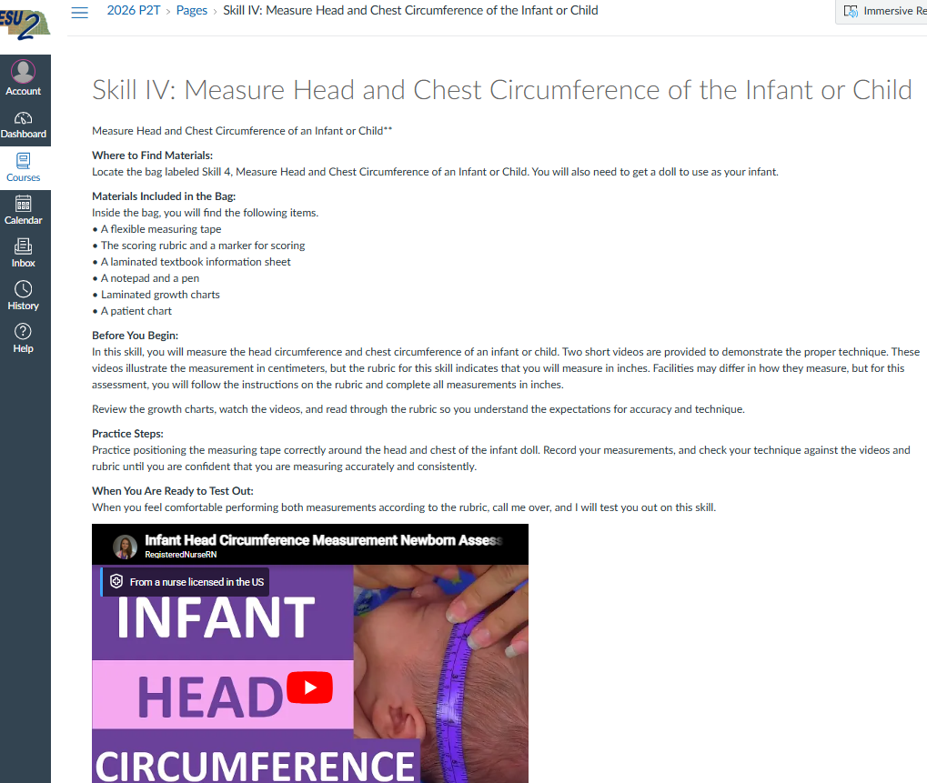
Canvas Organization

Slide 14
Student Choice Changed Everything
Before
Everyone doing the same career and skill
After
Students choosing careers
Students choosing skills
Students moving at different speeds

Slide 15
Students Become the Experts
Peer Testing
Student driven motivation
Film Testing
Guest tester

Slide 16
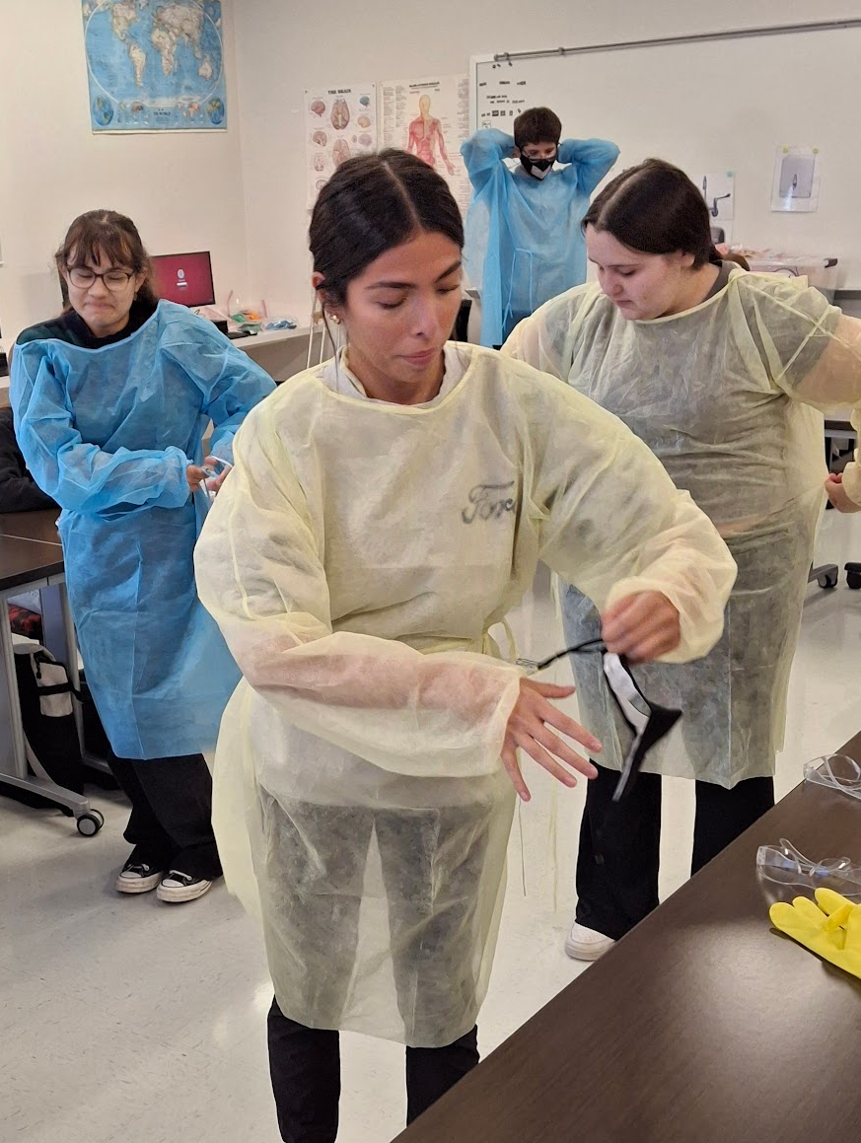
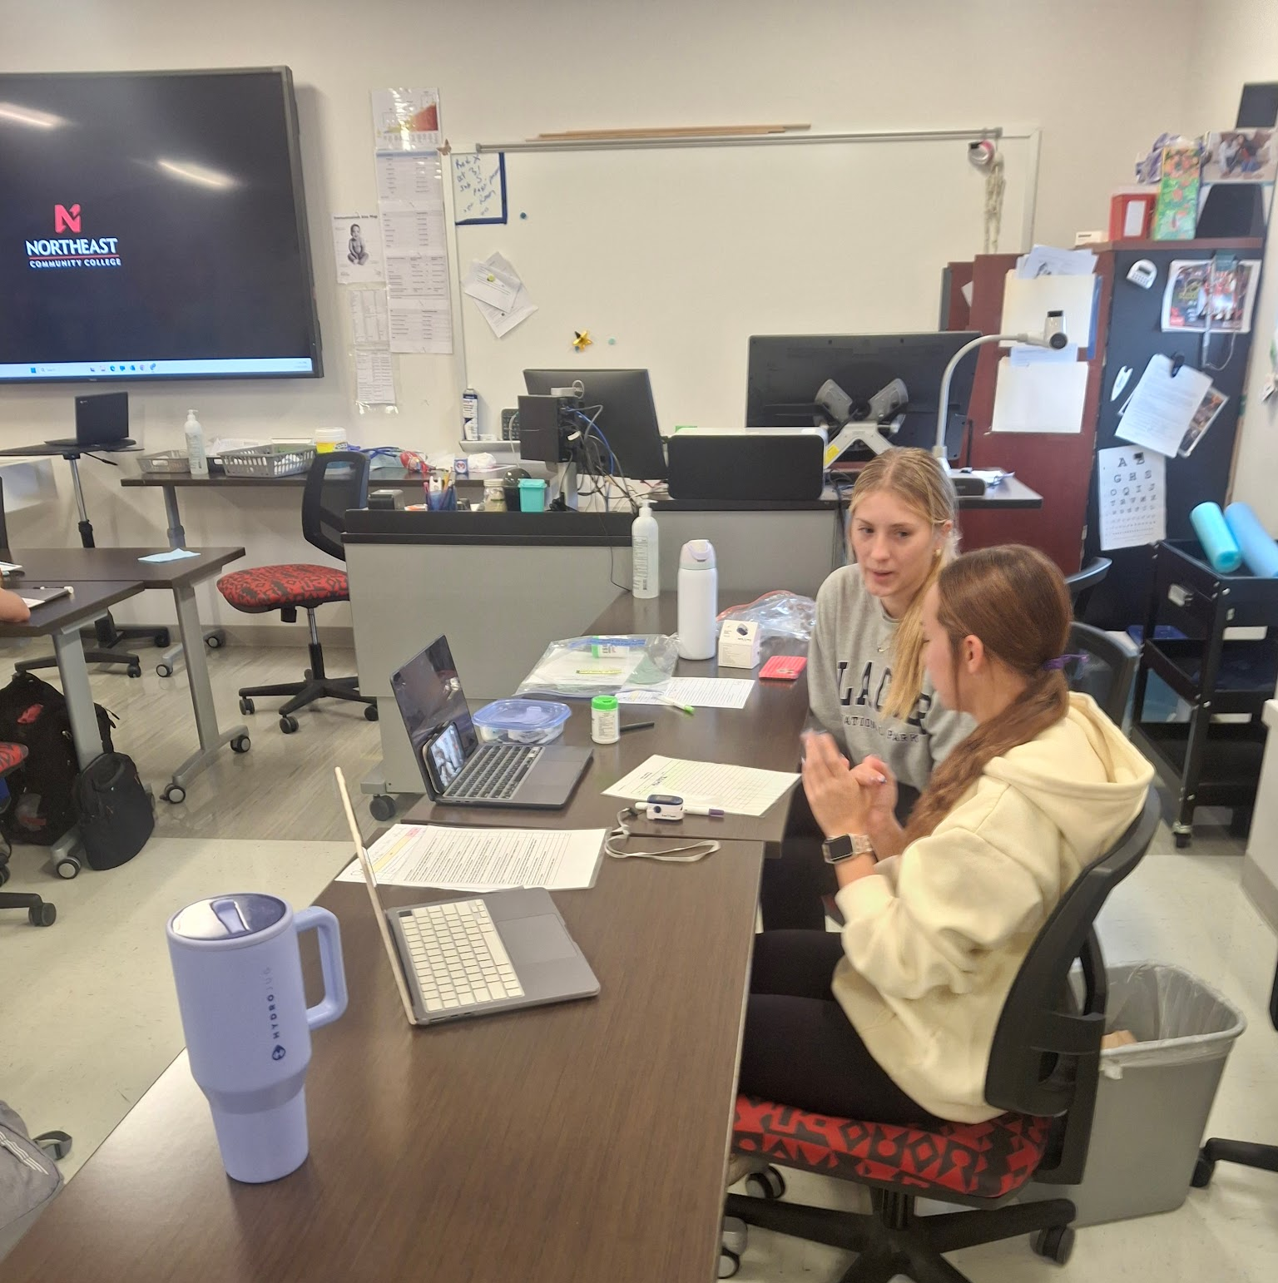
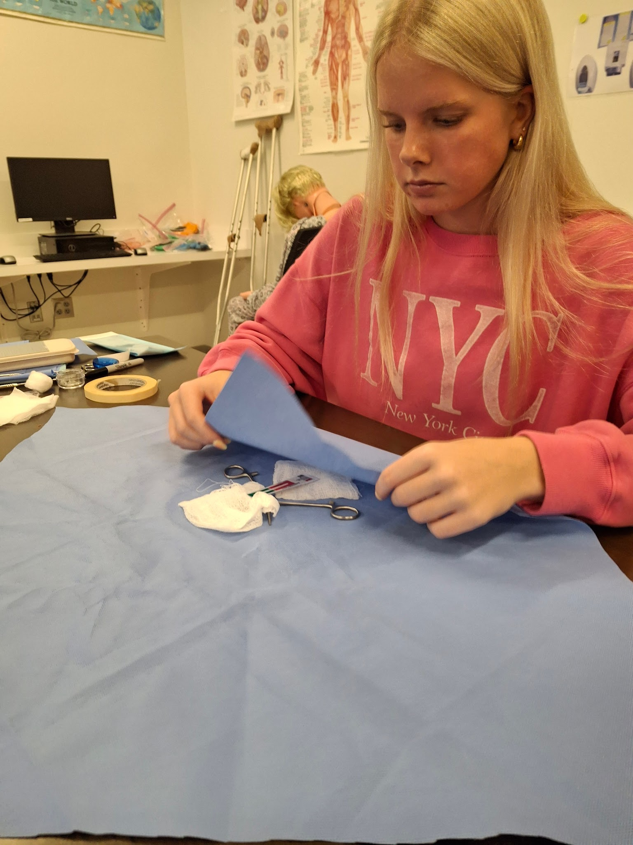
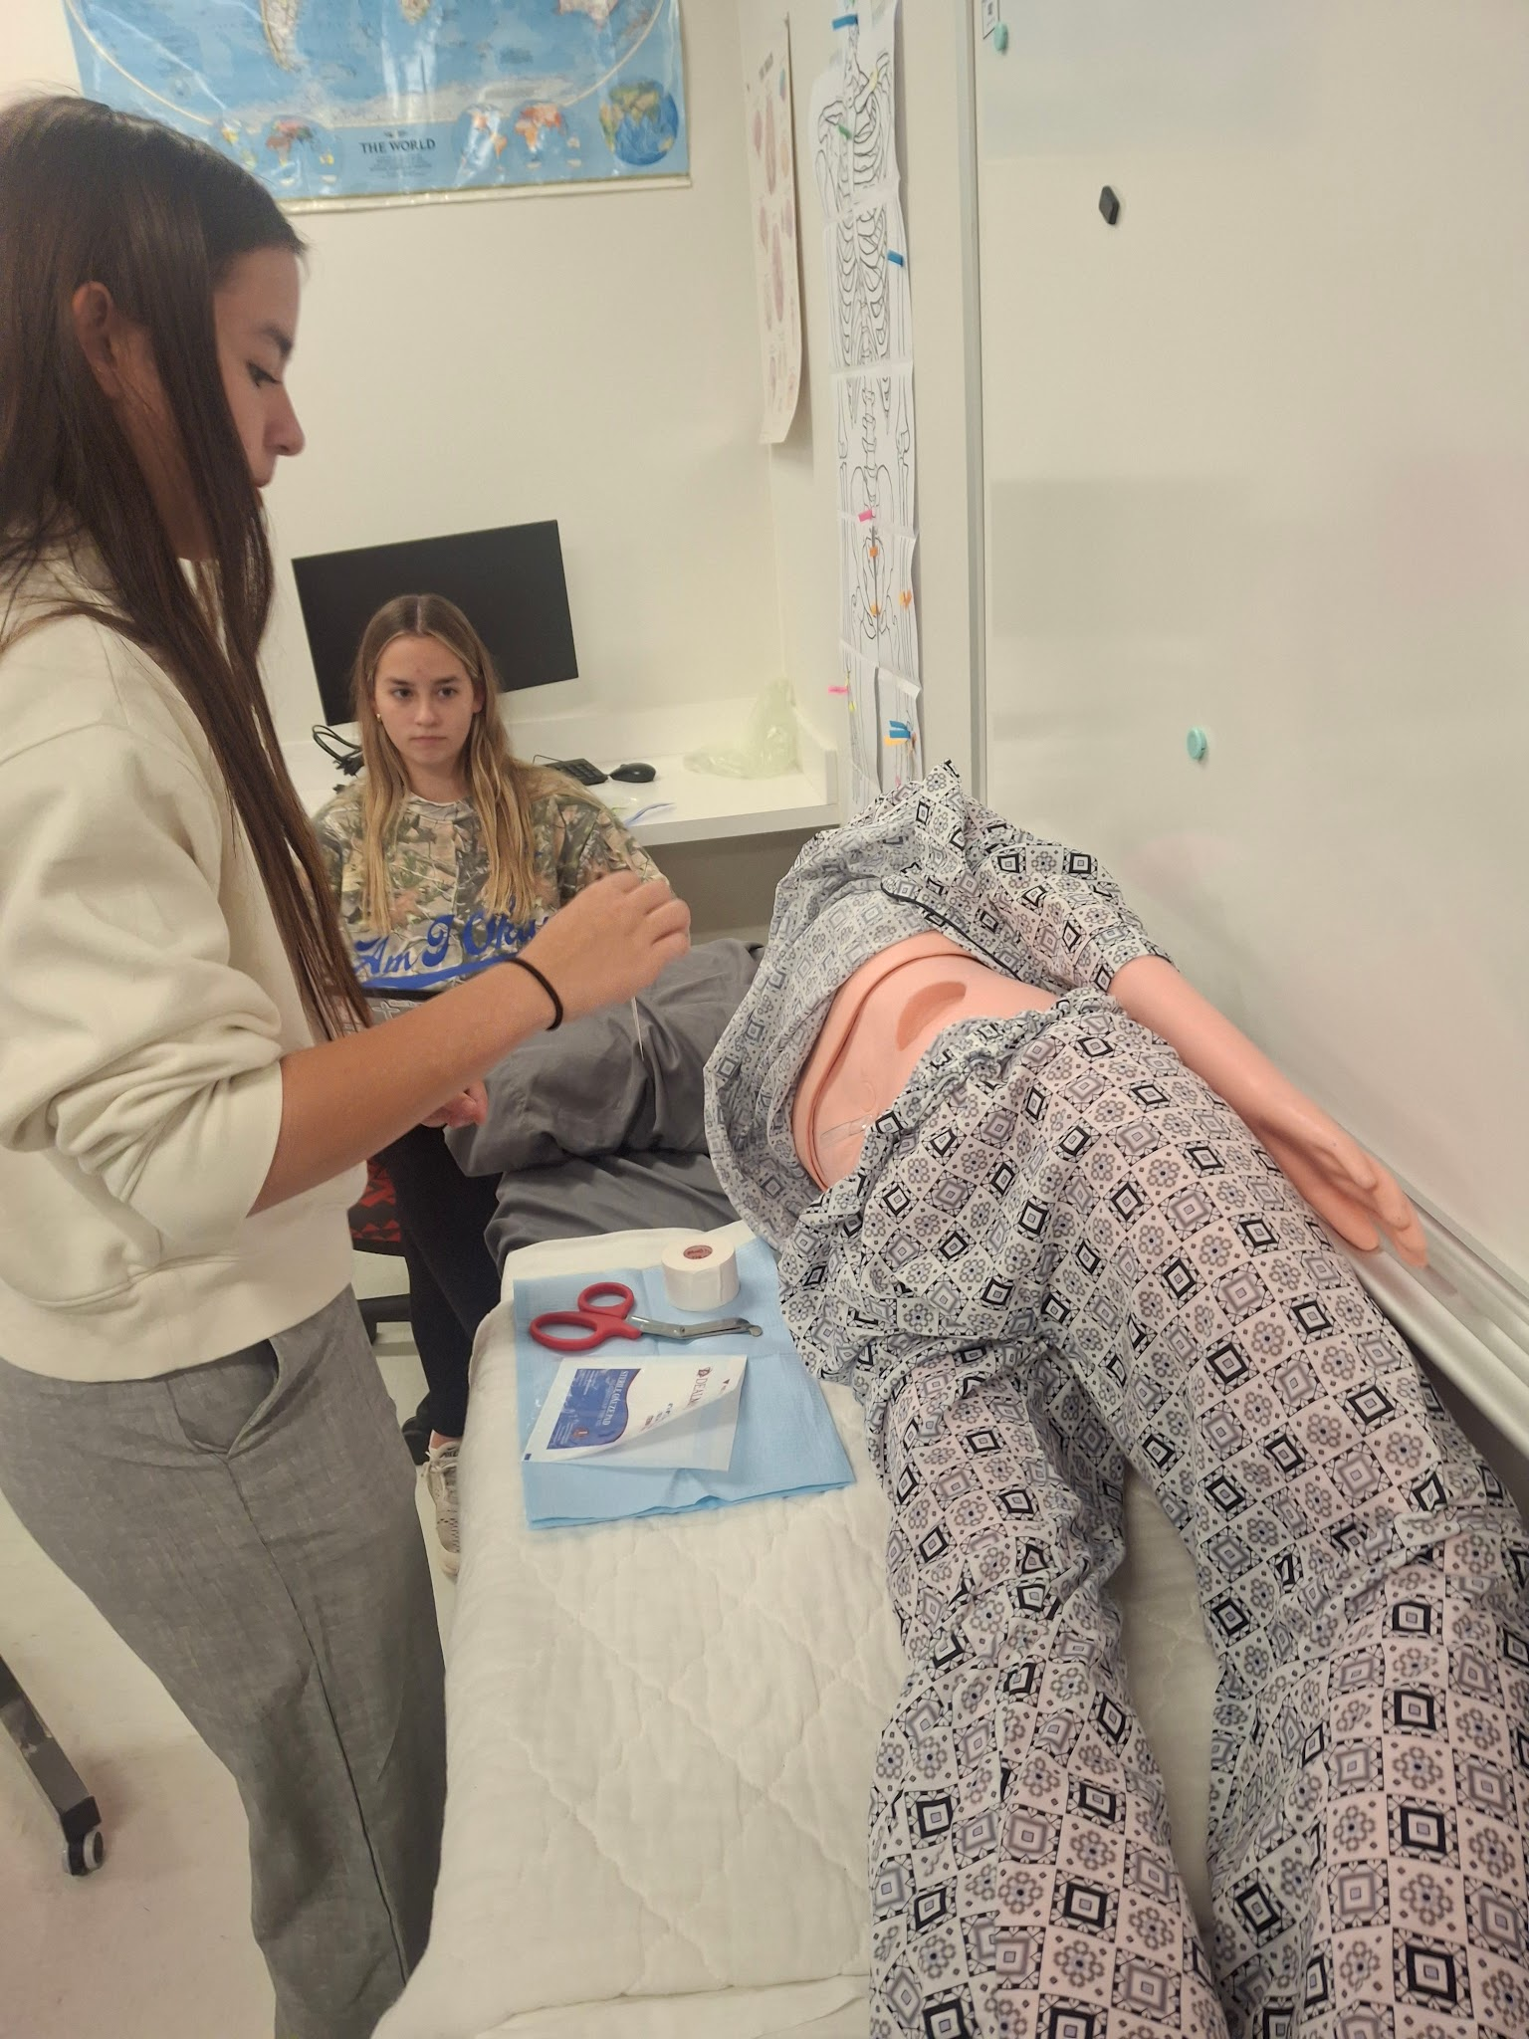
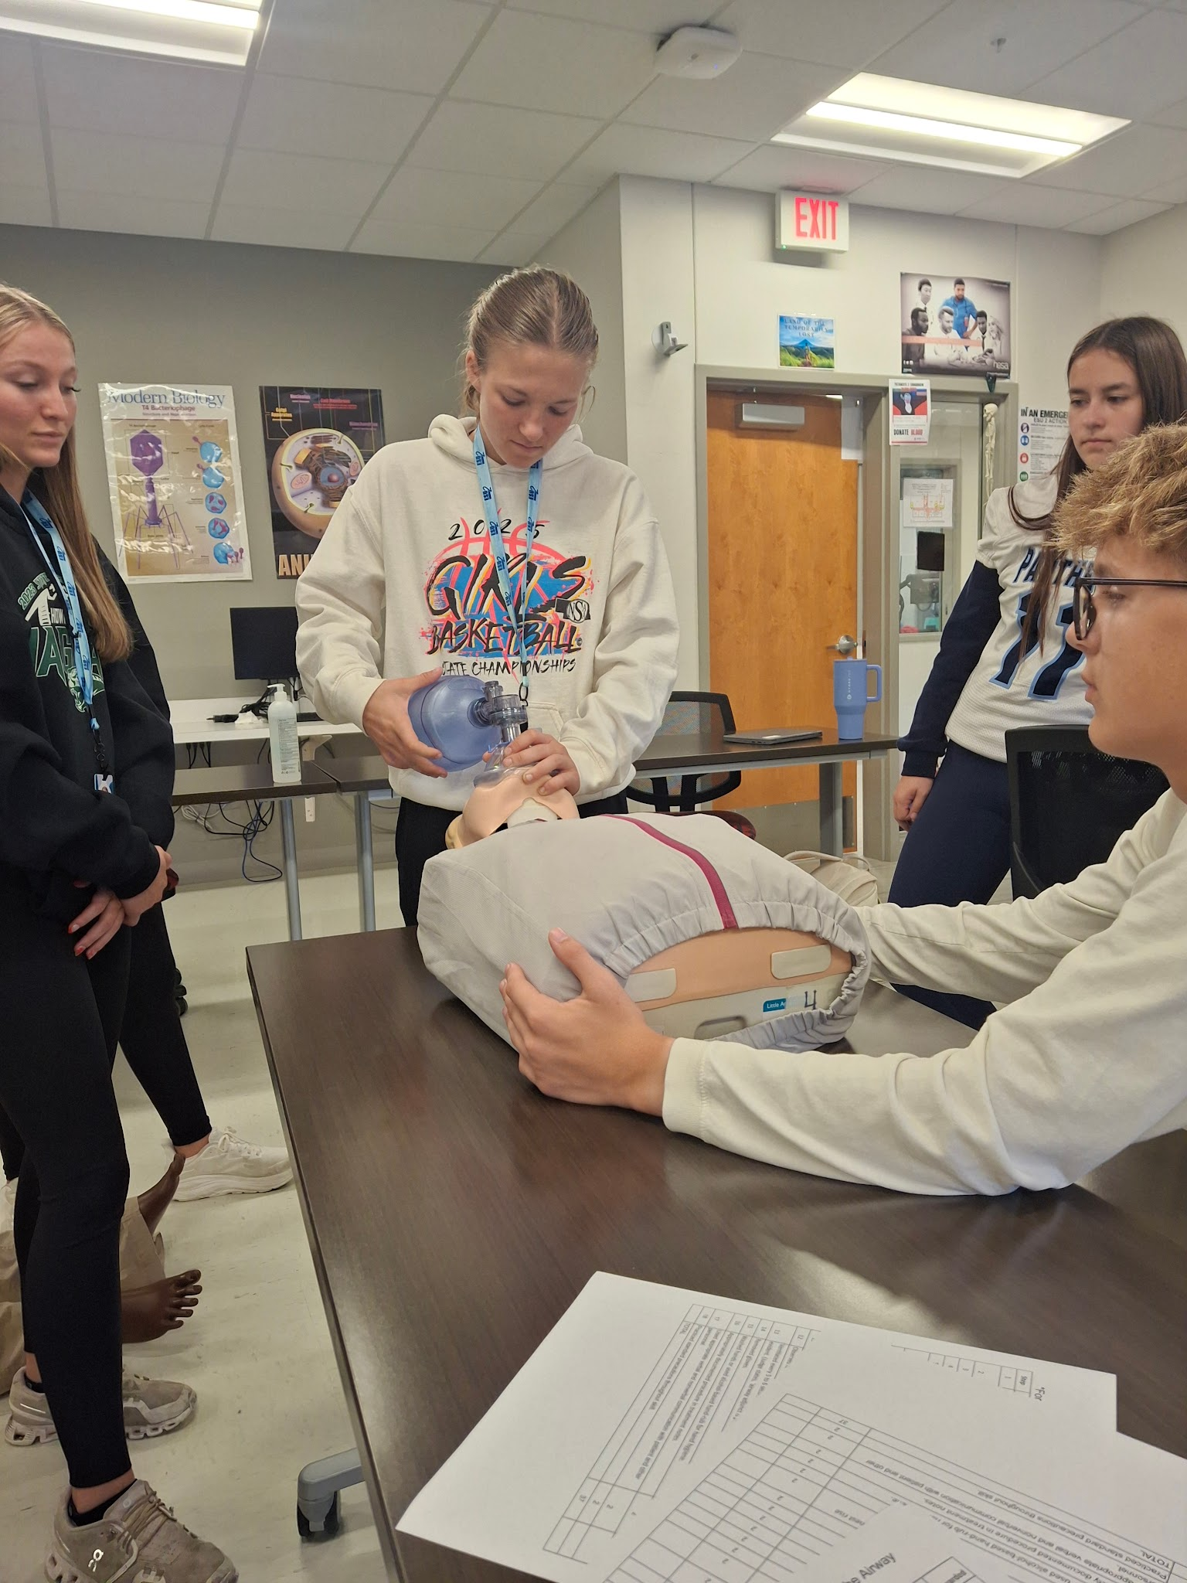
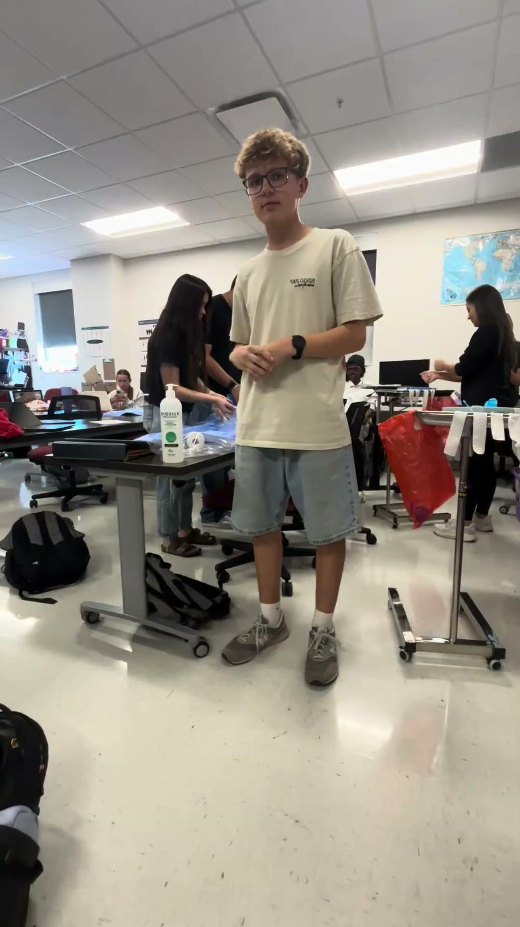
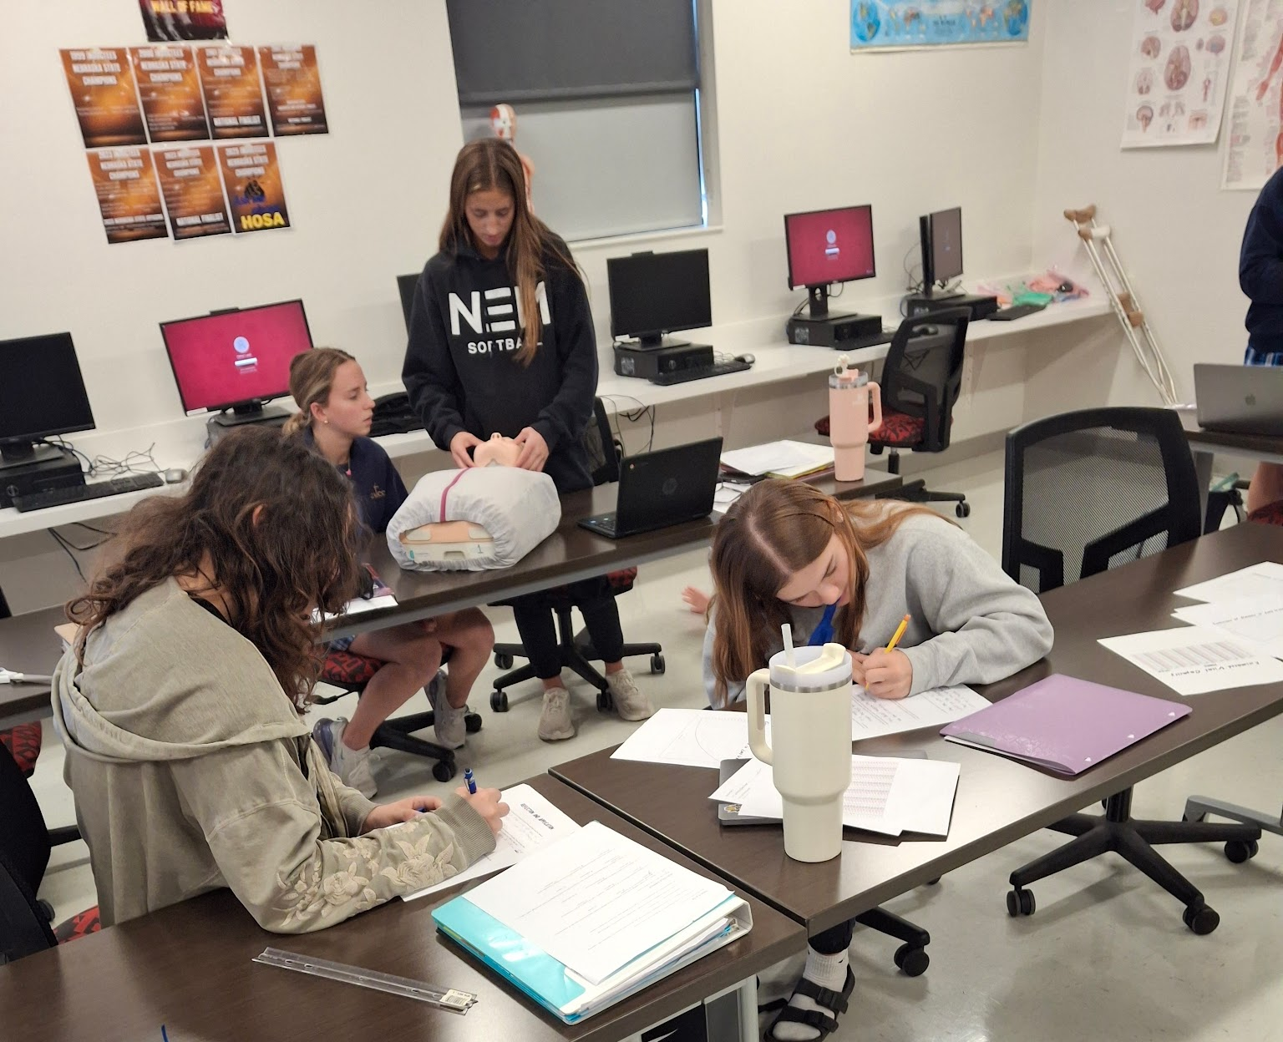
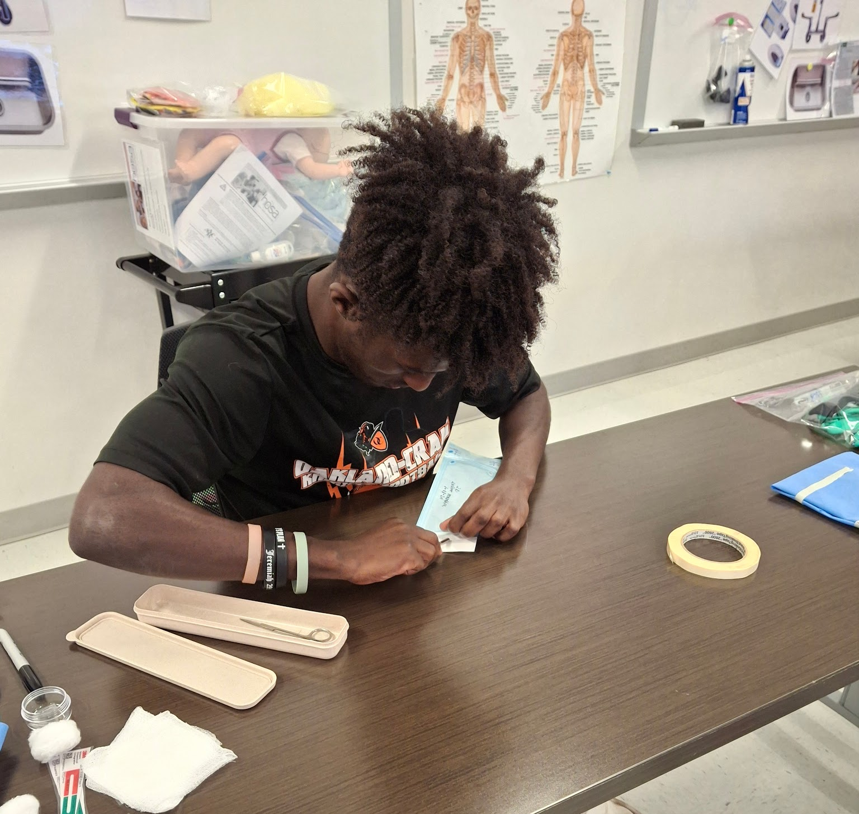
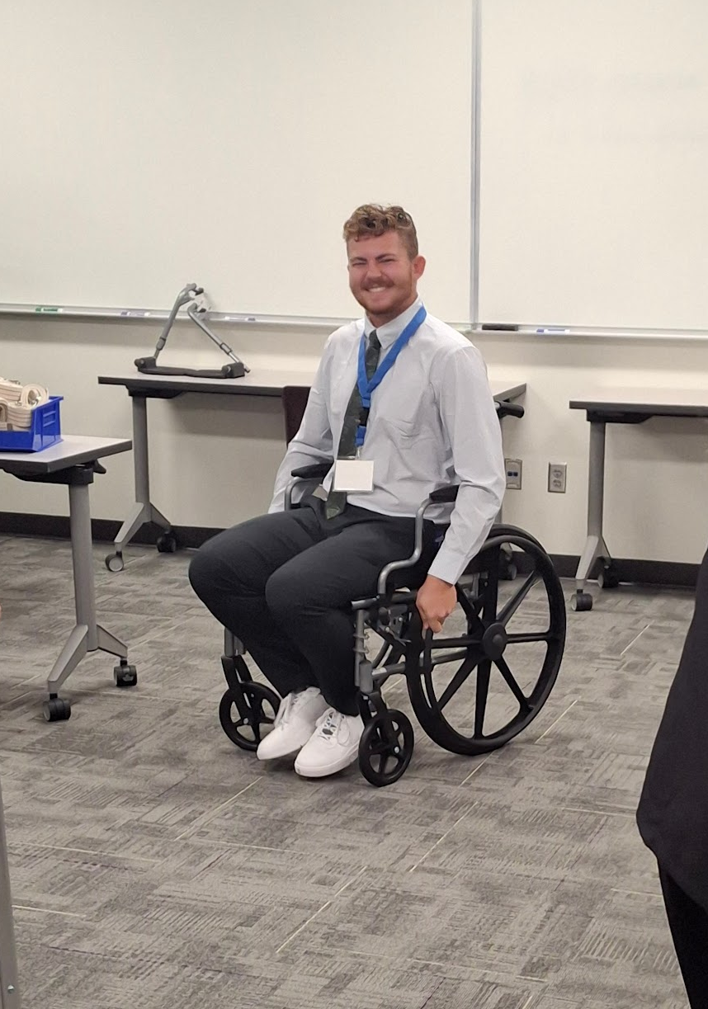
Controlled Chaos
My classroom no longer looks organized.
It looks engaged.

Slide 17
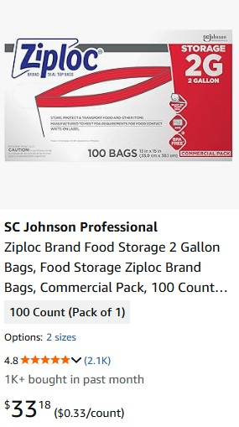
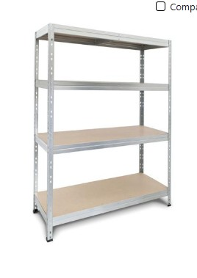
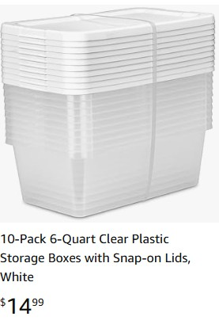
Building a Skill Box

Slide 18
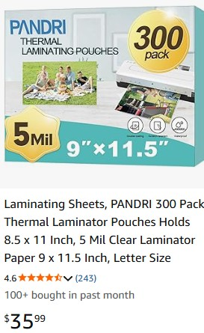
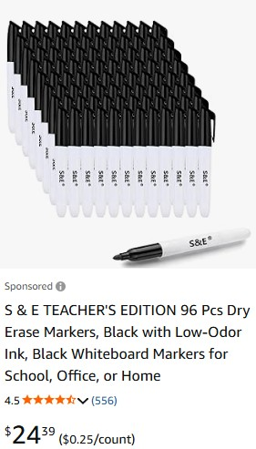

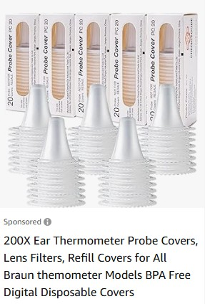
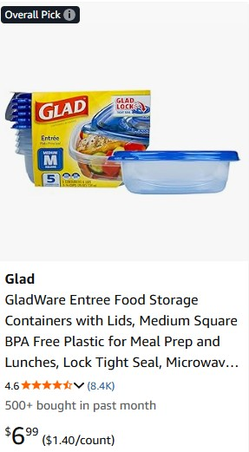
Real Cost Example
HOME HEALTH AIDE -Taking an Adult Tympanic Temperature
.33
.15
.15
.25
$25
$8
$1.40
$35.28 + $10 tote

Slide 19

Mistakes I Made
No inventory sheets
Not enough color coding
Underestimating storage needs

Slide 20
Why It Works
Hands-on
Student choice
Career exploration
HOSA preparation
Reusable year after year

Slide 21
Experience the Classroom
Questions to Think About
Directions:
Go to https://esu2.instructure.com/login/canvas
Use the credentials I gave you for canvas
Choose a career
Choose a skill
Explore
What surprised you?
What was easy?
What was difficult?
Could this work in your classroom?
What barriers do you see?

Slide 22
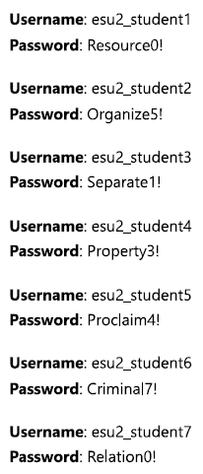
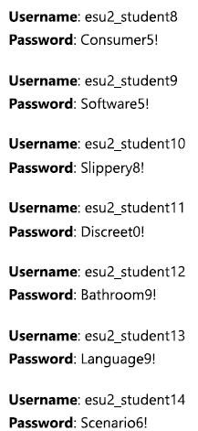
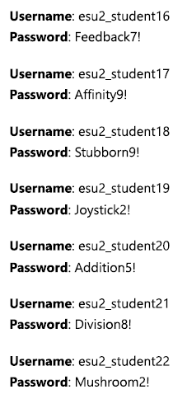
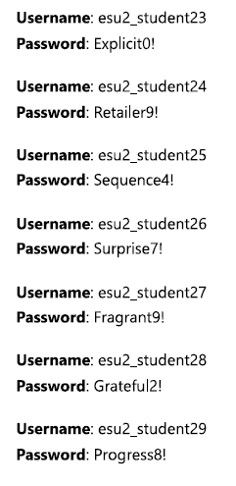

Slide 23
What did you Notice?
What concerns do you have?

Slide 24
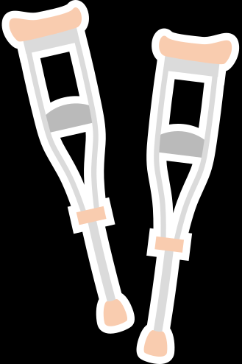
Okay... How Do You Build One?
Take a break and we will build a kit

Slide 25
From Rubric to Kit: Building a Surgical Technologist Skill Box from the Classroom
"If I handed you this box and told you to build it from scratch, where would you start?"
Start With the End in Mind
Don't start by shopping.
Start by finding the rubric.
The rubric tells you what students must do.
https://hosa.org/guidelines/
Surgical Technologist

Slide 26
Analyze the Six Skills
What is the skill?
What materials are needed?
What knowledge is needed?
What could be reused?
Look at rule “Competitors Must Provide”
Appendix I
The rubric tells me what students do.
Appendix I tells me what I need to buy.
Equipment Gathering
Here is what I have.
What skill does it go with?
Put it in the correct bag
Are we missing anything?

Slide 27
Build the Student Instructions
I've been trying to do a better job of following a consistent script so each skill is set up the same way. Some of my kits need to be redone to better match that format. You can use the instructions I've provided, or create your own by following the script. It works for every career exploration.
Student Instructions Script
Surgical Technologist Student Instructions

Slide 28

The Finished Product
You should have:
Six laminated rubrics
Six labeled bags
Equipment organized
Student instruction sheets (Docs)
Video resources
Could you take this exact process and build a Dentistry kit?

