Slide 1

Ask an Auditor
Tom Goeschel, Amanda Cole, Teri Sloup

Slide 2

What can CTE funds be spent on?
What can CTE funds be spent on?

Slide 3

It Depends.

Slide 4

Nebraska CTE Administrators’ Guide
All things CTE Grants!
Includes Guidance for
  Perkins Basic
  reVISION Action, and
  State CTE Grants
CTE Program Administration
Allowable and Non-Allowable Uses of Funds
https://www.education.ne.gov/nce/cte-grants/
Notes:
From “Perkins Grant Management Guide” to CTE Administrators’ Guide
Reminder of the Primary Source of Truth for CTE Implementation (and state policies)
The CTE Administrators’ Guide has been developed to be the main and trusted source of information for CTE administrators when administering CTE programs in Nebraska. All grant recipients (schools, consortia, and community colleges) are expected to adhere to the policies and procedures discussed in this guide for audit compliance and program quality purposes.
4

Slide 5

CTE Grant Administrators’ Guide
Notes: Relative to federally funded grants (Perkins and reVISION), federal funds cannot be used to pay for consumable supplies to maintain a CTE program. These include, but are not limited to items such as: CO2 cartridges; drill bits; food for culinary courses; ink; lumber; office supplies (e.g., markers, glue, shears); paper; plants; potting soil; printer filament, cartridges and toner; replacement batteries; markers and pencils/crayons; and welding rods/wire. However, if the supplies or equipment is for implementing a new approved CTE program of study or updating based on alignment to state standards, supplies to start-up the program may be considered allowable. Prior approval is required.
CTE Grants Administrators' Guide
Notes:
SAMPLE of Guidance

Slide 6
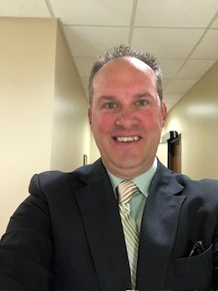
Tom Goeschel
Controller
CHI Health Center Omaha and Charles Schwab Field Omaha
Formally Director of Grants Compliance, Nebraska Department of Education
Manager, State of Nebraska Auditor of Public Accounts.

Slide 7
Frequently Asked Questions
Can a Grant sub-recipient make a payment for an item from a soon-to-expire grant, and then make the final payment from a successive grant?
Can a Perkins consortium use Perkins funds for a portion of the cost of a piece of equipment costing over $10,000 (capital asset) and a participating District use State CTE funds for the other portion?
If the Perkins Consortia uses Perkins funds for a portion of the cost of a piece of equipment costing over $10,000--would all associated costs need to be proportionally split?

Slide 8
Frequently Asked Questions
Can a 3-year subscription be paid using the funds for the current grant year and prepay the remaining 2 years?
Can a piece of equipment that has been “gently used” be purchased with Perkins funds?
What do we do with trade-in funds on equipment bought with Perkins funds?
Can we have a technician repair a piece of equipment purchased?

Slide 9
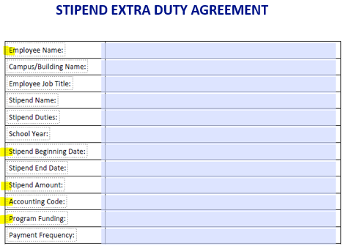
Stipends (example)
*may be requested to provide LEA’s Stipend Policy
District/LEA and the Stipend Recipient agrees to act in accordance with all applicable laws and regulations, and terms.
This agreement may be terminated by either party with or without cause by providing written notice to the other party. Further, the Stipend Recipient may be removed from their stipend duties at the discretion of the principal or designee prior to the actual termination of this agreement. Termination of this agreement by either party shall not constitute cause for termination of any separate teaching or employment contract between the Stipend Recipient and District/LEA.
Principal/Originator Signature: ________________________ Date: ___________
Stipend Recipient Signature: ______________________Date: ____________
Notes:
Where to find in NDE web

Slide 10
Stipends provided by the ESU
*may be requested to provide ESU’s Stipend Policy
Stipend Sample
REIMBURSEMENT STIPEND CLAIM FORM
(The SCHOOL will receive payment for the approved stipend amount)
School Name:_________ __________Teacher Name: _____________________________
School Address: ______________________________ School Phone: _____________________
Workshop Title: ______________________________ Date(s) of Workshop: ________________
Workshop Location (with address if not at ESU ) ____________________________________
Professional Development Stipend: (150.00 per day per teacher not currently on contract time. This payment will include FICA and Retirement in addition to the stipend fee)
Participant Payment: (a) $______________
FICA = (a) *.0765 (b) $ ______________
Retirement = (a) * .098778 (c) $______________
Total School Reimbursement = (a) + (b) + (c) = (d) (d) $______________

Slide 11
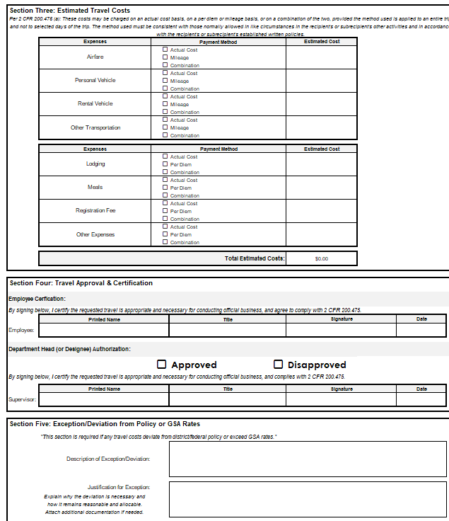
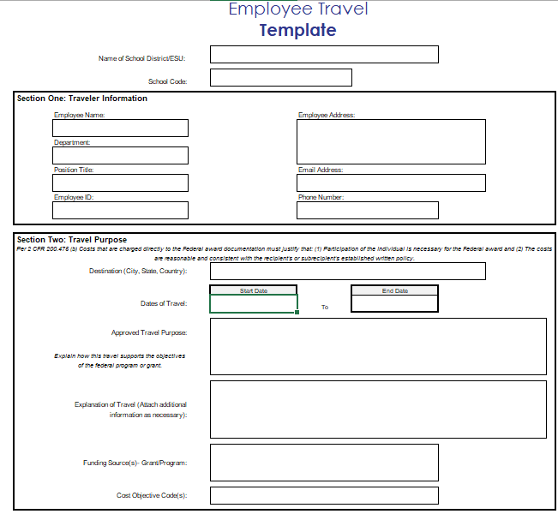
New Travel Form
www.education.ne.gov/gms2/technical-assistance-fact-sheets-templates/

Slide 12
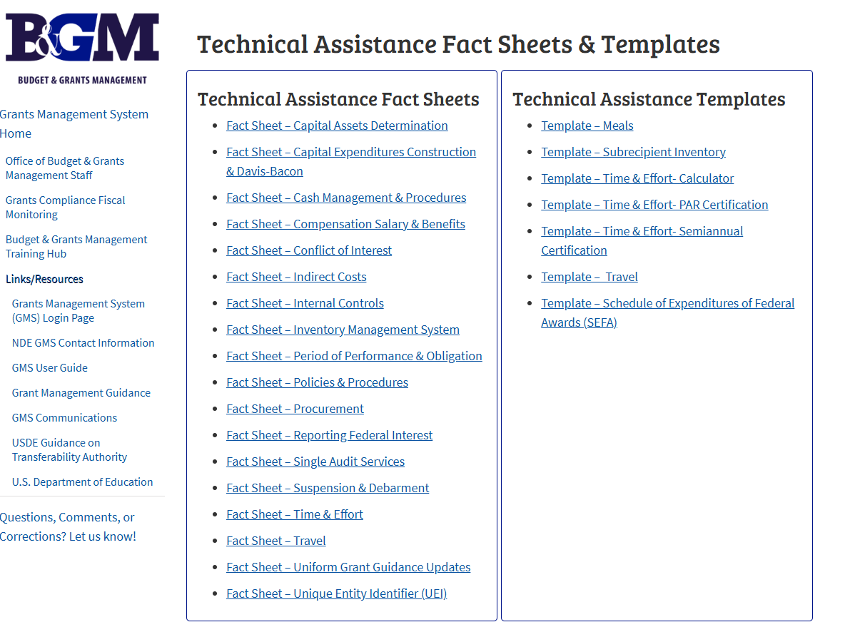
Budgets & Grants Management Technical Assistance Fact Sheets & Templates
www.education.ne.gov/gms2/technical-assistance-fact-sheets-templates/

Slide 13
Questions?

Slide 14

Thank You!
CTE Grants Support

