Slide 1
Strategies for Assisting
Multilingual Learners in
the CTE Classroom
Taylor Wilton-Cooper

Slide 2
Who are Multilingual Learners?
Any student that has a primary or “home” language other than English that are in the process of learning English.
Otherwise known as:
  English Language Learners (ELLs)
  English as a Second Language Learners (ESLs)
  English Learners
These students are seen as ELs until they can pass their ELPA exams that show they have an adequate mastery of English
But ML is a great term for all second
language learner at any level
Many multilingual learners may already know at least two languages before learning English
Many EL students will graduate highschool having never passing their ELPA

Slide 3
At My School:
about 1600 total students
  70% Hispanic or Latino
  13% White
EL Enrollment - around 650 students were in EL program and have exited
EL Enrollment - currently about 260 students in EL classes
Within My Ag Program:
219 in our Sophomore-Senior Urban Agriculture Academy & in FFA
  77% Hispanic or Latino
  15% White
EL Enrollment - around 100 current students were in EL program at one time and have exited
EL Enrollment - currently about 35 students in EL classes within our academy
My Why
These numbers have been increasing steadily over the past few years...my EL numbers grew little by little
After COVID and my Social Emotional Learning driven Masters Program...I knew I needed to do more for these kids so when our school and district improvement plan changed to be literacy focused, I started my EL endorsement track!

Slide 4
Objectives - 3 Steps to Help your MLs
Utilizing Techinques & Strategies
Establishing a Connection
Providing Supports

Slide 5
Establishing a Connection
“Relationships are at the core of any effective teaching strategy.”
How can you do that?
  Make a point to connect with a student’s culture (even if it is different from yours) and bring it into a lesson
  Find representation that fits ALL of your students

Slide 6
Establishing a Connection - How do you get to know them?
EASY - IT’S THE SAME WAY YOU WOULD ANYONE ELSE!
“But we don’t speak the same language.”
“But we have nothing in common.”
“But they don’t know what agriculture is.”
Play simple games at the beginning of the year -
  “Would you Rather”
  “20 Questions”
  “Riddles or Picture Games”
  “Who are You? Simple Writes”

Slide 7
Establishing a Connection - Representation Matters
If they don’t see it...they won’t believe they can...
National FFA Retiring Addresses
Yomar Roman - 2019-2020
https://vimeo.com/showcase/7865594/video/477819179
National FFA Spanish Resources
https://ffa.app.box.com/v/Spanishresources
New Horizons Magazine Digital Archives
https://www.calameo.com/books/00510752435776227ef29
News Articles
https://www.agweb.com/news/livestock/beef/hispanic-farmers-and-producers-help-keep-food-americas-tables
Notes:
https://moodynolan.com/news-ideas/hispanic-heritage-month/
https://timelycare.com/blog/why-black-representation-matters-in-healthcare-for-college-students/
https://nycdailypost.com/2025/01/26/education/exploring-alternative-pathway-english-learners-trades-certificate-programs/

Slide 8
Techniques & Strategies
*Note - Everything I talk about is actually good for all students to improve academic conversations and engagement in the classroom
Think-pair-share+
Vocabulary
QSSSA
Talk Read Talk Write

Slide 9
Think-pair-share+
Traditional
Read - Highlight - Pair - Share
Think - Pair - Share - Pair - Share - Out
Planned Groups - Share

Slide 10

Examples
Read – Highlight – Pair – Share – Mendell Reading, articles with current events
Think – Pair – Share – Out
– Short background reading before activity, hypothesis creation in experiments

Slide 11
Vocabulary
Word Walls
Inside – Outside Circles
Fill in the blank sentences
Examples and non-examples

Slide 12
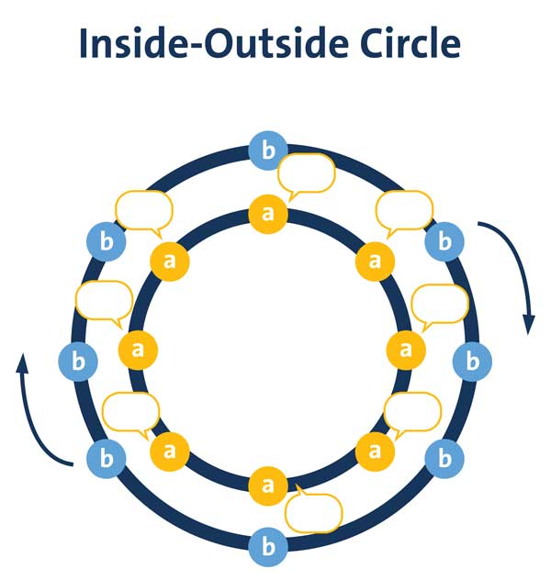
Examples
Inside - Outside Circle – Textbook readings, vocabulary review, shop equipment ID, quick math (fertilizers/ problem comparisons
Word Walls – Unit vocab walls, top 10 words list, words that represent agriculture/health/welding

Slide 13
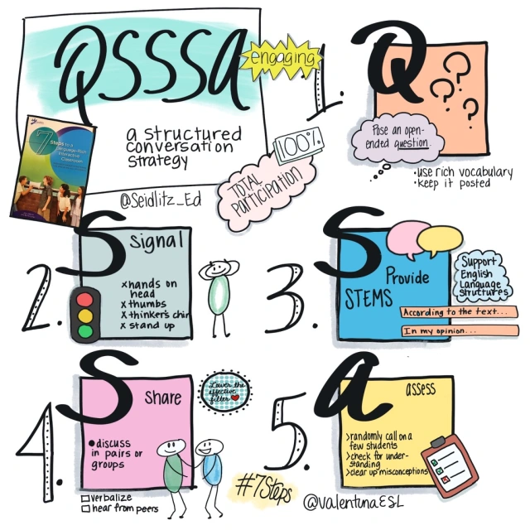
QSSSA
Great for structured discussion in any classroom - but it works really well in science classes!
Helps build academic language and supporting claims - both things EL students need to be able to do to pass their ELPA exams
Notes:
Question: What is the most important invention/precision agriculture discovering in history? How do you show codominance in a punnett square?
What should we keep in mind when first conducting a site analysis when building a house?
How can we make our building more sustainable in the design?

Slide 14
Examples
QSSSA topics – sustainable agriculture, technology in healthcare, environmental impacts of agriculture…big ticket issues or even review

Slide 15
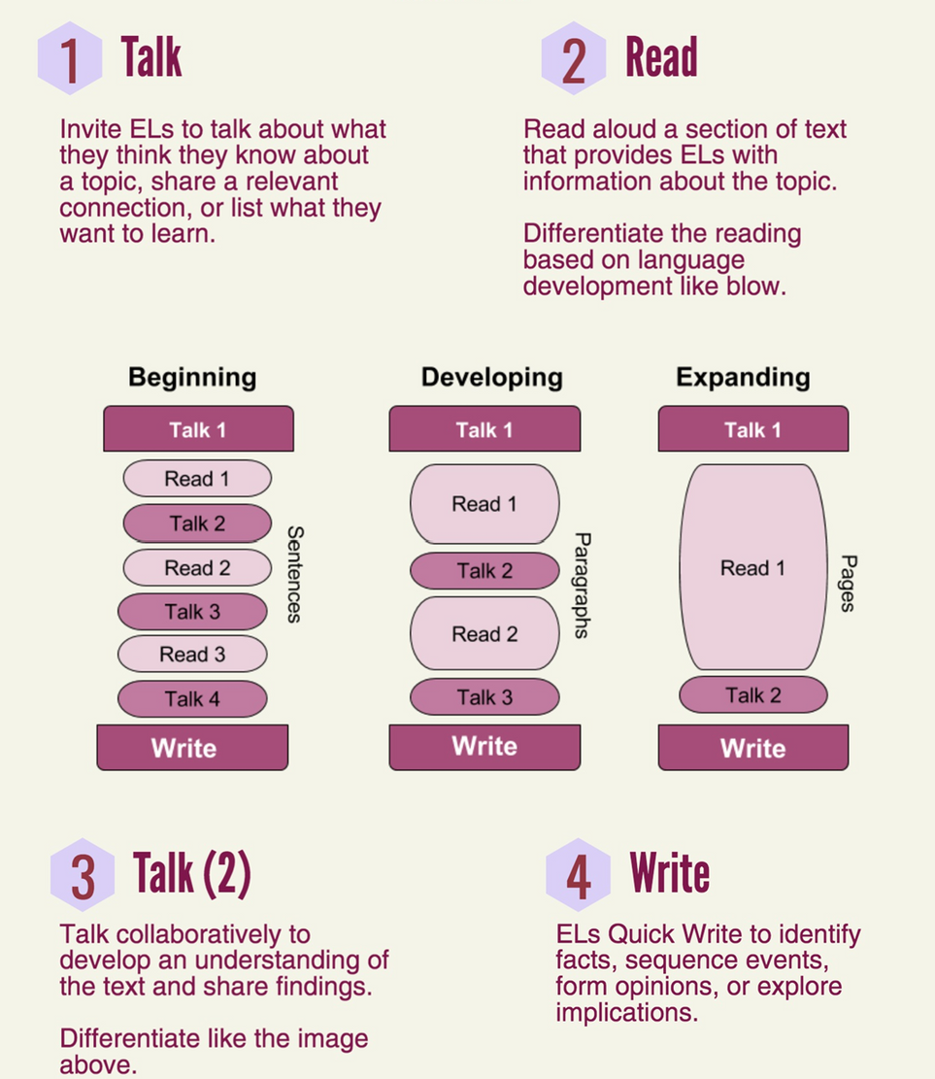
Talk Read Talk Write
This is a great way to chunk information...can be quick read and talk bellringer or it could take up the whole block
Helps incorporate more reading into your classroom to build on each of the 4 domains of literacy (reading, listening, speaking, and writing).
Notes:
https://nebraskapublicmedia.org/en/news/news-articles/nebraska-dhhs-will-pay-health-care-providers-to-live-and-work-in-rural-areas/
https://www.osmosis.org/answers/maslows-hierarchy-of-needs-in-nursing
https://www.npr.org/2023/02/14/1155405249/high-paying-jobs-that-dont-need-a-college-degree-thousands-of-them-are-sitting-e
https://www.millerwelds.com/resources/article-library/tig-it-how-a-tig-welder-works-and-when-to-tig-weld
https://www.thecrucible.org/guides/welding-2/types-of-welding/
https://financialliteracy.champlain.edu/research-advocacy/2017-national-report-card-on-high-school-financial-literacy/2017-case-summary/

Slide 16
Examples
Talk Read Talk Write structure – Mendell Reading, history of marigold, textbook reading, rural healthcare article, maslows hierarchy of needs in nursing reading, how to of TIG welding, etc.

Slide 17
Providing Supports
All students benefit from sentence stems or scaffolding questions when working on projects
Anytime you can give someone a starting point, they can build from there
Adding pictures in your texts or directions could be all the additional support a student needs

Slide 18
Work-Based Learning Experiences & Supports
SAE for ALL in FFA – allowing all students, no matter who they are explore career prep
Helping students find internships or work around school that allows them to show ownership of
- construction classes/internships
- school stores
- health job shadows
- entrepreneurship or service projects
Connect what they know already with the new information or skills you want them to learn

Slide 19
Other Advise...
  Be Real
  Be Authentic
  Share about you first...then, ask about them
  If you are really stuck, check in with your experts

Slide 20
Thank You
Email - tcoop1333@gmail.com
Facebook - Taylor Wilton-Cooper

