Slide 1
Low-Budget Healthcare Simulation For the High School Classroom
Acute Appendicitis ER Scenario
2026 Nebraska CTE Educators Conference
Tracy Long, RN, BSN
Healthcare Pathways Educator
Lakeview High School
Columbus, NE

Slide 2
Running High-Impact Simulations on a Budget
Acute Appendicitis Emergency Room Simulation
Designed with high school learners in mind
Minimal equipment required…use as little or as much as you want/have!
Focuses on clinical reasoning and teamwork
Running High-Impact Simulations on a Budget
Acute Appendicitis Emergency Room Simulation
Designed with high school learners in mind
Minimal equipment required…use as little or as much as you want/have!
Focuses on clinical reasoning and teamwork
Confidential
Notes:
the focus is less on expensive equipment and more on student engagement, critical thinking, and realistic clinical decision-making. This introduces students to the sim lab experiences of health professional programs.

Slide 3

I have goals for you!
I want you to have the confidence to:
Set up a low-budget healthcare simulation
Guide students through clinical reasoning
Facilitate assessment and intervention discussions
Incorporate interdisciplinary roles into simulation
Debrief effectively after simulation
Confidential

Slide 4
Why Low-Budget Simulation?
Encourages active learning
Gives students a peek into health professional programs, introduces them to simulation learning
Does not require expensive mannequins or equipment
Promotes teamwork and communication
Develops prioritization skills
Confidential
Notes:
Students will need access to a laptop, Chromebook, etc….they will need to look up answers. This also encourages them to use CREDIBLE websites…NO Wikipedia in my classroom!

Slide 5
“I am so impressed that at the HS level these students are learning critical thinking! This makes me so excited to have your students some day as critical thinking is the biggest struggle I am seeing with my students.”
—-Bethany Gifford RN, MSN
Nursing Instructor
Central Community College, Columbus Campus

Slide 6
Ideas for low-cost
supplies:
Printed monitor strips
Basic IV tubing and syringes
Clipboards and charts
Simulated medications
Student role-play cards
Confidential
Notes:
You can get as fancy or keep it as simple as you want

Slide 7

BEFORE WE BEGIN,
REMEMBER THIS:
Notes:
I DO NOT do these sims with the goal of grading the students on their correctness. They won’t know the answers to some of the questions/discussions….YOU won’t know the answers! The goals are PARTICIPATION AND CRITICAL THINKING…..and having some FUN with it!

Slide 8
Roles and Responsibilities:
ER Nurses:
ER Physicians:
Ancillary Staff:
Attach monitors
Get an initial assessment
Coordinate treatments and interventions
Start IV and administer IV meds
Team leaders
Encourage participation of classmates, organize ideas
Final word in any interventions
Draw labs
Deliver results
Organize ‘transport’ of patient
Confidential
Notes:
You can give roles or you don’t have to….it’s your simulation!
My rule is that EVERYONE participates in active decision making-whether you’re a doctor or a lab technician

Slide 9
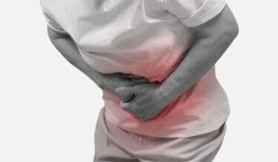
Simulation Overview
Scenario: Acute Appendicitis
Patient Name: Theodore Swanson
Age: 16 years old
Chief Complaint: Right lower quadrant
abdominal pain
Simulation Focus:
Patient assessment
Clinical reasoning
Medication administration
Team communication
Emergency interventions

Slide 10
Initial Presentation:
Patient appears:
Pale
Diaphoretic
In acute distress
Doubled over clutching abdomen
Complaining of severe nausea
Shortly after admission, patient vomits.
Notes:
dramatically role-play symptoms if using live actors You want to debrief anyone role-playing the patient prior to the sim

Slide 11

PRIORITY INTERVENTIONS:
What Should We Do FIRST?
Obtain vital signs
Begin physical assessment
Assess pain
Assess abdomen
Obtain patient history
Notify provider
Prepare for IV access

Slide 12

Initial Vital Signs >>>>>>
Admission Vital Signs:
Pulse: 125 bpm
Respirations: 20
Temperature: 102°F
Blood Pressure: 104/60
SpO2: 96% on room air
What is our “6th Vital sign?
PAIN 8/10
Notes:
ASK: What tools do we need to get vital signs? You could have the “nurse” take VS if using a student patient

Slide 13
Patient History:
History of Present Illness
Pain started approximately 24 hours ago
Pain has progressively worsened
Vomited 3 times in the last 12 hours
Allergies:
Sulfa
Contrast dye
Past Medical History:
Tonsillectomy at age 4
Family History:
Father: hypertension and hypercholesterolemia
Notes:
May have to have students research what hypertension and hypercholesterolemia are

Slide 14

Head to Toe Assessment >>>>
Lung Sounds:
Clear x4
Heart:
Within normal limits
Abdomen:
Slightly distended
Hypoactive bowel sounds
Guarded and painful with palpation
Last bowel movement yesterday

Slide 15
Student Discussion Questions >>>>
What information here is abnormal?
Tachycardia
Fever
Severe pain
Nausea/vomiting
Diaphoresis
What do you think might be wrong?
Notes:
Encourage all ideas initially! The goal is critical thinking, clinical reasoning…..NOT correctness

Slide 16

Critical Thinking Opportunity!
“What if the patient reported their last bowel movement was 10 days ago?”
“What if the patient had reported eating gas station sushi for lunch yesterday?”
“What if the patient was female?”
Notes:
Answers could be: food poisoning, bowel obstruction, constipation, ovarian torsion, ectopic pregnancy, etc.
This is a great time to discuss differential diagnosis-process to rule out conditions that share your symptoms and identify the most likely cause.

Slide 17
Appendicitis
Assessment:
Rebound tenderness
Rovsing’s sign
Psoas sign
Obturator sign
Confidential
Notes:
Have students look up and describe what these assessments are. Your “physician” student may assess your “patient” student if appropriate.
Rebound tenderness (also known as Blumberg's sign) is a clinical sign where a person experiences increased, sharp abdominal pain upon the sudden release of pressure, rather than when pressure is applied, indicating peritoneal irritation or peritonitis
Rovsing’s sign-deep pressure on the left lower quadrant (LLQ) of the abdomen causes pain in the right lower quadrant (RLQ). This indirect tenderness occurs because the pressure moves gases and feces toward the appendix, causing irritation
Psoas sign-patient lies on their left side (left lateral decubitus). The examiner holds the right thigh and passively extends the hip, stretching the iliopsoas muscle OR patient lies supine and lifts the right leg against resistance provided by the examiner.
Obturator sign-performed by flexing the patient's right hip and knee to 90 degrees and internally rotating the hip

Slide 18
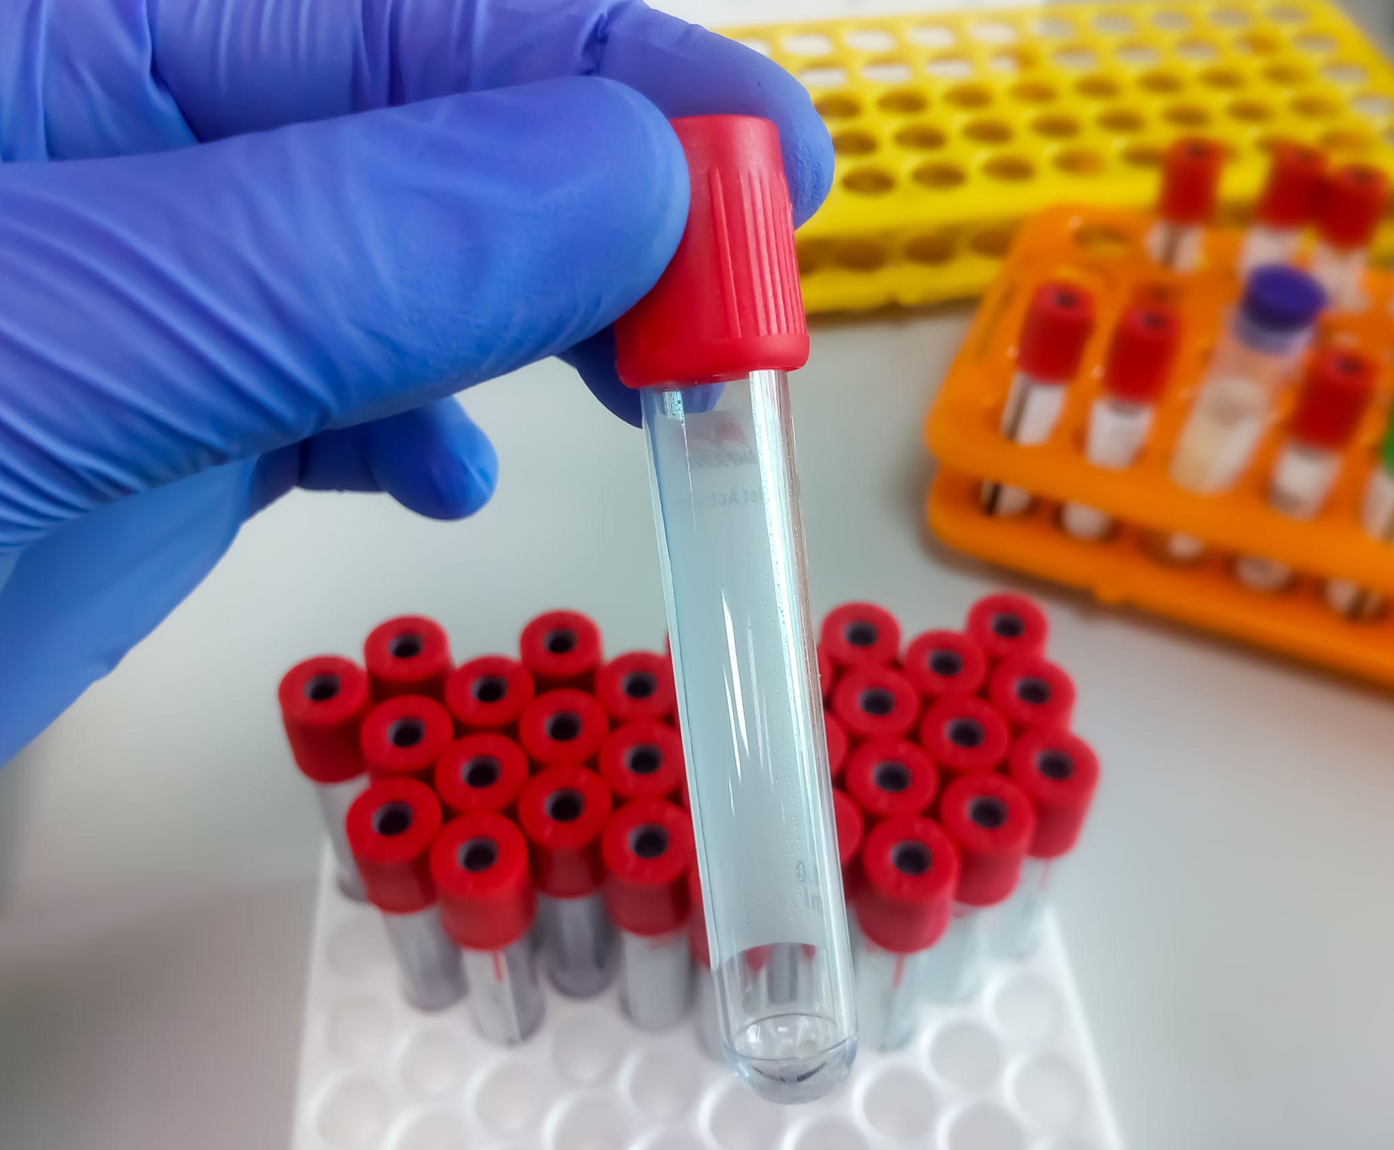
LAB WORK >>>>
What lab work should be collected?
What are we looking for?
CBC
CRP
Urinalysis
Notes:
Students may need a bit of guidance with what and where to look up what labs to order. Ask them why they answer the way they did.
“Phlebotomist” student will draw blood

Slide 19
LAB REPORT
CBC
TEST RESULT REFERENCE RANGE UNIT
WBC total 17 3.5-10.5 tho/cmm
RBC 5.26 4.4-5.7 mil/cmm
HGB 16.4 13.5-17.0 gm/dL
HCT 46.7 36.0-53.5 %
MCV 89 81-94 fL
MCH 31.2 28-32 pg
MCHC 35.1 32-36 gm/dL
RDW 11.8 12.4-16.4 %
PLATELET 248 150-450 tho/cmm
SPEC SOURCE Venous
CRP 15 <9 mg/dL

Slide 20
IV Access & Medications
IV Intervention:
ER nursing >>>>
Starts IV access
Begins IV fluids
Prepares medications
“What should we give through the IV?”

Slide 21
Let’s give him some
IV fluids.
Calculate the
Dosage >>>>
Doctor’s order reads:
Normal Saline IV fluid bolus 10ml/kg
Notes:
What do we need to know to calculate the rate?
His weight….this was not given in the initial assessment/report
He weighs 175lbs. This needs to first be converted into kilograms 175/2.2=79.5 kg
79.5x10=795
You will give Ted roughly 800ml of Normal Saline IV

Slide 22
To treat his
nausea >>>>
Which one is the appropriate
choice?
Remdesivir
Cephalexin
Ondansetron
Acetaminophen
C. Ondansetron
Notes:
Have students research what each medication is for before revealing the answer.
Remdesivir-antiviral used to treat Covid-19
Cephalexin-antibiotic
Ondansetron-anti nausea/anti-emetic
Acetaminophen-analgesic
If you have the available supplies, your “nurse” student may administer the drug

Slide 23
To treat his pain >>>>
Which one is the appropriate
choice?
Morphine Sulfate
Omeprazole
Decadron
Propofol
Morphine Sulfate
Notes:
Have students research what each medication is for before revealing the answer.
Morphine Sulfate-narcotic analgesic
Omeprazole-proton pump inhibitor for GERD
Decadron-corticosteroid for inflammation
Propofol-sedative/hypnotic for general anesthesia
If you have the available supplies, your “nurse” student may administer the drug

Slide 24
Let’s give him some morphine!
Calculate the
Dosage >>>>
Doctor’s order reads:
Morphine Sulfate 0.1 mg/kg IV-max dose 10mg
Notes:
79.5x.1=7.95 We can give him 8 mg

Slide 25
Critical Thinking Opportunity!
What do we need to watch for after administering morphine? Why?
How will we know the morphine is working? When should pain be reassessed?
What if he reported his pain 2/10. Would we give the morphine? Why or why not?
Notes:
We need to monitor the patient’s vital signs to make sure he hasn’t received too much–a drop in heart rate, blood pressure, SpO2 or difficulty to arouse may indicate that he’s gotten too much
We reassess his pain level at around 5 minutes after administering and look for other signs that it’s working-normalized VS, pt resting comfortably, decreased pain score

Slide 26
What is a test our physicians could order that would help confirm our suspicions?

Slide 27
INTERVENTION:
Doctor’s order reads:
CT scan with contrast ASAP
Notes:
If using props, fill a syringe with cloudy fluid-milk with water, etc. and make it available to administer
Looking for someone to realize one of his allergies is contrast dye and a CT with contrast is contraindicated
THIS IS AN EXCELLENT OPPORTUNITY TO REINFORCE VERIFICATION OF ORDERS AND PATIENT SAFETY, AS WELL AS HAVING THE COURAGE TO SPEAK UP WHEN SOMETHING ISN’T RIGHT!
Order needs to be changed to CT without contrast. Radiology staff “transport” patient to CT scan

Slide 28
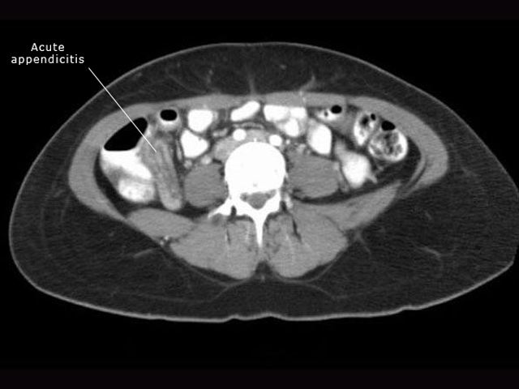
CT SCAN
RESULTS
Cae List |  | Objectives | Radiology | Images | Questions
SMALL INTESTINE AND APPENDIX Case #1 - A 21 year old with acute RLQ pain
S
Image #1 (#1 of 1 found)
CT scanFMP-IF: note3]
Detail: CT scan showing acute appendicitis

Slide 29
Doctors: What do
You order?
Doctor’s order reads:
Consult General Surgery
Consent for laparoscopic appendectomy
Apply knee high surgical stockings
Keep NPO
IV Ancef 1gm on-call to OR
Notes:
Talk about WHY---why compression stockings? What do they do? Why an antibiotic? Why NPO (Nothing by mouth)?

Slide 30
Debriefing Questions:
What went well?
What findings pointed toward appendicitis?
What interventions were our highest priority?
How did we communicate?
Is there anything we could have done differently?

Slide 31

FINAL THOUGHTS FOR FACILITATORS (that’s you!)
Allow productive struggle
Pause for teaching moments
Encourage teamwork
Redirect instead of immediately correcting
HAVE FUN!!

Slide 32
QUESTIONS?
To request a copy of this presentation, please scan the QR code and fill out the Google form.
THANK YOU!
Notes:
You can copy the slide show, then cut out any slides you don’t want, or add anything else. Ex) I will also throw in a vagal response when starting the IV or a Morphine overdose

