Slide 1
Basic principles of electrical engineering

Slide 2
Direct Current and Alternating Current

Slide 3
Below shows a simple DC circuit consisting of a voltage source, electrical lines, a control switch, and a load (here a lamp).

Slide 4
Ohm’s Law
V = R • I
V = Voltage; Unit: Volt (V)
R = Resistance; Unit: Ohm (Ω)
I = Current; Unit: Ampere (A)

Slide 5
Ohm’s Law
Ohm's law expresses the relationship between voltage, current and resistance. It states that in a circuit of given resistance, the current is proportional to the voltage, that is
If the voltage increases, the current increases.
If the voltage decreases, the current decreases.

Slide 6
Electrical Conductors
Electrical current is the flow of charge carriers in one direction. A current can only flow in a material if a sufficient number of free electrons are available. Materials that meet this criterion are called electrical conductors. The metals copper, aluminum and silver are particularly good conductors. Copper is normally used for conductors in control technology.

Slide 7
Electrical Resistance
Every material offers resistance to electrical current. This results when the free moving electrons collide with the atoms of the conductor material, inhibiting their motion. Resistance is low in electrical conductors. Materials with particularly high resistance are called insulators. Rubber- and plastic-based materials are used for insulation of electrical wires and cables.

Slide 8
Electrical Power
In mechanics, power can be defined by means of work. The faster work is done, the greater the power needed. So power is "work divided by time".
In the case of a load in an electrical circuit, electrical energy is converted into kinetic energy (for example electrical motor), light (electrical lamp), or heat energy (such as electrical heater, electrical lamp). The faster the energy is converted, the higher the electrical power. So here, too, power means converted energy divided by time. Power increases with current and voltage.

Slide 9
Electrical Power 1
P = V • I
P = Power; Unit: Watt (W)
V = Voltage; Unit: Volt (V)
I = Current; Unit: Ampere (A)

Slide 10
Electrical Power Example
Power of a coil
The solenoid coil of a pneumatic 5/2-way valve is supplied with 24 VDC. The resistance of the coil is 60 Ohm. What is the power?
The current is calculated by means of Ohm's law:
I = V = 24 V = 0.4 A
R 60 Ω
The electrical power is the product of current and voltage:
P = V· I = 24 V · 0.4 A = 9.6 W

Slide 11
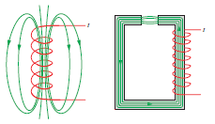
Function of a Solenoid
When current flows through an electrical conductor, a magnetic field builds up around it. This magnetic field expands if the current intensity is increased. Magnetic fields exert an attractive force on workpieces made from iron, nickel or cobalt. This force increases as the magnetic field grows

Slide 12
Structure of a Solenoid
The solenoid has the following structure:
The current-bearing conductor is wound around a coil. The overlapping of the lines of force of all loops increases the strength of the magnetic field resulting in a main direction of the field.
An iron core is placed in the centre. When current flows, the iron is also magnetized. This allows a significantly higher magnetic field to be induced with the same current (compared to an air-core coil).

Slide 13
Applications of Solenoids
In electropneumatic controls, solenoids are primarily used to control the switching of valves, relays or contactors. This can be demonstrated using the example of the spring-return directional control valve:
If current flows through the solenoid coil, the piston of the valve is actuated.
If the current is interrupted, a spring pushes the piston back into its initial position.

Slide 14
Function of a Capacitor
A capacitor consists of two metal plates with an insulating layer (dielectric) between them. If the capacitor is connected to a DC voltage source, a charging current flows momentarily. Both plates are electrically charged by this. If the circuit is then interrupted, the charge remains stored in the capacitor. The larger the capacitance of a capacitor, the greater the electrical charge it can store for a given voltage.
Capacitance is measured in Farad (F):

Slide 15
Measurement
Measurement means comparing an unknown variable (such as the length of a pneumatic cylinder) with a known variable (such as the scale of a measuring tape). A measuring device (such as a ruler) allows such measurements to be made. The result – the measured value – consists of a numeric value and a unit (such as 30.4 cm).

Slide 16
Measurement in Electrical Circuits
Electrical currents, voltages and resistances are normally measured with multimeters. These devices can be switched between various modes:
DC current and voltage, AC current and voltage
Current, voltage and resistance

Slide 17
Measurement in Electrical Circuits 1
The multimeter can only measure correctly if the correct mode is set.

Slide 18
Procedure for Measurements on Electrical Circuits
Proceed in the following order when performing measurements in an electrical circuit:
Switch off the supply voltage to the circuit.
Set the required operating mode on the multimeter (current or voltage measurement, DC or AC voltage, resistance measurement).
When using pointer measuring instruments, check and if necessary adjust the zero point.
When measuring DC voltage/direct current, connect the measuring device to the correct terminal ("+“ terminal of the measuring device to the positive terminal of the voltage supply).
Choose the largest measuring range.
Switch on the voltage supply to the circuit.
Monitor the pointer or display and gradually switch over to a smaller measuring range.
Read the display when the greatest pointer deflection occurs (smallest possible measuring range).
When using pointer instruments, always read the display by looking down onto it to avoid reading errors.

Slide 19
Voltage Measurement
For voltage measurements, the measuring device is connected parallel to the consuming device. The voltage drop across it corresponds to the voltage drop across the measuring device. Each voltage measurement device (voltmeter) has its own internal resistance. To get the truest possible measurement result, only a very small current may flow through the measuring device, i.e. the voltmeter's internal resistance must be as great as possible.

Slide 20
Voltage Measurement 2

Slide 21
Current Measurement
For current measurements, the measuring device is connected in series with the consuming device. The full consuming device current flows through the measuring device.
Each current measuring device (ammeter) has its own internal resistance. This additional resistance reduces the current flow. To keep measurement errors as low as possible, an ammeter may only exhibit a very small internal resistance.

Slide 22
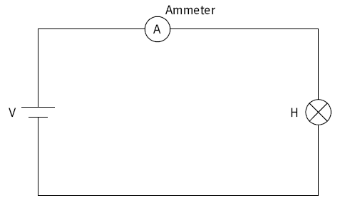
Current Measurement 1

Slide 23
Resistance Measurement
The resistance of a load in a DC circuit can either be measured directly or indirectly.

Slide 24
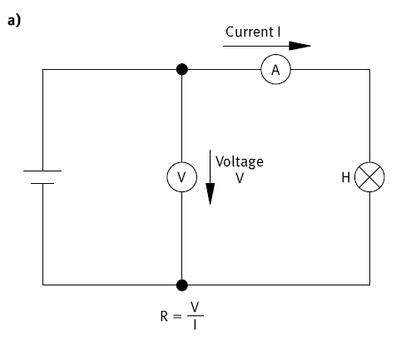
Indirect Measurement
Indirect measurement measures the current through the load and the voltage across the load. The two measurements can either be carried out simultaneously or one after the other. The resistance is then measured using Ohm's law.

Slide 25
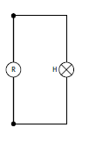
Direct Measurement
For direct measurement the load is separated from the rest of the circuit (Fig. 2.9b). The measuring device (ohmmeter) is set to resistance measurement mode and connected to the terminals of the load. The value of the resistance is displayed.

