Slide 1


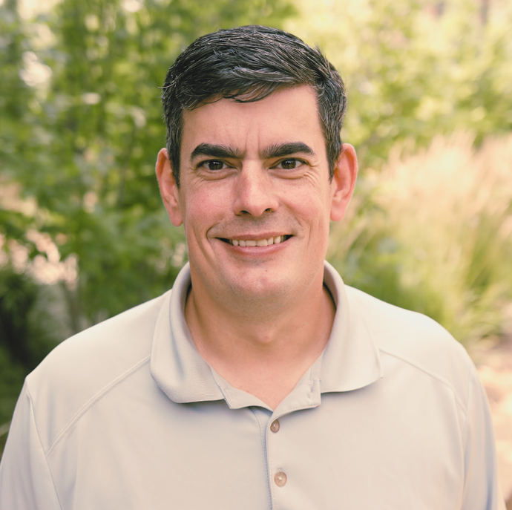
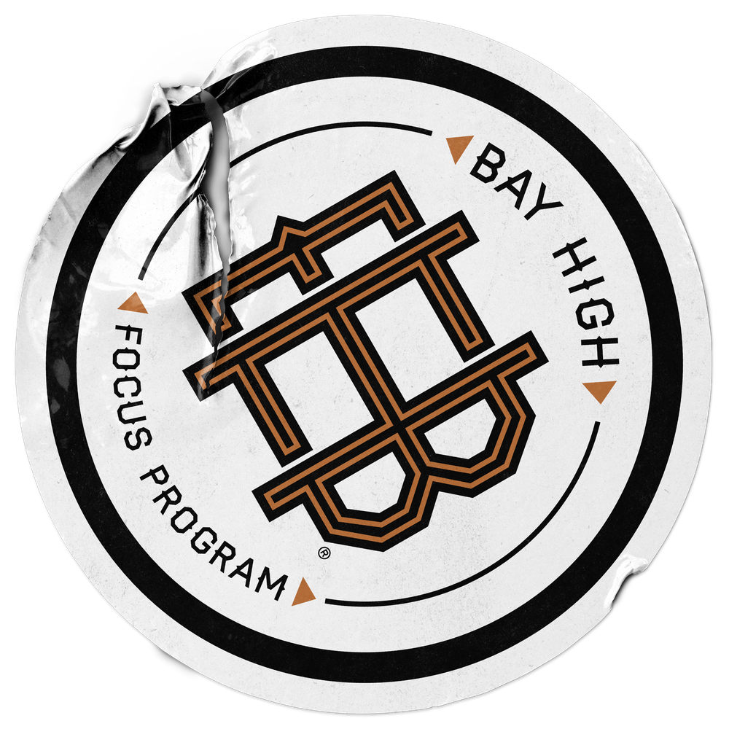
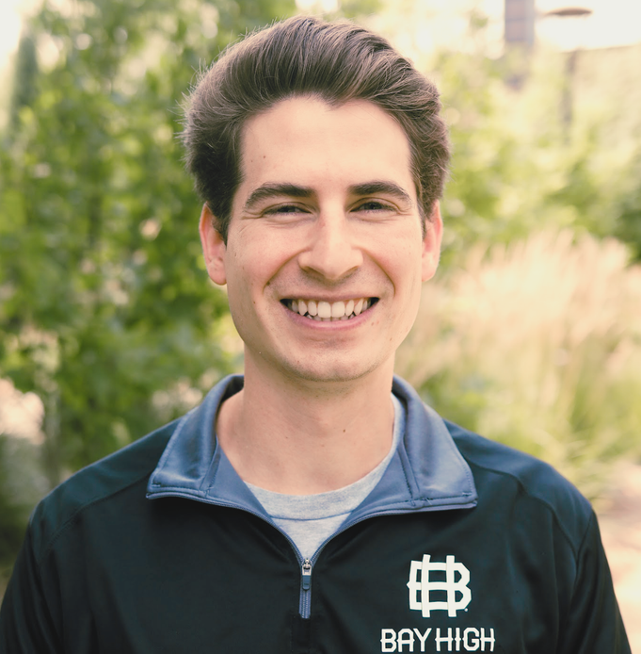
WELCOME TO
Remixing an Alternative CTE
Program
Notes:
Brent
Welcome everyone
Introduce ourselves

Slide 2

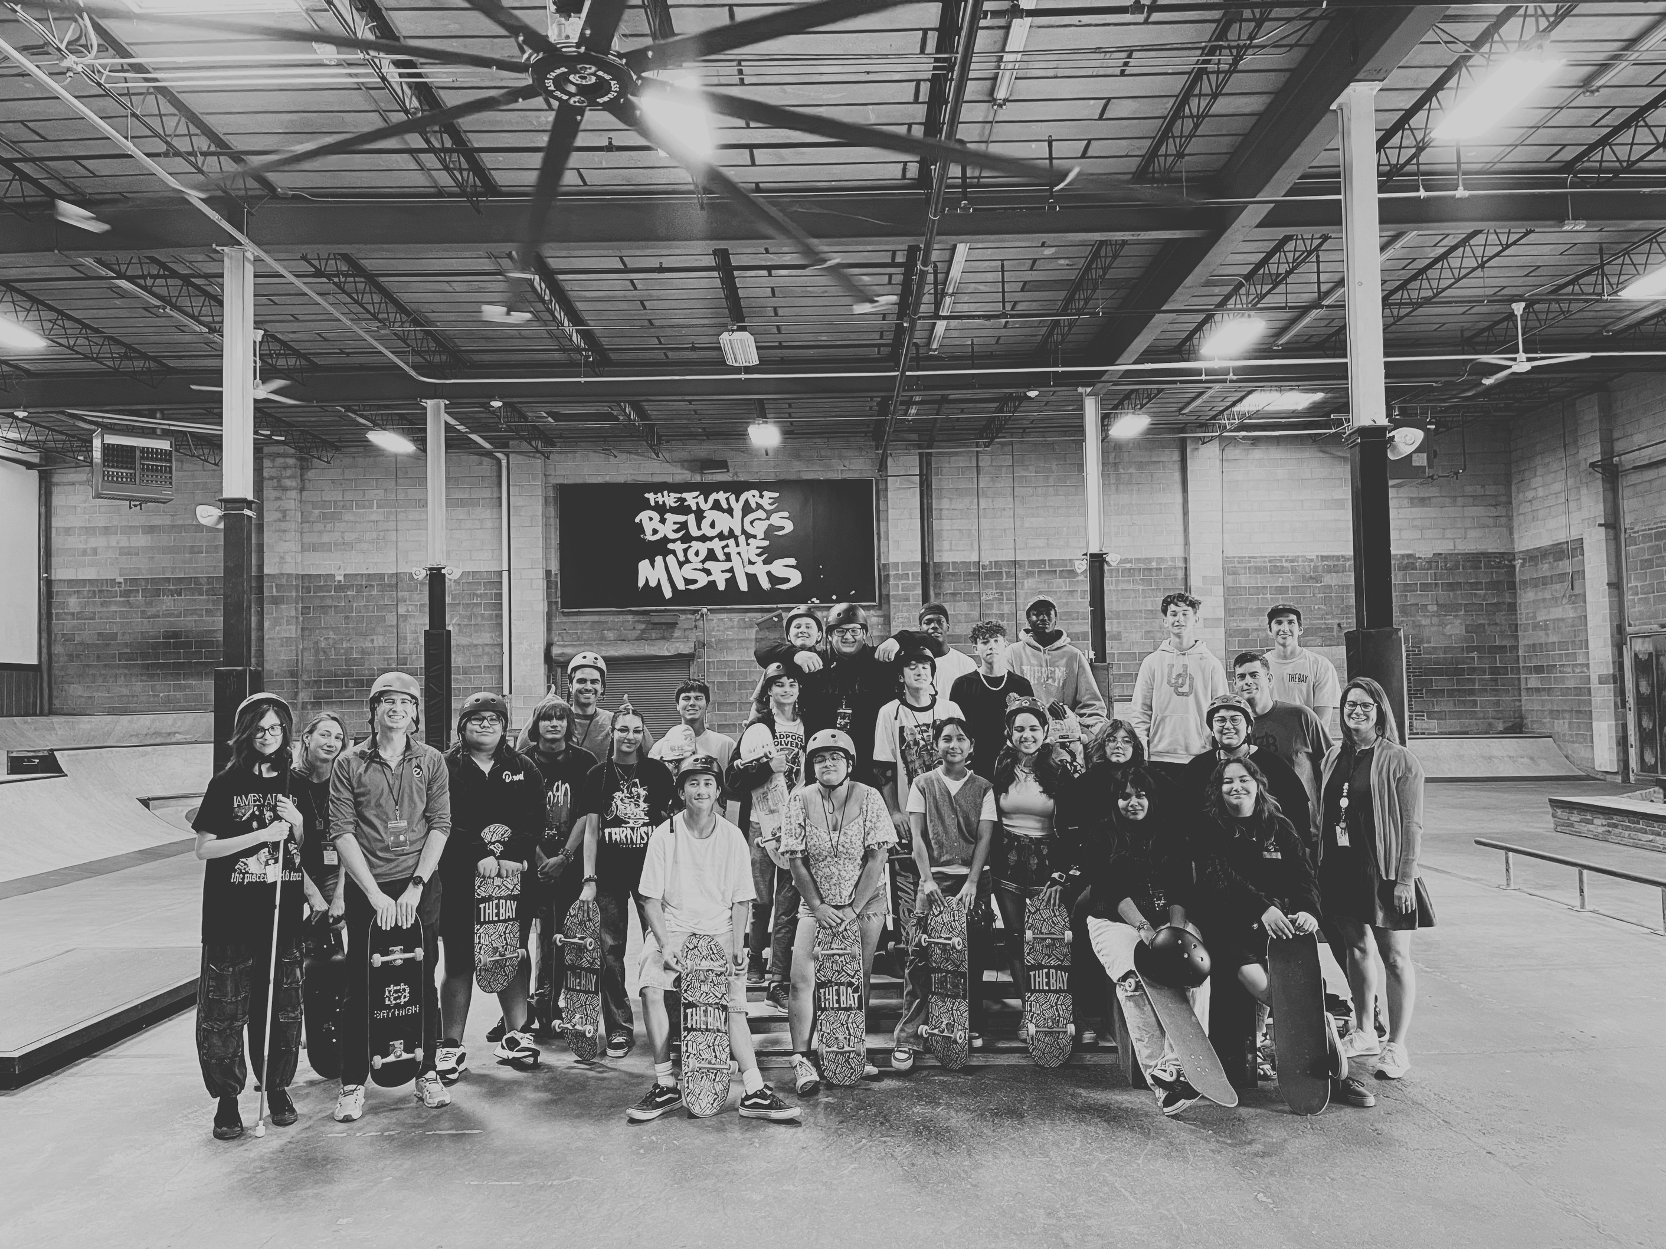

Bay High is A Lincoln Public Schools high school focus program located at The Bay LNK.
Notes:
Brent
-Give an overview of the program
-Juniors - Take Charge, Digital Media Design, Economics, Sports Entertainment Marketing, Podcasting, Composition & Content Creation
-Seniors - Personal Branding & Marketing, Video Production, Entrepreneurship, Film & Lit, and journalism, & Content Creation

Slide 3

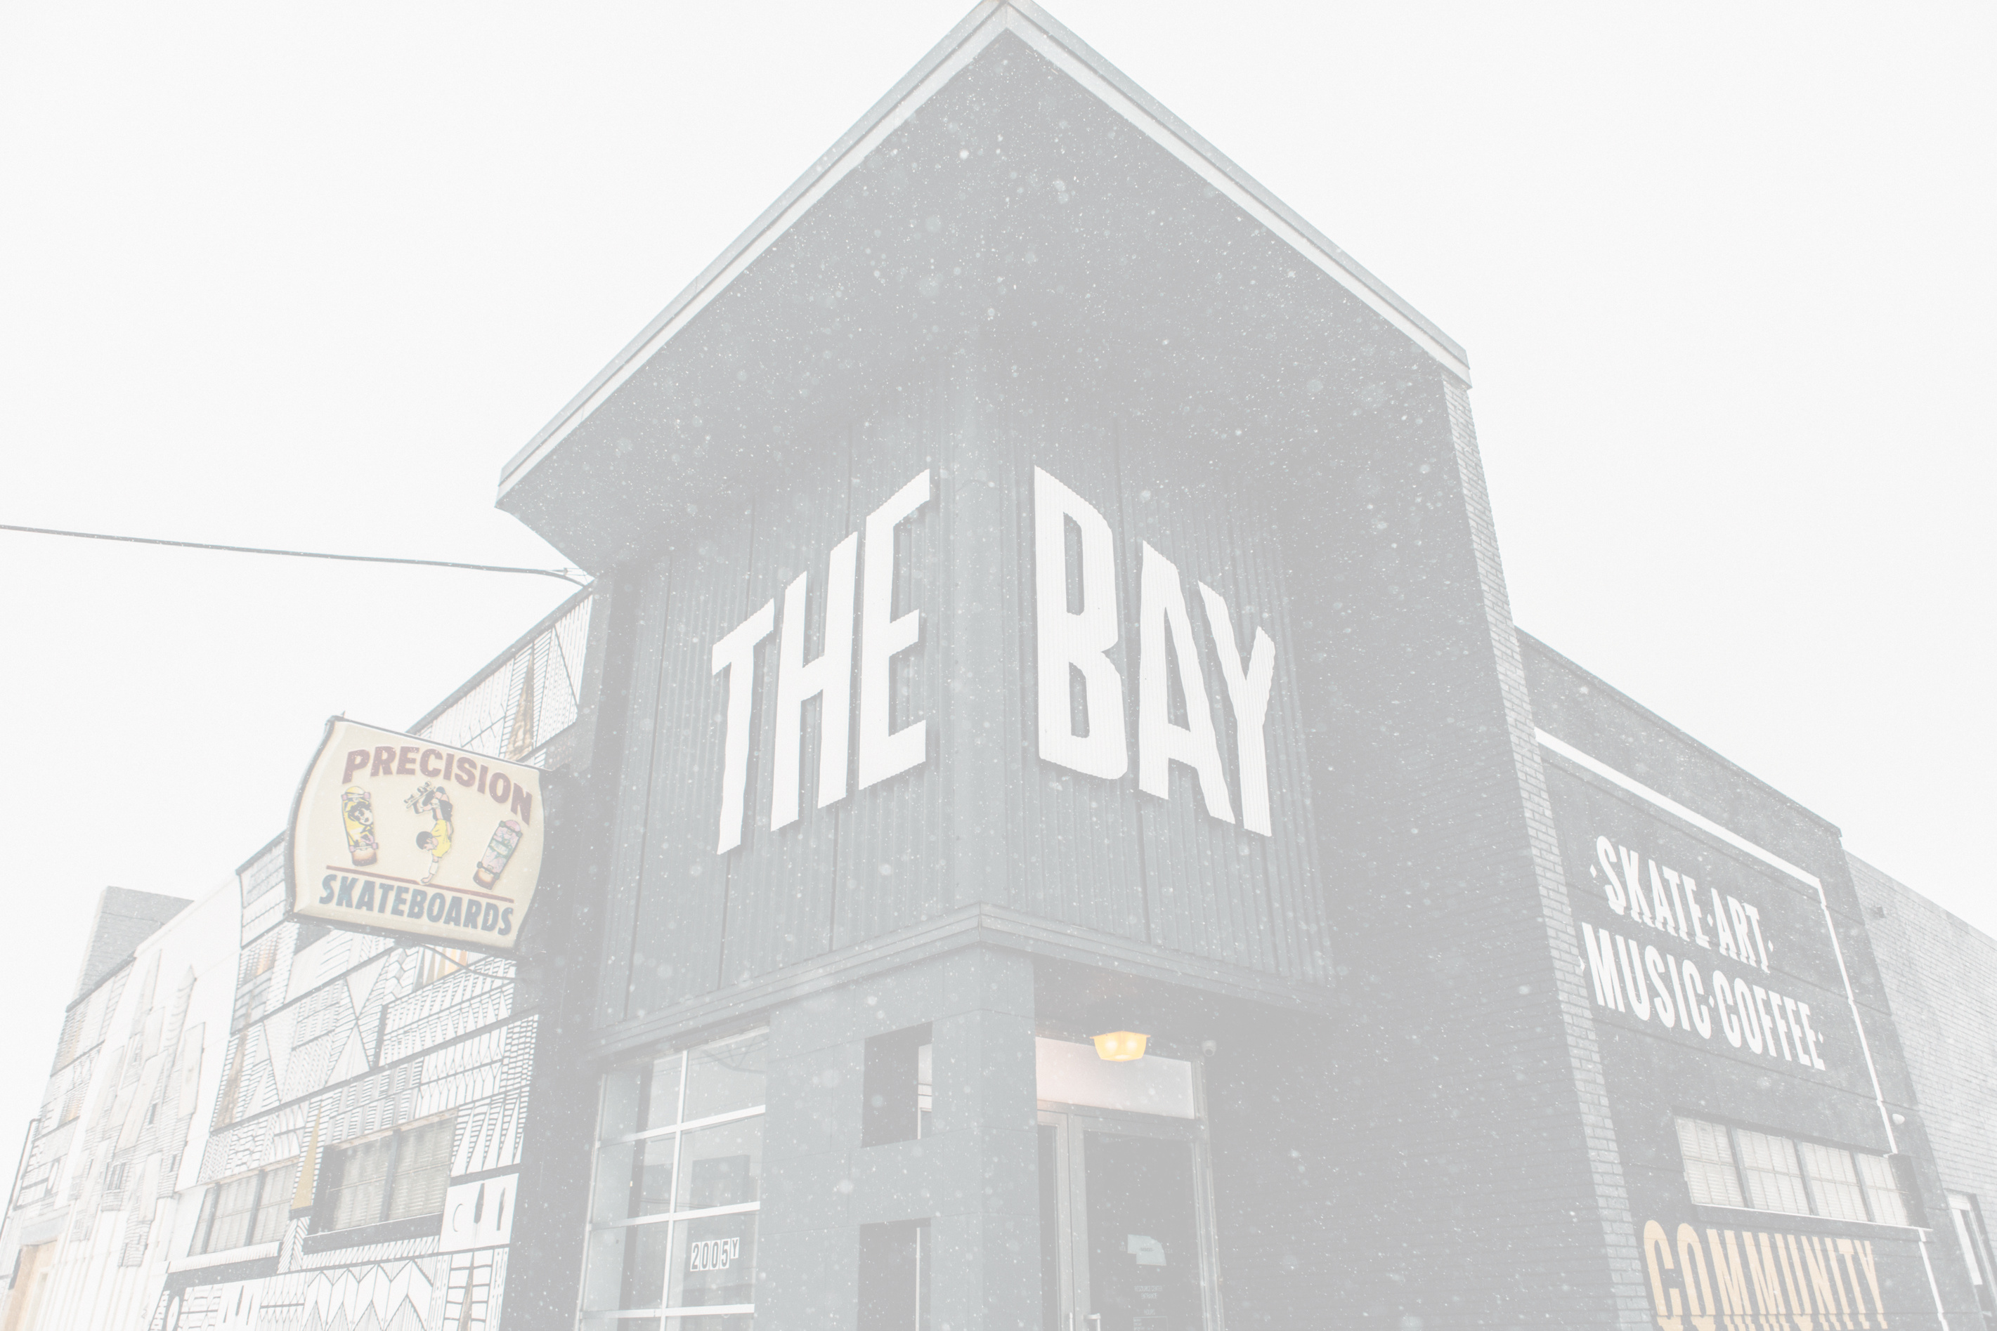


ABOUT THE BAY LNK
ABOUT BAY HIGH
The Bay LNK is Lincoln’s only youth-serving organization open until 10 p.m. on weeknights and midnight on weekends. Since 2010, it has done critical preventative work by providing a safe place to be, productive educational activities to do, and positive mentors who care.
Bay High offers a future-focused curriculum centered on content creation and emerging digital technologies. Anchored in marketing, journalism, and entrepreneurship, students gain technical skills in our four pillars: photography, videography, graphic design, and podcasting. Our project-based learning model fosters innovation and creativity, extending education beyond traditional boundaries to cultivate the mindset, character, and collaborative abilities students need to thrive in creative industries and in life. With strong ties to The Bay, we incorporate student passions—skate, art, music, fashion, and gaming—as meaningful creative disciplines, empowering the next generation of creators and changemakers.
Notes:
Brent
Tell how the idea started
Kids showing up to skate during school
Space not being used everyday
Why not open a school?

Slide 4



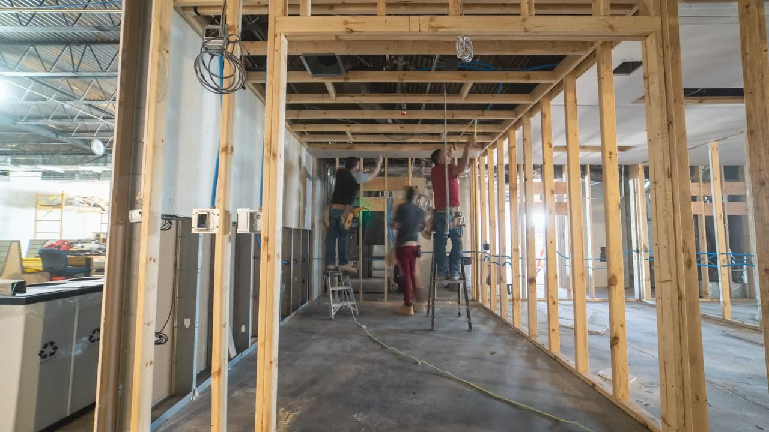
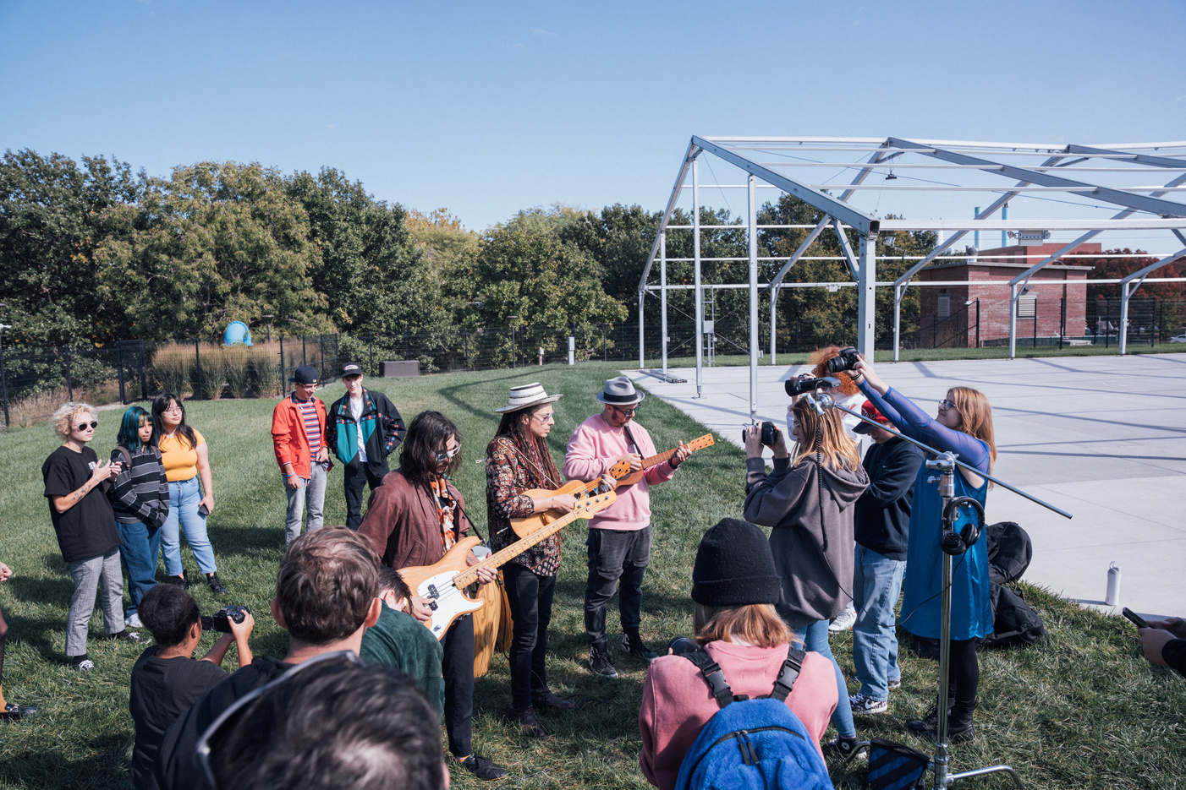


HOW IT STARTED
DREAMERS VS DOERS
  No Curriculum = Creativity Required
  Business Roundtable vision to actual day-to-day school operations
Notes:
Brent
Dreamers vs Doers - FIRST YEAR
--No Curriculum - Creativity Required - able to be inventive but the resources needed
Story: "Create Bay High" / "Bay High Branding"
--Business Roundtable vision (make it as much like the real world as possible) to the actual connection to standards
Story: Misfit Minute flop - unstructured time and self-ownership... soft skills not built yet
THE Takeaway: Iteration is GOOD! Try, fail, try again. Be honest with students about that process. School can reflect the real-world, but it takes the executers and smart teachers like us to make it possible!

Slide 5
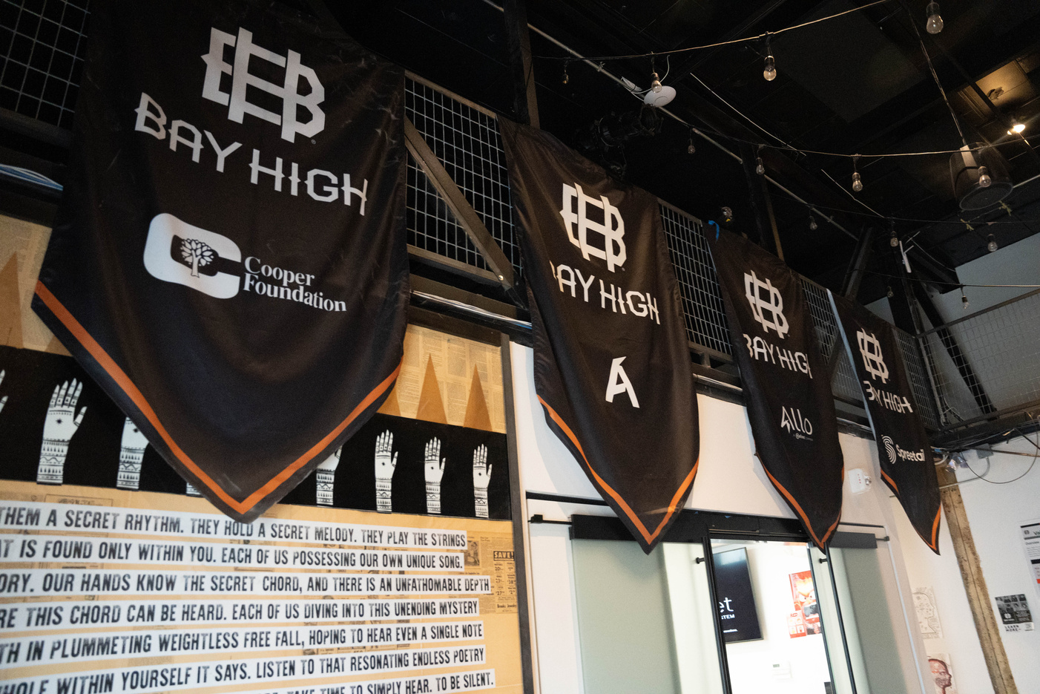
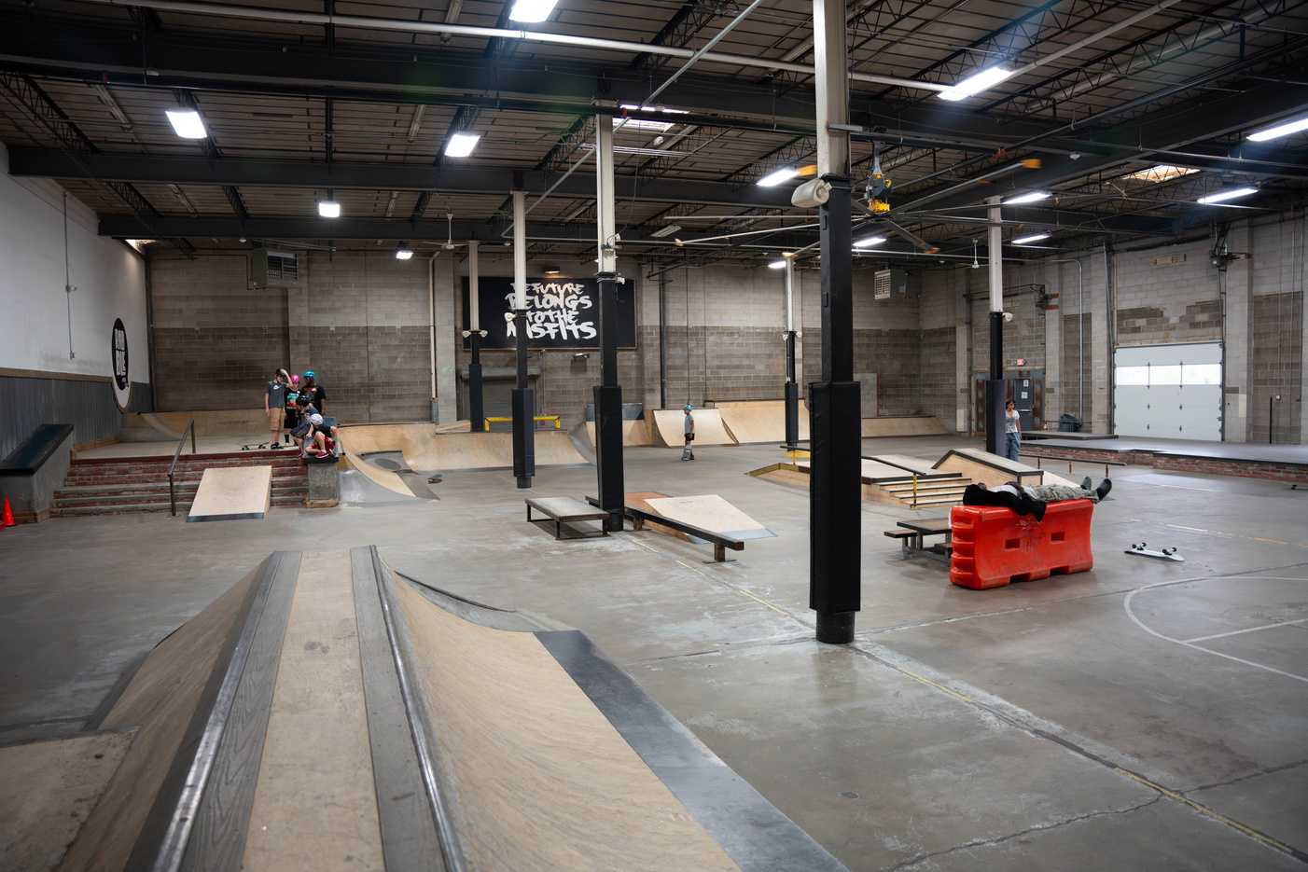
HOW IT STARTED
WHERE WE WENT WRONG
  HOW DO WE “DO SCHOOL DIFFERENT” AND STILL BE A SCHOOL?
    Freedom vs. Responsibility
    Unstructured Time vs. Teacher-Guided
    Real-World Projects vs. Test
Notes:
Ethan
Second year Reflect
Main idea: Alt Ed is awesome but we are different from a normal High School - feeling the tension and friction constantly
THE Takeaway - We needed move from Black and White to Grey and a mix of them - "living in the tension"
Students don't NEED an entirely different school; they just want to be heard and valued and given the chance to do different things often; they SEE the work we are doing!

Slide 6
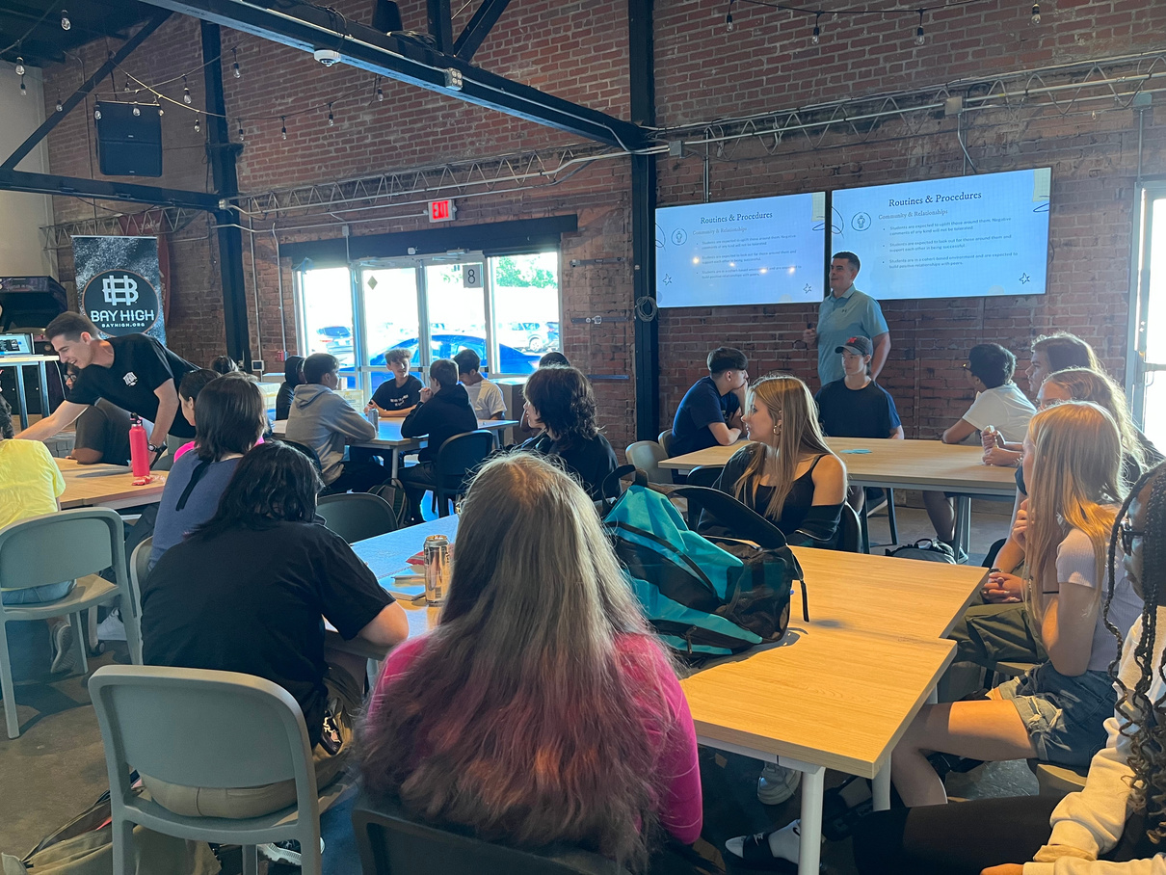
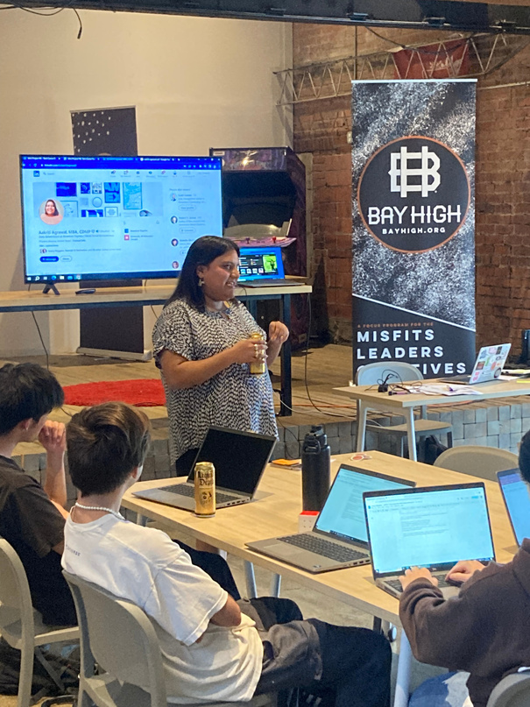
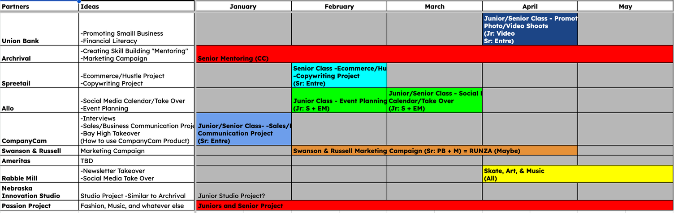
HOW IT STARTED
WHAT WE WISH WE WOULD’VE KNOWN/DONE SOONER
  Community Partnerships
  School Culture & Community
Notes:
Brent
What We Wish We Would've Known - YEAR 3
Community Partnerships - communication & coordination
- It takes a lot of time! You can't plan stuff a month in advance!
Summer meetings matter!
-Admin wants to take this off teachers plate but its also impossible
Strengths and resources - We are BETTER because of our community partners; it raises stakes; makes things real...
Culture - home school relationships vs being intentation about buildings them
Movement and slowing down!
Teaching students how to be humans
The chance to truly grow "human skills"

Slide 7

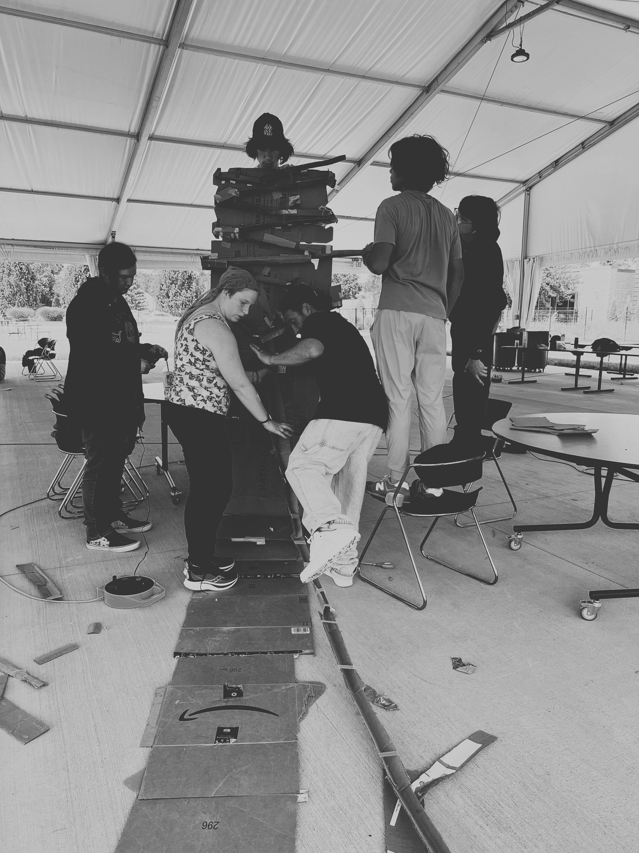


HOW IT STARTED
  Dreamers vs. Doers
    Iteration is good
  Where we went wrong
    Live in the tension
  What we wish we would’ve known/done sooner
    Relationships matter most
Notes:
Brent
Summarize the section!!

Slide 8
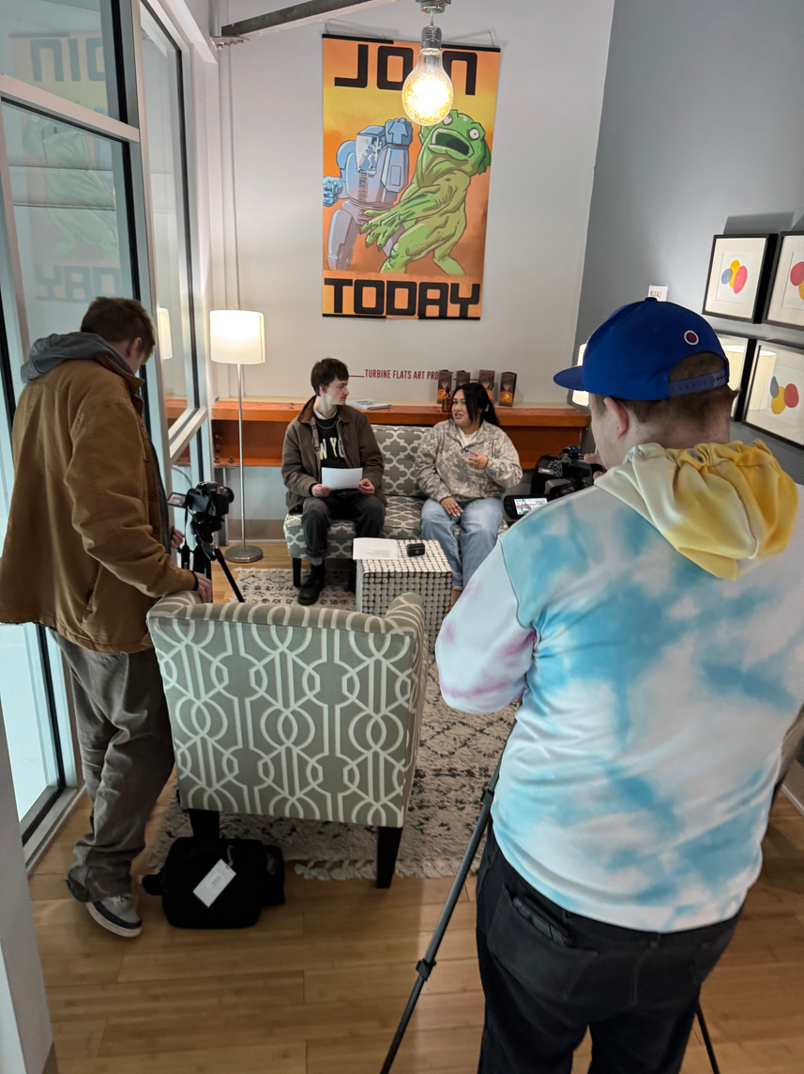
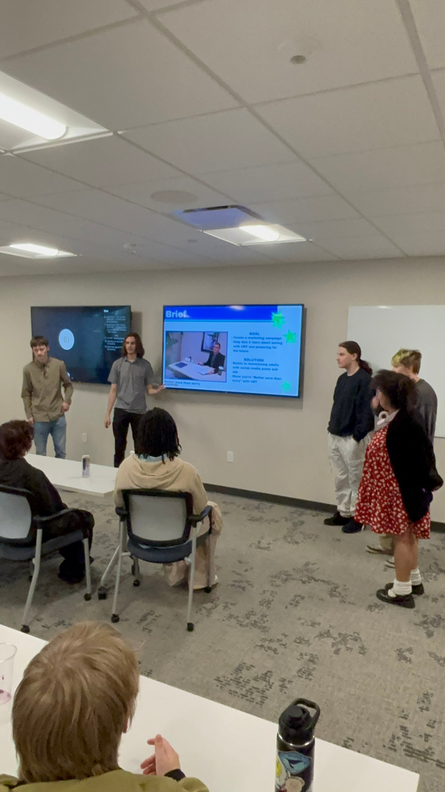
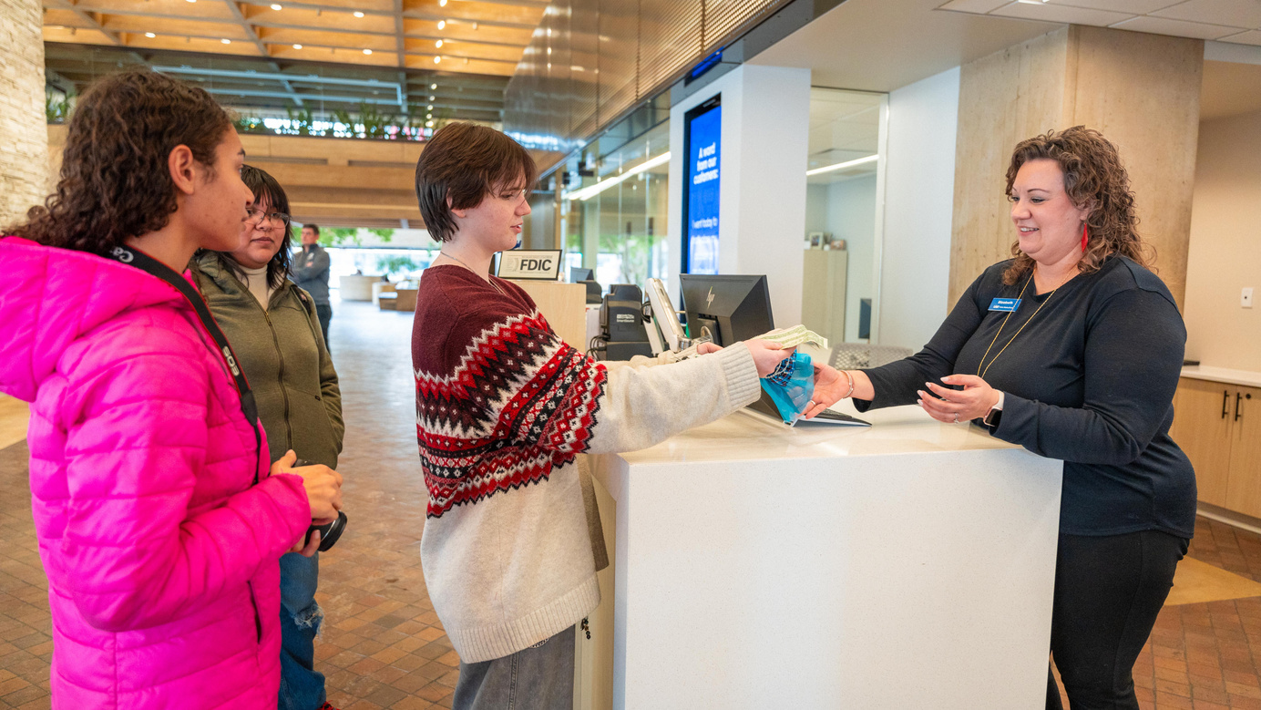
HOW IT’S GOING
CAREER-BASED & FUTURE-FOCUSED
  Blending Technical Skills learning with Human Skills
  Authentic connections to the future through community partners
  Unlocking passions and dreams
Notes:
Ethan
Bullet point #1 - Pillars and the iteration that has come from that
**Jump to Pillars
**Jump back
Bullet Point #2 - Opening their eyes to what's possible at our many community partners - as many opportunities as possible
Bullet Point #3 - Individually, students get to explore what they want to do still through specific projets we've developed to bring in their interests and passions

Slide 9
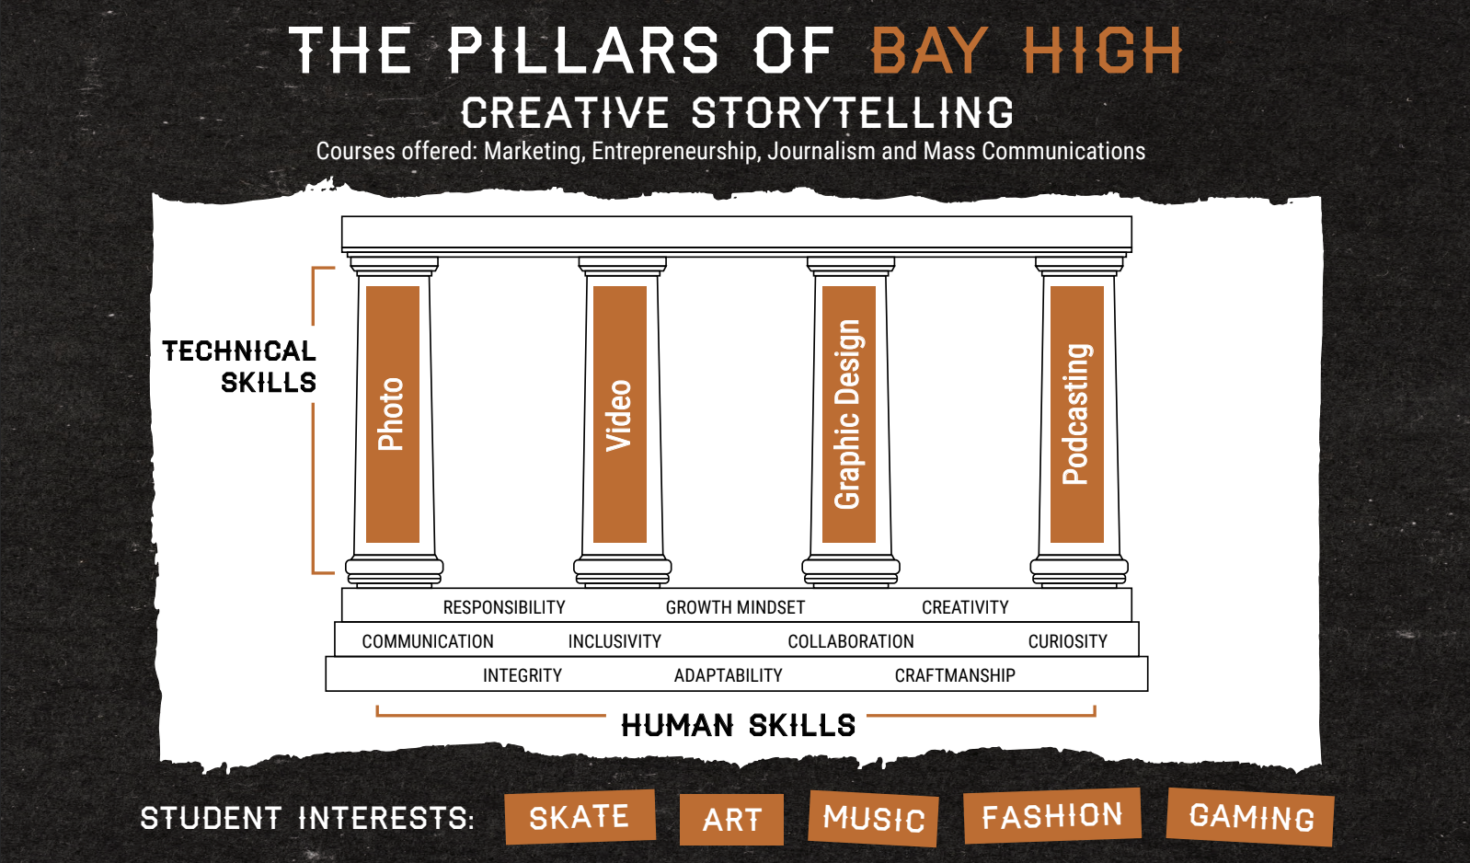
Notes:
Ethan

Slide 10
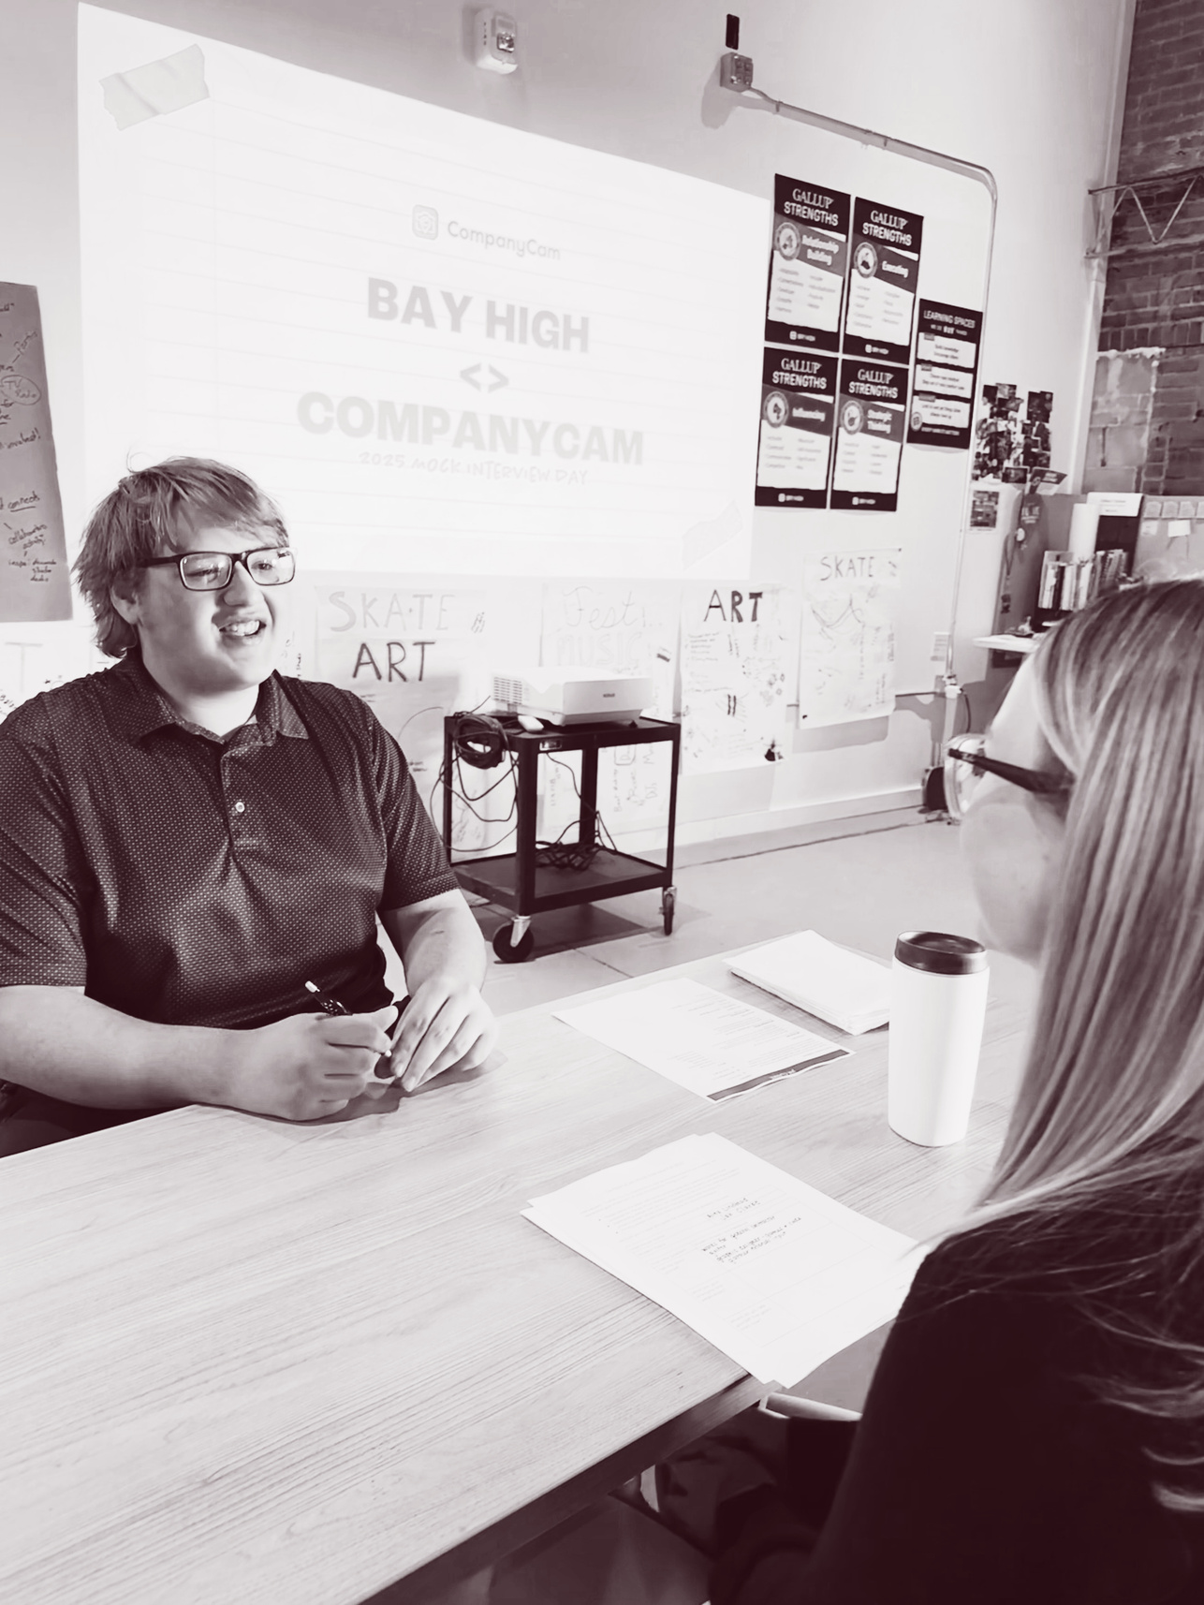

FAVORITE LEARNING
  CompanyCam CareerS Unit
  Swanson Russell & UBT
Notes:
Ethan - CompanyCam
Brent - Swanson Russell / UBT

Slide 11
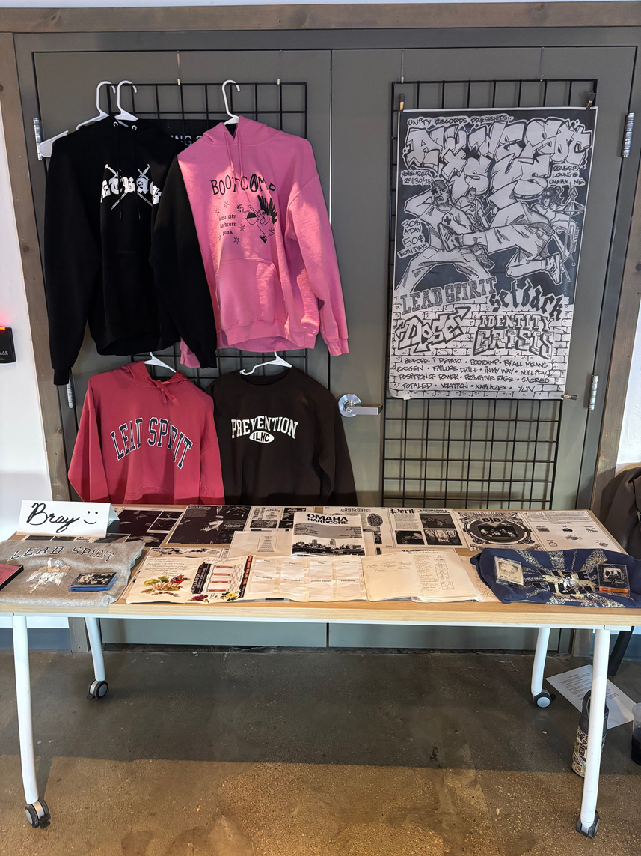
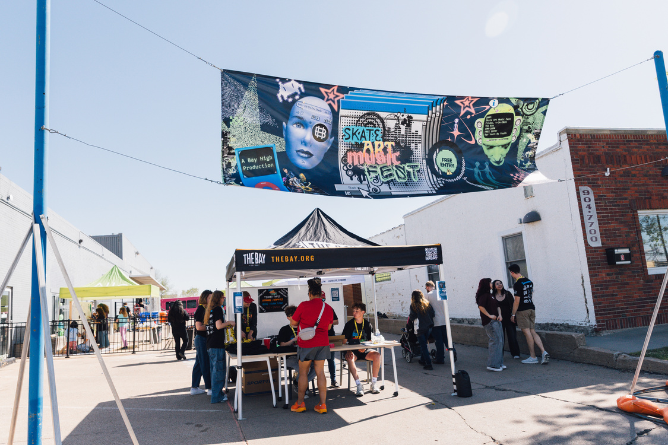
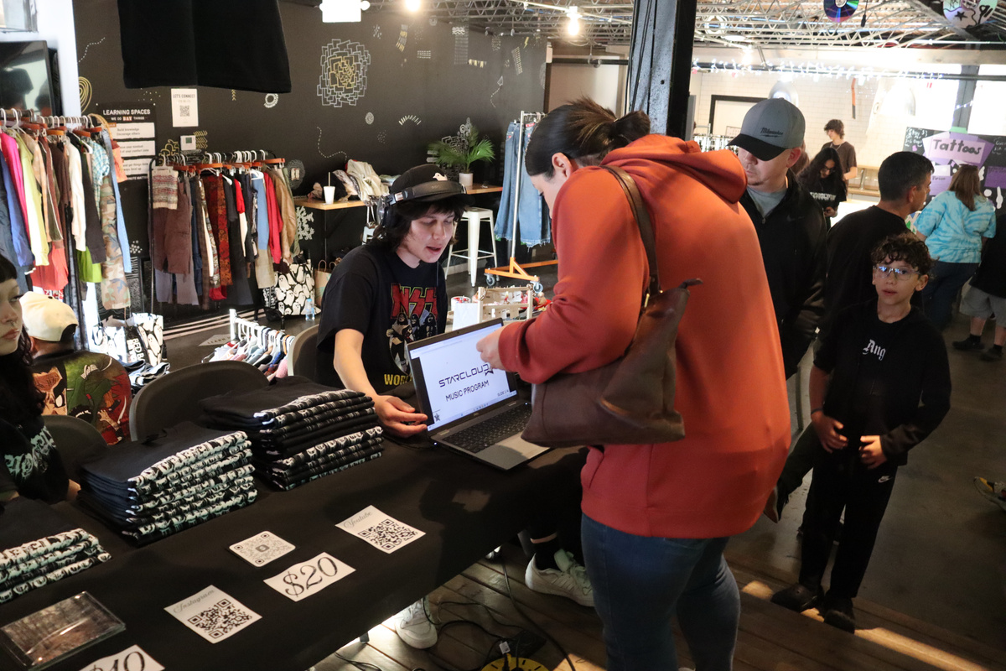
HOW IT’S GOING
PROJECT-BASED - LEARN BY DOING
  REENGAGEMENT W/ SCHOOL
  Project-based learning might be more work than traditional assignments
  No one right answer
  Leveraging reflection
Notes:
Brent
Reengagement w/ School - getting to do what they want to do WITHIN REASON and within Curriculum that matches standards!!
Project-based learning might be more work than traditional assignments - learning executive functioning skills; figuring out how to teach these skills
We're still figuring this out ^^
No one right answer
Authentic Failure
Process over Product
Life-time learning skills
Leveraging reflection - a powerful test and assessment
It requires a lot from teachers to dialogue about the learning process and create an ongoing conversation
Better way to create connections between disconnected curriculum

Slide 12
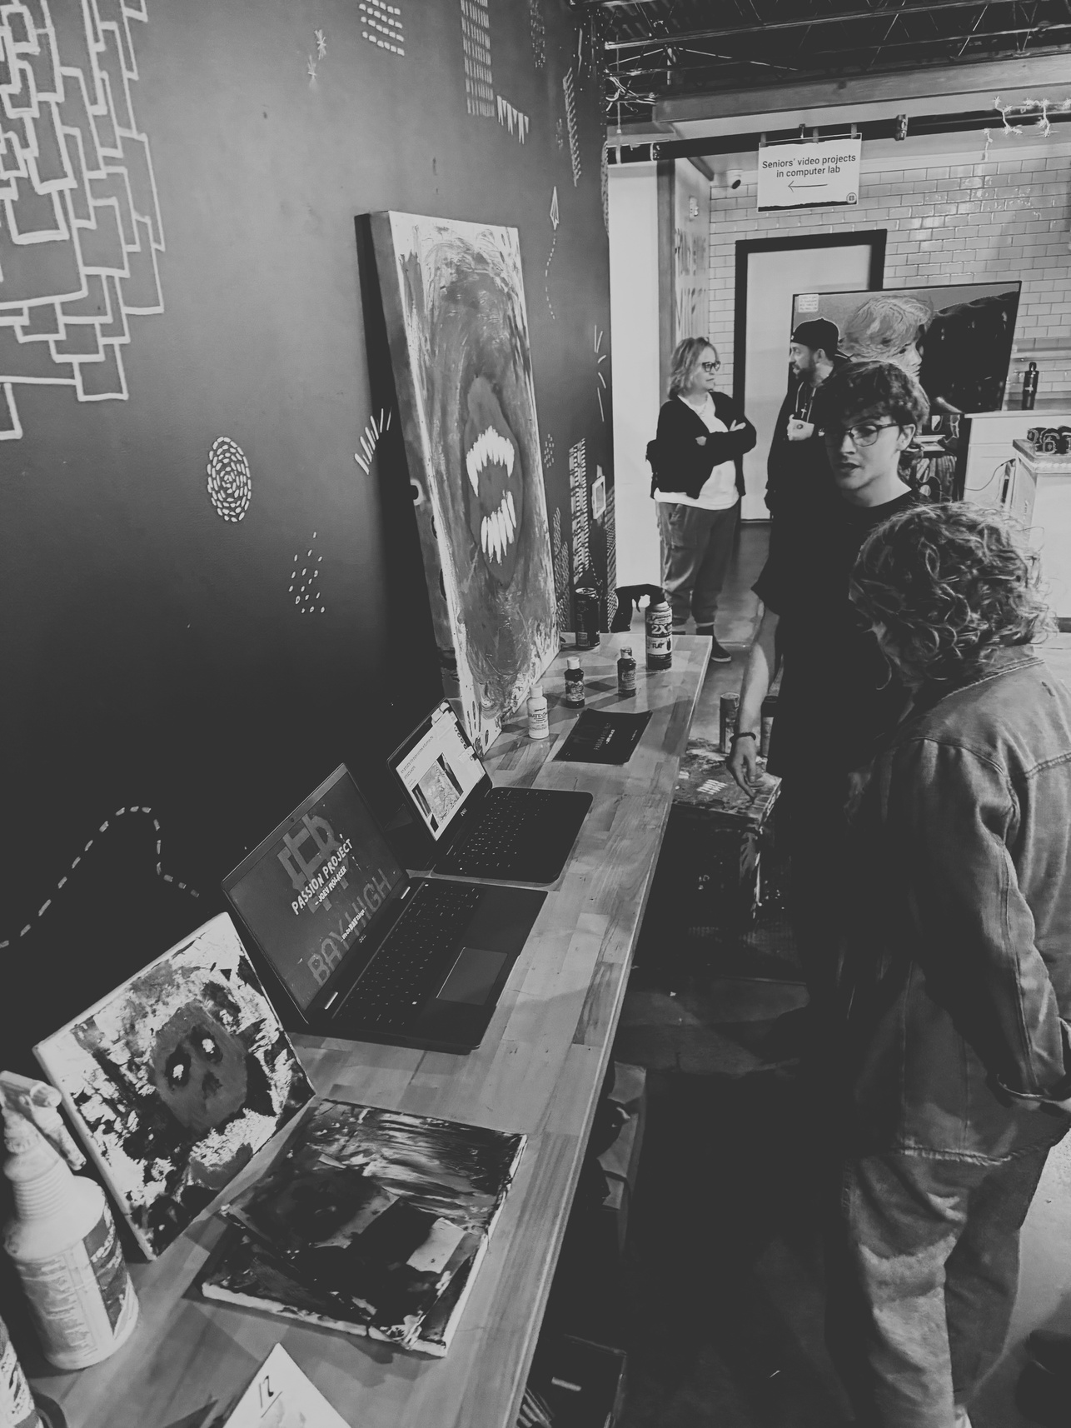
FAVORITE LEARNING
  PASSION PROJECT
  SKATE ART MUSIC FEST
Notes:
Brent - Passion Projet
Ethan - SAMF

Slide 13
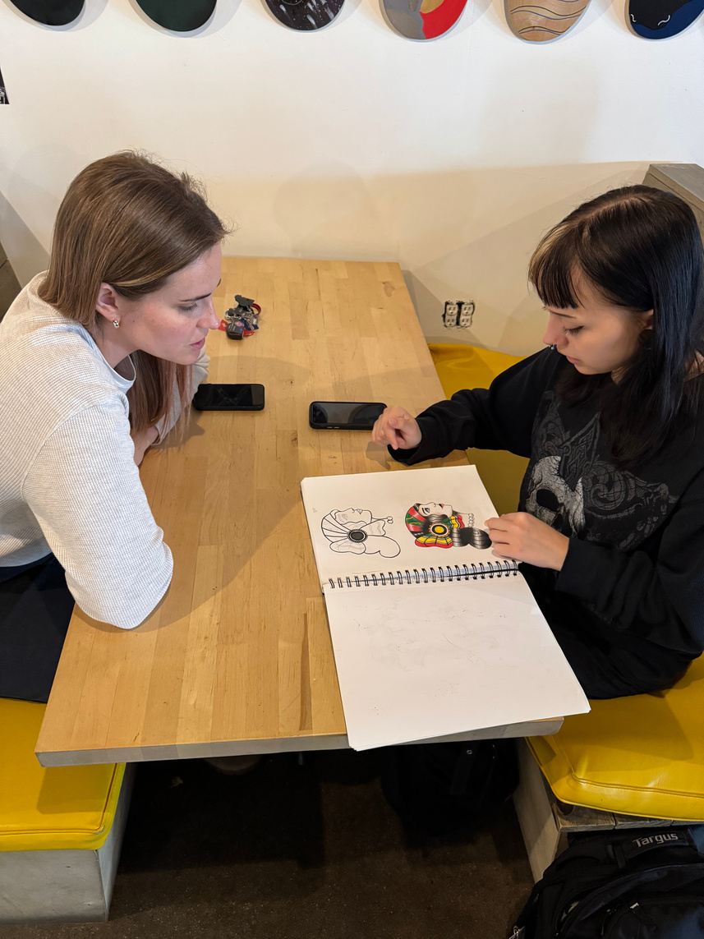
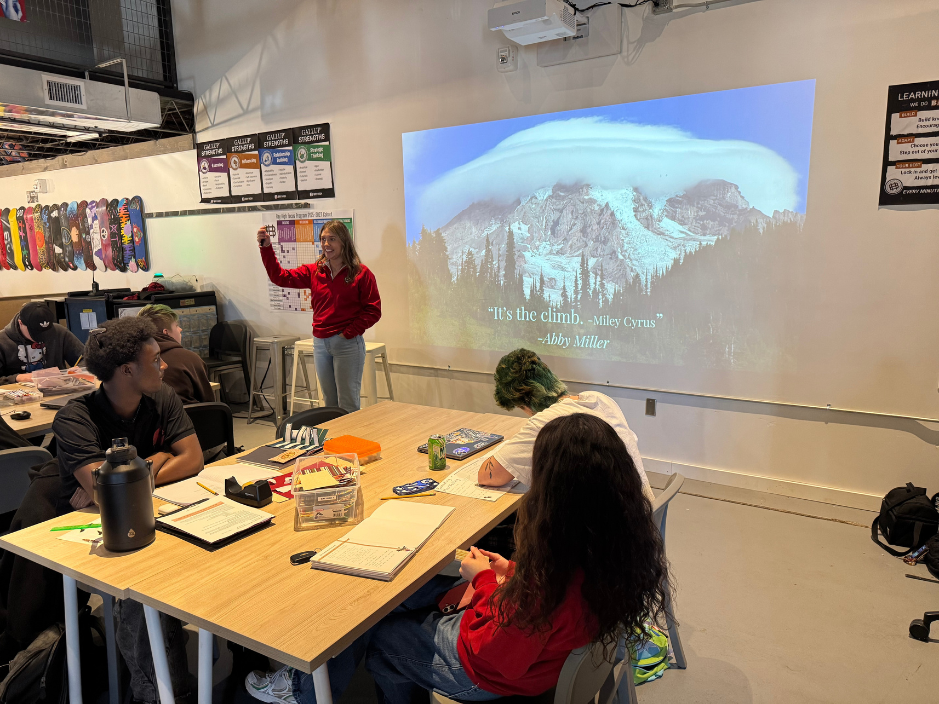
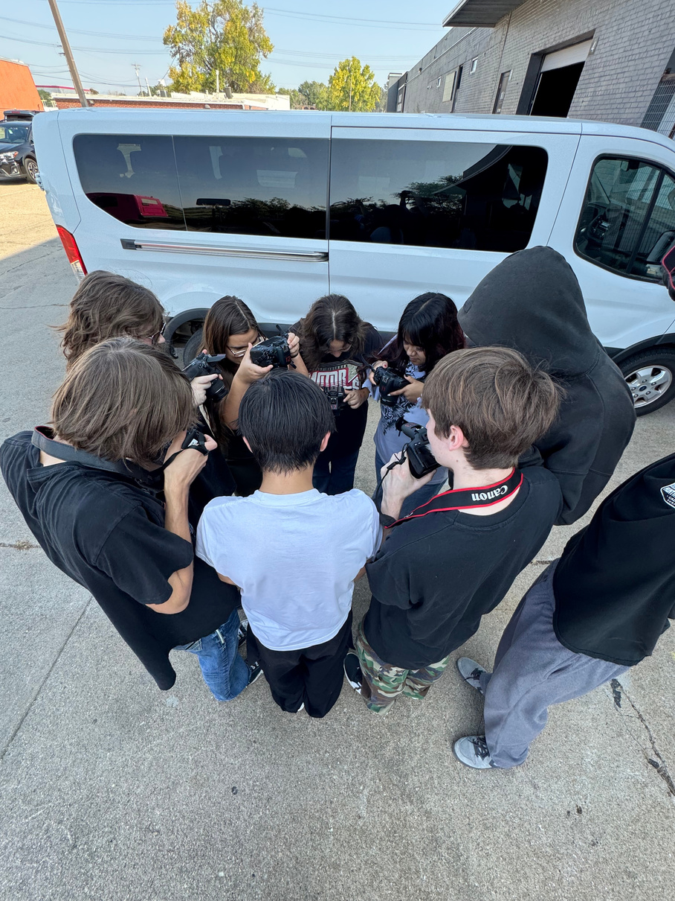
HOW IT’S GOING
RELATIONSHIP-BASED
  MOVEMENT AND PLAY
  Reciprocal Reinvestment
Notes:
Ethan
Movement and Play
"Not something we just say but do"
It's difficult to do, but it matters!
Take it one step at a time but iterate it - "scaffold vulnerability" and make sure students are ready for the next one
Our community invested in us so we invest in them and they continue to want to invest in us and our students feel more valued beacuse of it
"Networking is transformational; not transactional" - always something to add to each other!

Slide 14
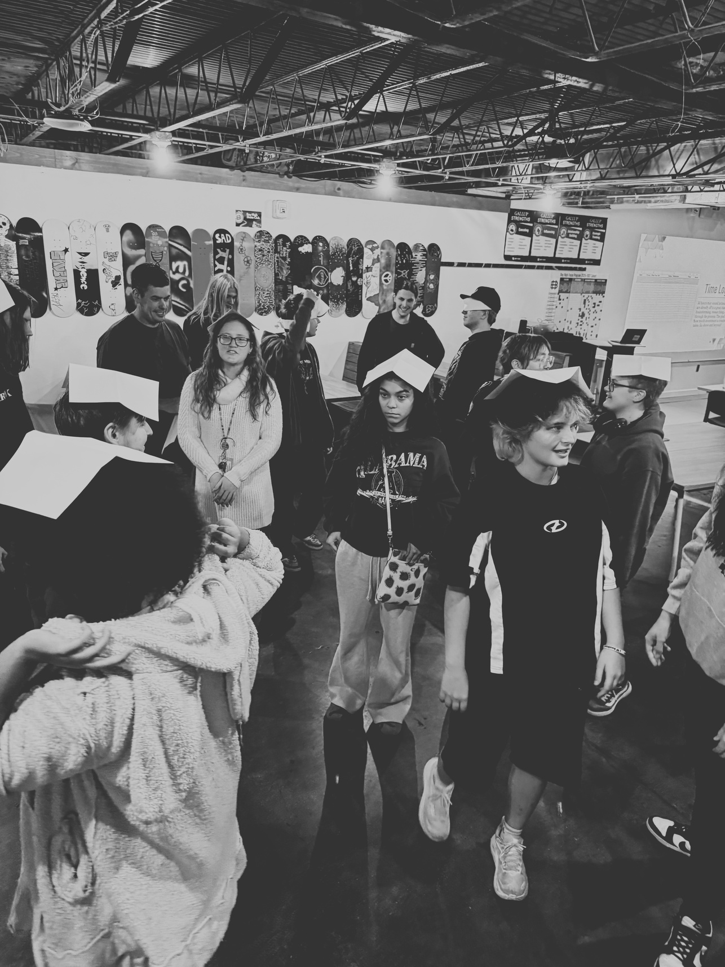
FAVORITE LEARNING
  MENTORING
  Community Building ACTIVITIES
Notes:
Ethan - Mentoring
Brent - Community Building

Slide 15
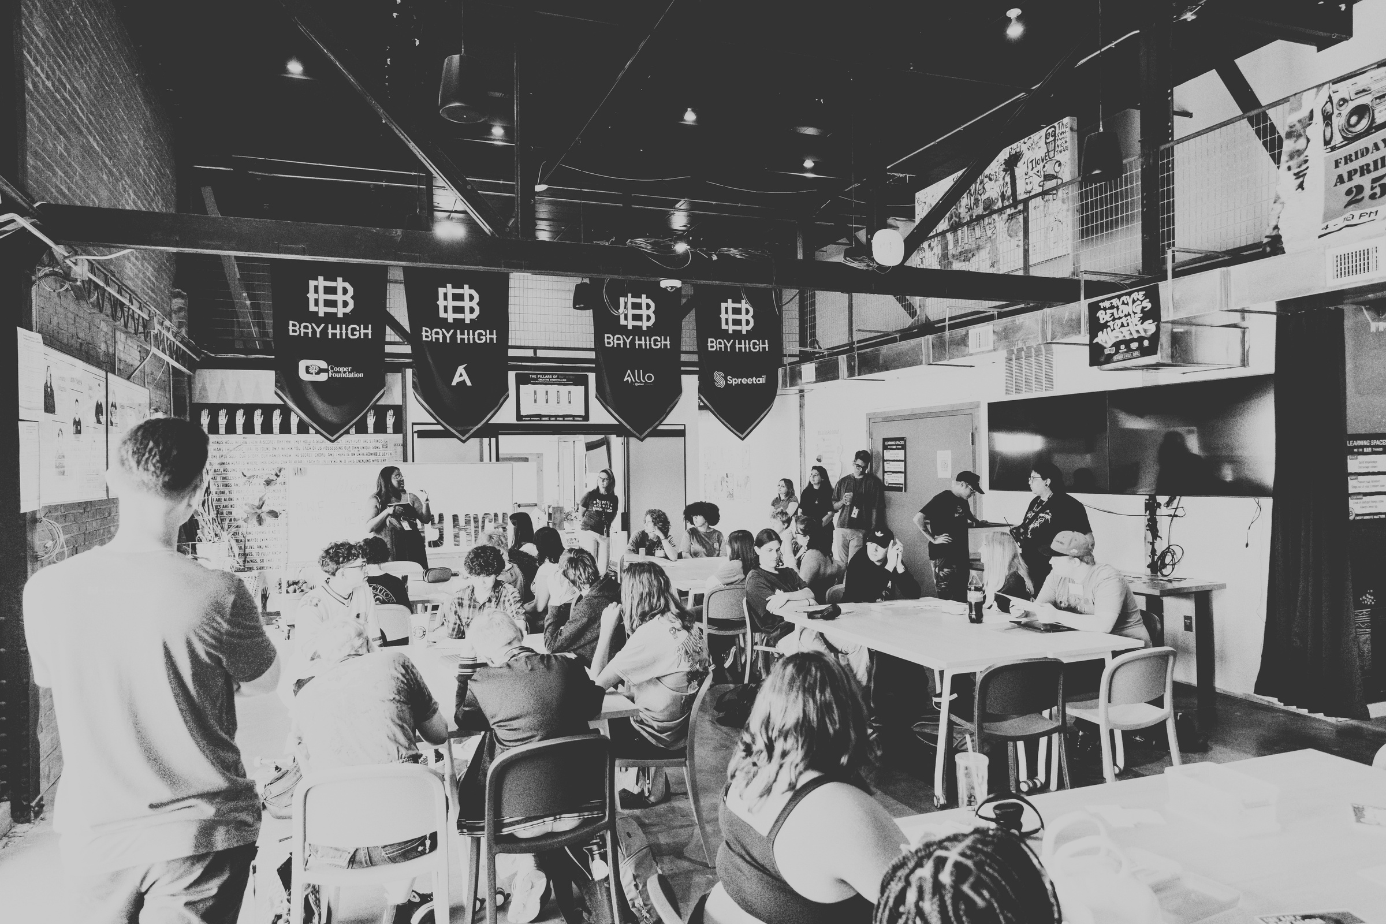
HOW IT’S GOING
  CAREER-BASED & FUTURE-FOCUSED
    Blending Technical Skills and Human Skills
    Unlocking Passions and Dreams
  Project-Based - Learn by Doing
    Process over Product
  Relationship-Based
    Reciprocal Reinvestment
Notes:
Brent
Summarize the section!

Slide 16


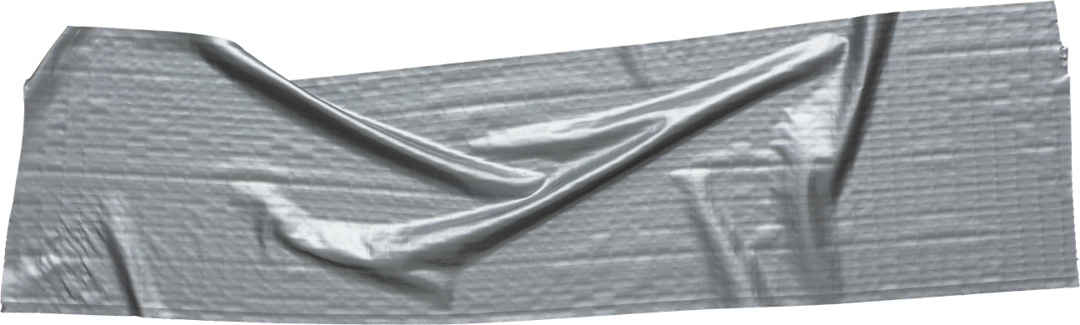
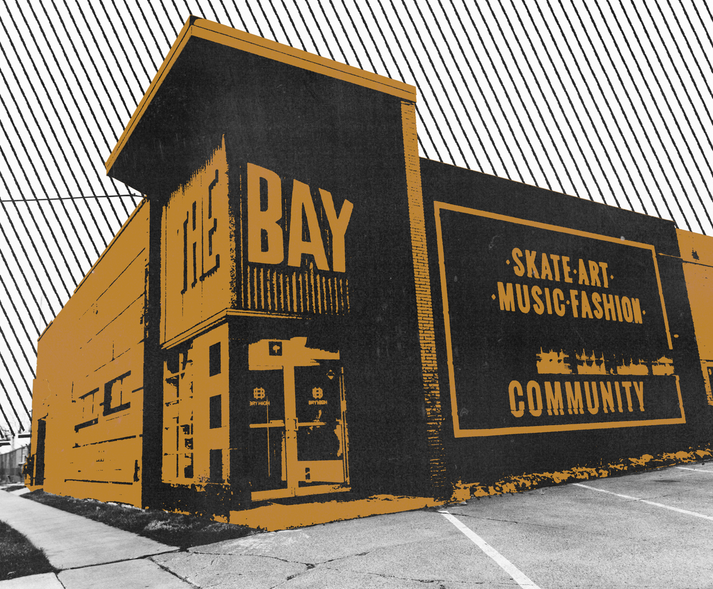

NDE CTE STats
How we’re defining success
  Created a self-assessment using NDE’s Career Readiness Standards
  On a 1-10 scale, students rate themselves on how likely they are to “consistently” and “excellently” demonstrate that skill.
    Ex: “Personal Responsibility - I follow through on what I say I will do and feel a sense of responsibility when given a task.”
  Overall, it’s been a very helpful indicator for us across the 35 subcategories on how our learning is impacting their self-efficacy and provides ideas on how to iterate our curriculum.
https://tinyurl.com/nhhvhfmh
Notes:
Ethan

Slide 17
NDE CTE STats
Some Numbers
8.23
Average Overall rating of our Seniors
7.40
Average Overall rating of our Juniors
+20%
The Average Growth in “Professional Development” of our Seniors
-14%
The Average Decline in “Critical Thinking” of our Juniors***
https://tinyurl.com/nhhvhfmh
Notes:
Ethan

Slide 18
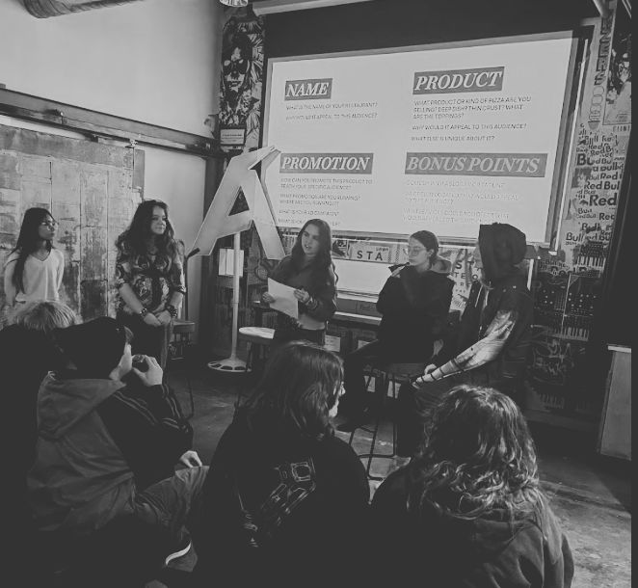
WHAT’S NEXT?
  Transitioning teaching staff
  Keeping Relationship Focus
  Focusing on Human Skill Development
Notes:
Brent
Growing size and as professionals - Starting a new school is hard!!
Needs - As teachers, we hit the ground running and don't look back or take time to breathe on what we need for leaders
It takes a lot on students to be in multiple buildings throughout the day. Helping with that

Slide 19

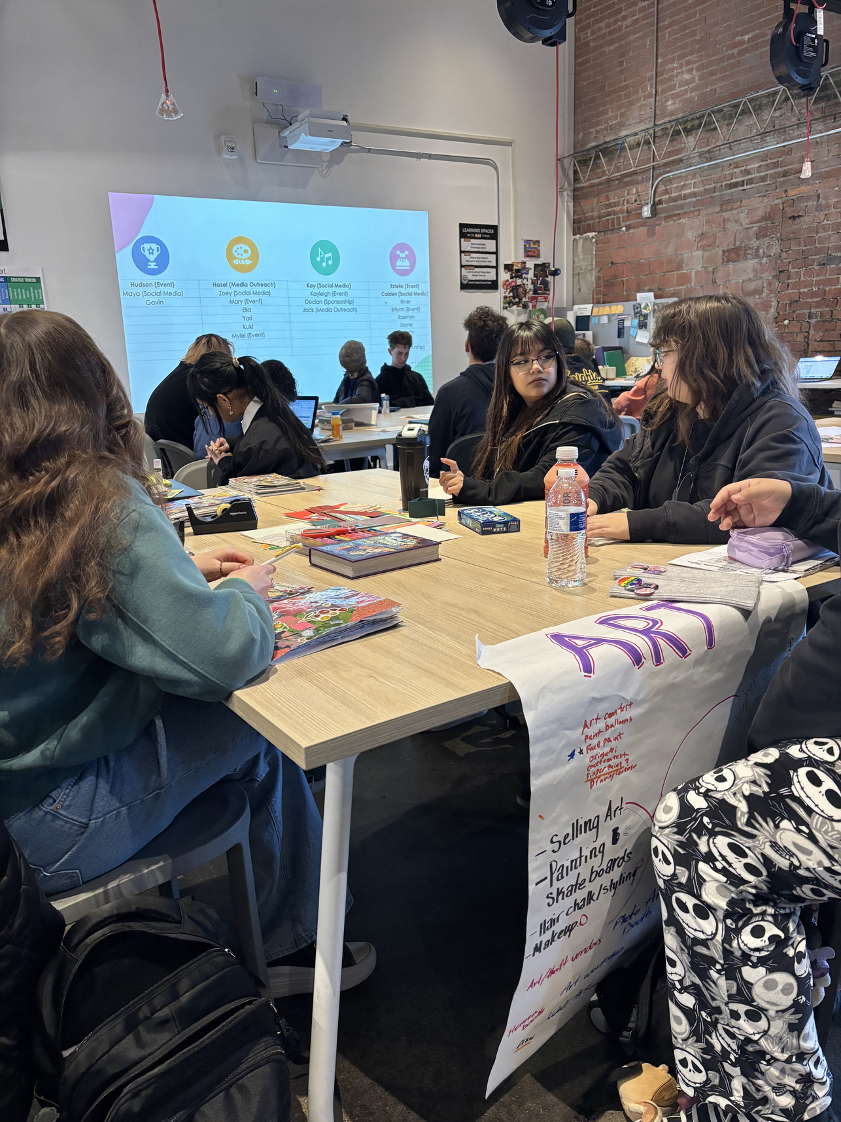
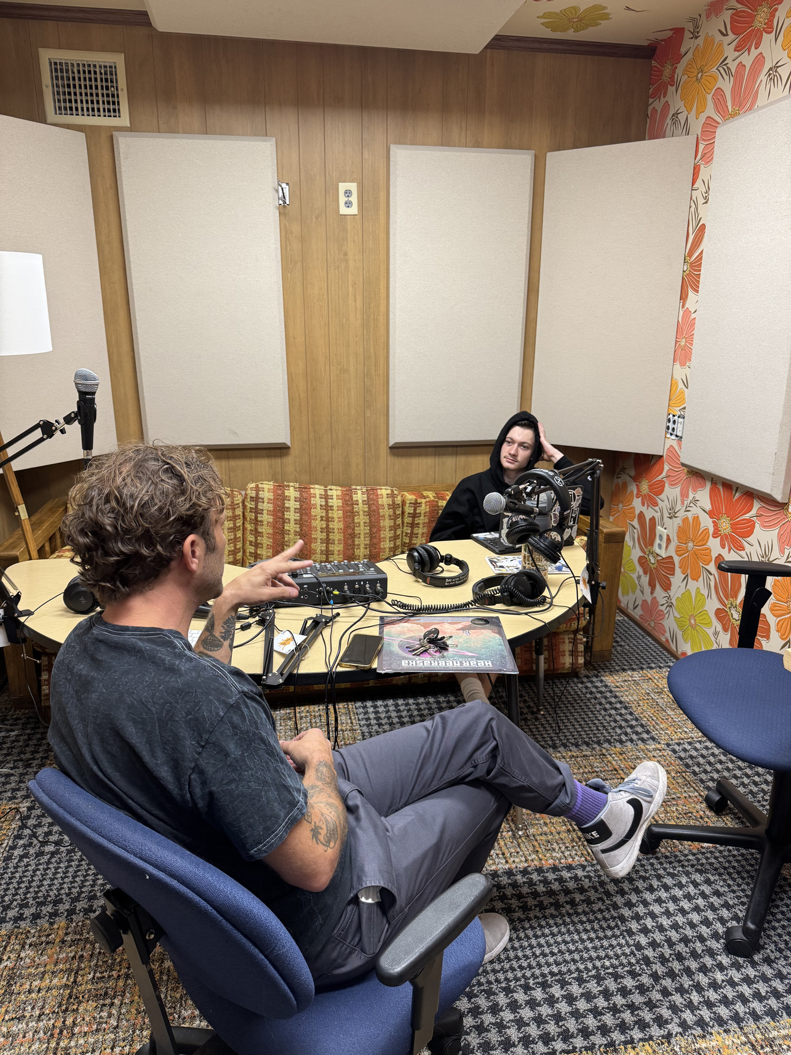
QUestions?
Notes:
Brent

