Slide 1

Wait, Canva Does
THAT?!
A deep dive into Canva's Visual Suite & Classroom Tools
🎨 Meet Canva's Visual Suite | 🎓 Engage Students with Canva
Notes:
Into: Who I am.
SLIDE 1: Title Slide ⏱ ~1 minute
💡 PRESENTER TIP: As people are settling in, have this title slide showing. Greet the room warmly and let the energy build before you start speaking.
Alright everyone, let's get started. I want to kick things off with a question — and I want you to actually think about this for a second.
How many of you use Canva? Maybe you've made a flyer, a poster, a presentation... show of hands.
🎯 ASK AUDIENCE: "How many of you use Canva at least once a week?"
Great. Now — how many of you think you know everything Canva can do?
💡 PRESENTER TIP: Pause here. Let people lower their hands or laugh.
Because I used to think I knew Canva pretty well. And then I discovered what it had become — and honestly, my first reaction was: Wait... Canva does THAT?
That's exactly what today is about. We're going to look at two things: first, the full power of Canva's Visual Suite as a creative platform, and second, how to use it specifically to engage your students in ways that weren't possible even a couple of years ago.
By the end of this, I guarantee you'll have at least two or three new tools you're excited to try.
➡️ TRANSITION: Let's start with a quick look at what we're covering today.

Slide 2
What We'll Cover Today
🎨 PART 1
🎓 PART 2
Meet Canva's
Visual Suite
Engage Students
with Canva
  Visual Suite 2.0 – One format for everything
  Canva Docs, Presentations & Whiteboards
  Canva AI & Magic Studio
  Canva Sheets & Magic Charts
  Canva Code & Video Editor
  Polls & Quizzes for real-time feedback
  Interactive Whiteboards
  Magic Activities & student creativity
  LMS integration (Google Classroom, Canvas…)
  Free for K-12 teachers & students
Two powerful sections. One game-changing platform.
Notes:
2SLIDE 2: Agenda — What We'll Cover Today ⏱ ~1 minute
💡 PRESENTER TIP: Point to each column as you introduce it. Keep this light and fast — it's just an overview.
We've got two parts today.
Part One is all about Canva's Visual Suite — what it actually is now, because it's grown way beyond a simple design tool. We'll look at Docs, Presentations, AI features, Sheets, Charts, Code, and more.
Part Two is where we get specific about the classroom. Polls, Quizzes, Magic Activities, connecting to your LMS, and the big one — it's completely free for K-12.
We'll move at a good pace, but I'll pause for questions as we go. And if you want to try something along the way, pull up Canva on your device.
➡️ TRANSITION: Let's dive in. Part One — Meet Canva's Visual Suite.

Slide 3
PART 1
🎨 Meet Canva's
Visual Suite
From design tool to creative operating system
Docs · Presentations · Whiteboards · Websites · AI · Sheets · Code
Notes:
3SLIDE 3: Part 1 Section Divider ⏱ ~30 seconds
💡 PRESENTER TIP: Read the room — you can be a little theatrical here. Build some suspense.
I want you to think about all the different tools on your computer right now. You probably have a document editor. A presentation tool. Maybe a spreadsheet app. Maybe a whiteboard tool. Maybe a video editor. Maybe a photo editor.
What if I told you Canva has quietly become all of those things — in one place?
They call it the Visual Suite. And here's what it means...

Slide 4
Visual Suite 2.0: One Format for Everything
A world-first: design anything from docs to websites in ONE unified format
230M+
monthly
users
📄 Docs
📊 Presentations
🎬 Video
🌐 Websites
📋 Whiteboards
📱 Social Media
"Canva's most ambitious update — a full creative operating system"
Notes:
4SLIDE 4: Visual Suite 2.0 — One Format for Everything ⏱ ~3 minutes
💡 PRESENTER TIP: This is a big concept slide. Slow down and let the idea land. The 230M+ stat is a great attention-getter.
In April 2025, Canva held its annual Canva Create event and unveiled what they called Visual Suite 2.0 — and it was their biggest product launch since the company was founded in 2012.
Here's the key idea, and this is genuinely a first in the industry: you can now design anything — a document, a presentation, a website, a social post, a video — all inside one single file, in one unified format.
That means no more — I made the doc in Google Docs, but the presentation is in Slides, and the social graphic is in Canva, and now I need to go update three different files. It's all in one place.
🎯 ASK AUDIENCE: "How much time do you spend every week just switching between different apps to create similar content?"
They've got over 230 million monthly users now — across 190 countries. And 95% of Fortune 500 companies use Canva. This isn't a niche tool anymore.
The formats you can work in include Docs, Presentations, Video, Websites, Whiteboards, and Social Media — and you can mix them all in the same project.
🖥️ DEMO OPTION: If you want to do a quick live moment here: open Canva, create a new design, and show the format options available — it really drives this point home.
➡️ TRANSITION: So let's look at a couple of the core formats. Starting with Docs and Presentations.

Slide 5
Canva Docs
Beautiful documents and slides — no design skills required
📄 Canva Docs
  Rich text editing with drag-and-drop design elements
  Embed charts, images, and videos inline
  Real-time collaboration with comments
  Share as link, PDF, or publish as website
  Templates for lesson plans, reports, newsletters & more
Notes:
5SLIDE 5: Canva Docs & Presentations ⏱ ~3 minutes
💡 PRESENTER TIP: Teachers in the room will light up here — connect every point back to something they already do in a more painful way.
Let's talk about Canva Docs first, because this one surprises people. Most folks don't think of Canva as a document tool — they think of it as a design tool. But Canva Docs is genuinely powerful.
You get rich text editing, but with the ability to drag in design elements — images, charts, videos, color blocks — right inline with your text. Your lesson plan doesn't have to look like a Word document from 2007 anymore.
You can collaborate in real time — leave comments, make edits together. And when you're done, you can share it as a link, export as PDF, or even publish it as a website.
Think about this for teachers: lesson plans, newsletters to parents, project briefs for students, rubrics, syllabi — all of these become visual, branded, and beautiful without any extra work.

Slide 7
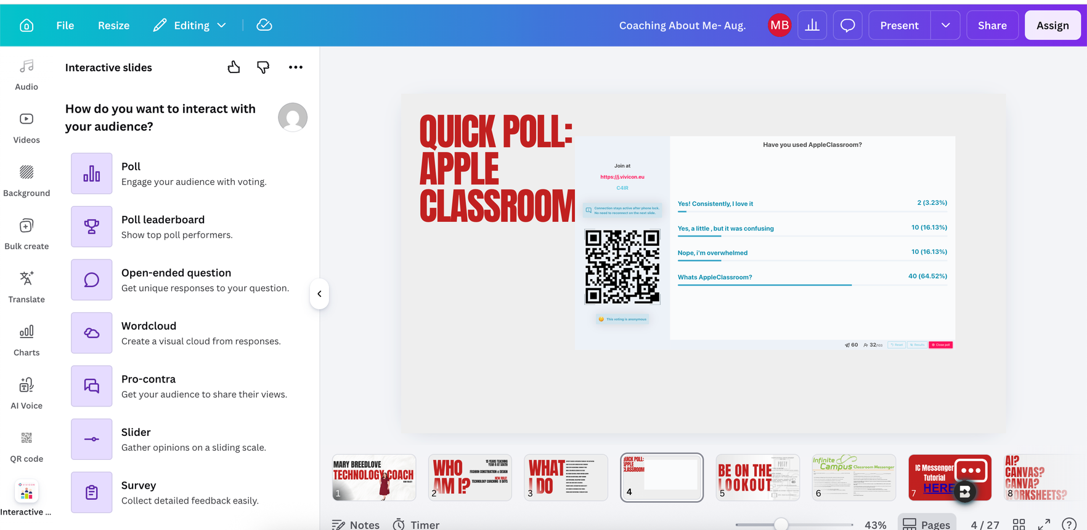

Canva Presentations
📊 Presentations
  Thousands of professionally-designed templates
  Presenter mode with notes & timer
  Present live or share as a link
  Embed polls, quizzes & animations
  Export to PowerPoint, PDF, or MP4 video
Notes:
Now presentations. This is where a lot of people already use Canva, but there are some features that fly under the radar.
First — presenter mode. You get your notes, a timer, and a preview of the next slide — just like PowerPoint, but cleaner. You can present live, or share a link for async viewing. Its also interactive with your students. By using the "Interactive" Menu you can formally assess your students quickly, with all the data saved to back it up!
And here's the one that will change your life: you can export your Canva presentation as an MP4 video. So if you need to record a lesson, you can animate your slides, add your voice, and export as video — without ever opening another tool.
💡 PRESENTER TIP: Pause here for a beat — that last point tends to get a reaction.
➡️ TRANSITION: Okay, now let's get into the part that's been growing the fastest — the AI features.

Slide 8
✨ Canva AI & Magic Studio
Design at the speed of conversation — generate and edit in seconds
🤖 Canva AI Design Partner
🖼️ Magic Media
✍️ Magic Write
Describe what you need — Canva generates full designs, layouts, and text for you
Generate images and videos from text prompts directly inside your design
AI-powered copywriting: headlines, captions, summaries — instantly
🔄 Magic Resize
📦 Bulk Create
🌍 Bulk Localization
Instantly resize any design to fit any format or platform with one click
Personalize hundreds of designs at once by connecting to spreadsheet data
Translate and adapt content at scale for multiple languages and audiences
Notes:
SLIDE 6: Canva AI & Magic Studio ⏱ ~4 minutes
💡 PRESENTER TIP: This is often the highest-energy slide in the deck. People either lean in with excitement or get nervous about AI. Acknowledge both reactions.
I know some of you might have mixed feelings about AI in education — and that's totally valid. We'll actually talk about that specifically in Part Two. But for right now, I just want to show you what these tools can do, and you can decide how you want to use them.
Canva has leaned hard into AI, and they've built what they call the AI Design Partner. The idea is simple: you describe what you need in plain language, and Canva builds it. Full designs, layouts, text — generated in seconds.
🎯 ASK AUDIENCE: "Has anyone here used an AI tool to help create classroom materials? What did you make?"
Let me walk you through the Magic Studio tools — these are all under one umbrella in Canva.
Magic Media lets you generate images and short videos from text prompts. You type something like 'a student reading under a tree in a watercolor style' and you get an image. Right inside your design, no switching apps.
Magic Write is the AI copywriting tool. Need a caption for a poster? A header for a worksheet? A summary of a topic? You describe it, Magic Write drafts it.
Magic Resize is one of my favorites. You design something once — say, a presentation slide — and with one click, Canva resizes and reformats it for Instagram, for a flyer, for a different slide dimension. It handles all the layout adjustments automatically.
Bulk Create is a time-saver for anyone who creates personalized content. Connect your design to a spreadsheet, and Canva will auto-generate a unique version of the design for every row. Think student certificates, personalized name tags, individual progress reports.
And then there's Bulk Localization — if you're in a multilingual school or district, you can create your content once and have it automatically adapted for different languages at scale.
🖥️ DEMO OPTION: If you have Canva open: go to any design, click the Apps section or the Magic Studio button. Show Magic Write generating a caption from a prompt.
➡️ TRANSITION: Now let's talk about something that surprised me — Canva's new data tools.

Slide 9
📊 Canva Sheets & Magic Charts
💡 No more switching between Excel, Tableau, and PowerPoint — it all lives in one place!
Notes:
SLIDE 7: Canva Sheets & Magic Charts ⏱ ~3 minutes
💡 PRESENTER TIP: Lead with the relatable pain point — the tool-switching problem. Most teachers know this frustration.
Quick show of hands — how many of you have ever made a chart in Excel or Google Sheets... and then had to screenshot it... and paste it into a presentation... and then the colors didn't match... and you had to go back and fix it...
💡 PRESENTER TIP: Let the audience groan. This is very relatable.
Canva Sheets and Magic Charts are designed to eliminate exactly that workflow.
Canva Sheets is a visual spreadsheet — think Google Sheets, but built natively inside Canva. So your data and your design live in the same place. You can have a table of student data right next to a designed infographic that uses that same data. No copy-paste. No format mismatch.
And Magic Charts takes it further. You connect your data, and Magic Charts instantly transforms it into beautiful, interactive charts and visualizations. These aren't static screenshots — they're live, animated, and interactive. Students can click on them to explore the data.
Here's the backstory on why these charts are so good: Canva acquired a company called Flourish in 2022. If you've ever seen those beautiful interactive data visualizations in news articles from the Guardian or the New York Times — that was Flourish. Now that power is built right into Canva.
For teachers, think about the possibilities: data literacy projects, student research presentations, visualizing class survey results, tracking progress visually. All of it, all in one place.
➡️ TRANSITION: Let's keep going — a couple more Visual Suite features and then we'll shift to the classroom tools.

Slide 10
Canva Advanced Video Editor
Full power video editor: included!
Notes:
8Now the Photo Editor. Canva acquired a professional software company called Affinity in 2024 — they make professional design tools that compete with Adobe. As a result, Canva's photo editing has become genuinely powerful.
We're talking one-click AI background removal, advanced color correction, lighting adjustments, retouching — professional tools that used to require expensive software like Photoshop. And it's all integrated right into your Canva designs. Edit a photo and it updates in your presentation instantly.
➡️ TRANSITION: Two more Visual Suite features — Whiteboards and Websites — and then we get into the classroom stuff.

Slide 11
Canva Code:
New superpowers that expand what's possible — without leaving Canva
Notes:
Okay, this one is genuinely surprising. Canva Code.
Canva has added the ability to create interactive elements from a simple text prompt. You describe what you want — a quiz, a calculator, a clickable game, a countdown timer — and Canva Code generates it. No coding knowledge required. It lives right inside your design.
I know what some of you are thinking: 'That's for computer science teachers.' But think bigger. Imagine a science worksheet with an embedded unit converter. Or a history timeline that students can click through. Or a math review game embedded right in a lesson. Any teacher can now make interactive digital experiences for their students.
🎯 ASK AUDIENCE: "What's one interactive tool or game you wish you could embed in your lessons but never had time to build?"

Slide 12
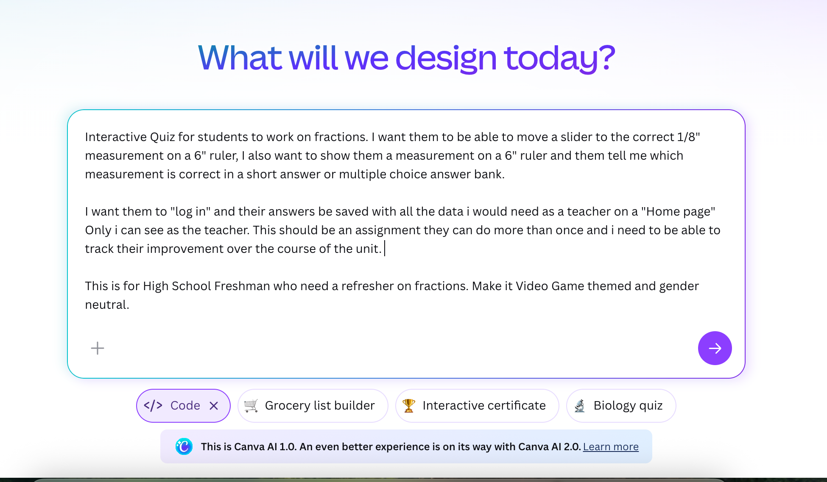

Slide 13
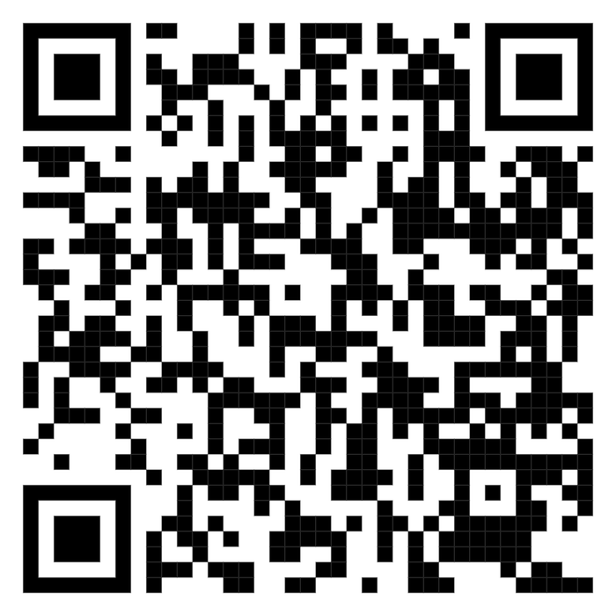

Slide 14
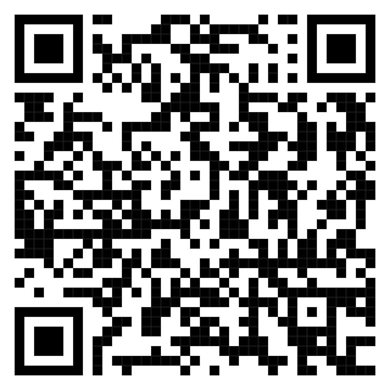
🖊️ Whiteboards
Whiteboards
  Infinite digital canvas for brainstorming and ideation
  Sticky notes, shapes, connectors, and freehand draw
  Real-time collaboration — whole class, same board
  Works great for concept mapping and group projects
  Add images, videos, and embeds from the web
💡 Everything updates together — change a brand color once, it updates across your entire Visual Suite
Notes:
💡 PRESENTER TIP: Keep this slide moving — you've covered a lot of ground and the classroom section is coming up.
Whiteboards in Canva are exactly what they sound like — an infinite digital canvas. Sticky notes, shapes, connectors, freehand drawing, images, videos. Great for brainstorming, mind mapping, concept webs, or just collaborative ideation.
The key thing is real-time collaboration. Your whole class can be on the same whiteboard simultaneously. You can use it as a class warm-up, a group activity, an exit ticket — anywhere you'd want students to contribute ideas visually.

Slide 15

🌐 Websites
Canva Websites
  Build a professional website without writing any code
  Drag-and-drop sections, animations, and scroll effects
  Publish with a free Canva domain or custom domain
  Perfect for class portfolios, project showcases, events
  Mobile-responsive and SEO-optimized automatically
Notes:
And then Canva Websites — this one is really cool for student projects. Students can build a fully functional, mobile-responsive website without writing a single line of code. Drag and drop sections, choose layouts, add content, and hit publish. They can have a free Canva domain, or connect a custom domain.
Imagine a student science fair project where instead of a tri-fold poster board, they submit a website. Or a social studies project that's a mini-website about a historical figure. It changes what's possible for student expression.
➡️ TRANSITION: Okay — Part One done. That's the Visual Suite. Now let's talk about what this all means for your students specifically.

Slide 16
PART 2
🎓 Engage Students
with Canva
Interactive tools that transform passive students into active learners
Polls · Quizzes · Whiteboards · Magic Activities · LMS Integration · 100% FREE
Notes:
SLIDE 10: Part 2 Section Divider ⏱ ~30 seconds
💡 PRESENTER TIP: Use this as a moment to re-energize the room. Shift your energy — get a little excited. You're about to talk about the stuff that directly helps them in their classroom tomorrow.
Now we're getting to the good stuff — the classroom-specific tools. Everything I just showed you is great for creating content as a teacher. But Part Two is about getting your students actively involved.
Because here's the truth: passive learning doesn't stick. Students remember what they do, not just what they see. And Canva now has a whole suite of tools designed specifically to turn your lessons from something students watch into something students do.

Slide 17
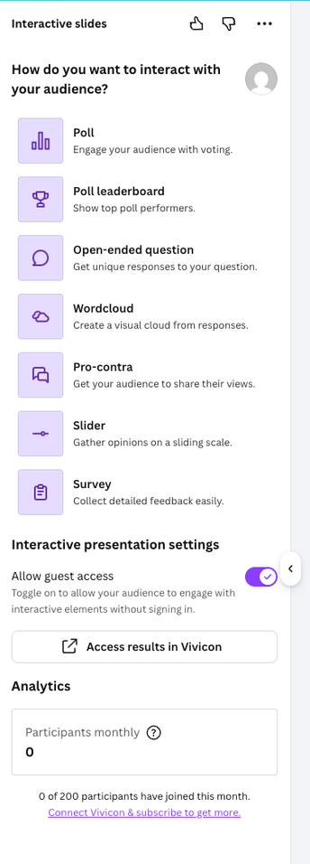
📊 Polls & Quizzes — Real-Time Classroom Engagement
Check understanding, gamify lessons, and adapt teaching on the fly — without leaving Canva
📊 Polls
❓ Quizzes
  Embed polls directly into any presentation slide
  Students respond on their own device instantly
  See live results as they come in — no waiting
  Spark classroom discussions and debates
  Multiple choice, word cloud, open-ended formats
  Create pop quizzes in seconds from your lesson content
  Gamified experience students actually enjoy
  Timed questions, multiple choice, true/false
  Instant results — see where students need support
  Adapt your lesson in real-time based on responses
Notes:
SLIDE 11: Polls & Quizzes — Real-Time Engagement ⏱ ~4 minutes
💡 PRESENTER TIP: This is a crowd-pleaser. If you can, actually run a quick live poll or quiz with your audience right now — it's a great demonstration of exactly what you're talking about.
Let's start with one of the most recent and most exciting additions: Polls and Quizzes built right into Canva presentations.
Here's the scenario: you're in the middle of a lesson. You've just explained a concept. You want to know if students actually got it — not just the two kids with their hands raised, but the whole class. With Canva Polls, you embed a question in your slide, students respond on their own device, and you see the results live as they come in.
No separate app. No QR code that won't scan. No switching windows. It's right there in your presentation.
🖥️ DEMO OPTION: If you have Canva on your screen: open a presentation, click Insert, and show where to add a poll. If your audience has devices, actually run a quick poll — something like 'What subject do you teach?' This is a powerful live demo moment.
Quizzes work the same way, but with a more gamified feel. You can set timers on questions, make it competitive, and students see how they did immediately. Imagine ending a lesson with a five-question quiz — students are engaged, you get instant data on who got it and who needs support, and you didn't have to grade anything.
Here's what this changes: you can now adapt your lesson in real time. If 70% of your class got a question wrong, you know to stop and reteach before moving on. If everyone nailed it, you can accelerate. The data is instant.
🎯 ASK AUDIENCE: "Think about your last unit. What's one concept where you wished you'd known sooner that students were confused?"
Polls can also be used for discussion starters — not just comprehension checks. Start class with a controversial question, show the class results, and let the disagreement spark a conversation. It's an instant engagement hook.
➡️ TRANSITION: Now let's look at the tools specifically designed to spark student creativity.

Slide 18
✨ Magic Activities & Student Creativity Tools
Hands-on, fun tools that turn students into active creators
🪄 Magic Activities
🎮 Canva Code in Class
🎨 Student Design Projects
AI generates ready-to-use classroom activities tailored to your topic — worksheets, sorting tasks, fill-in-the-blanks, and more in seconds
Students build their own interactive projects: mini-games, calculators, and digital art — no coding experience needed
Assign creative projects — infographics, posters, presentations, videos — using Canva's full design toolkit
🖊️ Collaborative Whiteboards
📋 Choice Boards
🤖 Safe AI Tools for Students
Whole-class brainstorming on an infinite canvas. Students contribute sticky notes, drawings, and ideas simultaneously
Create differentiated learning menus where students choose how they engage with content — great for UDL classrooms
Age-appropriate, teacher-controlled AI tools with built-in protections and transparent guardrails for student use
Notes:
SLIDE 12: Magic Activities & Student Creativity Tools ⏱ ~3 minutes
💡 PRESENTER TIP: Keep the energy high. These tools map directly to things teachers already want to do — just make the connection explicit.
Canva has a feature called Magic Activities — and this is a time-saver for lesson planning. You describe your topic and your grade level, and the AI generates a ready-to-use classroom activity. Sorting tasks, fill-in-the-blank worksheets, graphic organizers, matching exercises — built and formatted, ready to assign.
It's not about replacing your teaching judgment — it's about removing the 90 minutes you spend formatting a Google Doc to look like something students actually want to engage with.
For student projects, Canva opens up a whole new vocabulary of expression. Instead of 'write a five-paragraph essay,' you can now say: 'Create an infographic about the water cycle,' or 'Make a video explainer of this math concept,' or 'Build a presentation arguing your position.'
Students can use Canva Code to build interactive projects. Collaborative Whiteboards for group work. They can create actual websites as project deliverables.
And for differentiated instruction — Choice Boards. You create a menu of activity options in Canva, each option designed differently for different learning styles. Students choose how they engage. This is a best practice for Universal Design for Learning, and Canva makes the visual design of a choice board actually look good and feel professional.
On the AI side: Canva has built in age-appropriate guardrails. The AI tools available to students are different from what you see as a teacher. You control what students can access, and the platform has content filters built in. It's designed to let students experience AI tools safely.
➡️ TRANSITION: Let's talk about how Canva connects to the tools your school already uses.

Slide 19
🏫 LMS Integration & Teacher Workflow Tools
Canva connects seamlessly with the tools you already use
✅ Integrates with: Google Classroom · Canvas LMS · Schoology · Classlink · PowerSchool · Infinite Campus · Skyward · Aeries
📌
📂
🔒
📚
Assign & Track
Class Management
Privacy & Safety
Resource Library
Assign Canva tasks directly in your LMS. Monitor student progress and review submissions from one dashboard.
Invite students with school email — no extra accounts. Set permissions and control what students can access.
FERPA and COPPA compliant. Signatory of the US National Data Privacy Agreement. GDPR-compliant Data Processing.
Access thousands of pre-made educational templates — lesson plans, worksheets, syllabi, newsletters, rubrics.
🎓 100% FREE for all K-12 teachers, students, and eligible schools worldwide
Notes:
SLIDE 13: LMS Integration & Teacher Workflow Tools ⏱ ~3 minutes
💡 PRESENTER TIP: This is the 'practical logistics' slide — it answers the 'but how does it actually work with my school setup?' question.
One of the things that holds teachers back from adopting new tools is the integration question — 'Does this work with what we already use?' So let me walk you through how Canva fits into your existing workflow.
Canva integrates directly with Google Classroom, Canvas LMS, Schoology, Classlink, PowerSchool, Infinite Campus, Aeries, Skyward — and more. That means you can assign Canva work through your existing LMS, students submit through the LMS, and you review their Canva designs right there.
For student access: if your school is set up through Google Workspace for Education, students can sign into Canva with their school Google account. No new passwords, no separate signup, no 'I forgot my login' situations.
As a teacher, you have a class dashboard where you can see all your students' work, track who's submitted and who hasn't, and give feedback directly on their designs.
For privacy — and I know this matters a lot in K-12 — Canva for Education is fully FERPA and COPPA compliant. They're a signatory of the US National Data Privacy Agreement. GDPR-compliant for international schools. This isn't an afterthought for them — it's a requirement for working in education.
And the resource library is genuinely useful. Thousands of pre-made templates specifically for educators — lesson plan templates, rubrics, parent newsletters, certificates, schedules, syllabus templates — all customizable, all free.
🎯 ASK AUDIENCE: "What tool do you currently use for student assignments? I'll show you specifically where to find the integration for that."
➡️ TRANSITION: And now the best part — the part that makes all of this a no-brainer decision.

Slide 20
Why Canva for Education?
90M+
Students &
teachers globally
100%
FREE for
K-12 verified
250K+
Ready-to-use
templates
190+
Countries
worldwide
How to Get Started:
1
Visit canva.com/education and sign up with your school email address
2
Get verified within 1-2 days — or sign up instantly via Google Workspace for Education
3
Invite your students — they join with their school email, no extra software needed
4
Start from a template or design from scratch — full access to all premium tools, free
Notes:
SLIDE 14: Why Canva for Education — Free + Getting Started ⏱ ~3 minutes
💡 PRESENTER TIP: This is the call to action slide. Be enthusiastic. The 'free' angle is genuinely remarkable — make sure it lands.
I've saved the best part for almost last. All of this — the AI tools, the interactive presentations, the Whiteboards, the Magic Activities, the Polls and Quizzes, the Docs, the entire Visual Suite — all of it is one hundred percent free for verified K-12 teachers and their students.
Not a free trial. Not a limited version. The full platform, with premium features unlocked, no cost.
There are 90 million students and teachers using this globally right now. It works in 190 countries. And it has 250,000+ templates ready to use.
Getting started is genuinely easy. You go to canva.com/education and sign up with your school email address. They verify you as a teacher within a day or two — sometimes faster. Then you invite your students, and they join with their school email. That's it.
If your school uses Google Workspace for Education, you can actually skip the verification queue and sign up the same day through your Google integration.
Once you're in, you'll see an Education dashboard with all your class tools, the resource library, and all those premium features unlocked.
💡 PRESENTER TIP: If time allows, this is a great moment to have people actually pull out their phones or laptops and start the signup process. Offer to help anyone who gets stuck.
🎯 ASK AUDIENCE: "How many of you are going to sign up for Canva for Education this week? Let's see a hand."
➡️ TRANSITION: Okay. One more slide — and it's the most important one.

Slide 21
So... Wait, Canva Does
ALL of THAT?!
Yes. Yes it does. 🎉
Visual Suite 2.0
Canva AI
Magic Charts
Canva Code
Polls & Quizzes
Magic Activities
LMS Integration
100% Free for K-12
canva.com/education · canva.com/design-school
Notes:
SLIDE 15: Closing Slide ⏱ ~2 minutes
💡 PRESENTER TIP: This is your big finish. Bring the energy up. You want people leaving the room feeling inspired and ready to try something.
So... wait. Canva does ALL of that?
Yes. Yes it does.
💡 PRESENTER TIP: Pause and let the room react.
Visual Suite 2.0 in a single unified format. Canva AI generating designs in seconds. Magic Charts turning data into stories. Canva Code building interactive experiences without a single line of code. Polls and Quizzes giving you live classroom data. Magic Activities saving your lesson planning time. LMS integration connecting to what you already use. And all of it, completely free.
Here's my challenge for you: pick one thing you heard today that you want to try before the end of the week. Just one. Not everything — just one.
Maybe it's setting up your free teacher account. Maybe it's trying the Poll feature in your next presentation. Maybe it's having students create an infographic instead of writing a paragraph.
The best time to start is now, and Canva for Education is at canva.com/education. Canva's Design School is at canva.com/design-school — they have free tutorials and professional learning resources, including ones specifically for educators.
Thank you so much for your time today. I genuinely believe this platform can change how you work and how your students create. I'm happy to take questions — what can I help you with?
💡 PRESENTER TIP: Open the floor for Q&A. Common questions: 'Is it really free?', 'Can I use this on a Chromebook?', 'What about students who don't have devices?', 'Does it work offline?' — be ready for these.

Slide 22




Q: Is it really completely free?
A: Yes — Canva for Education is 100% free for verified K-12 teachers and students. All premium features are unlocked. You just need to verify your teaching status at canva.com/education.
Q: What devices does it work on?
A: Canva works in any web browser, so Chromebooks, Windows, Mac, iPad, and even smartphones. There are also dedicated iOS and Android apps. No software to install.
Q: Does it work offline?
A: Canva requires internet access for most features. For offline work, you can download designs as PDFs or PowerPoint files to use locally.
Q: Can I control what students can see or do?
A: Yes. As the teacher admin, you can control student permissions, restrict certain features, and manage what content students can access. The student experience has built-in content filters.
Q: Is student data safe?
A: Canva for Education is FERPA and COPPA compliant, and a signatory of the US National Data Privacy Agreement. Student data is not used for advertising.
Q: What if my school doesn't have Google Workspace?
A: You can still sign up directly at canva.com/education using your school email address. Verification usually takes 1-2 days.
Q: Can students work together on the same design?
A: Yes — real-time collaboration is built in. Multiple students can work on the same design simultaneously, just like Google Docs.
Q: Does this replace PowerPoint or Google Slides?
A: It can, but it doesn't have to. Canva exports to .pptx format, so you can always move designs into PowerPoint. It also imports PowerPoint files. You can use it as much or as little as you want.
Q: How do I find time to learn this?
A: Canva's Design School has free, short tutorials specifically for educators. Most teachers feel comfortable in 20-30 minutes of self-guided exploration. And the templates mean you don't have to start from scratch — ever.
FAQ

