Slide 1

Cultivating the Next Generation of STS Educators
Dr. Jason Thomsen & Eric Knoll

Slide 2
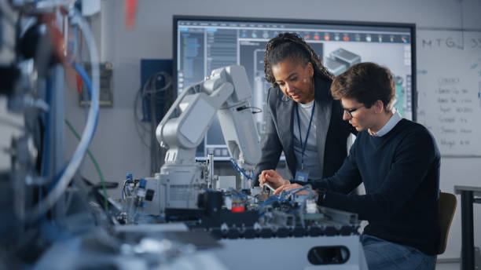
Agenda
Speakers
The Problem
Brainstorm Solutions
Develop a Plan
Exposure Events

Slide 3
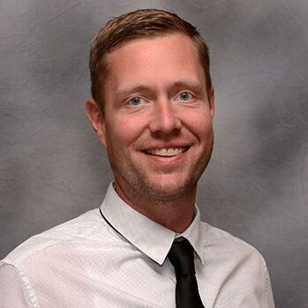
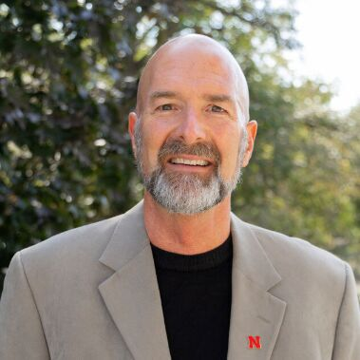
Speakers
Dr. Jason Thomsen
Eric Knoll
Lincoln Public Schools
CTE Curriculum Specialist
University of Nebraska - Lincoln
Associate Professor of Practice - STS Teaching

Slide 4
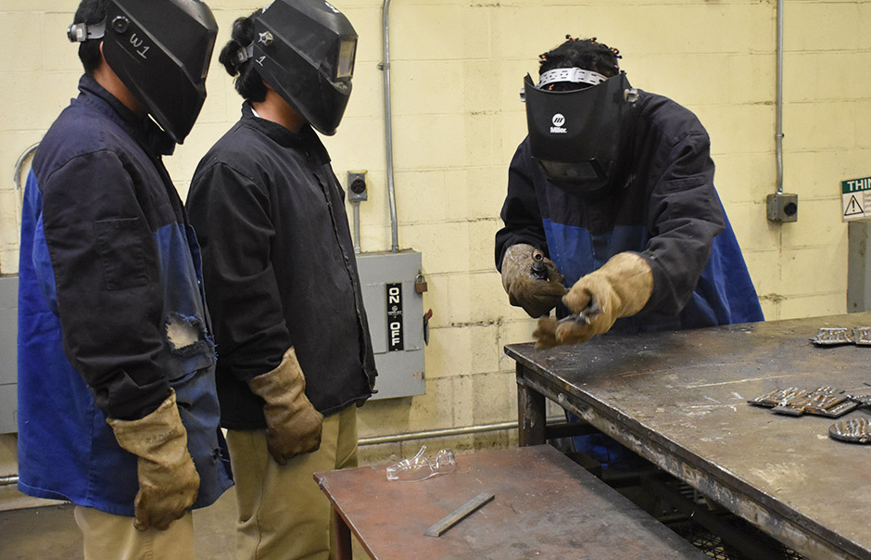

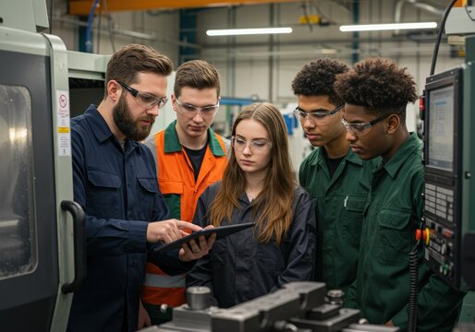
The Problem
Aging STS Staff
A significant portion of current Skilled and Technical Sciences staff are approaching retirement age.
Filling Vacancies
It is becoming increasingly difficult to find qualified candidates to fill open STS teaching positions.
Pipeline Deficit
There are not enough students currently entering STS teacher preparation programs to meet demand.

Slide 5
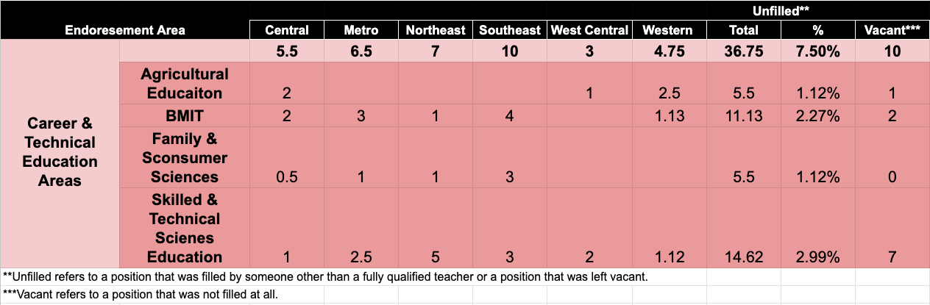
The Problem
Unfilled Positions in Districts/Systems by Endorsement Area & Region
Source: NDE Teacher Vacancy Survey Report; 2025

Slide 6

STS Advisory Group: Brainstorming Ideas
Dual Ag & STS Certification
Pay Student Teachers
State Scholarship Funds
Longevity Bonuses
Industry-Sponsored Scholarships
Loan Forgiveness
Cross-Train Existing Teachers
Ease Certification Requirements
Community College Teachers Teach High School

Slide 7

STS Advisory Group: Brainstorming Ideas
Dual Ag & STS Certification
Pay Student Teachers
State Scholarship Funds
Longevity Bonuses
Industry-Sponsored Scholarships
Loan Forgiveness
Cross-Train Existing Teachers
Ease Certification Requirements
Community College Teachers Teach High School
These things require systems level change -
which we don’t control

Slide 8

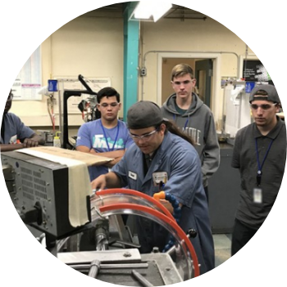
What Can We Do Locally?
Wanted to move beyond the negative stereotypes of teaching...
...to celebrate the impact, creativity, and fulfillment of being a Skilled & Technical Sciences educator.

Slide 9
Career Exposure Plan
Authentic Teacher Stories
STS Teacher Program
TAG 1
Field Trip
Family Information Night
Why They Chose Teaching
Their Journey to Teaching
What They Enjoy About Teaching
Expose Students to UNL’s 2+2 Program
  UNL Presentation
  UNL STS Promo Video
Teachers Identify Students That Enjoy Helping Others
Individual Conversations With Those Students About Becoming a Teacher
SCC & UNL Tour
Hear From UNL Students and Program Directors
Discuss Benefits of Teaching
Invite Students & Parents
Free Meal
Open Discussion About STS Teaching & the 2+2 Program

Slide 10
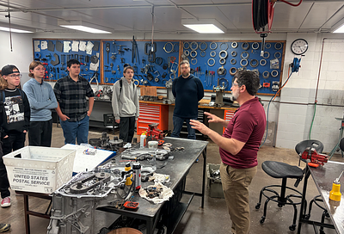
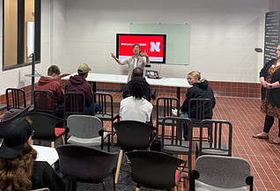
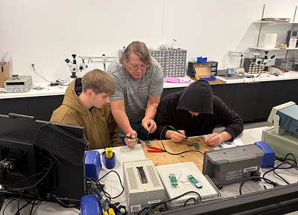
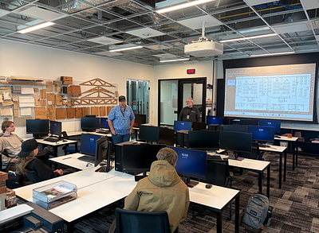
Highlights
Campus Engagement
86 Students Attend The SCC & UNL Field Trip
Family Night
6 Families Attend the UNL Family Night
Future Planning
Several Students Plan on Entering the 2+2 Program After Graduation

Slide 11



Discussion
Institutional Integration
How might pieces of this model be incorporated into your own school or situation?
Growth Strategies
Other thoughts or ideas on growing the STS teacher pool?

Slide 12
Thank
you
Dr. Jason Thomsen: jthomse@lps.org
Eric Knoll: eknoll2@unl.edu

