Slide 1
Nebraska Manufacturing Credential
Building a Talent Pipeline

Slide 2
2024 Nebraska Manufacturing Workforce
What are the top two industries by GDP in Nebraska?
UNO Center for Public Affairs Research

Slide 3
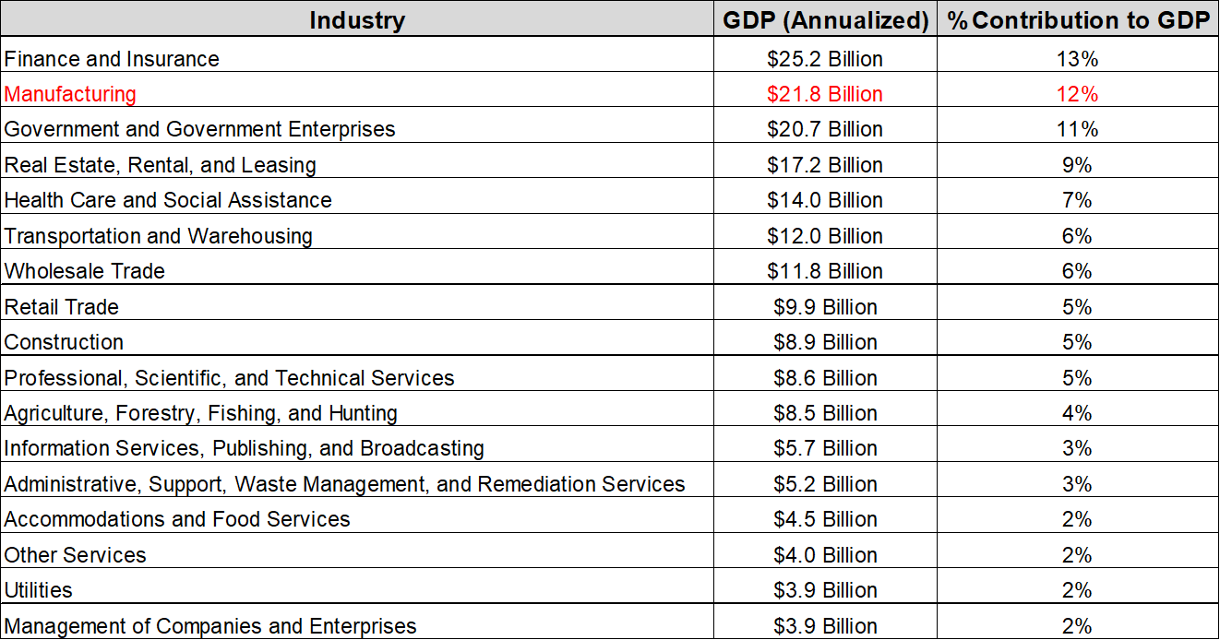
2024 Nebraska Gross Domestic Product by Industry
UNO Center for Public Affairs Research

Slide 4
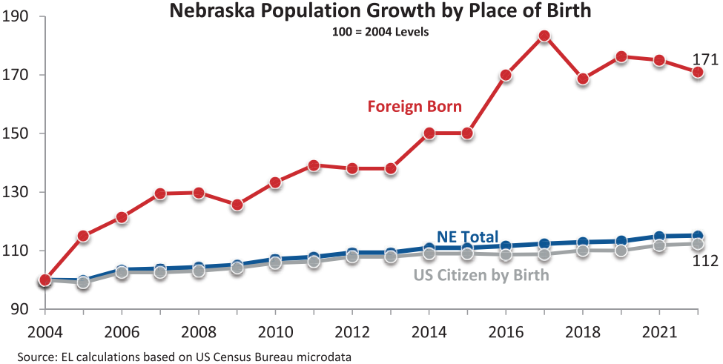
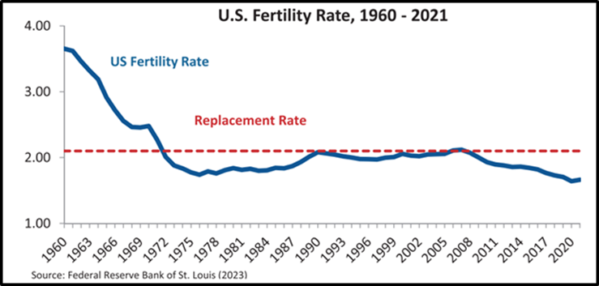
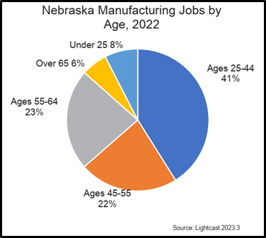
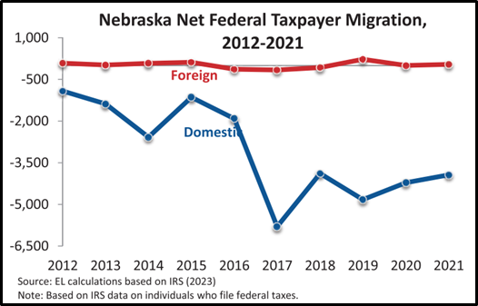
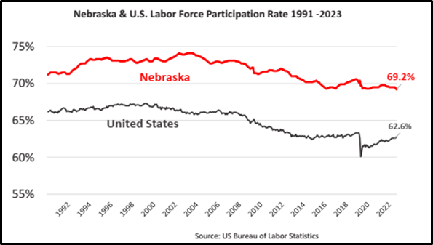
Nebraska Chamber Foundation Workforce Study 1/30/24
≤44 = 49%
≥45 = 51%

Slide 5
Nebraska’s Workforce Problem
Workforce Shortages
Limit Business Growth
Limit GDP Growth
Limit Tax Revenue Growth

Slide 6
2026 Omaha Center for Public Affairs Research
Nebraska’s Workforce
Total Population Growth – 23rd (nationally)
International Migration Rate – 19th
Domestic Migration Population Loss – 35th
Share of Residents in Prime Working Ages – 48th
Full-Time Employment Rate – 4th
Labor Force Participation Rate – 3rd
Labor Force Participation, Parents of Young Children – 8th
Nebraska’s Innovation
Density of High-Skill, High-Wage Jobs – 31st
Adults With Science and Engineering Degrees – 49th
Business R&D Spending – 34th
Patents Per Capita – 41st

Slide 7
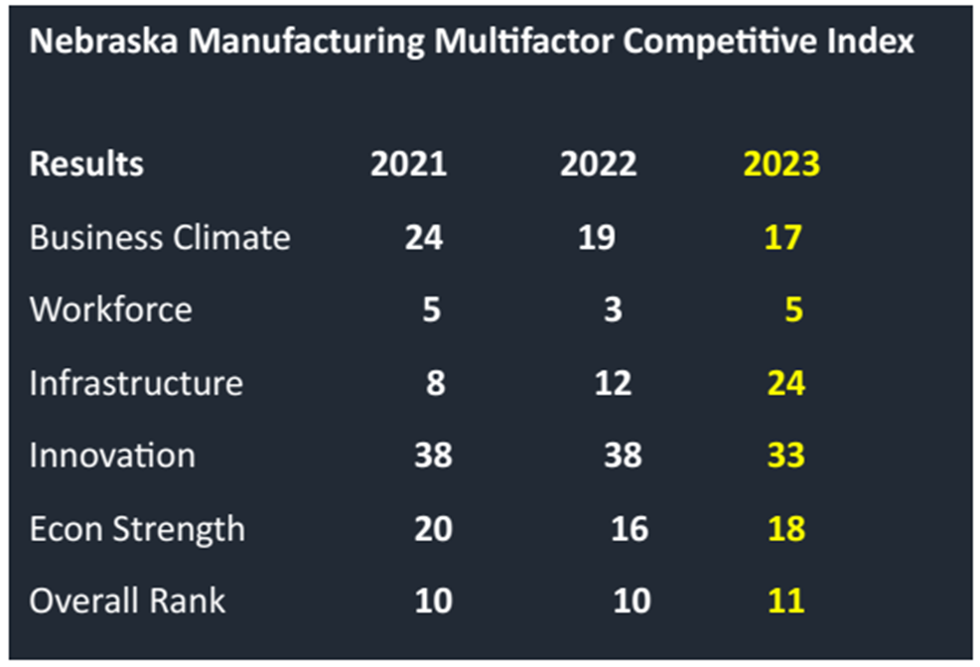
Nebraska Chamber Foundation
Manufacturing Study 1/30/2024

Slide 8
Nebraska’s Productivity Problem
Low Productivity
More Workers Required
Doing Lower Level Jobs
Not as Competitive

Slide 9



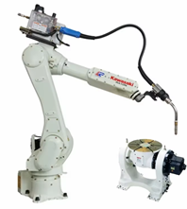

Talent Pipeline Headwinds
Manufacturing not a desired career path – the 3 D’s remain
Only successful if going to college
Don’t know about local tech careers
Don’t know about “hands on” opportunities or not available
Don’t know about the cool things we work on
School tech/shop classes may not be available
School class times don’t align with personal schedules
Can’t afford school beyond high school
Not enough Career and Technical Education (CTE) teachers

Slide 10
Nebraska Manufacturing Credential
Examined best practices in other industries.
Created core competencies for Manufacturing in Nebraska.
Followed Six Regions-One Nebraska model.
This engage all Community Colleges and allow for local regional effort with a consistent statewide curriculum.
Three Major Pathways
Adult Learning
Immigrants/Refugees
High School/Middle School
Partners so far: NDOL, NDE, NeMAC, CC’s and hopefully, Educators!

Slide 11
Taking on the Challenge
Nebraska Manufacturing Credential
  Developed with NeMAC leadership
  Aligned with Nebraska’s industry expectations
  Enhances Skilled and Technical Science Instruction
  Strengthens pathways to high demand careers

Slide 12
Nebraska Manufacturing Credential
Module 1- Workplace Safety and OSHA Concepts
Module 2- Quality Control and Defect Identification
Module 3- Daily Readiness and Personal Responsibility
Module 4- Introduction to Manufacturing Metrics
Module 5- Tool Use, Gauging, Basic Metrics and Print Reading
Module 6- Workplace Communication and Teamwork
Module 7- Problem Solving and Critical Thinking
Module 8- Foundations of Lean Manufacturing

Slide 13
Nebraska Manufacturing Credential
Module 1-Workplace Safety and OSHA Concepts
  OSHA and Worker Rights
  Hazard Identification
  PPE Selection and Use
  HazCom and SDS Basics
  Lockout-Tagout and Machine Guarding
  Fire Safety/Emergency Response
  Ergonomics and Safe Work Practices
  Safety Culture, Near Miss and Incident Reporting

Slide 14
Nebraska Manufacturing Credential
Module 2-Quality Control and Defect Identification
  Introduction to Quality Concepts
  Measuring Tools: Calipers
  Measuring Tools: Micrometers
  Tolerances and Specifications
  Defect Tracking and Logs
  Quality Control Procedures
  Practical Lab
  Review and Assessment

Slide 15
Nebraska Manufacturing Credential
Module 3-Daily Readiness and Personal Responsibility
  Workplace Expectations and Professional Conduct
  Attendance, Punctuality and Dependability
  Time Management in Manufacturing
  Organization and Clean Work Habits
  Accountability and Following Directions
  Self-Assessment and Continuous Improvement
  Managing Stress and Maintaining Focus
  Reflection and Readiness Assessment

Slide 16
Nebraska Manufacturing Credential
Module 4- Introduction to Manufacturing Metrics
  Introduction to Workplace Safety
  Hazard Identification and Control
  PPE and Safe Equipment Operation
  Emergency Procedures and Incident Response
  Environmental Stewardship
  Safety Documentation and Communication
  Teamwork and Professional Communication
  Integrated Safety Lab and Review

Slide 17
Nebraska Manufacturing Credential
Module 5- Tool Use, Gauging, Basic Metrics and Print Reading
  Introduction to tools and Safety
  Measurement Fundamentals and Units
  Using Steel Rules and Calipers
  Micrometers and Precision Measuring
  Math for Manufacturing Applications
  Interpreting Tolerances and Fit Decisions
  Gauging and Inspection Tools
  Quality Verification Capstone

Slide 18
Nebraska Manufacturing Credential
Module 6- Workplace Communication and Teamwork
  Foundations of Effective Workplace Communication
  Listening and Feedback Skills
  Team Roles and Collaboration Dynamics
  Written and Digital Communication
  Conflict Resolution and Problem Dialogue
  Team Decision Making and Consensus
  Communicating for Continuous Improvement
  Team Project and Peer Evaluation

Slide 19
Nebraska Manufacturing Credential
Module 7- Problem Solving and Critical Thinking
  Introduction to Problem Solving and Kaizen
  Understanding the PDCA Cycle
  Root Cause Analysis Tools (5 Whys and Fishbone)
  Observation and Data Collection
  Generating and Selecting Solutions
  Implementing Change Safely
  Evaluating Results and Standardizing
  Kaizen Capstone Project

Slide 20
Nebraska Manufacturing Credential
Module 8- Foundations of Lean Manufacturing
  Introduction to Lean Thinking
  The Eight Wastes (Muda)
  Value vs. Non-Value Activity
  Standardized Work
  Visual Management and 5S Revisited
  Flow and Pull Systems (Kanban Basics)
  Measuring Lean Performance
  Lean Simulation and Capstone

Slide 21
Nebraska Manufacturing Credential
Current Results:
4 Community Colleges have completed or have began1 or 2 cohorts (Metro, Southeast, Central, Northeast)
An estimated 40+ people earning credentials by Fall 2026
Level 2 Apprenticeship Pilot will be launching in Fall 2026.
Full time jobs are the expected outcome. We estimate ?? of the 4+ people have already.
All 6 Community Colleges are participating.
NE Dept of Ed is working on launch process for Level 1 Credential to be earned in your classrooms.

Slide 22
Business Innovation Headwinds
Don’t have in-house skills
Difficult to deeply understand the technology
Difficult to get started
Difficult to select projects
Difficult to maintain the technology
Too much risk, can’t sell to stakeholders
No local support, dependent on consultants
Too expensive, low ROI

Slide 23
Nebraska Manufacturing Credential
Level-2
Tied to apprenticeship (NDOL Office of Apprenticeships/Community College Apprenticeship Offices)
  State-wide pathway to advanced manufacturing careers
  Customized to meet individual needs
Pathways technology/automation driven
Both Kawasaki and Collins Aerospace are deploying apprenticeship
Watch for updates from NDE

Slide 24

Nebraska Manufacturing Credential
Questions

Slide 25


Nebraska Manufacturing Credential
Contact Info:
Jim Townsend
Doug Rood

