Slide 1
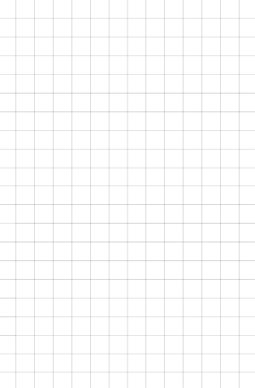

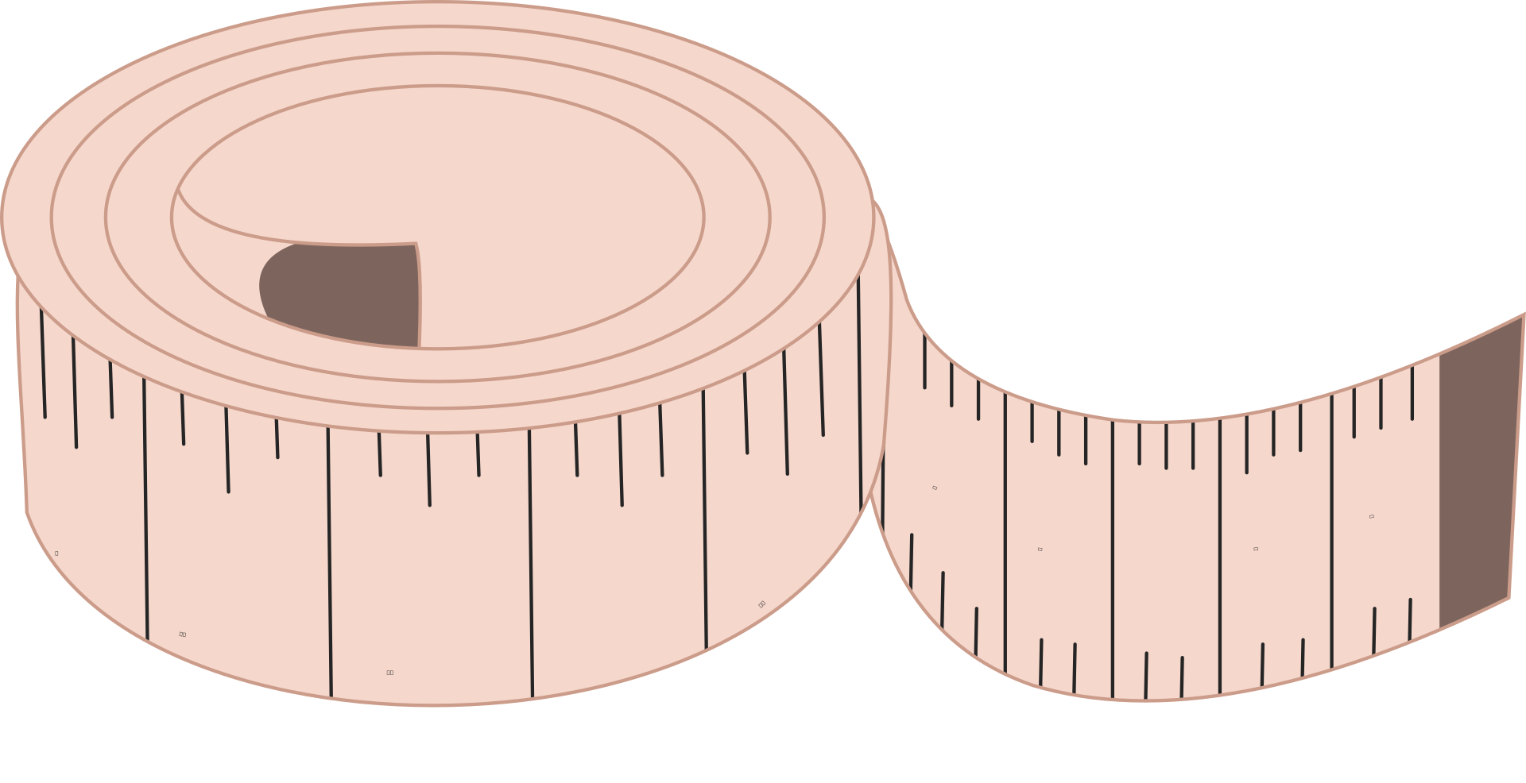


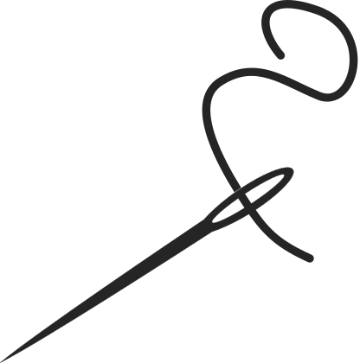
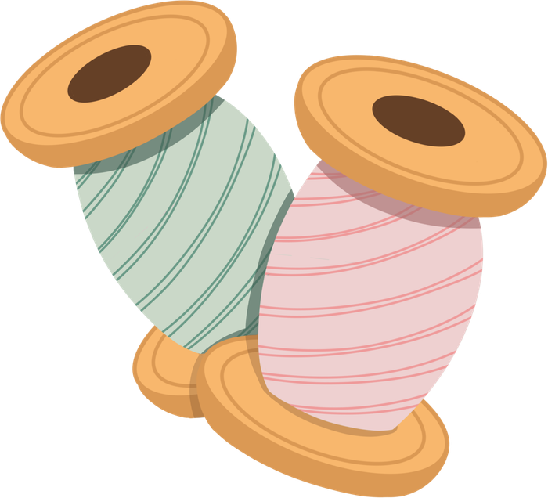
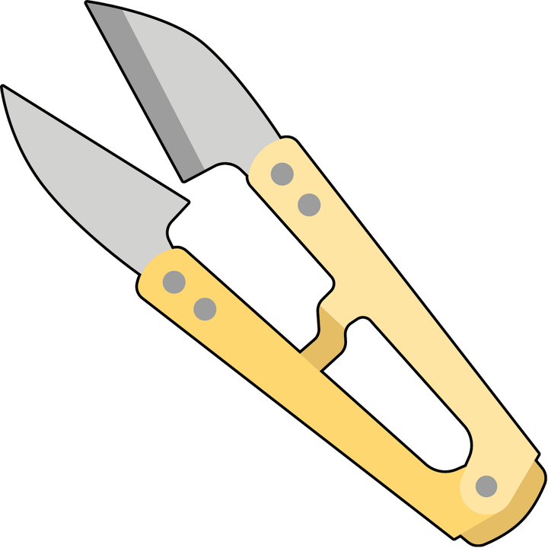
Pattern Layout & Grain Line

Slide 2
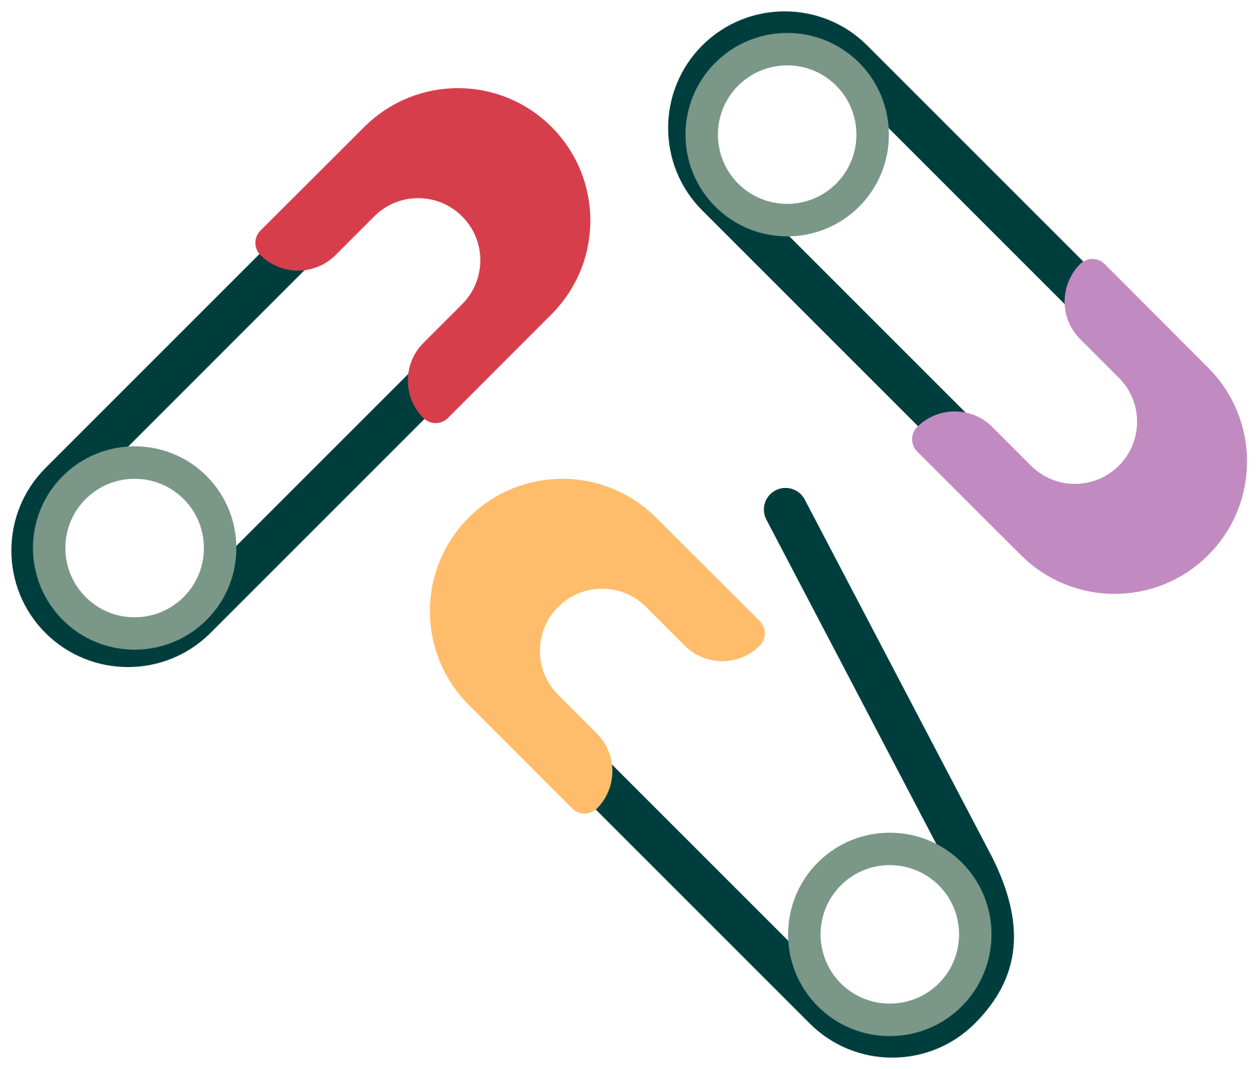
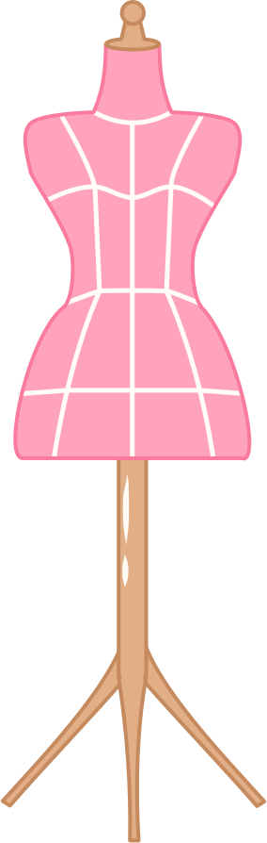
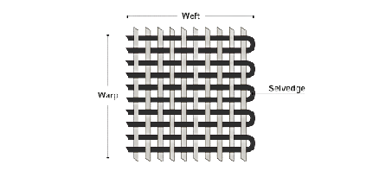

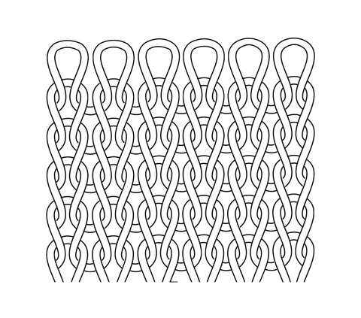
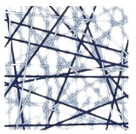
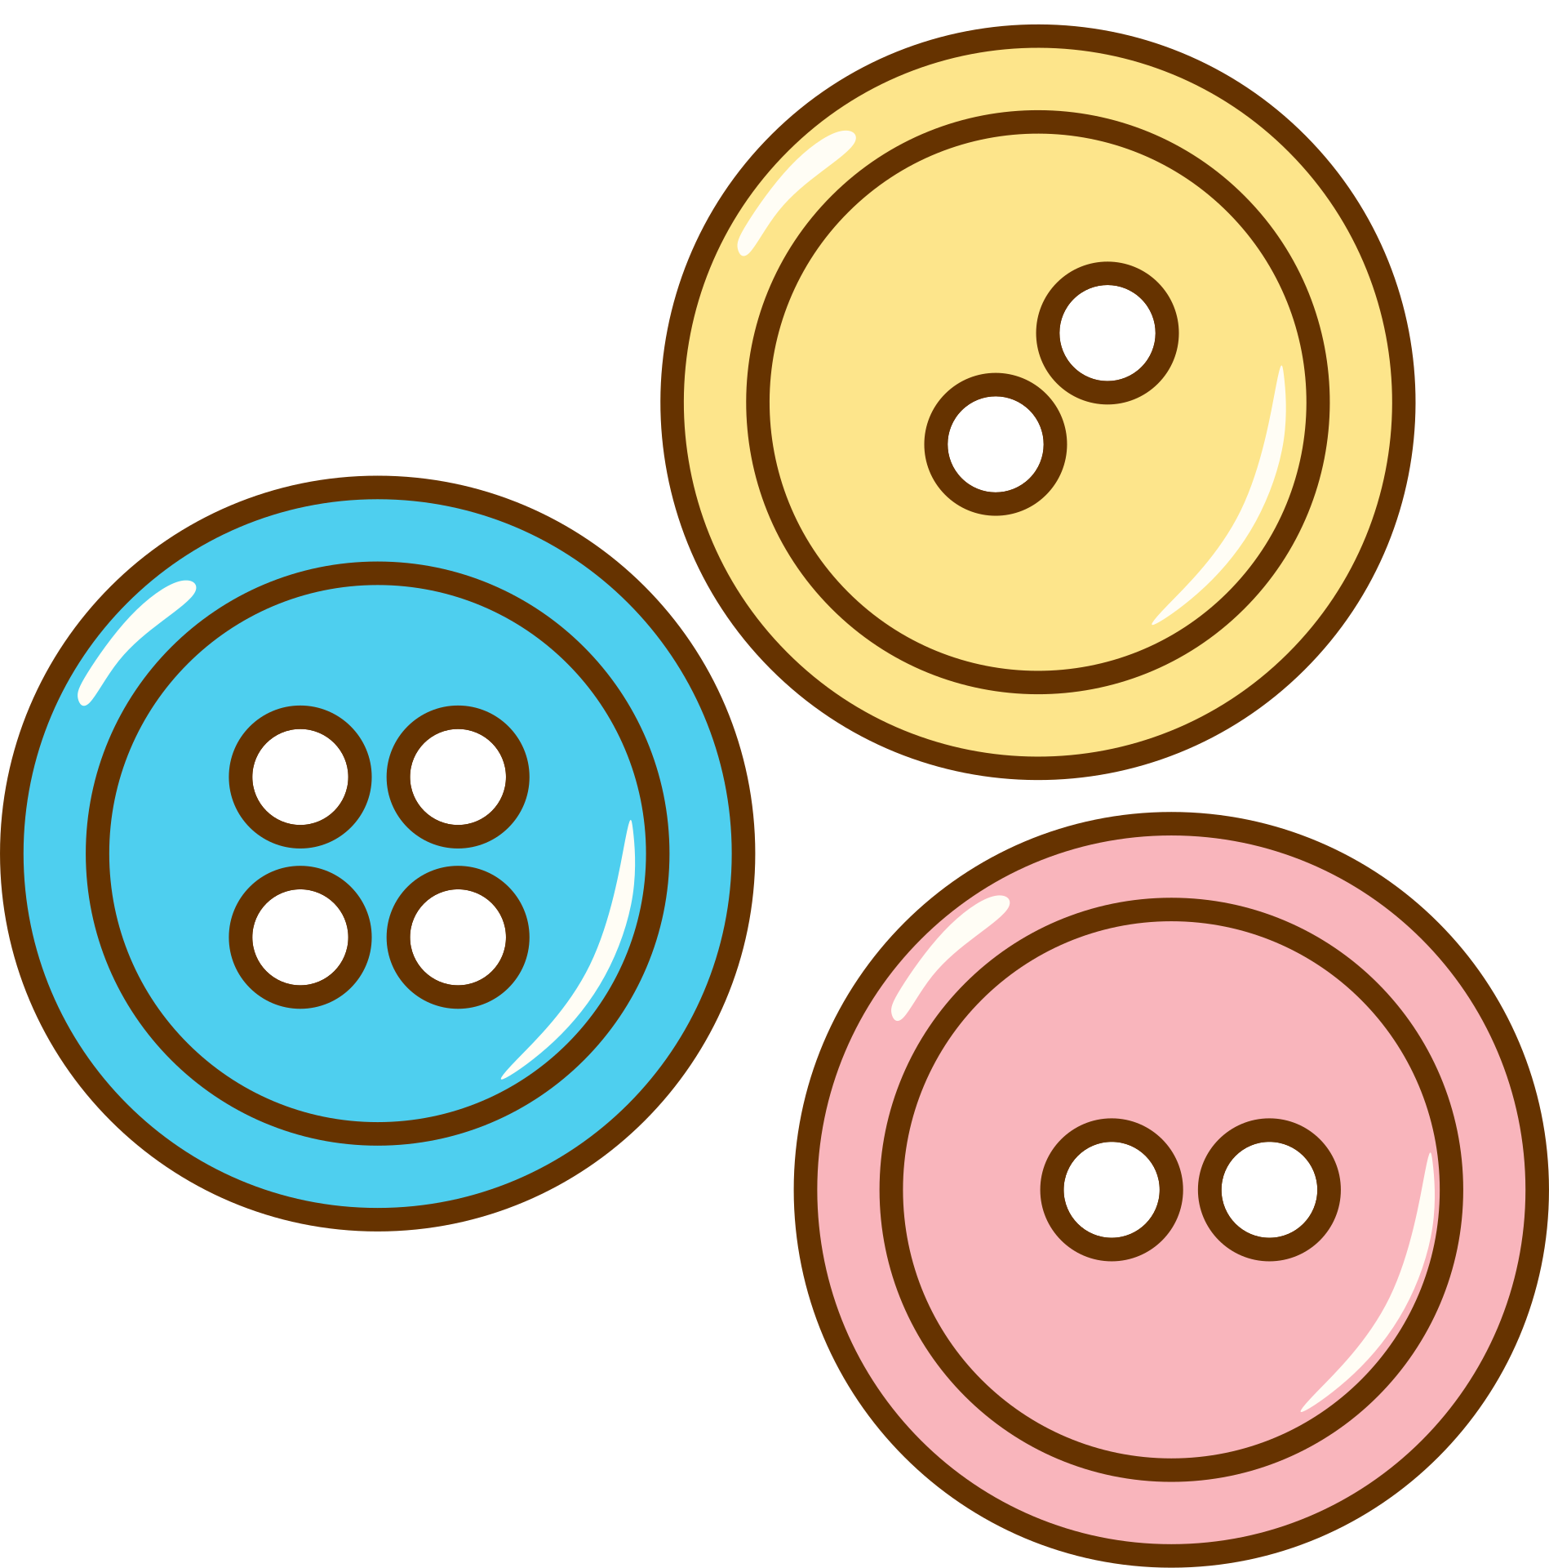
Types of Fabric
3 types of fabric
Woven
Knit
Non-Woven

Slide 3
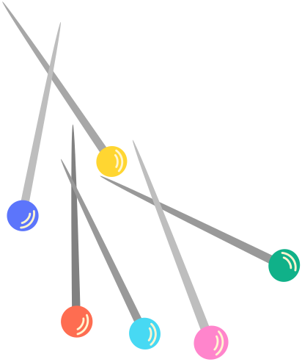
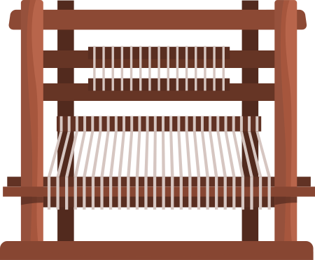
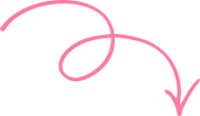
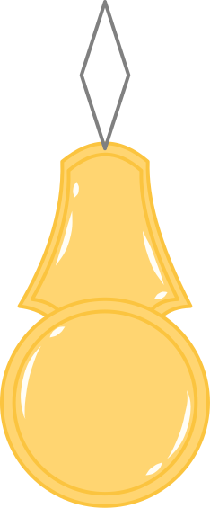
Woven Fabrics
Made on a loom
Warp Threads

Slide 4
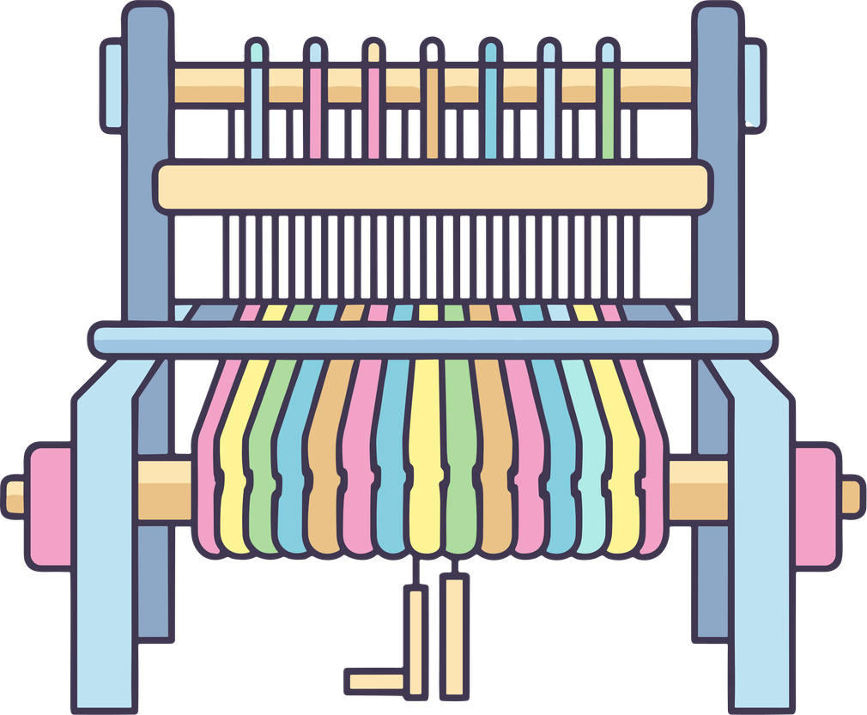

Woven Fabrics
Weft threads
Filler threads
“Weft threads go weft and wight”

Slide 5
Grain Line & Selvage Edge

Slide 6
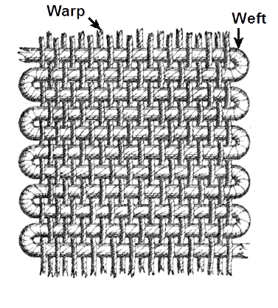
Selvage:
Factory made edge of the fabric

Slide 7

Grain Line
Straight grain line is always parallel to selvage

Slide 8
Grain Line
Grain is Parallel to the selvage.
ANY point on the grain line, should be the exact same distance to the selvage edge.
You can check by measureing from the selvage edge to the grain line on your pattern.
3"
Selvage
3"

Slide 9
Types of Pattern
Pieces

Slide 10

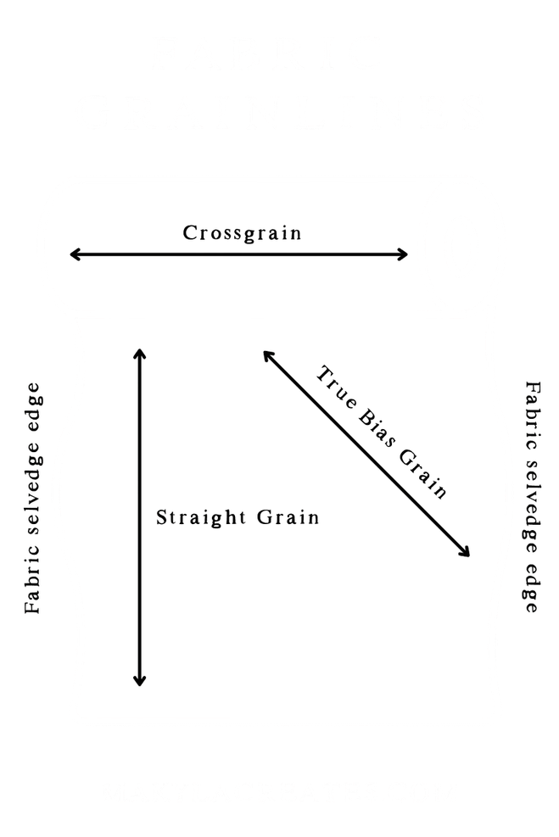
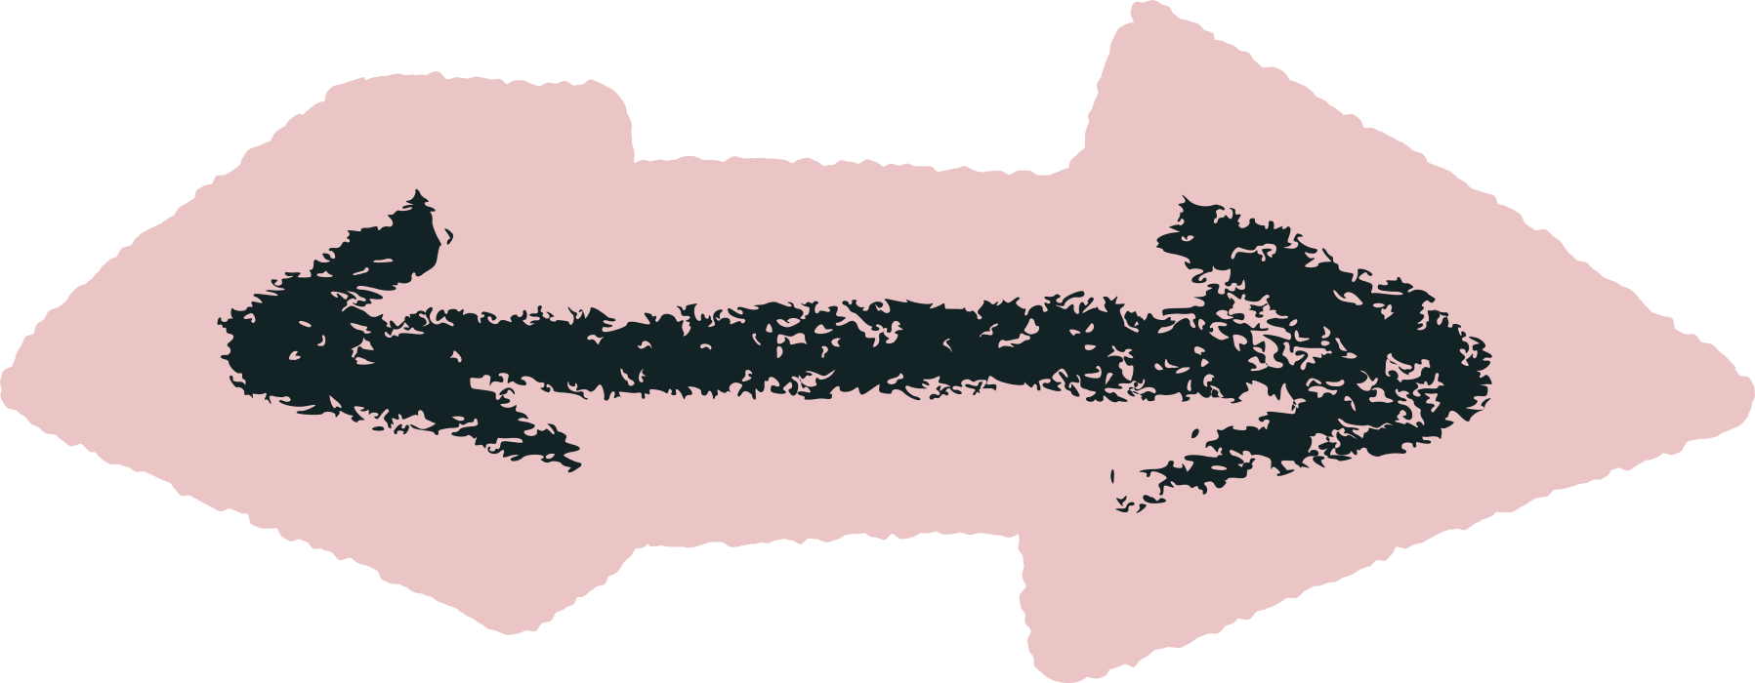
cUt on grain
*

Slide 11
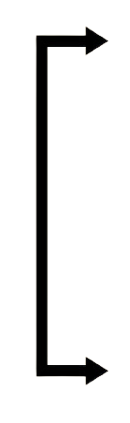
cUt on fold
Arrows point to the edge of the pattern piece that goes directly on the fold.
NEVER cut on the folded edge.

Slide 12
Pattern layout

Slide 13
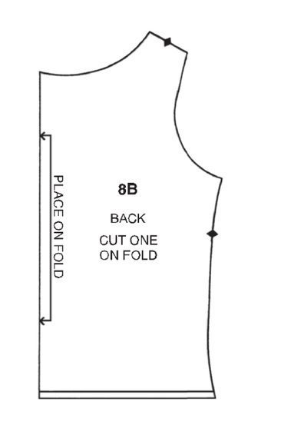

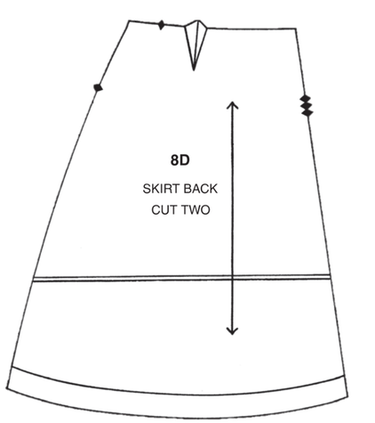
layout tips
Place cut on folds first!
they take up a lot of room!
Then work from the biggest to smallest pattern pieces

Slide 14
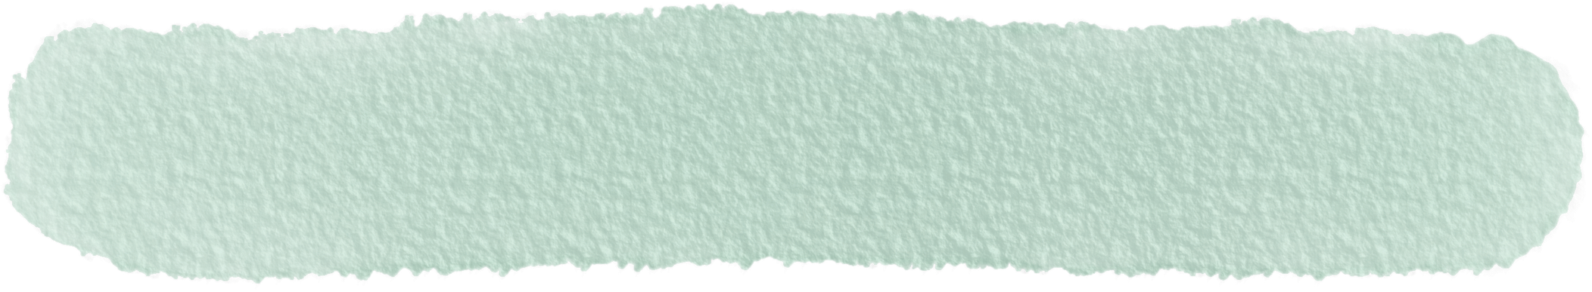

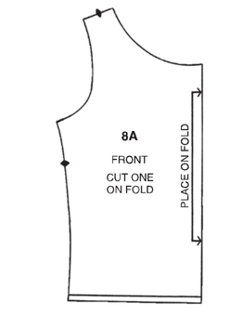
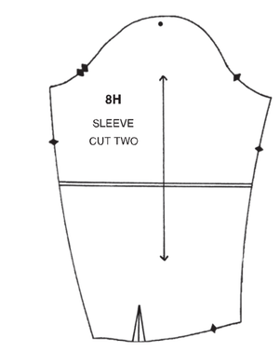
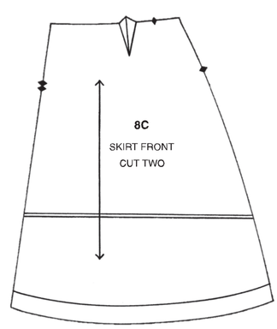
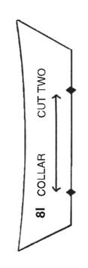
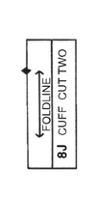
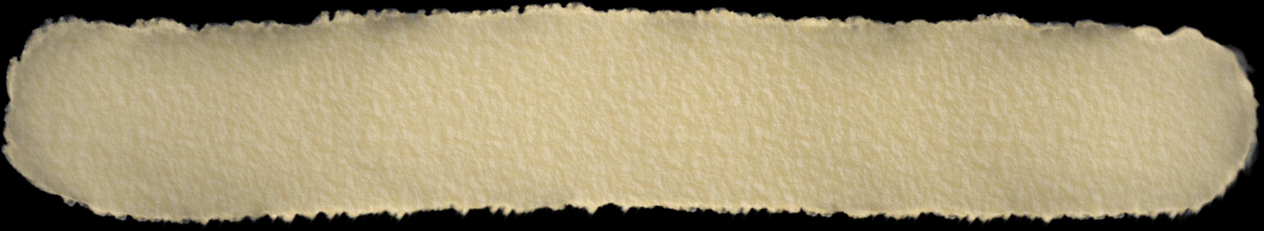
place the pattern pieces correctly on the fabric
label:
the folded Edge
Sevlages
grain line

