Slide 1

Planning with the End in Mind - The Semester Project Model
Kris Spath
Waverly Ag Education
Date: 6/8/2026
Notes:
Welcome, purpose, and quick agenda overview.

Slide 2
Learning Goals
Apply course concepts to a real-world project
2. Practice research, planning and record keeping skills
3. Demonstrate knowledge and reflect on learning

Slide 3
So, What is the plan?
Pillar & Project days
  Introduce the project with your beginning of the year procedures.
  Teach your curriculum as planned.
  Hold a project day for the first time while you are present - early in the semester.
  Interject project days wherever they make sense.
  Example calendar
Notes:
Explain alignment with curriculum and skills students will develop.

Slide 4
Guidelines
All projects need to focus on the course objectives OR follow the guidelines of the project you have chosen.
2. All projects must be teacher approved & have 2-3 SMART goals.
3. Every student must complete the Check-in form before beginning work on a project day.
4. Every student must complete a Check-out journal at the end of the project day.

Slide 5
How does this project look during the semester?
1
2
3
4
Project goals
Project Workdays
Quarterly Self-Evaluation
Final Self-Evaluation
While you are present early in the semester, students choose their project & set SMART goals.
When you are present or have a sub, schedule project days. Students check in, work on their project, then check out with a journal.
At or around the quarter mark in the semester, students complete the Quarterly Evaluation form & go through a one on one interview with you.
Near the end of the semester, students complete the Final Evaluation form & go through a one on one interview with you.

Slide 6
The opportunity
Record keeping skills (check in and check out)
Autonomy of choosing their own challenging project
Time management skills
Great “sub plans” for you!!

Slide 7
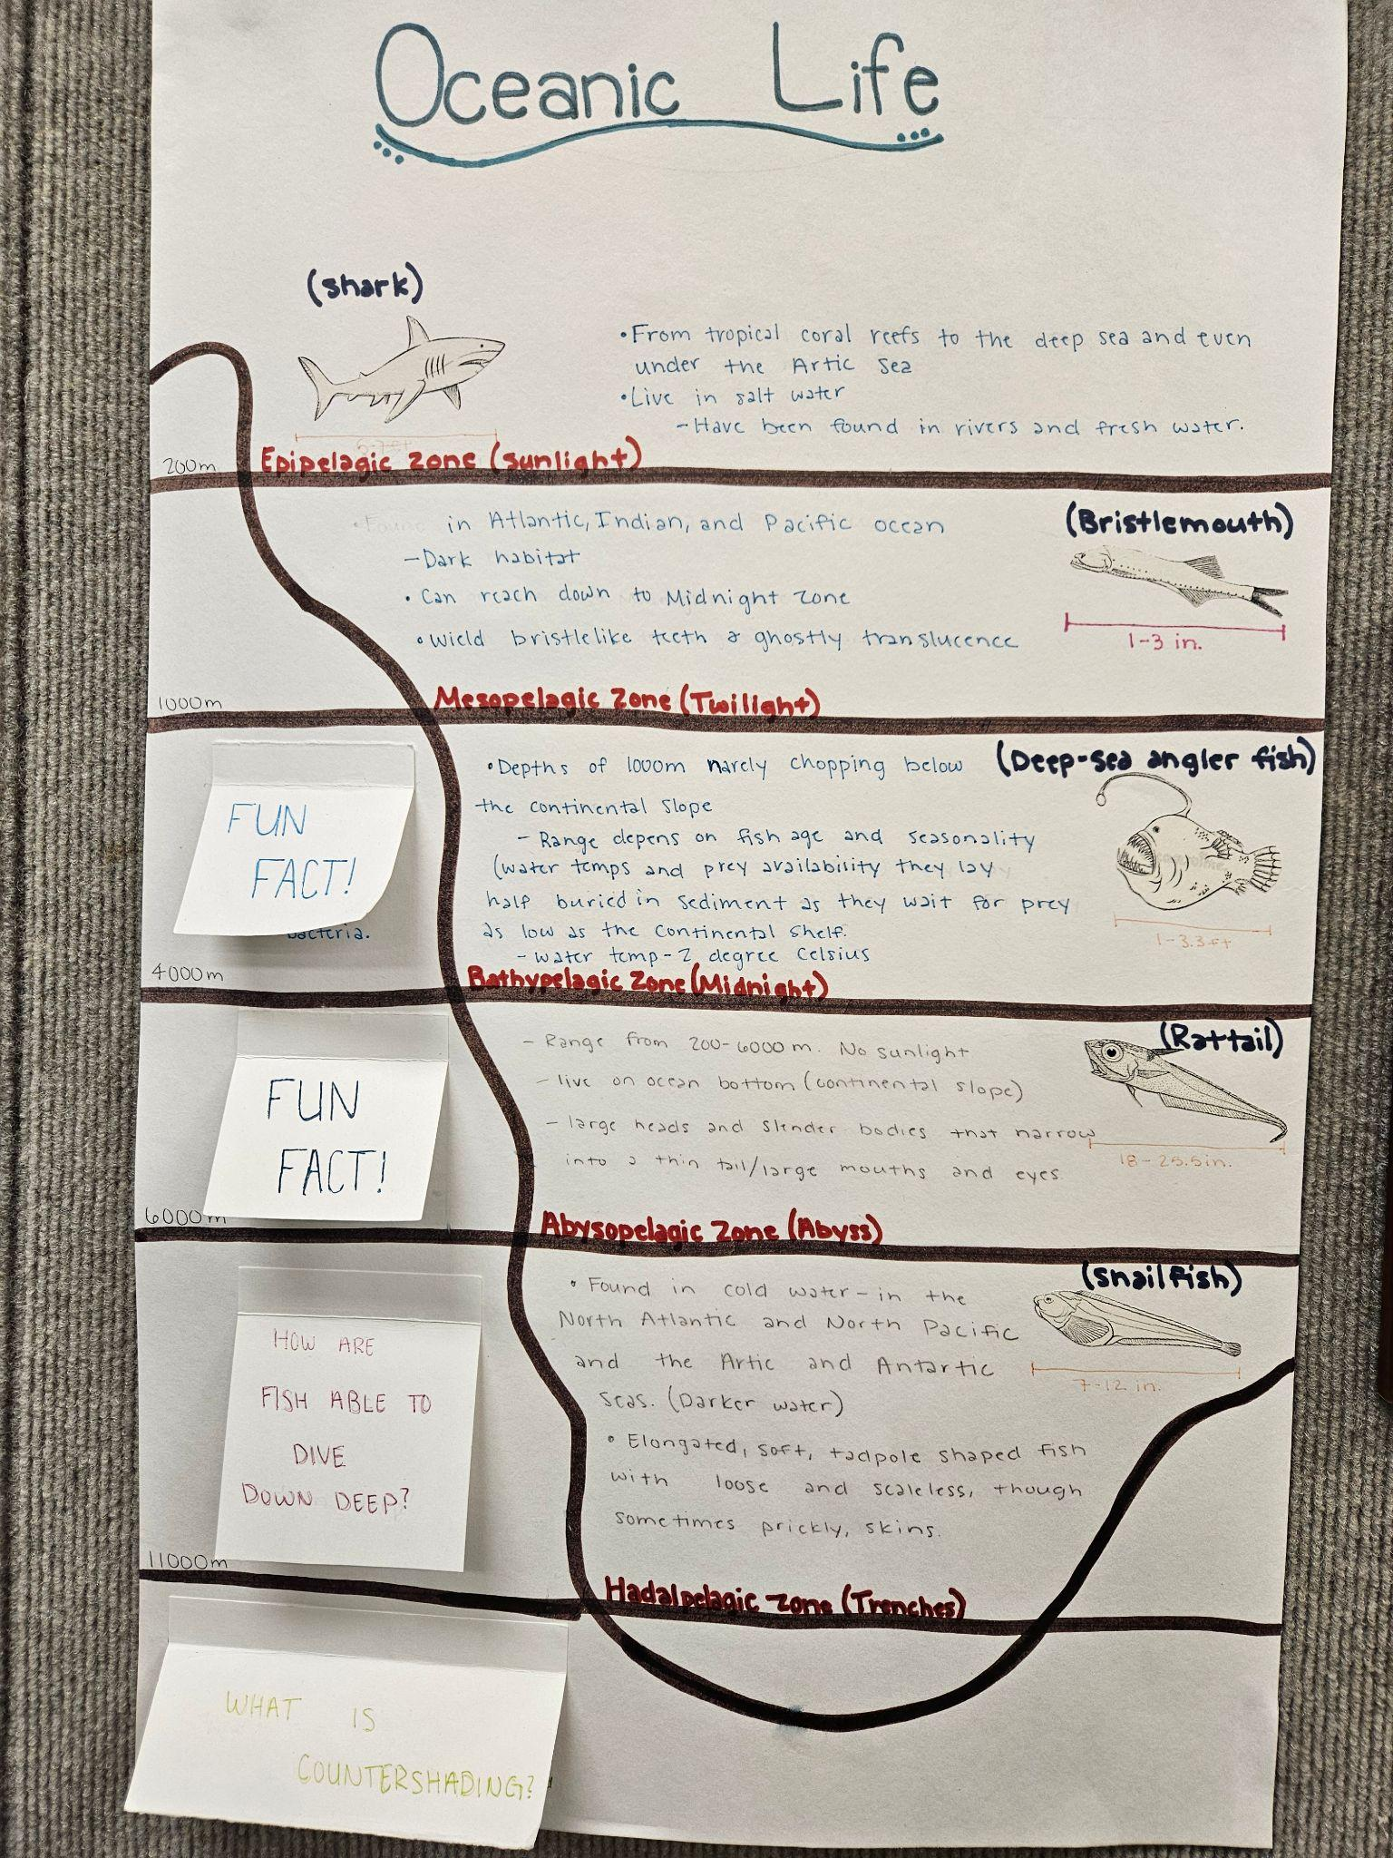
Examples
Animal Science Projects
Research paper - Crispr Gene in Swine
All projects have a written component to support the physical project.

Slide 8
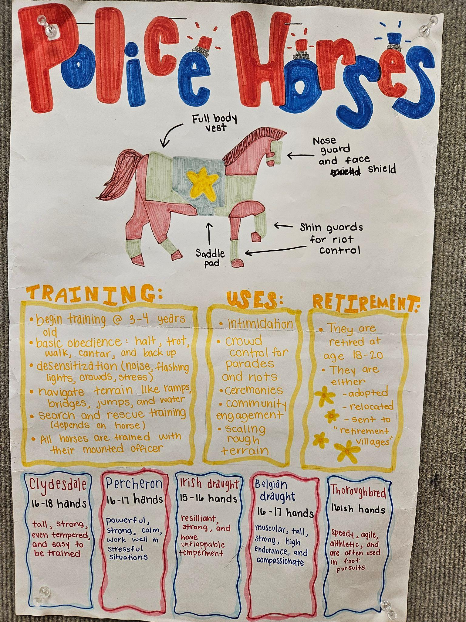
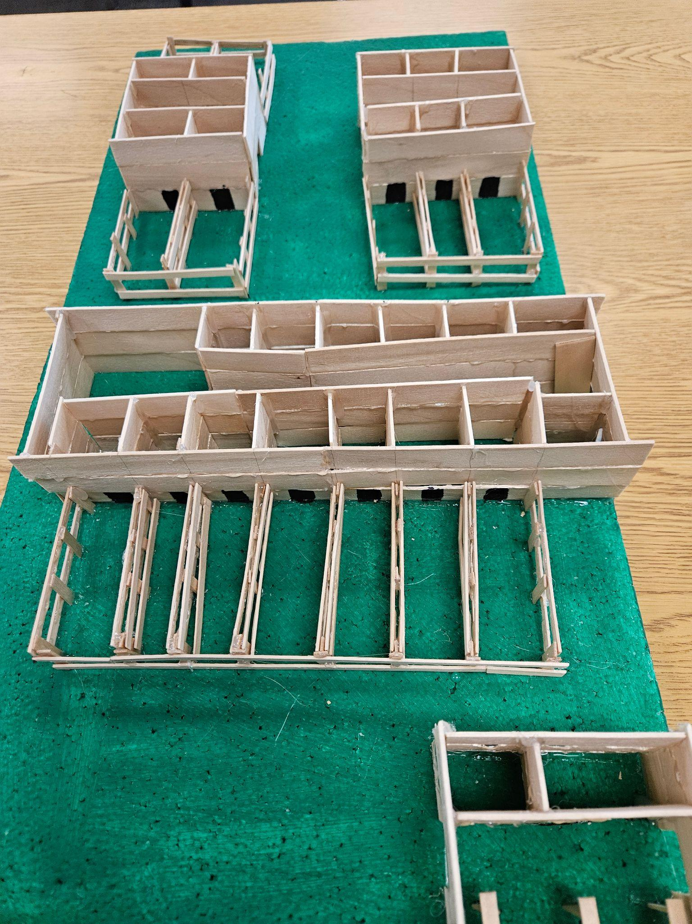
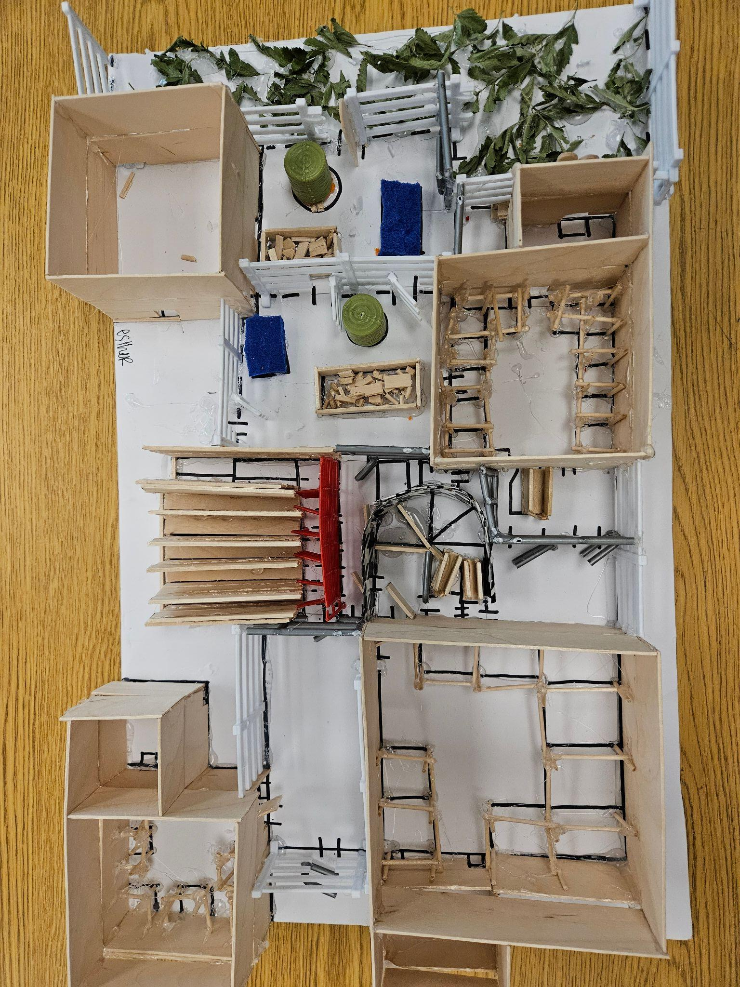
Examples
Companion Animal Projects
Large Animal Management
This one is scripted but students have a choice of the animal facility.

Slide 9
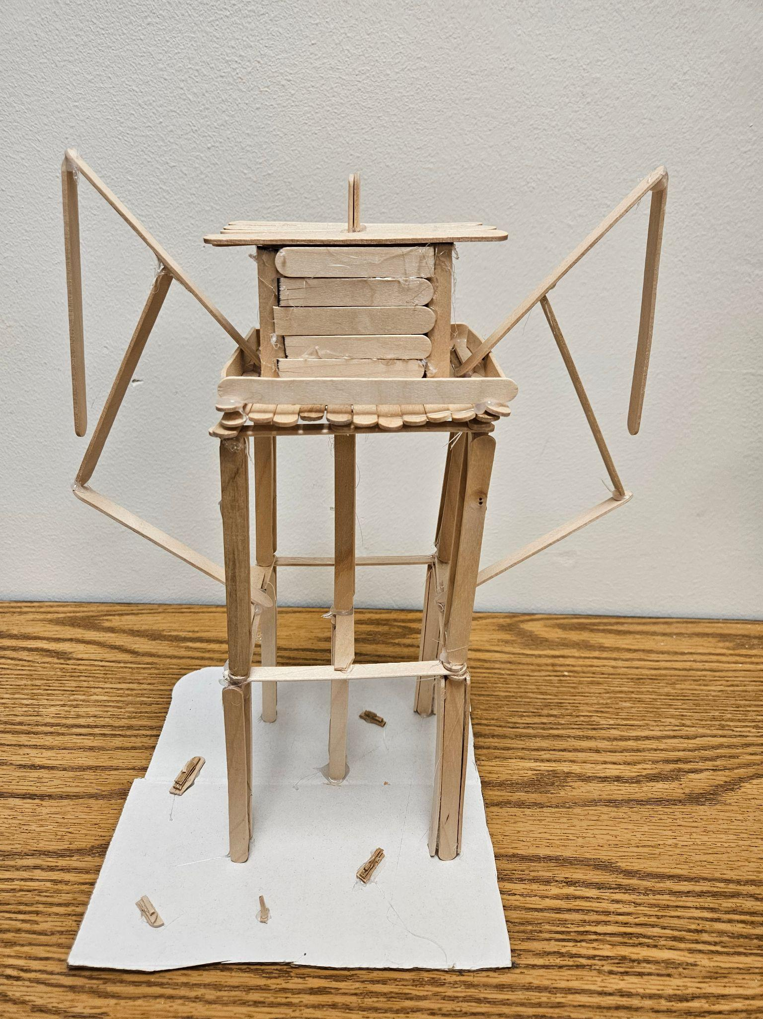
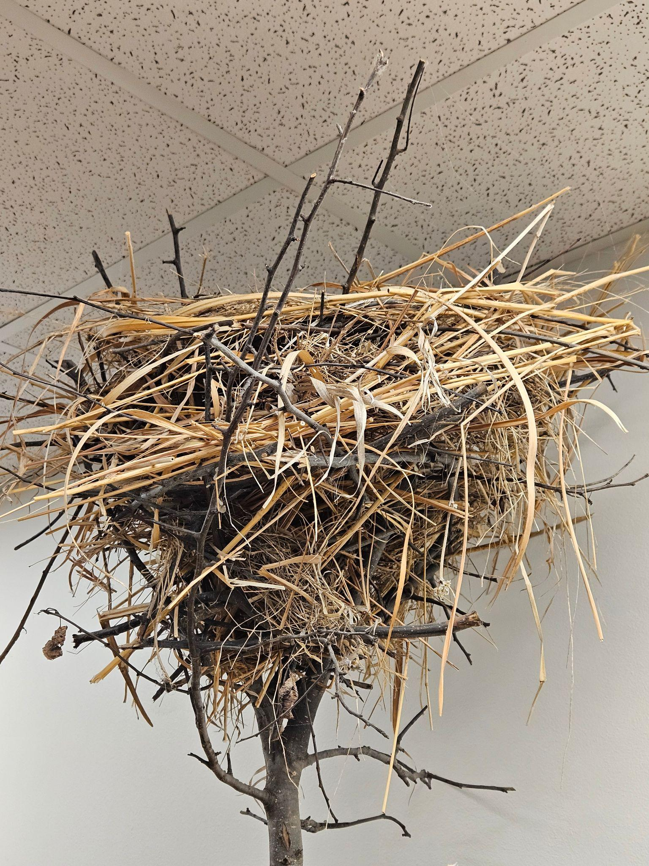
Examples
Wildlife Management Projects
This one is scripted but students have a choice of the habitat.
Students work in groups to design a habitat management plan focusing in a real property close to town and present their management plans to the landowner at the end of the semester.
Habitat options on the land:
Riparian, Aquatic, Grassland or Wetland.
Natural Resources Projects

Slide 10
Examples
Floriculture Projects
This one is scripted but students have a choice of the scenario.
Students work in pairs or by themselves to design floral arrangements, create an event floor plan, complete individual price sheets and a job invoice. Final project is a presentation for their customer showing examples of each arrangement and their floor plan.
Plant Science Projects
Starting vegetable plants in the school greenhouse
Research paper - Use of Medicinal Plants to Treat Depression.
Research paper - Most Effective Propagation Methods for Popular Houseplants

Slide 11
Examples
Landscape Projects
This one is scripted but students have a choice of the space to design. Many choose their own properties, although I have had some students design sports facilities and a golf course.
Students work individually to design a landscape including a plant list and a perspective view.
Example on next slide.
Agribusiness
This one is scripted but students have a choice of the business.
Students work in pairs or by themselves to develop a business plan on a potential business they could start in high school.

Slide 12
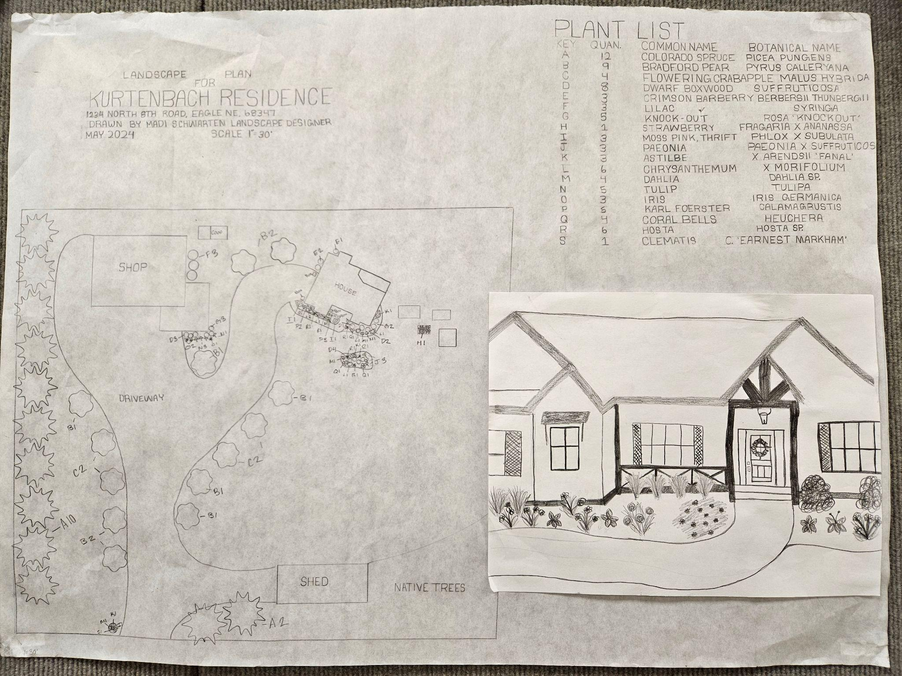

Slide 13
Questions?

Slide 14
Contact information:
Kris.spath@district145.org
Thank you!

