Slide 1
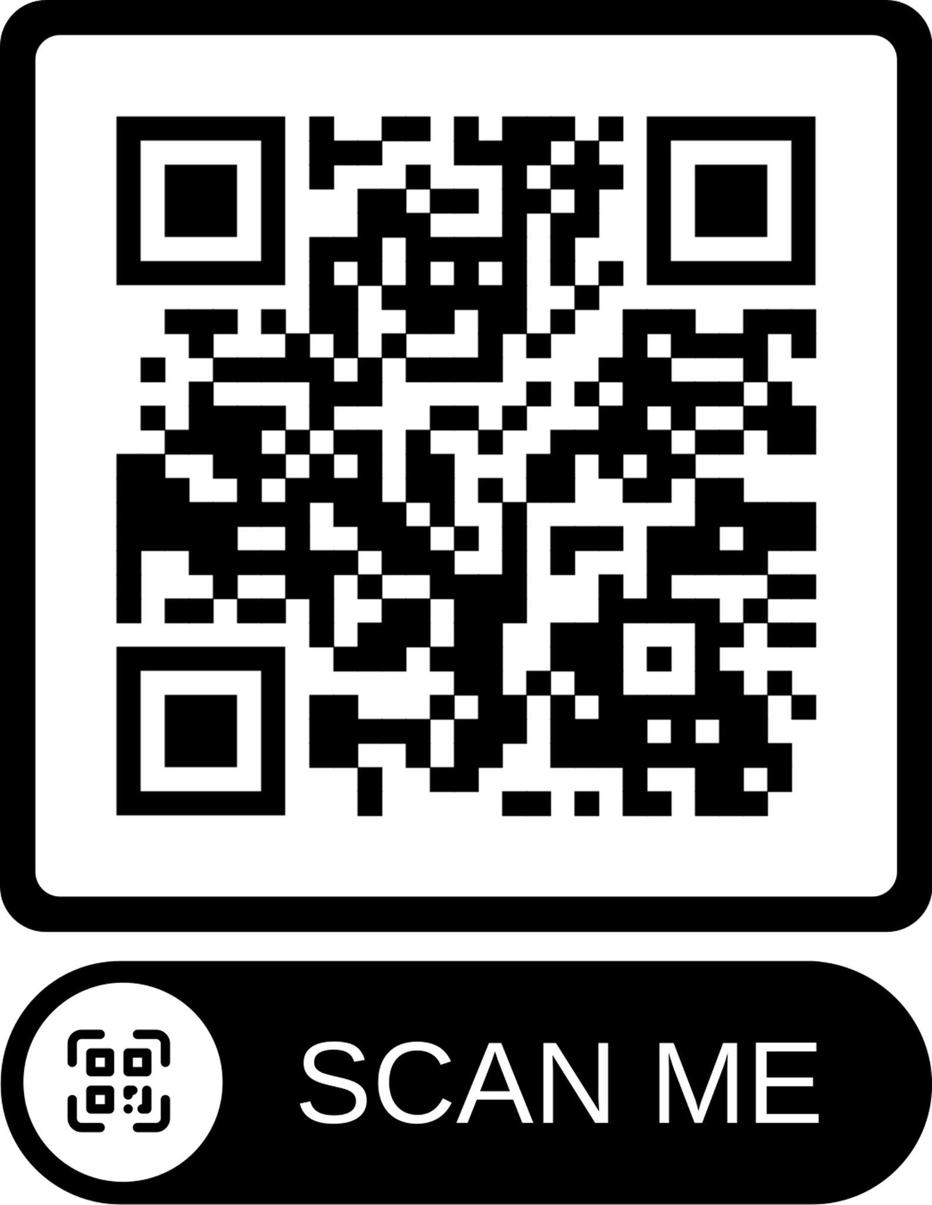
Welding Assessment
Welding assessments give students feedback about the quality of their work. This session will give teachers an assessment to grade students work. The assessment follows the American Welding Society standards in a simple check list that is measurable to help students improve their welds. The session will look at an assement, how to use measuring tools, and discussion from teachers about what practices teachers use in their classroom.

Slide 2
Evaluating students welds
Will Winchester, Hershey Public Schools
This presentation could be a 4 hour workshop
I will share my journey, resources I found, and what I have created.
I am not a Certified Welding Inspector
I presented this in 2022

Slide 3
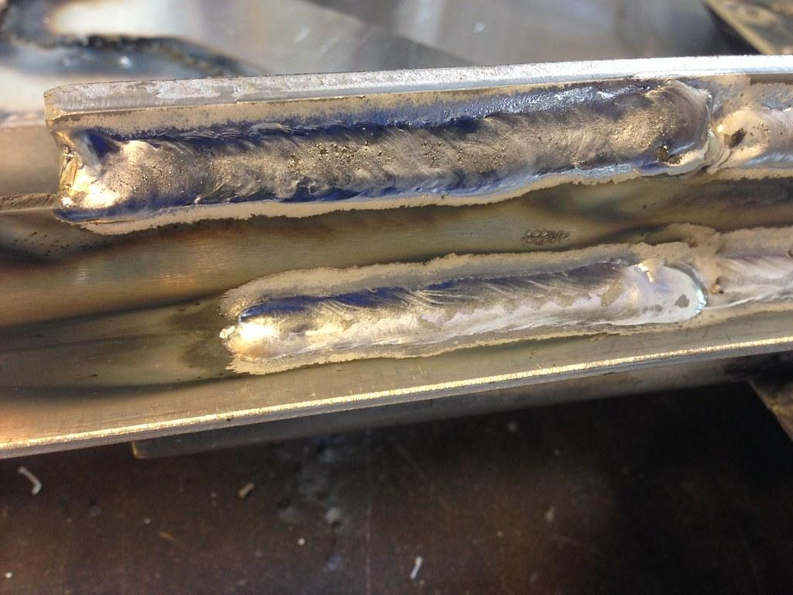
How do teachers assess students welds in their classroom?
This session will look at welding assessments. There will be time for discussion of what teachers are doing in their classes.
How do you assess welds in your classes?
Is our method of assessment similar to industry?
This Photo by Unknown Author is licensed under CC BY

Slide 4
How are you assessing your student welds?
What is a quality Weld?
According to James F. Lincoln Arc Welding Fourteenth edition to the procedure handbook of arc welding. Quality in a weld can be defined as conforming to a specification which lists the limits of discontinuities.
How do you measure, inspect, and who sets the standard for a quality weld?
Ever had an administrator, student, or parent question your expertise of assessing welds?
How are you defining the specifications for the weld?

Slide 5
According to James F. Lincoln Arc Welding Fourteenth edition to the procedure handbook of arc welding. Quality in a weld can be defined as conforming to a specification which lists the limits of discontinuities.
What is a discontinuities?
How do I teach a bunch of visual learners what discontinuities are?
How do I teach what a quality weld looks like

Slide 6
REALCAREER
WELD DEFECTS KIT
CREATED BY REALITYWORKS
THANK YOU CARL PERKINS FUNDS AND ESU16!!!!
HTTPS://WWW.REALITYWORKS.COM/PRODUCT/WELD-DEFECTS-KIT/

Slide 7
Who determines the specifications for a quality weld?
AWS, FFA, SkillsUSA, or local codes
You Determine the quality but following the guidelines from the above organization is a way to help make that determination.

Slide 8
REALCAREER
WELD TEST BENDER
CREATED BY REALITYWORKS
THANK YOU CARL PERKINS FUNDS AND ESU16!!!!
JUST BREAK THE WELDS!!!!
HTTPS://WWW.REALITYWORKS.COM/PRODUCT/BEND-TESTER/

Slide 9
My journey to what I use
1,2,3 assessment
Points
SkillsUSA National competition
SkillsUSA World SkillsUSA
  Competition against yourself more than the other schools.
AWS forum
CWI information from AWS D1.1 book
  https://pubs.aws.org/
  https://www.welding.org/technical-specialized-training/
FFA, Southeast community college.

Slide 10
How I organize the welds
Surface welds
Fillet welds
Butt welds
Level of the class

Slide 11
Measurement Tools
Welding Fillet Gauge https://weldinganswers.com/proper-use-of-weld-gages/
The Pit Depth Gauge by GAL GAGE Company https://www.youtube.com/watch?v=1GUSQMxWYuM
Use what works for you.
Assess the welds in front of you

Slide 12
Thank you for your time
Would you like a longer session about this topic?
Will Winchester will.winchester@hpspanthers.org 308-539-1588
https://forms.gle/fhZFWDob35RPsKsD8

