Slide 1

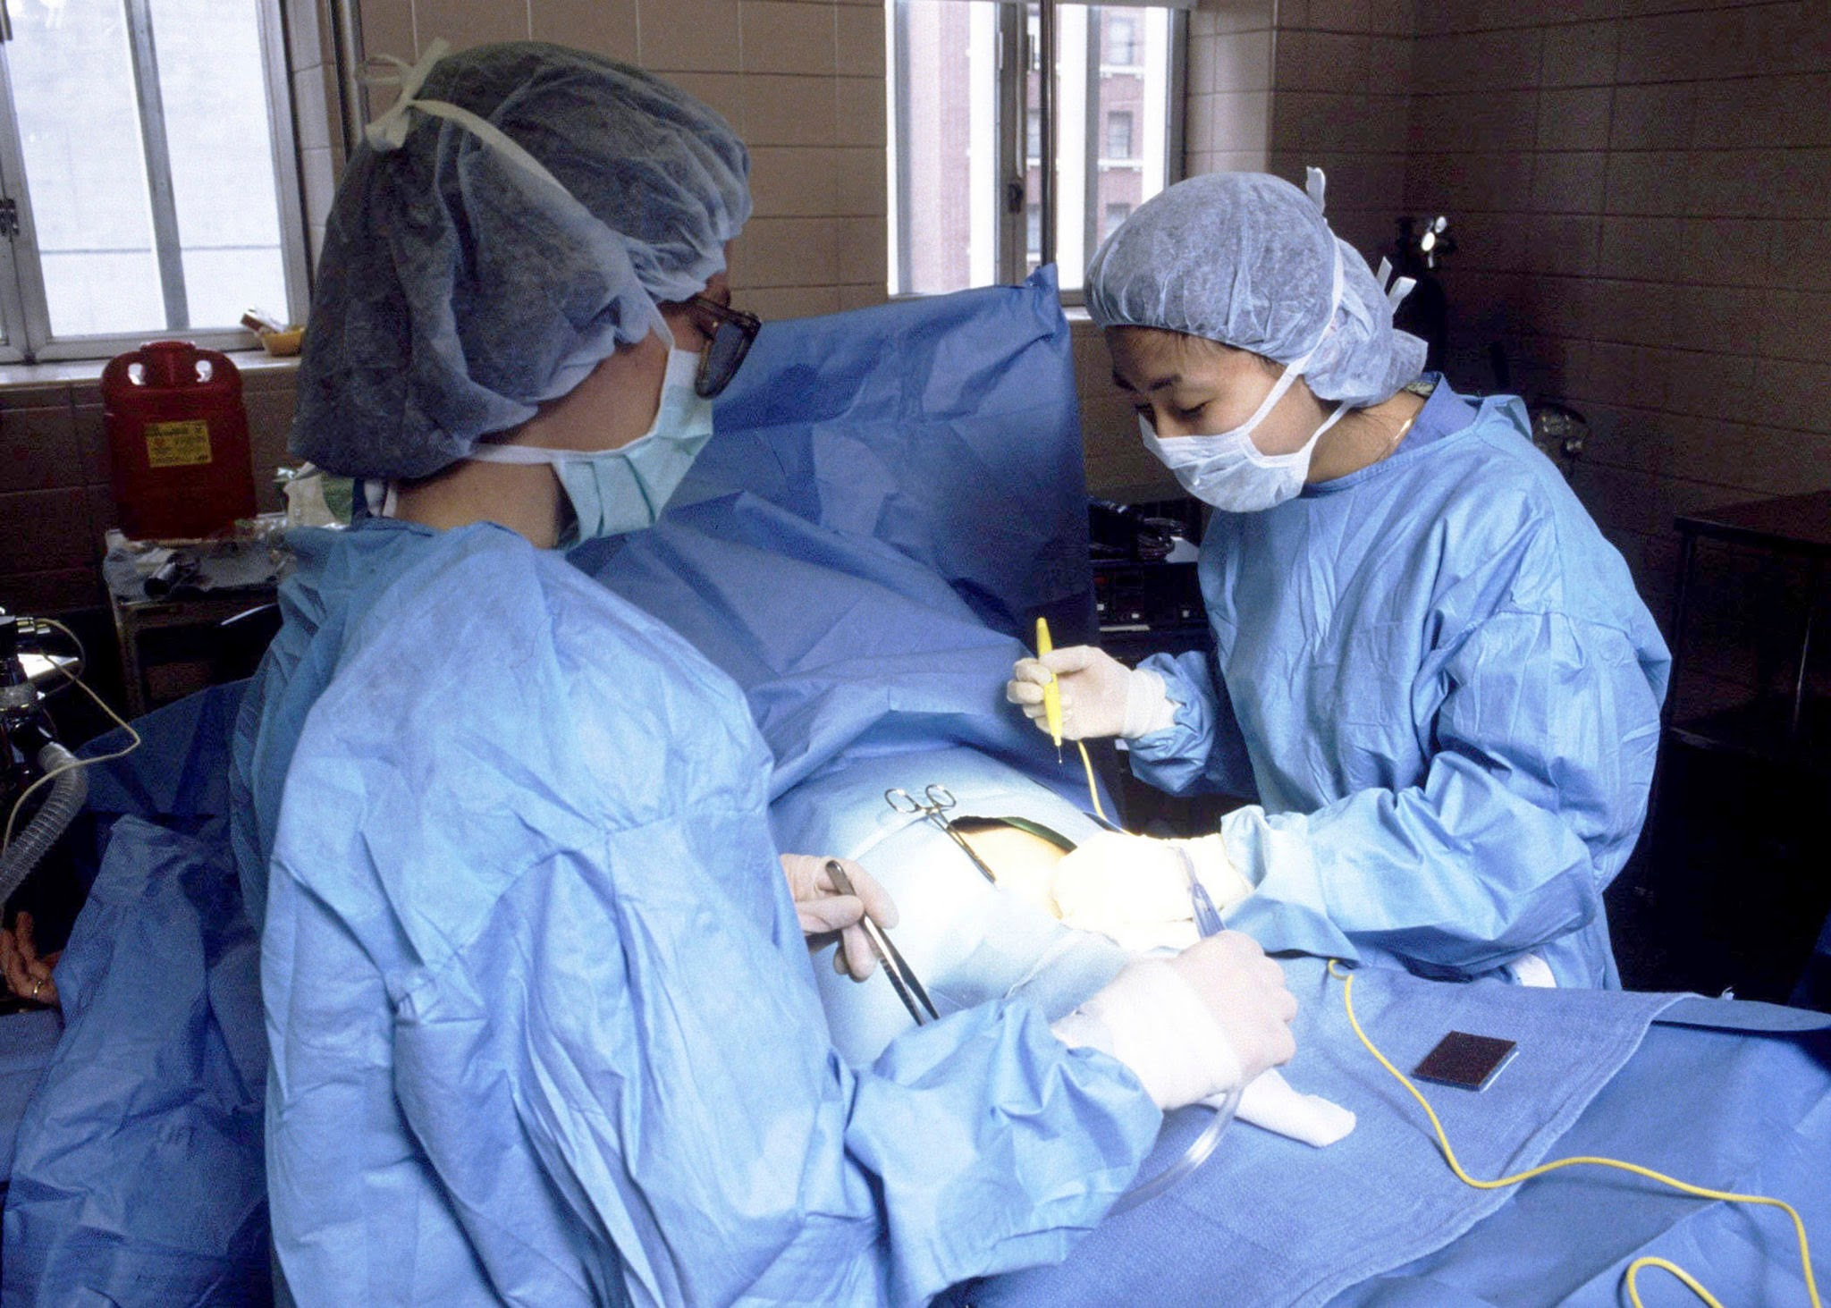
Cesarean Section Simulation Part 1: Building the Simulator
2026 Nebraska CTE Conference
Tracy Long RN, BSN
Healthcare Pathways Educator
Lakeview High School
Columbus, NE

Slide 2
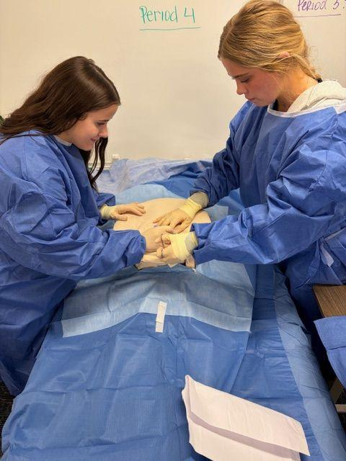
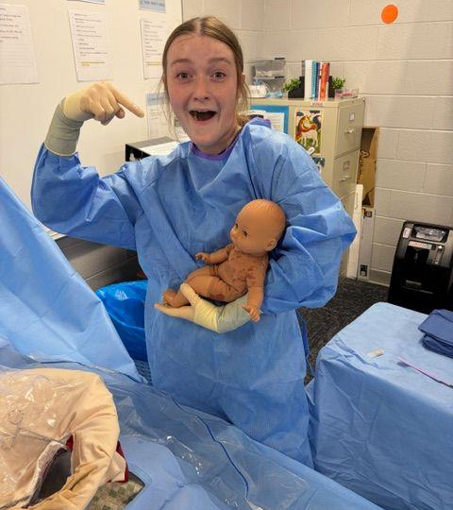
Mrs. Long’s Delivery Room
My students said “This was the best day EVER!”

Slide 3
My goals for you are:
Identify materials needed to build a C-section simulator
Assemble and understand a layered abdominal anatomy
Create a reusable fetal delivery model
And, as ALWAYS….have some fun with it!
Video inspiration:
YouTube Cesarean Section Simulator Video

Slide 4
Overview of the simulator components
Tissue layers
Uterus/amniotic sac
Infant model
Placenta/umbilical cord
Surgical drapes, gowns, and other materials

Slide 5

We will go through the slides as we assemble the simulator together.
Materials will be distributed as we go along.
PLEASE feel free to stop me if you have any questions, suggestions or ideas–we’re a team, people!!
Ready?...................OKAY!!

Slide 6
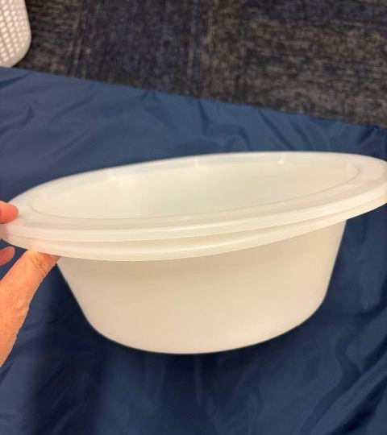
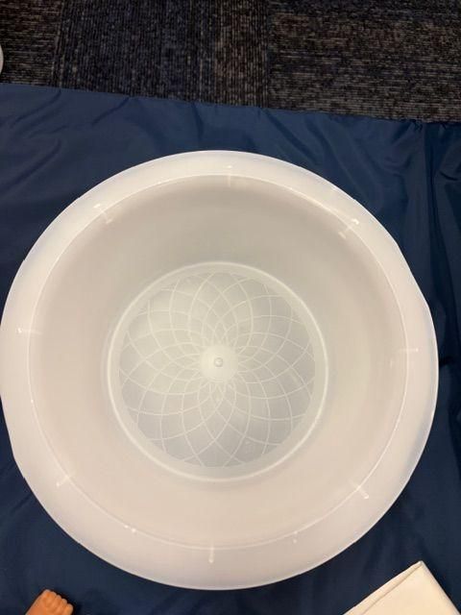
1. Basin OR
box
You will need something to act as the uterus, to house the baby and attach the layers to. I use plastic OR basins (pictured here), a box will work just as well.

Slide 7
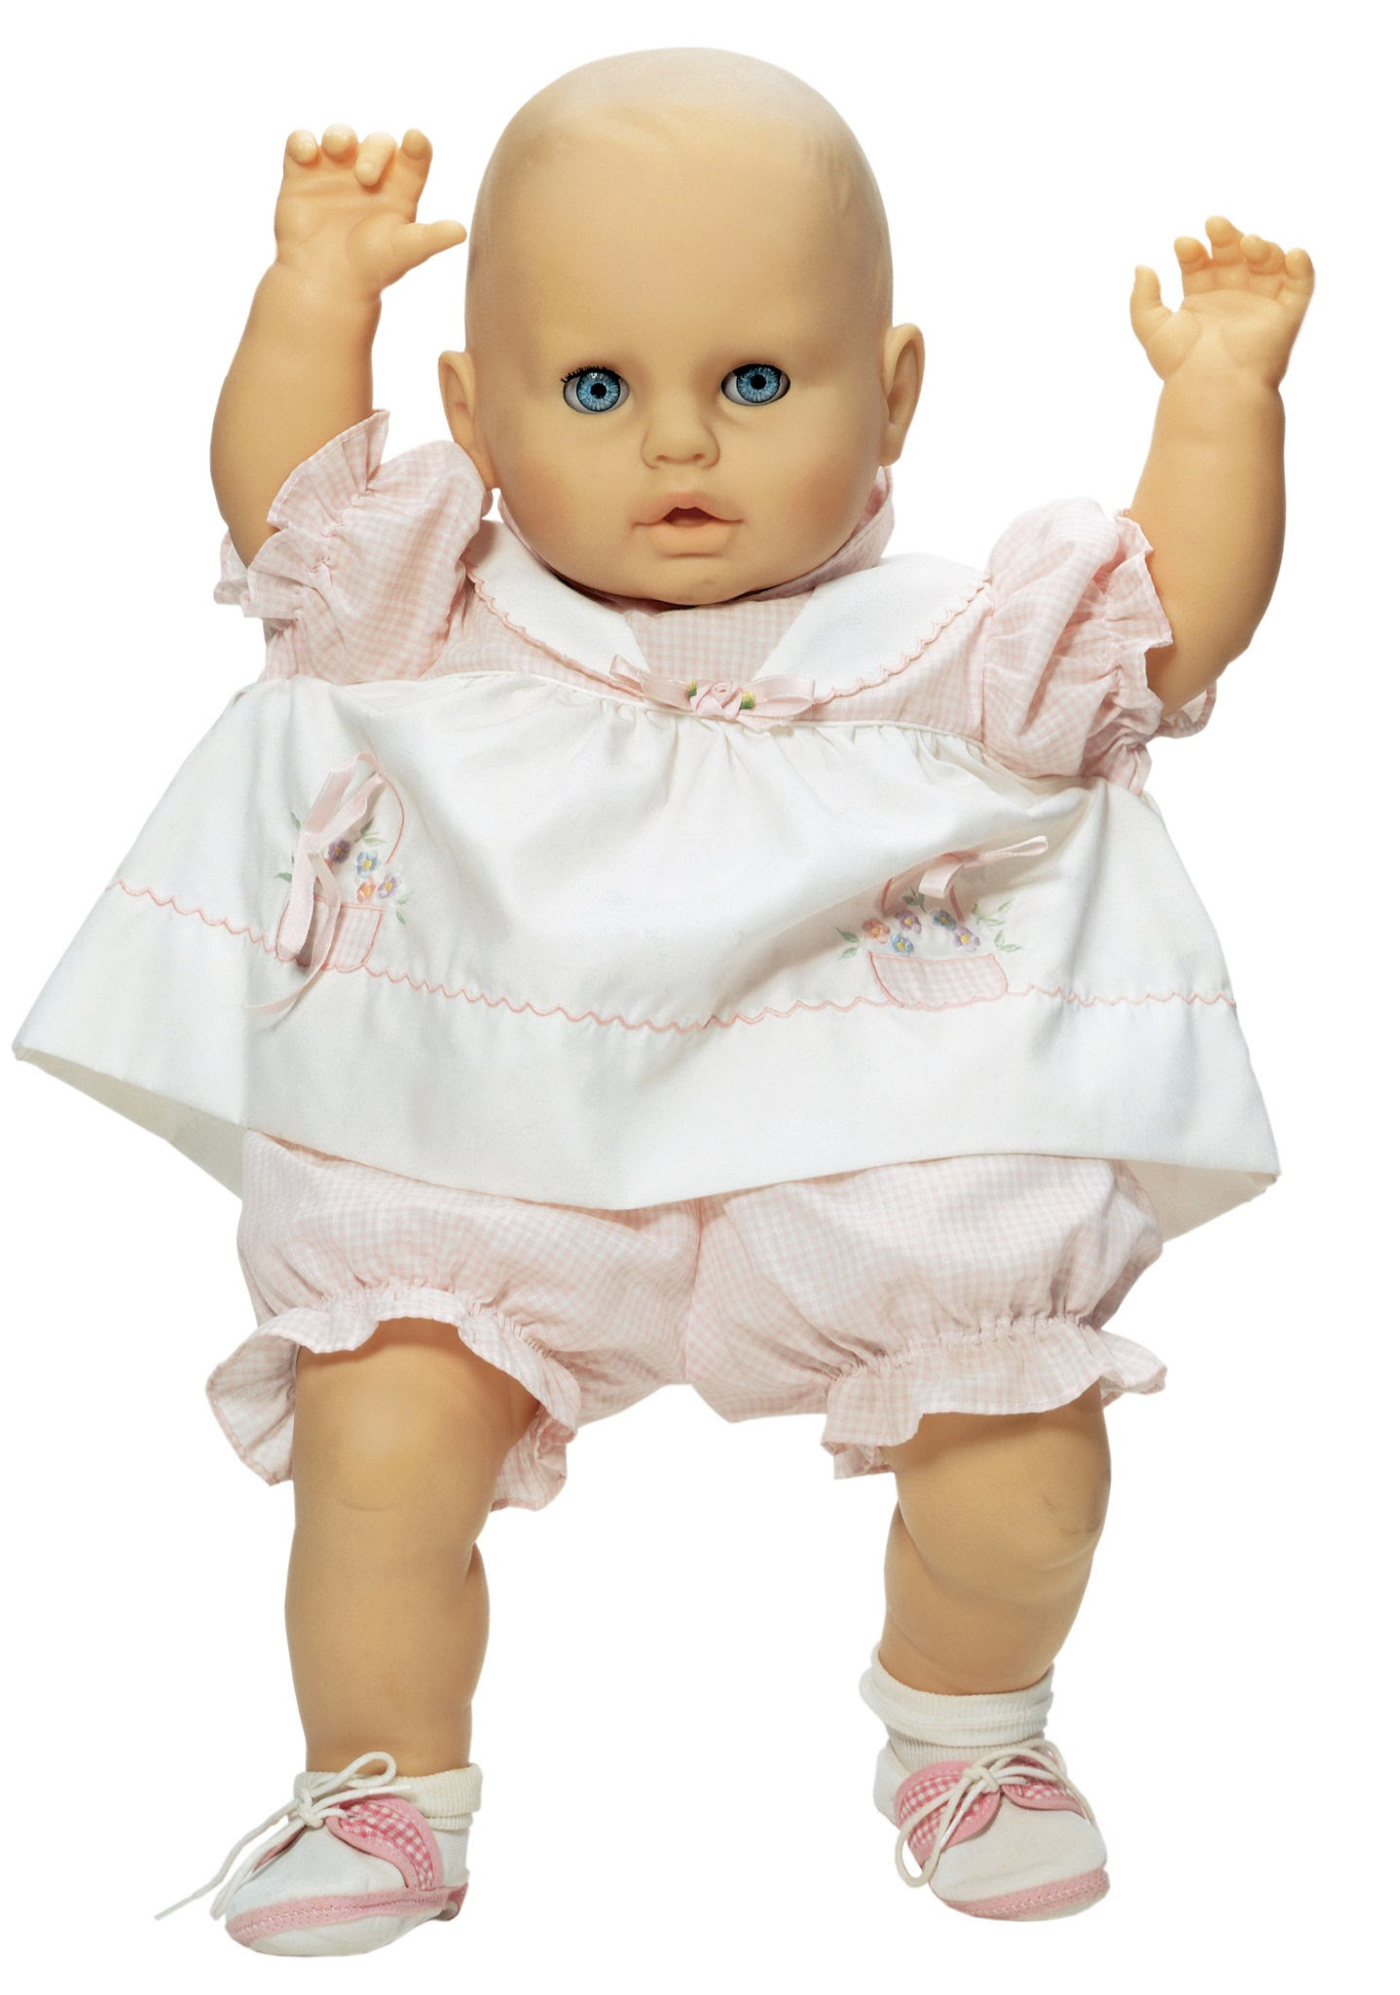
2. Baby/fetus
I purchased 10” dolls at WalMart for less than $9 each. All plastic is ideal, but fabric bodies dried out okay.
Notes:
I now regret rehoming the plethora of dolls my girls were “mommies” to years ago.

Slide 8
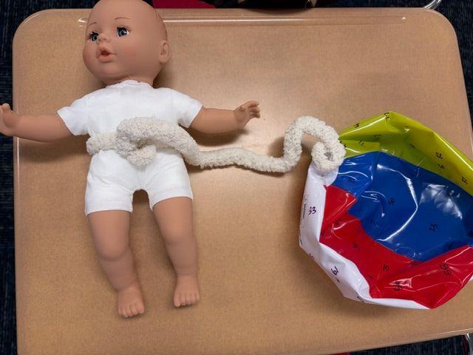
3. Placenta and umbilical cord
Any type of yarn can be used to simulate the umbilical cord. Thinner yarn can be braided or twisted to add thickness. Attach one end of the umbilical cord to the fetus using tape or staples (fabric body). The other end is attached to the placenta (a deflated balloon, small beach ball or rubber ball).

Slide 9
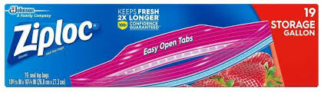

4. Amniotic Sac
Gallon zip lock bags work very well. I double bag them. IF you wish to add some realistic touches (and REALLY gross your students out), you can add jello to the inner bag. The outer bag is then filled with water to simulate an amniotic sac. (If using a cardboard box, you may want to skip the water)

Slide 10
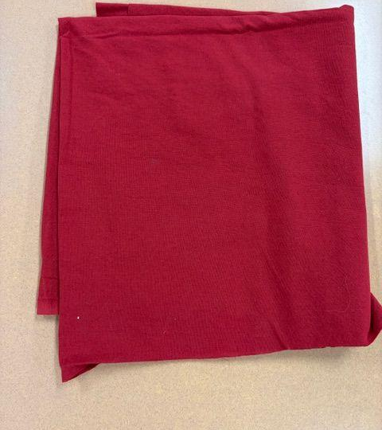
5. Uterine wall
Thick red fabric-cotton. For a more realistic feel, a rubber ball could be deconstructed and used instead.

Slide 11
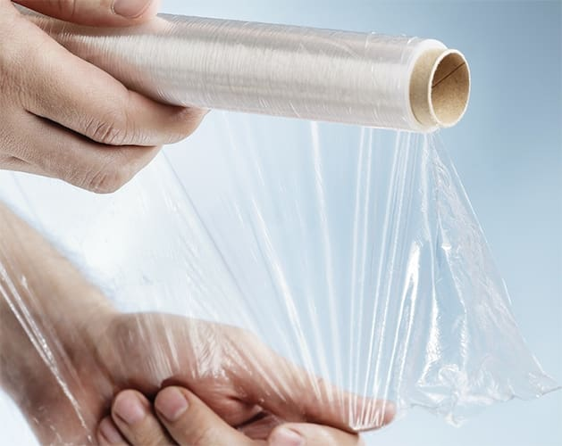
6. Peritoneum
This needs to be something thin and transparent. I use plastic wrap, you could also use a sheet protector in a pinch.

Slide 12
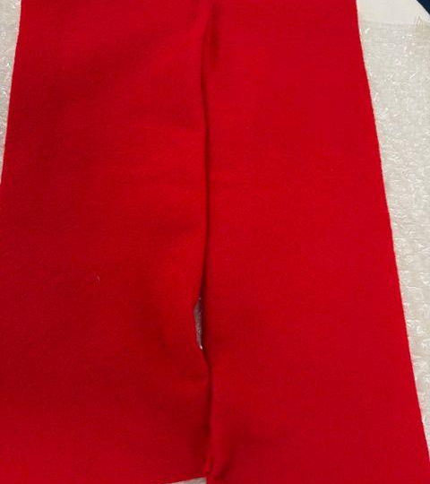
7. Muscle layer
During c-section this layer is not cut. It is separated by pulling the rectus abdominis muscles apart. This layer is created by folding or double layering thick red felt and stapling it together at each end, allowing students the ability to pull it apart.

Slide 13
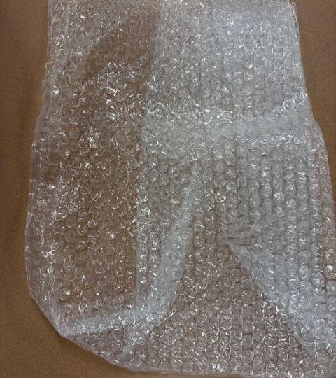
8. Fascia
Bubble wrap!
The texture of bubble wrap is pretty close to actual fascia.

Slide 14
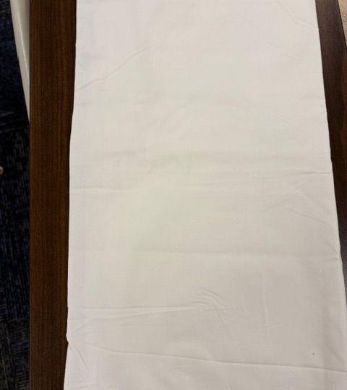
9. Subcutaneous Layer
Thick white fabric-cotton. You could also use a thin foam layer if you have some available. Thicker foam simulates a more overweight patient.

Slide 15
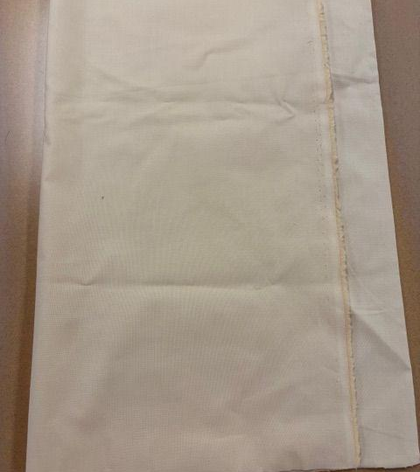
10. Skin
Flesh colored fabric mid-weight cotton

Slide 16
Once everything is layered over the
basin or box, we need to secure it.
Notes:
String or duct tape works well with a basin, duct tape works best if using a box. This keeps your layers in place and tight so that they can be cut into.

Slide 17
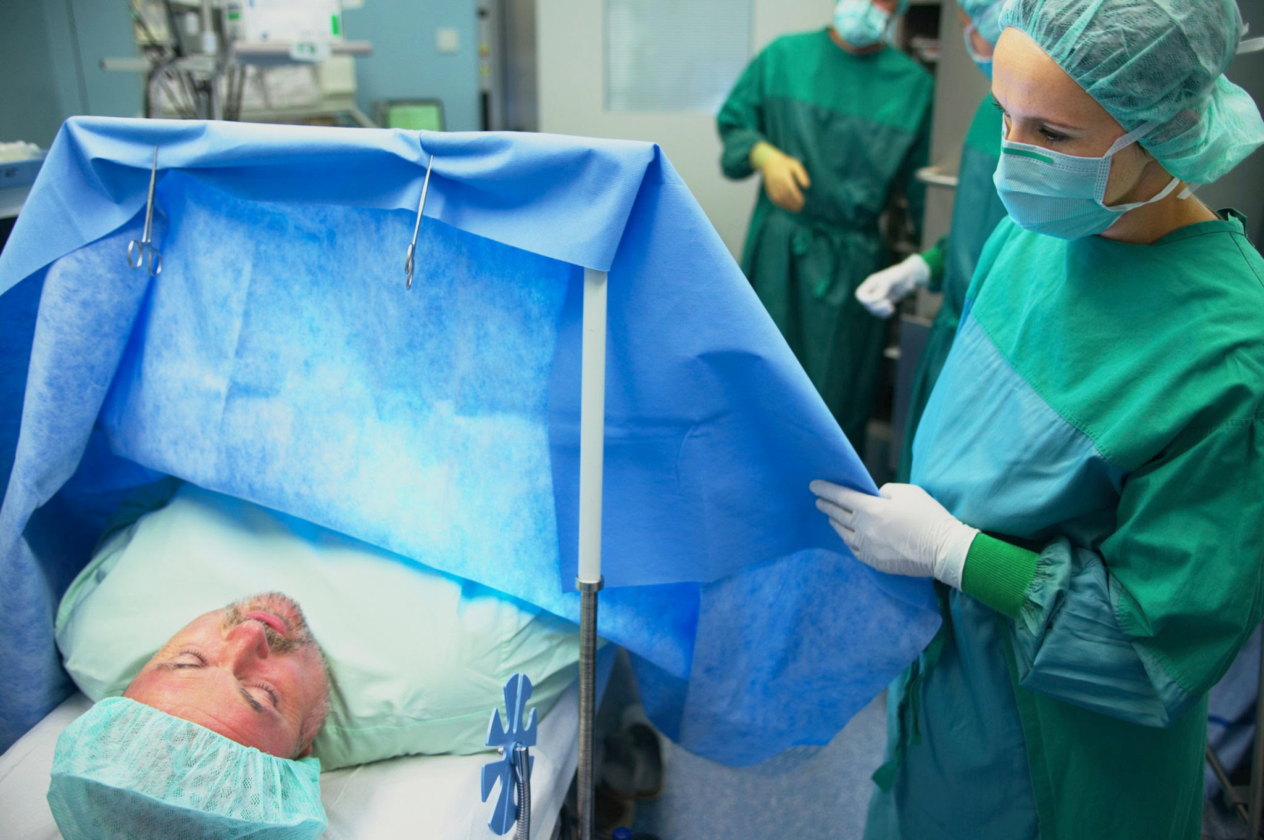
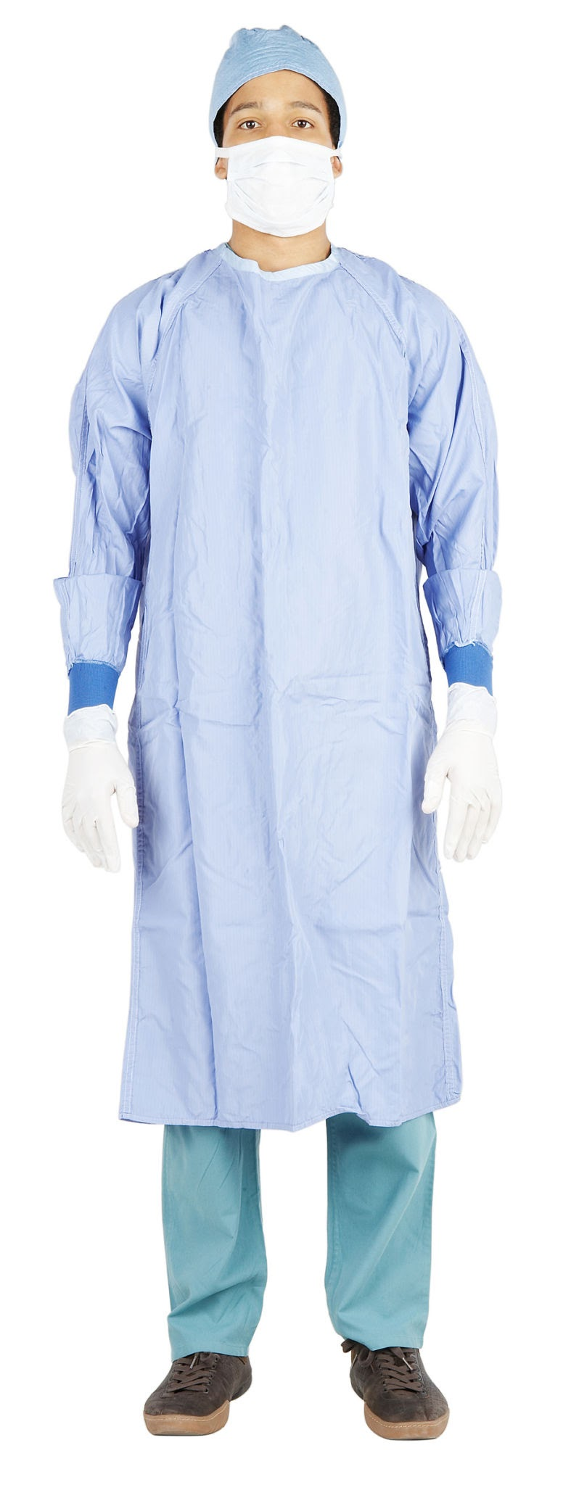
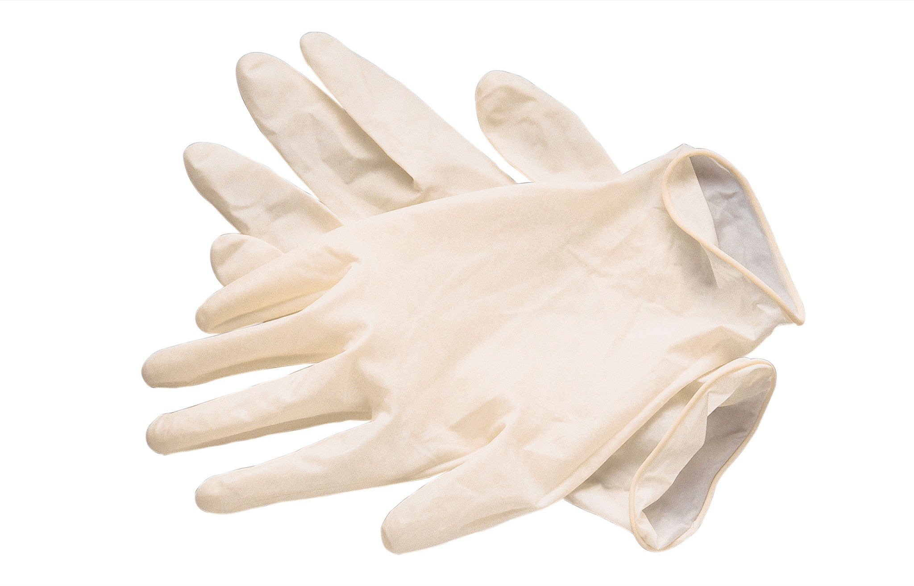
Surgical gowns, drapes
and other
materials
You can use whatever you have available to you. Reaching out to your local hospital is a great way to obtain these items–supplies opened accidentally or that outdate are almost always thrown away!
Notes:
You can get as elaborate as you are able! I fold and reuse all of my gowns and drapes. They don’t look nice, but they do. If you or someone you know is handy with a sewing machine, you could make cloth drapes. Another idea is to use surgical towels (or hand towels) to ‘square off’ your surgical site.

Slide 18
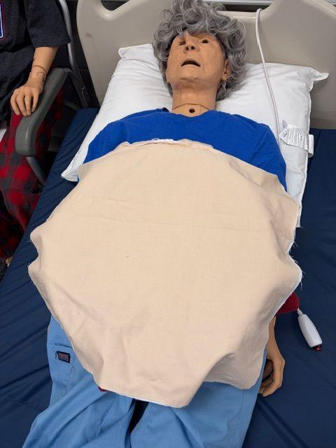
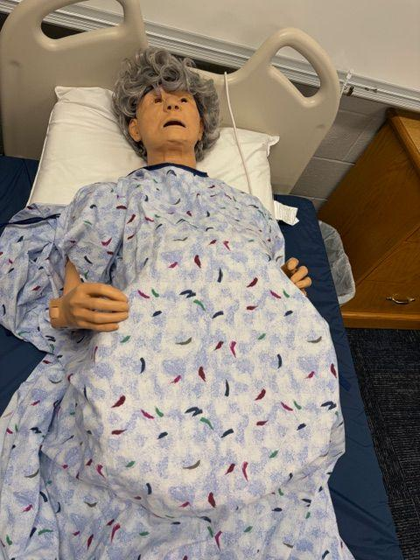
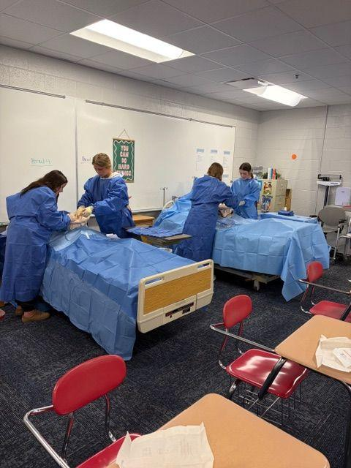
The finished product!
If your students are careful, you can actually use the same fabric twice in a day if needed. Just turn it around and drape out the opposite side of where you made your first incision.
A fabric piece could possibly be used 3-4 times…..

Slide 19
Where
I
purchased:
Fabric, yarn, felt-I purchased all of my fabric at Hobby Lobby
Bubble wrap-https://a.co/d/0dkQXiRG
This one is a bit wider (16” vs. 12”)
Dolls- I have found Walmart to be probably the cheapest option if purchasing new. If you have enough time, keeping an eye out at thrift stores or Goodwill would be a cheap option as well!
Balloons-https://a.co/d/0i97ztxT
(scope out Dollar Tree this time of
year for small beach balls!)
*This a list of where I purchased my items and are only suggestions. The cheaper the better I say-I’m a HUGE fan of Dollar Tree for classroom items and sim supplies!

Slide 20
You will
also need:
Scalpels
https://a.co/d/006mRl8E
String or duct tape
  To secure the layers to the ‘uterus’

Slide 21

Questions?
In the next session, we will gown up, glove up and perform a C-section!
If you would like a copy of this presentation, please scan the QR code above to submit a request. Thank you!

