Slide 1






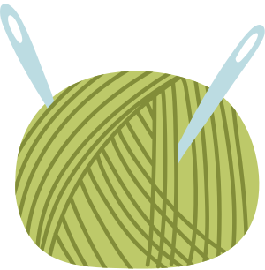

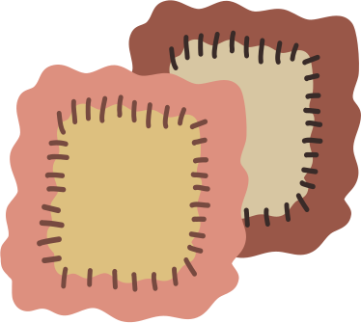


Building Foundational Sewing Skills Through Technique Notebooks
Gathering Sample

Slide 2
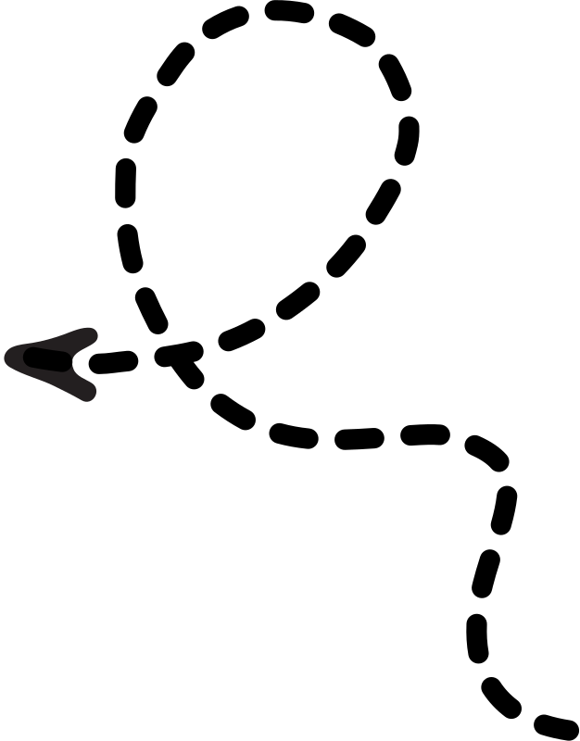
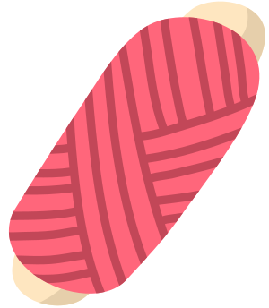

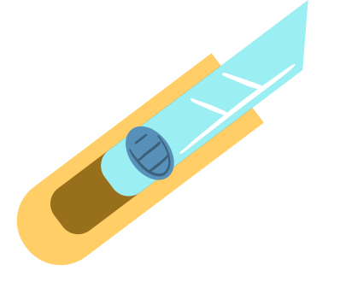
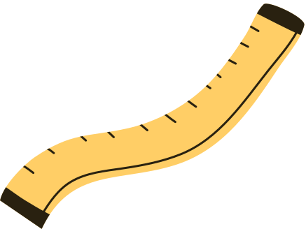
Materials Needed:
  One cotton square of fabric
  Shears/Scissors
  Hand sewing needle
  Thread
  Technique Notebook

Slide 3
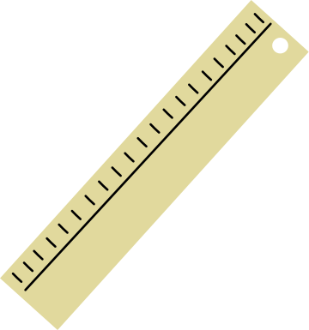
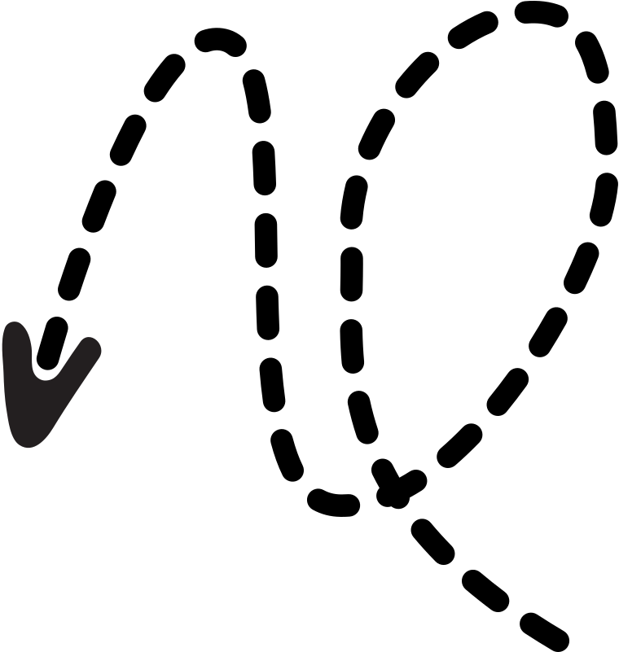
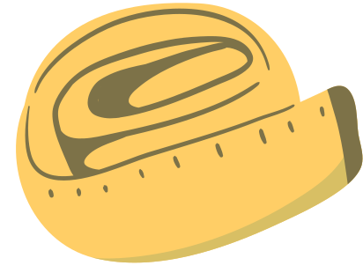
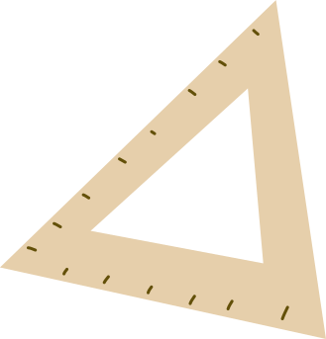
Technique Notebook
The Technique Notebook is a single, organized portfolio that follows students through their entire sewing education. By bringing construction assignments, samples, and lab resources together in one bound volume, students build a lasting record of their skill growth while teachers gain a clear picture of each student's progress. It doubles as a personal reference guide in the lab, fostering independence and confidence at every stage of learning.

Slide 4
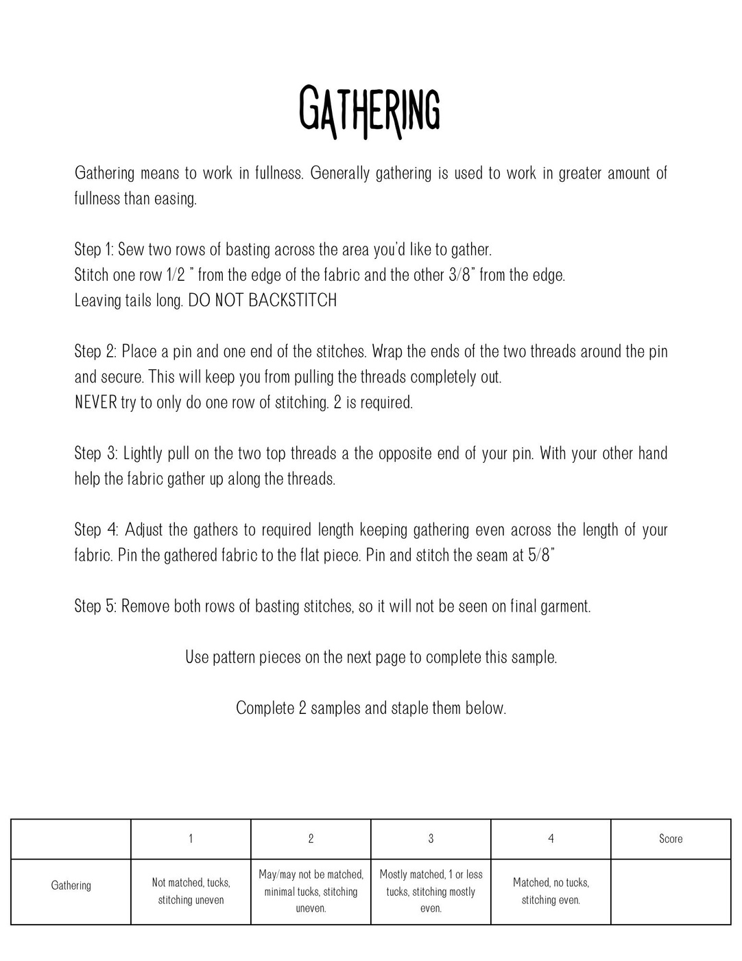


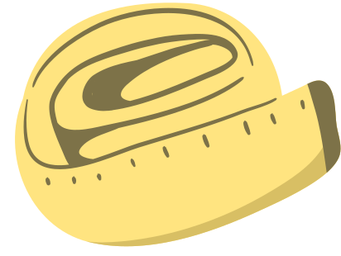
Gathering Worksheet

Slide 5


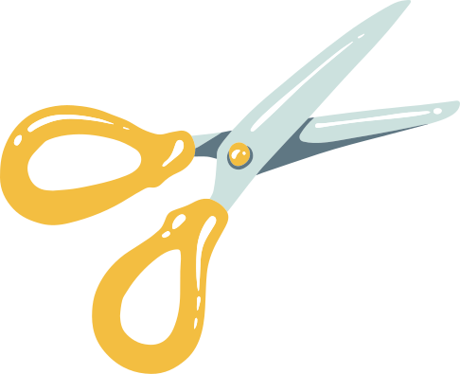

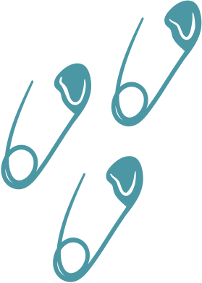
Step 1:
Cut the square in half.
We are doing a Gather.
Gathering in sewing is a technique used to reduce the length of a fabric piece so it can be attached to a shorter piece, creating soft, controlled fullness or ruffles

Slide 6
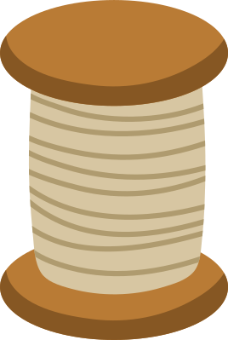

Basting
Basting is a technique of using long, loose, and temporary stitches to hold fabric layers together before final, permanent sewing.
3/8"
&
1/2"

Slide 7



Gather
Place a pin and one end of the stitches. Wrap the ends of the two threads around the pin and secure. This will keep you from pulling the threads completely out.
NEVER try to only do one row of stitching. 2 is required.
Lightly pull on the two top threads a the opposite end of your pin. With your other hand help the fabric gather up along the threads.

Slide 8
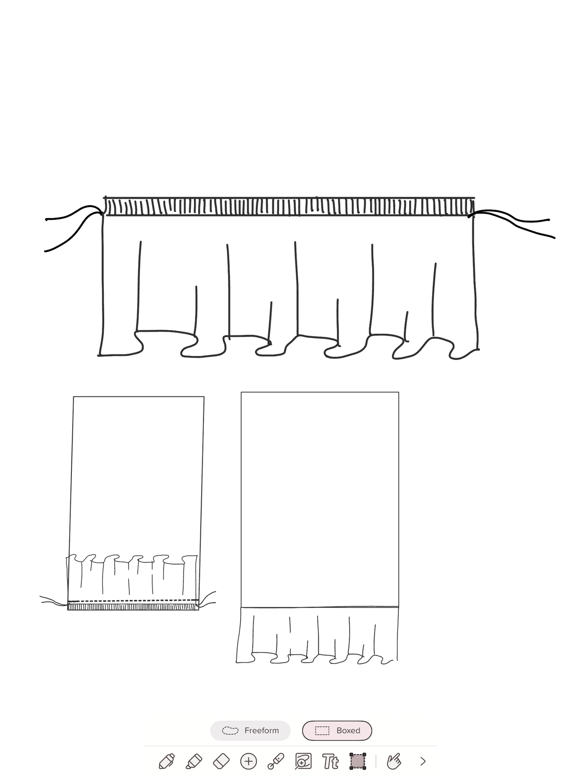
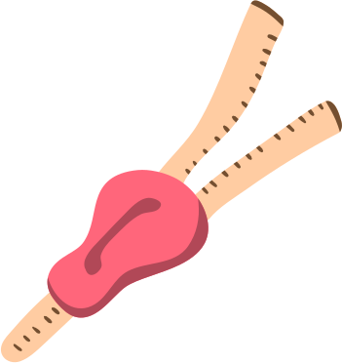

Adjust the Gather
Adjust the gathers to required length keeping gathering even across the length of your fabric.

Slide 9
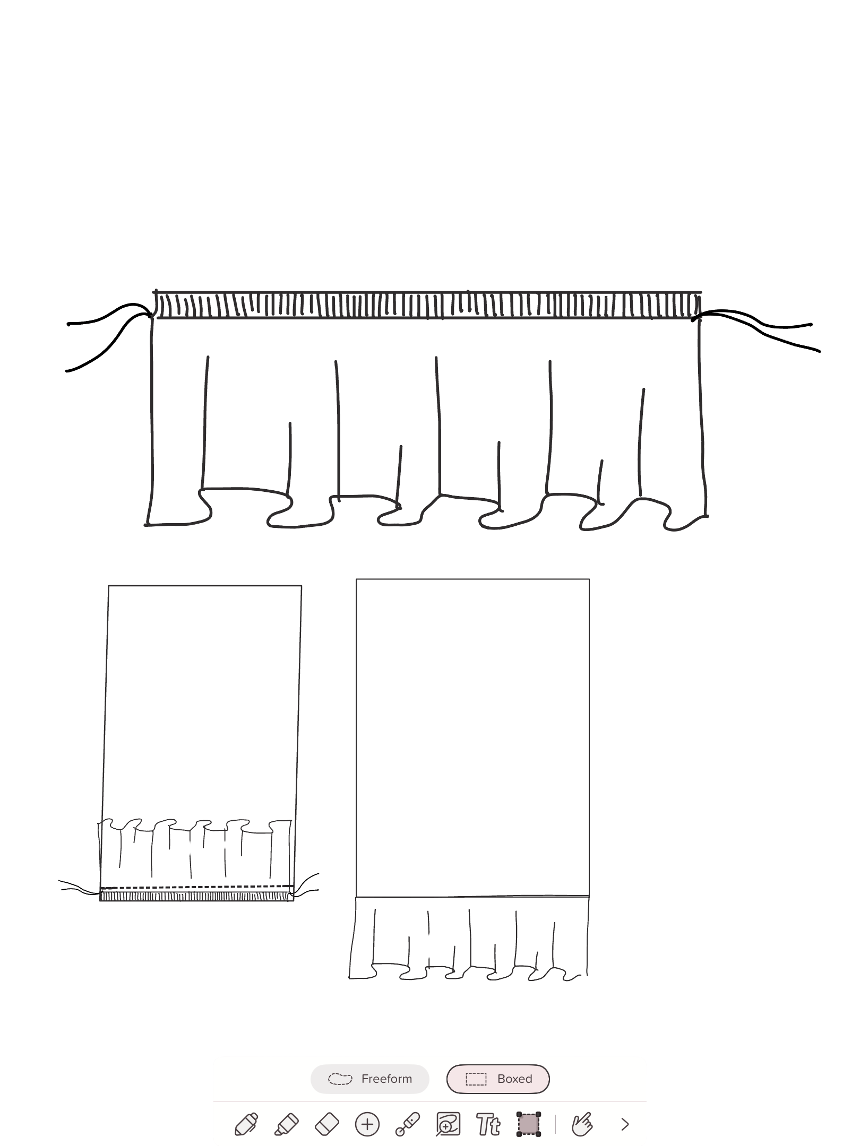
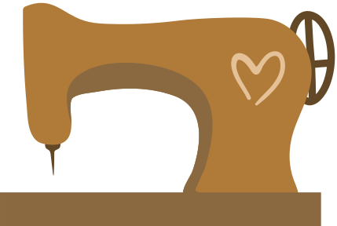

Stitch Gather Down
Pin with right sides together and stitch the seam at 5/8” backstitching the beginning and end

Slide 10
Finishig Touches
Remove both rows of basting stitches, so it will not be seen on final garment. Flip gather down.
Press and staple into your Technique Notebook

Slide 11
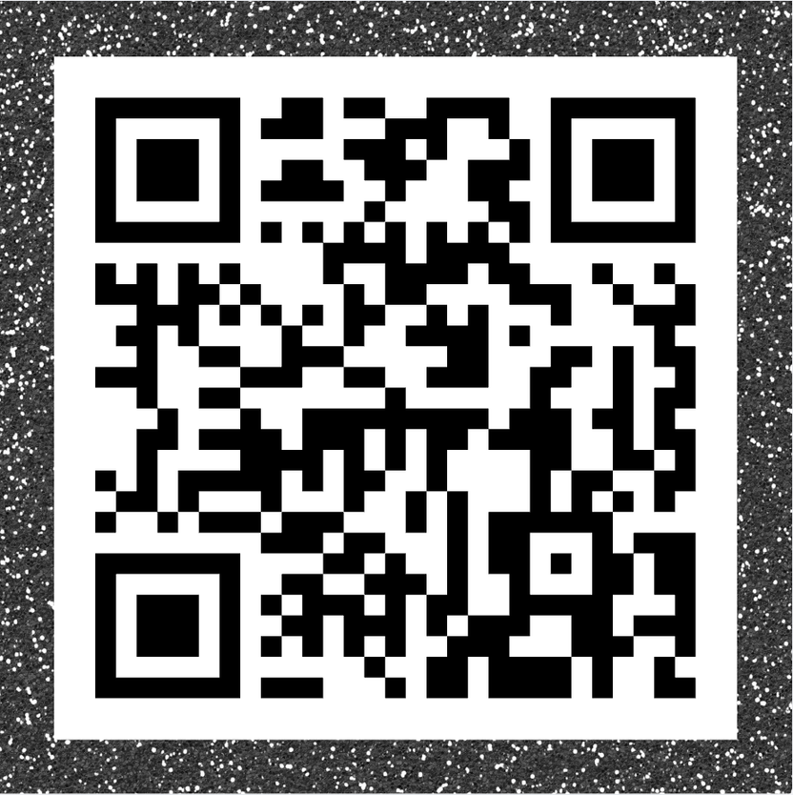



Link to Technique Notebook

