Slide 1
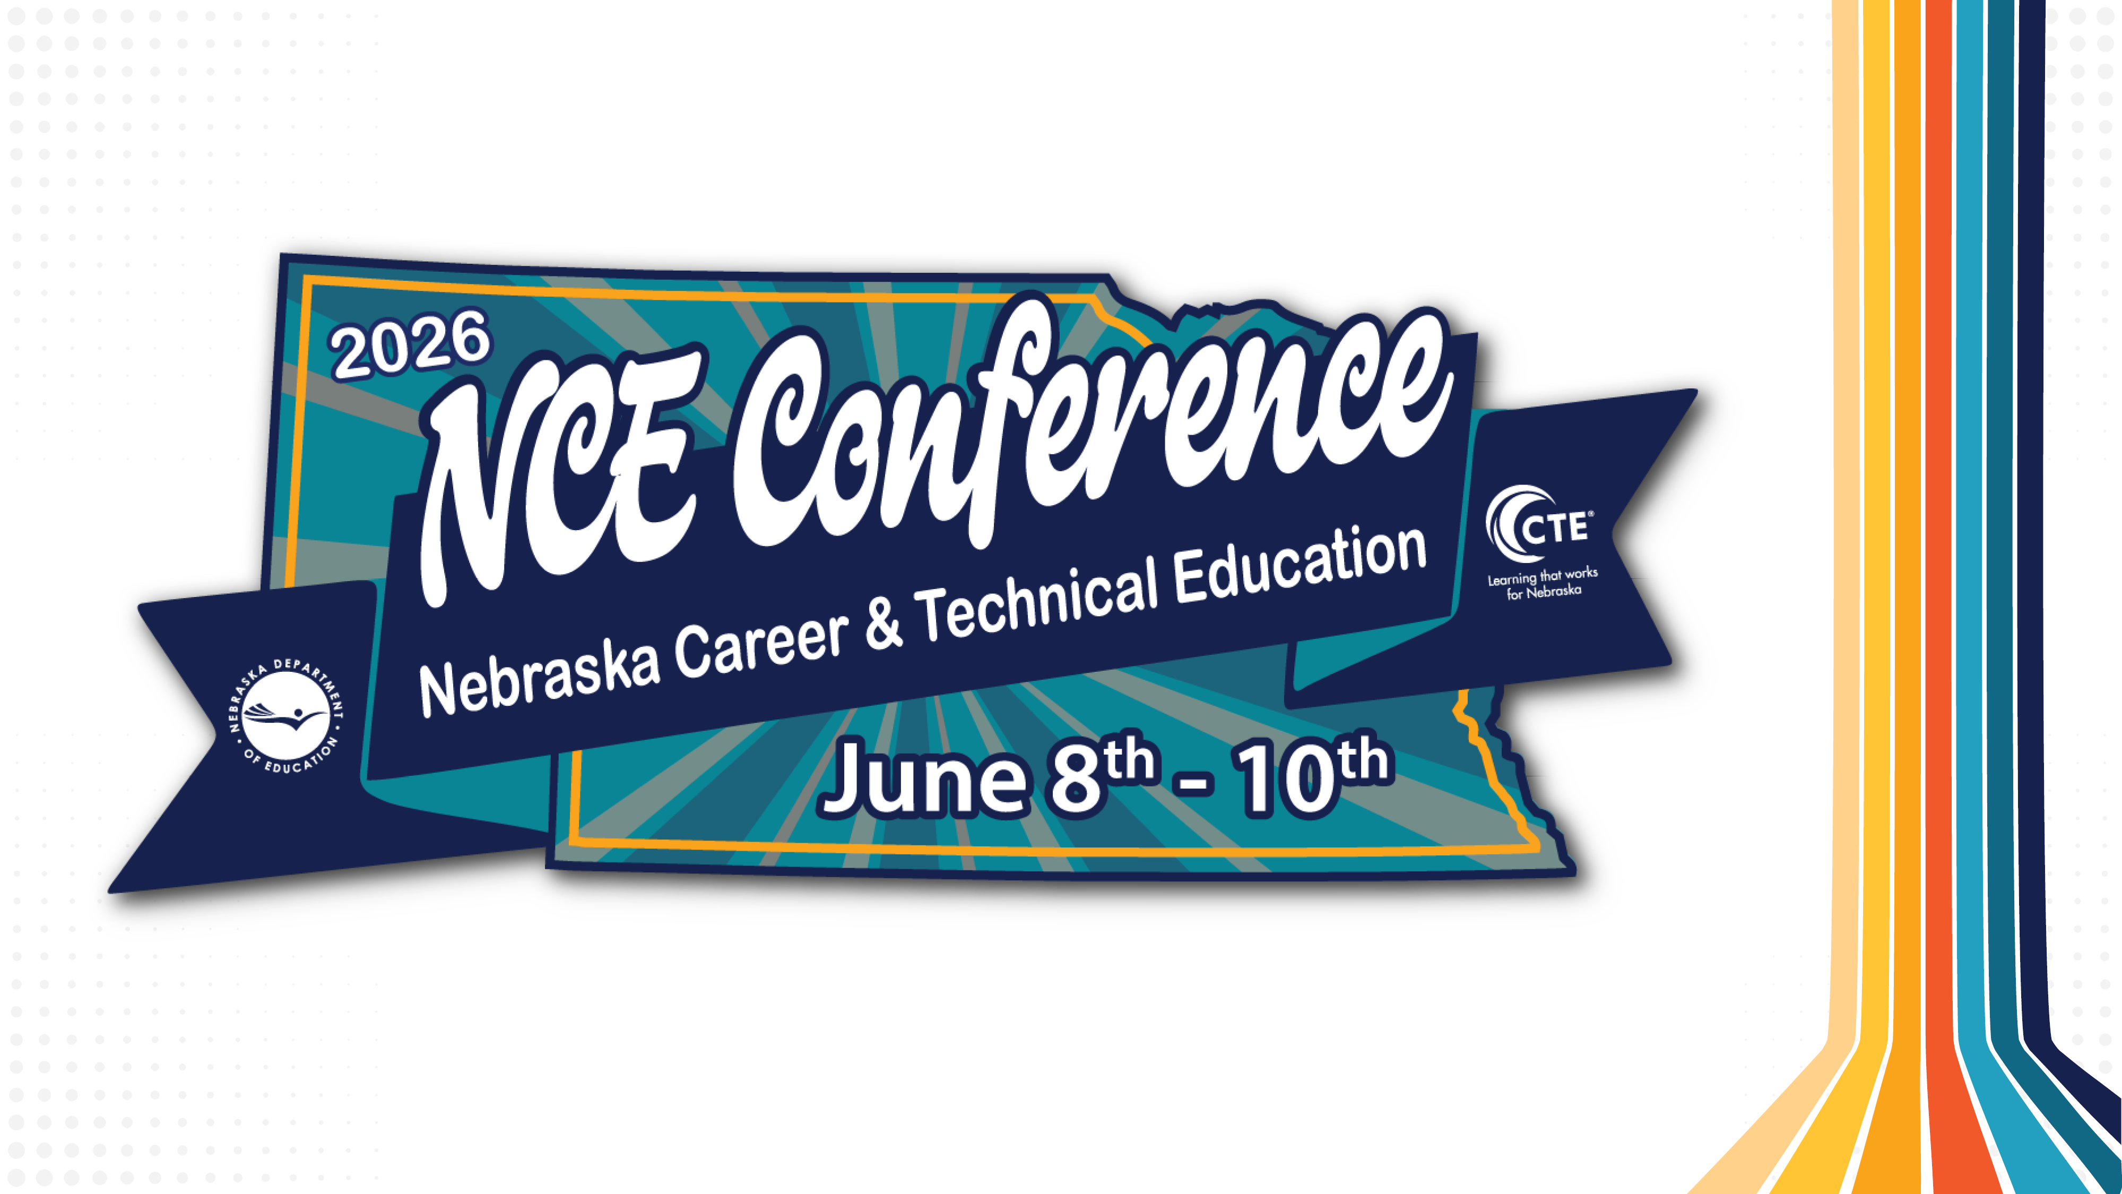
Creating Classroom-Ready Case Studies for Health Science Courses
Welcome!

Slide 2

Background

Slide 3


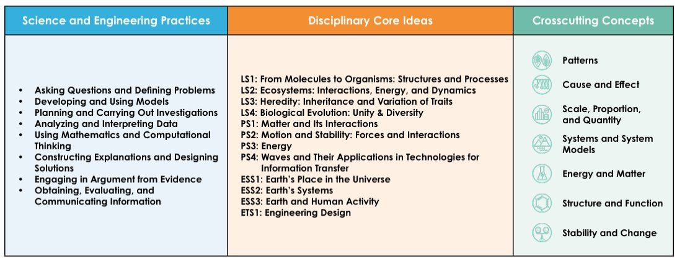
Background
Science, Biology
NGSS & NE College & Career Ready Standards for Science
Phenomena & storyline-driven units in biology & health science courses

Slide 4
Session Objectives
Identify key elements of an effective high school-appropriate health sciences case study
Analyze and refine case studies for use in the classroom.
Collaborate with peers to build a shared bank of adaptable case studies.
Leave with multiple vetted case studies ready for classroom use.

Slide 5
"Case-Based Learning"
The authors of the paper cited propose the definition:
"The goal of Case-Based Learning (CBL) is to prepare students for clinical practice, through the use of authentic clinical cases. It links theory to practice, through the application of knowledge to the cases, using inquiry-based learning methods."
"Teachers enjoy CBL. As well as potentially making better use of teaching time available, more engaged and motivated students make for a more enjoyable teaching experience."
"CBL appears to foster effective learning in small groups, possibly through the effect of having more engaged learners, but perhaps also through having more structured learning activities closely linked to authentic clinical practice scenarios."
Source:
Jill Elizabeth Thistlethwaite, David Davies, Samilia Ekeocha, Jane M. Kidd, Colin MacDougall, Paul Matthews, Judith Purkis & Diane Clay (2012) The effectiveness of casebased learning in health professional education. A BEME systematic review: BEME Guide No. 23, Medical Teacher, 34:6, e421-e444, DOI: 10.3109/0142159X.2012.680939

Slide 6

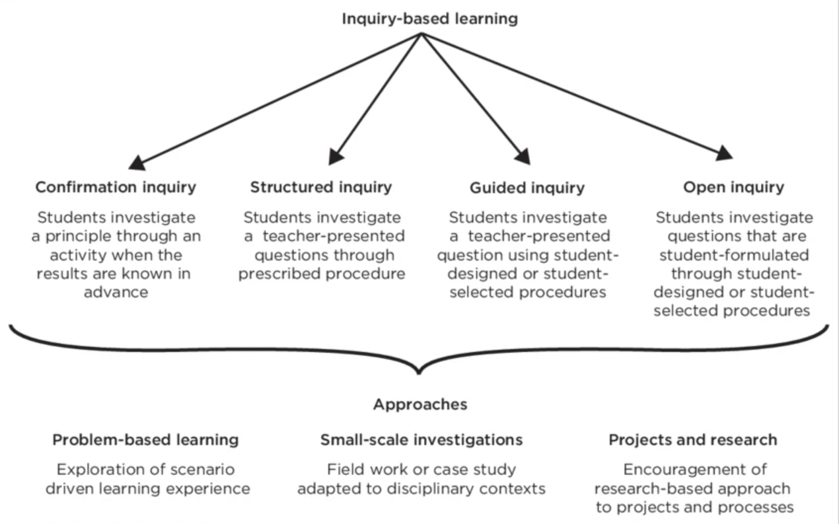
Notes:
Four levels of inquiry-based learning (confirmation, structured, guided and open), defined by Banchi and Bell (2008)
Image source:
Kruger, Donnavan & Werlen, Egon & Bergamin, Per. (2022). Curiosity killed the cat, but satisfaction brought it back: Inquiry-based learning in blended environments to promote self-directed learning. 10.4102/aosis.2022.BK366.02.

Slide 7
More Reading on CBL:
McLean. Case-Based Learning and its Application in Medical and Health-Care Fields: A Review of Worldwide Literature. Journal of Medical Education and Curricular Development 2016:3 39–49.
Wijnia, L., Noordzij, G., Arends, L.R. et al. The Effects of Problem-Based, Project-Based, and Case-Based Learning on Students’ Motivation: a Meta-Analysis. Educ Psychol Rev 36, 29 (2024).

Slide 8

Questions for the group
Introductions & background
How do you currently use case studies in your classroom?​
What are opportunities to utilize an additional case study?

Slide 9
Example 1 from NSTA

Slide 10

Case Studies by NSTA
Collection
  Anatomy
  Physiology
  Public Health
  Nursing
  Sports Science
Cases are freely accessible.
Type "high school" as a keyword to narrow results.
Notes:
NSTA – National Science Teaching Association

Slide 11

"Feeling the Pressure" case study
Objectives:
Define the following terms related to blood pressure: pulse pressure, mean arterial pressure (MAP), cardiac output, flow rate, flow velocity, vessel compliance, resistance, vasodilation, vasoconstriction.
Review the current American Heart Association definitions for hypotension and hypertension.
List the health complications associated with chronic hypertension.
Describe how physiological changes that occur with pregnancy can produce alterations in maternal blood pressure.
Describe proper techniques for assessment of blood pressure.
Define and briefly describe the current understanding of the pathophysiology of preeclampsia.
Explain danger signs or risk factors related to preeclampsia.

Slide 12
"Feeling the Pressure" case study
1. Take 2 minutes to skim through what is included. ​
Part I – Something is Wrong
Part II - What is Blood Pressure?
Part III – Medical Tests
Part IV – The Diagnosis
Part V – Conclusion
2. First impressions?
Level?
​Adaptations needed?
Engaging?
Background knowledge needed?
3. Reflections
Sharing one way to modify and build off this example case study

Slide 13
Adapting the case study
These are my reflections, but there is not one "correct" way to adapt.
Standards alignment
  NE Health Science course standards alignment:
    HS.HS.6.4, HS.HS.7.2, HS.HS.7.4, HS.HS.8.1, HS.HS.8.3
Strengths: Storyline, objectives, identification of high-quality resources, case is broken up into sections
Weaknesses: Reduce amount of the self-directed learning to reduce amount of time online; currently set up for some students to rush through & others to struggle to begin
Beginning or end of a unit?
  My instinct is to put this at the beginning to grab students'
  attention & pique their curiosity, then continue to build over unit

Slide 14
Adapting the case study
Additions:
  CTE for All
    Chunking the content
    Model building
  Integrating career readiness skills
    Academic & technical skills
      Defining the medical terms
      Calling out the healthcare careers
      Bringing in a connection across body systems
  HOSA connections

Slide 15
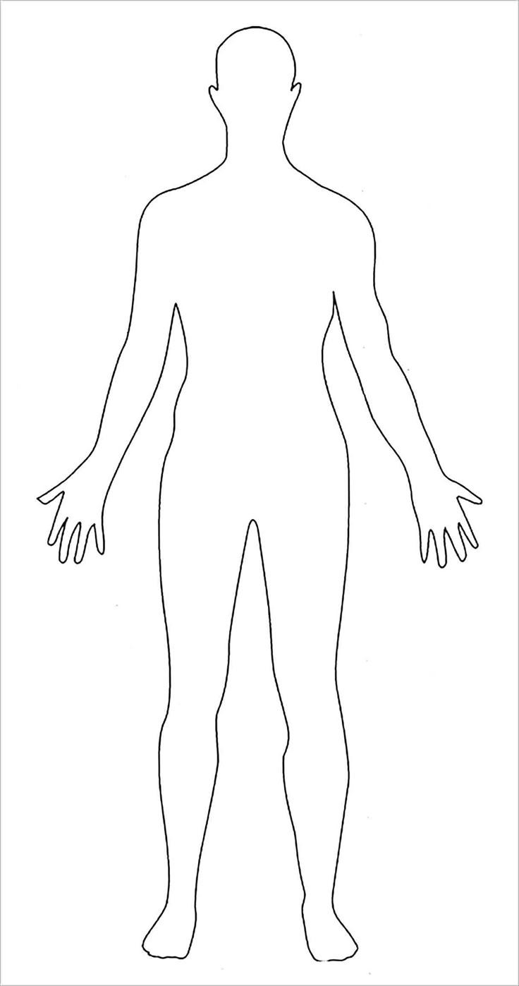
Model-Building
Connections to NGSS Science & Engineering Practices
As students are reading part I, they will:
  Underline any medical terms and include these on the model. Option to add a vocabulary strategy.
  Circle any health careers mentioned
Make a model on butcher paper
Write a list of questions as a class.
Add to model as you learn more, including connections to other organs & body systems

Slide 16
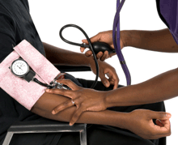
Technical Skills & Terms
Blood Pressure Basics
  An opportunity to learn or practice measuring a vital sign
Introducing the definition of blood pressure & associated terms (pg. 2).
  Lecture or following instructions as written
Notes:
Image: US DHHS, National Institute of Health

Slide 17
Inquiry
What are the factors affecting blood pressure?
  Blood vessel diameter
  Heart rate
  Blood volume
  Blood viscosity
Model:
  Balloon
  Straw
Slowing down to build understanding/chunking the content

Slide 18
Career Readiness Skills
"Communicates effectively and appropriately"
  Option to add role-play of patient-centered care or measuring, communicating, and recording blood pressure of "patient"
"Applies appropriate academic and technical skills"
  Using medical terminology
  Measuring blood pressure
  Gathering and analyzing data
Resource: Nebraska Career Readiness Standards

Slide 19
HOSA Alignment – extend learning
Medical Terminology
Anatomy & Physiology
Nursing Assisting (Skill VII: Measure & Record Vital Signs)
Resource: HOSA Competitive Event Guidelines

Slide 20
Input from the group
How would you adapt this case study for a course that you teach?

Slide 21
Building or Modifying a Case Study

Slide 22
Your turn!
In groups of 2, pick one of the following:
  Select a case study already written in the NSTA case studies collection (hint: use "high school" or "middle school" as a key term)
  A group member who already uses a case study accesses it using their laptop
  Five minutes for this step.

Slide 23
Preparing the case study
Using the case study selected, your group will either:
  Modify the case study to how YOU would use it in the classroom in an existing unit, or
  Reflect on how you have used the case study and modify it to extend learning opportunities
  Be ready to share your ideas and work with the group in ___ minutes. I have a case study lesson template if you want to write down an original case study.

Slide 24
Sharing with the group
Group 1:
Group 2:
Group 3: ​

Slide 25
That's a wrap!
Questions or need to be added to the Health Sciences listserv?
  Email Jami Denny at jamelyn.denny@nebraska.gov
I will post this to SCHED with our notes.
More resources:
  Strategies for special populations success
  Careers in Healthcare book

Slide 26


