Slide 1

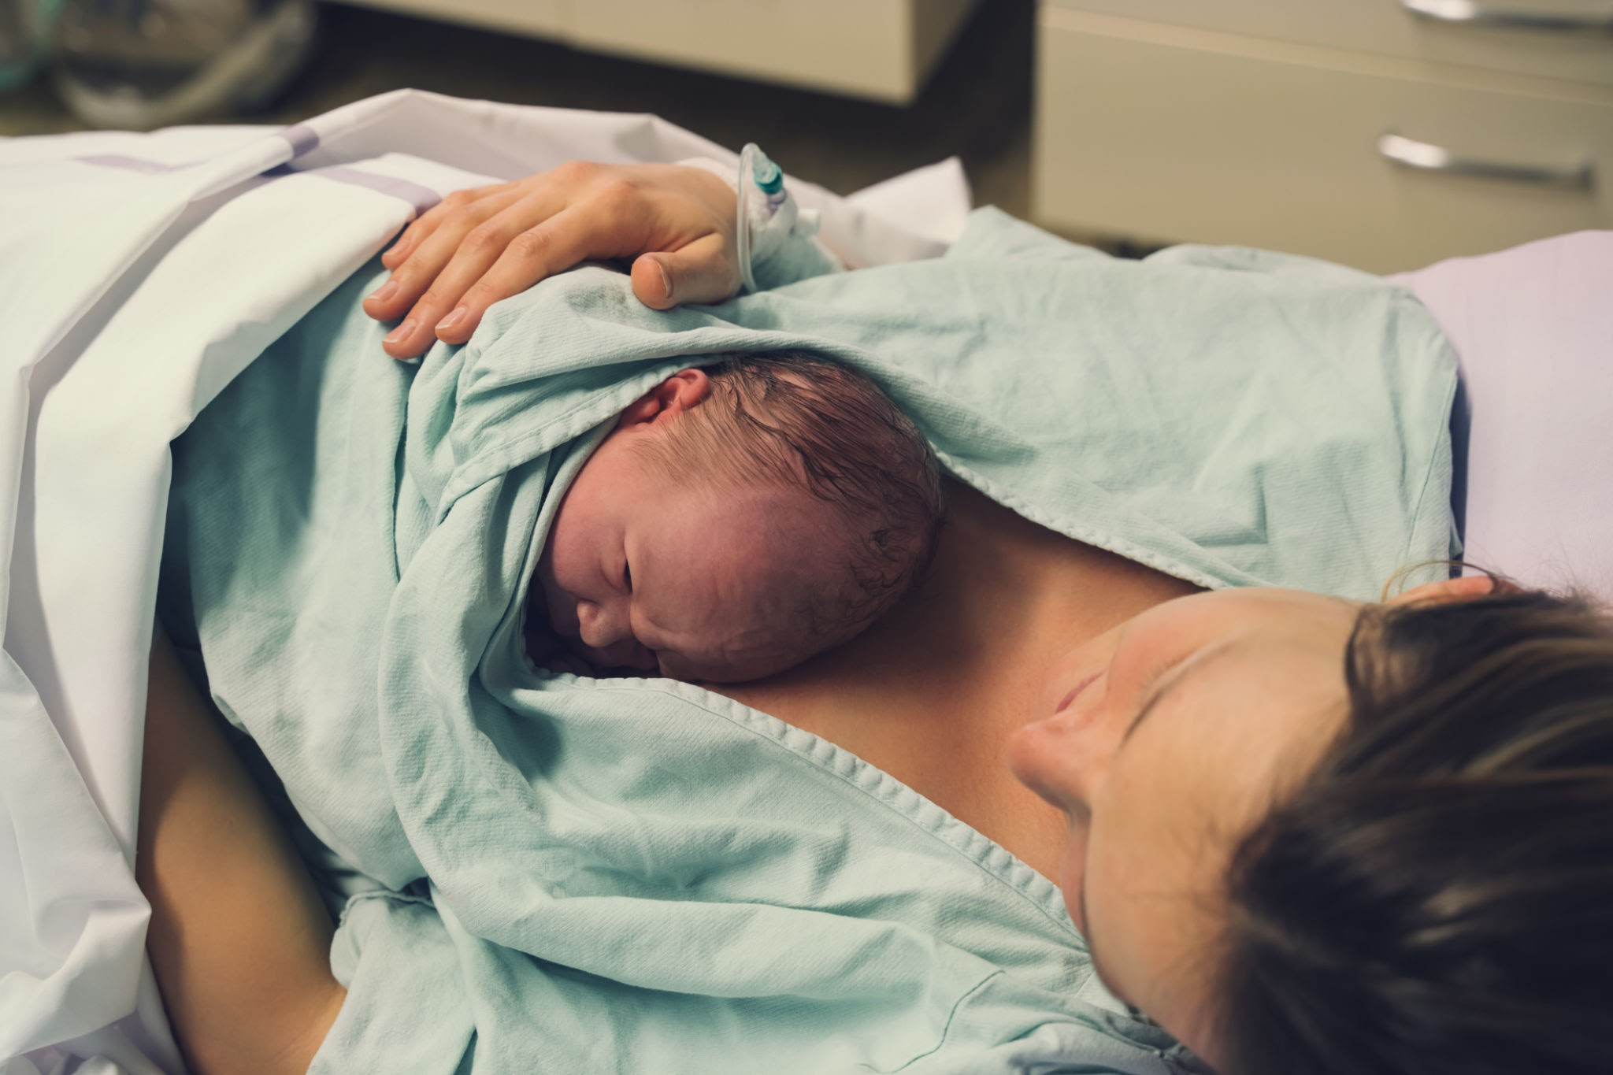
Cesarean Section Simulation Part 2:
The Simulation
2026 Nebraska CTE Conference
Tracy Long RN, BSN
Healthcare Pathways Educator
Lakeview High School
Columbus, NE

Slide 2
Why simulation?
Where can this fit in my curriculum?
There are several ways this sim can be utilized to enhance your curriculum. Focus could include:
Surgical
  Sterile technique
  Job roles of surgical technicians/OR nurse
Women’s Health
  Job roles of OB-GYN physicians, OB nurses
Child development
Encourages active learning
Introduces students to simulation learning used in professional education programs
Teamwork and communication focused
Helps to develop prioritization skills
students to think critically
Promotes critical thinking
Notes:
I do my sim after a visit from Rick Horne, ST instructor at SCC. We focused primarily on the surgical aspect of the c-section-gowning, gloving, draping, etc.

Slide 3
“I am so impressed that at the HS level these students are learning critical thinking! This makes me so excited to have your students some day as critical thinking is the biggest struggle I am seeing with my students.”
—-Bethany Gifford RN, MSN
Nursing Instructor
Central Community College, Columbus Campus

Slide 4

Student Roles:
Primary Nurse
    OB nurse
    Circulator
Provider/OB
Surgical Tech
Family Support Person
Newborn Nurse(s)
Notes:
This will depend on how many students you have and how involved you want them to be.

Slide 5
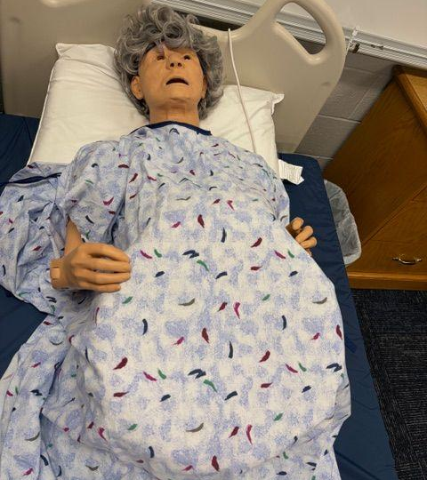
The Patient:
Patient Profile
Name: Sarah Mitchell
Age: 27
Pregnancy Status: G1P0
Gestation: 39 weeks
Current Situation
In labor for 14 hours
Increasing pain and exhaustion
Baby showing signs of distress

Slide 6

Maternal Vital Signs
BP: 146/92
HR: 118
RR: 24
Temp: 99.8°F
O2 Sat: 96%
Fetal Monitor Findings
Fetal heart rate drops into 80s
Late decelerations
Minimal variability
History:
Healthy pregnancy overall
No known allergies
Epidural placed 4 hours ago
Membranes ruptured 10 hours ago
Cervix stalled at 8 cm for 3 hours
Notes:
If doing as part of a MCH unit, you would focus on and discuss the fetal findings. Ask: Is 80 low for FHR? What do late decels mean? Minimal variability? What happens when the cervix stalls?

Slide 7

Critical Thinking Opportunity!
“What concerns you most right now?”
“Would you continue monitoring or notify the provider immediately?”
Notes:
You will get varied answers. The focus is not on being correct, but on thinking things through. Depending on what unit you are attaching this to, they may have more context to develop answers. For example, if they’ve been learning about MCH they may recognize the decelerations and stalled cervix

Slide 8
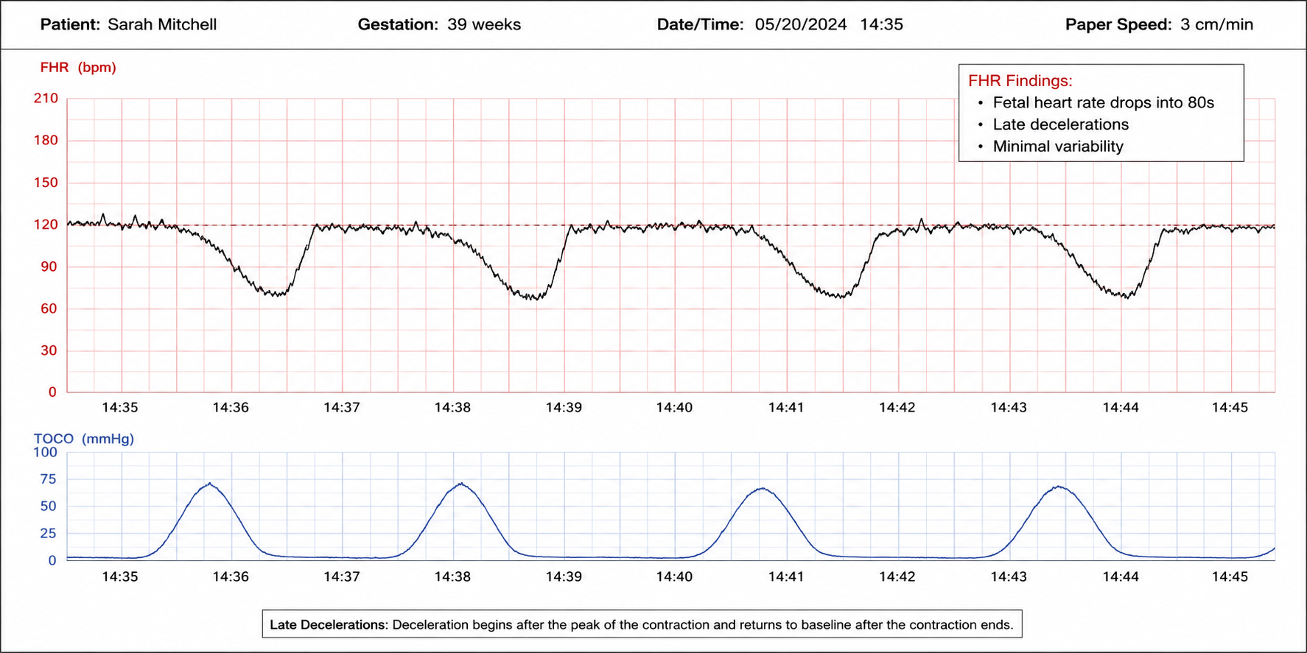
Deceleration

Slide 9
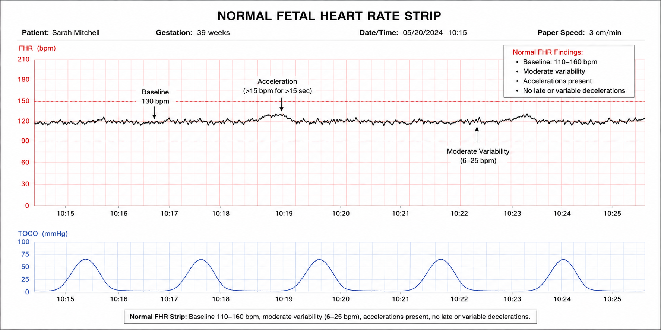

Slide 10
You choose to notify the provider. They arrive, assess the patient and monitor strips, then write the following order:
Doctor’s order reads:
Prepare patient for Cesarean Section
Notes:
At this point, if you’re using IV simulator you can start an IV, place a foley catheter in the manikin, etc. If not, simulators can be placed on a table or student desk and draped (if using).

Slide 11
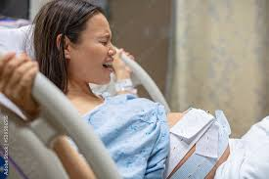
Communication Challenge >>>>
Your patient says:
“Please, is my baby going to be okay? Somebody tell me what’s wrong!”
How do you respond?
Notes:
This allows students to practice their therapeutic communication skills. You may want to do some role playing at this point if time permits.

Slide 12
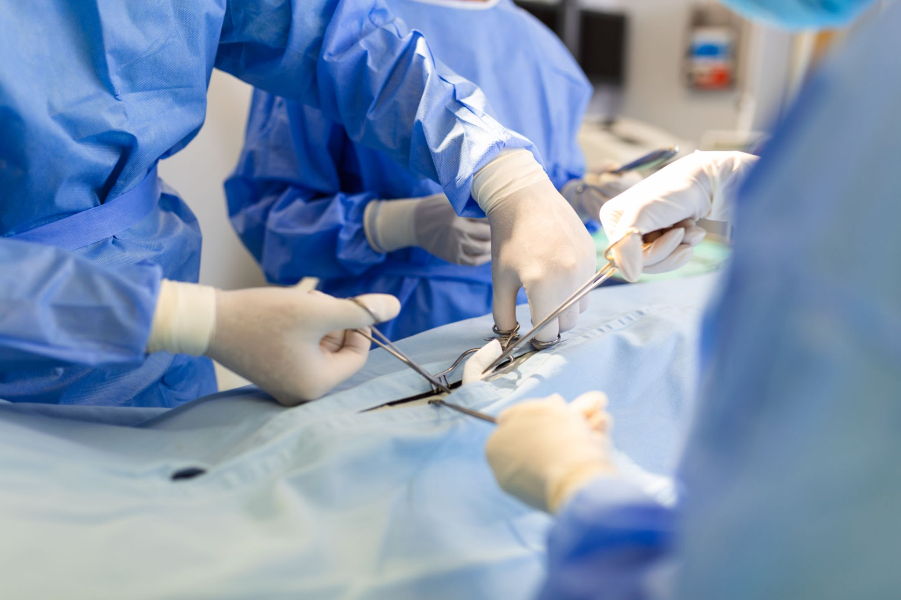
Let’s Begin!
Notes:
At this point, we will stop slides to do the c-section on the simulator that we made during part 1

Slide 13
Debriefing Questions:
How did the healthcare team communicate before the c-section? During?
How was emotional support provided?
What went well during the simulation?
What could be improved?
Notes:
After performing the c-section, we will debrief

Slide 14
FINAL THOUGHTS FOR FACILITATORS (that’s you!)
Allow productive struggle
Pause for teaching moments
Encourage teamwork
Redirect instead of immediately correcting
Allow productive struggle
Pause for teaching moments
Encourage teamwork
Redirect instead of immediately correcting

Slide 15

To request a copy of this presentation, please scan the QR code and fill out the Google form

