Slide 1
Electropneumatic
Basic Level

Slide 2
Control Systems
Both pneumatic and electropneumatic controllers have a pneumatic power section. The signal control section varies according to type.

Slide 3
Pneumatic Control
In a pneumatic control pneumatic components are used, that is , various types of valves, sequences, air barriers, etc.

Slide 4
Electro-Pneumatic Control
In and electro-pneumatic control the signal control section is made up of an electrical components, for example with electrical input buttons, proximity switches, relays, or a programmable logic controller.

Slide 5
1
The directional control valve form the interface between the signal control section and the pneumatic power section in both types of controller.

Slide 6
2
In contrast to a purely pneumatic control system, electropneumatic controllers are not known in any single overall circuit diagram, but in two separate circuit diagrams.

Slide 7
Electropneumatic
Components
Switches,
Coils
Relays
Sensors
Directional Control Valves

Slide 8
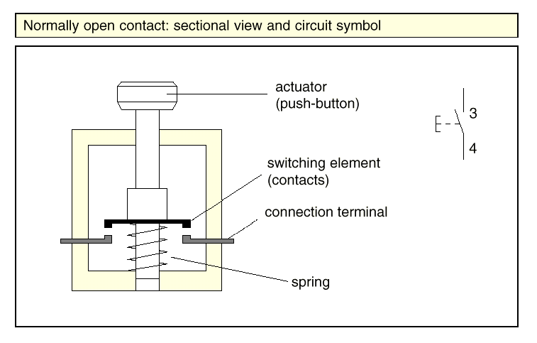
Normally open switch

Slide 9
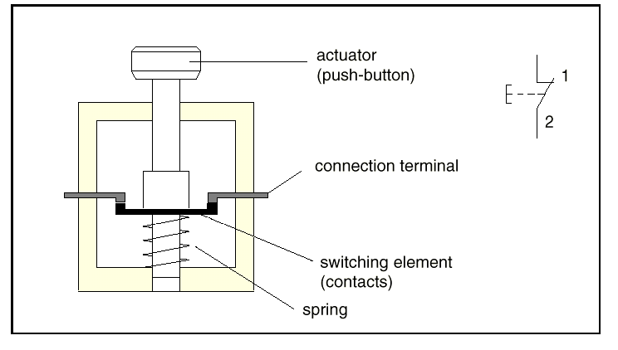
Normally closed switch

Slide 10
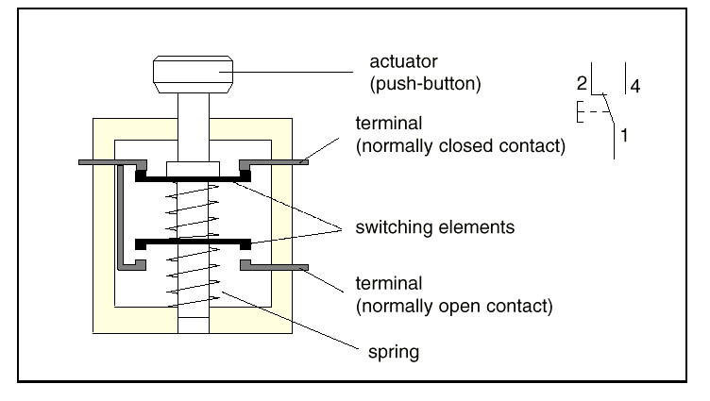
Changeover switch

Slide 11
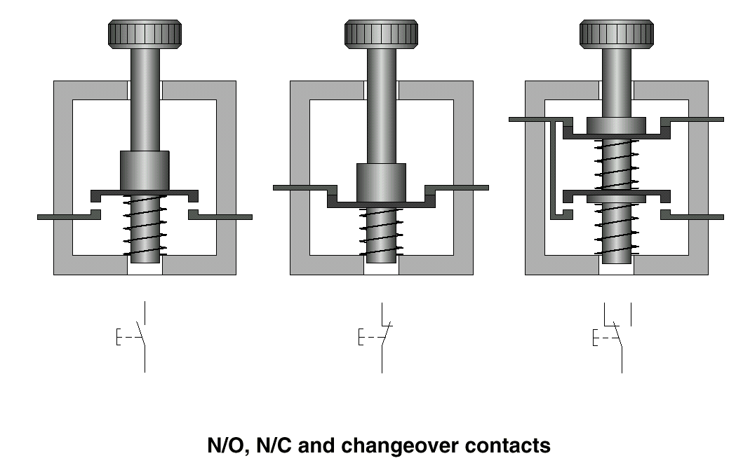
Switches

Slide 12
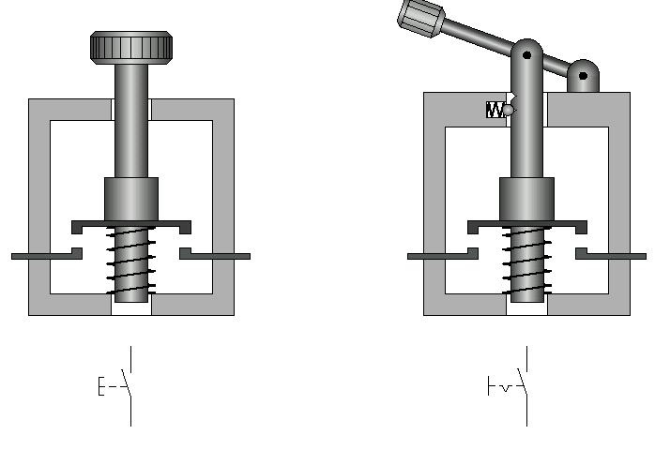
Momentary and sustained switches

Slide 13
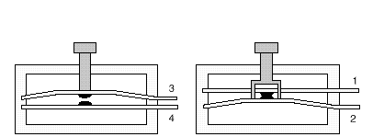


Switches 1

Slide 14
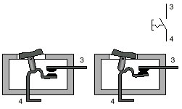
Sustained normally open switch

Slide 15
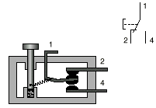
Changeover switch 1

Slide 16
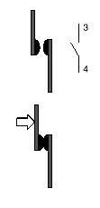
Normally open contact

Slide 17
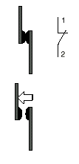
Normally closed contact

Slide 18
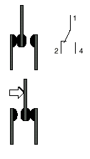
Changeover contact

Slide 19
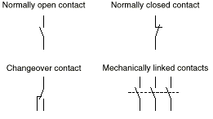
Contacts

Slide 20
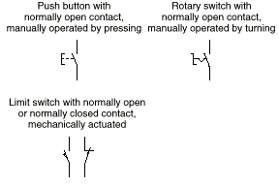
Switches 2

Slide 21
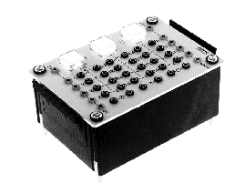
Typical push button switches

Slide 22

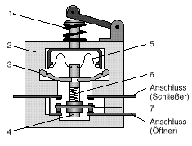
Mechanical limit switch
1: Reset spring
2: Housing
3: Swing lever
4: Guide pin
5: Leaf spring
6: Contact spring
Normally open contact
Normally close contact

Slide 23
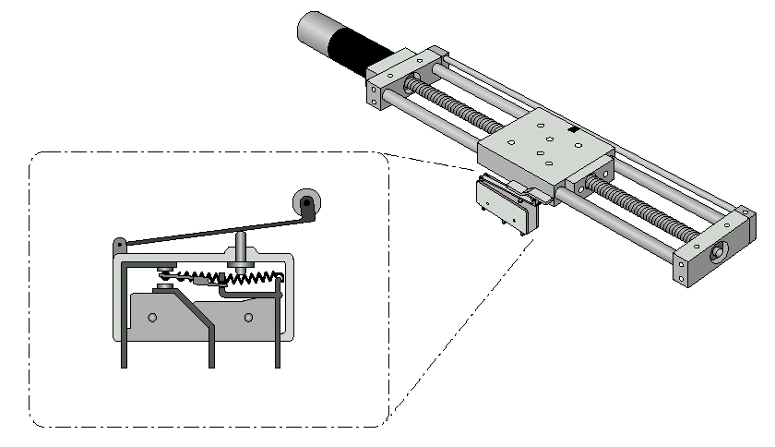
Mechanical limit switch 1

Slide 24
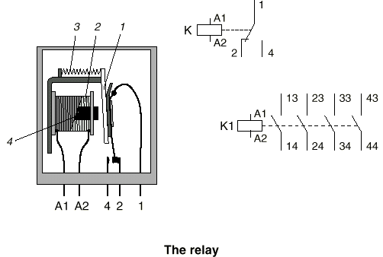
Relays

Slide 25
Relays 1
A Relay has Certain Characteristics
Low Maintenance
Able to Switch a Number of Independent Circuit Paths
Easily Adaptable to Various Operating Voltages
High Operating Speed, ie. Short Switching Times
Can be Used as a Logic or Interlocking Device

Slide 26
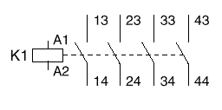
Relay Contact Configuration

Slide 27
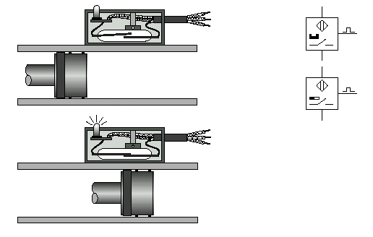
Reed Switches

Slide 28
Reed Switches 1

Slide 29
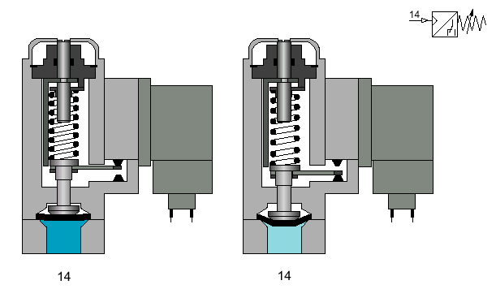
Pressure Switches

Slide 30
Inductive Sensors

Slide 31
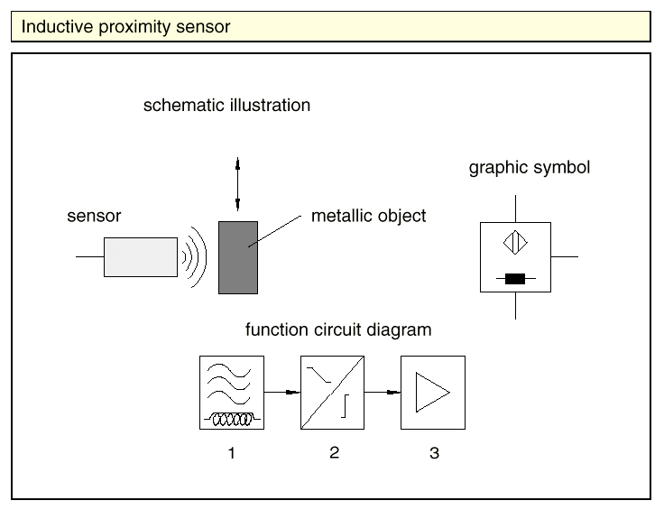
Inductive Sensors 1

Slide 32
Inductive Sensors 2

Slide 33
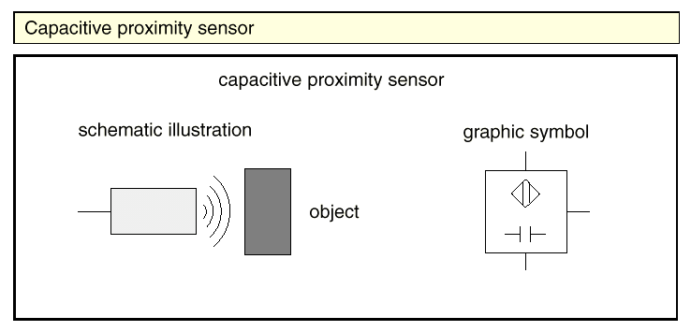
Capacitive Sensors

Slide 34
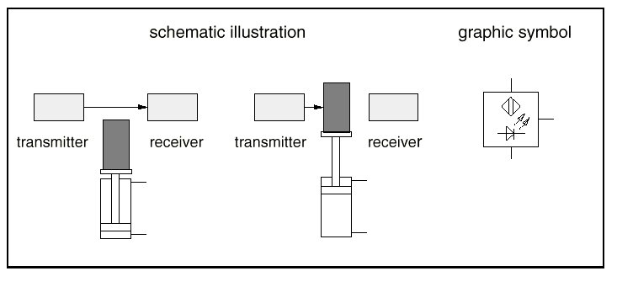
Through Beam Sensors

Slide 35
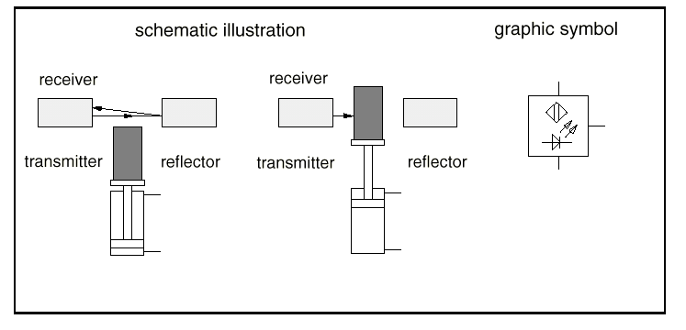
Retro-Reflective Sensors

Slide 36
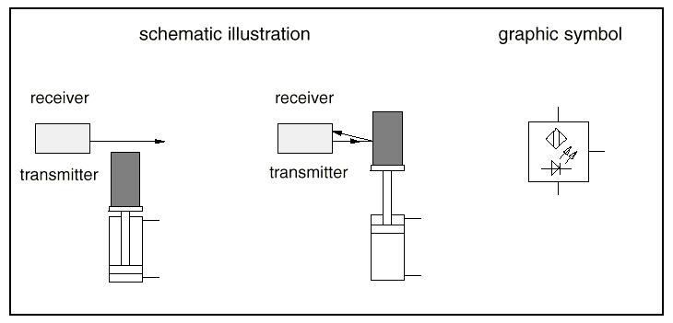
Diffuse Sensors

Slide 37
Directional control valves

Slide 38
Design principles
The design of control valves are categorized as
Poppet valves
  Ball seat valves
  Disc seat valves
Slide valves
  Longitudinal slide valve
  Longitudinal flat slide valve

Slide 39
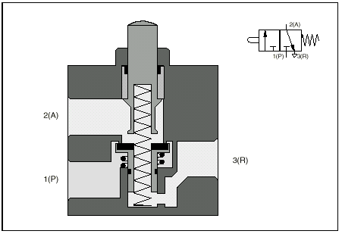
Poppet valves

Slide 40
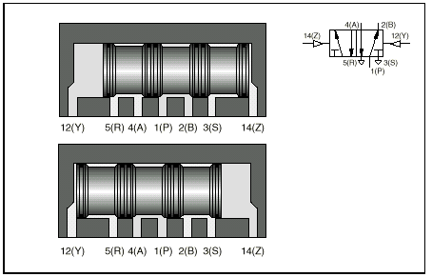
Slide valves

Slide 41
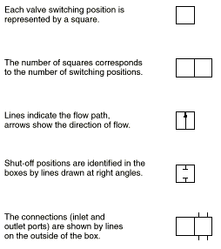
Symbol development

Slide 42
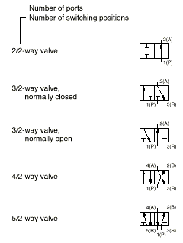
Ports and Positions

Slide 43
Solenoid valves
The directional control valves used in electropneumatics are similar to those used in pure pneumatics. The only difference is that they are actuated by solenoids.

Slide 44
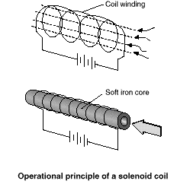
Solenoids

Slide 45
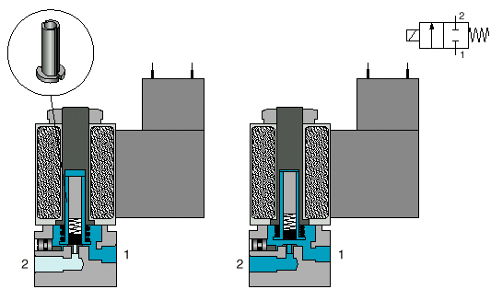
2/2-way single solenoid valve

Slide 46
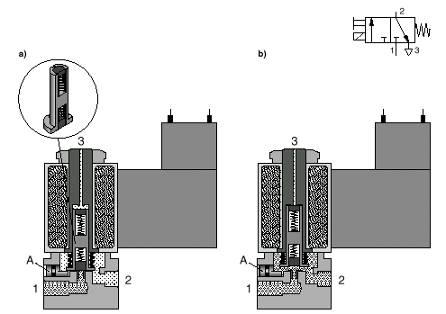
3/2-way single solenoid valve

Slide 47
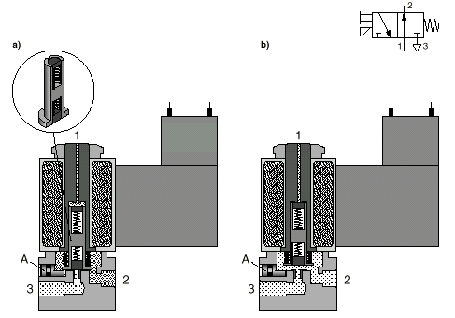
3/2-way single solenoid valve 1

Slide 48
Pilot signal flow
ELECTRICAL SIGNAL
APPLIED TO
SOLENOID
SOLENOID ACTUATES
PILOT VALVE
PILOT ACTUATES
MAIN VALVE

Slide 49
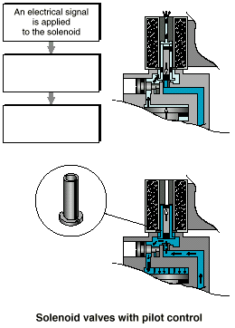
Pilot control

Slide 50
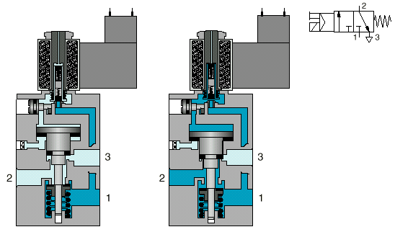
3/2-way single solenoid valve with pilot control

Slide 51
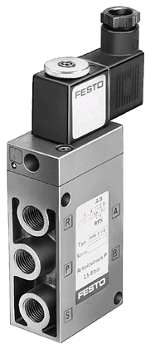
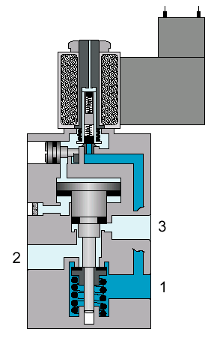
3/2-way single solenoid valve with pilot control 1

Slide 52
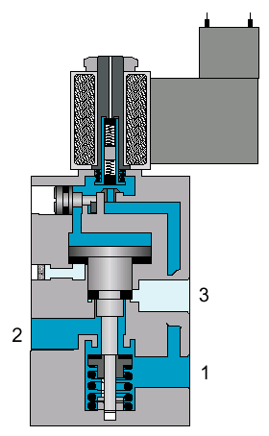
3/2-way single solenoid valve with pilot control 2

Slide 53
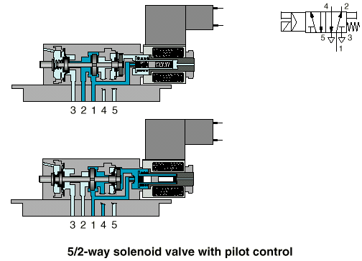
5/2-way single solenoid valve with pilot control

Slide 54
5/2-way single solenoid valve with pilot control 1
5
(A)
4
(S)
1
(P)
2
(B)
3
(R)

Slide 55
5/2-way single solenoid valve with pilot control 2
5
(A)
4
(S)
1
(P)
2
(B)
3
(R)

Slide 56
5/2-way single solenoid valve with pilot control 3
5
(A)
4
(S)
1
(P)
2
(B)
3
(R)

Slide 57
5/2-way single solenoid valve with pilot control 4
5
(A)
4
(S)
1
(P)
2
(B)
3
(R)

Slide 58
5/2-way single solenoid valve with pilot control 5
5
(A)
4
(S)
1
(P)
2
(B)
3
(R)

Slide 59
5/2-way single solenoid valve with pilot control 6
5
(A)
4
(S)
1
(P)
2
(B)
3
(R)

Slide 60
5/2-way single solenoid valve with pilot control 7
5
(A)
4
(S)
1
(P)
2
(B)
3
(R)

Slide 61
5/2-way single solenoid valve with pilot control 8
5
(A)
4
(S)
1
(P)
2
(B)
3
(R)

Slide 62
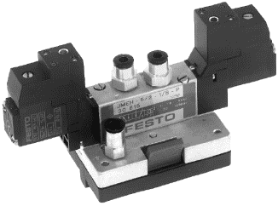
5/2-way single solenoid valve with pilot control 9
5
(A)
4
(S)
1
(P)
2
(B)
3
(R)

Slide 63
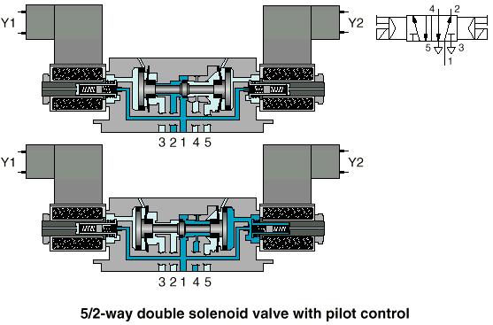
5/2-way double solenoid valve with pilot control

Slide 64
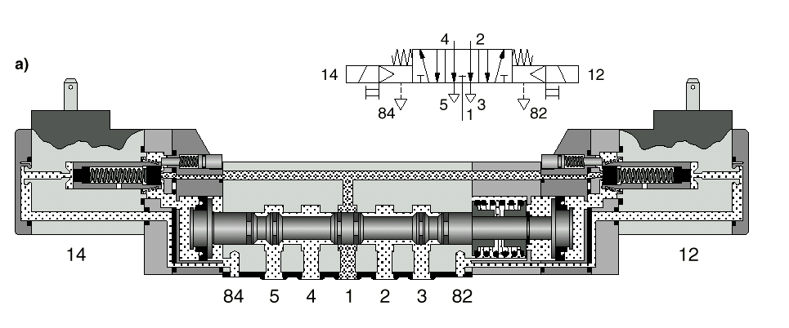
5/3-way double solenoid valve with pilot control

Slide 65
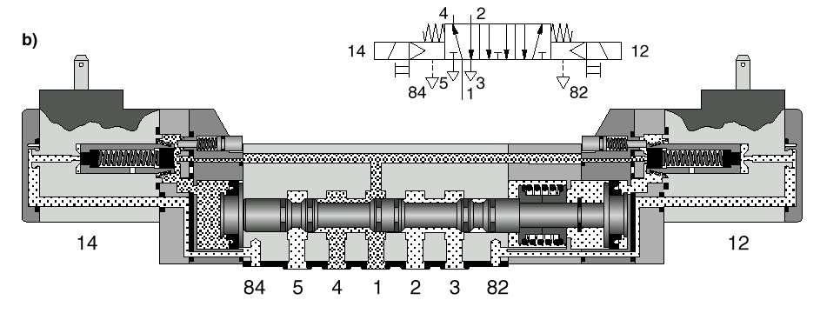
5/3-way double solenoid valve with pilot control 1

Slide 66
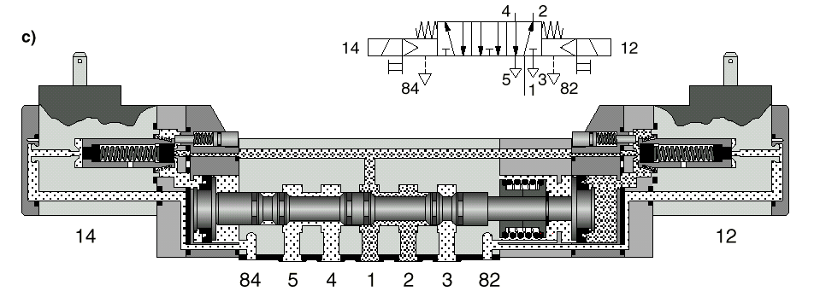
5/3-way double solenoid valve with pilot control 2

Slide 67
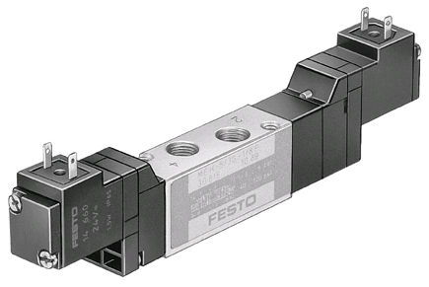
5/3-way double solenoid valve with pilot control 3
4
2
4
2
5
3
5
3
1
1
4
2
5
3

Slide 68
Pneumatic Cylinders
Single Acting
Double Acting

Slide 69
Single acting cylinder
Construction

Slide 70
Single acting cylinder 1
Construction
Rod
Bearing
Vent
Spring
Connection
Seal
Piston

Slide 71
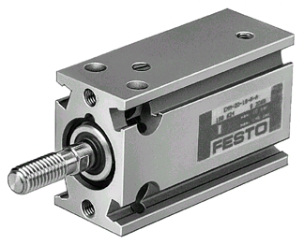
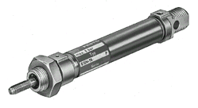
Single acting cylinder 2
Diameters 10mm to 32mm
Stroke Lengths 5mm to 50mm

Slide 72
Double acting cylinder
With magnetic piston
Designed to allow the position of the piston to be monitored by appropriate devices.

Slide 73
Double acting cylinder 1
With adjustable end position cushioning
and magnet in piston

Slide 74
Double acting cylinder 2
Sensors can be positioned
on the cylinder to monitor
the position of the piston.
e.g. Reed switch
Magnets incorporated
in/around piston
Magnetic field extends
outside body of cylinder

Slide 75
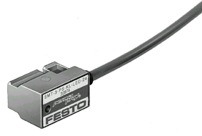
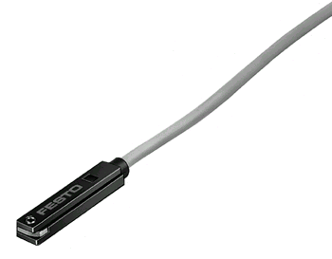
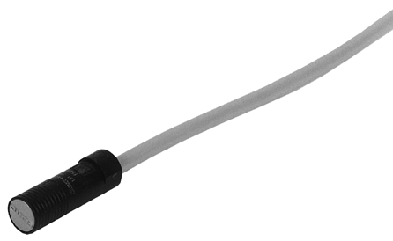

Double acting cylinder 3
Types of cylinder mounted sensors available are:
Electronic
Electrical
Pneumatic

Slide 76
Double acting cylinder 4
With magnetic piston
Allows the position of the piston to be monitored.
Mounting the sensors on the cylinder keeps them
out of the work area.

Slide 77
Electropneumatic symbols

Slide 78

Switches and contacts

Slide 79
Switches and contacts 1

Slide 80
Switches and contacts 2

Slide 81

Relays, timers and solenoids

Slide 82


Relays and solenoid coils

Slide 83
Electrical Symbols

Slide 84
Electrical Circuits
Identification
System Structure
Basic Logic Functions

Slide 85
Identification Code for Components
The identification code contains the following information
Unit Number
Circuit Number
Component Identification
Component Number

Slide 86
Component Number
Within each circuit, components with the same component identification are numbered consecutively from the bottom to the top and from left to right.
For Example:
Directional control valve: 1V1
One-way flow control valve: 1V2

Slide 87
Electropneumatic Component Identification

Slide 88
Control System Component Identification

Slide 89
Control System Component Identification Examples
Manually operated switches S1, S2 and S3.
Limit switches 1S1 AND 1S2.
Pressure switch 1B1.
Relays K1, K2, K3, and K4.
Solenoid coil 1Y1.
Lamp H1.

Slide 90
System structure
Components in a control system belong to four basic groups:
Energy supply
Input elements
Processing elements
Final control elements & actuators

Slide 91

Pneumatic component
Actuator
Final Control Element
Energy Supply

Slide 92

Electrical component

Slide 93

Electropneumatic elements

Slide 94
Control chain
SIGNAL OUTPUT
SIGNAL PROCESSING
SIGNAL INPUT
SIGNAL FLOW

Slide 95

Signal flow

Slide 96
Basic logic functions

Slide 97
Basic logic functions 1
Logic operations are funcions which link binaary signals according to the rules of Boolean algebra. Four basic logic operations are available for this purpose.
Identity (YES) Input and output signal have the same status.
Negation (NOT) The output signal has the opposite value to the input signal.
Conjunction (AND) The output signal only has the value 1, if all the input signals have the value 1
Disjunction (OR) The output signal has the value 1, if at least one of the input signals has the value 1.

Slide 98
Basic logic functions 2
There are four commonly used logic functions in Electro-Pneumatics.
YES Function
NOT Function
OR Function
AND Function

Slide 99
Basic electrical circuits
YES Function

Slide 100
Basic electrical circuits 1
NOT Function

Slide 101
Basic electrical circuits 2
OR Function

Slide 102
Basic electrical circuits 3
AND Function

Slide 103
YES Circuit Exercise
Create the YES Circuit on the trainer.

Slide 104
AND Circuit Exercise
Create the AND Circuit on the trainer.

Slide 105
Control of a single-acting cylinder
The piston of a single-acting cylinder is to travel out when a push button switch is pressed. When the button is released, the cylinder is to return to the final rear position.

Slide 106
Direct Method
The circuit is closed when push button switch S1 closes. A magnetic field is produced in coil Y1. The armature in the coil opens the passage for the compressed air. The compressed air flows from 1 to 2 to the cylinder, which travels to the final forward position.
When push button switch S1 is released, the circuit is interrupted. The magnetic field at coil Y1 collapses, the 3/2-way valve switches back to its original position and the cylinder travels to the final rear position.

Slide 107
Indirect Method
With the indirect method, the push button switch S1 energizes a relay K1. The coil Y1 is energized via a normally open contact of K1 (indirect energizing).
Otherwise the sequence is the same as the direct method.
The indirect method must be applied when the switching capacity of signaling device (S1) is not sufficient to switch coil Y1, or if further processing is required with a different voltage (220V).

Slide 108
Exercise 1
Realising a Sorting Device
A sorting device is to be used to sort water samples according to the since of the sample bottle.
Pressing of a pushbutton causes the piston rod of a singe-acting cylinder to push the sample bottle off the conveyor.
When the pushbutton is released, the piston rod is to return into the retracted end position.

Slide 109
Exercise 1
Solution

Slide 110
Control of a double-acting cylinder
The piston of a double-acting cylinder is to travel out when a push button switch is pressed. It is to return when the push button switch is released

Slide 111
Exercise 2
Realising a Shut-off Device
In a water treatment system numerous pipes need to be opened or and closed by means of shut-off devices. A test setup is to be used to find a possible means of actuating the shut-off valve.
Pressing of a pushbutton is to cause the valve to open the slide.
Releasing of the pushbutton is to cause the slide to close.

Slide 112
Exercise 2
Solution

Slide 113
Exercise 3
Realising a Lid Press
In a filling plant, wall or ceiling paints are filled into plastic pots. Once filled, slip-lids are to be pressed onto the plastic pots.
Pressing of a pushbutton is to cause the pressing ram to advance and the slip-lid to be pressed on.
Once the pushbutton is released, the pressing ram is to be returned into the initial position.

Slide 114
Relays 2
Allow
  multiple switching operations
  different voltage levels
  different control paths
Used for logic functions and interlocking
Ease of maintenance
Switching cycles ~ 10’s of millions

Slide 115
Relay
Cover
Symbol
Return spring
12
22
A1
14
24
Armature
Coil
A2
11
21
Contacts
Coil connections
Contact connections

Slide 116
Relay 1
Symbol
12
22
A1
14
24
A2
11
21
A1 A2 4 2 1

Slide 117
Relay 2
Symbol
12
22
A1
14
24
A2
11
21
A1 A2 4 2 1

Slide 118
Relay 3
Symbol
12
22
A1
14
24
A2
11
21
A1 A2 4 2 1

Slide 119
Relay 4
Symbol
12
22
A1
14
24
A2
11
21
A1 A2 4 2 1

Slide 120

Relay 5
2 changeover relay
size
14mm x 9mm x5mm

Slide 121

Relay 6
4 contact relay
Up to 2 x 10⁸
switching cycles

Slide 122
Exercise 3
Solution

Slide 123
Parallel circuit (OR logic)
The piston of a double-acting cylinder is to travel out when either one of two push button switches is pressed. It is to return when the both push button switches are released.

Slide 124
Exercise 4
Realising the Operation of a Hinge Lid
Plastic granulate is to be filled from a storage silo. The silo is to be opened or closed using a hinged lid. The process is to be effected from two points.
Pressing of either one of the pushbuttons is to cause the hinged lid to open and to empty the bulk material form the container.
Once the pushbutton is released, the hinged lid closes.

Slide 125
Exercise 4
Solution

Slide 126
Indirect control of a double acting cylinder
The piston of a double-acting cylinder is to travel to the final forward position when push button switch S1 is pressed. It is to remain there until the return stroke is activated via push button switch S2

Slide 127
Exercise 5
Realising a Diverting Device
Packages are to be pushed from one conveyor to another via a diverting device.
Pressing of a pushbutton is to cause the frame of the diverting device to be advanced. The package is transferred ad transported away.
Pressing of another pushbutton causes the frame to be moved into the initial position.

Slide 128
Exercise 5
Soluiton

Slide 129
Automatic return of a double acting cylinder
The piston of a double-acting cylinder is to travel to the final forward position when push button switch S1 is pressed. When it reaches this position, it is to return automatically to its original position.

Slide 130
Exercise 6
Actuation of a Stacking Magazine
Wooden boards are to be pushed from a stacking magazine into an assembly device.
Pressing of a pushbutton causes a wooden board to be pushed out of the stacking magazine.
Once the forward end position is reached, the slide is moved into the initial position.

Slide 131
Exercise 6
Solution

