Slide 1
Nebraska Career Educators Conference
June 9 2026
Basic Mechatronics Class Concepts
Presenter:
Allen Stenzel

Slide 2
Allen Stenzel
Mechatronics Instructor
CCC Columbus
21 years

Slide 3
My Info
Allen Stenzel
Mechatronics Instructor
astenzel@cccneb.edu
402 562 1475

Slide 4
Full semester classes
I suggest IMEC 2.0 courses
Concepts of Electronics
Intro to Instrumentation
Industrial Sensors
Intro to Programmable Controllers

Slide 5
IMEC 2.0 Courses
Contact:
Dan Davidchik
Associate Dean Training Develop
ddavidchik@cccneb.edu
402 562 1408

Slide 6
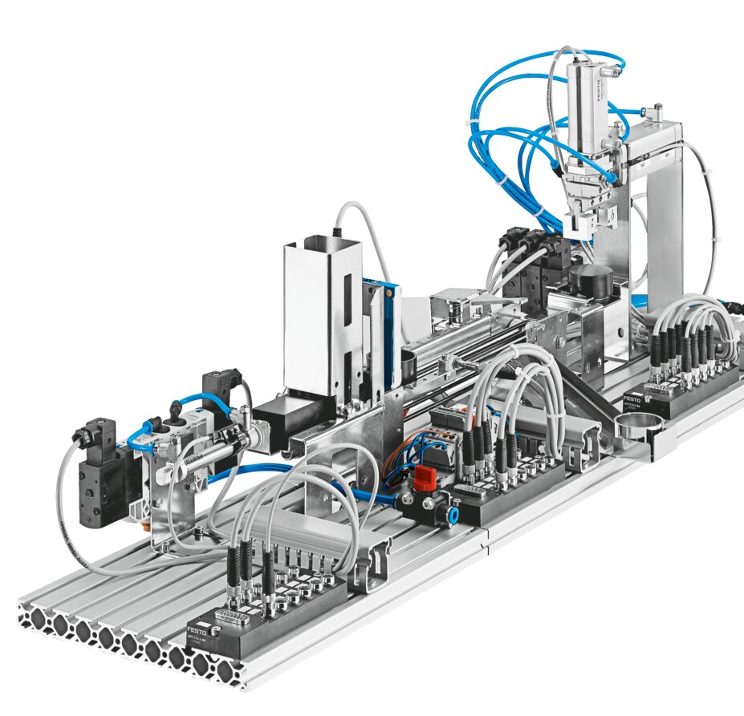
Festo MecLab
https://stem.festo.com/us/en/products-courses/mechatronics/meclab/index.html

Slide 7
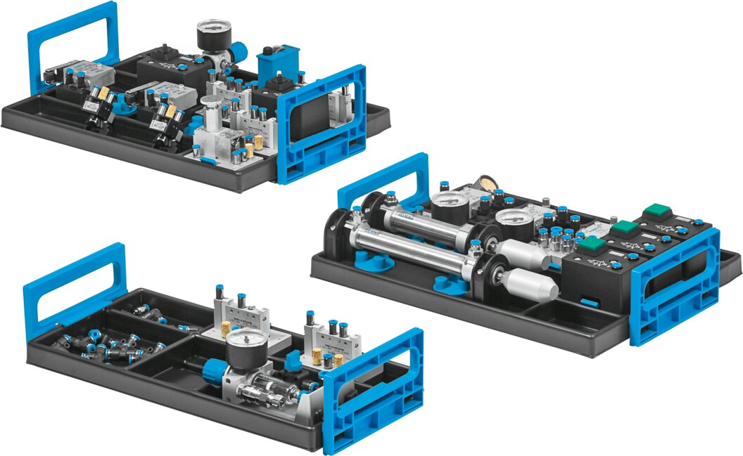
Festo TP 101
Festo TP101

Slide 8
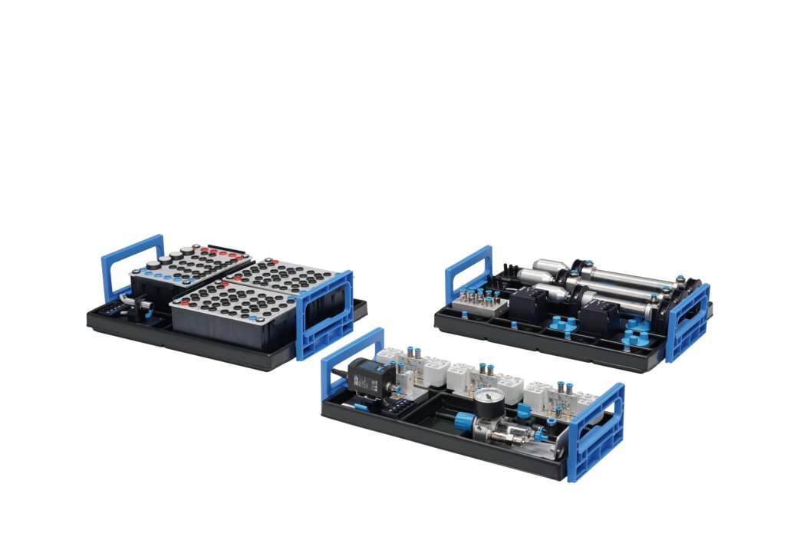
Festo TP 201
Festo TP201

Slide 9
Fluid Sim
Drawing software
https://www.festo.com/us/en/e/technical-education/digital-learning/virtual-simulation-and-modeling/fluidsim-id_1663056/

Slide 10
Automation Direct
I get a lot of my individual parts that I use in my labs from here.
https://www.automationdirect.com/adc/home/home

Slide 11
Parts lists
I have compiled a lists of parts for completing labs.
These are something I have been working on and are not complete.
Pneumatics
Electro Pneumatics

Slide 12
That’s all folks

