Slide 1

Empowering Education: Creating High School College and Career Academies in Small Schools Under 1000 Students
Presenters:
Marcy Harrifeld- Assistant Principal/Academy Coordinator
Camelle Kinney- Academy Business Partner Liaison
Notes:
MH

Slide 2

A general high school diploma is no longer enough to remain a competitive member of the workforce.
(Source: Bureau of Labor and Statistics)
Notes:
MH

Slide 3
THE BIG QUESTION
Are We Preparing Students With The Career and Skill Sets Needed for Their Future?
Notes:
MH

Slide 4

Top three skill sets workers will need to secure the best careers for their future:
Higher Cognitive
Social and Emotional
Technological
Source: McKinsey Global Institute
Notes:
CK

Slide 5

Higher Cognitive
Skills: These include advanced literacy and writing, critical thinking, and quantitative and statistical analysis.
Careers: Health Care, Business/Finance, Science/Research, Engineering/Programming
Notes:
CK

Slide 6

Social and Emotional
Skills: Advanced communication, empathy, to be adaptable, and the ability to learn continuously.
Careers: Business Development, Programming, Health Care, and Education/Counseling require these skills. These jobs are also amongst the best careers for the next ten years.
Notes:
CK

Slide 7

Technological
Skills: Includes everything from basic to advanced information technology skills, data analysis, technical reading and writing.
Careers: Information Technology, Programming, Data Analysis, Virtual Reality/Artificial Intelligence, Robotics/Automation, and Engineering/Energy. These future skills are likely to be the most highly paid.
Notes:
CK

Slide 8

Total employment is projected to grow from 153.5 million to 165.4 million over the 2020–30 decade, an increase of 11.9 million jobs, the U.S. Bureau of Labor Statistics.
Healthcare and social assistance are projected to add the most jobs - about 3.3 million jobs.
Technological advancements are expected to support strong employment growth in professional, business, and scientific services industries, including computer systems design and related services
THE CHALLENGE
Notes:
CK

Slide 9

SOLUTION
COLLEGE AND CAREER ACADEMIES
Notes:
MH

Slide 10
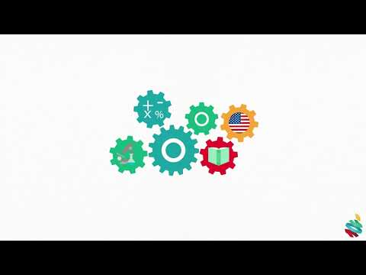
Notes:
MH

Slide 11
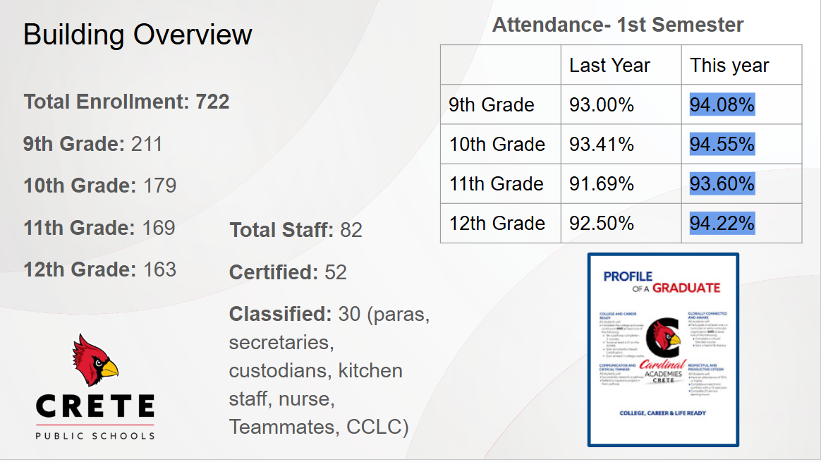

Building Overview
Attendance- 1st Semester
 | Last Year | This year
9th Grade | 93.00% | 94.08%
10th Grade | 93.41% | 94.55%
11th Grade | 91.69% | 93.60%
12th Grade | 92.50% | 94.22%
Total Enrollment: 722
9th Grade: 211
10th Grade: 179
11th Grade: 169
12th Grade: 163
Total Staff: 82
Certified: 52
Classified: 30 (paras, secretaries, custodians, kitchen staff, nurse, Teammates, CCLC)
Notes:
MH
# of Staff
# of students

Slide 12
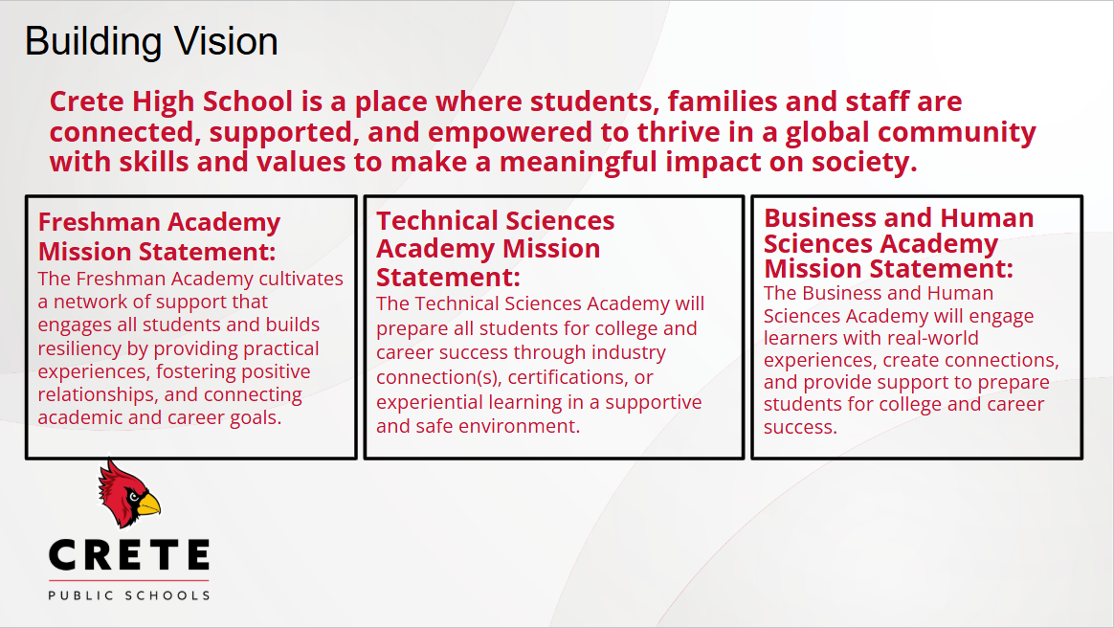
Building Vision
Crete High School is a place where students, families and staff are connected, supported, and empowered to thrive in a global community with skills and values to make a meaningful impact on society.
Freshman Academy Mission Statement:
The Freshman Academy cultivates a network of support that engages all students and builds resiliency by providing practical experiences, fostering positive relationships, and connecting academic and career goals.
Technical Sciences Academy Mission Statement:
The Technical Sciences Academy will prepare all students for college and career success through industry connection(s), certifications, or experiential learning in a supportive and safe environment.
Business and Human Sciences Academy Mission Statement:
The Business and Human Sciences Academy will engage learners with real-world experiences, create connections, and provide support to prepare students for college and career success.

Slide 13

Crete High School
Action Plan
Notes:
MH

Slide 14
THREE YEARS IN THE MAKING
VISITED ACADEMY SCHOOLS
STUDENT AMBASSADORS SELECTED
FRESHMAN EXPLORATION
ACADEMY
BEGINS
SCHOOL BOARD PRESENTATION
$100,000 REVISION GRANT AWARDED
NOV 2021
DEC 2021
JAN 2022
SEPT 2022
AUG 2023
MAR 2021
AUG 2022
FEB 2023
MAR 2023
NCAC
CONFERENCE
IMPLEMENTATION TEAM FORMED
PARTNERED WITH STEELE DYNAMICS
KICK OFF
8TH GRADERS & PARENTS
Notes:
MH

Slide 15
THIRD YEAR OF IMPLEMENTATION
2ND YEAR PATHWAY CLASSES BEGIN
ANATOMAGE TABLE DELIVERY
PATHWAY SELECTION
PATHWAY SELECTION- MOCK INTERVIEWS
NOV 2023
APR 2023
JULY 2024
AUG 2024
NOV 2024
APR 2024
AUG 2025
SEPT 2025
NCAC
CONFERENCE ARIZONA/ FELLOWS
100K REVISION GRANT AWARDED
NCAC CONFERENCE IN CHICAGO WITH LEAD TEACHERS- HIRED ACADEMY BUSINESS PARTNER LIAISON WITH GRANT
100K REVISION GRANT AWARDED & 3RD YEAR PATHWAY BEGINS WITH INTERMEDIATE CLASSES
Notes:
MH

Slide 16
HIGH SKILL
HIGH WAGE
HIGH DEMAND
Notes:
CK
Academies linked to the Nebraska Career Education Model (https://www.education.ne.gov/nce/career-clusters/)
Closely aligned with local industry--offering what matches with H3: HIgh Skill, High Wage, High Demand in our area (http://h3.ne.gov/)

Slide 17




Business
ACADEMY
Health Sciences
Education
Multimedia Design
Agriculture
PATHWAYS
Information Technology
Construction
CRETE HIGH SCHOOL
Automotive
Engineering
Welding
Notes:
MH

Slide 18
Programs of Study
Programs of Study
Notes:
MH

Slide 19
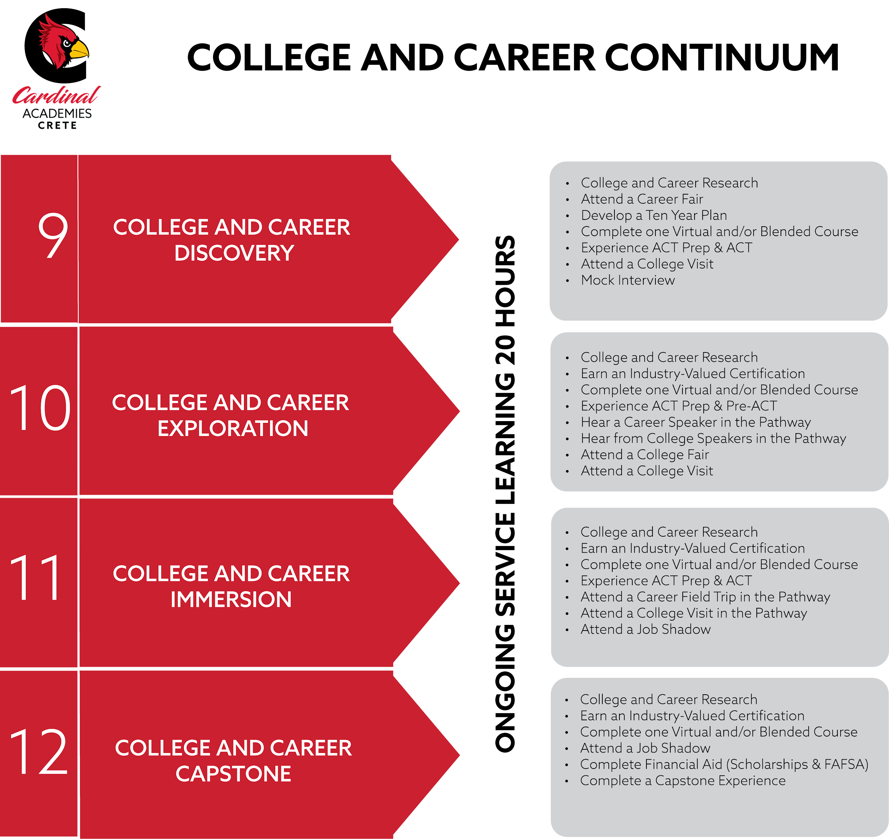

Notes:
MH

Slide 20
KEY COMPONENTS OF ACADEMIES
Transforming
School Design
Transforming
Teaching & Learning
Transforming
Business & Civic Engagement
CAREER THEME
A college prep curriculum with a career theme enabling students to see relationships and connections between academic subjects and their application to a broad field of work
COMMUNITY
ENGAGEMENT
Partnerships with employers, the community, and colleges bringing resources from outside the high school to improve student motivation and achievement…
SLC
A small learning community comprised of a group of students within the larger school that takes classes together and is taught by a team of teachers from different disciplines.
RELATIONSHIPS RIGOR RELEVANCE
Notes:
CK

Slide 21

English
Vestibulum congue
Academy/Pathway/CTE
Math
Vestibulum congue
Social Studies
Science
Notes:
CK
One Pathway class each year 10-12. This still leaves room for 6 electives a year, 3 each semester which can be fine arts, PE, world language, etc.

Slide 22
COLLEGE
READY
MILITARY
READY
CAREER
READY
World Ready …
Students who THRIVE!
Notes:
CK

Slide 23
Cardinal Academies ensure a inclusive learning environment that is endlessly relevant based on us and what we want to do. Our community is diverse where everyone has a place and a voice to speak about our passions. Through diversity, we are proud of who we are and what we want to do. We have ‘the want” to learn and with “the want” comes success. But most of all, we have enjoyable hands-on experiences that prepare us for life after high school.
Student Developed
Cardinal Academies ensure a supportive, inclusive learning environment that is endlessly relevant based on us and what we want to do. | Our community is diverse where everyone has a place and a voice to speak about our passions. | Through diversity, we are proud of who we are and what we want to do. We have ‘the want” to learn and with “the want” comes success | But most of all, we have enjoyable hands-on experiences that prepare us for life after high school.
Supported Inclusive Relevancy You -based | Diversity Everyone has a place Student voice | Pride in who we are Want to learn Success | Hands-on Prepared Fun
STUDENT AMBASSADORS
Notes:
CK

Slide 24
STUDENT AMBASSADORS
Currently about 40 students
  After Re-Evaluation… this will shrink.
  Going forward: Students will apply mid sophomore year.
  Then it will be 2nd semester sophomores, juniors and seniors.
Currently: tours, Career Expo Day, Cardinal Kickoff in 8th grade classes, Cardinal Kickoff Night
Goal: All pathways represented
Goal: More student driven projects. Example: want to partner with StuCo on HOCO. Include each pathway in the spirit week, or include community business partners.
Goal: Student Swap with another school who has Academies. We visited Omaha North this spring, hoping they can come visit us next year.
Notes:
CK

Slide 25
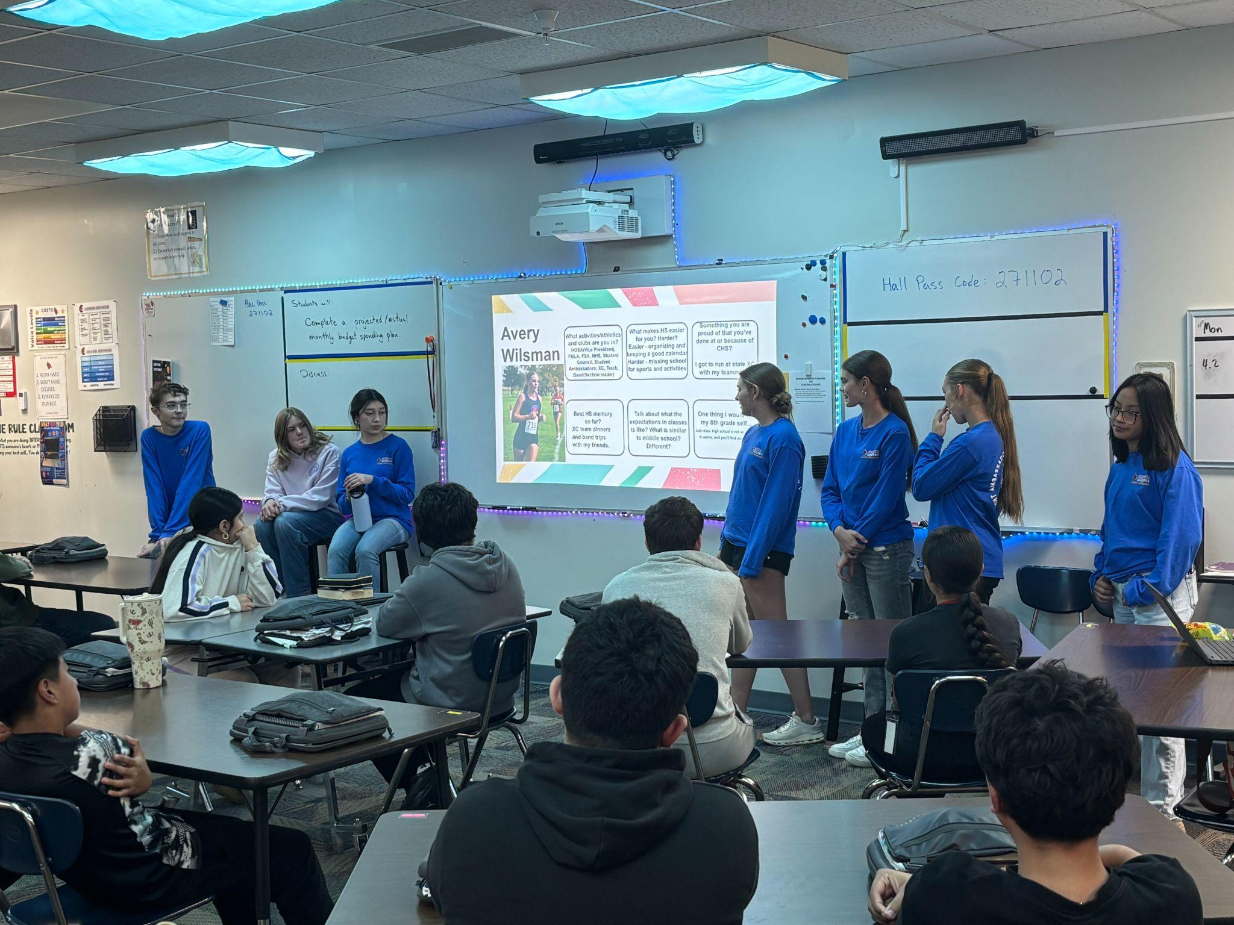
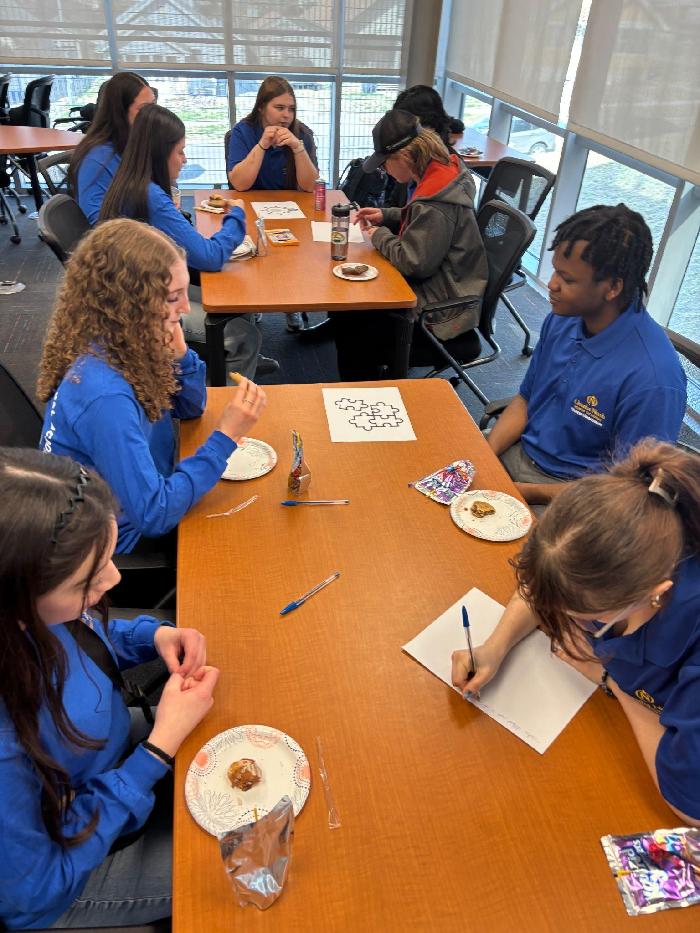
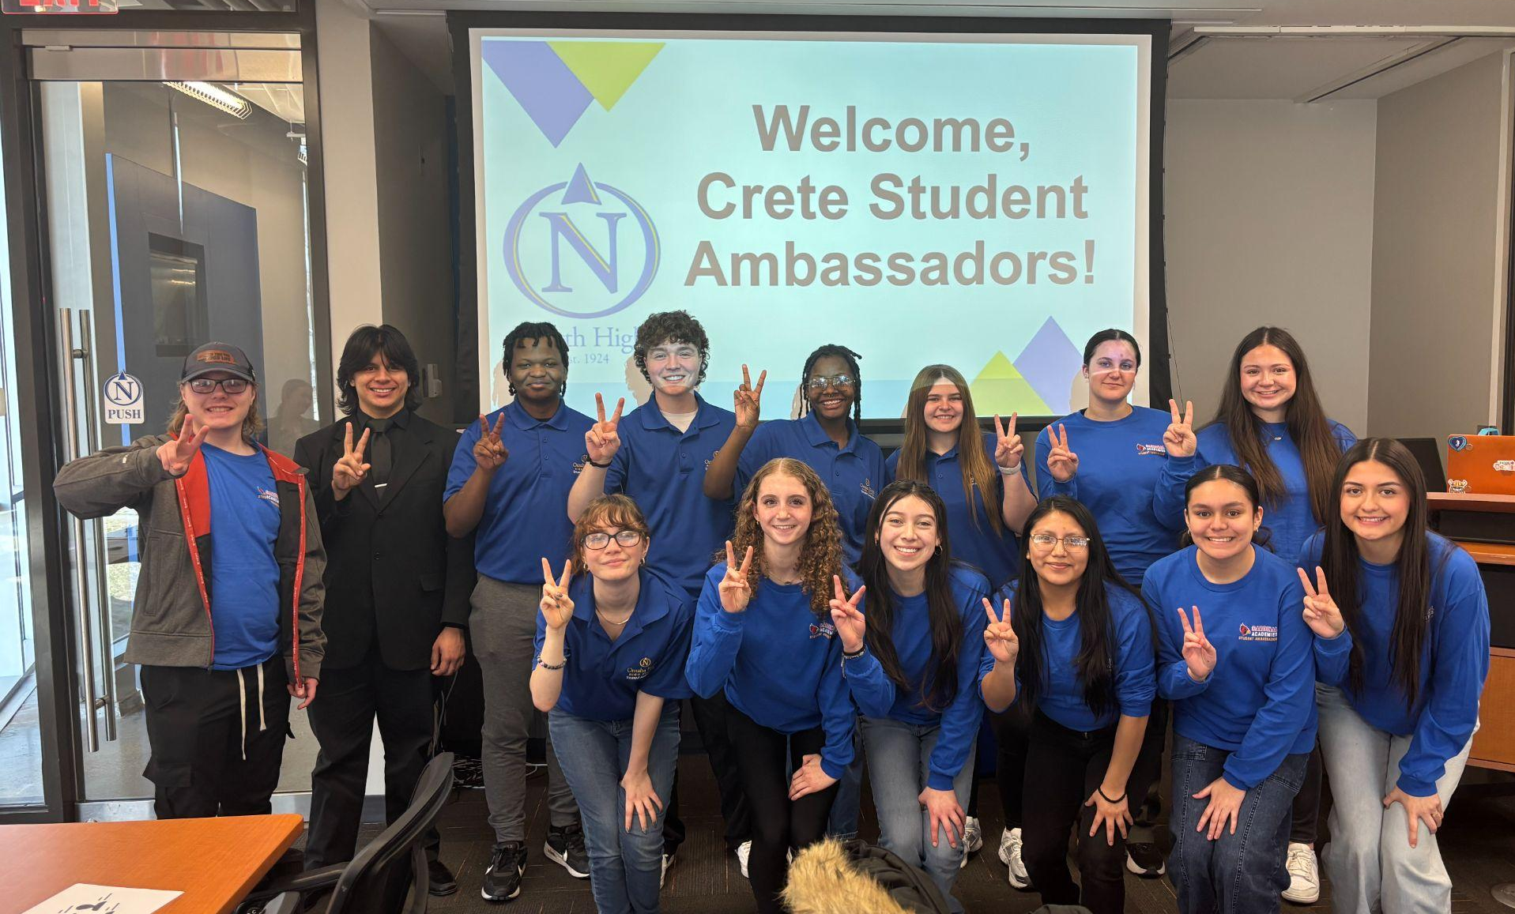
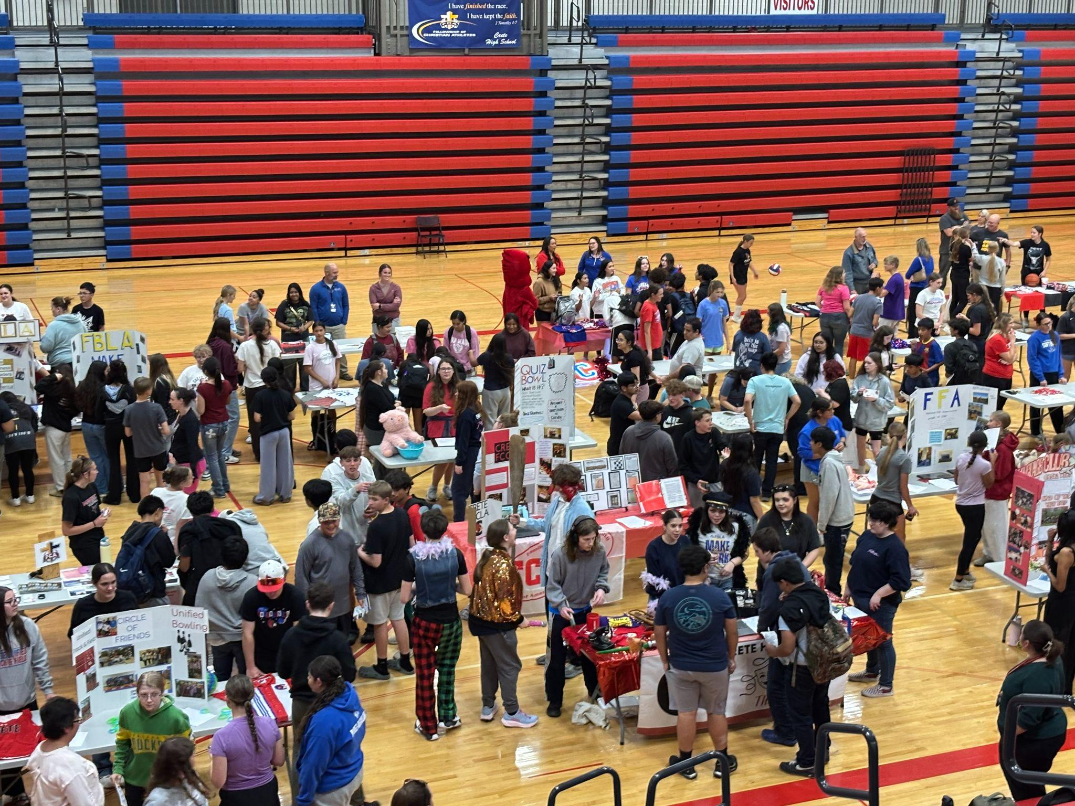
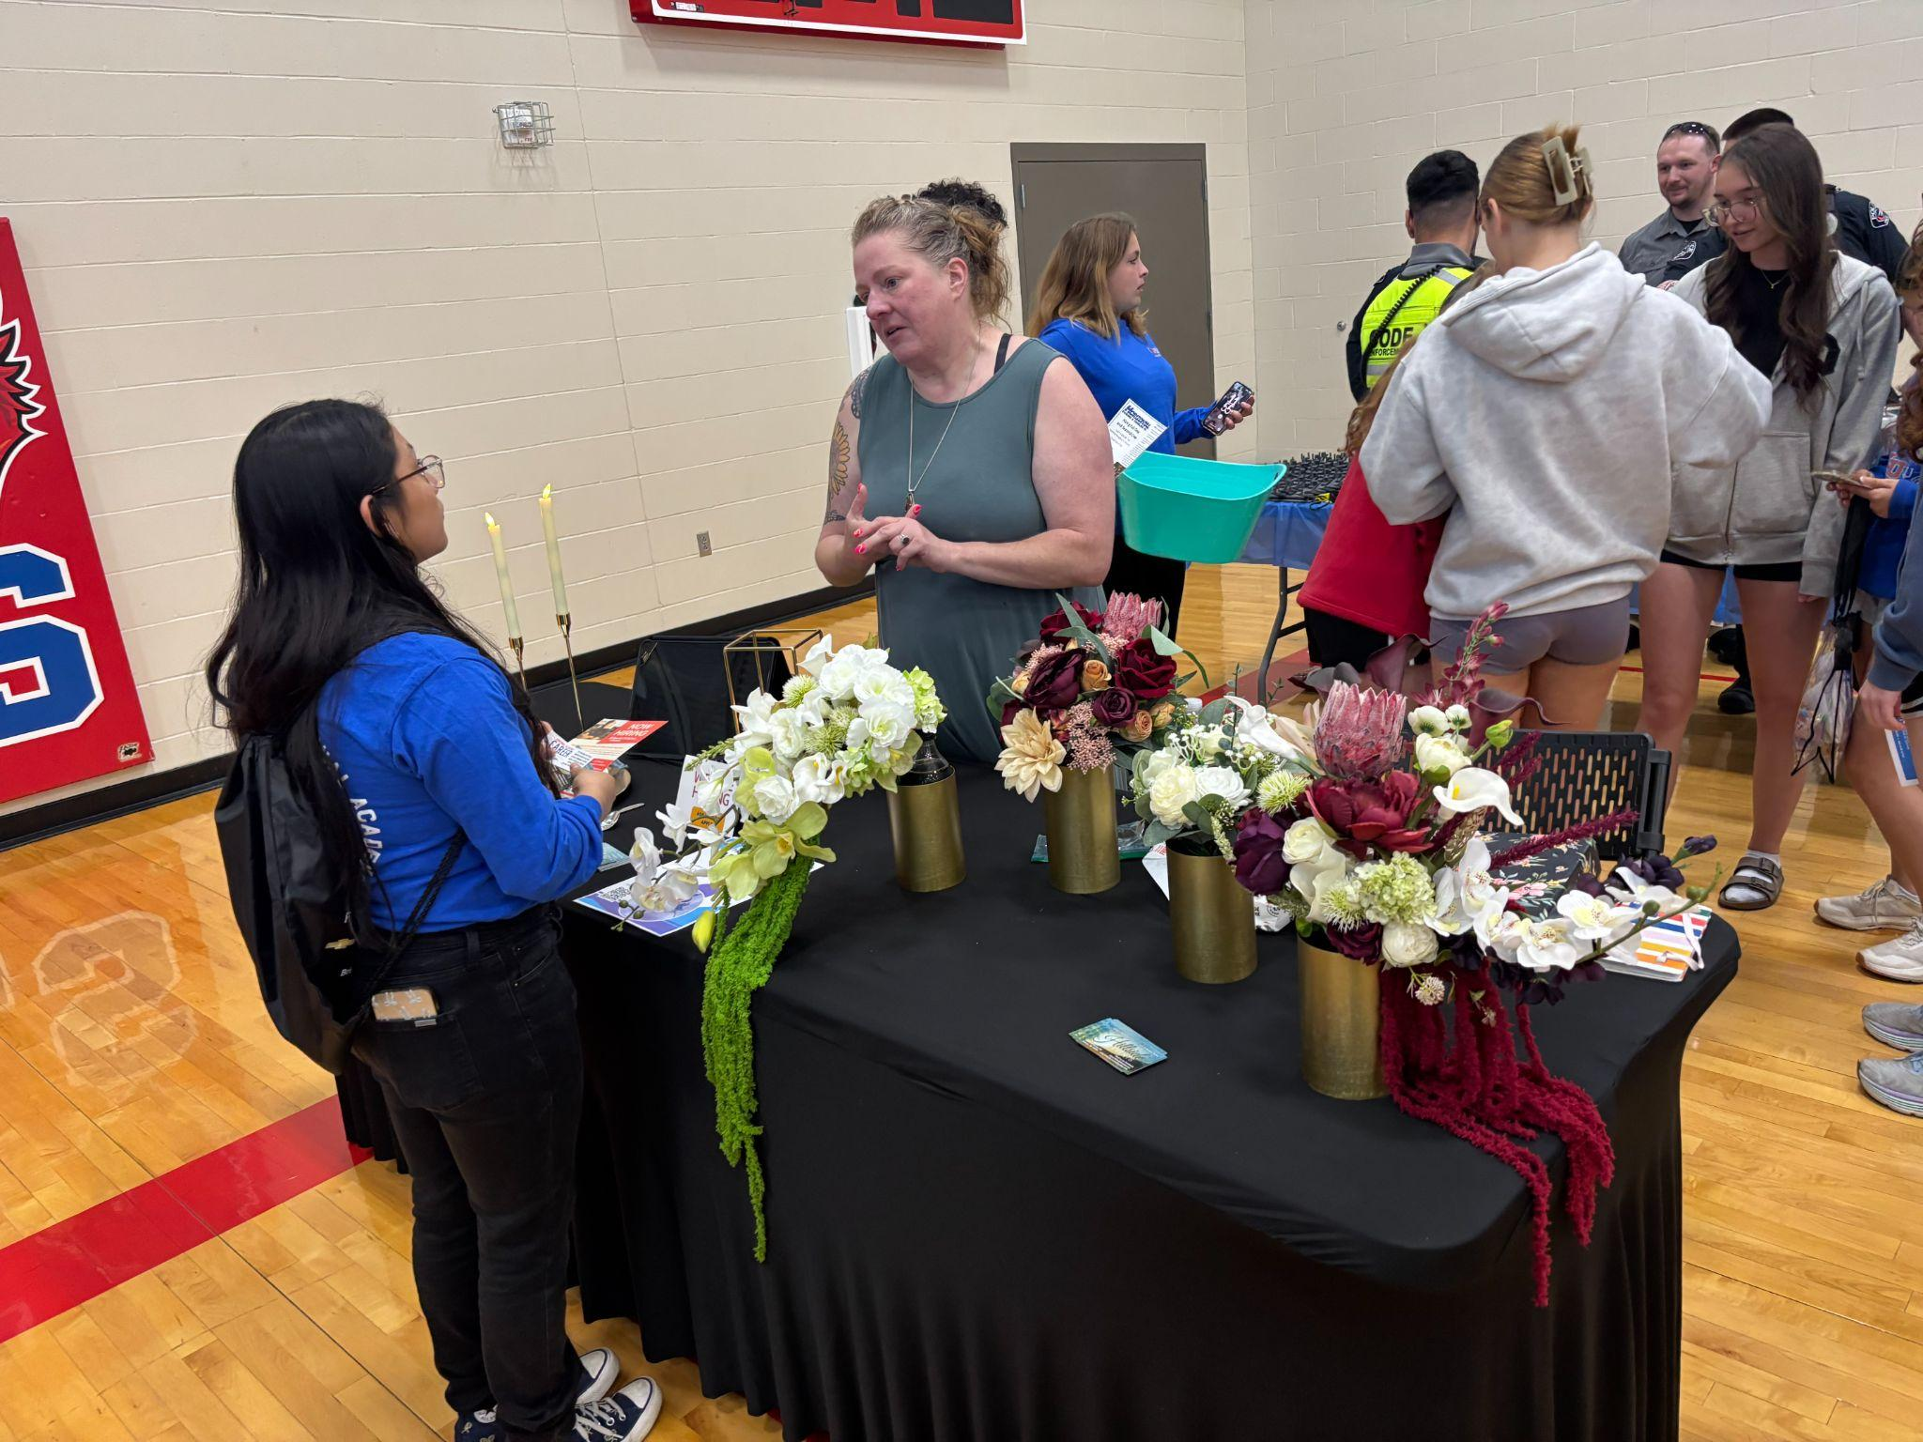
Notes:
CK

Slide 26

Advisory Board
Began this year
  Includes at least one representative from each pathway
  Tried to be culturally diverse
  Met 2x during the year
  Created a year end summary to share with them
College and Career Continuum
Connections with others in their industry
Teacher Externships
Student Experiences – Job Shadowing, Resume Writing, Internships, Field Trips, Research Opportunities, Authentic Projects, Student Competitions, College Classes, Apprenticeships, Student-based enterprises, and more
Going forward: Adding the role of Advisory Board Chairperson, and Secretary.
Going forward: Evaluating our curriculum with them to compare to current industry trends and standards.
Notes:
CK

Slide 27
Business Partners
ACE Hardware
ACEC (American Council of Engineering
Companies of NE)
APT Interactive
Air National Guard
AKRS
Angie Murry-Pate & Associates
BAYER Corp
Benesch Engineering
Blue River Arts Council
CAMC
City of Crete: Parks and Rec
Crete Carrier Corporation
Crete Nutrition
Crete Lumber
Crete Police Dept
Cristina’s
Crystal’s Bakery
Cyclonaire
Doane
Edward Jones
Eventide
Farmers Co-Op
FoodMart
Grain Craft
Heath Sports & Apparel
Hillside Events
Hilltop Fitness
Horizontal Boring
Hotworx
ISIS Theater
JEO Consulting
Kathy's Cardinal Kids
Legendary Travel NE
LPD
Nebraska Department of Corrections
Nebraska Dept of Labor
Nebraska Public Power
Nestle Purina
Pinnacle Bank
Precision Dental
Public Health Solutions
Rafa Roofing
Ross Plumbing
Sack Lumber
Saline Medical Center
Scooters Coffee
Sid Dillon
State Farm Insurance
The Crete News
TMCO
Tuttle Industries
US Army
US Army National Guard
US Navy
Wackel's Machine Shop
YMCA: Lincoln
Yost Net Solutions
Notes:
CK Currently have 46 partners representing all 10 pathways.

Slide 28
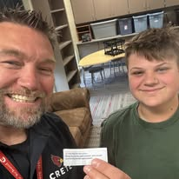

Freshman Academy
All freshmen take Freshman Seminar
  Research each pathway
  Personality Inventories
  Field trip to Doane University
  Career Inventories
  Create Cover letter and Resume
  Start their Google Site that will be used all 4 years
  Select Pathway to be in using a software that will sort students into pathways based on student preference and spots available in the pathway, in an unbiased way.
  Participate in a Mock Interview with a community partner
Notes:
CK Where it all begins!

Slide 29
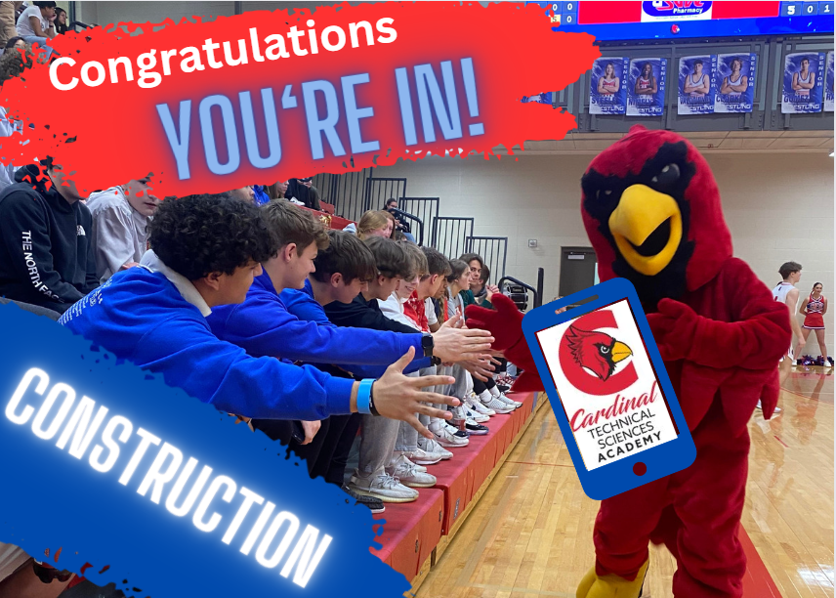
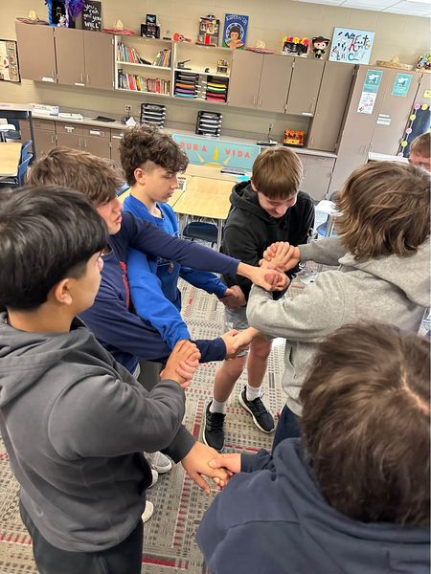
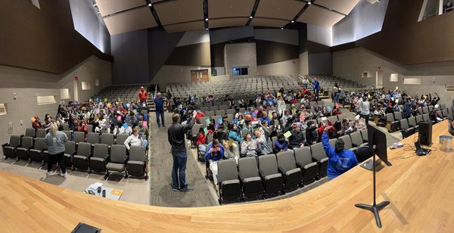
Academy Selection Ceremony
Every student received an envelope with their pathway selection and they opened them at the same time and then went with their cardinal time teacher to do a team bonding activity!
Notes:
CK

Slide 30
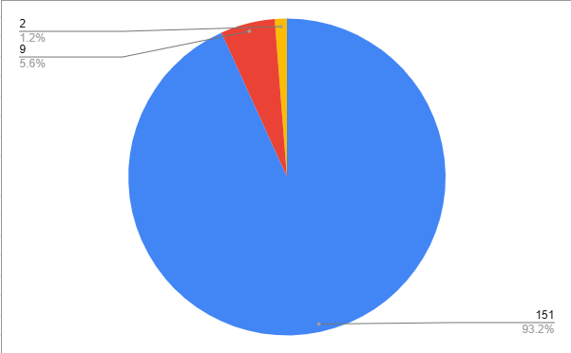
Pathway Selection
100% Top 3
98.8% Top 2
93.2% Top 1
First Choice 151
Second Choice 9
Third Choice 2
Notes:
MH

Slide 31
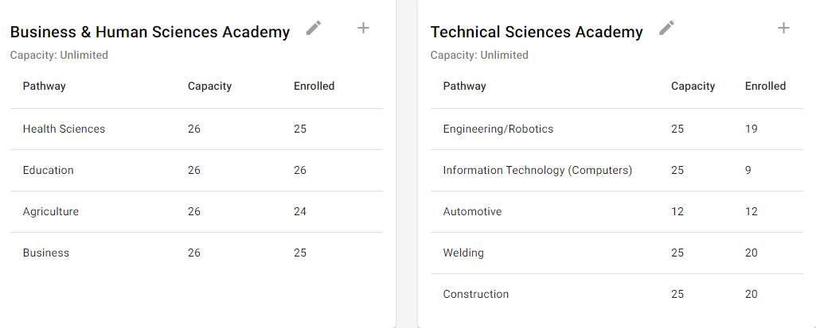
Pathway Numbers
Notes:
MH

Slide 32
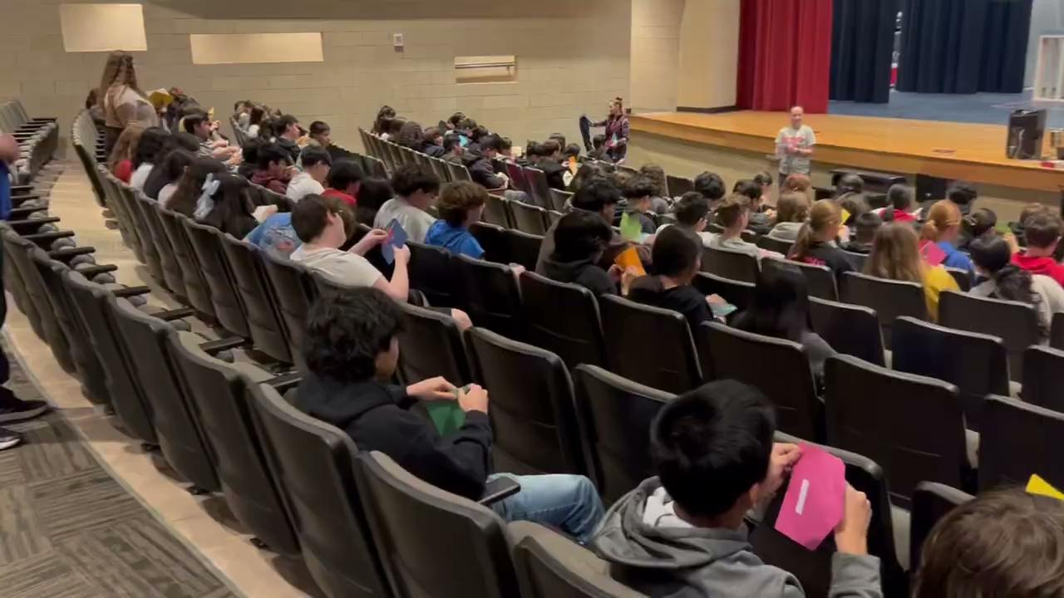
Every Student Has a Defined Purpose
Notes:
MH

Slide 33
Sophomore Year
First semester: Introduction to whatever their pathway is course.
  Intro to Business
  Intro to Health Science
  Construction Technical Sciences
These classes are either a year long, or students take two classes, one each semester.
All of these classes are taught by a CHS teacher
  We learned that sophomores really need the in person courses vs online or college level.
All sophomore pathway classes go on a Community College visit.
  Visits are on the days SCC has set up for the specific pathway, if possible.
  Teachers can opt to go to CCC instead of SCC if they feel that might be a better option for their students. (Automotive this year went to Hastings CCC.)
Notes:
MH

Slide 34
Junior Year
More pathway classes. Again, one each semester, or a year long one.
  Some of these are Doane University or SENCAP
CHS pays for these classes!!!
Students who want to change pathways, may do so, one time, at the end of their sophomore year. They have to complete a request, and we also have to have room for them in the pathway they want to move into.
Working on creating a common field trip for each pathway. Previously everyone went to UNO.
Notes:
CK

Slide 35
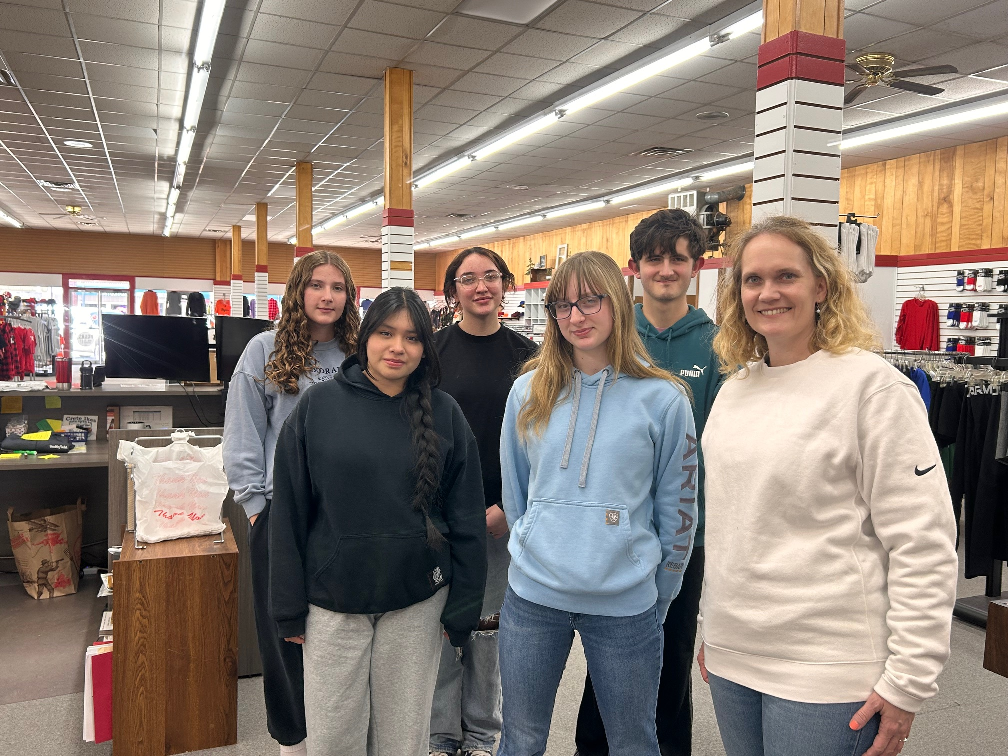
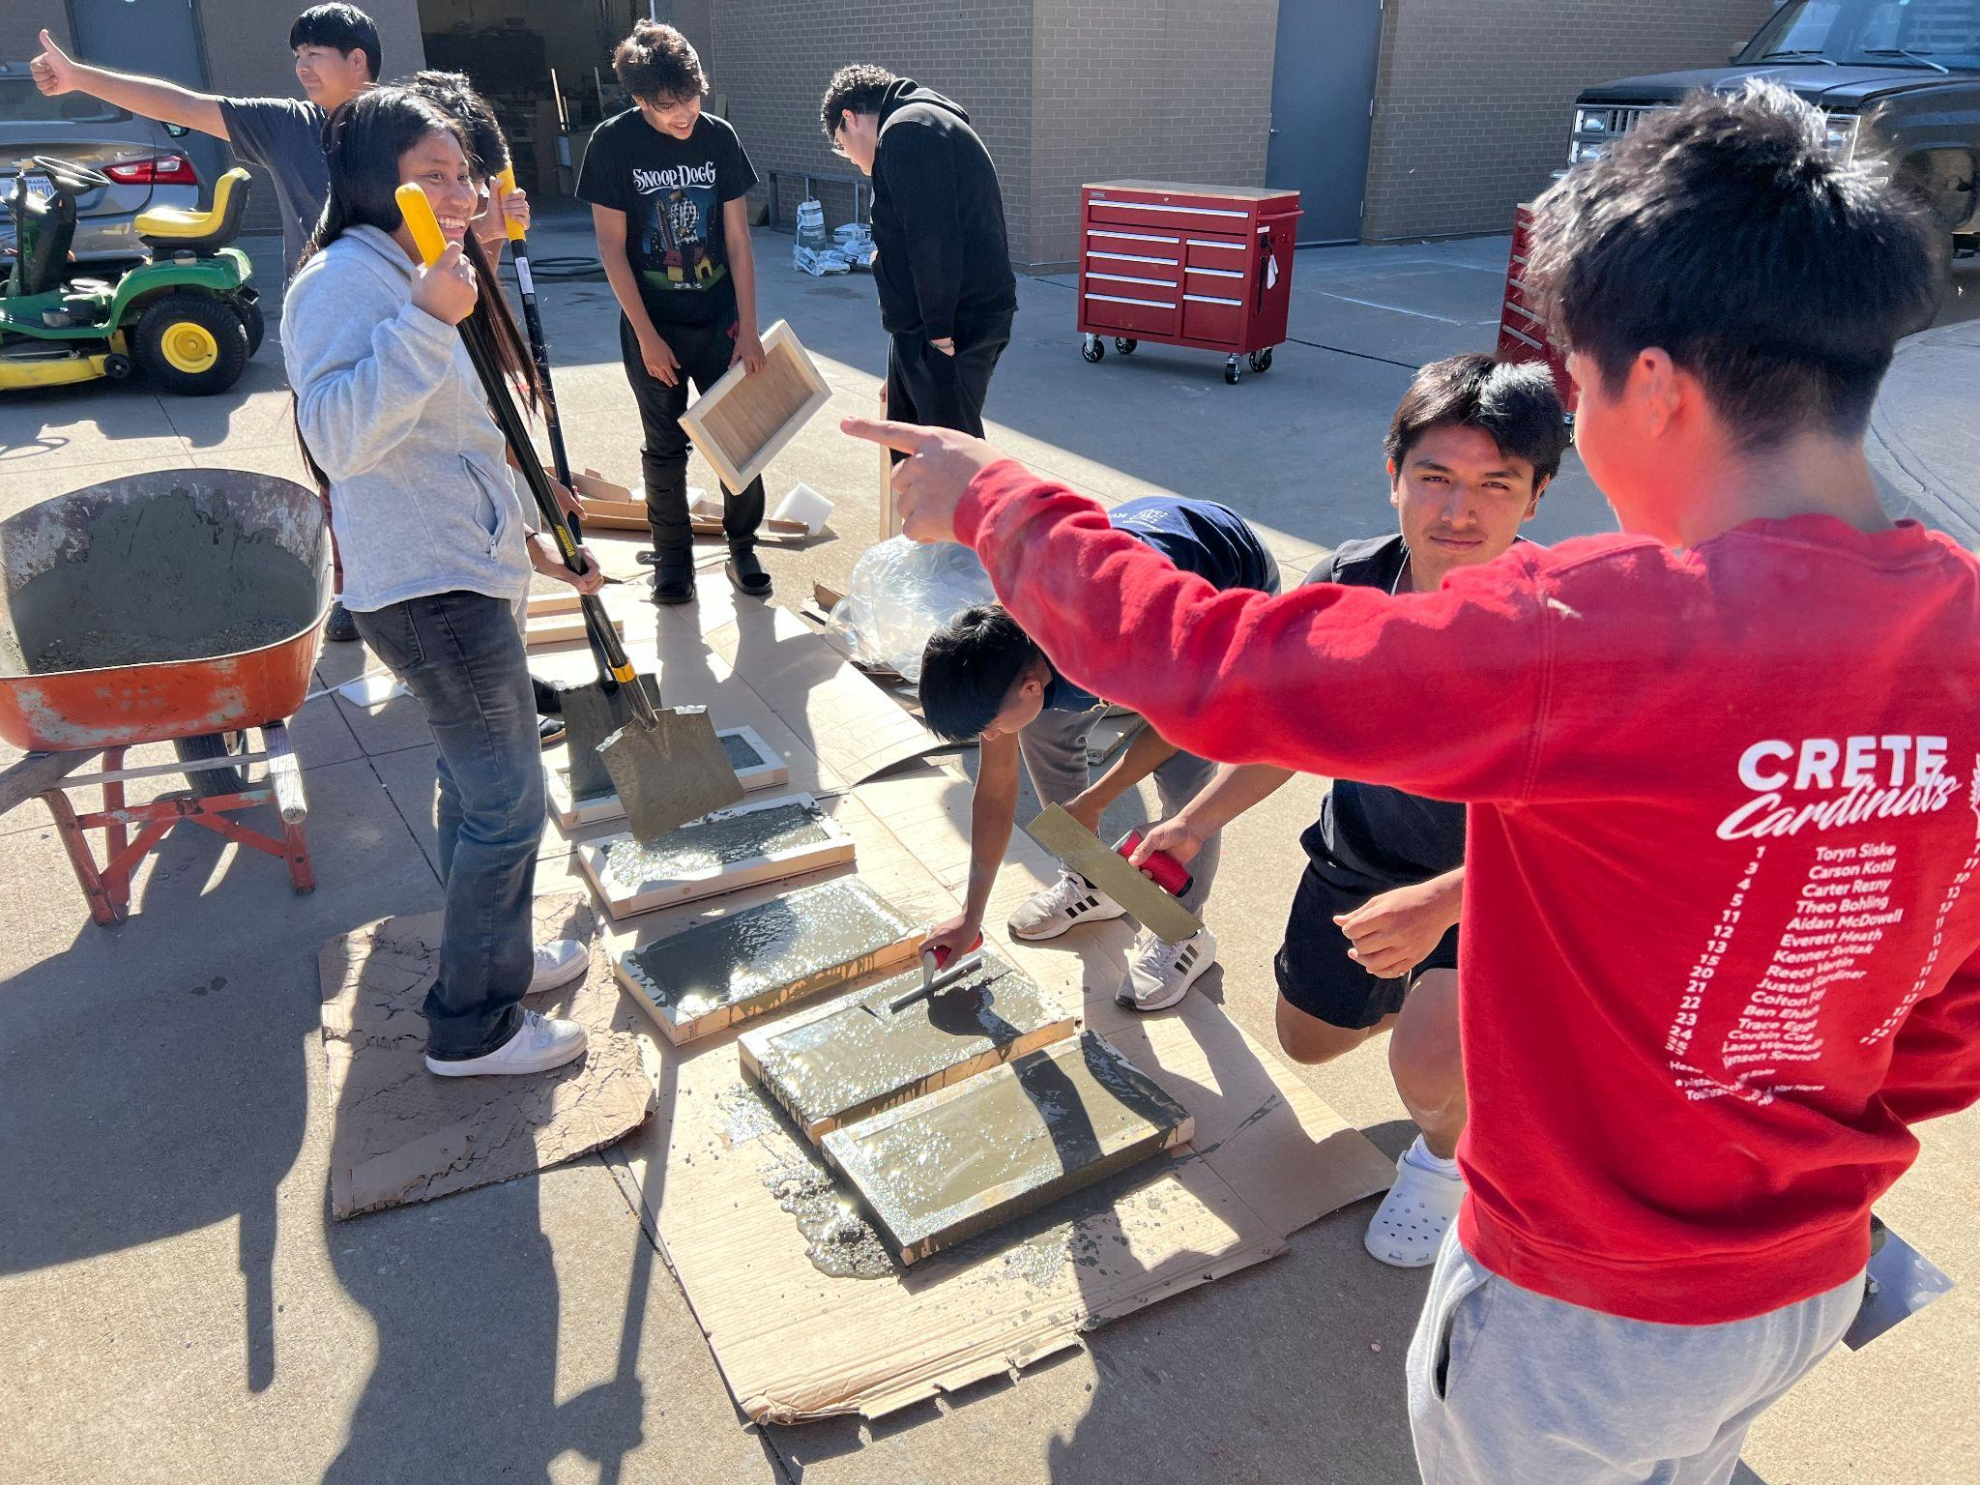
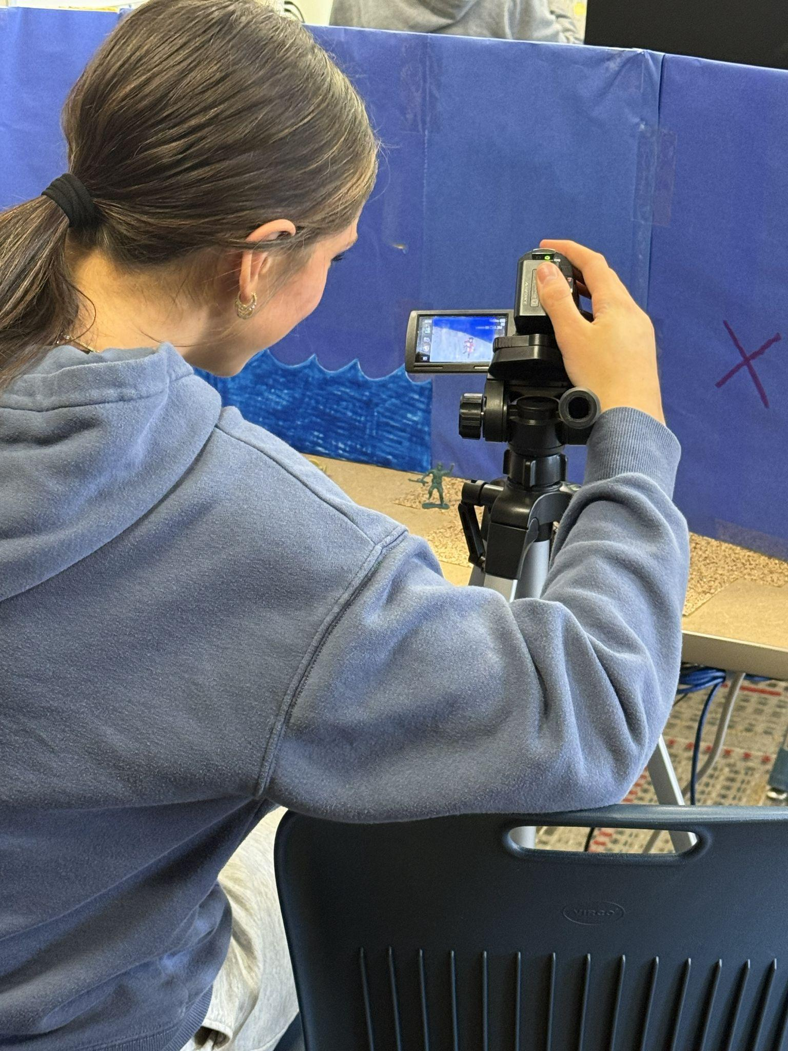
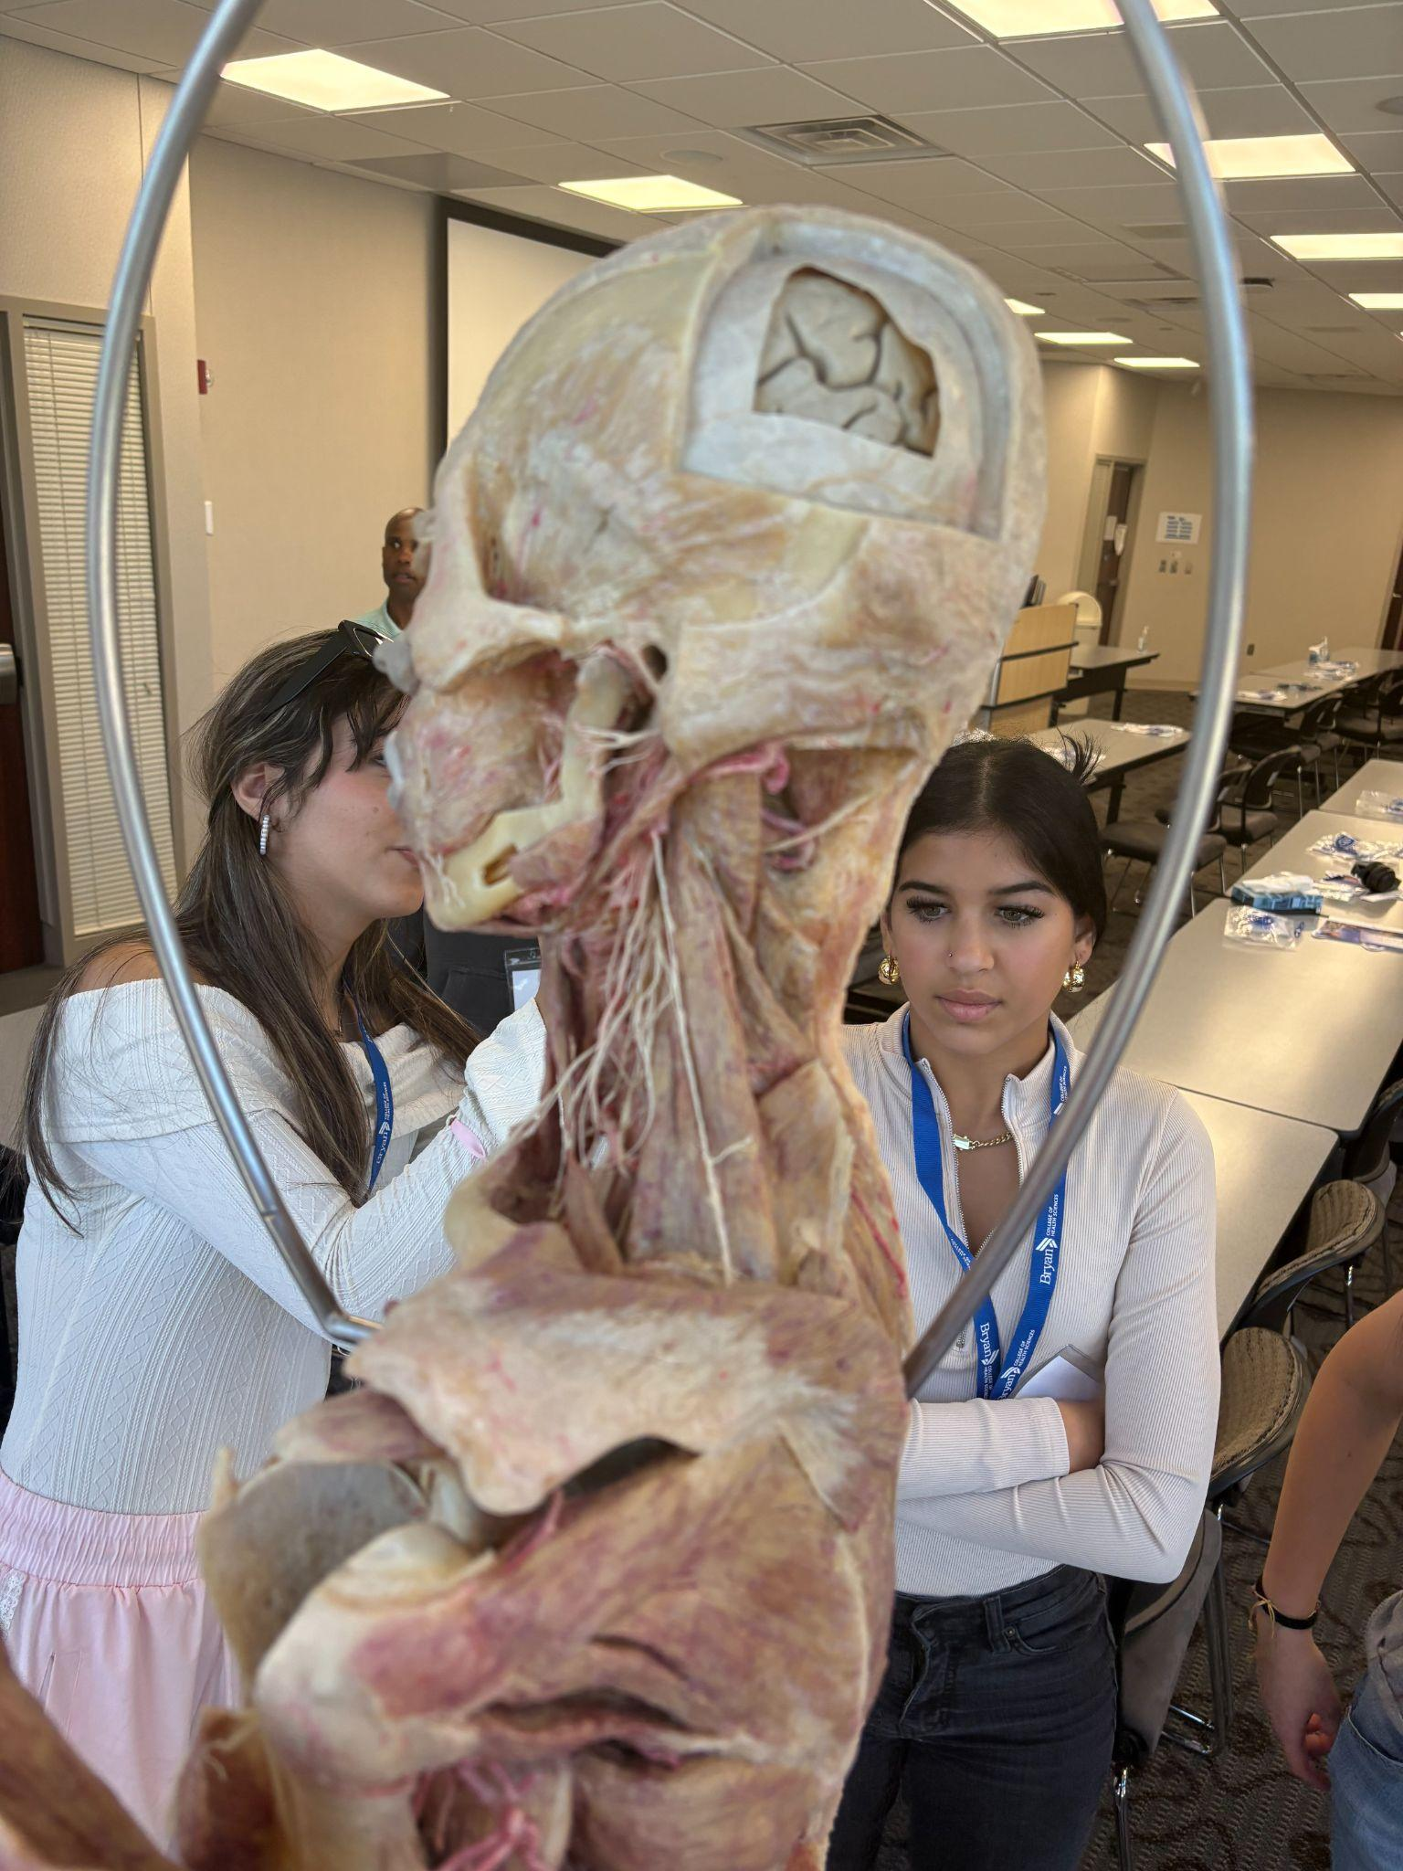
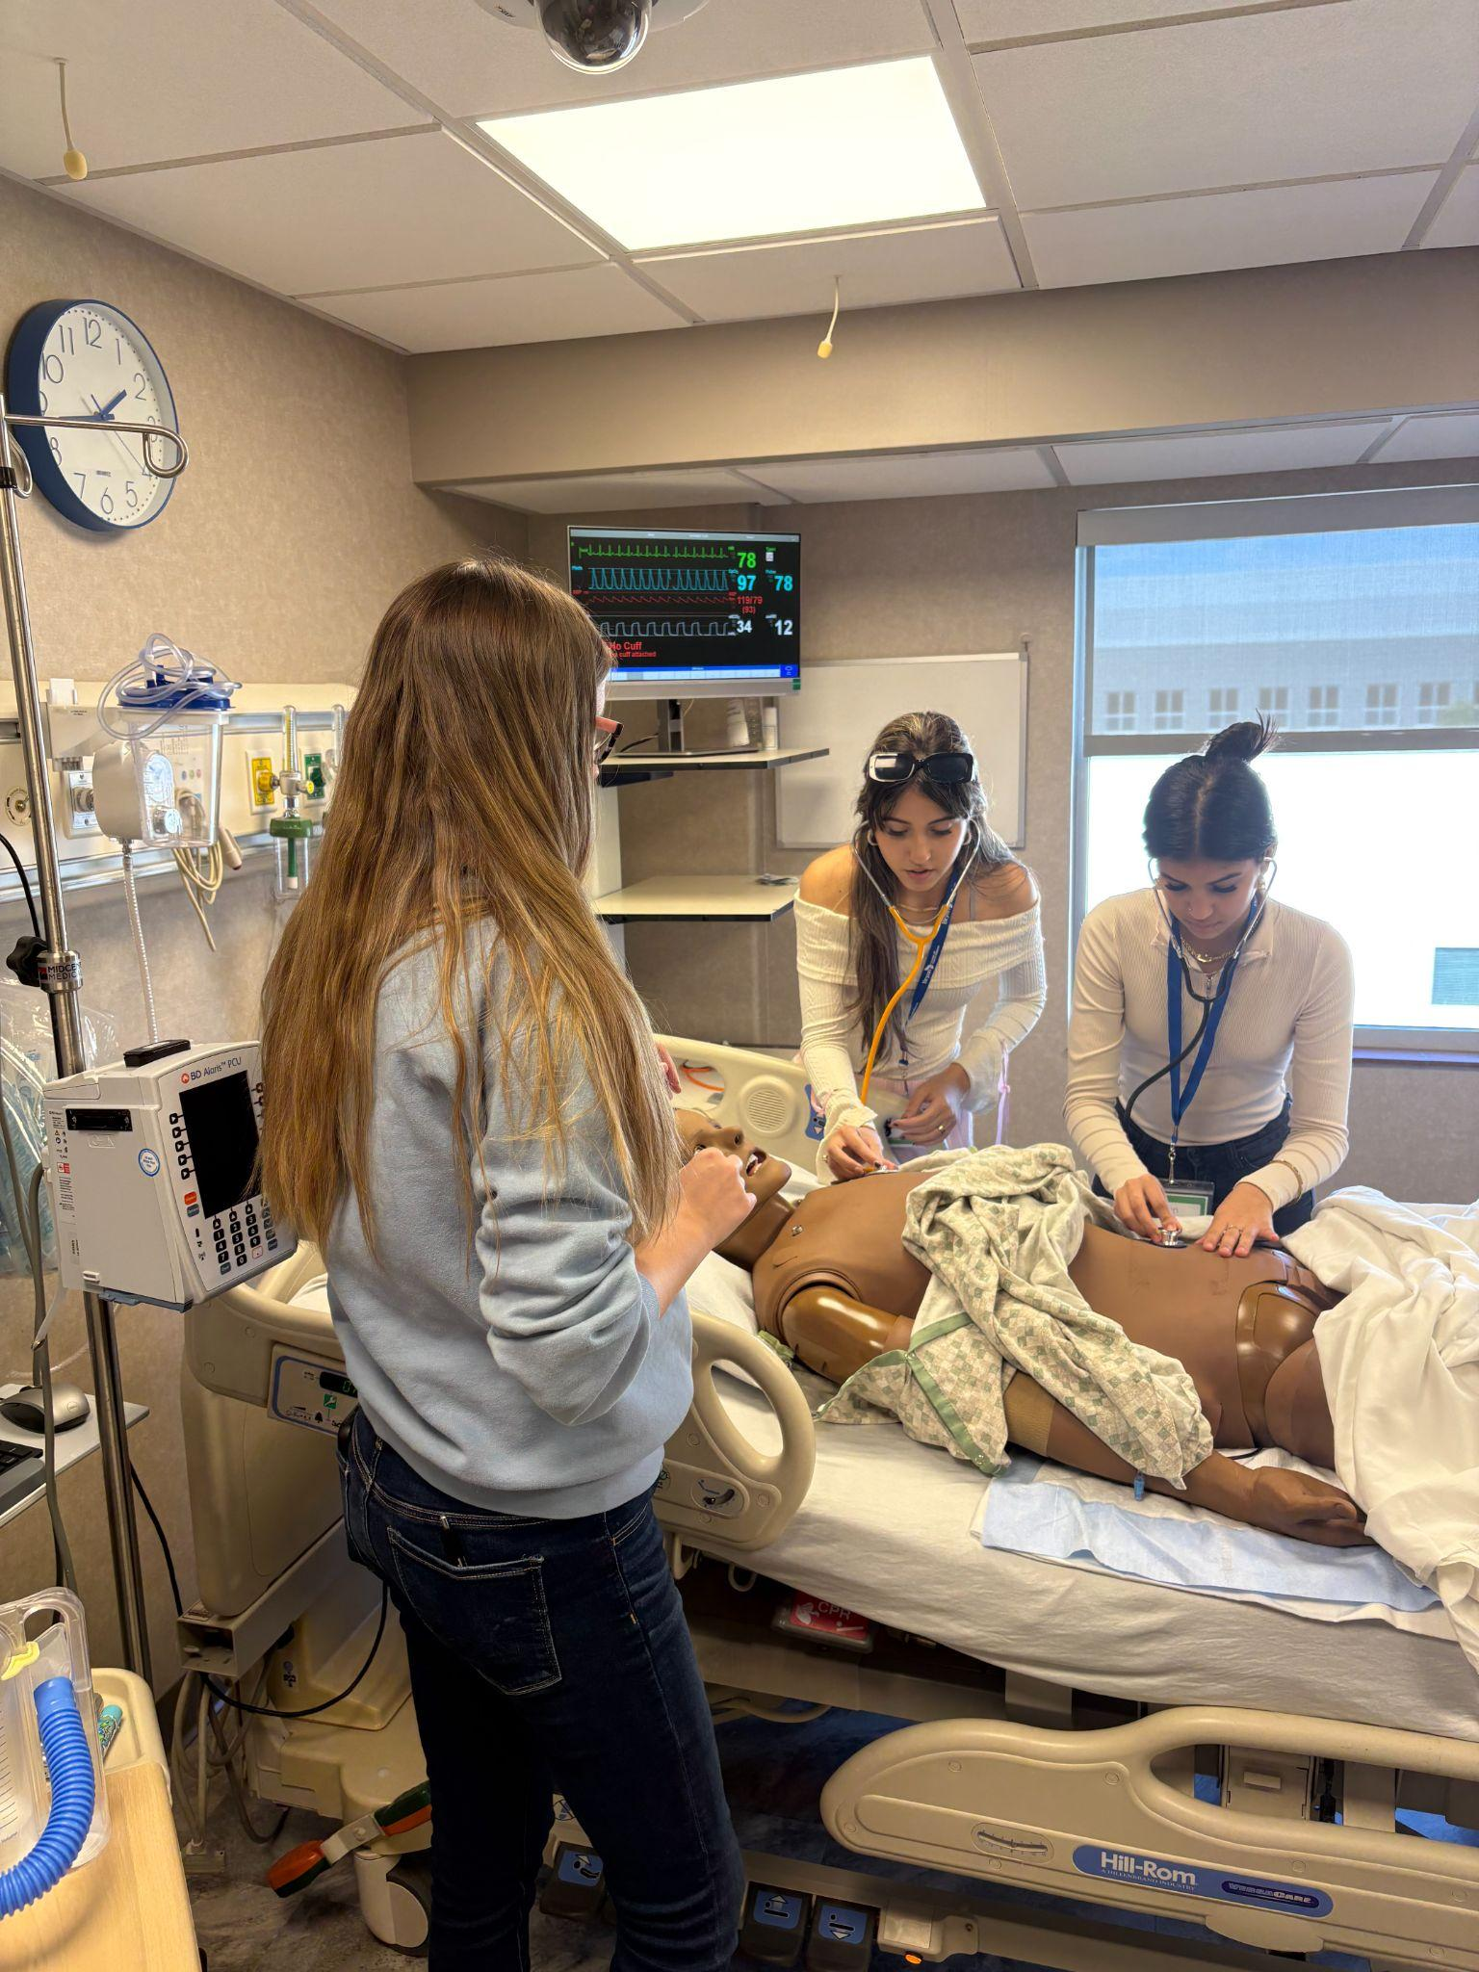
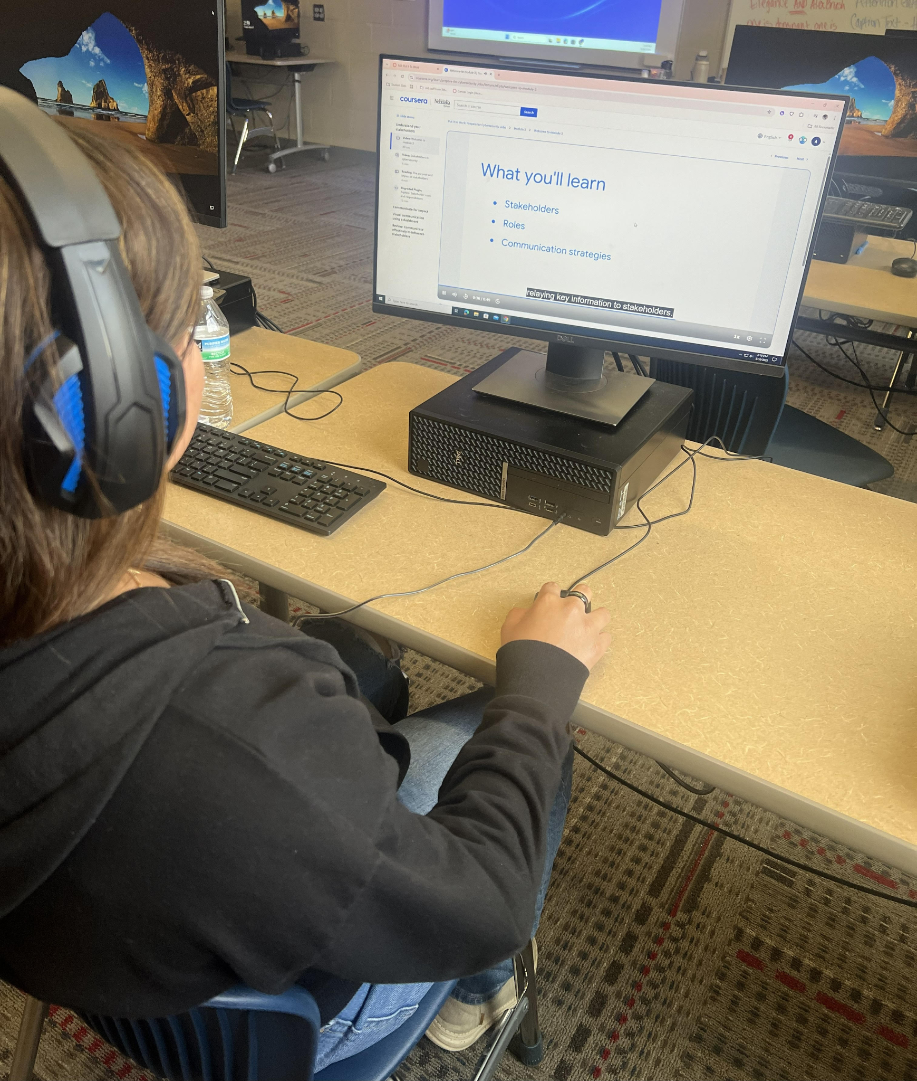
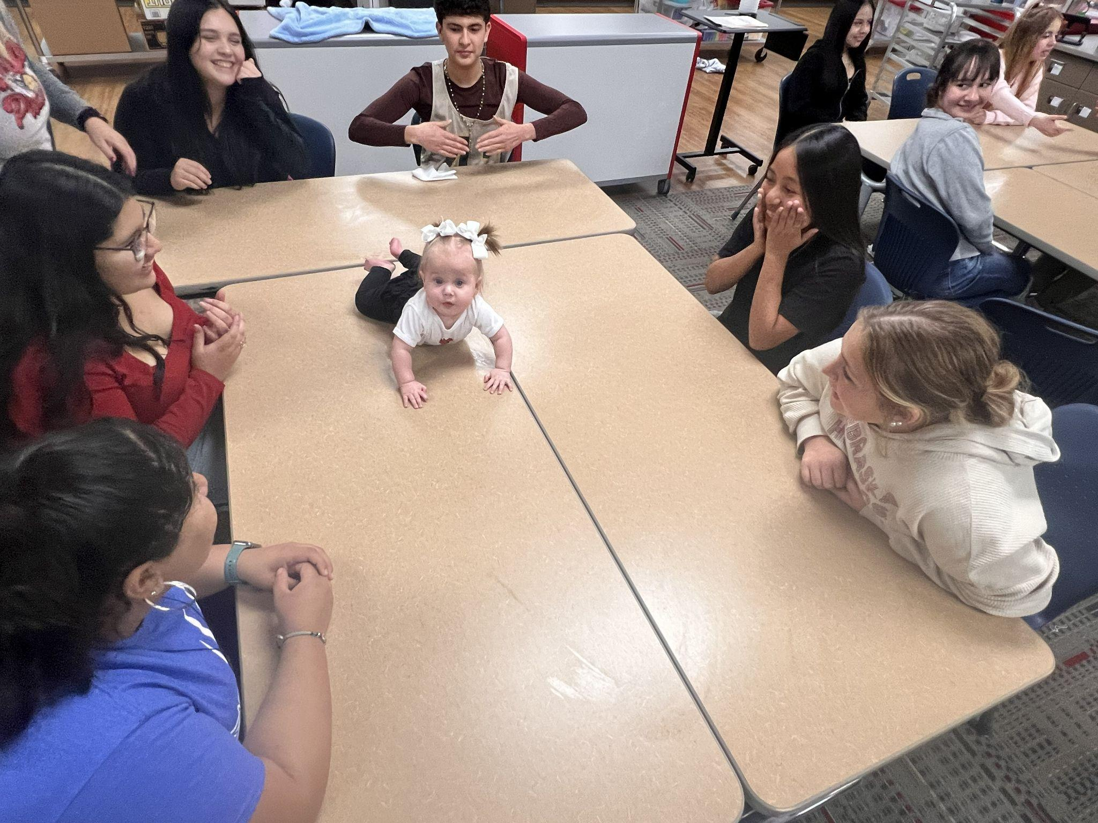
Pathway Experiences
Notes:
CK

Slide 36

Senior Year
BIG Year Ahead!
  Graduating class of 2027 is our FIRST “Pathway Completer” class.
  Will graduate with the title of “Diploma Plus”
    Still working on what that looks like. Seal on their diploma? Cord? Other? Ideas?
    All of our pathway completers will graduate with college credits and or industry certifications.
Capstone Project: Project, Paper, Presentation
  Grades for the Paper and Presentation in their Senior English Class. Project graded by the pathway teacher and reviewed by business partners during Career Expo.
  Proposal Due before summer of their senior year.
  Project can be done with partners, but everyone has to do the paper independently, and participate in the presentation.
  We will add a Capstone Project Presentation as a portion of our Career Expo.
  Work Based Learning Experience
    All seniors will complete between May after junior year, and sometime during their senior year.
    Job Shadow, Apprenticeship, Internship, Hired part Time
      Must relate to pathway.
Notes:
MH

Slide 37
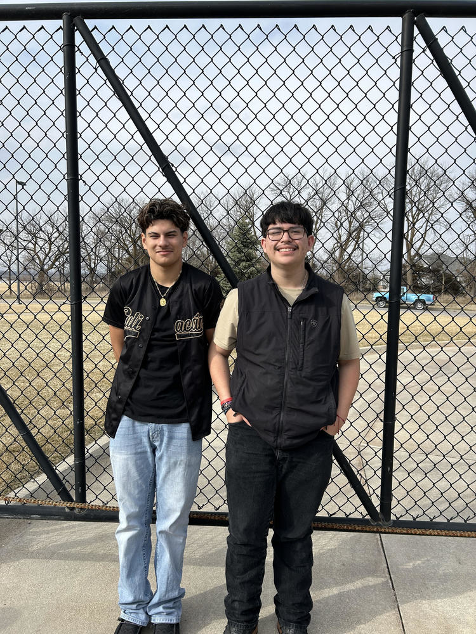

Kawasaki Paid Internship
Two of our Welding Pathway juniors were selected to be in the Summer Kawasaki Paid Internship Program! This will count as their Work Based Learning Experience!
Raul Escandon and Julian Lopez-Ochoa
Notes:
MH

Slide 38

Which result in…………
Increased Graduation Rate
Increased Daily Attendance Rate
Increased Student Achievement
Students Invested in the Community
Discipline Incidents Decrease
ACT Scores Rise
Improved Teacher Efficacy
Notes:
MH

Slide 39
HOW WE WILL MEASURE SUCCESS
PERFORMANCE
Drop-out rates
Attendance
Course Failure Rates
5-year Historical Freshman Data
College and Career Metrics
FEEDBACK
Student Engagement
Teacher-Student Relationships
Community Partner Feedback
Stakeholder Feedback
Increased Teacher Collaboration
LONG-TERM PATHWAY MEASURES
Industry Certifications
Course Failure and credit deficiencies decline
Dropout rate decline
Graduation rate increase
Student and graduate placement in the workforce
Notes:
MH

Slide 40

Great Things Happening at Crete High School
Leveraging revision grant funding to design and implement innovative College and Career Academies that prepare Crete High School students for future success.
Notes:
MH

Slide 41
Funding your academy
Perkins
Revision
Local businesses
Foundations
Notes:
MH

Slide 42
New Equipment
NCAC Professional Development for entire staff on transitioning to the academy model.
Welding equipment, Construction equipment, SnapOn Tools tool boxes, robots, drones, medical devices, cameras.
Field trips
8th grade transition nights
Student ambassador training.
  Grand Island HS
  Omaha North HS
Notes:
CK

Slide 43
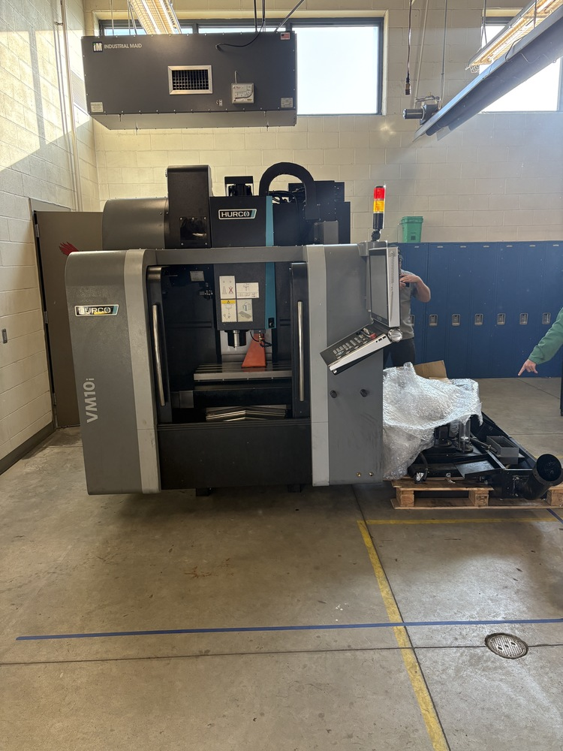
HURCO CNC MILL
Real-world experience in machining and manufacturing
Hands-on STEM learning through math, engineering, and technology applications
Preparation for careers in welding, machining, robotics, engineering, and industrial technology
Workforce readiness skills such as problem-solving, precision, teamwork, and safety
Exposure to college, apprenticeship, and certification opportunities in technical fields
Project-based learning that allows students to create
real products and prototypes
The machine helps bridge classroom learning with high-demand career pathways and provides students with opportunities that mirror modern manufacturing environments.

Slide 44
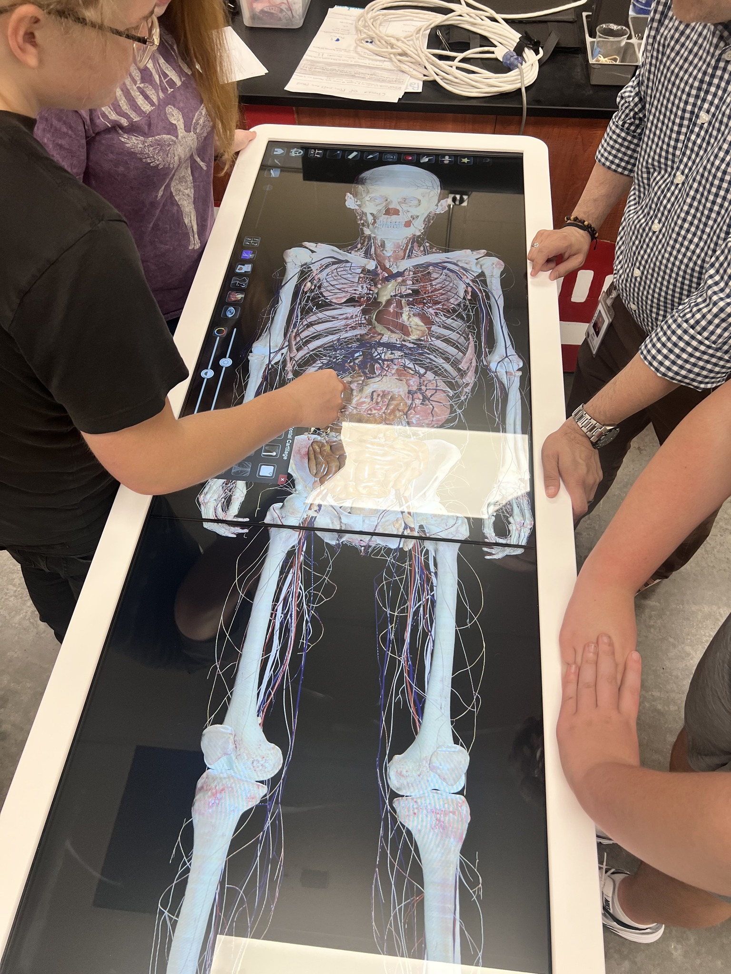
Anatomage Table
Technology for Health Science Pathway and Agriculture Pathway (Vet Sciences).
Hands on, Industry relevant learning experiences.
Strengthens delivery of instructions and student engagement.
Ensures that ALL learners no matter their status are fully engaged in CTE programming.
Prepares our students for college level science courses.
Notes:
MH

Slide 45
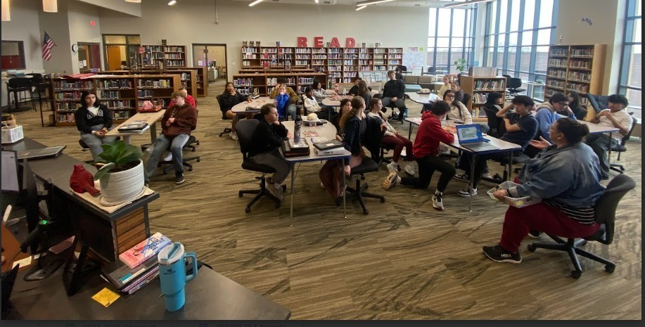
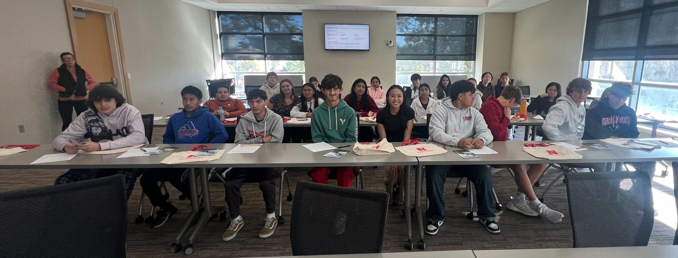
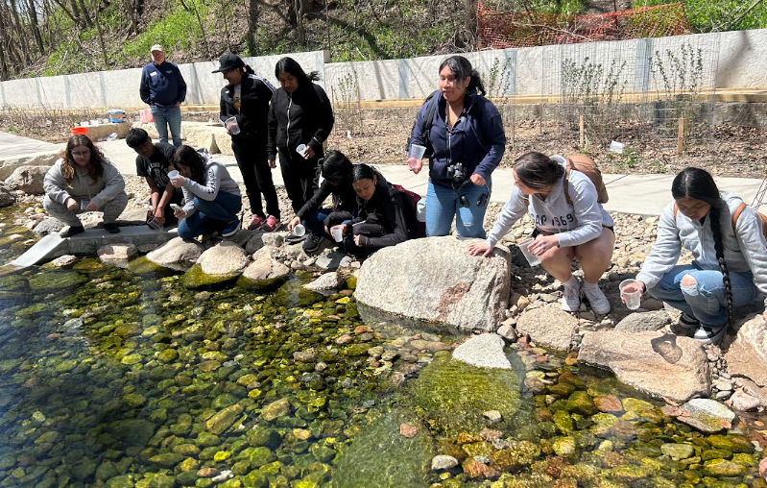
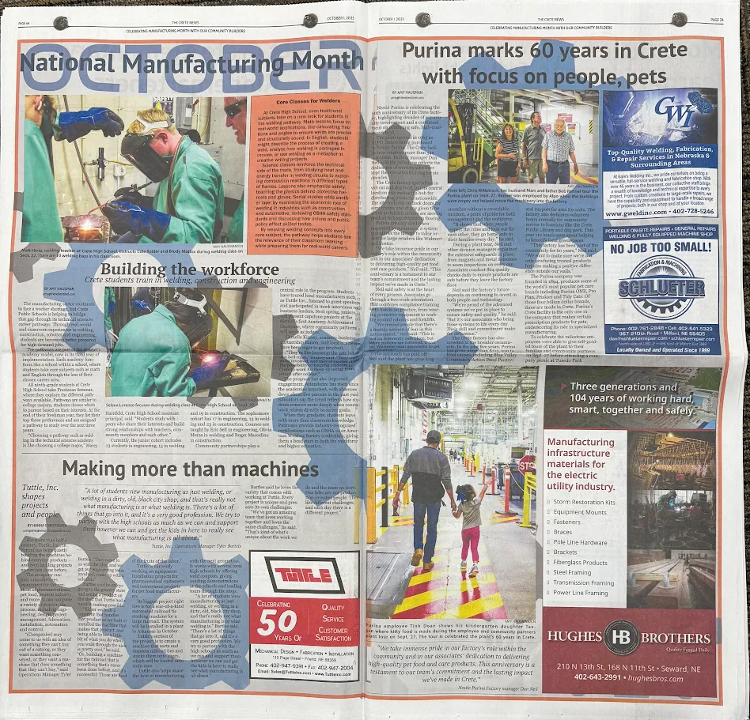
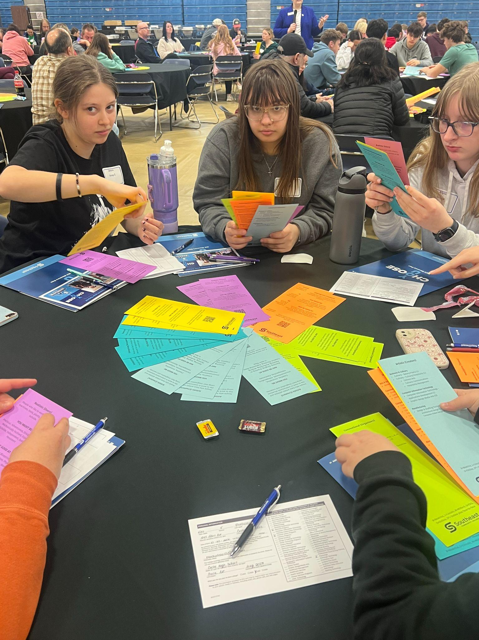
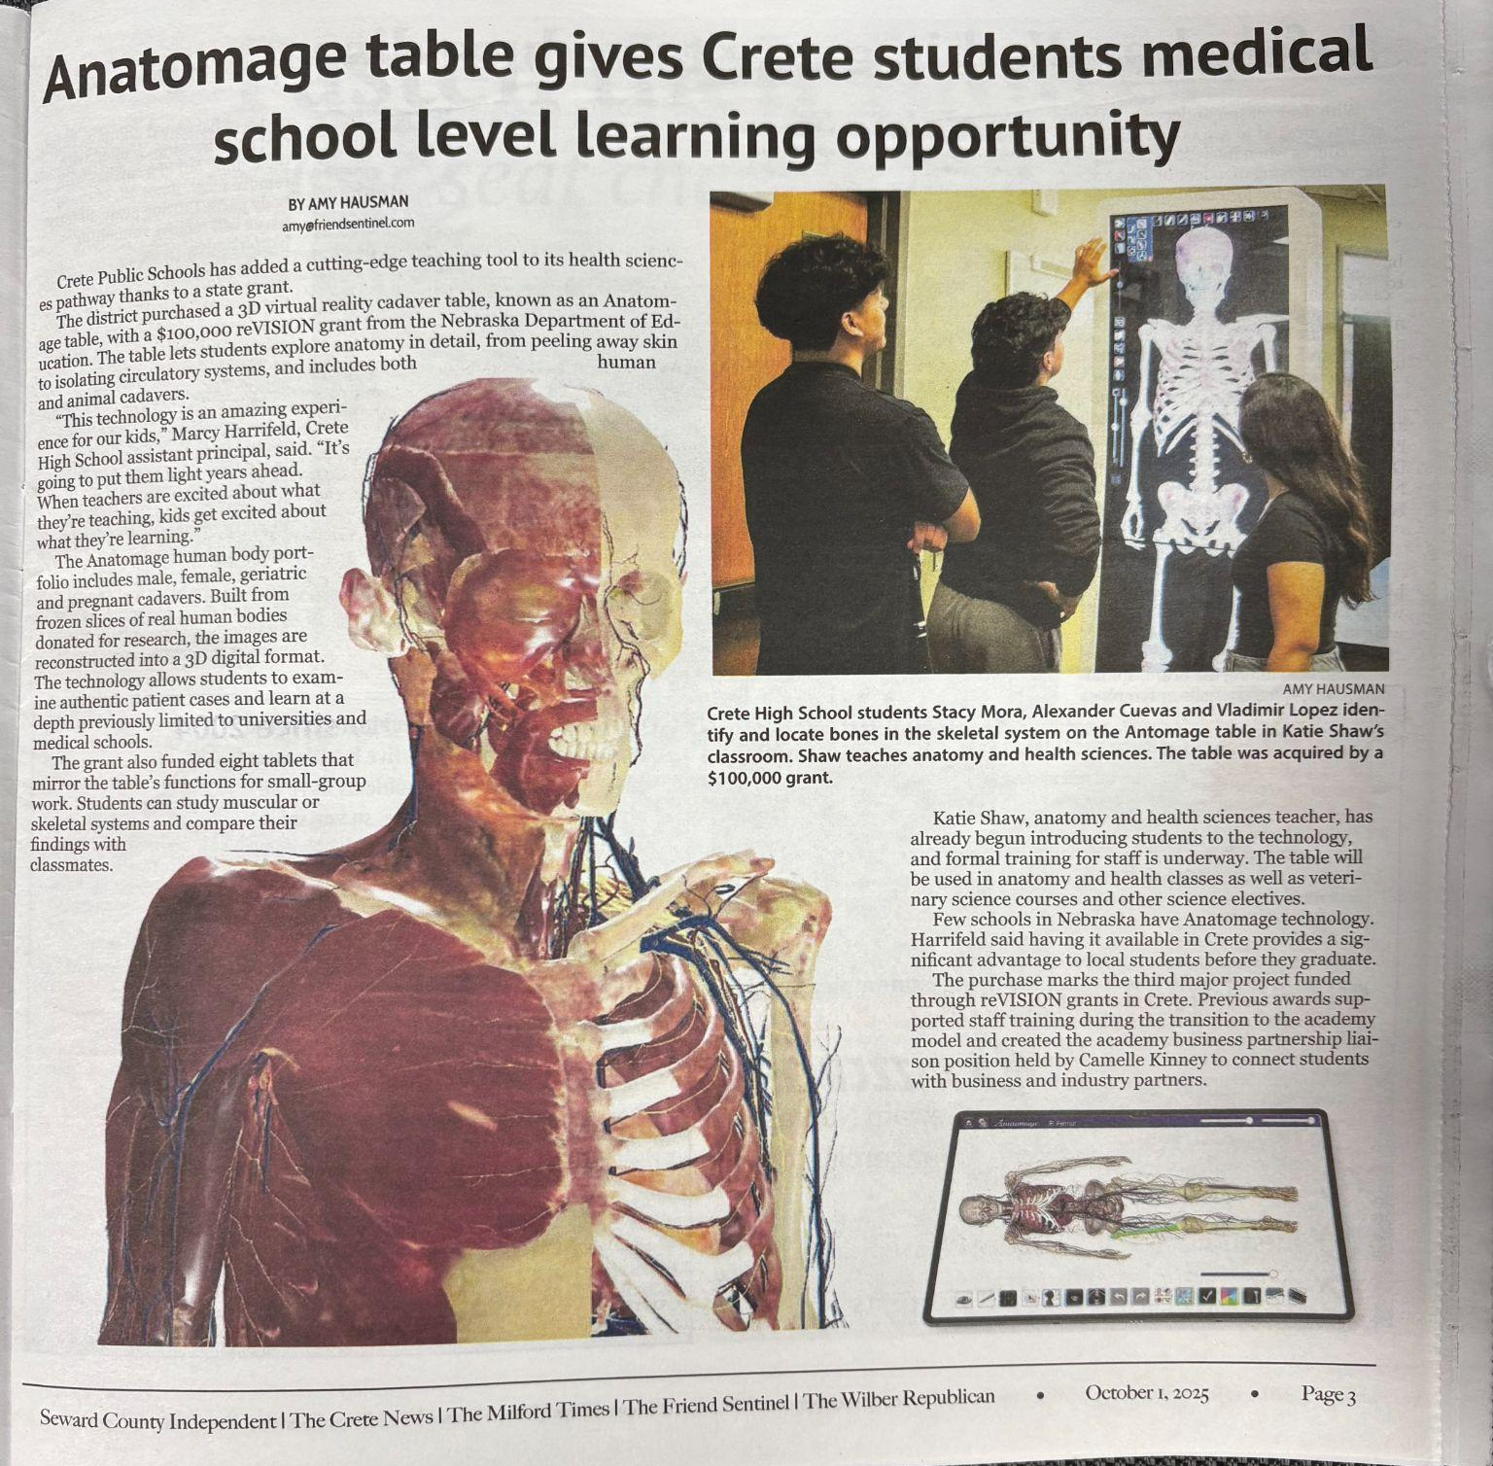
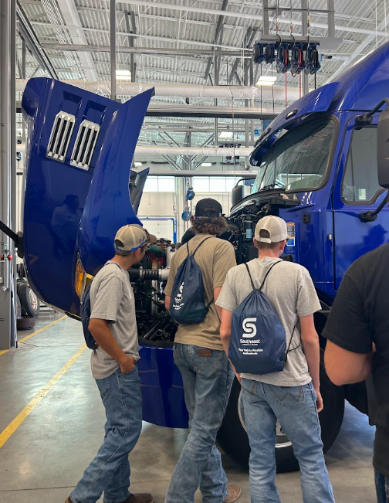
Notes:
MH

Slide 46

ALL GRADUATES
READY FOR COLLEGE, CAREER AND LIFE!
Notes:
MH

Slide 47

SO NOW WHAT?
How can you get started at your school?
Notes:
MH

