Slide 1

Have You Considered Becoming an STS Teacher?

Slide 2

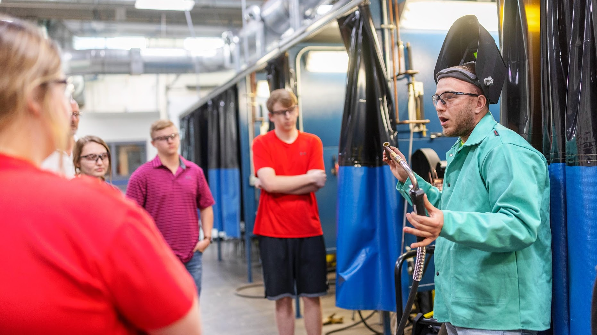
TEACHING AS A CAREER
Why might someone consider teaching as a career?
  You get to teach something you are good at and enjoy doing
  High Wage, High Skill, & High Demand Career
    Good Benefits
  Schedule
    Good Working Hours
    Summers Off, Fall Break, Winter Break, Spring Break
  Rewarding - You have the opportunity to build relationships & change lives!
  Respected Career in the Community

Slide 3
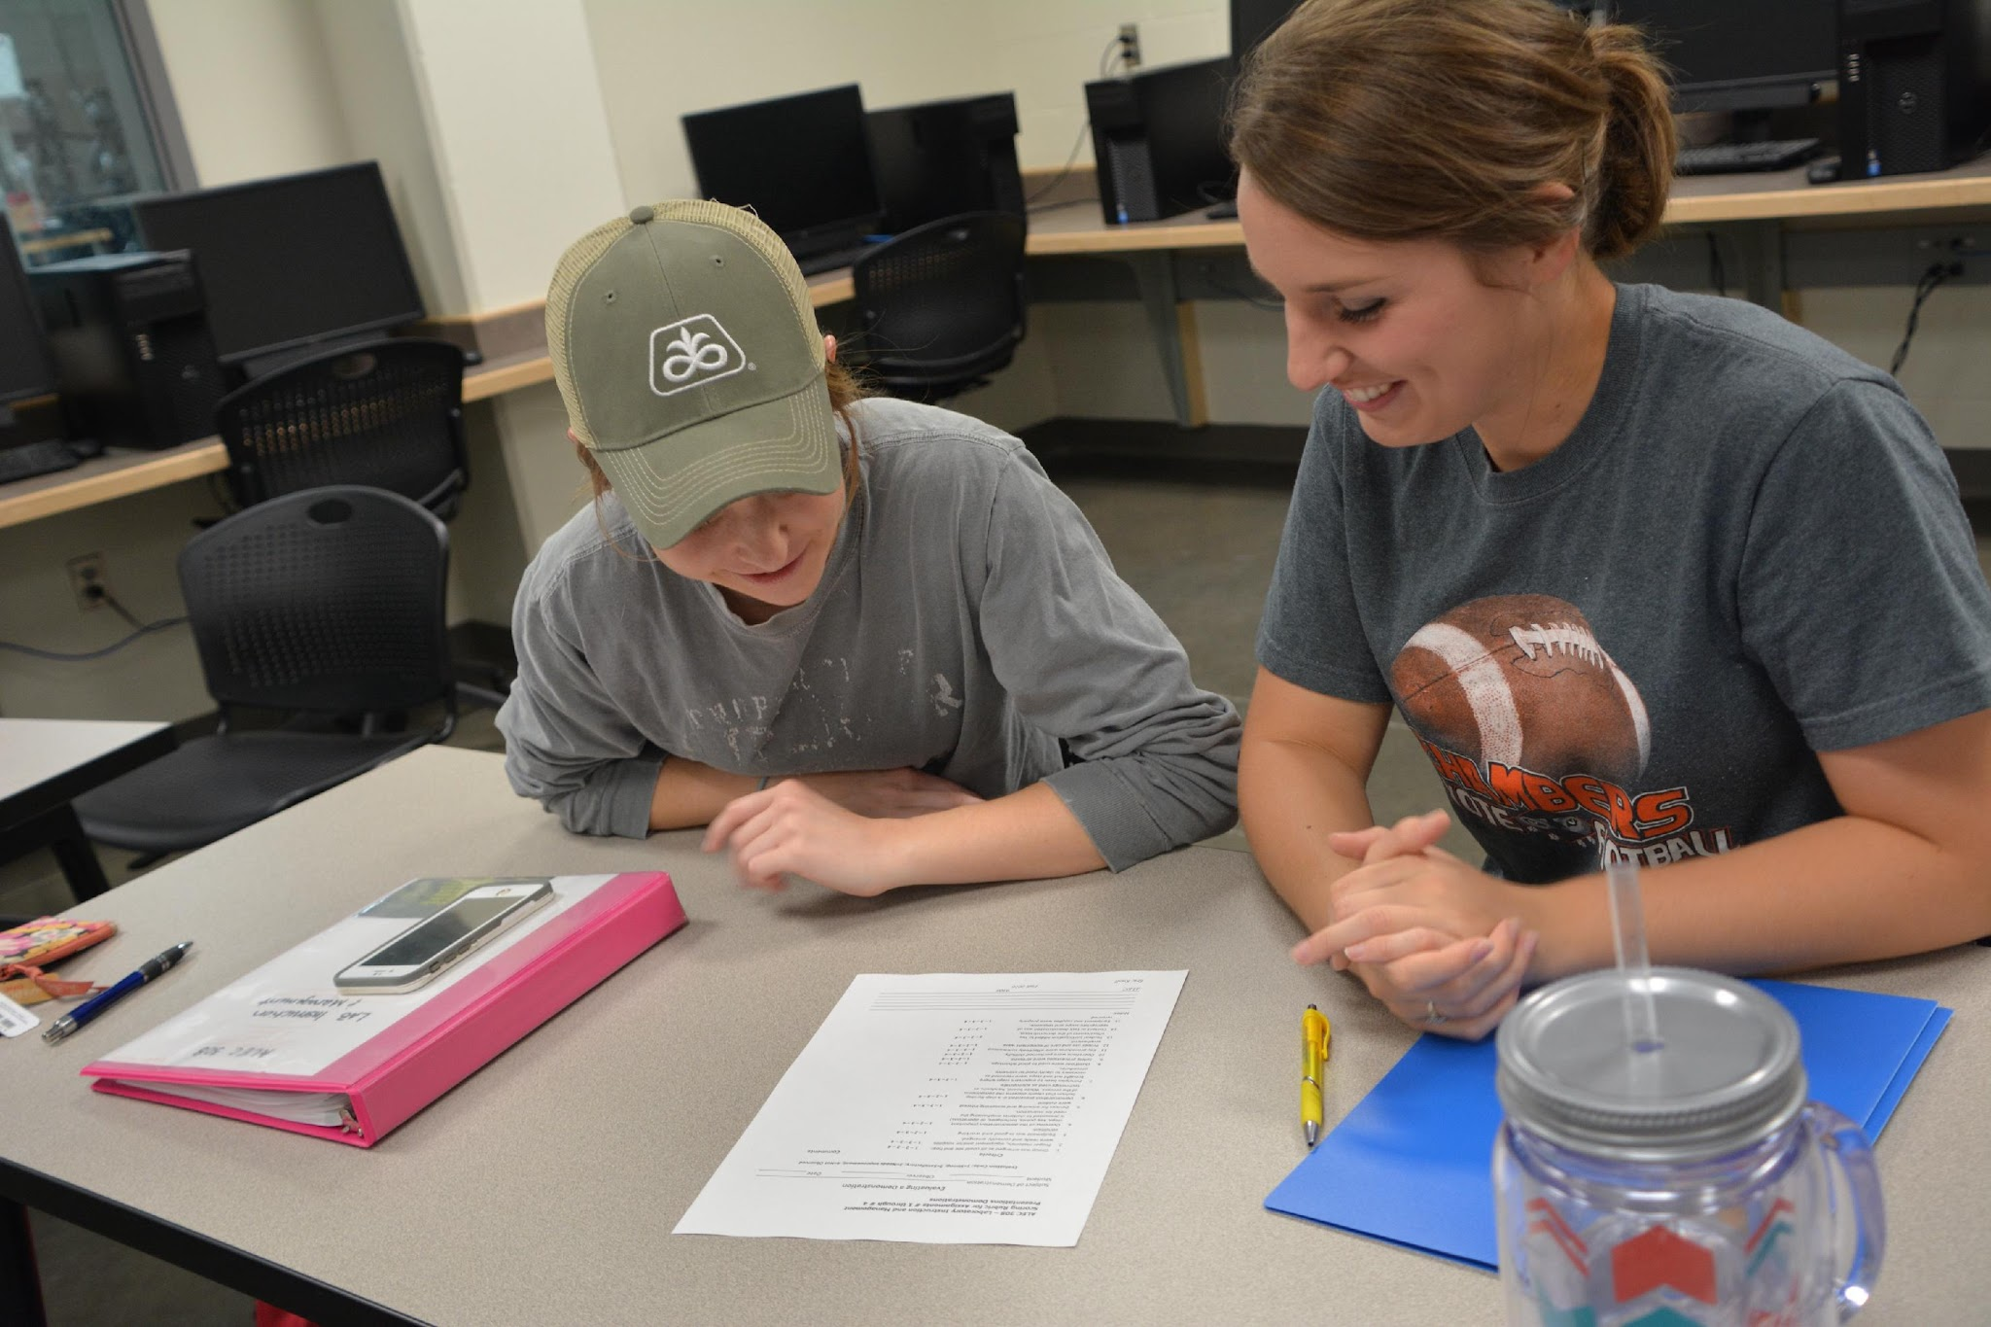
Perceptions About Teaching
Why People Might Not Choose Teaching As A Profession
  The perception that the pay is not very good
  The perception that all you deal with is behavior
  The perception that there is no work-life balance

Slide 4
Teaching As A Career
Schedule
  Teachers have a work a 189-day contract (175 student learning days) meaning there are 176 days they have off.
Pay
  New LPS Teacher: $49,556
    = $37.46 / hour (work 189 days)
  First year engineer in the workforce: $60,000 (work all year)
    = $30 / hour

Slide 5
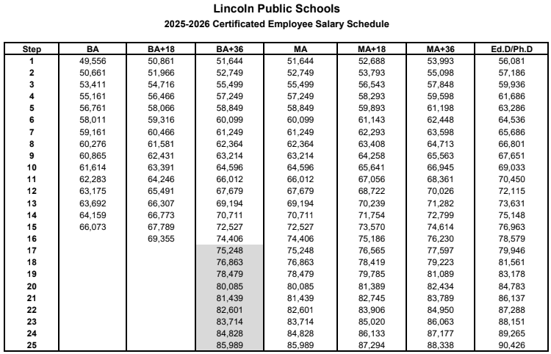

Slide 6



AVERAGE PAY COMPARISON
NEBRASKA
BUREAU OF LABOR STATISTICS
The annual mean wage for all occupations in Nebraska is $50,990
Teachers make about $10,000 more than the average wage
On average CTE teachers make $1300 more than other teachers

Slide 7
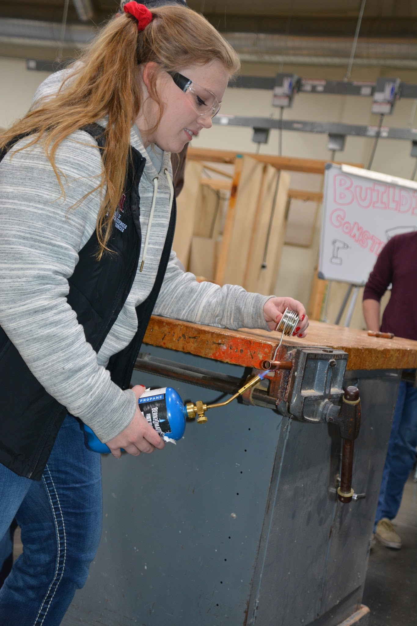
Teaching As A Career
Insurance
  Schools offer a range of insurance options including health, dental, vision, life, disability, accident, and critical illness coverage.
Retirement Benefits
  401K Retirement Plan
  NE Retirement System - At retirement age, a monthly payment is provided until death (usually 55%-70% of your ending salary)

Slide 8
Teaching As A Career
Working Conditions
  Colleagues - The other teachers you work with often become very good friends.
  Students - There is a perception that all teachers do is deal with behavior.
    90%-10% Rule: 90% of the students are great to work with and very rewarding.
    In every career there will be people (10%) that you may not get along with.

Slide 9


Slide 10


Slide 11
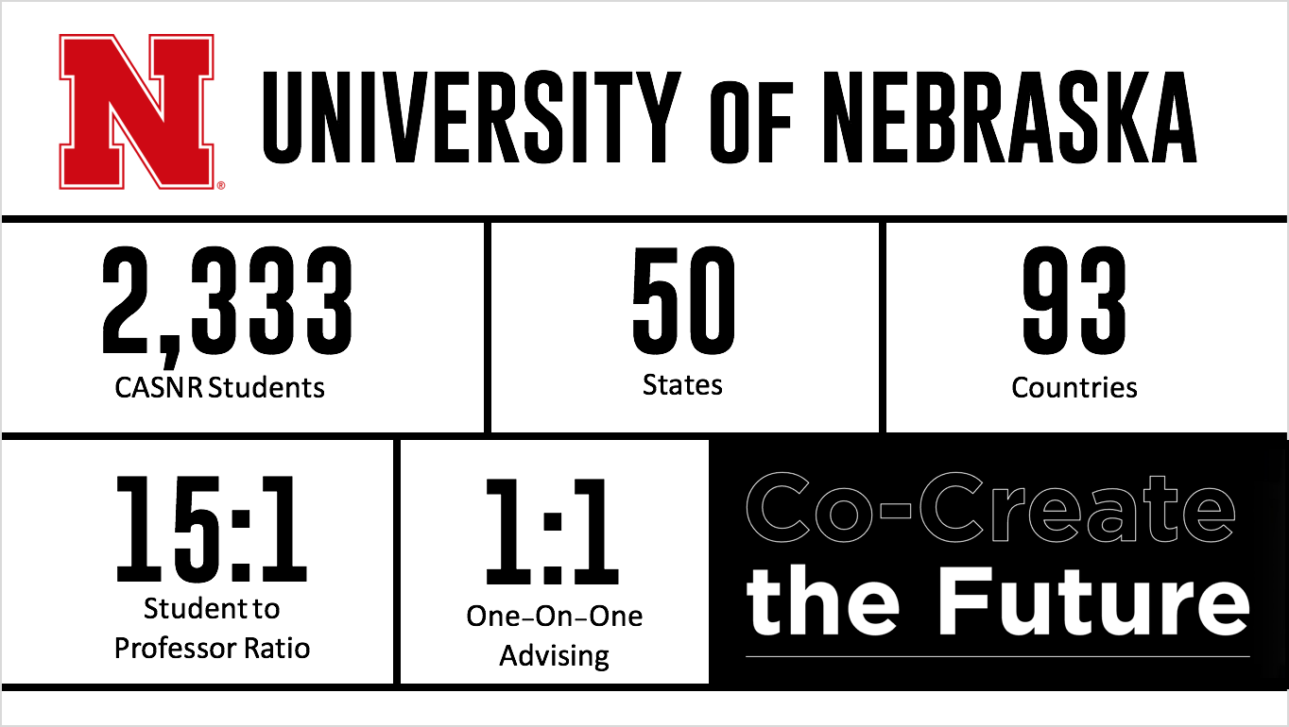

Slide 12
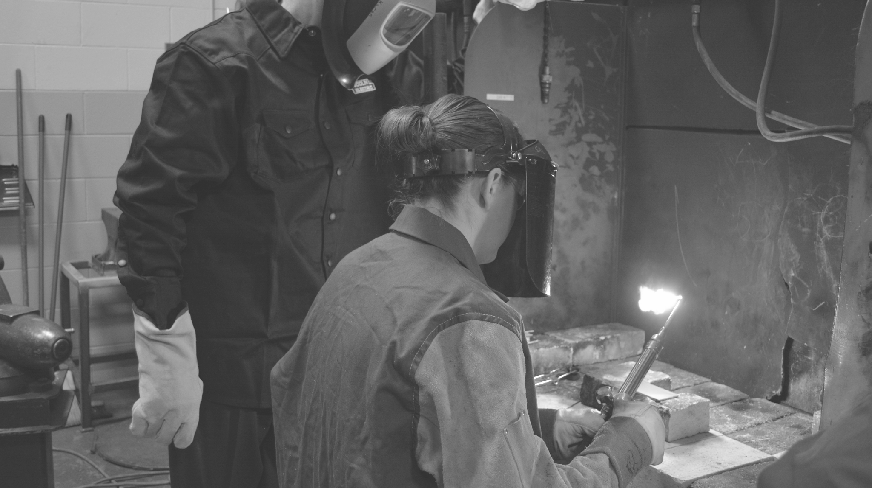
UNL 2 + 2 STS TEACHING PROGRAM
Tuition cost savings at the community colleges will result in over $9,000 in savings during the first two years of this degree option.
$ 1000 and $2500 scholarships are available from local industry to support the STS teaching program. Paid internships are also available with Kawasaki, Molex, and the Association of General Contractors at $4500.
Students in the program are considered UNL students for all four years and may take advantage of all of UNL’s student experiences.
Our goal is students graduate DEBT FREE!

Slide 13
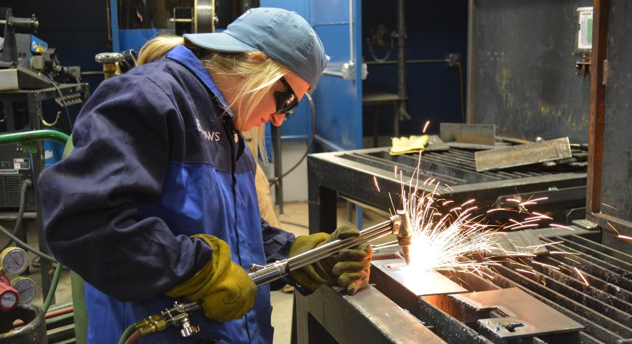
EMPLOYMENT OUTLOOK
In 2023 there were approximately 430 industrial technology (STS) teachers in Nebraska.
The Nebraska department of education is projecting 15 to 20 retirements each year for the next 7 – 10 years.
This school year, there were multiple STS jobs throughout the state that didn’t get filled due to a lack of applicants.

Slide 14
ARE YOU CONSIDERING A CAREER AS AN STS TEACHER OR WANT TO LEARN MORE?
LPS is partnering with Southeast Community College (SCC) and the University of Nebraska-Lincoln (UNL) to offer LPS students an opportunity to visit each campus and learn more about the program and a career as an STS Teacher.
Transportation & lunch will be provided
If you are interested in learning more about the program OR are interested in taking a field trip to SCC & UNL please fill out the Google Form using this Jump Code: GGCX

Slide 15
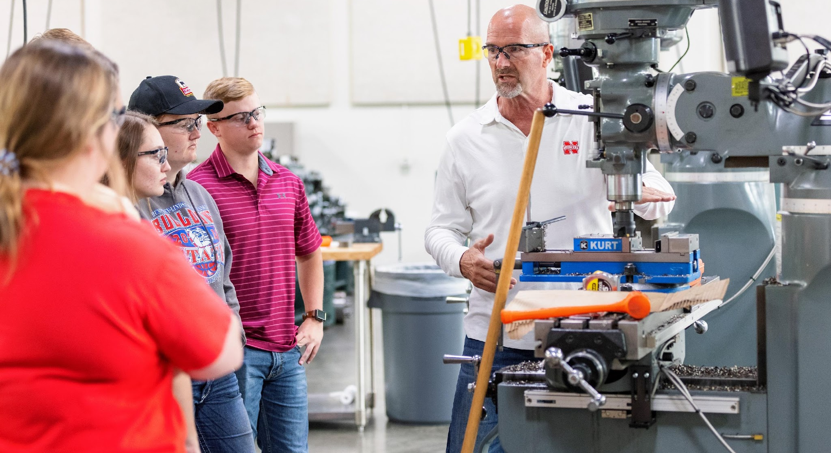
CONTACT INFORMATION
UNL PROGRAM CONTACT
ERIC KNOLL
  E-MAIL: EKNOLL2@UNL.EDU
  CELL: 402-310-2109

