Slide 1

Human Sciences & Education &
Health Sciences Career Field Luncheon
Welcome!

Slide 2

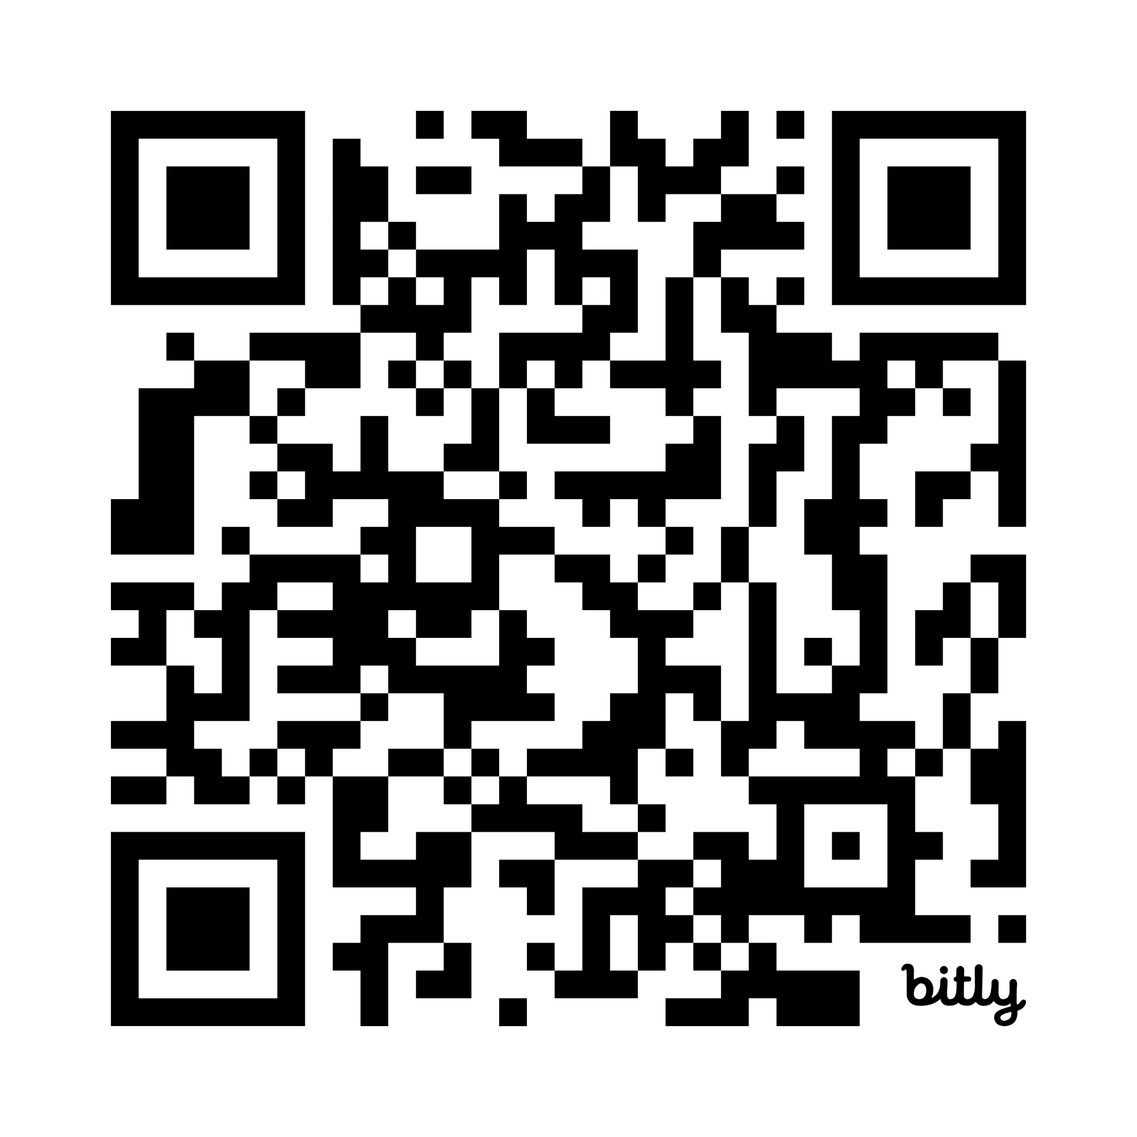
bit.ly/NCE26checkin
Welcome!
Human Sciences & Education &
Health Sciences Career Field Luncheon

Slide 3


The Marigold Effect
Gonzalez, J. (2013, August 29). Find your marigold: The one essential rule for new teachers. Cult of Pedagogy. https://www.cultofpedagogy.com/marigolds/
Notes:
Teaching is hard work, and the people around us matter more than we sometimes realize. In every profession, there are people who help others grow. These are the marigolds.
Marigolds are encouraging, supportive, positive, and willing to help. They celebrate successes, share ideas, and remind us why we chose this profession. When you spend time around marigolds, you leave conversations feeling more hopeful, capable, and motivated.
Just like marigolds help gardens thrive, positive educators help schools thrive.

Slide 4

Beware of the Walnut Trees
Notes:
But every profession also has walnut trees.
Walnut trees represent negativity, discouragement, and constant criticism. These are the people who drain energy, focus only on problems, and make others question themselves or the work they do.
The important thing to remember is that negativity spreads just as easily as positivity. The people we surround ourselves with can shape our mindset, our energy, and even our passion for teaching.
That is why it is so important to recognize the difference and intentionally choose who influences you.

Slide 5
Grow Good Things
Be A Marigold
Notes:
As educators, we all have a choice in what we grow in our profession and classrooms.
We can choose encouragement over criticism.
We can choose support over competition.
We can choose to help others grow.
Seek out the marigolds. Learn from them. And most importantly, be a marigold for someone else.
I encourage you to grow good things. Be a marigold.

Slide 6
Human Sciences
& Education
Career Field Update

Slide 7

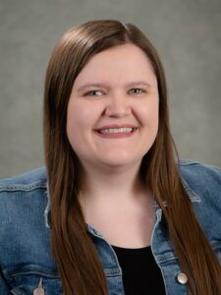
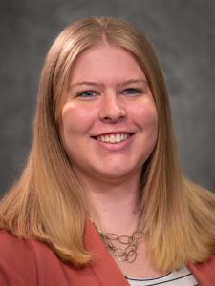
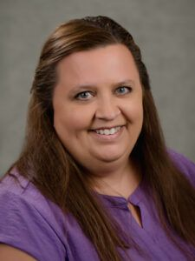
Human Sciences & Education Staff
Miranda Bright
Human Sciences & Education Career Field Specialist
(402) 937-5095
miranda.bright@nebraska.gov
Chelsey Greene
Nebraska Family, Career & Community Leaders of America State Adviser
Nebraska Educators Rising State Advisor
Human Sciences & Education
Career Field Specialist
(531) 207-3104
chelsey.greene@nebraska.gov
Erin Johnson
Human Sciences & Education Office Associate
(402) 309-6413
erin.johnson@nebraska.gov

Slide 8

To email, simply address your email to the list's assigned email address
Share and request resources
Monthly update shared on the first Wednesday
Email Miranda if you would like to be added to a Listserv
Education & Training & Educators Rising
nde-educationtraining@listserv.nebraska.gov
Family & Consumer Sciences
nde-fcs@listserv.nebraska.gov
FCCLA
nde-fccla@listserv.nebraska.gov
Law & Public Safety
nde-lawpublicsafety@listserv.nebraska.gov
Listserv

Slide 9


Join Professional Organizations
Benefits Include:
Advocacy
Networking
Resources
Awards & Scholarships
Leadership Opportunities
Law and Public Safety Education Network (LAPSEN)
Family & Consumer Sciences Teachers of Nebraska (FCSTN)
Division of the Association of Career and Technical Education of Nebraska (ACTEN)
Annual Membership Dues
$142 Professional Membership
($80 ACTE + $30 ACTEN + $32 FCSTN)
$32 Student Membership
Nebraska Association of Family & Consumer Sciences (NAFCS)
Affiliate of the American Association of Family and Consumer Sciences (AAFCS)
Annual Membership Dues
$150 Professional Membership
$50 Student Membership
NDE pays for a state membership to cover annual membership dues

Slide 10
Teacher of the Year (1-5 Years)
Audrey Foster
Teacher of the Year (6-15 Years)
Sarah Hubel
Teacher of the Year (16+ Years)
Darla Windholz
Special Service
Kristin Vest
Partnership
University of Nebraska–Lincoln’s Textiles, Merchandising, & Fashion Design
FCSTN Award Recipients

Slide 11


Slide 12
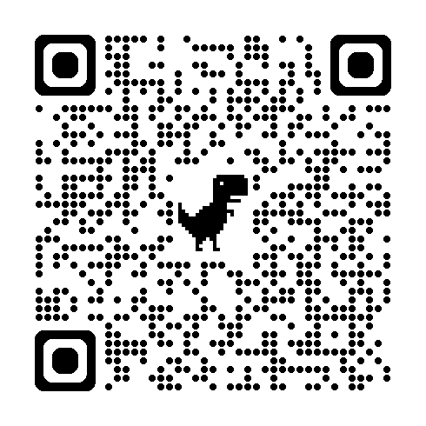

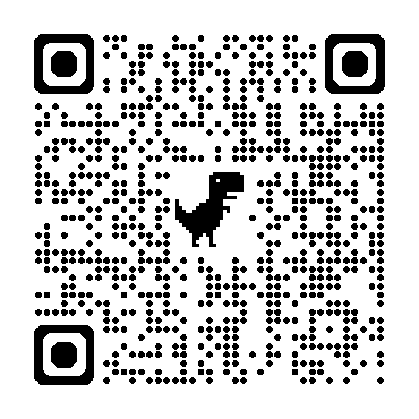
Family & Consumer Sciences
Teachers of Nebraska
2026-2027 Nebraska FCS
Teacher Directory
Nebraska FCS School-Based Enterprise Directory
Participation
Form
Teaching at a new school? Recently changed your name?
Check out the directory and make suggested changes!
Do you have a simulated or actual economically viable business that’s a part of your courses and generates money for your CTSO or school? It can be for short or long periods of time or sporadically.
shorturl.at/fCRG6
ALL FCS teachers are encouraged to complete the form!

Slide 13

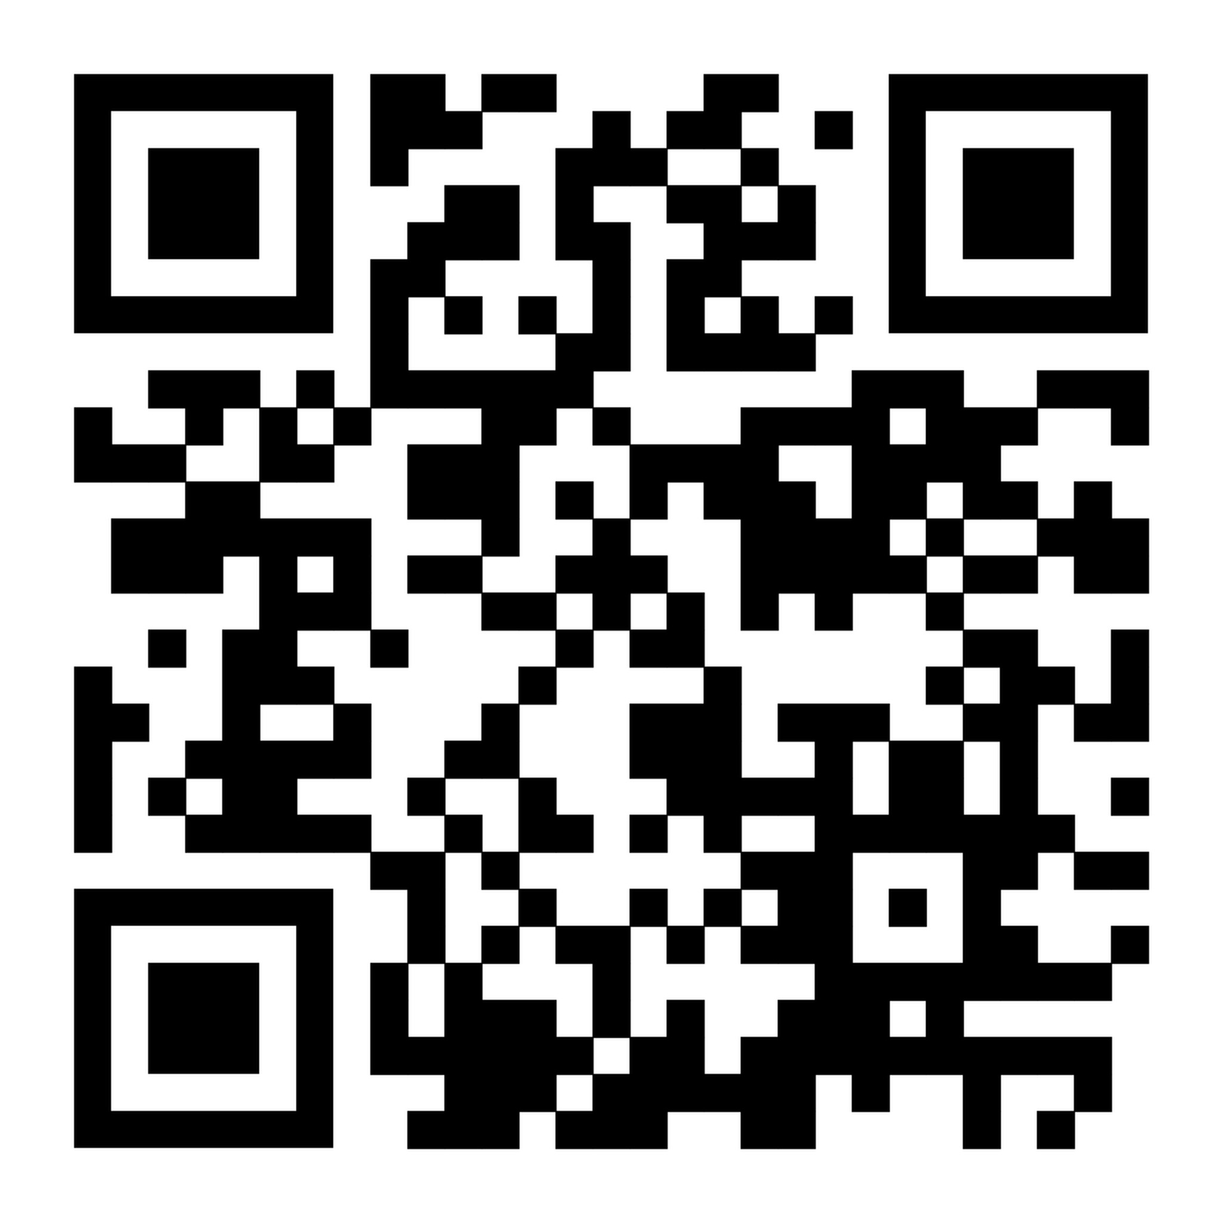
FCSTN: Cultivating Connection
Threads Across Nebraska 2026
FCSTN Cookbook Club
Meeting Social Ideas
Please give feedback on these ideas via the Google Form

Slide 14

National Professional Development
AAFCS Annual Conference
June 18–21, 2026, in Louisville, Kentucky
AAFCS Leadership Summit
September 18-20, 2026, in Pittsburgh, Pennsylvania
ACTE CareerTech VISION Conference
December 2-5, 2026, in New Orleans, Louisiana
CTE Region V Conference
April 7–9, 2027, in Colorado Springs, Colorado
WindowsWear National Teacher Professional Development Conference
TBD 2027, in New York City, New York

Slide 15
Human Sciences & Education Fall Workshops
Monday, October 5, 2026
Culinary Arts &
Event Planning
Central Community College in Hastings, NE
Relevant for those teaching:
Culinary Arts & Event Planning
Nutrition & Wellness
Middle School FCS
Thursday, October 8, 2026
Child Development Associate (CDA)
Educational Service Unit 3
in LaVista, NE
Relevant for those teaching:
Early Childhood Education
Education & Training
Monday, October 19, 2026
Adverse Childhood Experiences (ACEs)
BraveBe Child Advocacy Center in Lincoln, NE
Relevant for those teaching:
Behavioral Health
Child, Youth, & Family Studies
Counseling & Mental Health
Early Childhood Education
Education & Training

Slide 16
ESU Collaboration Days*
September 30, 2026
ESU 13 CTE Collaboration Day; Scottsbluff, NE
October 13, 2026
ESU 4,5,6 Collaboration Day; Beatrice, NE
October 27, 2026
ESU 1,2,7,8,17 NNNC Collaboration Day; Norfolk, NE
October 22, 2026
ESU 7 FCS Network Meeting; Columbus, NE
January 19, 2027
ESU 9,10,11 Collaboration Day; Kearney, NE
*These events are hosted by the ESUs with NDE staff presenting.

Slide 17

Save the Date
FCSTN New Teacher Workshop
November 9, 2026
ESU 10 in Kearney
Kids Feeding Kids Educator Institute
November 12-14, 2026
Wayne State College
NCE Conference
June 7-9, 2027
Younes Conference Center South in Kearney

Slide 18
Nebraska FCCLA Update

Slide 19
EdRising Teacher Leader Webinars
August 18, 2026 – Welcome Back!
November 2, 2026 – Competitive Events
December 1, 2026 – Recognition Opportunities + Supporting State Officer Candidates
January 5, 2027 – SLC Registration & Details
March 2, 2027 – Preparing for Nationals
April 13, 2027 – Reviewing National Competitors

Slide 20
Educators Rising Chapter Officer Leadership Academy
September 10, 2026 – Virtual
Western Nebraska CTSO Fall Leadership Conference
October 12, 2026 – Western Nebraska Community College; Scottsbluff, NE
Educators Rising Fall Leadership Conference
October 14, 2026 – UNO Milo Bail Student Center; Omaha, NE
National Educators Rising Week
February 1-5, 2027
Educators Rising State Leadership Conference
February 22-23, 2027 – Younes South Conference Center; Kearney, NE
Educators Rising National Conference
June 17-20, 2027 – Columbus, OH

Slide 21
Nebraska EdRising
Update

Slide 22
FCCLA Adviser Webinars
August 19, 2026 – Welcome Back!
October 7, 2026 – Competitive Events
December 16, 2026 – Supporting SPOT, State Officer, & National Officer Candidates
January 6, 2027 – FCCLA Week + Recognition Opportunities
February 3, 2027 – SLC Registration Details & Opportunities
April 14, 2027 – NLC Information

Slide 23
FCCLA Fall Leadership Conference
September 16, 2026 – Wayne State College; Wayne, NE
September 24, 2026 – University of Nebraska-Kearney; Kearney, NE
September 28, 2026 – University of Nebraska-Lincoln East Campus; Lincoln, NE
Western Nebraska CTSO Fall Leadership Conference
October 12, 2026 – Western Nebraska Community College; Scottsbluff, NE
Mind Bending Careers Conference with HOSA
November 9, 2026 – University of Nebraska Kearney; Kearney, NE
FCCLA Chapter Adviser Summit
January 13-17, 2027 – Grand Hyatt San Antonio River Walk; San Antonio, TX
National FCCLA Week
February 8-12, 2027
FCCLA State Leadership Conference
April 4-6, 2027 – Pinnacle Bank Arena; Lincoln, NE
FCCLA National Leadership Conference
June 22-26, 2027 – San Antonio, TX

Slide 24
Health Sciences
Career Field Update

Slide 25
To email, simply address your email to the list's assigned email address. Jami will receive a notification there is a message to be approved.
Share and request resources
Newsletters sent out during the school year.
Email Jami if you would like to be added to a Listserv.
Nebraska Health Science Educators
nde-healthsciences@listserv.nebraska.gov
Nebraska HOSA Advisors
nde-hosa@listserv.nebraska.gov
Listservs

Slide 26

National Consortium for Health Science Education (NCHSE)
Health Science Educators Association (HSEA)
  Professional learning network sponsored by NCHSE
  Annual membership fee - $50
  Access to exclusive classroom resources through a membership portal

Slide 27
National Consortium for Health Science Education (NCHSE)
2026 National Health Science Conference
  Birmingham, Alabama
  October 20-22, 2026, with Pre-conference on October 19
  Pre-conference:
    "See it. Touch it. Teach it. Bringing Health Science Education Back to Life."
    "Precision in Practice. Integrating Suturing Competency into Health Science Education."
  Information & registration
  Allowable use of Perkins funds if aligned with reVISION

Slide 28
College Board Opportunity
Did you teach Intro to Health Science or Anatomy & Physiology this past year?
College Board is looking for educators to review two new AP courses this July
  Compensated
  2-3 hours
  Let Jami know if interested – jamelyn.denny@nebraska.gov

Slide 29
Nebraska HOSA
Update

Slide 30
Nebraska HOSA
50 years of HOSA!
2,240 members across 60 chapters in 25-26; 250% growth in five years
International Leadership Conference to be held next week
HOSA Kickoff! scheduled for August 25th from 6:00-7:00 pm
Community Impact Summit with Educators Rising, FCCLA, and HOSA
State Leadership Conference will be held March 7-9, 2027
Health Science Experiences throughout the fall

Slide 31
Nebraska HOSA
Health Science Experiences throughout the fall:
Bryan College of Health Sciences – Oct. 20; Hastings, NE
Metro Community College – Oct. 30; Omaha, NE
Bryan College of Health Sciences – Nov. 18; Lincoln, NE
Northeast Community College – date TBD; Norfolk, NE

Slide 32
Nebraska HOSA
Chapter Grant Program (last year's for reference)
College Scholarships; ILC Scholarships
HOSA Advisor Development Program
Over 100, healthcare-focused competitive events

Slide 33
Career & Technical Education Update

Slide 34
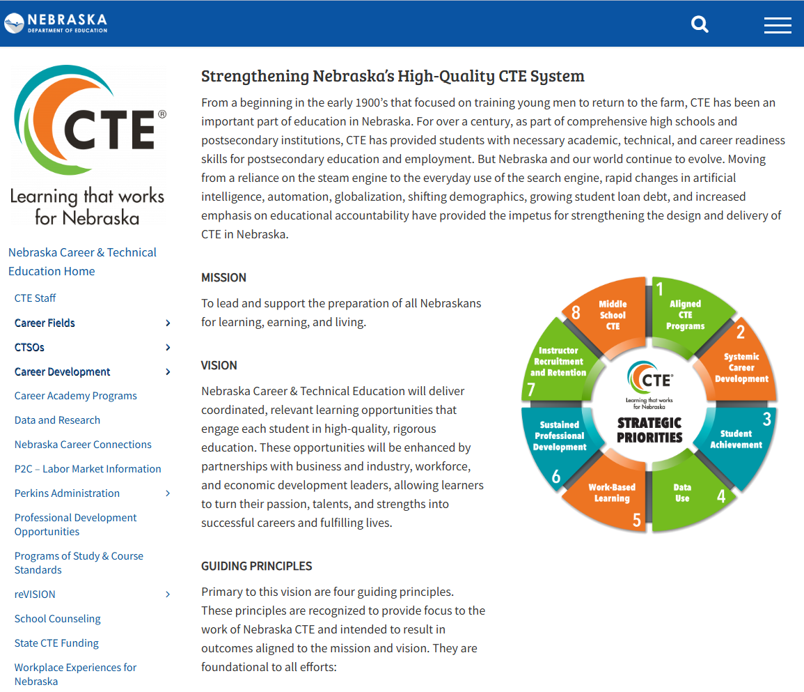
State Model Programs of Study
www.education.ne.gov/nce
Click on “Programs of Study & Course Standards”
Tip: Bookmark pages, not PDFs, so you have access to the most up-to-date file!

Slide 35

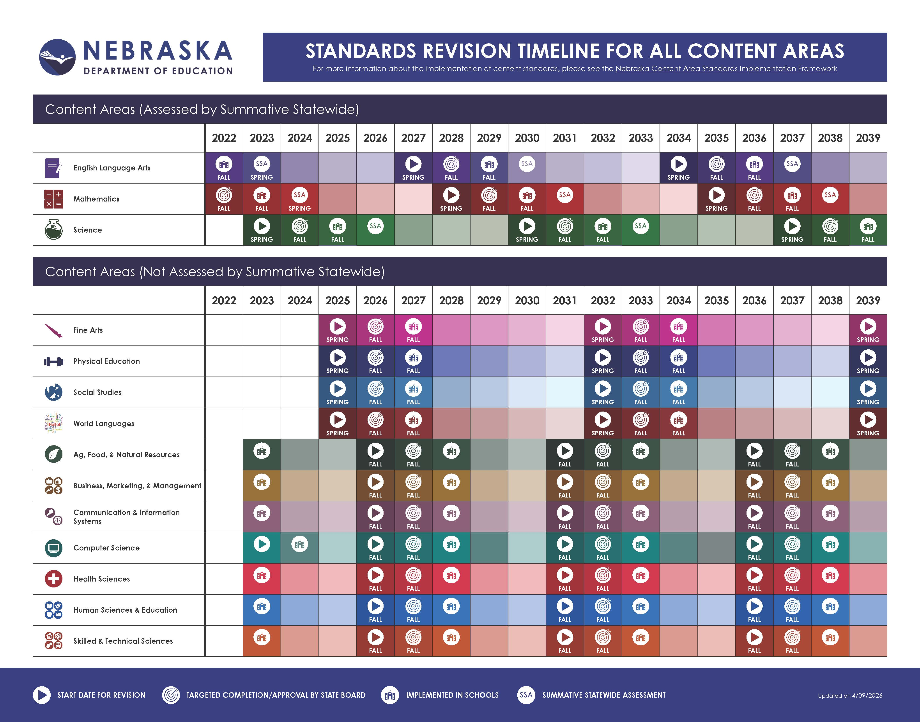
Notes:
CTE State Model Programs of Study and course-based standards are revised on a five-year cycle to remain responsive to the rapid advances and needs of business and industry, help students explore a variety of postsecondary options and corresponding entrance requirements to help identify their next steps, and to align to changes in postsecondary programs.

Slide 36
CTE Levels of Participation
CTE Participant
CTE Concentrator
Programs of Study
A student who has earned one or more credits in any CTE program area
A secondary student who, in grades 9 through 12, has earned credit in at least two courses in a single career cluster program at the intermediate or capstone level
Includes at least three sequential career education courses in a career cluster
Sequential courses build on knowledge and skills without duplication
CTE enrollment data is tracked at the course level

Slide 37
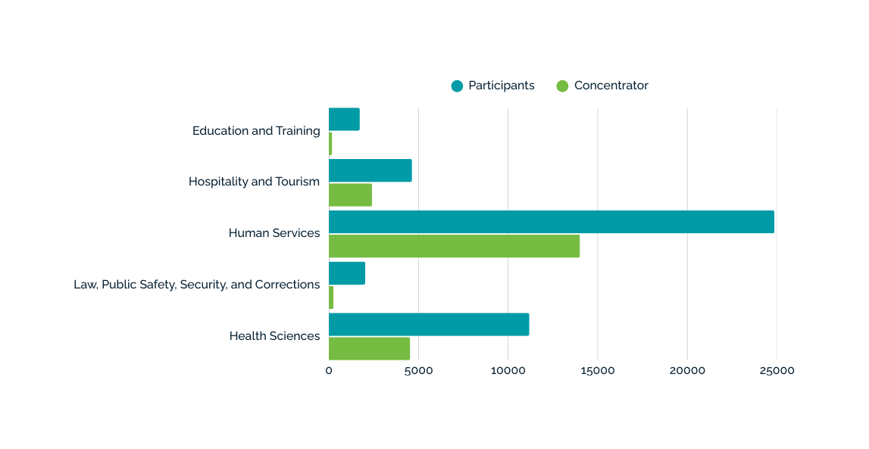
2024-2025 Participation Data
1,724 183
4,639 2,412
24,863 14,010
2,032 259
11,187 4,537
Nebraska overall had 129,520 CTE participants and 37,823 CTE concentrators

Slide 38
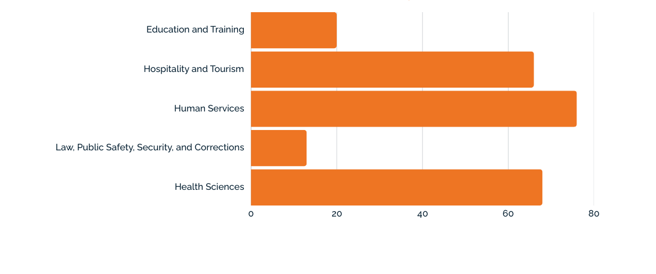
2024-2025 Participation Data
20
66
76
13
68
Schools offering at least one Program of Study

Slide 39
CTE Funding in Nebraska
Local District Funds
State CTE Grant
Federal Perkins Grant
Determined locally how district funds will support CTE.
Intended to improve and expand high-quality CTE learning opportunities for all students.
Career Development
Professional Development
Workforce Alignment
Technical Skills for H3 Careers
Integration of Academic Skills
Evaluate Activities

Slide 40
Nebraska CTE Formula Grants
 | Perkins Grants | State CTE Grant
Funding Source | Federal | State
Flow-Through to LEAs | $5,992,000 | $4,809,040
Allocation | Formula | Formula, $7,500 Minimum
Application/Budget Due | Spring | Spring
Grant Year | July 1 - June 30 | July 1 - June 30
Eligible Expenditures | See Grant Administrators’ Guide | Perkins+
Required Uses of Funds | 6 | None
Rational/Justification | reVISION Outcomes | reVISION Outcomes

Slide 41

Nebraska CTE Grant Administrators’ Guide
Access the Guide

Slide 42

Allowable &
Non-Allowable Expense​s
Need to be justified with your reVISION Outcomes
Need to be commercial or industry-grade
Ask yourself, is this heavy-duty and going to last?
Culinary Arts
Look for National Sanitation Foundation (NSF)
Ask yourself, would this be something they would use in a commercial culinary kitchen?

Slide 43
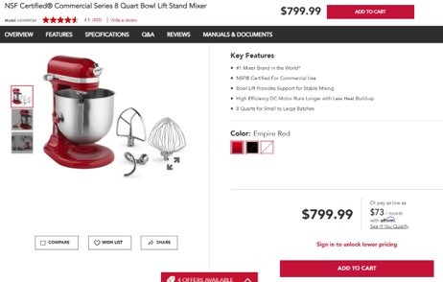
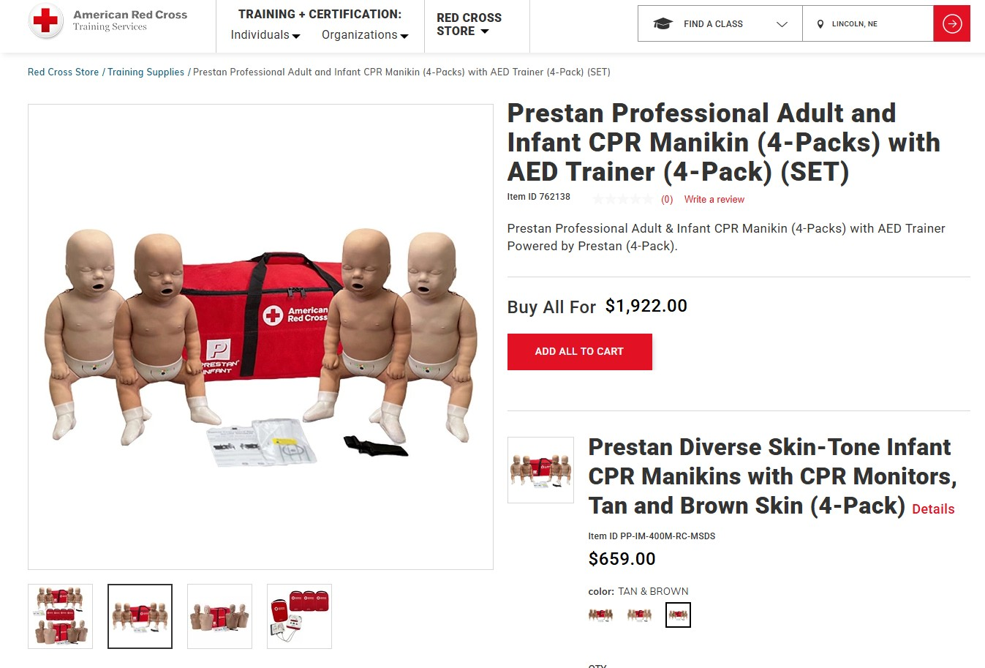
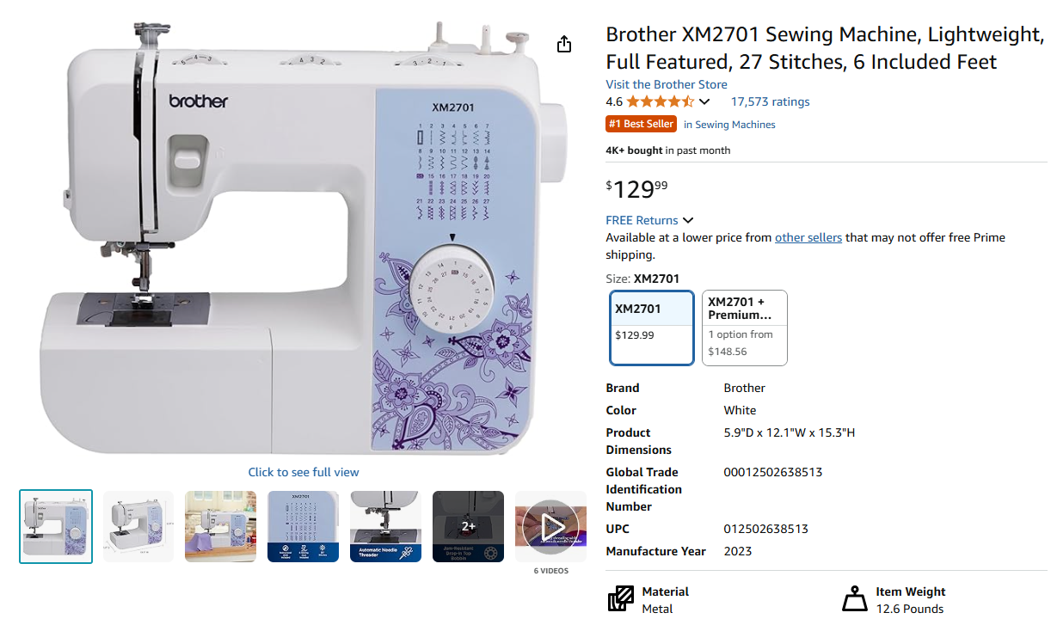
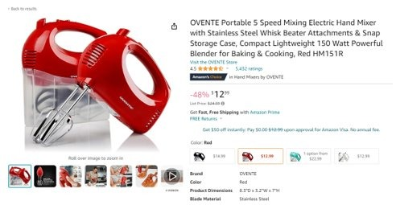
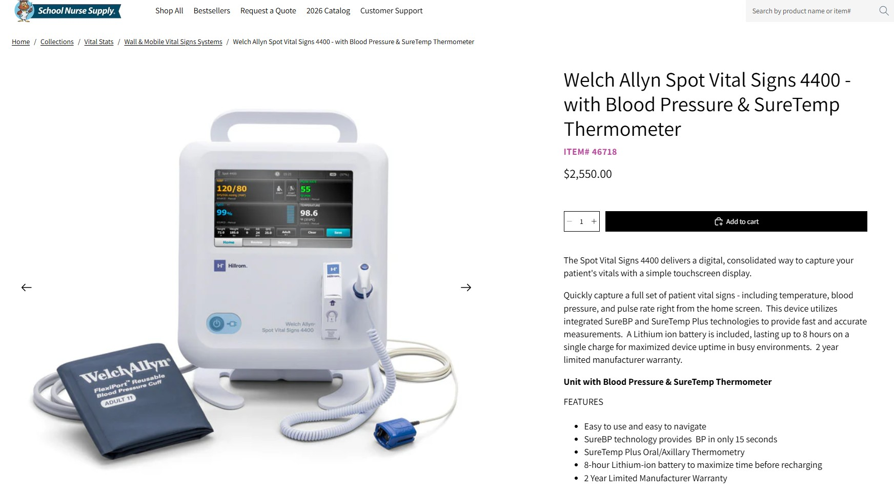
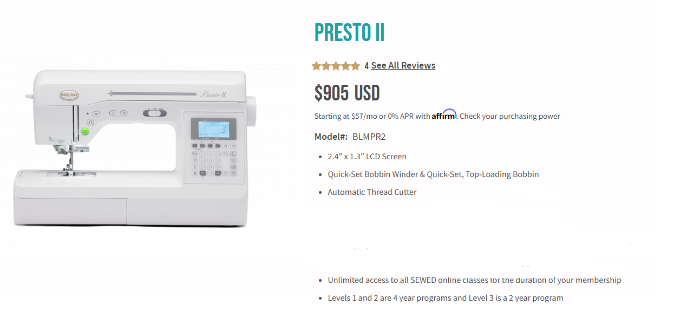
Allowable & Non-allowable Expense​s
Culinary Arts & Event Planning Program of Study
Health Sciences
Program of Study
Design
Program of Study
Industry Grade: Allowable​
Industry Grade: Allowable​
Not Industry Grade: Non-Allowable​
Not Industry Grade: Non-Allowable​
Industry Grade: Allowable​
Industry Grade: Allowable​

Slide 44



OER Commons

Slide 45

Take Your #FCSTNSidekick on Summer Adventures!
NCE Conference Google Photos Album
Be sure to grab your very own CTE-themed duck sidekick
This summer, we are encouraging CTE educators to take their sidekick along on all of their adventures and share photos using #FCSTNSidekick or email them to Miranda!

Slide 46



Slide 47
FCSTN Membership

