Slide 1
It’s A-bot Time!
Nebraska Robotics

Slide 2
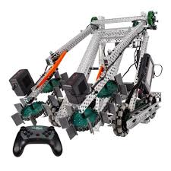
State of Robotics
Important for Nebraska’s tech culture
Ages K-12 – More kids participating at the younger ages
STEM Education:
  Working with hands
  Programming
  Problem solving
  Teamwork
  Mechatronics
  Electro-Mechanical

Slide 3
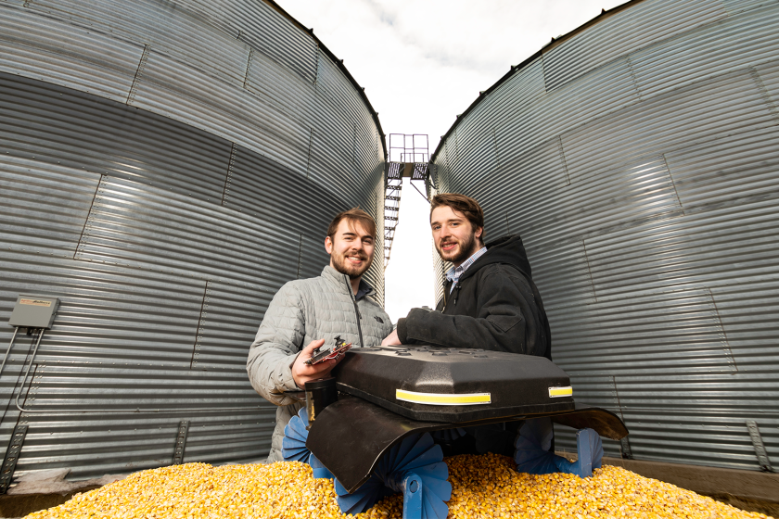
Grain Weevil

Slide 4
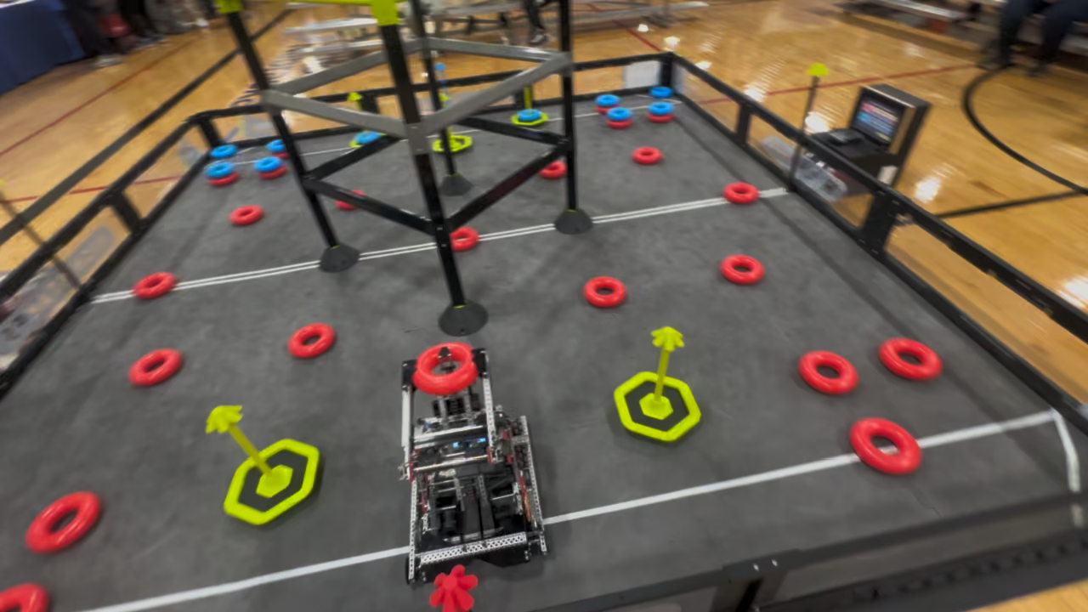
Robot Video

Slide 5
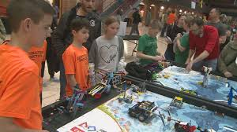
Team format
Typically 4-6 per team
Co-Ed
Roles:
  Designer
  Programmer
  Driver
  Design/Operation Manual
Start building in the summer/fall for fall/winter/spring competitions

Slide 6
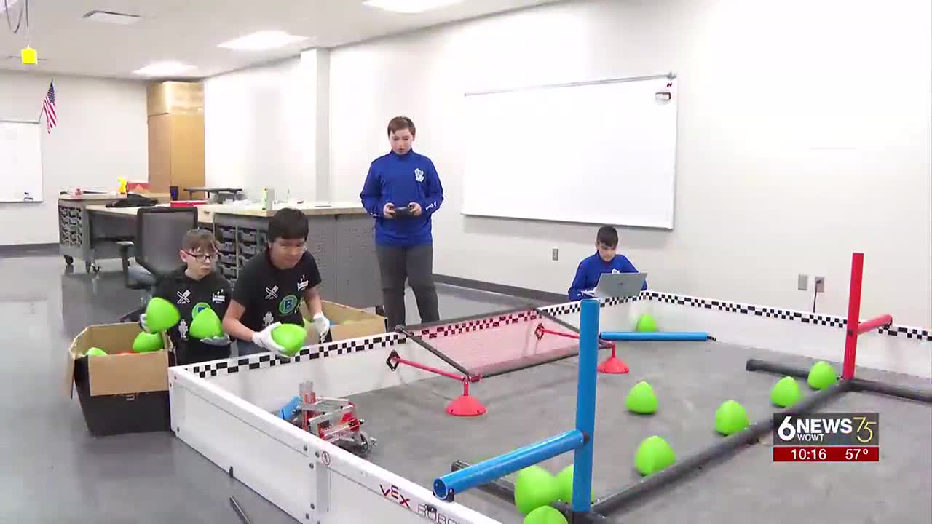
Competitions
4 teams compete, 2v2
Spirit of sharing and helping other teams
VEX, FIRST and Open all have their own competitions and rules

Slide 7
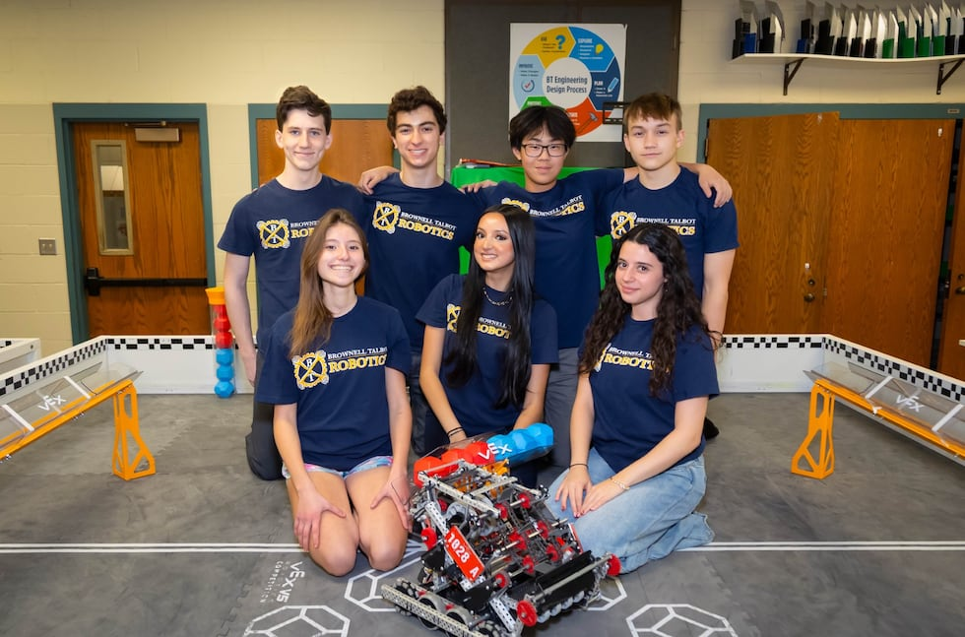
Leagues
VEX - 143 high school teams (31 Schools)
FIRST - 19 High school teams (10 Schools)
OPEN - 38 high school teams (16 Schools)
Brownell Talbot – Omaha
2026 World Champions
#1 out of 14,000 teams

Slide 8
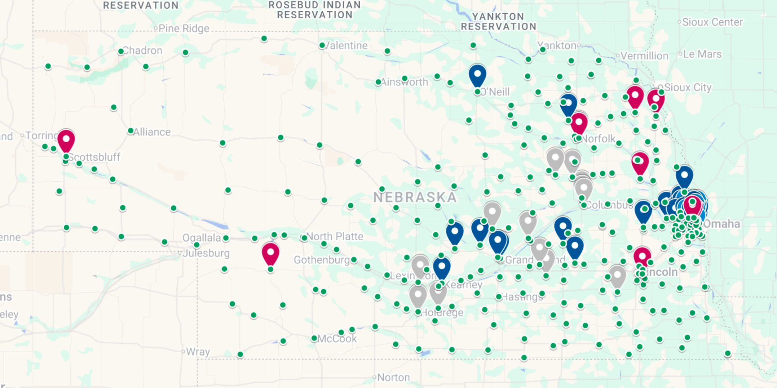
Map (57 out of 308 Schools)
Nebraska Robot League Map Link

Slide 9
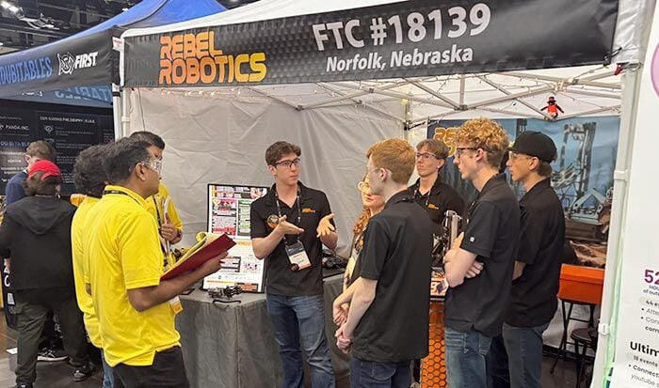
Cost/Time/Space
~$1,000-5,000 per team per year, more expensive first year
Teachers shouldn’t build the robot!
A classroom is about the space needed
May help meet other IT requirements!
Rebel Robotics – Norfolk
2025 World Champions
#1 out of 8,500

Slide 10
Contacts
VEX – Carrie Rise– Brownell-Talbot - carrie.rise@brownell.edu
Randy Decker – REC Foundation - randy_decker@recf.org
Mark Brown – OPS – Robotics - Mark.Brown1@ops.org
FIRST - Brandy Schultze – UNL/4H Elementary - bschulze@unl.edu
Randy Veach – MCC – High School - rjveach@mccneb.edu
Open – Gary Needham – gneedham@nebraskachristian.org
Adam Whitmore - whitmorea@discoverers.org
Kim Liebig – NPPD - kkliebi@nppd.com

Slide 11
NSAA Sanctioned Activity
Working on application to make Robotics a state sanctioned activity
Similar to Debate, Journalism, Music, Play Production, Speech
Application is inclusive of different robotics leagues
Application leans on rules of each robot league
Please vote “Yes” this fall and help submit to NSAA
NEED YOUR HELP SUBMITTING/REVIEWING – jklute@kluteinc.com

Slide 12
Q&A #1
Carrie – How long did it take you to get the program really going?
Carrie – If you were just starting a team, what would you do, where would you go to find help?
Carrie - What has Brownell-Talbot done as a school that has increased your success?
Carrie – Can you talk about how you have seen robotics affect kids and their career/college choices?

Slide 13
Q&A #2
Team – Was it easy or hard working as a team to build the robot? What roles did each team member have?
Team – How many times did you tear down/rebuild the robot? How many hours did it take?
Team - You beat people from all over the world, what breakthroughs did you have that allowed you to be so much better?
Team – You have a massive documentation book, what was it like to build this and how important was it?

Slide 14
Q&A #3
Team - How do you program the robot? Is it hard? Is the programming applicable to the real world?
Team – What is it like to compete at the tournaments?
Team – How did being in robotics influence your college decision. How did it influence the colleges you applied to?

