Slide 1



AI IN AGRICULTURAL EDUCATION
AGRICULTURAL EDUCATION INSTRUCTOR & FFA ADVISOR
Enhancing Curriculum Without Replacing It
Session Goal: Use AI to improve curriculum, increase engagement, and save planning time
Collin Swedberg
North Platte High School

Slide 2



WOULD AI PASS YOUR CLASS?
01
Could AI complete your assignment in under 30 seconds?
02
Could a student copy and paste a prompt and earn full credit?
03
What assignments are easiest for AI to complete?
04
What classroom experiences are hardest for AI to replace?

Slide 3

THE REALITY OF AI - AI IS NOT GOING AWAY
01
Students are already using AI tools in their daily lives and schoolwork. This isn't a future trend—it's happening right now in every classroom.
02
Colleges are adapting their curricula and employers are integrating AI into workflows. Agricultural businesses are beginning to use AI for precision farming and data analysis.
AI adoption is accelerating across education and industry. Rather than resist this change, agricultural educators have an opportunity to lead by teaching students how to use AI as a tool while preserving the hands-on, experiential learning that makes our programs unique.
03
The question isn't "How do we stop AI?" The real question is: "How do we teach effectively in a world where AI exists?"

Slide 4

WHAT AI DOES WELL
AI Is Basically a Really Fast Teaching Assistant
It handles the time-consuming tasks that used to eat into your planning periods, giving you more bandwidth to focus on what matters most—your students and their hands-on learning experiences.
01
Brainstorming & Creating Examples: AI excels at generating ideas quickly, providing multiple examples, and helping you think through concepts from different angles.
02
Generating Activities & Differentiating Instruction: AI can create varied activities for different learning levels, helping you meet diverse student needs efficiently.
03
Creating Assessments & Saving Planning Time: From quizzes to rubrics to study guides, AI dramatically reduces the time spent on material creation.

Slide 5

Build relationships with students or truly understand their individual needs, backgrounds, and learning styles.
01
Know your community context or replace the irreplaceable value of hands-on agricultural learning experiences.
02
Evaluate student character and work ethic, or consistently provide accurate, up-to-date agricultural information.
03
WHAT AI DOES POORLY
Reminder: AI is a starting point—not the final product. Always apply your professional judgment, community knowledge, and authentic agricultural teaching expertise to create meaningful learning experiences.

Slide 6

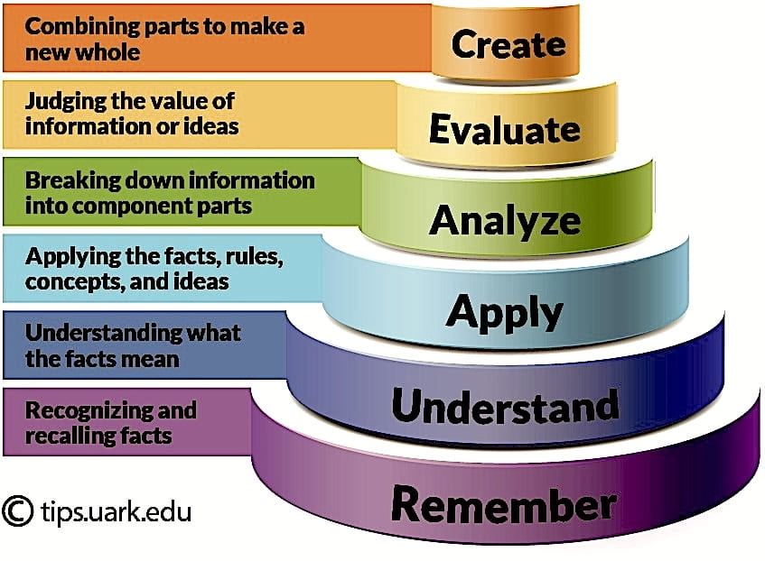

THE BIG PROBLEM WITH TRADITIONAL CURRICULUM
Input: Textbook, Lecture, Worksheet → Output: Quiz, Test. This linear model has defined education for decades.
The traditional model focuses on information transfer rather than skill development and authentic application.
Students can increasingly use AI to complete low-level tasks without actually learning the material or developing critical thinking skills.
AI can now complete worksheets, answer test questions, and summarize readings faster than students can learn from them.

Slide 7
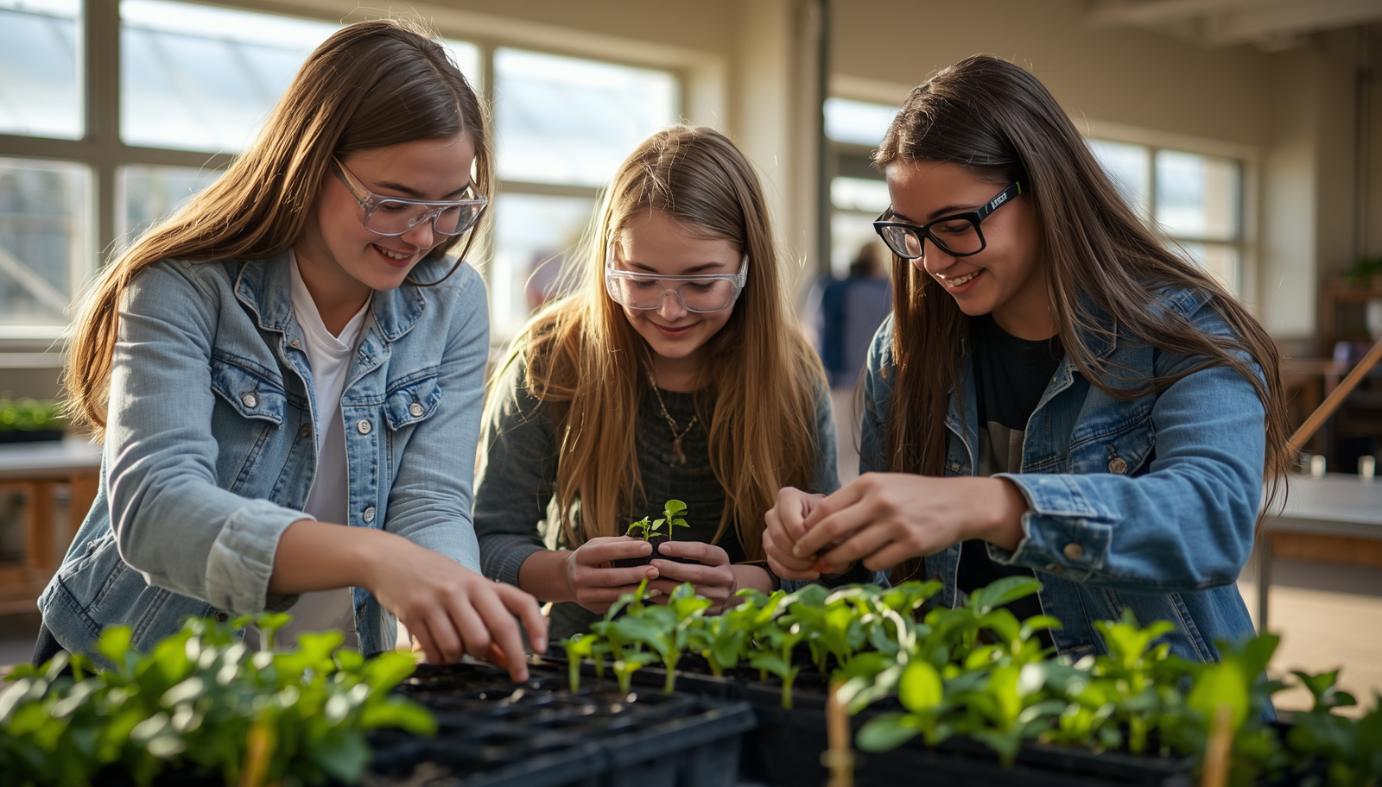


Application and problem solving skills that require real-world critical thinking and practical implementation.
Leadership and communication through FFA activities, team projects, and public speaking opportunities.
Hands-on skills and career readiness that prepare students for agricultural industry careers.
WHAT MAKES AGRICULTURAL EDUCATION DIFFERENT?
Decision making in authentic scenarios—our advantage: real experiences are difficult for AI to replace.

Slide 8
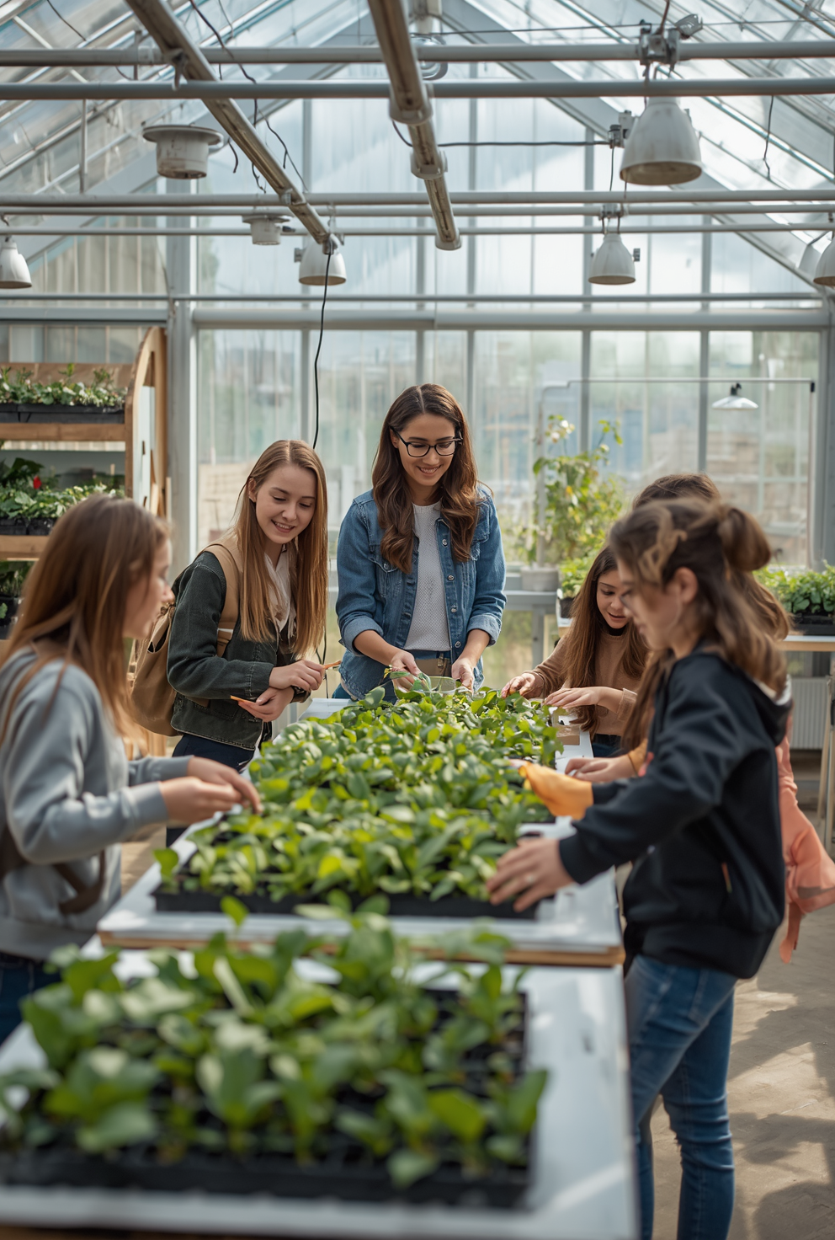
AI CAN HELP US SHIFT OUR FOCUS
01
02
03
Less Time Creating: Worksheets, study guides, rubrics, review questions
More Time Creating: Labs, simulations, projects, industry scenarios, student discussions, real-world applications
Key Idea: AI helps us build experiences instead of paperwork

Slide 9
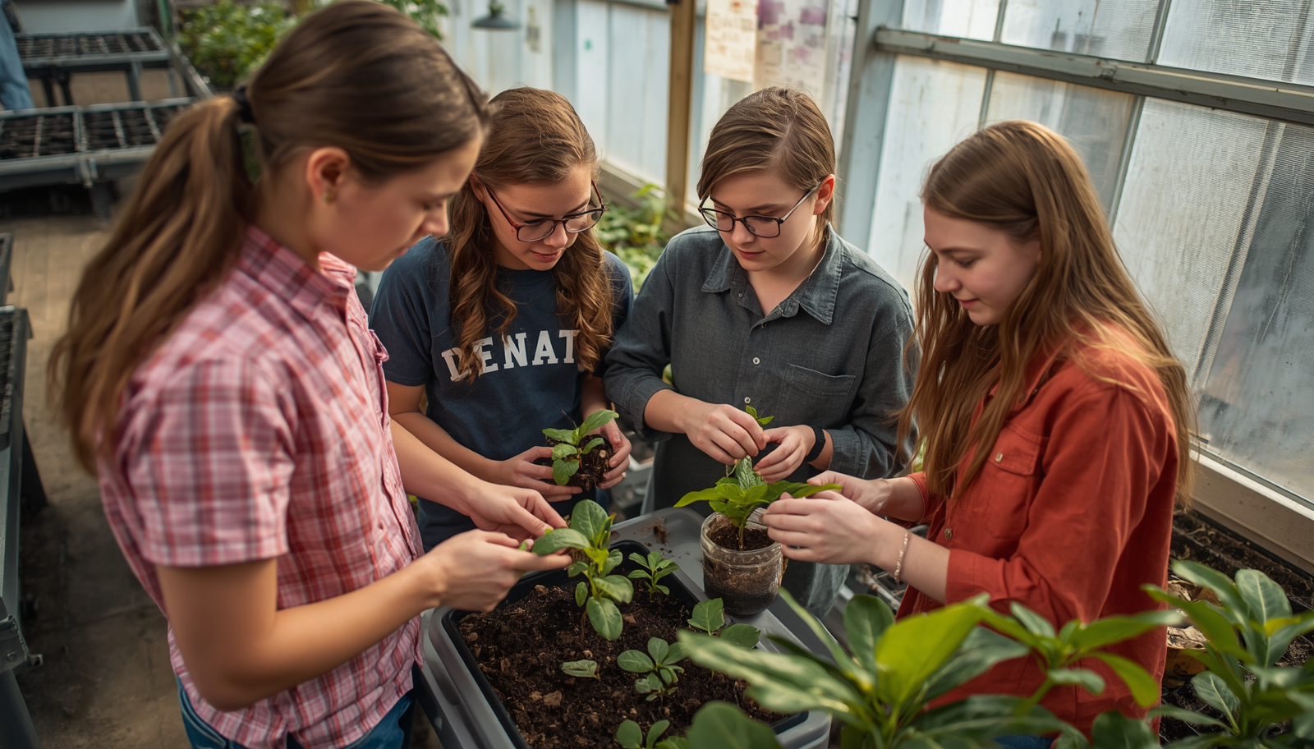
EXAMPLE: UPGRADING A LESSON
AI Prompt: "Turn this plant nutrient lesson into a 90-minute hands-on activity for a high school agriculture class."
This simple prompt transforms traditional content into an engaging, application-based learning experience.
Lecture: Traditional delivery of plant nutrient content to students in classroom setting.
01
Guided Notes: Students fill in blanks while following along with instructor presentation.
02
Worksheet & Quiz: Paper-based practice and assessment of nutrient knowledge.
03
Original Lesson: Plant Nutrients

Slide 10
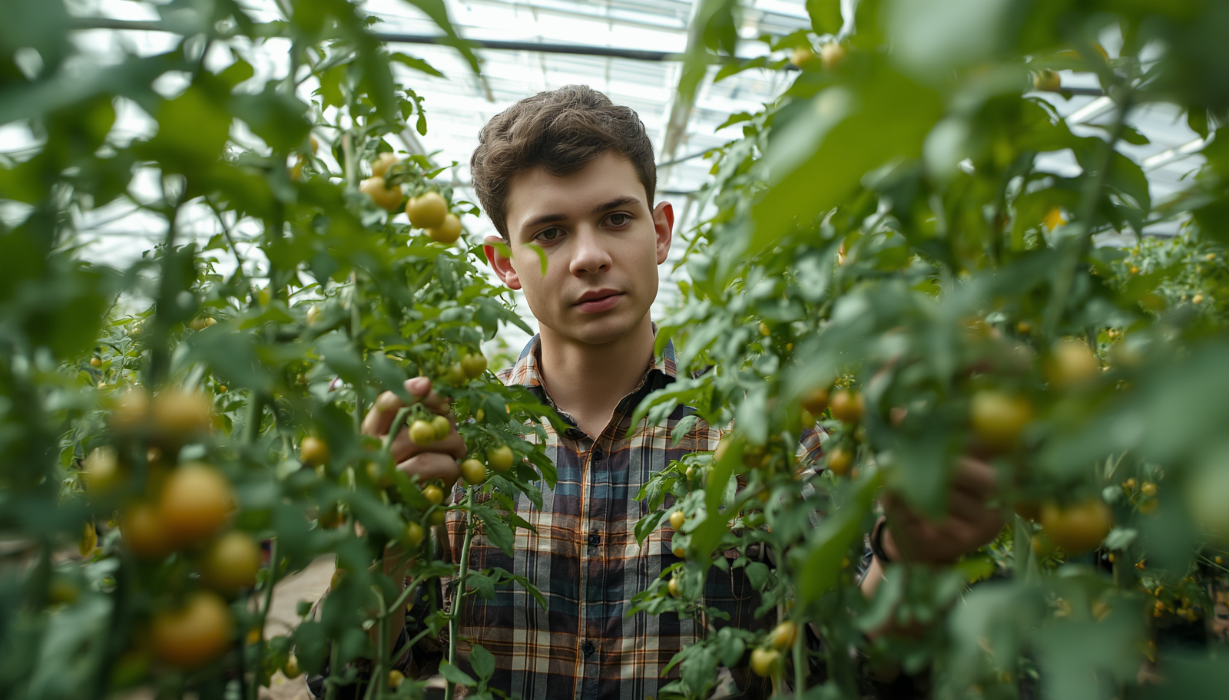
EXAMPLE OUTPUT
Nutrient deficiency diagnosis lab using real plant samples and greenhouse troubleshooting scenario with actual symptoms.
01
02
Team-based problem solving challenges and crop consulting activity where students advise "farmers" on nutrient issues.
03
Soil fertility recommendation challenge. Is it perfect? No. Is it a better starting point than a blank page? Absolutely.

Slide 11

PRACTICAL WAYS TEACHERS CAN USE AI
01
Rewrite readings at different levels, create learning supports for struggling students, and develop enrichment activities for advanced learners.
02
Move beyond simple recall questions. Add analysis tasks, evaluation challenges, and creation-based assignments that require deeper thinking.
AI helps teachers work smarter, not harder. Use these strategies to differentiate instruction, increase academic rigor, and refresh existing curriculum units with engaging, real-world applications.
03
Turn traditional lectures into hands-on activities. Add industry scenarios, collaborative projects, and real-world decision making opportunities.

Slide 12

WORK SESSION - STEP 1: IDENTIFY A PROBLEM
✓
Choose a lesson that is boring or too lecture-heavy for students to stay engaged.
✓
Choose a lesson that is too easy or requires too much time grading.
✓
Choose a lesson that is lacking real-world application or practical skills.
✓
Choose a lesson that is missing student engagement or active participation.

Slide 13

WORK SESSION - STEP 2 & 3
Step 2: Choose a Goal - I want more:
Application, Differentiation, Better Assessment
Step 3: Use AI
Prompt: "Here is my lesson. Help me redesign it to increase ______." Fill in the blank with your chosen goal.
Engagement, Collaboration, Rigor

Slide 14




AI ETHICS & CLASSROOM BOUNDARIES
Three Questions to Consider:
• What AI use is acceptable?
• What AI use is unacceptable?
• How will students know the difference?
Establishing clear guidelines helps students understand expectations and use AI responsibly as a learning tool.
Green Light Uses: Brainstorming ideas, studying and review, getting feedback on work, organizing thoughts and ideas. These uses support learning without replacing student thinking.
Yellow Light Uses: Editing and revising drafts, AI-assisted projects with disclosure. These require teacher guidance and clear expectations about attribution.
Red Light Uses: Copy/paste assignments, replacing original thinking, submitting AI-generated work as student work. These undermine learning and academic integrity.

Slide 15

AI Will Not Replace Agricultural Education. Students still need welding, floral design, livestock evaluation, greenhouse management, leadership, and public speaking.
1
AI Can Help Us save planning time, differentiate instruction, increase rigor, modernize curriculum, and create better learning experiences.
2
The human elements of agricultural education—hands-on skills, relationship building, and real-world application—remain irreplaceable. AI is a tool to enhance, not replace.
3
FINAL TAKEAWAYS
"The goal isn't to use AI to do less teaching. The goal is to spend less time creating materials and more time creating meaningful learning experiences."

