Slide 1
Run the Lab:
Don’t Let the Lab Run You
Building Disciplined, High-Functioning Kitchen Labs

Slide 2






Run the Lab, Don’t Let the Lab Run You:
Building Disciplined, High-Functioning Kitchen Labs
Dominic Hawkes M.C.G.B.
Culinary Arts | Lancaster Career Center, SC
Ed. Consultant | Author
ACTE | ProStart | NRAEF | MCGB | CMAA | ACF EFAC

Slide 3
The Foundation
Your Syllabus:
The Route Map to Success

Slide 4
Does your syllabus:
Answer the “WHY?”
Use identity for answers like a professional would
Show how to avoid rookie mistakes
Explain FDA Food Code for food safety
Explain personal safety

Slide 5
Where is Our Success?
Stop using motivation as your only fuel. Use routine! Motivation will only go so far and so long. It's a short term fuel. Routine is about changing 5% each time to form habits.
Arnold Schwarzenegger

Slide 6
Routines:
Building Strong Habits

Slide 7
Establishing Routines
Roles of Responsibility:
No one standing around!
Recipe review
Mise en Place/Preparation Plans
Safety Routines (Hot/Sharp)
Sanitation Procedures & Standards

Slide 8
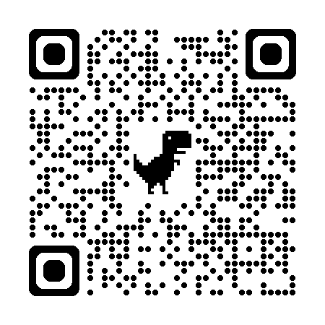
Mise en Place: The Yearlong Operating System
Social communication norms, responsibility, accountability, teamwork
Forming, Norming, Storming, Performing – Bruce Tuckman
Conflict resolution skills
Result: fewer surprises, fewer behavior issues, higher-quality work
Leadership Style

Slide 9
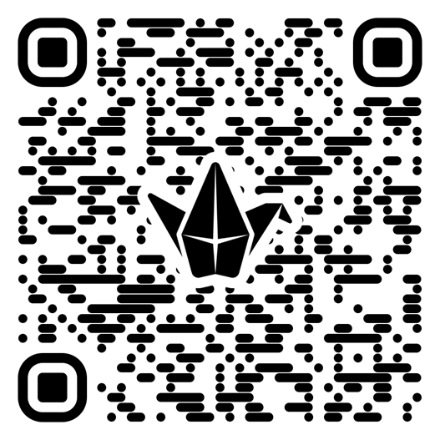
Week 2: Where Do You Want Your Students to Be?
What do you want students to be able to do in the kitchen, without you prompting them?
Think routines entry, setup, transitions, cleanup
Think communication behind, hot, sharp, heard
Think quality portion, knife cuts, sanitation

Slide 10
Reward the Routine
Chef of the Week
Most Improved
Professional Sanitation Champion
Leadership Award

Slide 11
Behavior Expectations
Be on Time
No Horseplay/Be Safe
No Foul Language
Be Part of the Team
Help Clean Up
Taste EVERYTHING for Standards
Be Correctly Attired (for Your Safety)

Slide 12
Attire/Appearance Policy
Personal Cleanliness
Long Hair Tied Back
Cover Cuts/Scrapes
Report Illness
No Strong Fragrances
No Long, Polished or Artificial Nails
No Large Earrings
No Finger/Wrist Jewelry (Necklaces must be under clothing)
No Gum
Closed Toe, Non-Slip, Flat Shoes
No Leggings, Long Pants MUST Be Worn

Slide 13
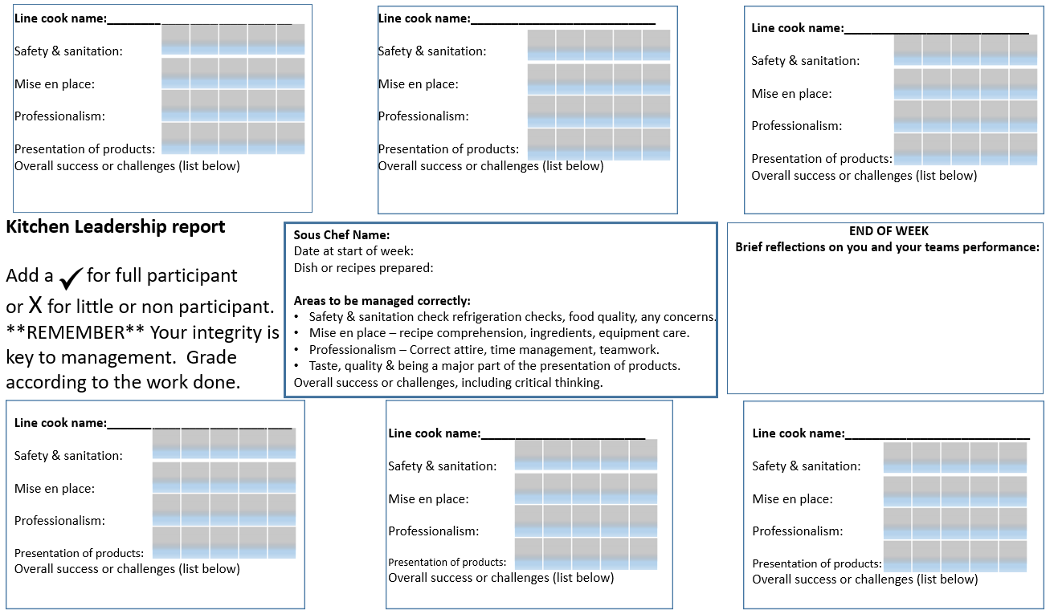
Clean Up & Evaluate
Students Self-Evaluate Their Teams

Slide 14

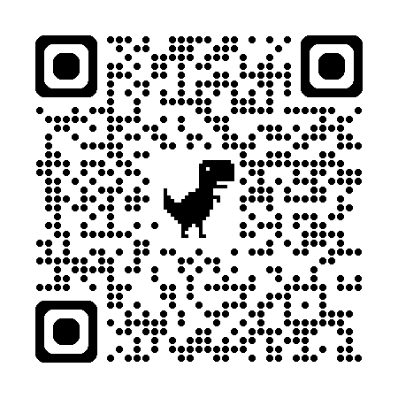

Thank
You!
Feel free to reach out if you have any questions!
Dominic Hawkes MCGB
dominic.hawkes@lcsd.k12.sc.us
NCE Conference Series Session 2 of 5
Next session coming up!

