Slide 1

Finding the Inspiration
What’s YOUR “Why?”

Slide 2

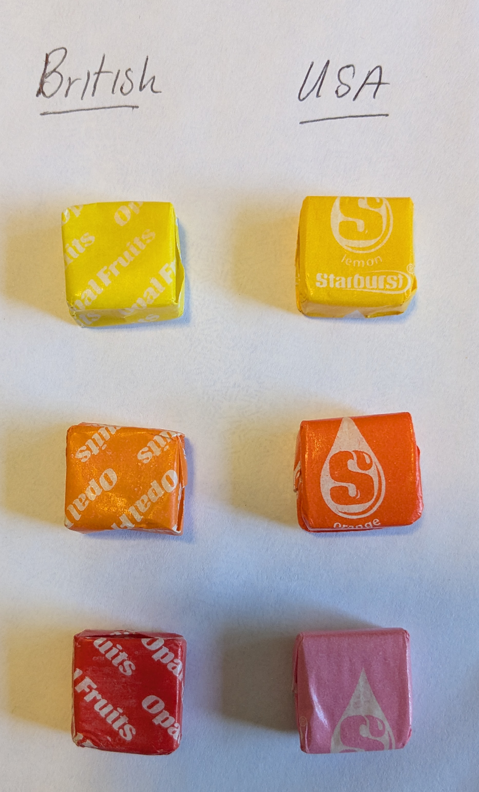

Be
Authentic

Slide 3
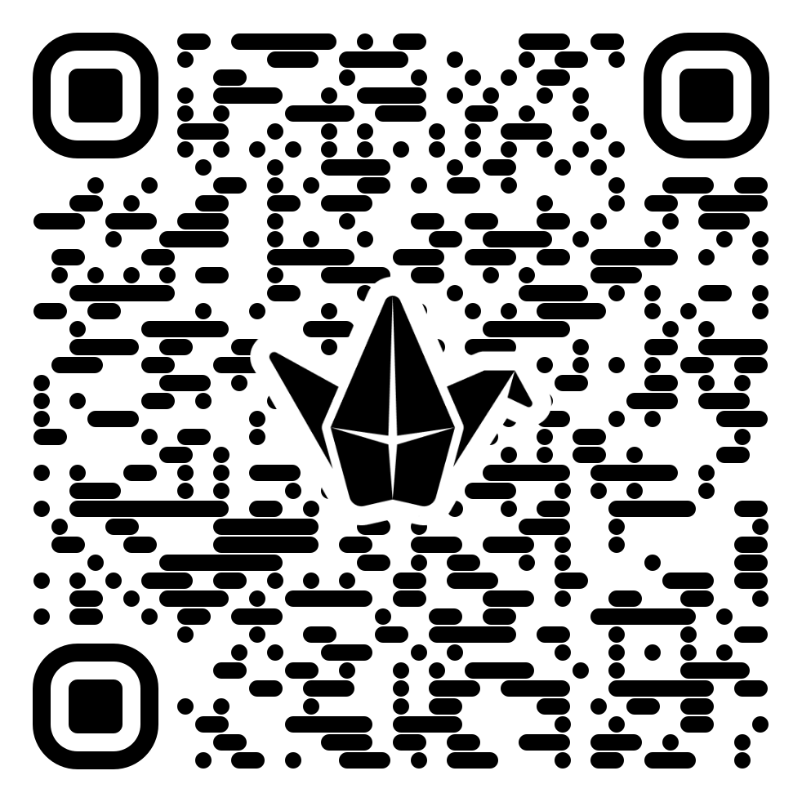
Be
Authentic

Slide 4


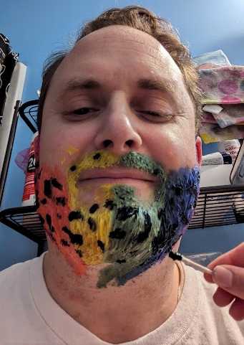
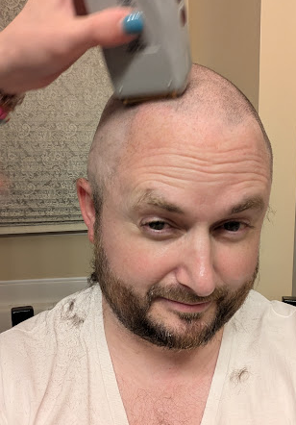
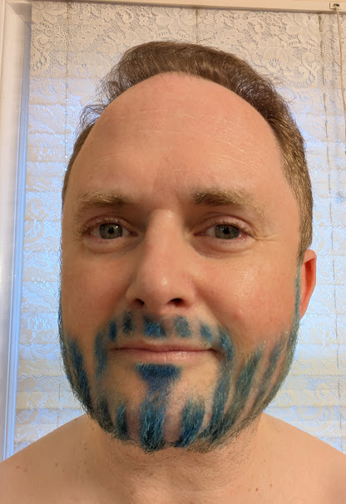
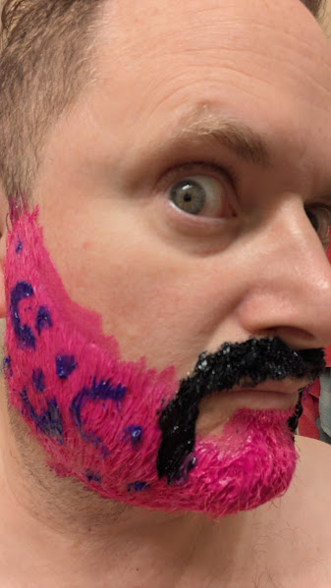
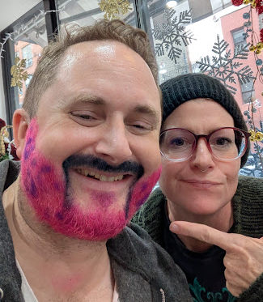
They WILL Know!
Challenge
Them!
Love
Them!

Slide 5
The difference YOU make!
1960's Dr. Robert Rosenthal tested students "Blooming Intelligence" at Oak Elementary School. He disclosed incorrect, higher scores for some students. He faked the whole experiment. One year later the students had risen to the top of their class and tested on average 9 points higher than their peers.

Slide 6
—APS. G.E.B. (Gabriel Barrett - LCSD Truancy)
“Give a child a taste of success one time, and watch them become addicted to it.”

Slide 7

Quick-Fire Round
Integrity
Student Wellbeing
You and your students.
Don’t be a liar!
Cultural awareness, create a safe space.
Positive Relationships
Adaptability through Critical Thinking
Find what inspires your students.
The world needs problem solvers.
Considered Communication
Classroom Management
You are their teacher, not their friend.
Accountability

Slide 8
Being Uncomfortable
Saving money will make you feel broke when it's actually making you rich.
Setting boundaries can make you feel like you are alone, while you are creating new healthy relationships.
Digging up trauma will make you feel broken, while it's actually healing you.
Working out will make you feel weak, while it's really making you stronger.
Learning something new can make you feel dumb, while it's making you more intelligent.
Your ability to attain the thing you want is directly correlated: with how willing you are to experience the opposite.
You have to be okay with being uncomfortable to truly experience success.

Slide 9
Students can feel they aren’t good at anything…
They may not even try something they are great at.
Teachers need to have a bigger conception of aptitude.
Look for their talents and help them find their passion.
Remember passion used to mean suffering.
Now it’s what fulfills you, what brings you purpose meaning.

Slide 10
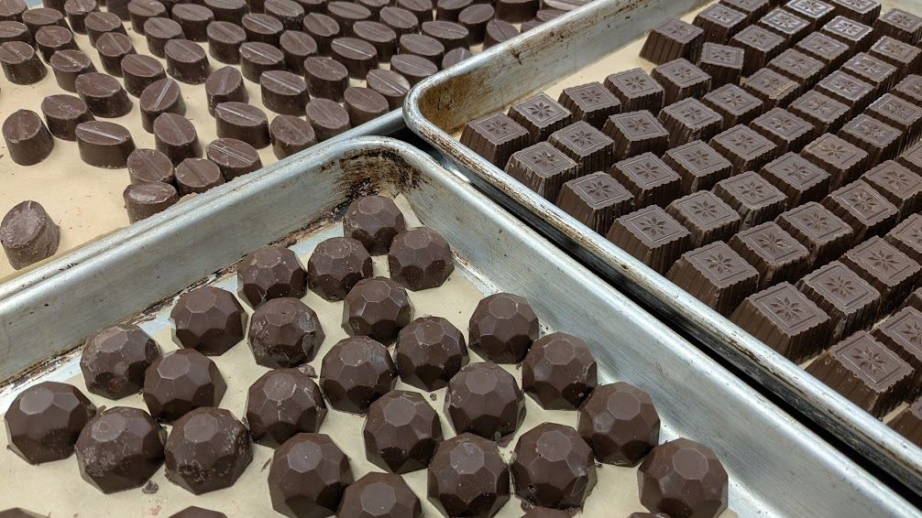
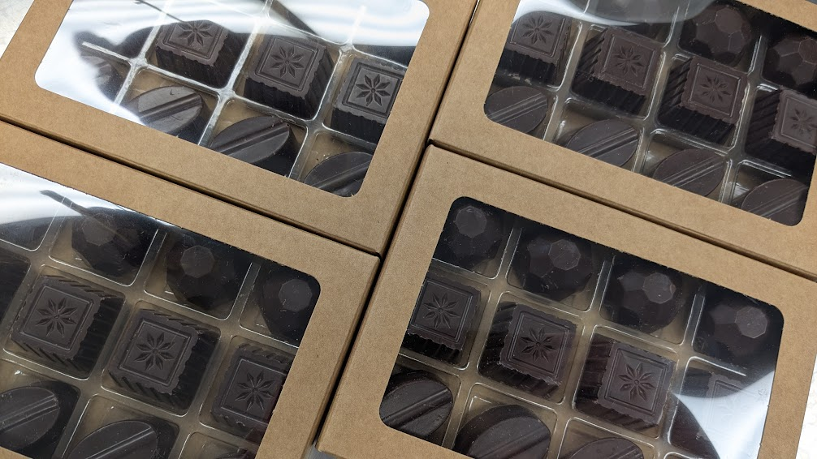
Find the Spark!

Slide 11
How Happy Are You?
Happiness = Quality of life – Envy!
Change your Have to’s to Get to’s!
Take pleasure in everything you have!

Slide 12
100
Years
Ago…
No one had a guarantee of a hot shower.
Childhood mortality was high.
We now have plenty of food, entertainment - the life of kings!
Life expectancy 35, now more than double!
Food, water and mold caused this!
Chlorination, pasteurization, refrigeration.
Have we seen the healthy life span peak?
Does FACS and Culinary Medicine hold the key?

Slide 13
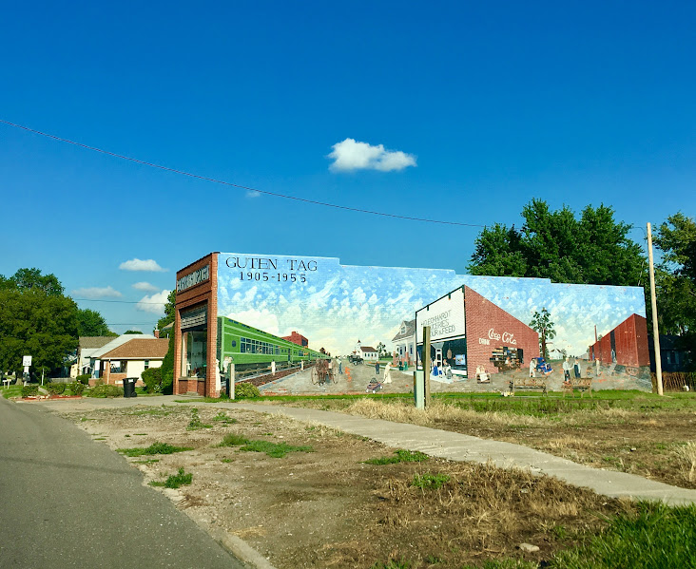
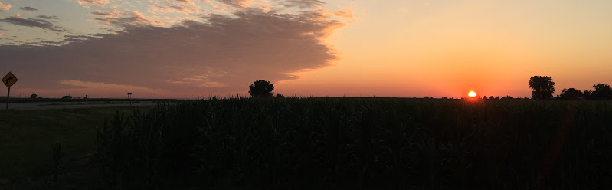
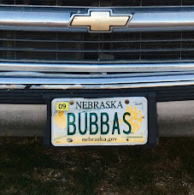
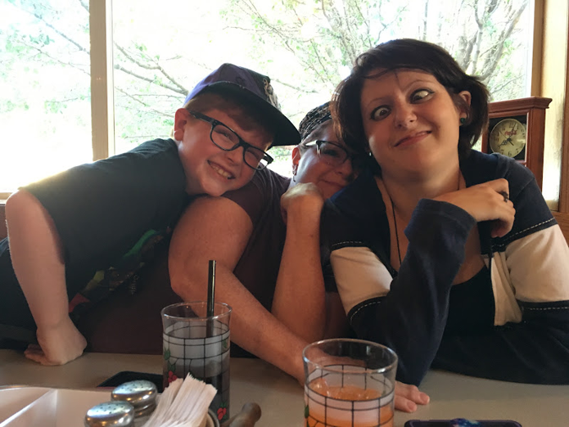
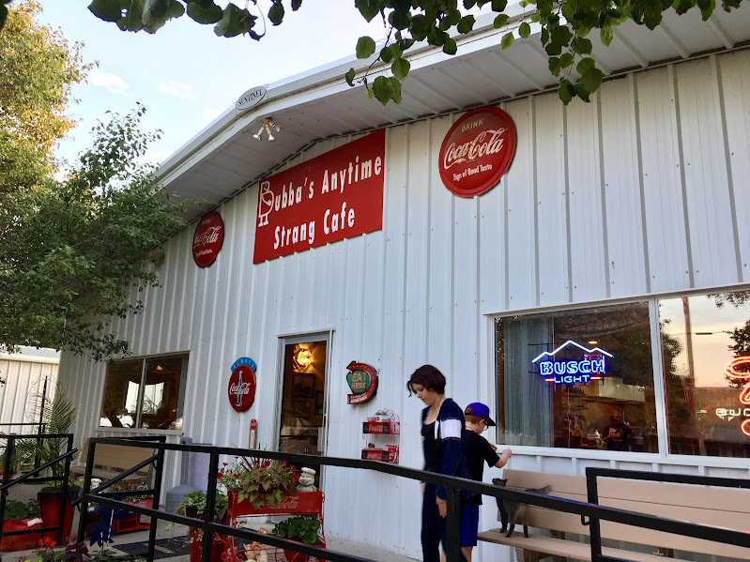
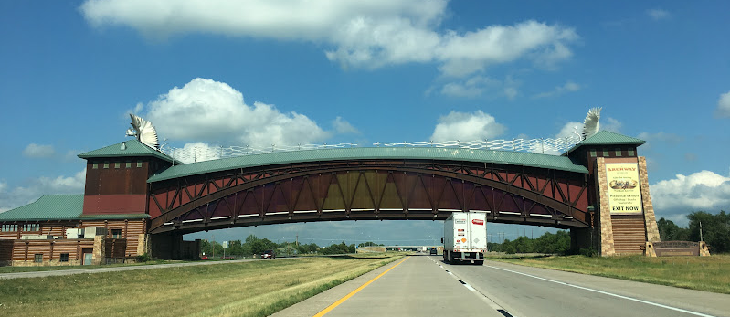
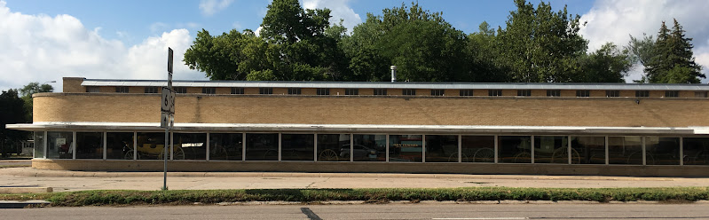
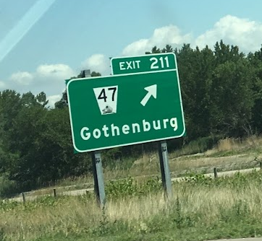
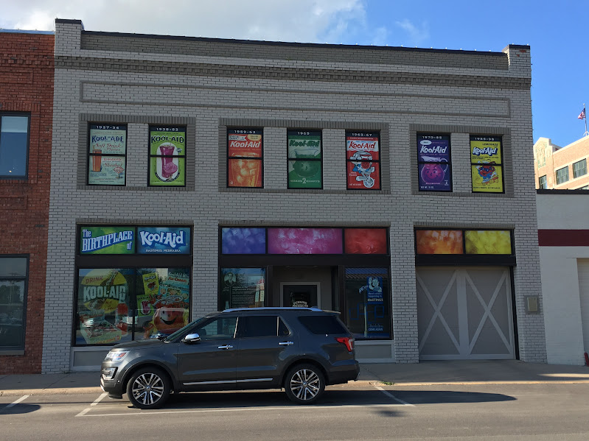
Nebraska Hospitality
Bubba’s Anytime - Strang

Slide 14
What Do We Want for Our Students?
Mastery is the best goal, because the rich can’t buy it, the impatient can’t rush it, the privileged can’t inherit it, and nobody can steal it!
You only earn it through hard work.
Mastery is the ultimate status!

Slide 15
The life you want is on the other side of what you are avoiding.

Slide 16

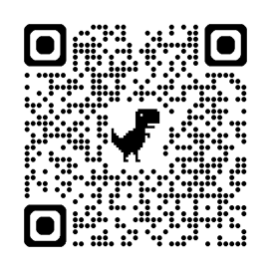
Thanks!
Does anyone have any questions?
Dominic Hawkes
dominic.hawkes@lcsd.k12.sc.us
NCE Conference Series Session 5 of 5
Author: Introduction to Culinary Arts Management
Author: The Food Protection Manager's Handbook

