Slide 1

From Classroom Learning to Career Earning:
Engaging FFA Alumni & Supporters

Slide 2
This session will highlight practical ideas, successful strategies, and valuable resources that FFA Advisors can use to engage their local FFA Alumni & Supporters chapters in meaningful ways. Through shared examples and real-world experiences, participants will explore how alumni and community supporters can strengthen student learning, leadership development, and career readiness through mentorship, career connections, advocacy, fundraising, and hands-on opportunities. Advisors will leave with useable ideas to build stronger partnerships that support students, enhance agricultural education programs, and help tell the FFA story within their communities.

Slide 3
Supporting FFA Members
Breakfast Items for State Convention Send-Off
Contest Coaching
Organize & Host CDE Night
Edit & Critique LDE Speeches
Sponsor a Sit-Down Chapter Dinner at National Convention
Scholarships to all State Degree Recipients
Awards for American Degree Recipients
Financial Support for National Convention Trips

Slide 4
Supporting FFA Members
Purchase FFA Jackets/Ties/Scarves
Personalized Garment Bags for State & National Qualifiers & Officers
FFA Week Treats & Pizza Party
FFA Week Dinner at a local Steak House for FFA Officers and Executive Board of Alumni & Supporters

Slide 5
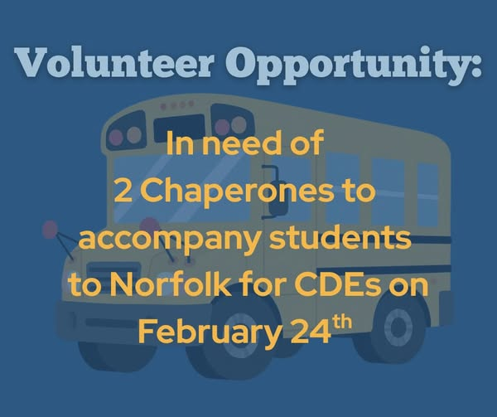
Supporting FFA Members
Chaperone Events

Slide 6
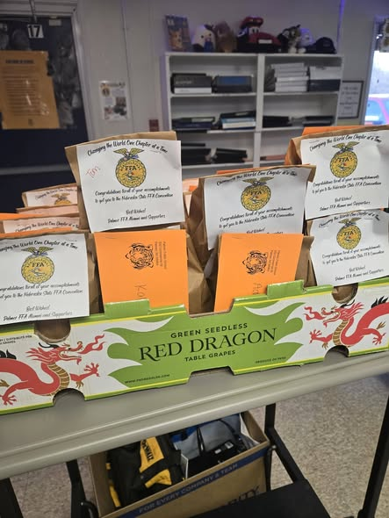
Supporting FFA Members
                Snacks for Bus Trips

Slide 7
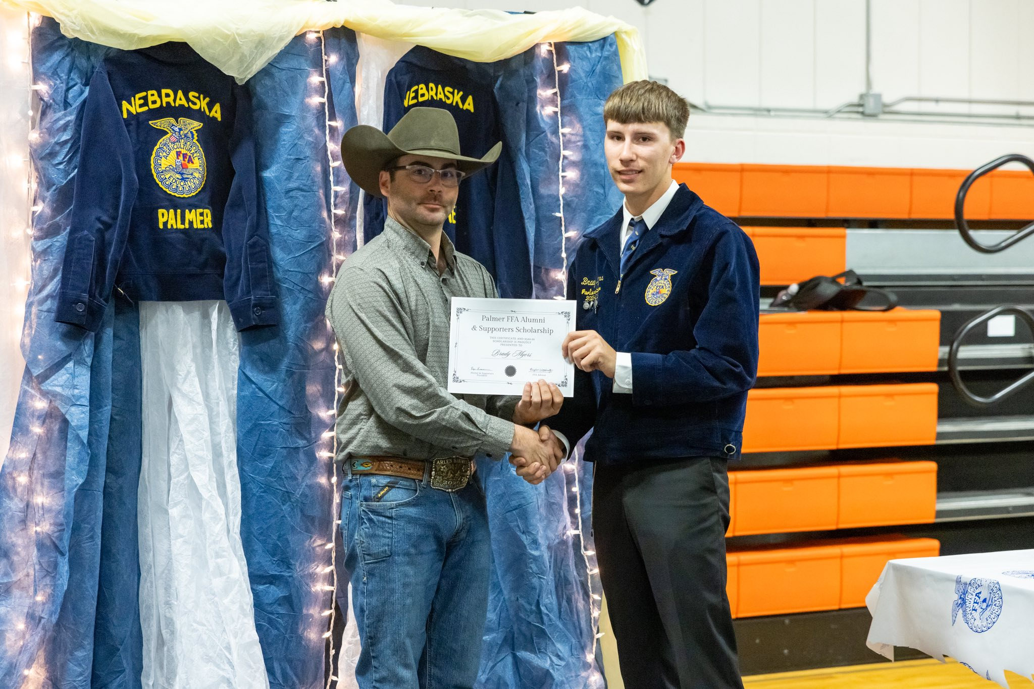
Supporting FFA Members
      Scholarship Program for Graduating Seniors

Slide 8
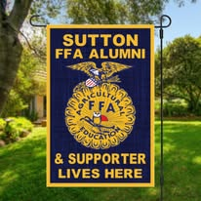
Supporting FFA Members
  “FFA Member Lives Here” signs for 1st year FFA members

Slide 9

Supporting FFA Members
        Back to School BBQ for FFA Families

Slide 10
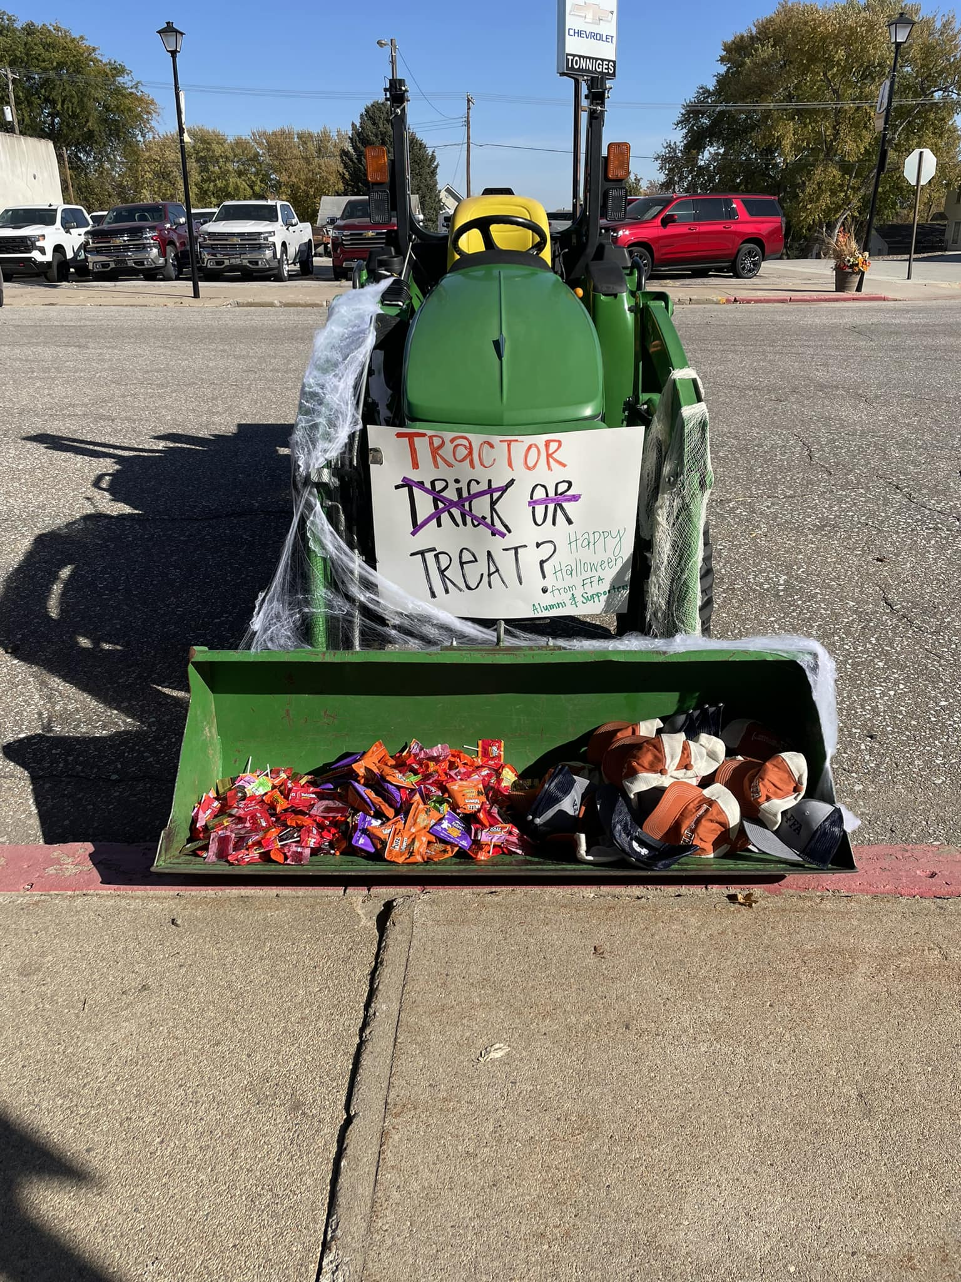
Supporting FFA Members
                Trunk or Treat

Slide 11
Supporting FFA Advisors
Floral arrangements purchased for banquet gifted to Advisors
Retention Bonus for three years after hiring new Advisor
Ag Teacher Appreciation Day Gifts
Organize “extra” things for celebrations
Provide refreshments
Assist as asked
Request Wish List at the beginning of the year from Advisor
Meet Quarterly with Advisor to get perspective on needs
Help with Officer Interviews, Employment Skills, & Mock Interviews

Slide 12
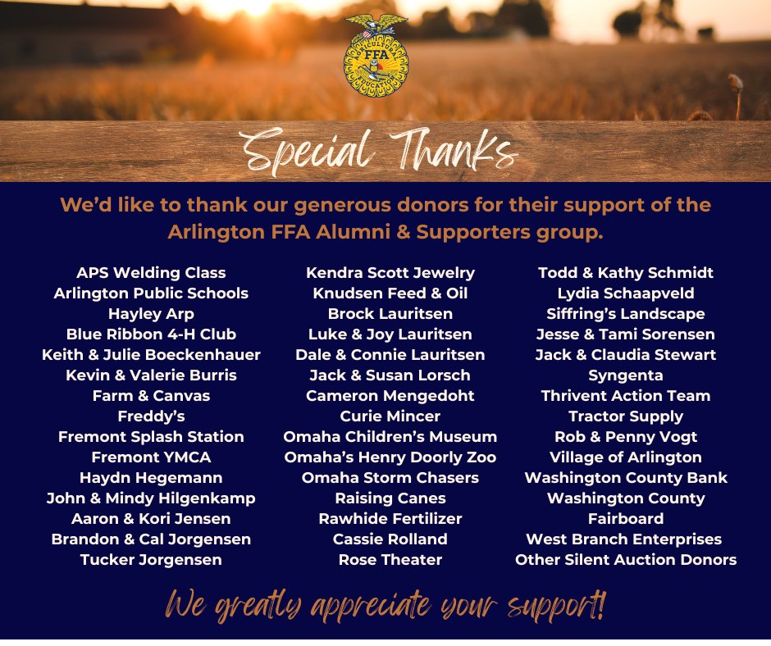
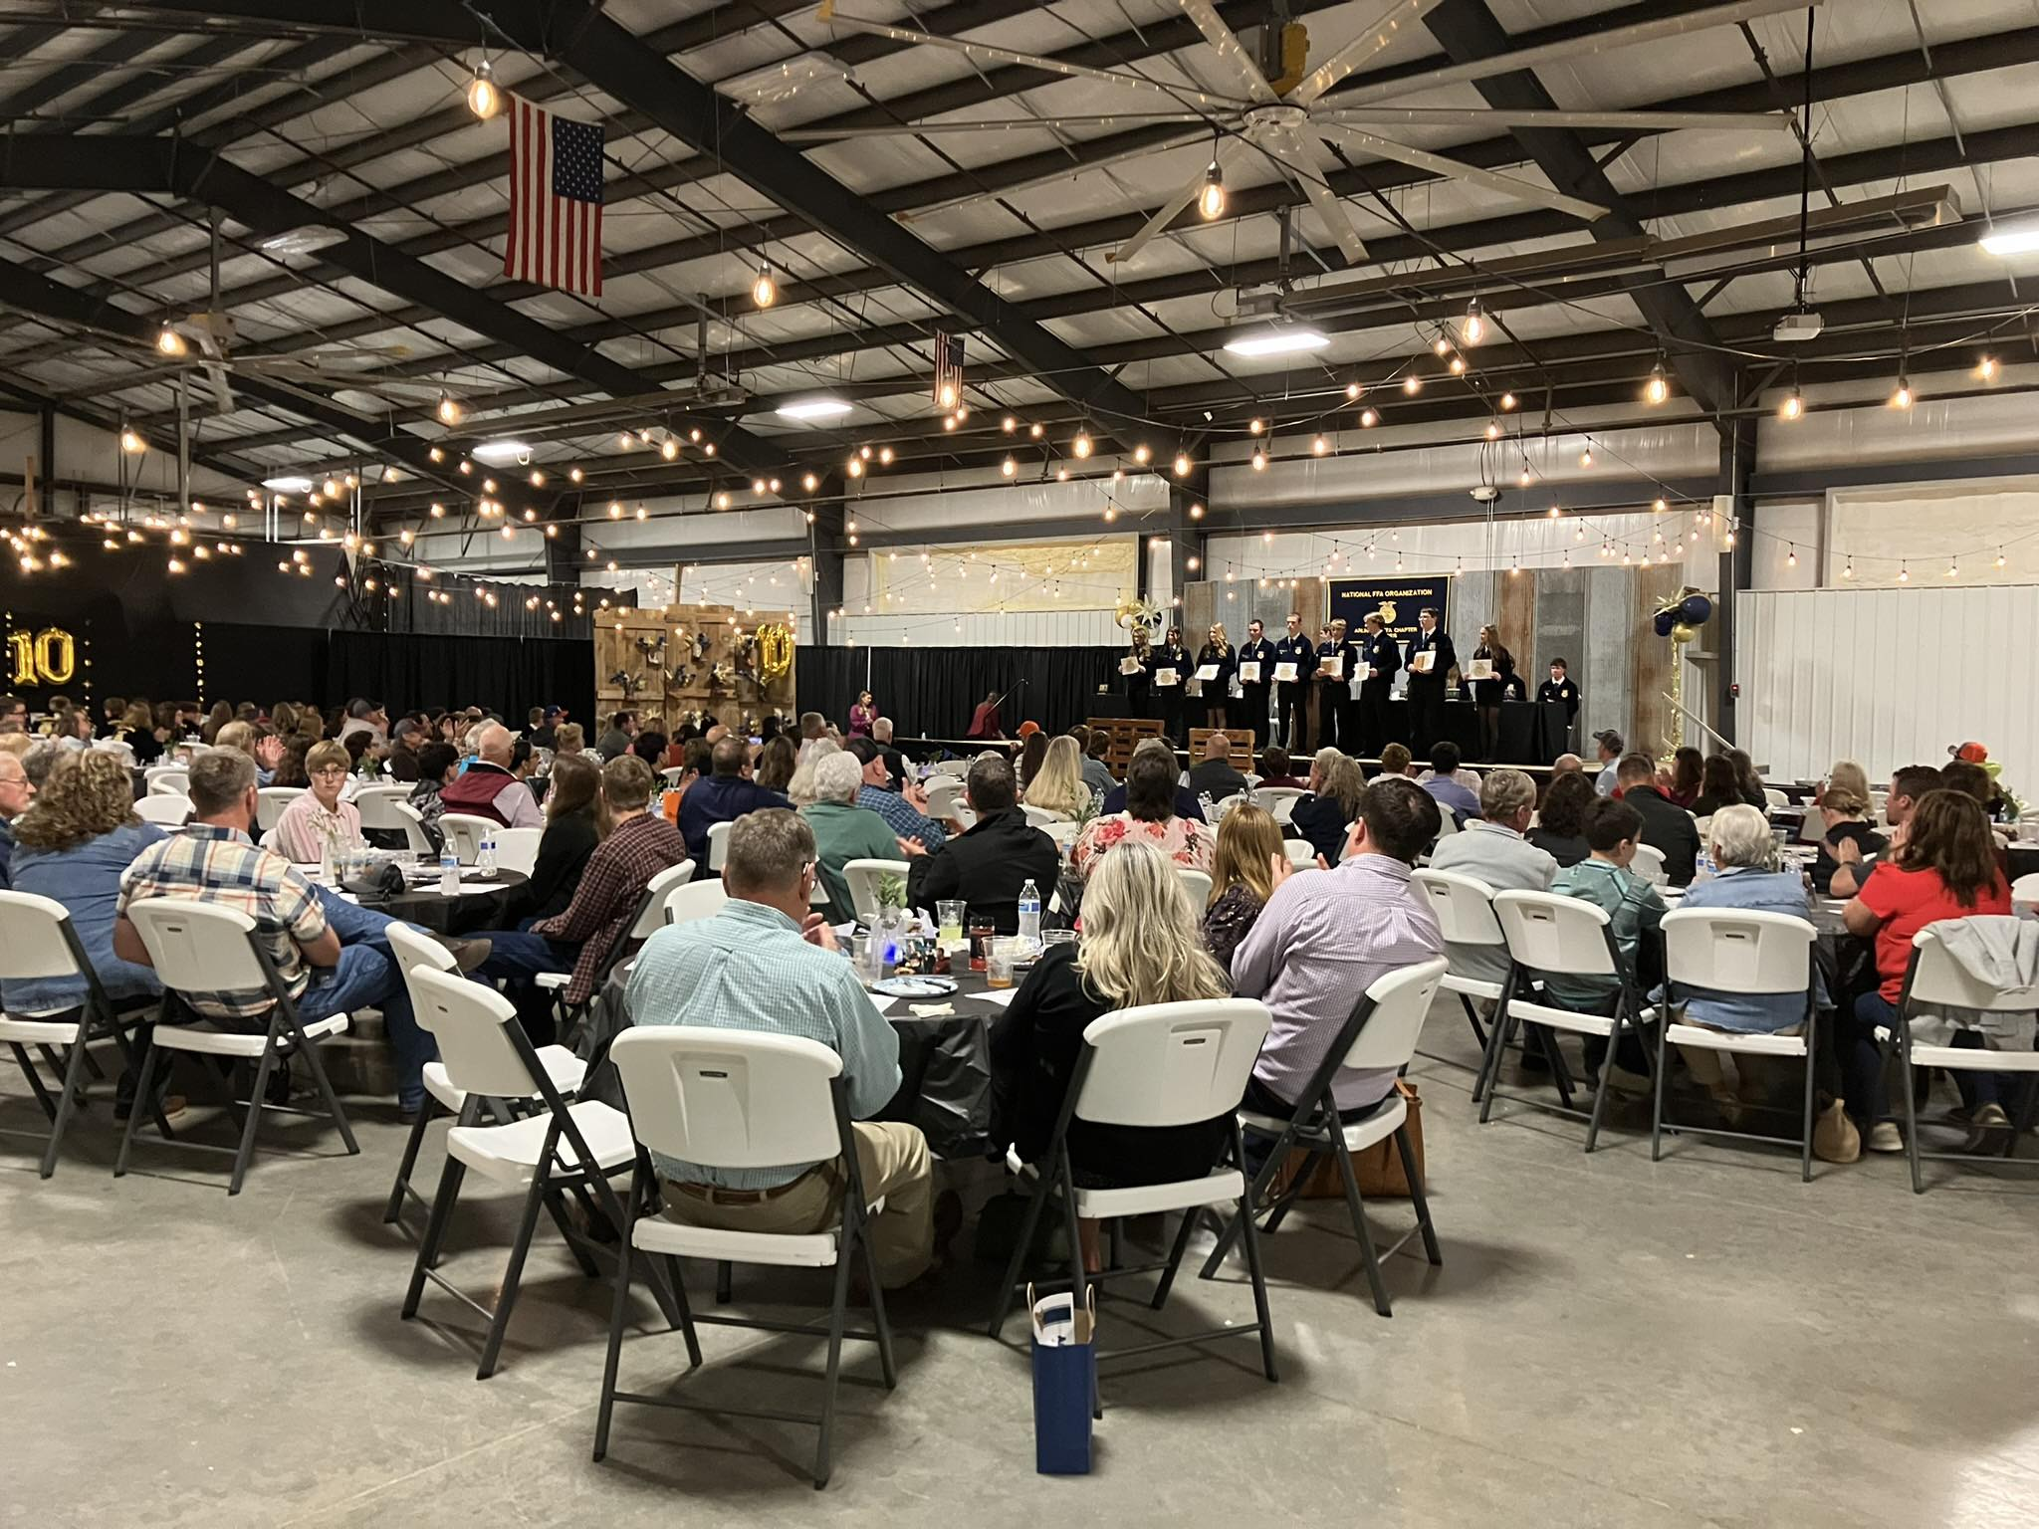
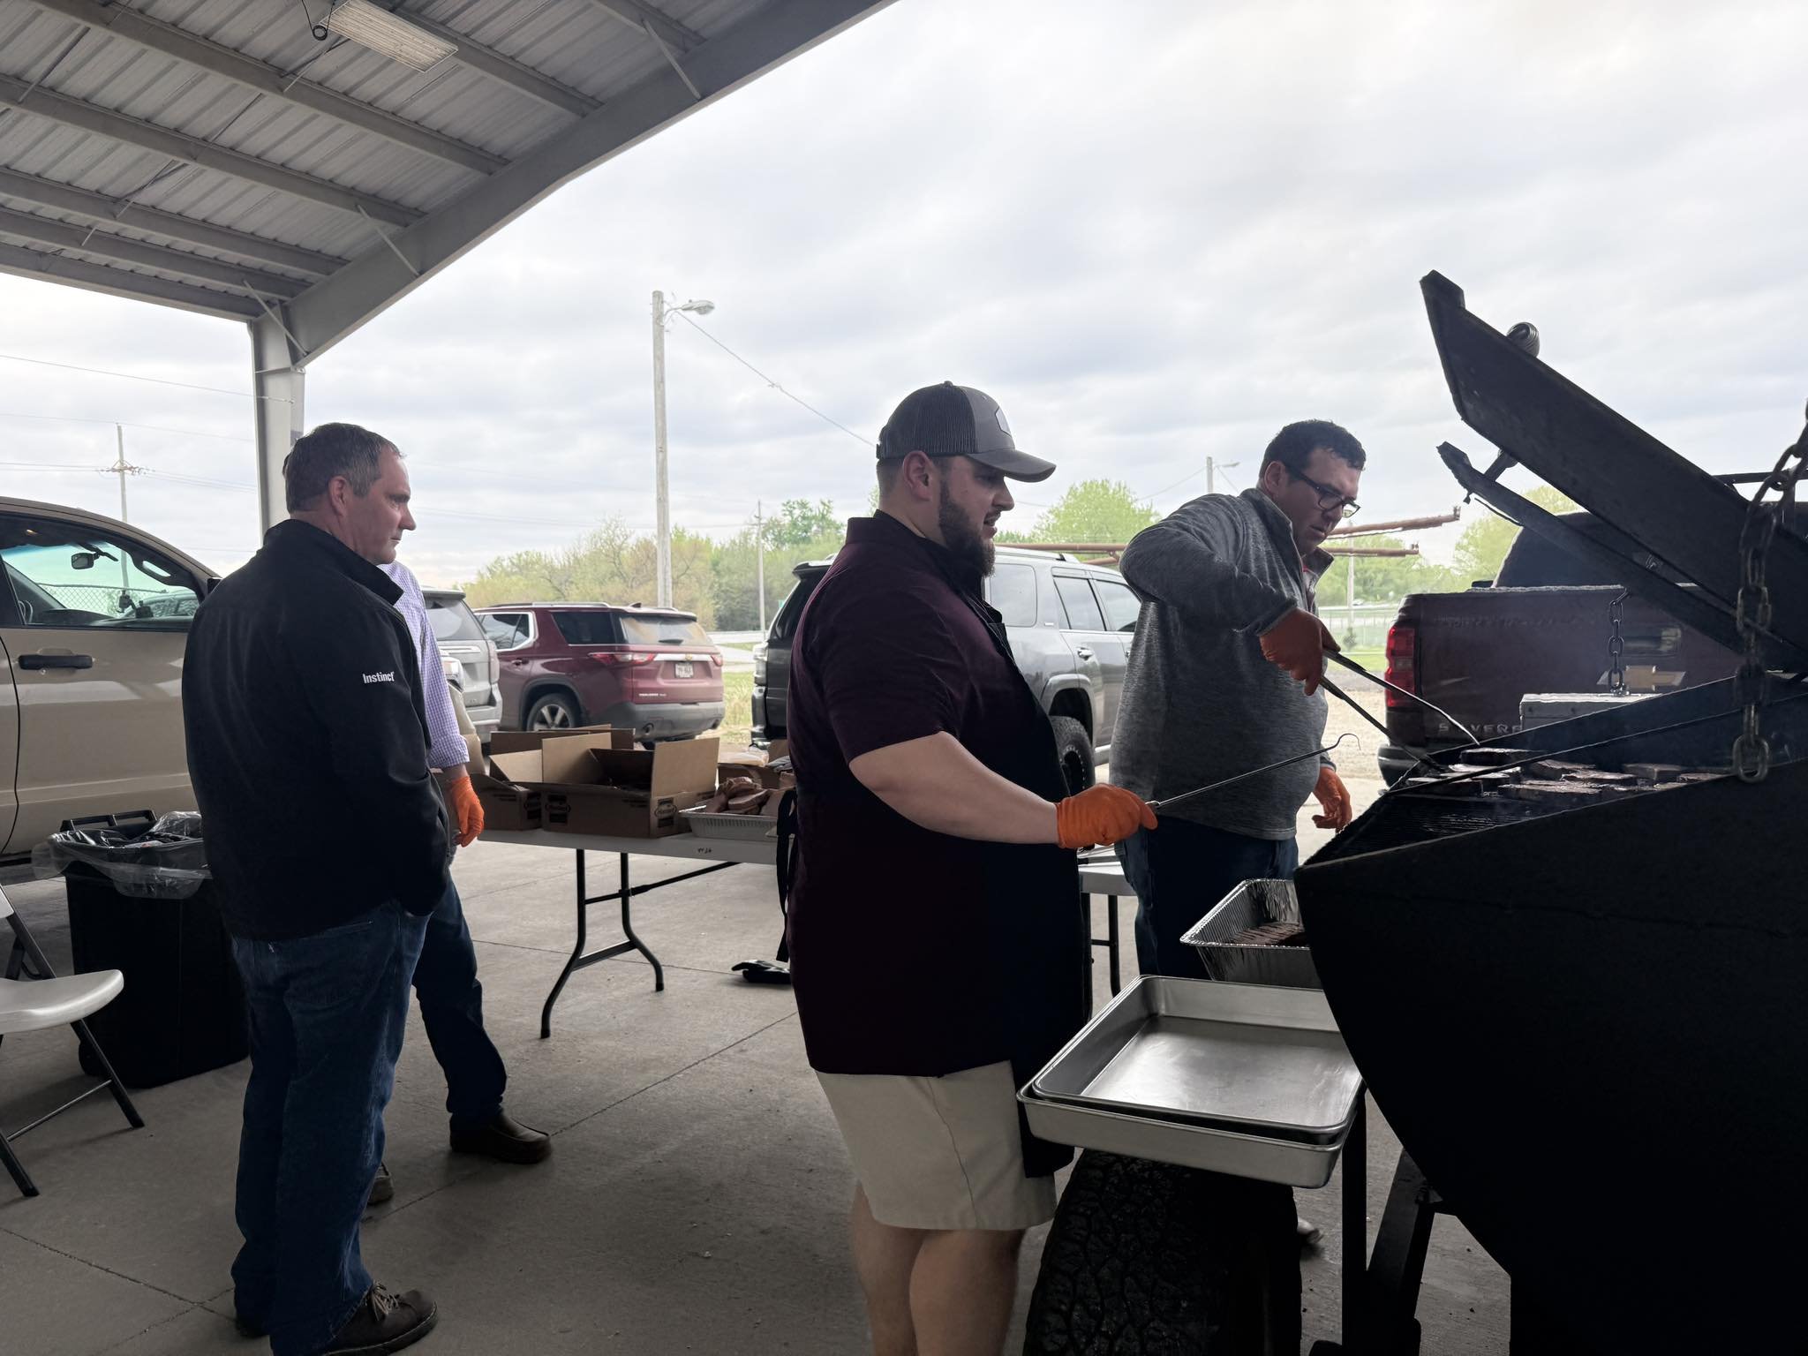
Supporting FFA Advisors
Serve Meal at Banquet

Slide 13
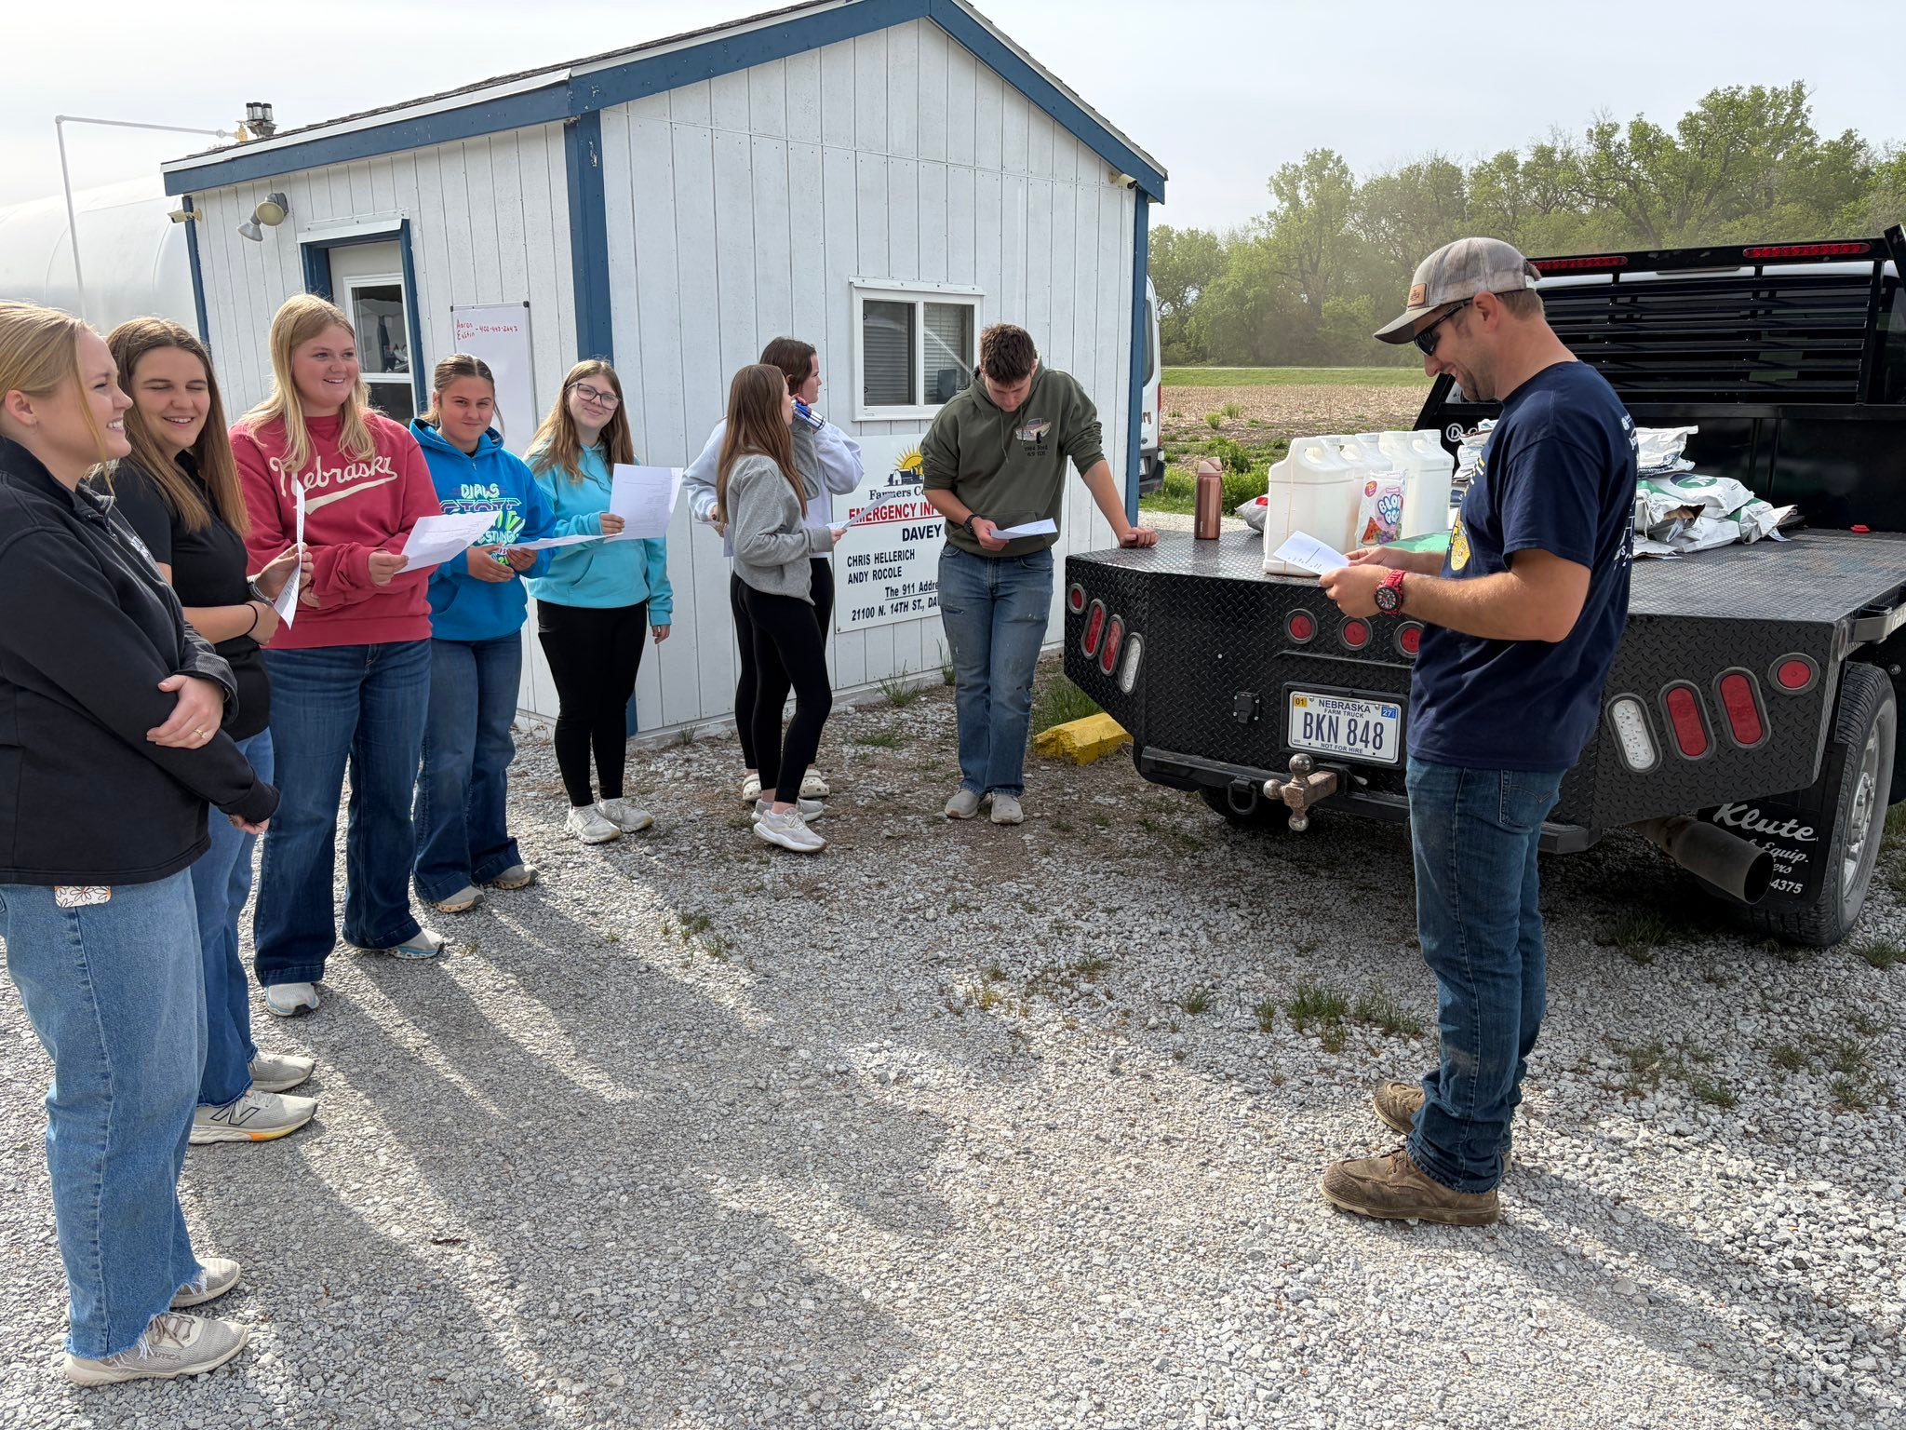
Supporting FFA Advisors
Host Corn Test Plot

Slide 14
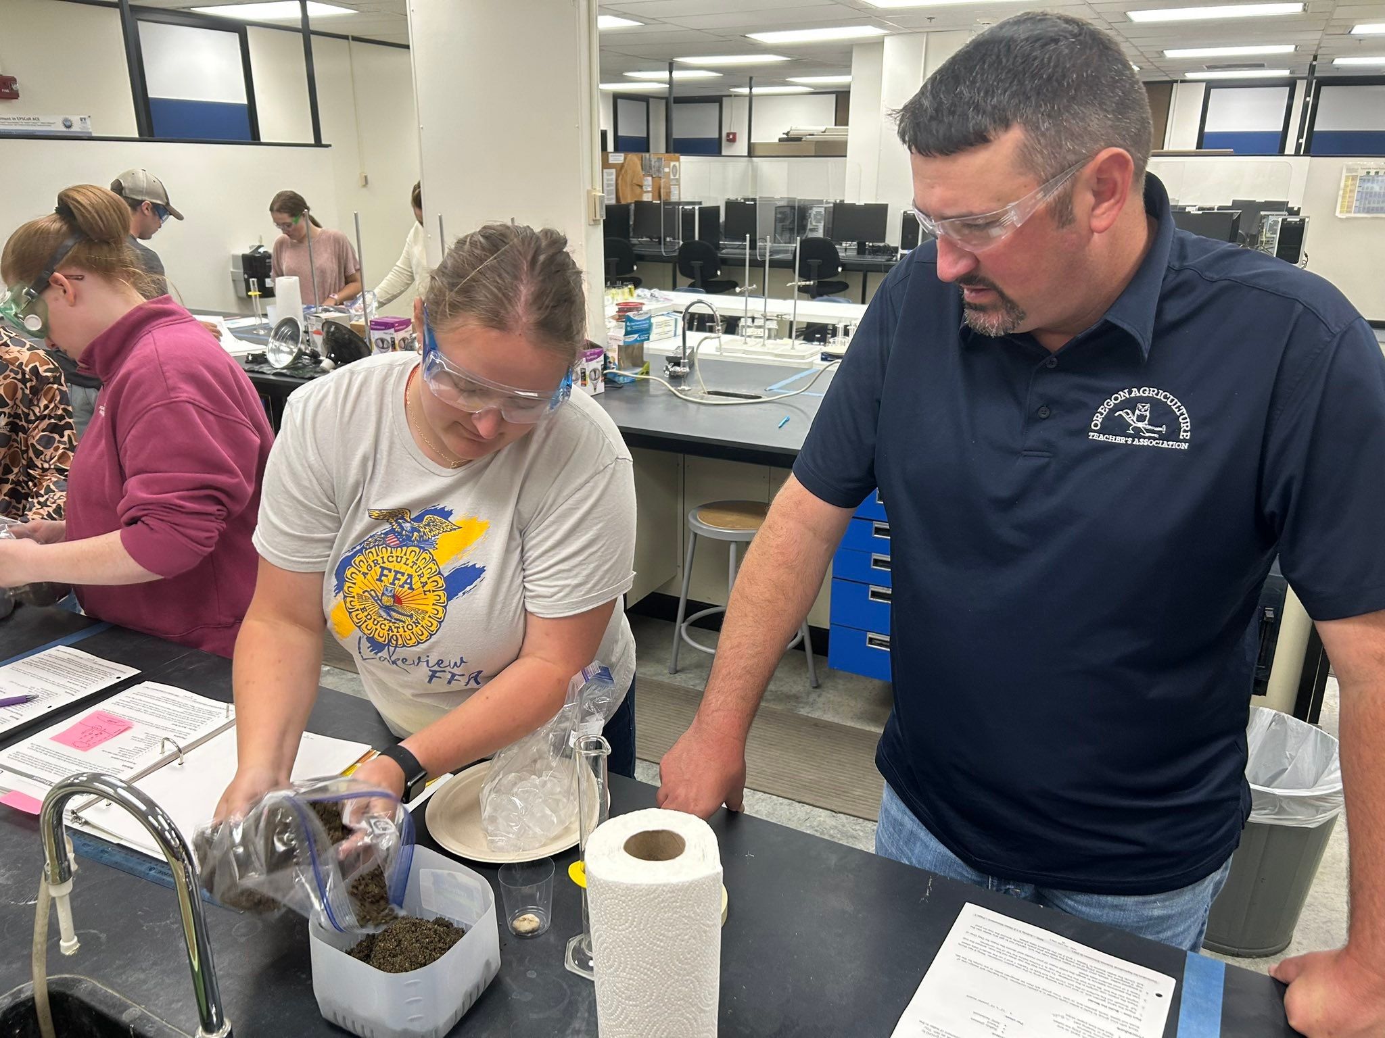
Supporting FFA Advisors
Continuing Education reimbursement for Advisors

Slide 15
Telling the FFA Story
Speak at banquet & recruit new members at FFA Banquet
Hosted a “Mission True Blue” with the NE FFA Foundation
Community Visibility and Support Community Members in need
March in Community Festival Parade (Respondent dressed up as a Cow!)
Sponsorship at County Fair – BBQ, Kiddie Tractor Pull, Food Stand
Embroidered Hats with Logo given away to get name out there!
Co-hosted Petting Zoo with FFA Chapter
Letter Writing Campaign to Area Ag Businesses

Slide 16
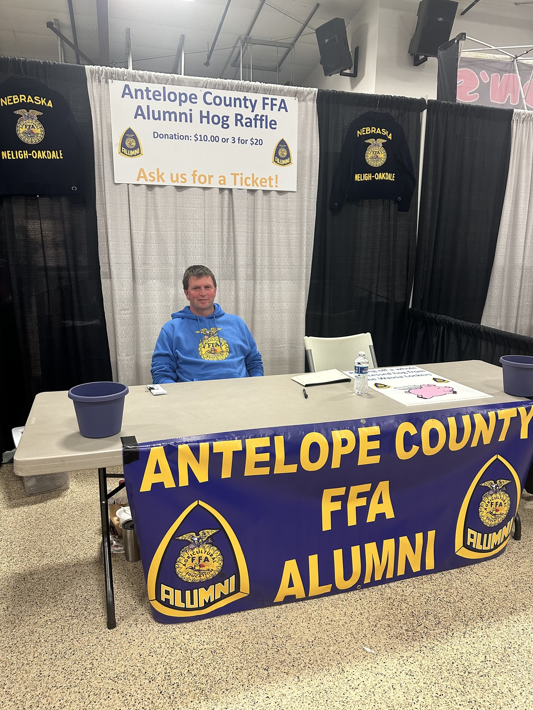
Telling the FFA Story
Facebook Posts & Share the FFA Chapter Social Media Posts

Slide 17
Fundraising Ideas
Windsor Loin Fundraiser during County Fair
Sweet Corn Patch
County Fair Food Truck
Annual Hog Raffle to support scholarship & FFA Jacket Fund
County Fair Premium Auction Raffle
Golf Tournament
Cow Bingo (100 squares sold at $10/square) portion of proceeds go to winner
Steak Sandwich Feed during Homecoming Kick-Off
Letter Writing/Donation Campaign

Slide 18
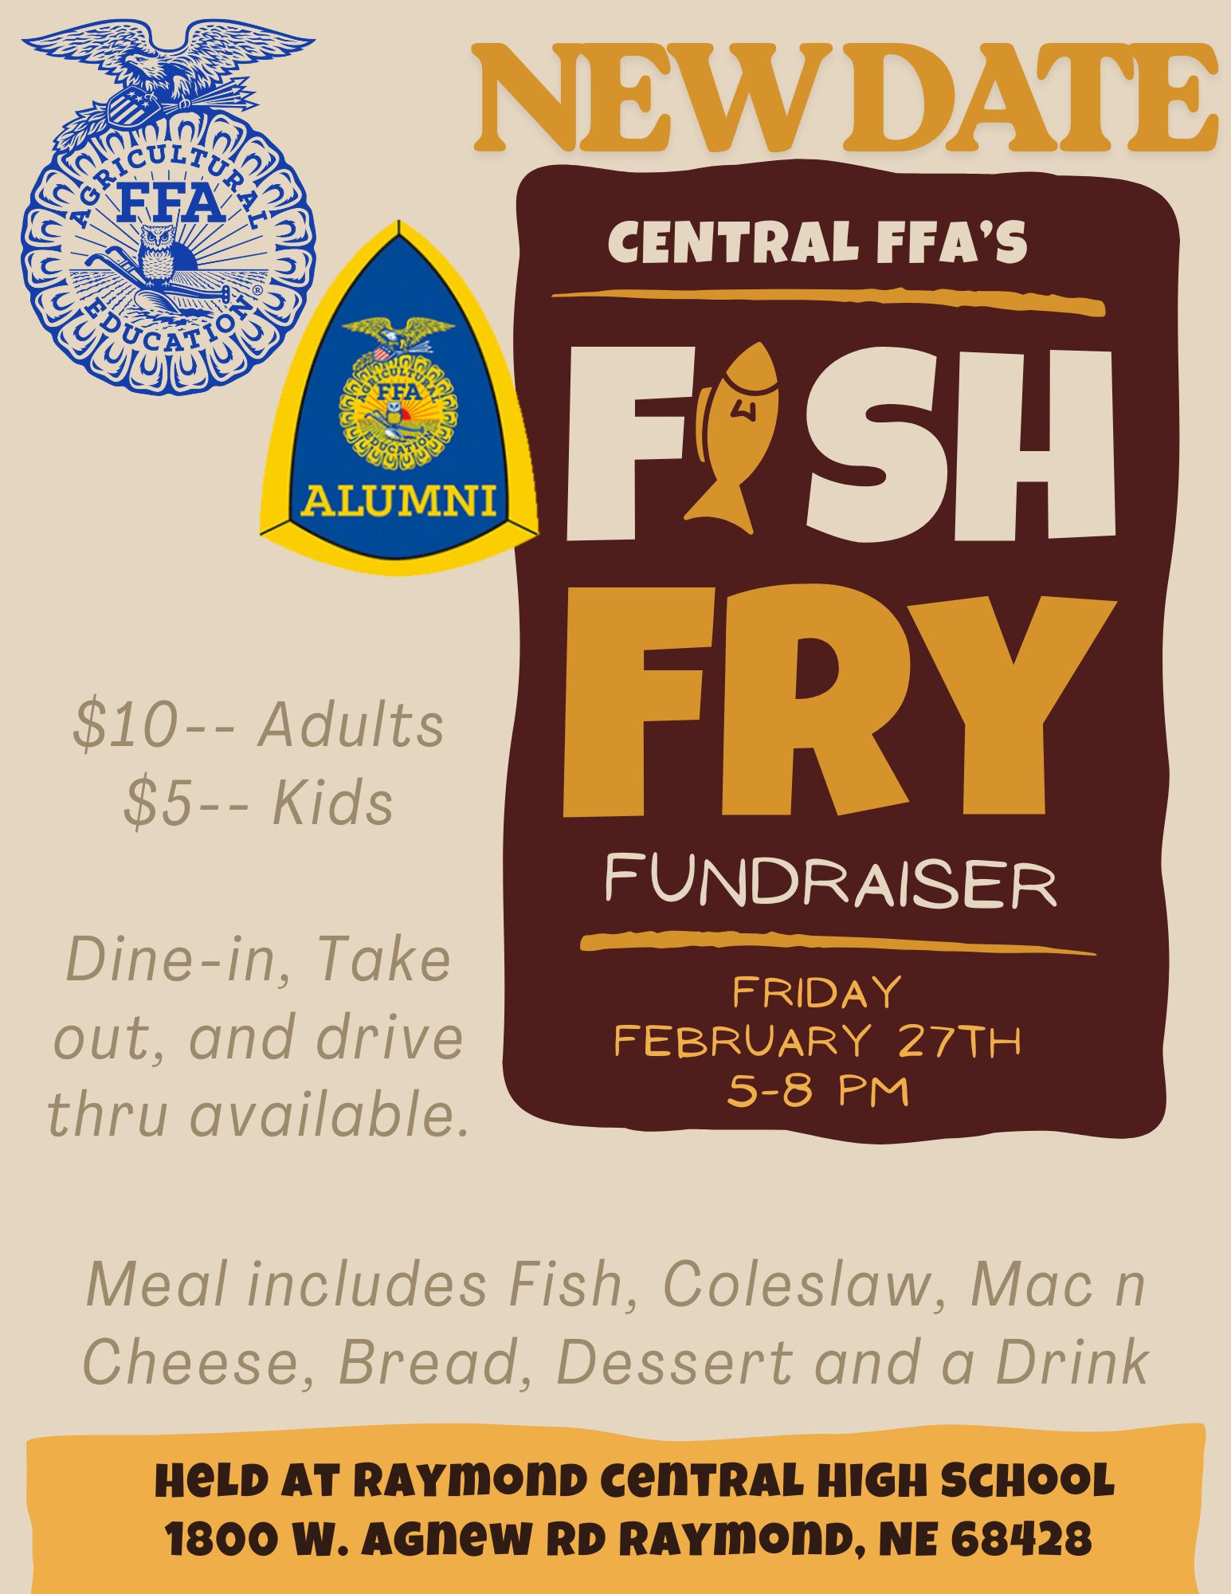
Fundraising Ideas
  Fish Fry

Slide 19
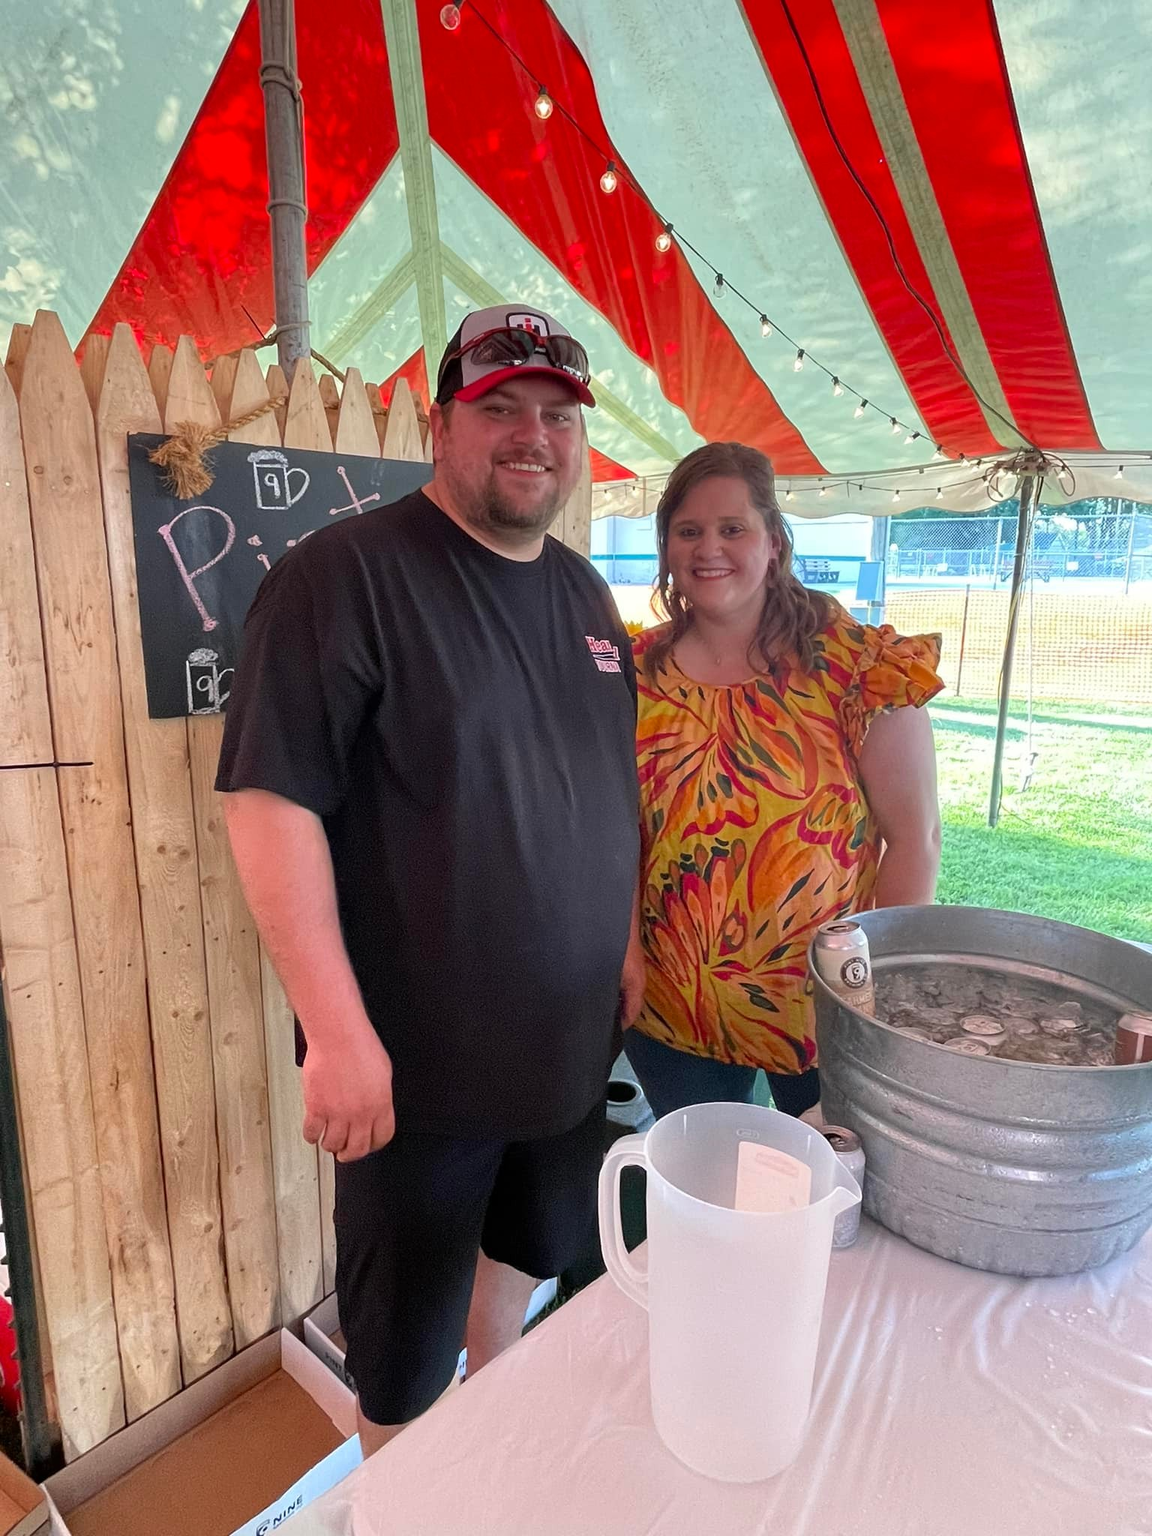

Fundraising Ideas
Wine & Beer Tasting Event at “Taste of Old Settler Days”

Slide 20
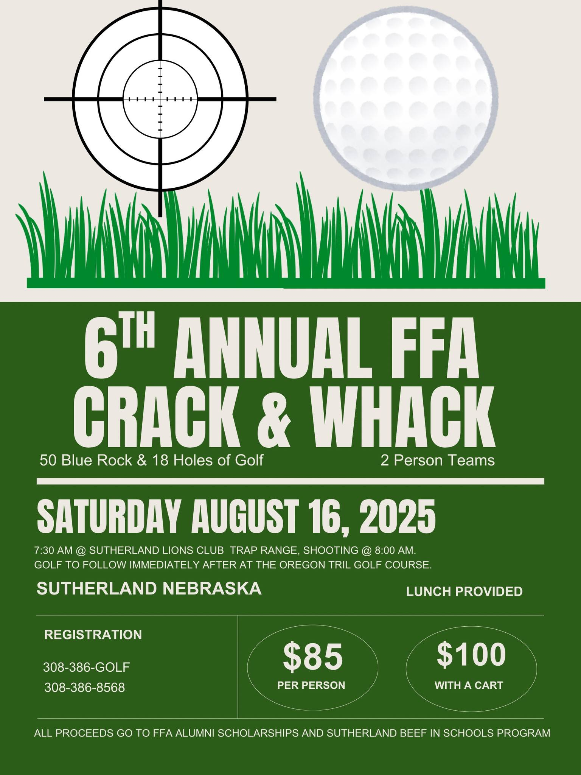
Fundraising Ideas
    “Crack & Wack” – 50 Bluerock Shoot & 18 holes of golf

Slide 21
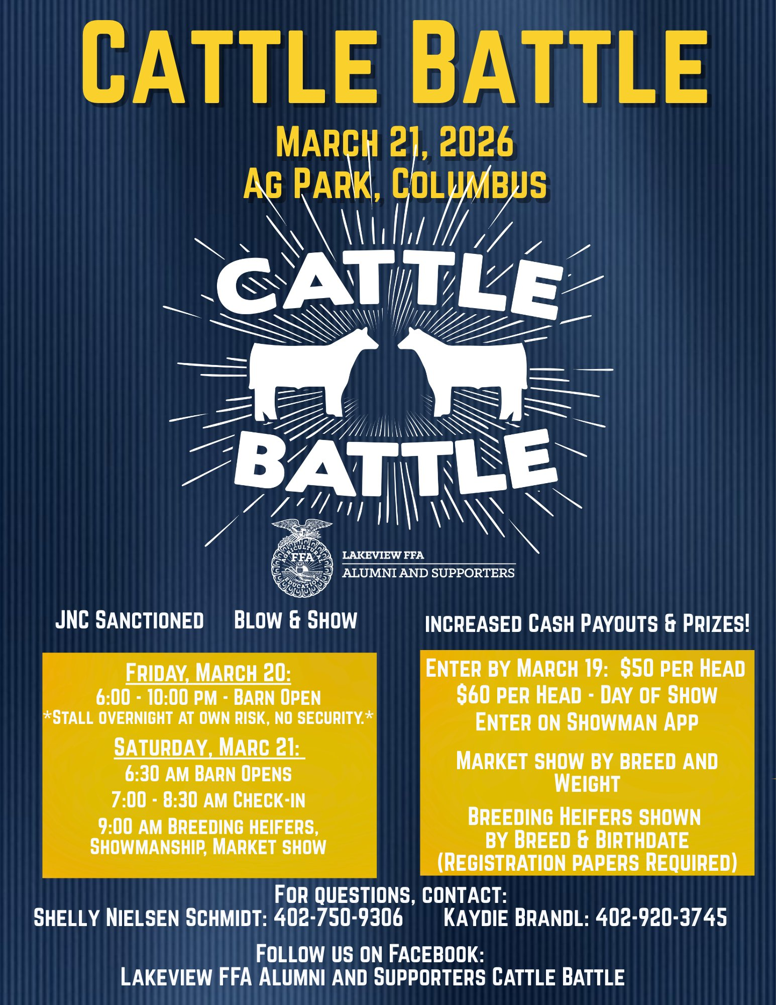
Fundraising Ideas
      “Cattle Battle” Progress Show & Lunch Stand

Slide 22
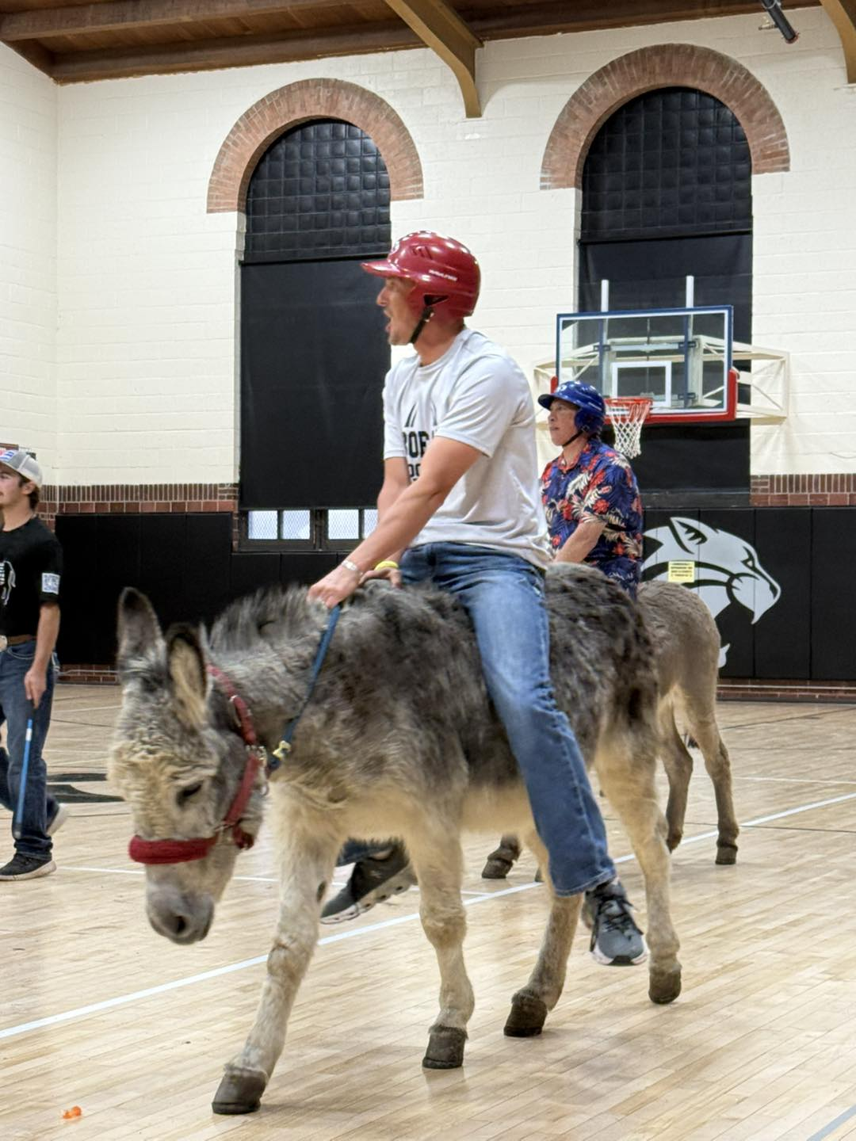
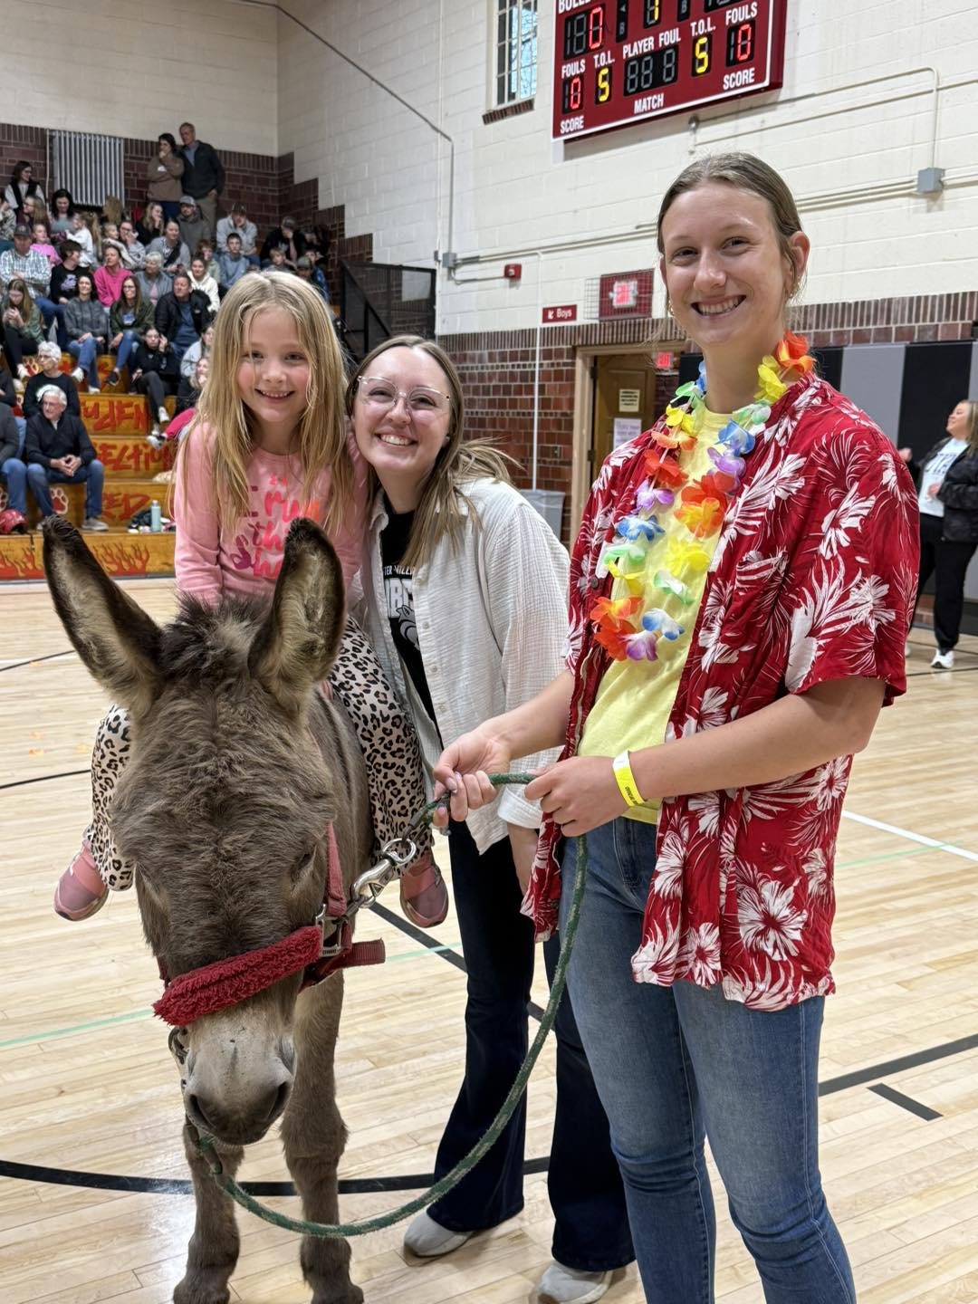
Fundraising Ideas
              Donkey Basketball

Slide 23
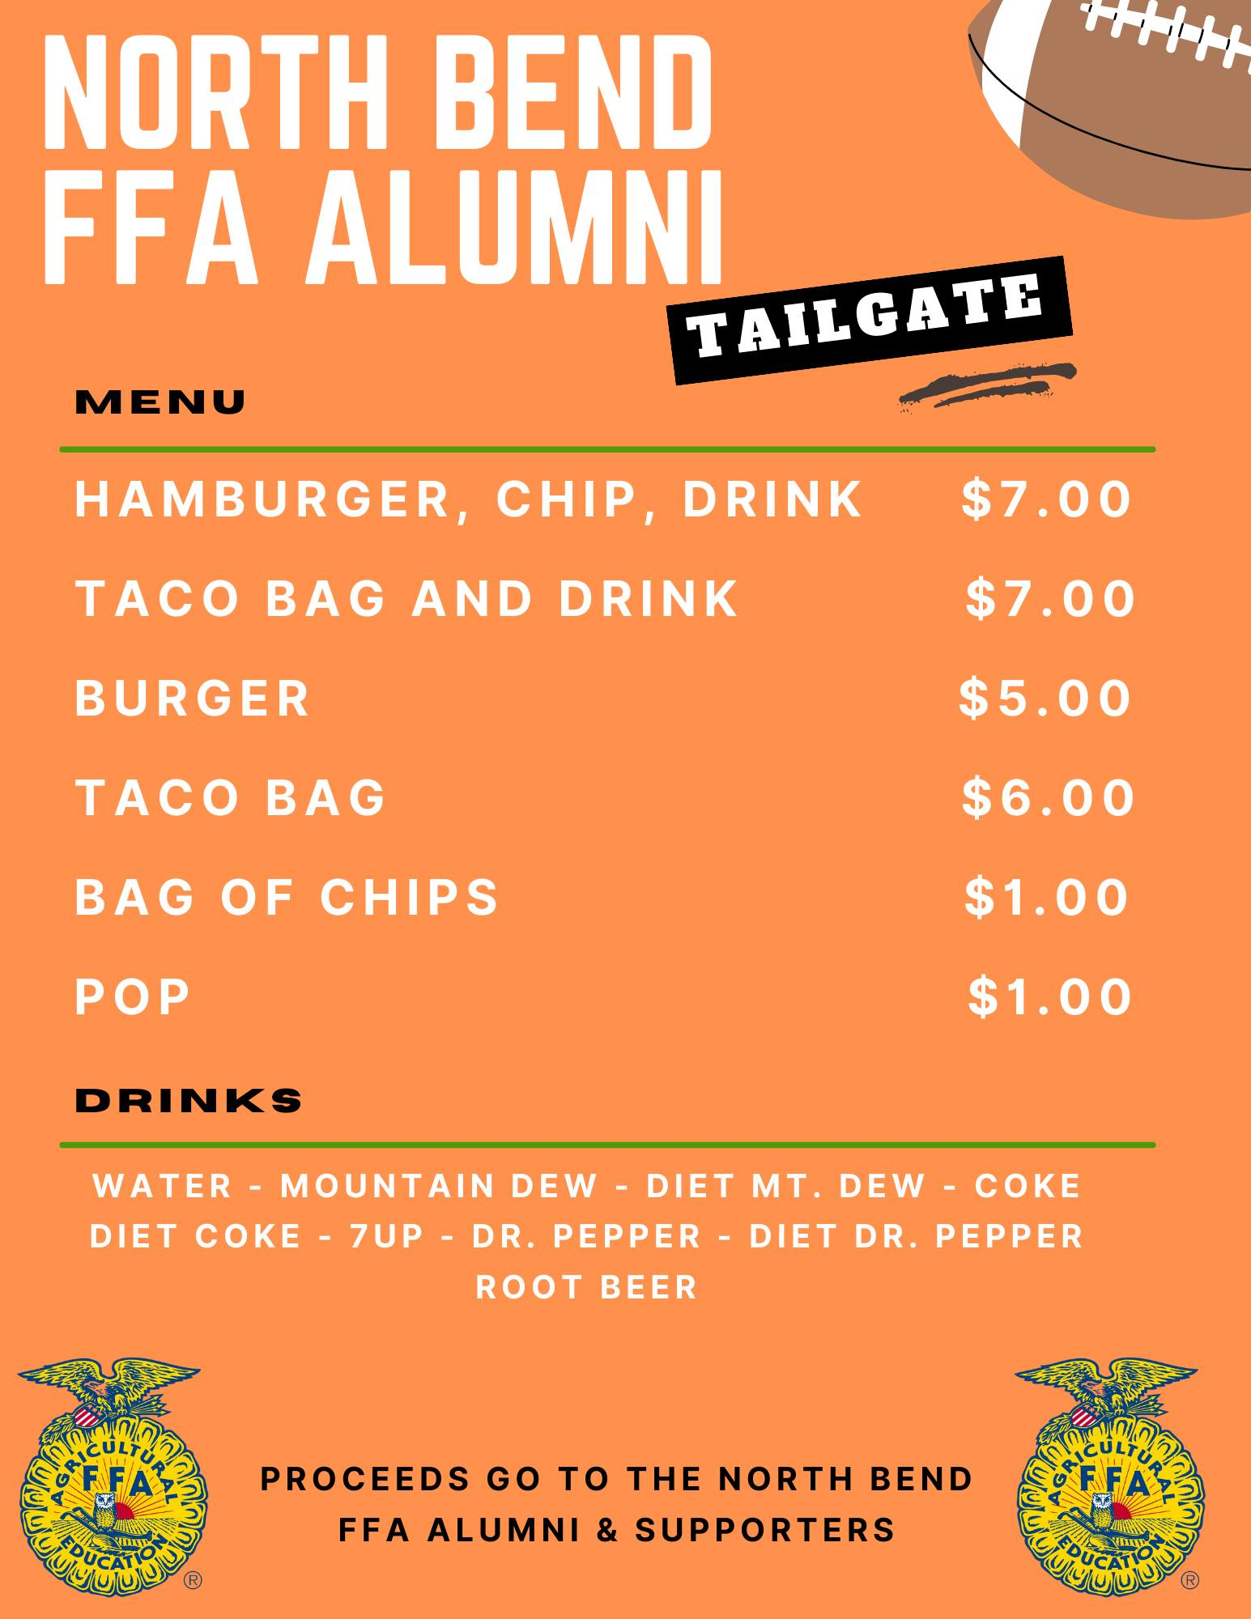
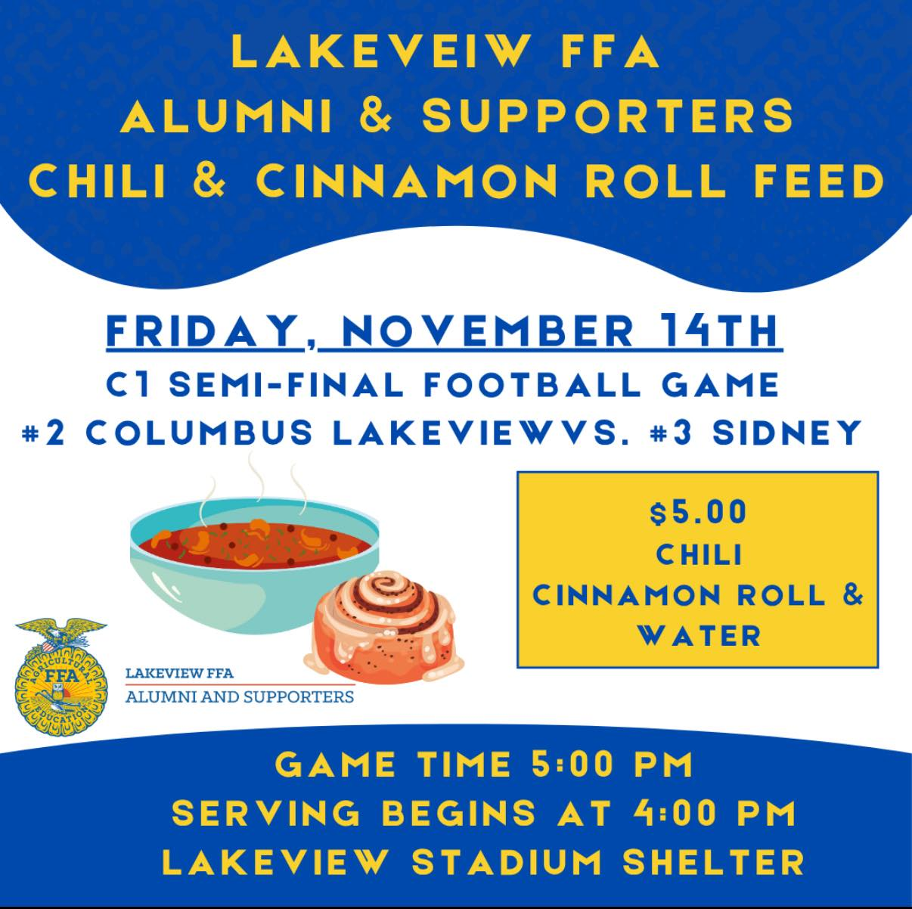
Fundraising Ideas
          Tailgates at School Events

Slide 24
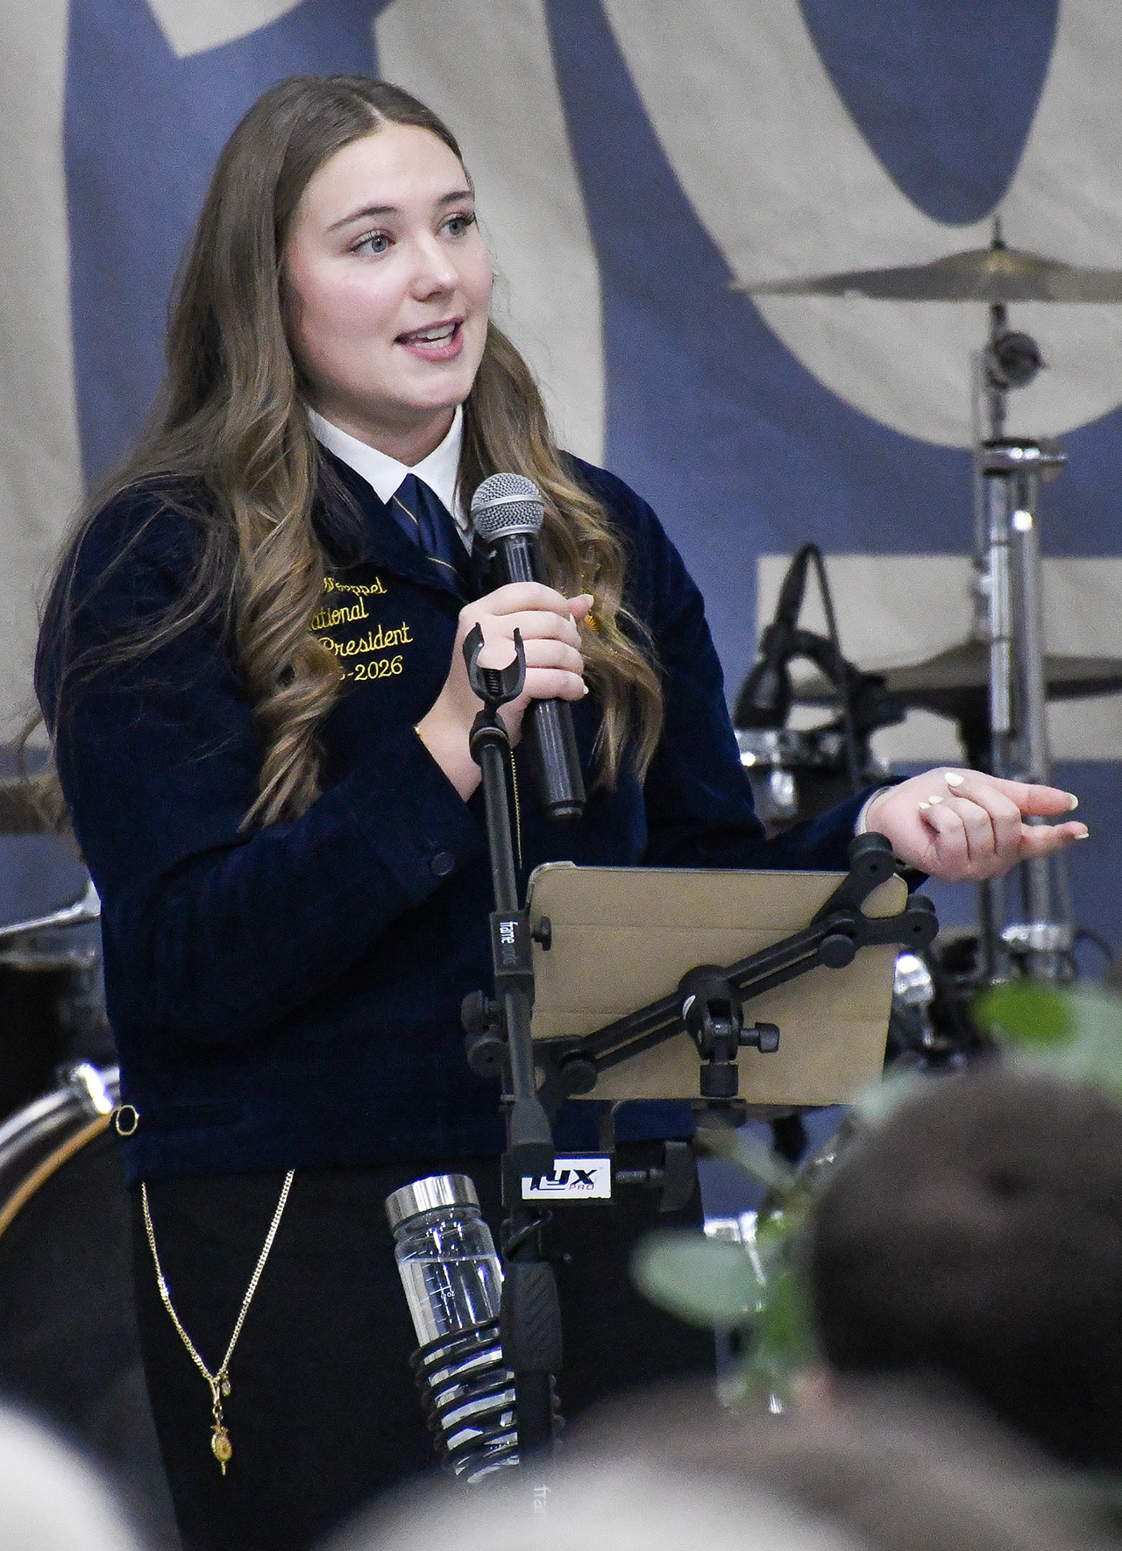
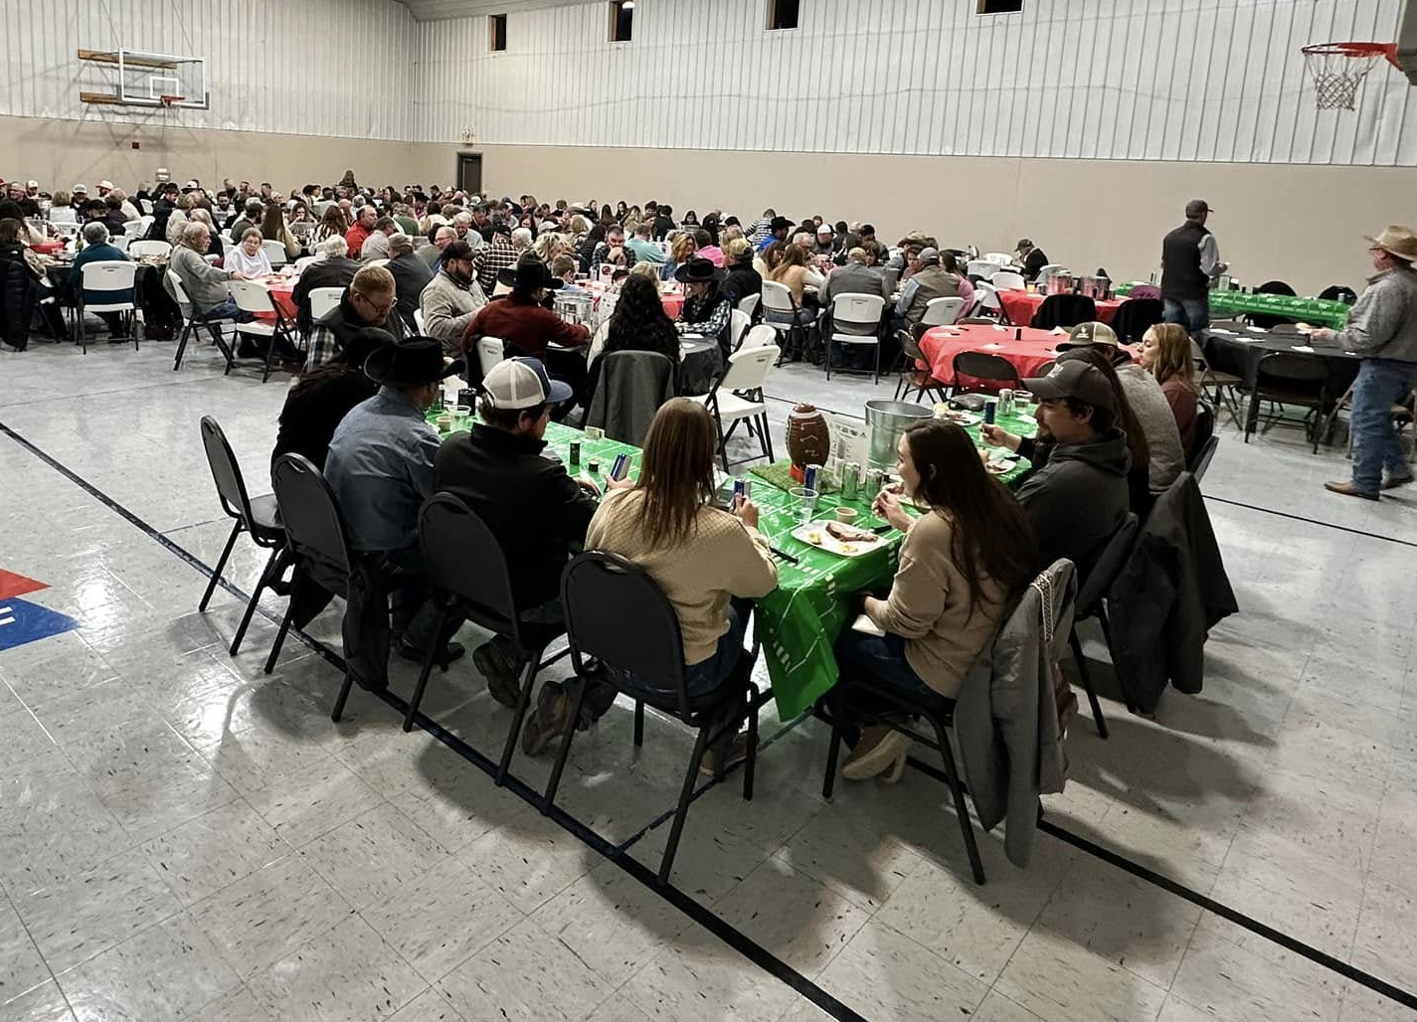
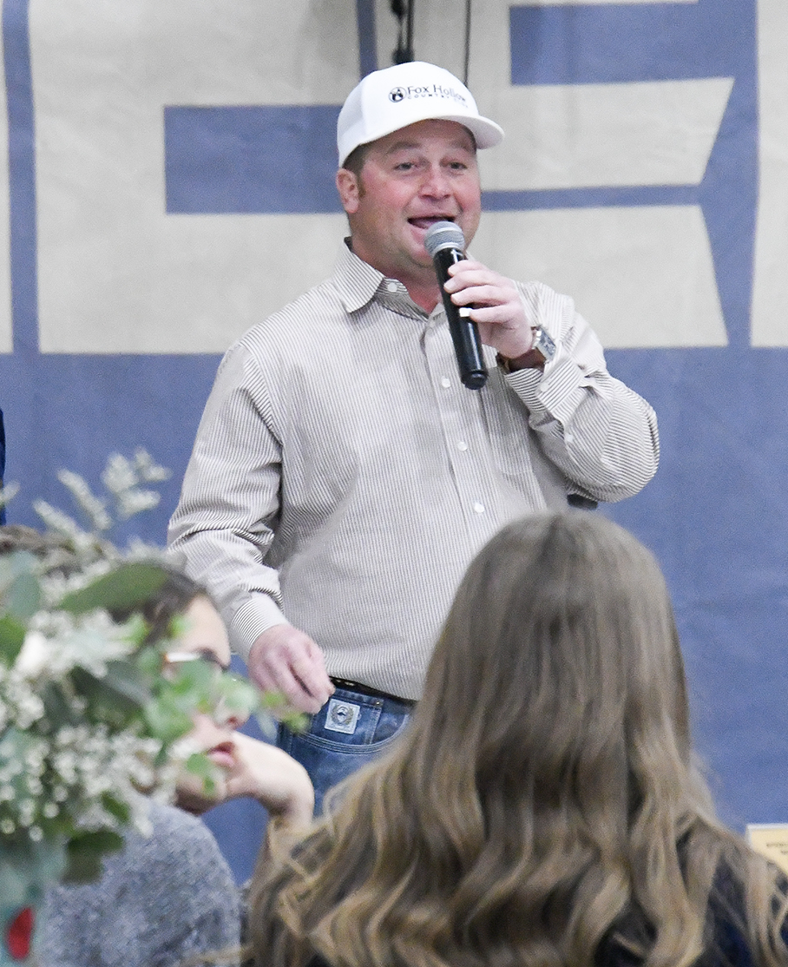
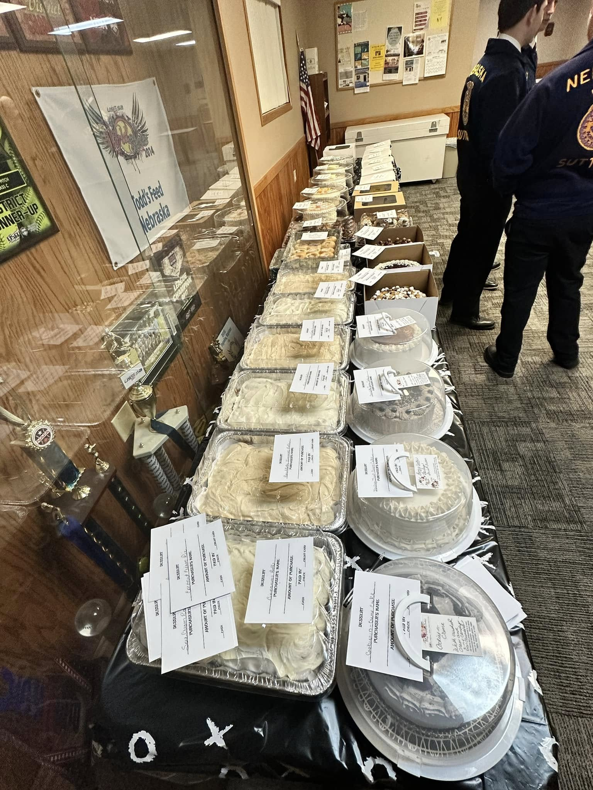
Fundraising Ideas
        Winter Extravaganza with Dessert Auction

Slide 25

Fundraising Ideas
Trivia Night

Slide 26
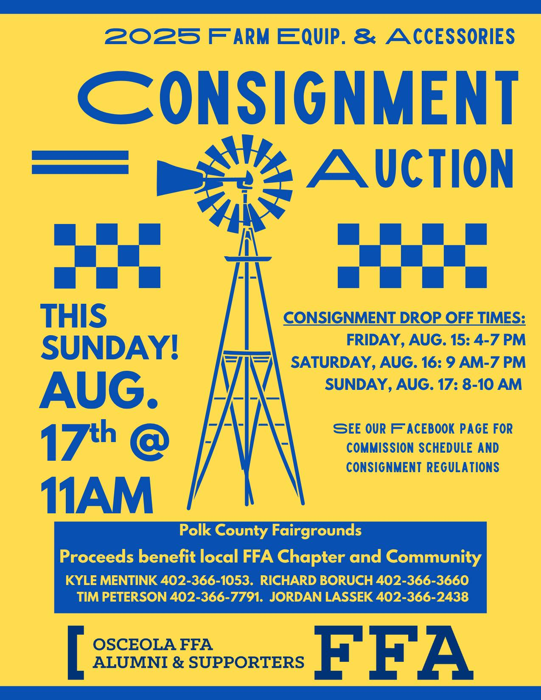
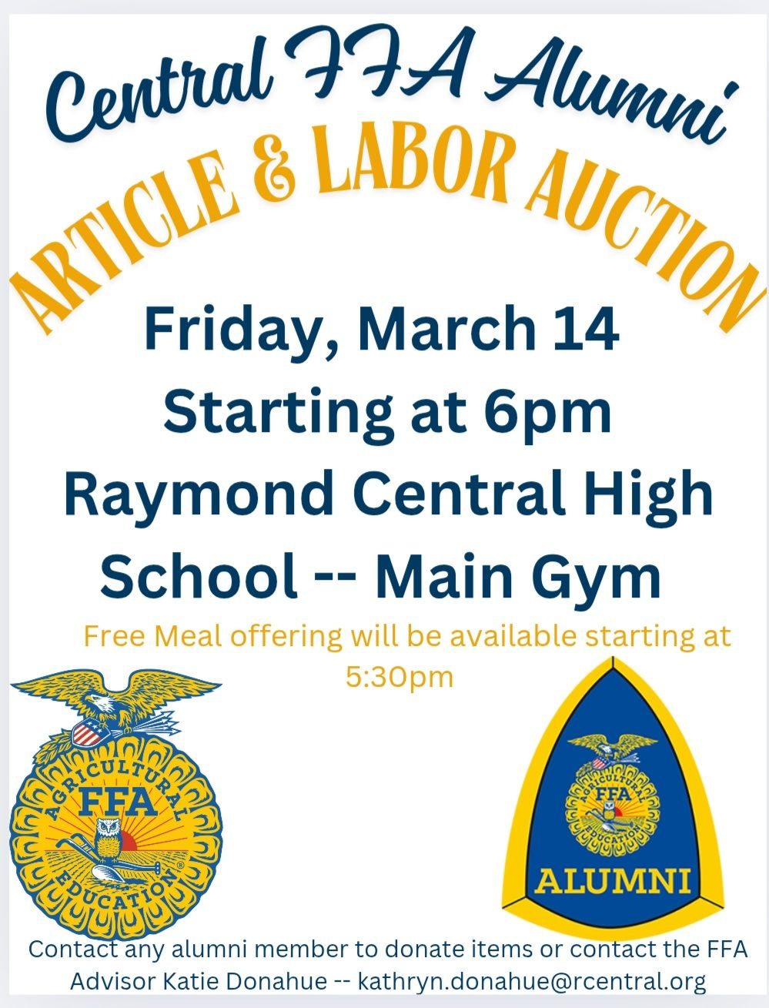
Fundraising Ideas
      Consignment, Article, Silent, and Labor Auctions

Slide 27
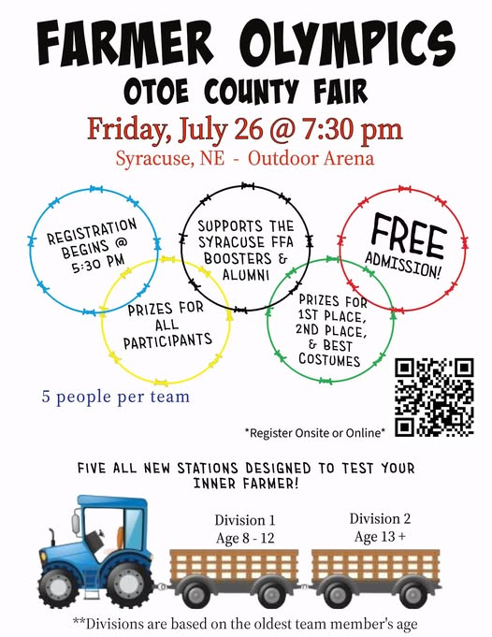
Fundraising Ideas
              Farmer Olympics

Slide 28
Social Activities for
Alumni & Supporters
Banquet Meal
Annual Meeting & Social in January
Refreshments served during meetings
Annual Christmas Party
Comradery while working events
Social Meeting and meal during the winter as a recruiting meeting
Members golf in local golf tournament (We pay registration fee)
Tour nearby Breweries

Slide 29
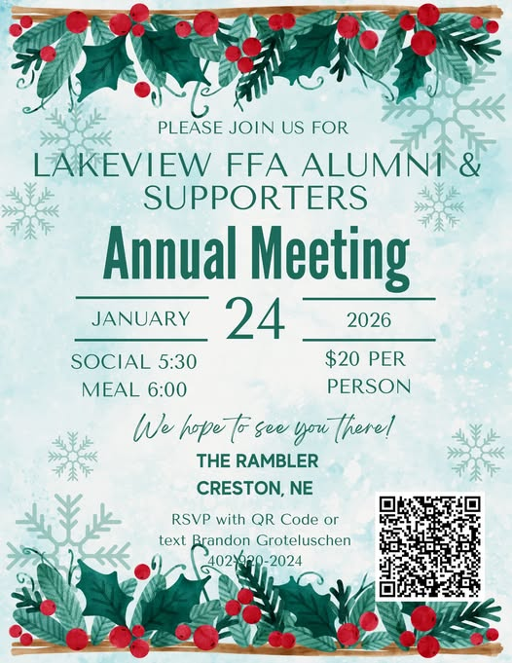
Social Activities for
Alumni & Supporters
          Annual Meeting & Social in January

Slide 30
Activities in Collaboration
With FFA Chapter
Hay Hauling Contest
Pancake Feed at County Fair
Collaborate and work with the FFA Chapter with everything we do and everything they do

Slide 31
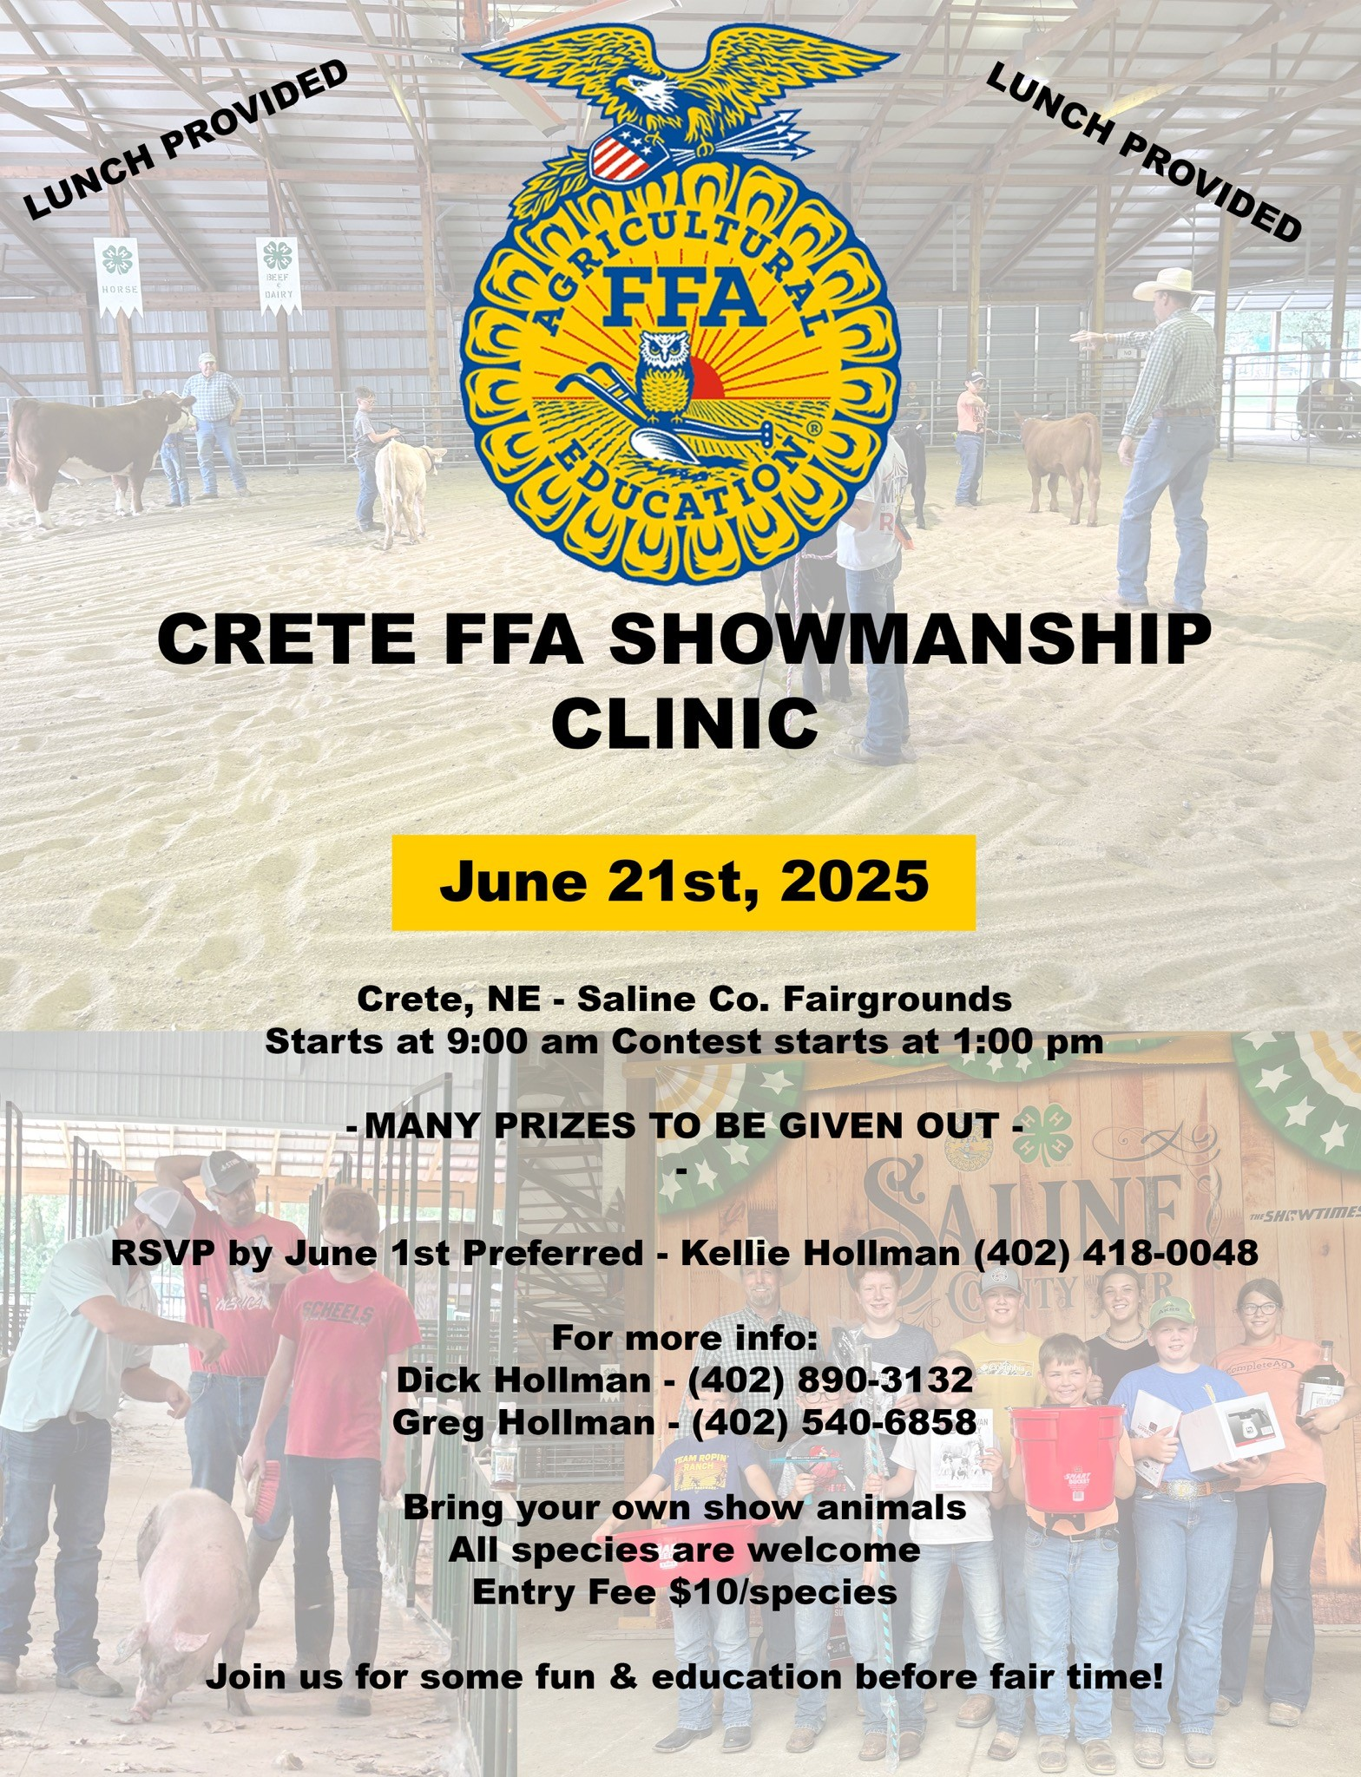
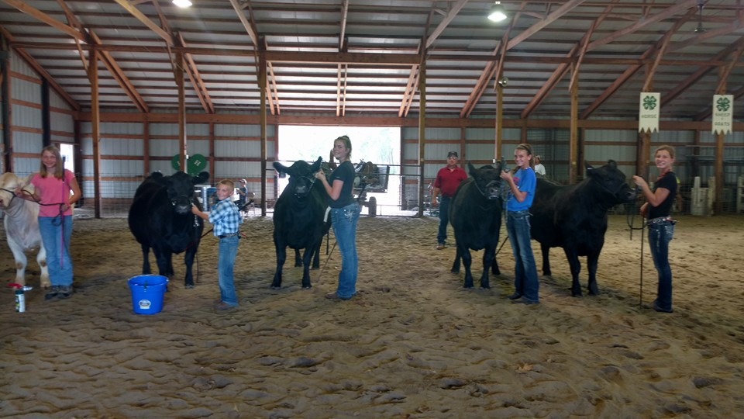
Activities in Collaboration
With FFA Chapter
Showmanship Clinic

Slide 32
Other Activities
Petting Zoo during FFA Week
Beef in the Schools
Farmer’s Market
Setting Tables & Chairs and making food for local funerals
Racoon Hunt Free Will Offering Breakfast
Provide 1/3 of Cost for Summer Camps
Provide Decorated Cookies for Seniors during FFA Week
Locker Magnets for all FFA members during FFA Week
Breakfast Free Will Donation during Wrestling Tournament
Hamburger Burn during Kids Rodeo at County Fair
Park Clean-up

Slide 33

Other Activities
  Kick Off the Year Burger Bash with Games & Prizes

Slide 34

Other Activities
    Farmer’s Market

Slide 35
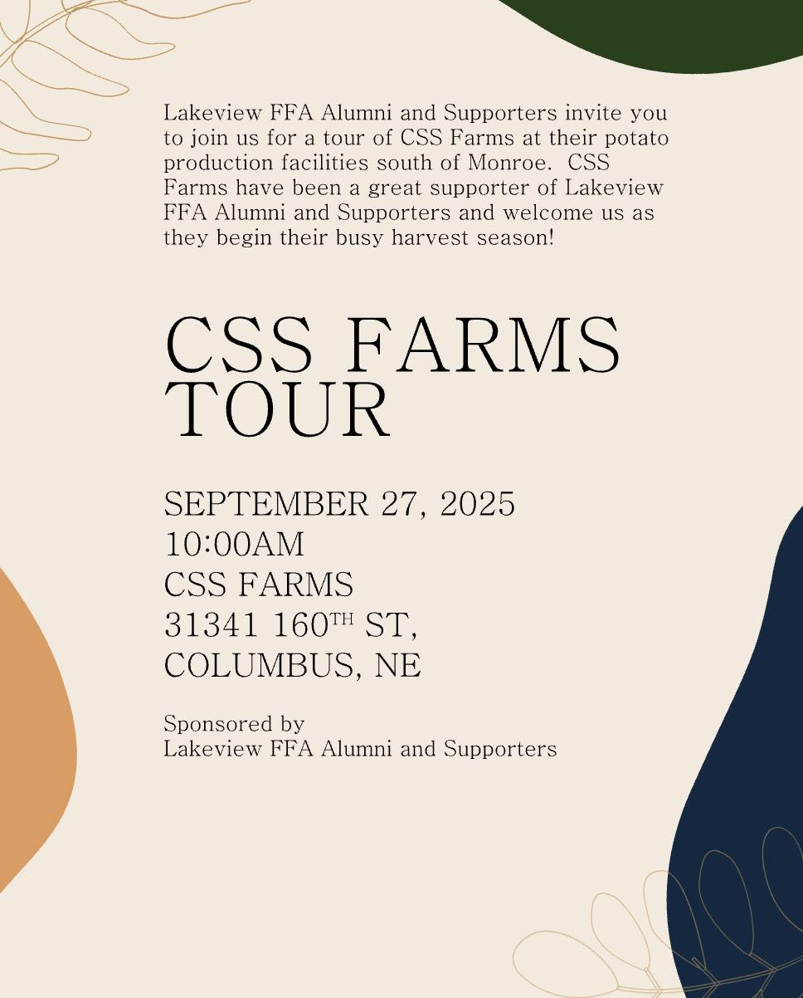
Other Activities
Business & Industry Tours

Slide 36
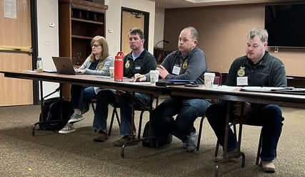
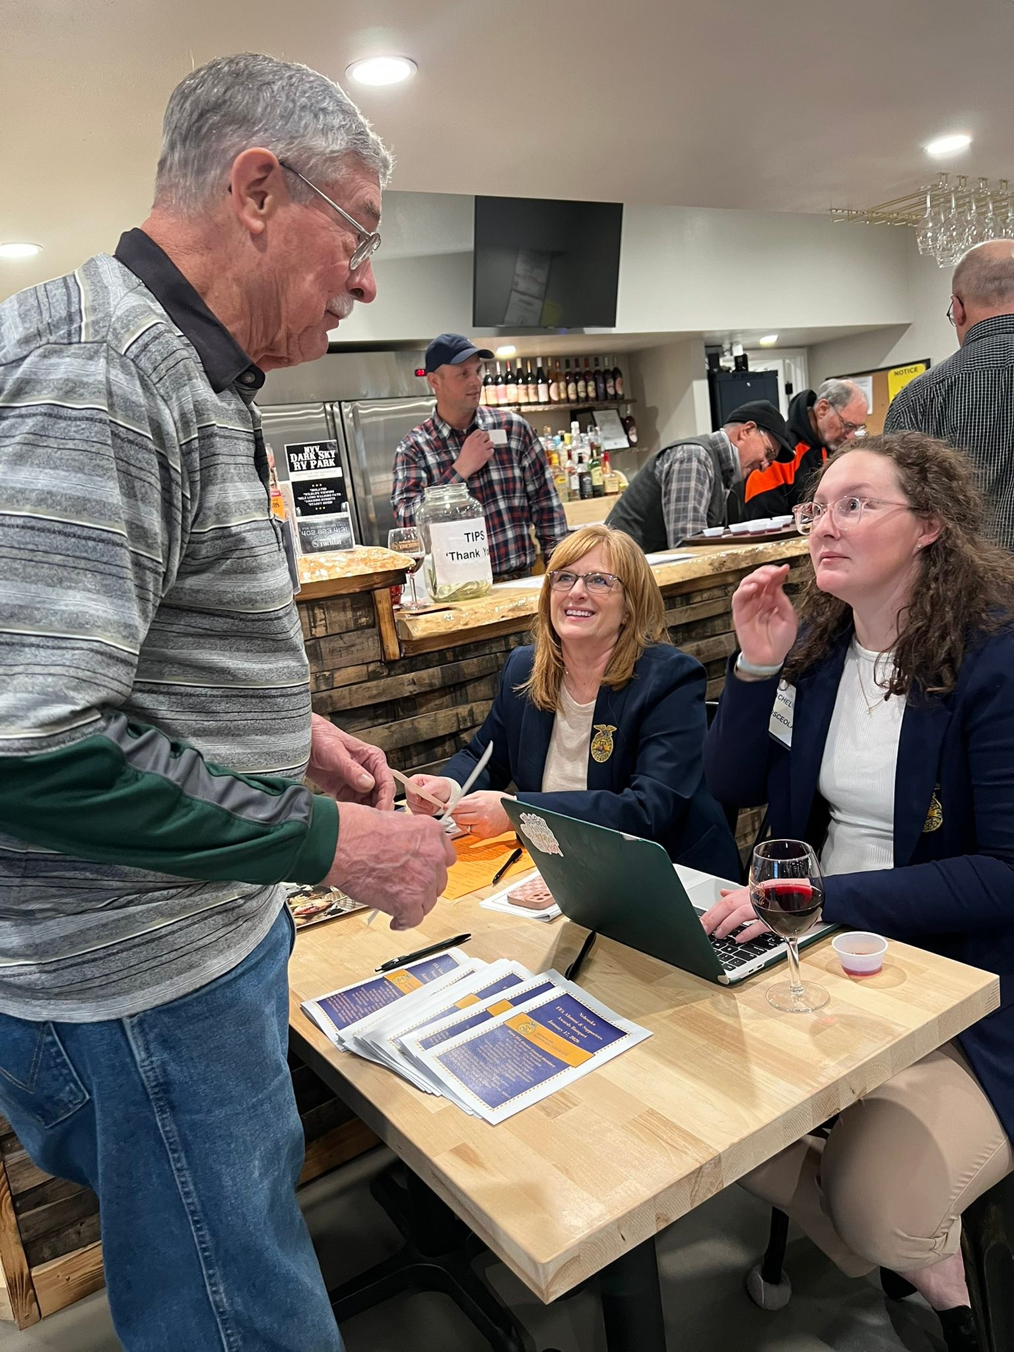
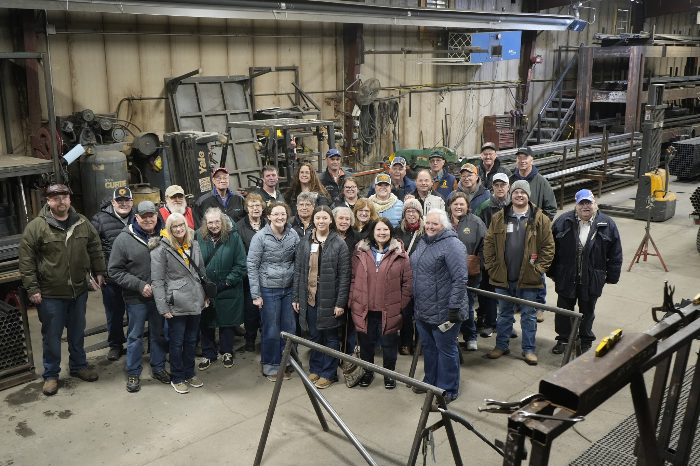
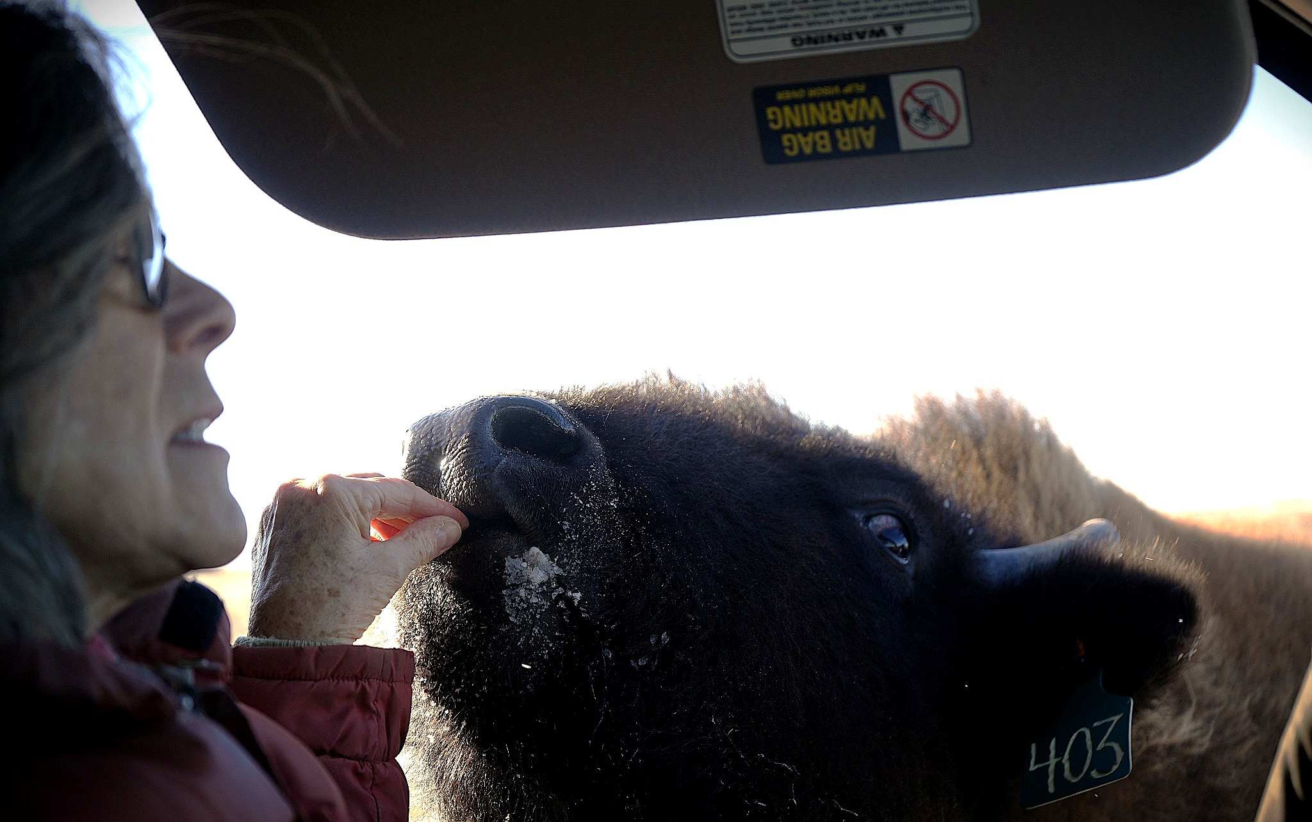
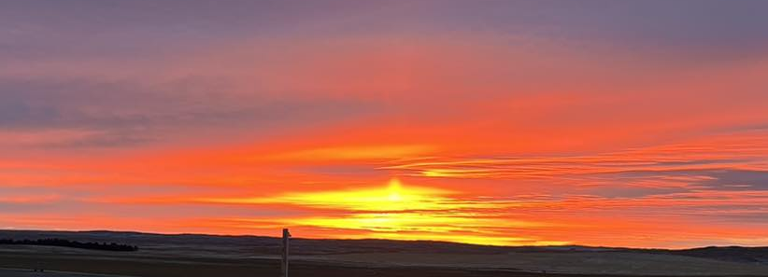
Other Activities
    Attend State FFA Alumni & Supporters Convention

Slide 37
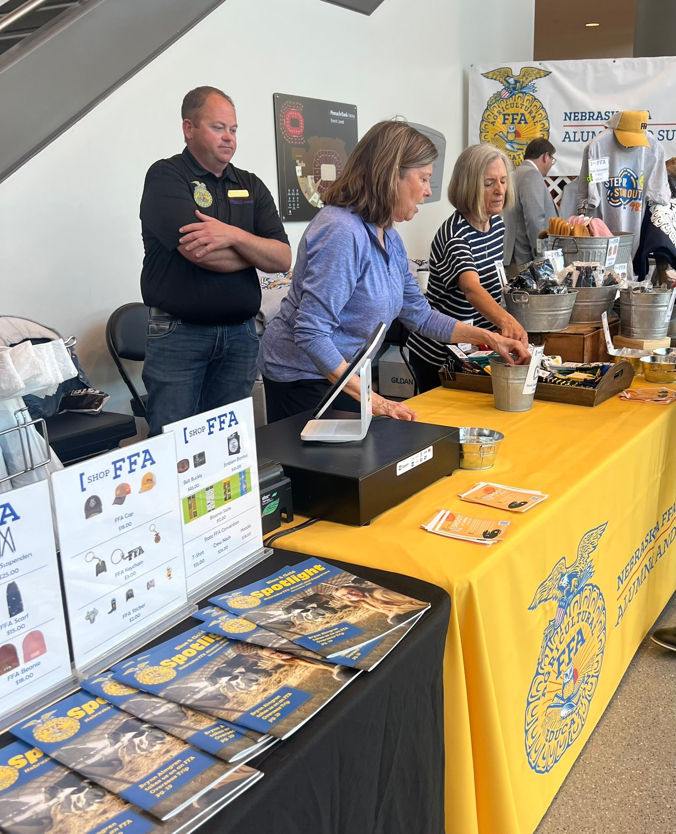
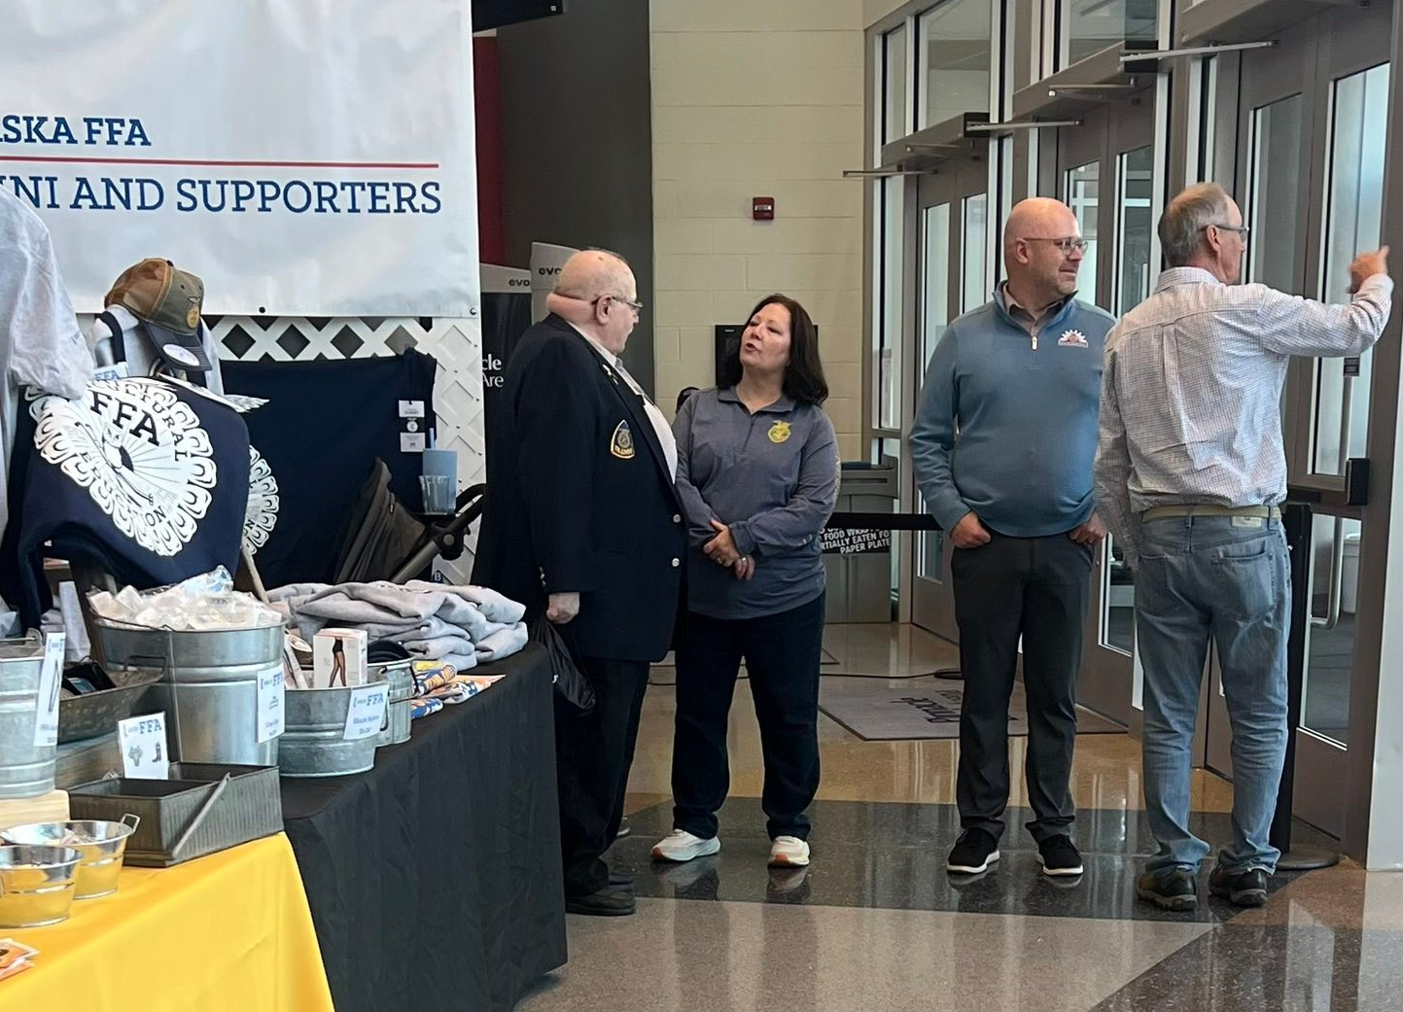
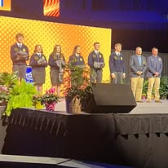
Other Activities
Attend State FFA Convention & Volunteer to Work at the Alumni & Supporters Booth or as a Judge

Slide 38
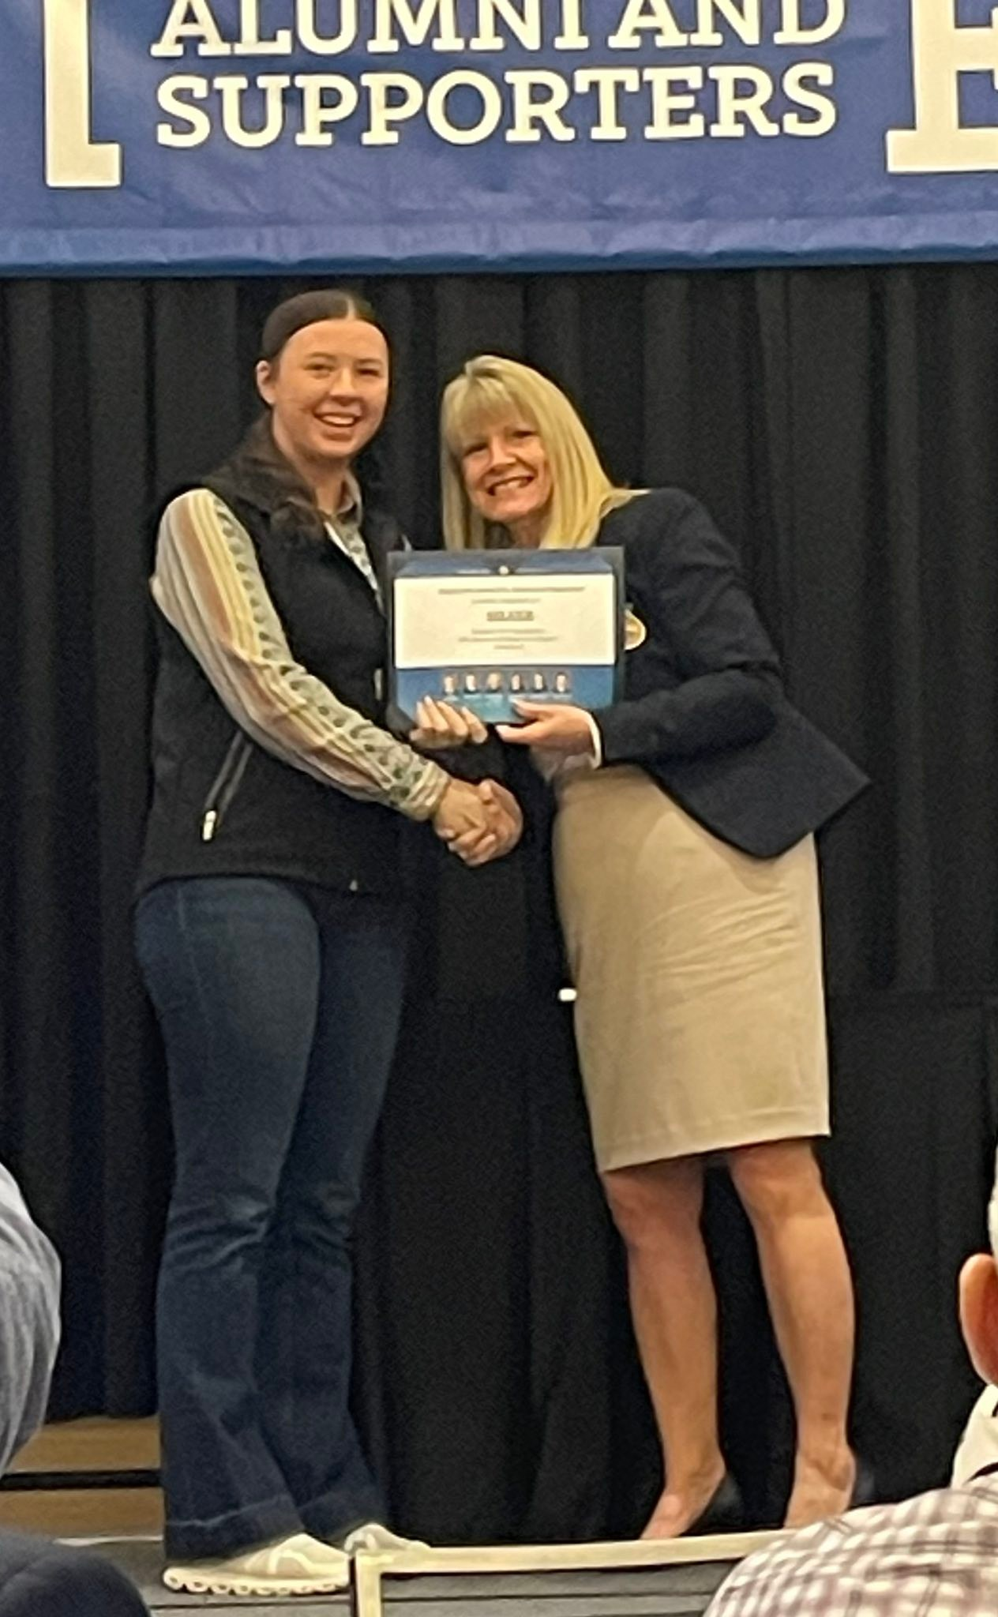
Other Activities
Apply for National Awards and attend National Convention

Slide 39
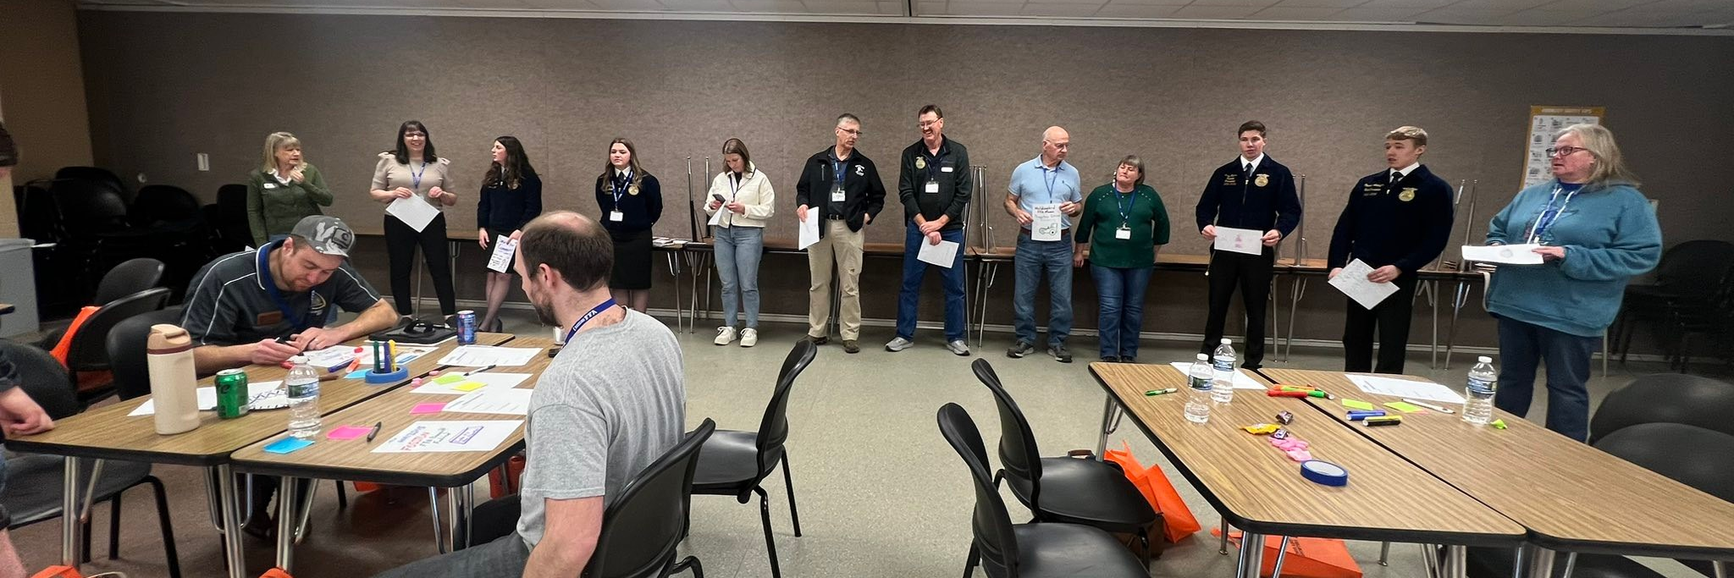
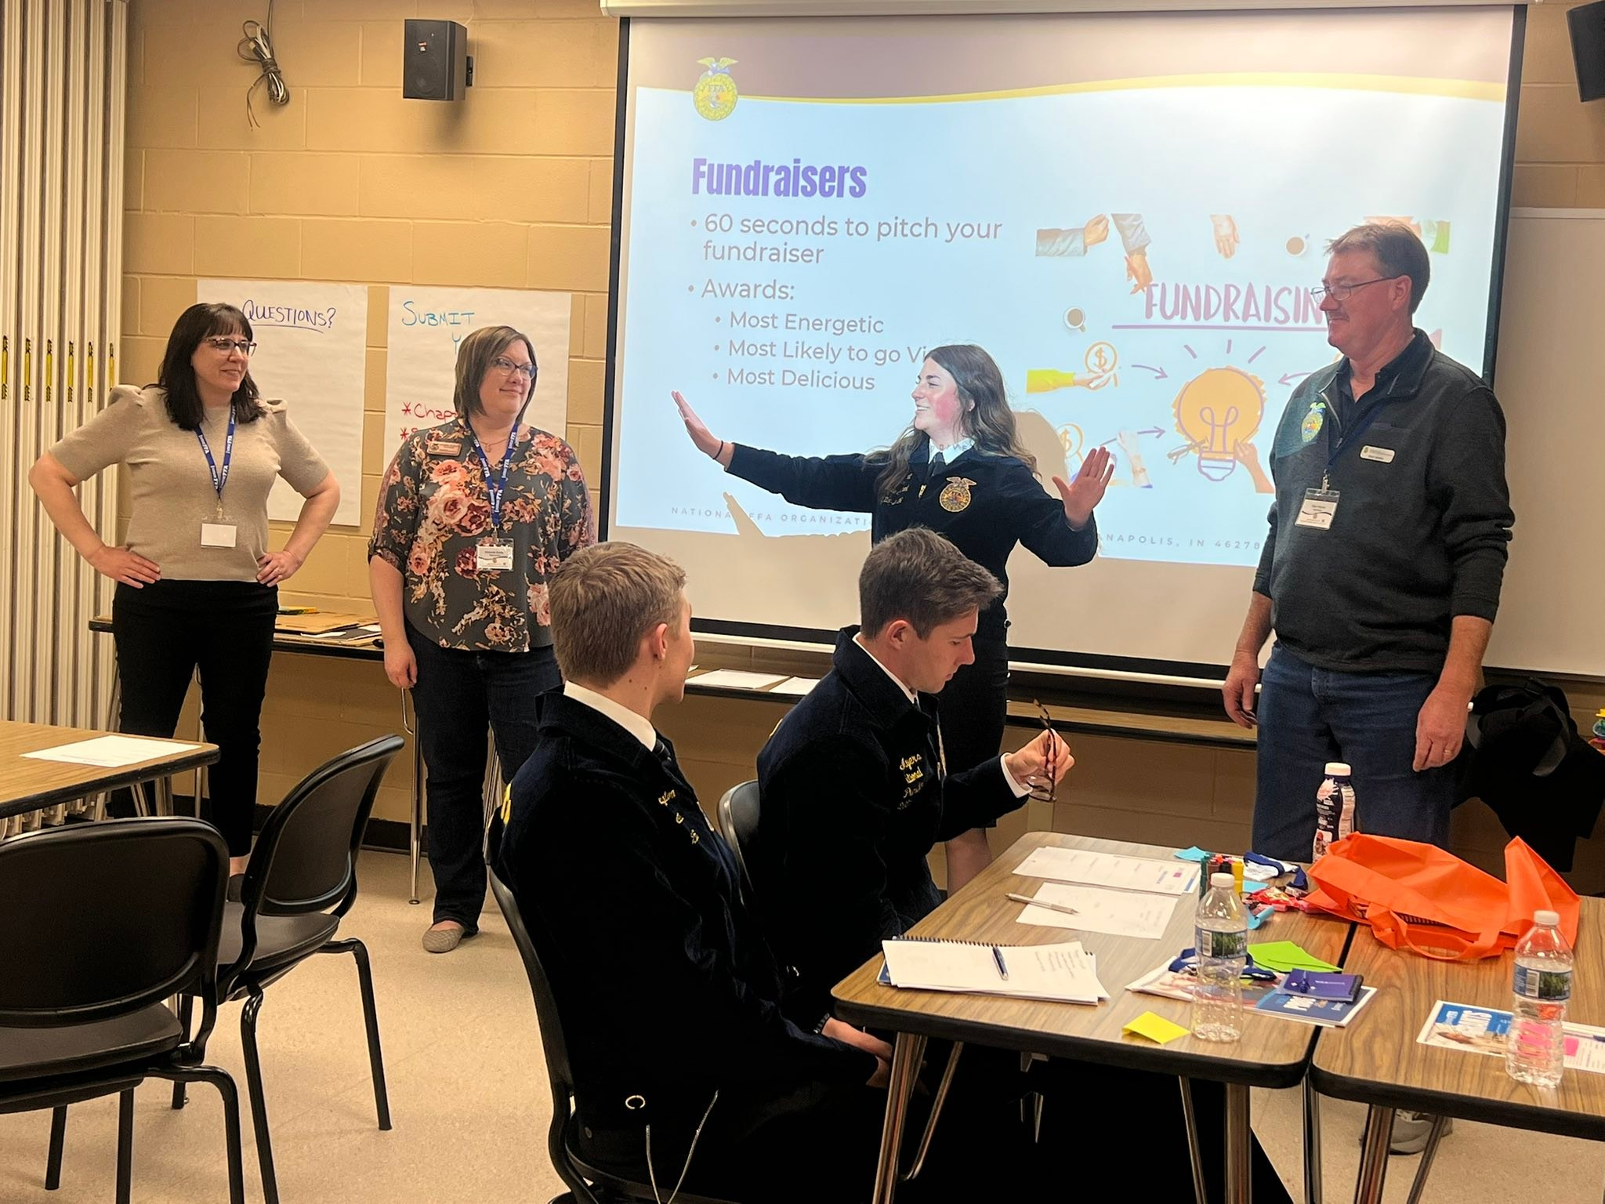
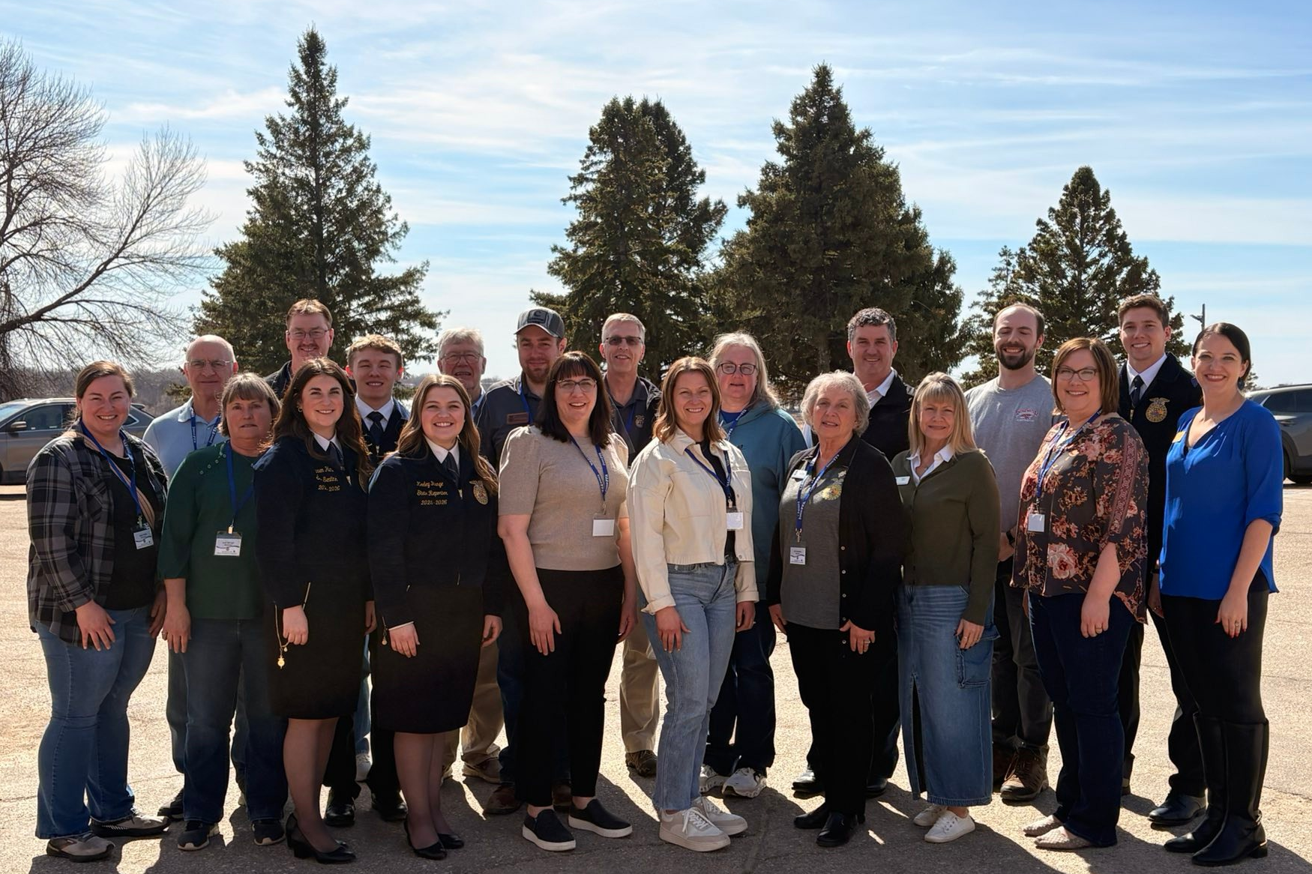
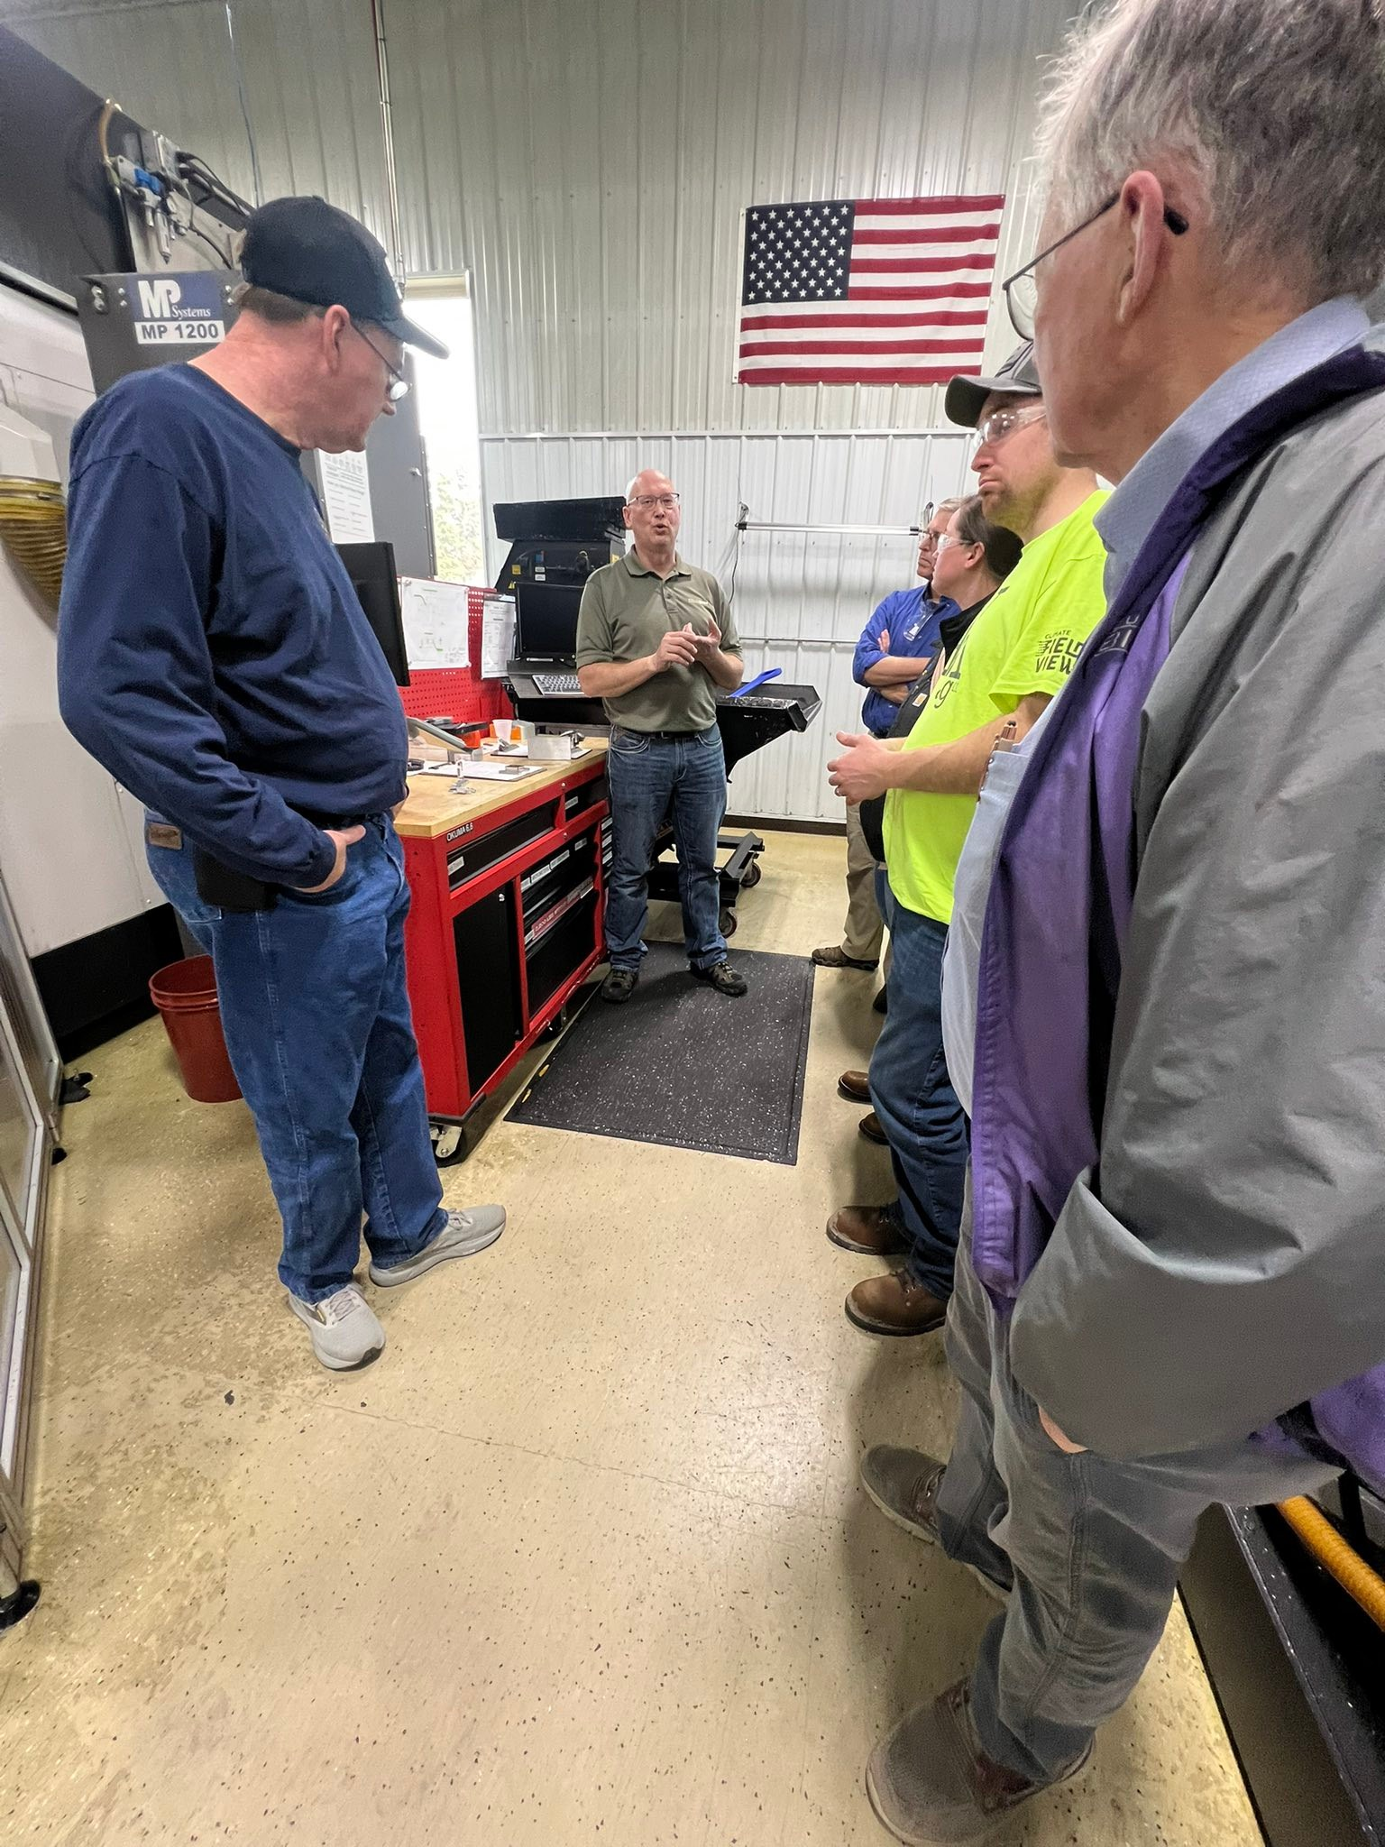
Other Activities
        Attend Regional Development Conference

Slide 40
Thank You
To the Chapters Who Completed the Survey
Antelope County Osceola
Arlington Palmer
Crete Raymond Central
Exeter Milligan Friend Sutton
Lakeview Sutherland
North Bend Syracuse

