Slide 1









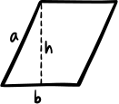



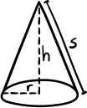
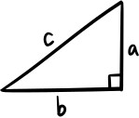














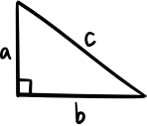


FROM TPACK TO THE FASHION RUNWAY:
Blending Tech and Creativity in CTE

Slide 2

Hello, everyone!
I’m Mary Breedlove, a Family and Consumer Sciences educator and technology coach at Omaha South High School. I co-lead Fashion Pathway that blends design, technology, and project-based learning .Ending each year in professional-scale fashion shows. I hold a Master's in Curriculum & Instruction with a focus on Educational Technology.

Slide 3
Agenda:
Frame works and Foundational Standards
How South High did it.
Whats your “Big Idea”
Fashion Show etc.
Reflection & Takeaway

Slide 4
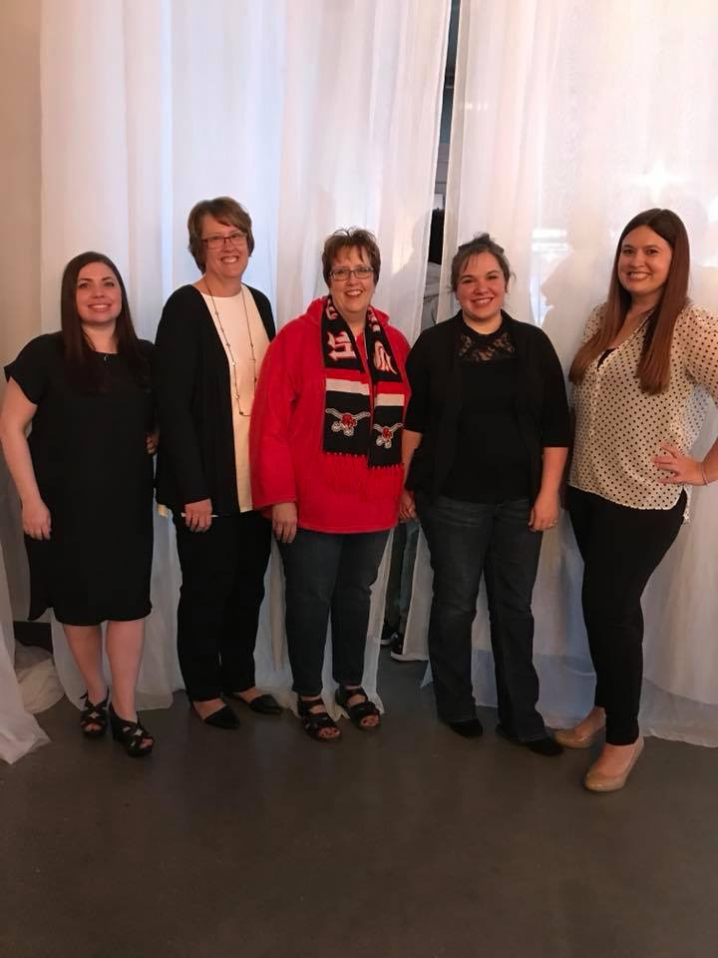
South’s Story
Julie Ermel
Patty Hansen
Sara Policky
Samantha Koehler-Overton

Slide 5


Slide 6
Technology Intergration
2025:
Started Masters at
SouthEastern Oklahoma State University

Slide 7


Frameworks vs. Standards
What's the Difference?
Technology Frameworks (SAMR, TPACK, RAT) help teachers reflect on how effectively they're integrating technology into their practice.
ISTE Standards define what students should be able to do and demonstrate as digitally empowered learners.
Think of it this way: frameworks guide your design decisions; standards define the destination.

Slide 8
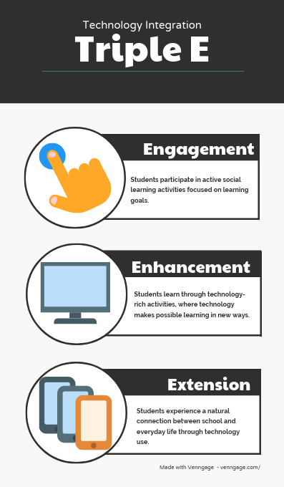
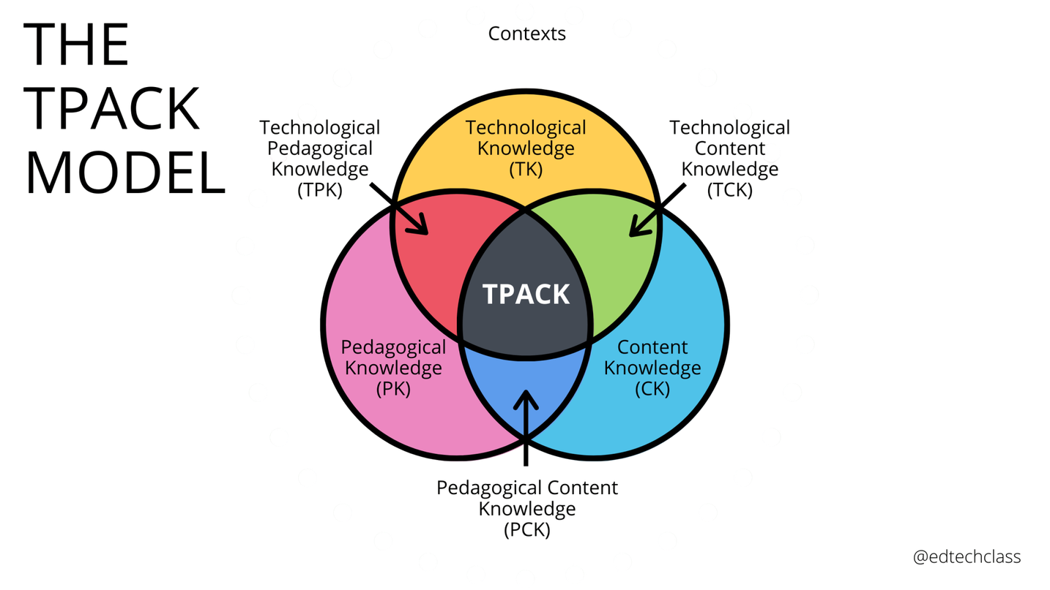
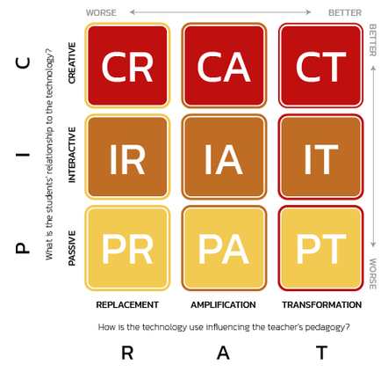
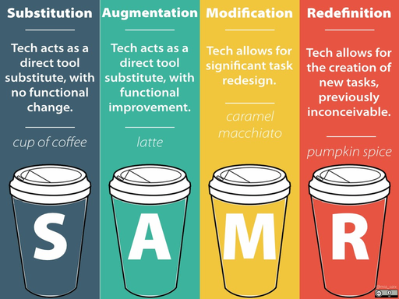
Technology Frameworks
There are so many! Pick one thats right for your school.
TPACK
SAMR
PICRAT
Triple E
Notes:
Though at first glance TPACK and SAMR seem to have similarities, the two models are actually quite different.
SAMR – which stands for Substitution, Augmentation, Modification, and Redefinition – is best for providing a high-level view of technology integration in the classroom. SAMR is simple. The issue with SAMR, however, is that it might be overly simple.
TPACK does not treat technology as separate from teaching and learning. Instead, TPACK incorporates the interdisciplinary nature of pedagogy, content, and technology.
PIC RAT has two parts representing two guiding questions: PIC and RAT. The PIC part responds to the question “What is the student’s relationship to the technology” with one of three responses: Passive, Interactive, or Creative. The RAT (Hughes et al., 2006) part responds to the question “How is the use of technology influencing the teacher’s existing practice” with one of three responses: Replacement, Amplification, or Transformation.
The Triple E is that practical tool that brings together instructional strategies, learning goals and purposeful tool selection. Most frameworks focus on how technology substitutes for traditional tools or if the technology use is creative, but not if the tools were able to actually leverage the learning goals.
All About TPACK: A Teacher’s Guide to the TPACK Tech Integration Model. (2021, June 30). EdTech Classroom. https://edtech-class.com/2021/06/30/all-about-tpack-a-teachers-guide-to-the-tpack-tech-integration-model/
EdTech Books. (2026). Edtechbooks.Org. https://edtechbooks.org/encyclopedia/picrat
‌
About. (2017). Triple E Framework. https://www.tripleeframework.com/about.html
‌
‌

Slide 9

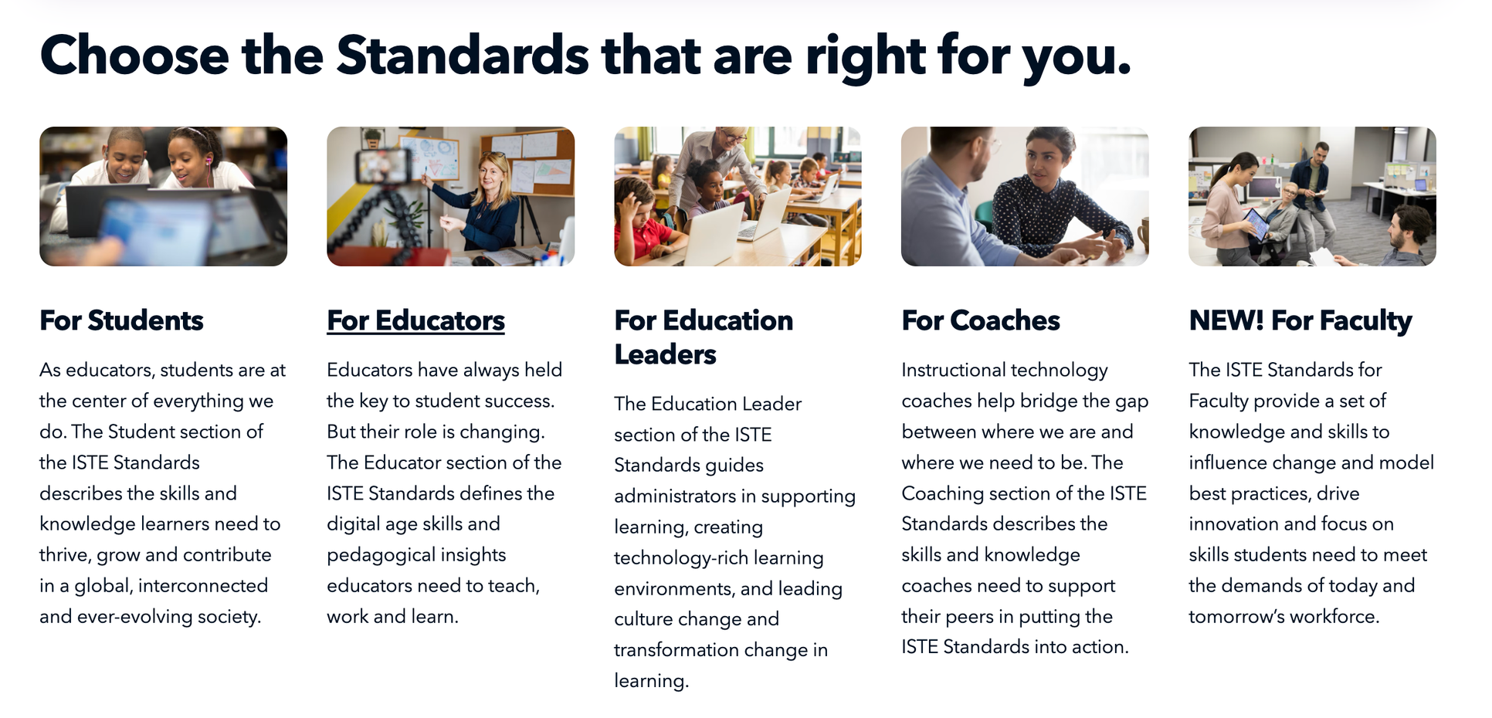
ISTE Standards:

Slide 10

Student
Standards
1.3
Knowledge
Constructor
1.1
Empowered Learner
1.2
Digital Citizen
1.6
Creative Communicator
1.4
Innovative Designer
1.5
Computational Thinker
1.7
Global Collaborator

Slide 11
Lesson Title:
Digital Patterned Fabric and Garment Creation
Empowered Learner (1.1)
  1.1a — Set goals, reflect on and refine strategies, and monitor progress to achieve learning goals
Creative Communicator (1.6)
  1.6a — Choose the appropriate platforms and tools for meeting the desired objectives of their creation or communication
  1.6b — Create original works or responsibly repurpose or remix digital resources into new creations
  1.6d — Publish or present content that customizes the message and medium for their intended audiences
Knowledge Constructor (1.3)
  1.3a — Plan and employ effective research strategies to locate information and other resources
  1.3b — Evaluate the accuracy, perspective, credibility, and relevance of information, media, data, or other resources
  1.3c — Curate information from digital resources using a variety of tools and methods to create collections of artifacts
Innovative Designer (1.4)
  1.4a — Engage in a design process and employ it to generate ideas, create innovative products, or solve problems
  1.4b — Select and use digital tools to plan and manage a design process that considers design constraints and calculated risks

Slide 12

TPACK
In my Fashion Pathway, TPACK looks like this:
students use Adobe Illustrator (TK) to apply color theory and design principles (CK) through a scaffolded, project-based process with peer feedback and reflection (PK) — all three working together, not in isolation.
Notes:
The sweet spot isn't using technology in your class. It's using the right technology, to teach your content, the way your students learn best.

Slide 13
Putting it
all together
Digital
Design
  Garment Consturction
  Fabric Printing
Students create original fabric patterns using design software
Designs transferred to real fabric using professional printers
Students construct wearable garments from their printed fabrics
Fashion
  Show
Professional-scale runway event showcasing student work

Slide 14
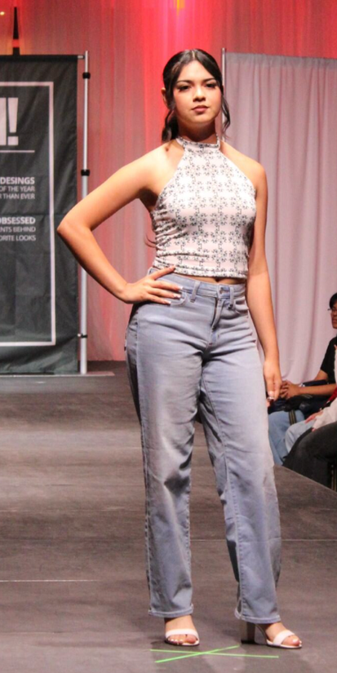

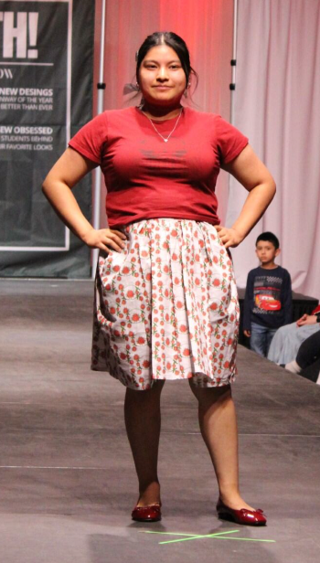



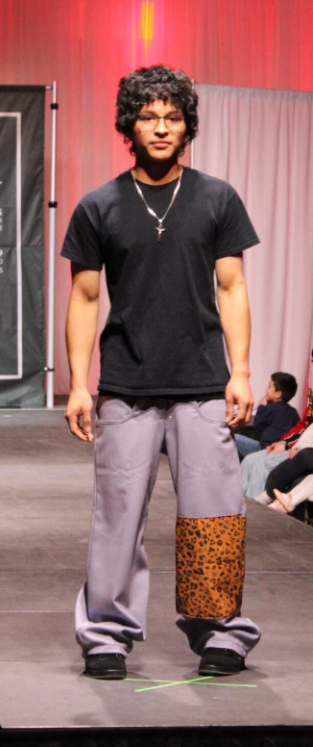
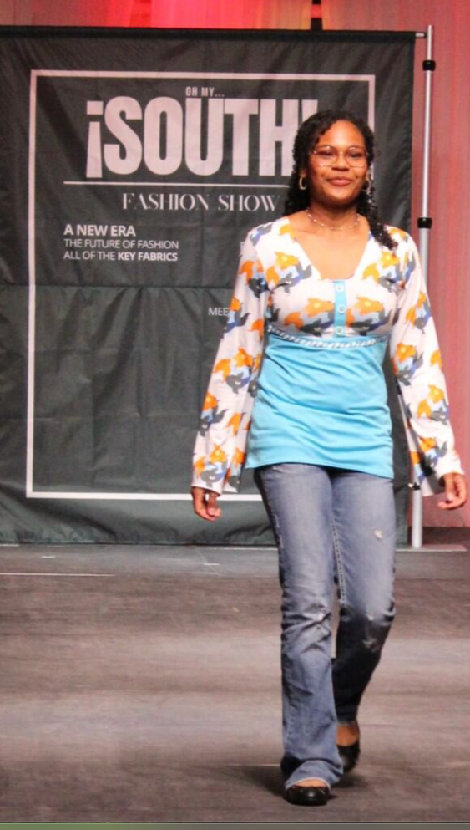
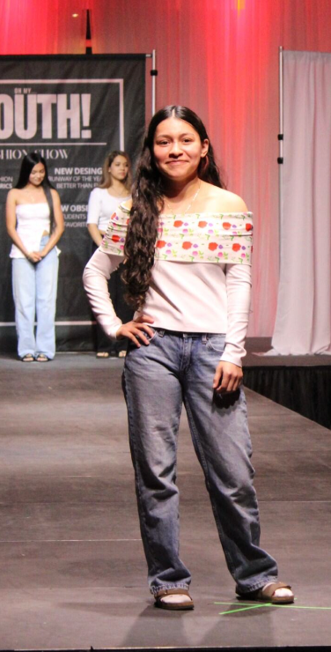




Slide 15
Capstone ideas
Business & Marketing
FCS
Industrial Technology
Health Sciences
Pitch competition or trade show showcase with professional branding
Pop-up restaurant or nutrition fair with digital menus and signage
Design expo with CAD portfolios, prototypes, and client presentations
Students research a community health issue, create a public awareness campaign with digital media, and present findings to a panel of healthcare professionals.
Agriculture
Communication & Information Systems / IT
Students use precision agriculture tools or soil mapping software to analyze a local farm challenge and propose data-driven solutions.
Students design and build a functional website or app prototype for a real client — a school organization, local business, or community group.

Slide 16
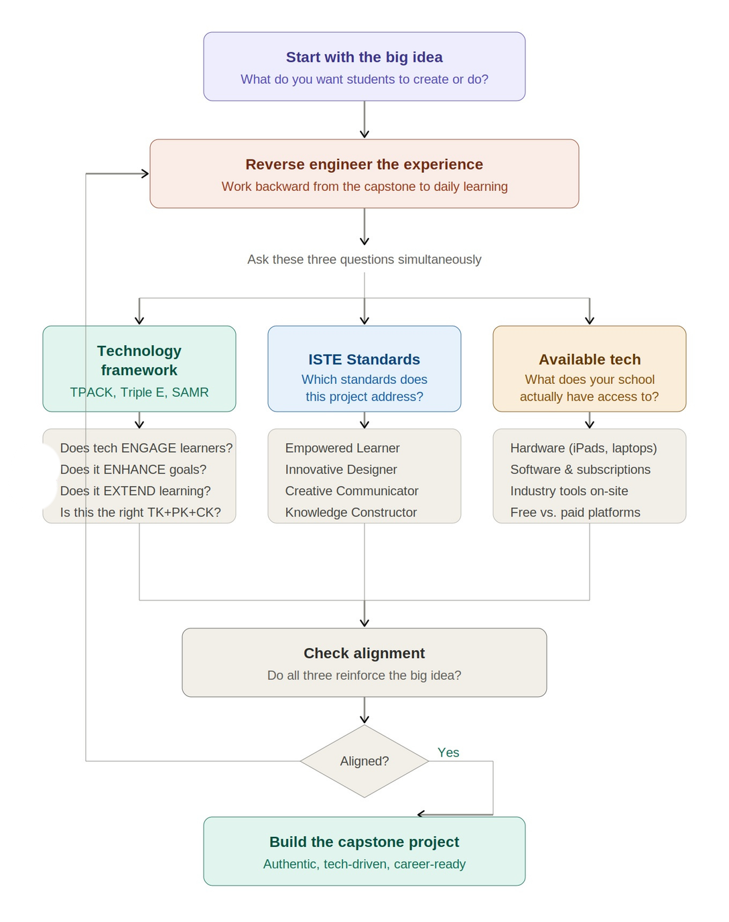
Let’s
Get Started!
No? Revisit

Slide 17
Reflection:
What's one authentic, tech-enhanced project you'll take back to your classroom?

Slide 18

Thank you!
Mary Breedlove
Mary.Breedlove@OPS.org
South High, Omaha Public Schools
BLOG:

