Slide 1
Growing the Teacher Pipeline:
Education and Training
Program of Study Overview
Notes:
Help shape the future of the teaching profession by strengthening your high school Education and Training Program of Study. This session will provide an overview of the course sequence and show how each course builds the knowledge and skills students need to pursue careers in education. Explore valuable resources and learn practical ways to integrate CTSOs to enhance student learning and engagement.

Slide 2
Session Goals
Describe the components of the Education and Training Program of Study Overview.
Examine the connections between the Education and Training Program of Study and related Career & Technical Student Organizations.
Locate and experience curriculum resources that support Education and Training courses.

Slide 3
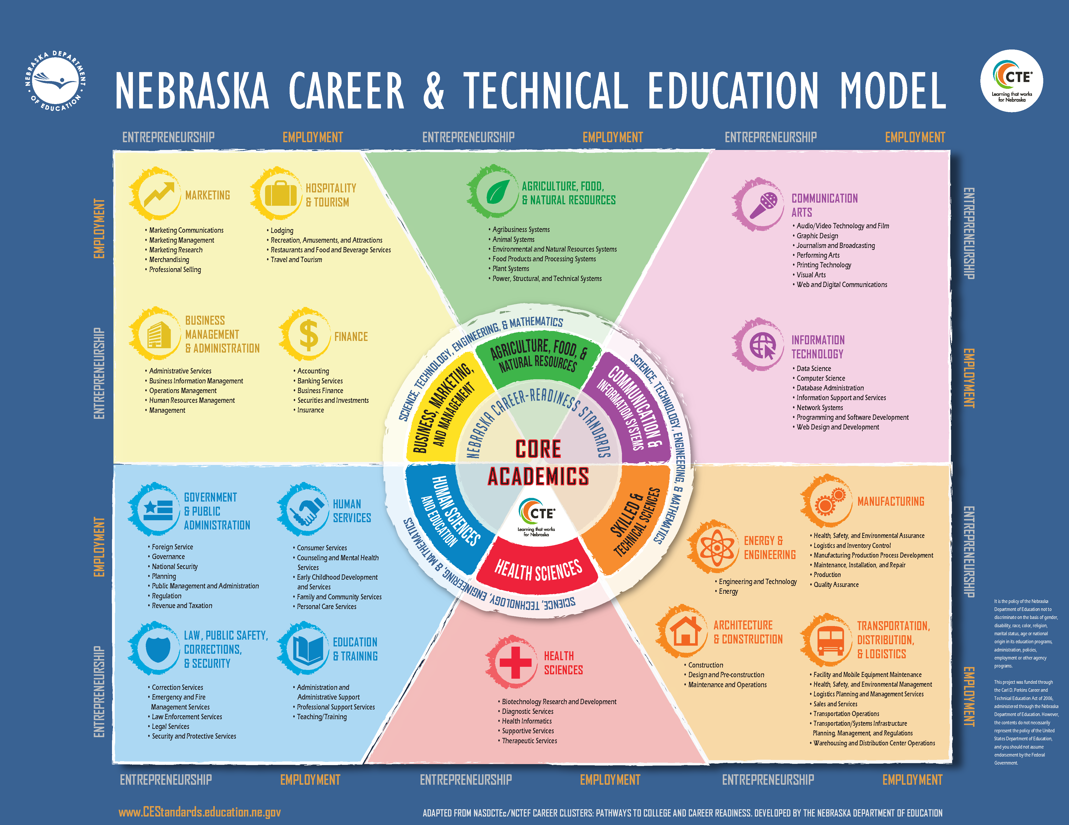
Nebraska Career & Technical Education Model
Notes:
Is this model familiar?
How many offer courses in at least 1 Career Field? 2-3 Fields? 4-5 Fields? 6 Fields?
How many offer courses in HSE?
How many offer courses in Education & Training?

Slide 4
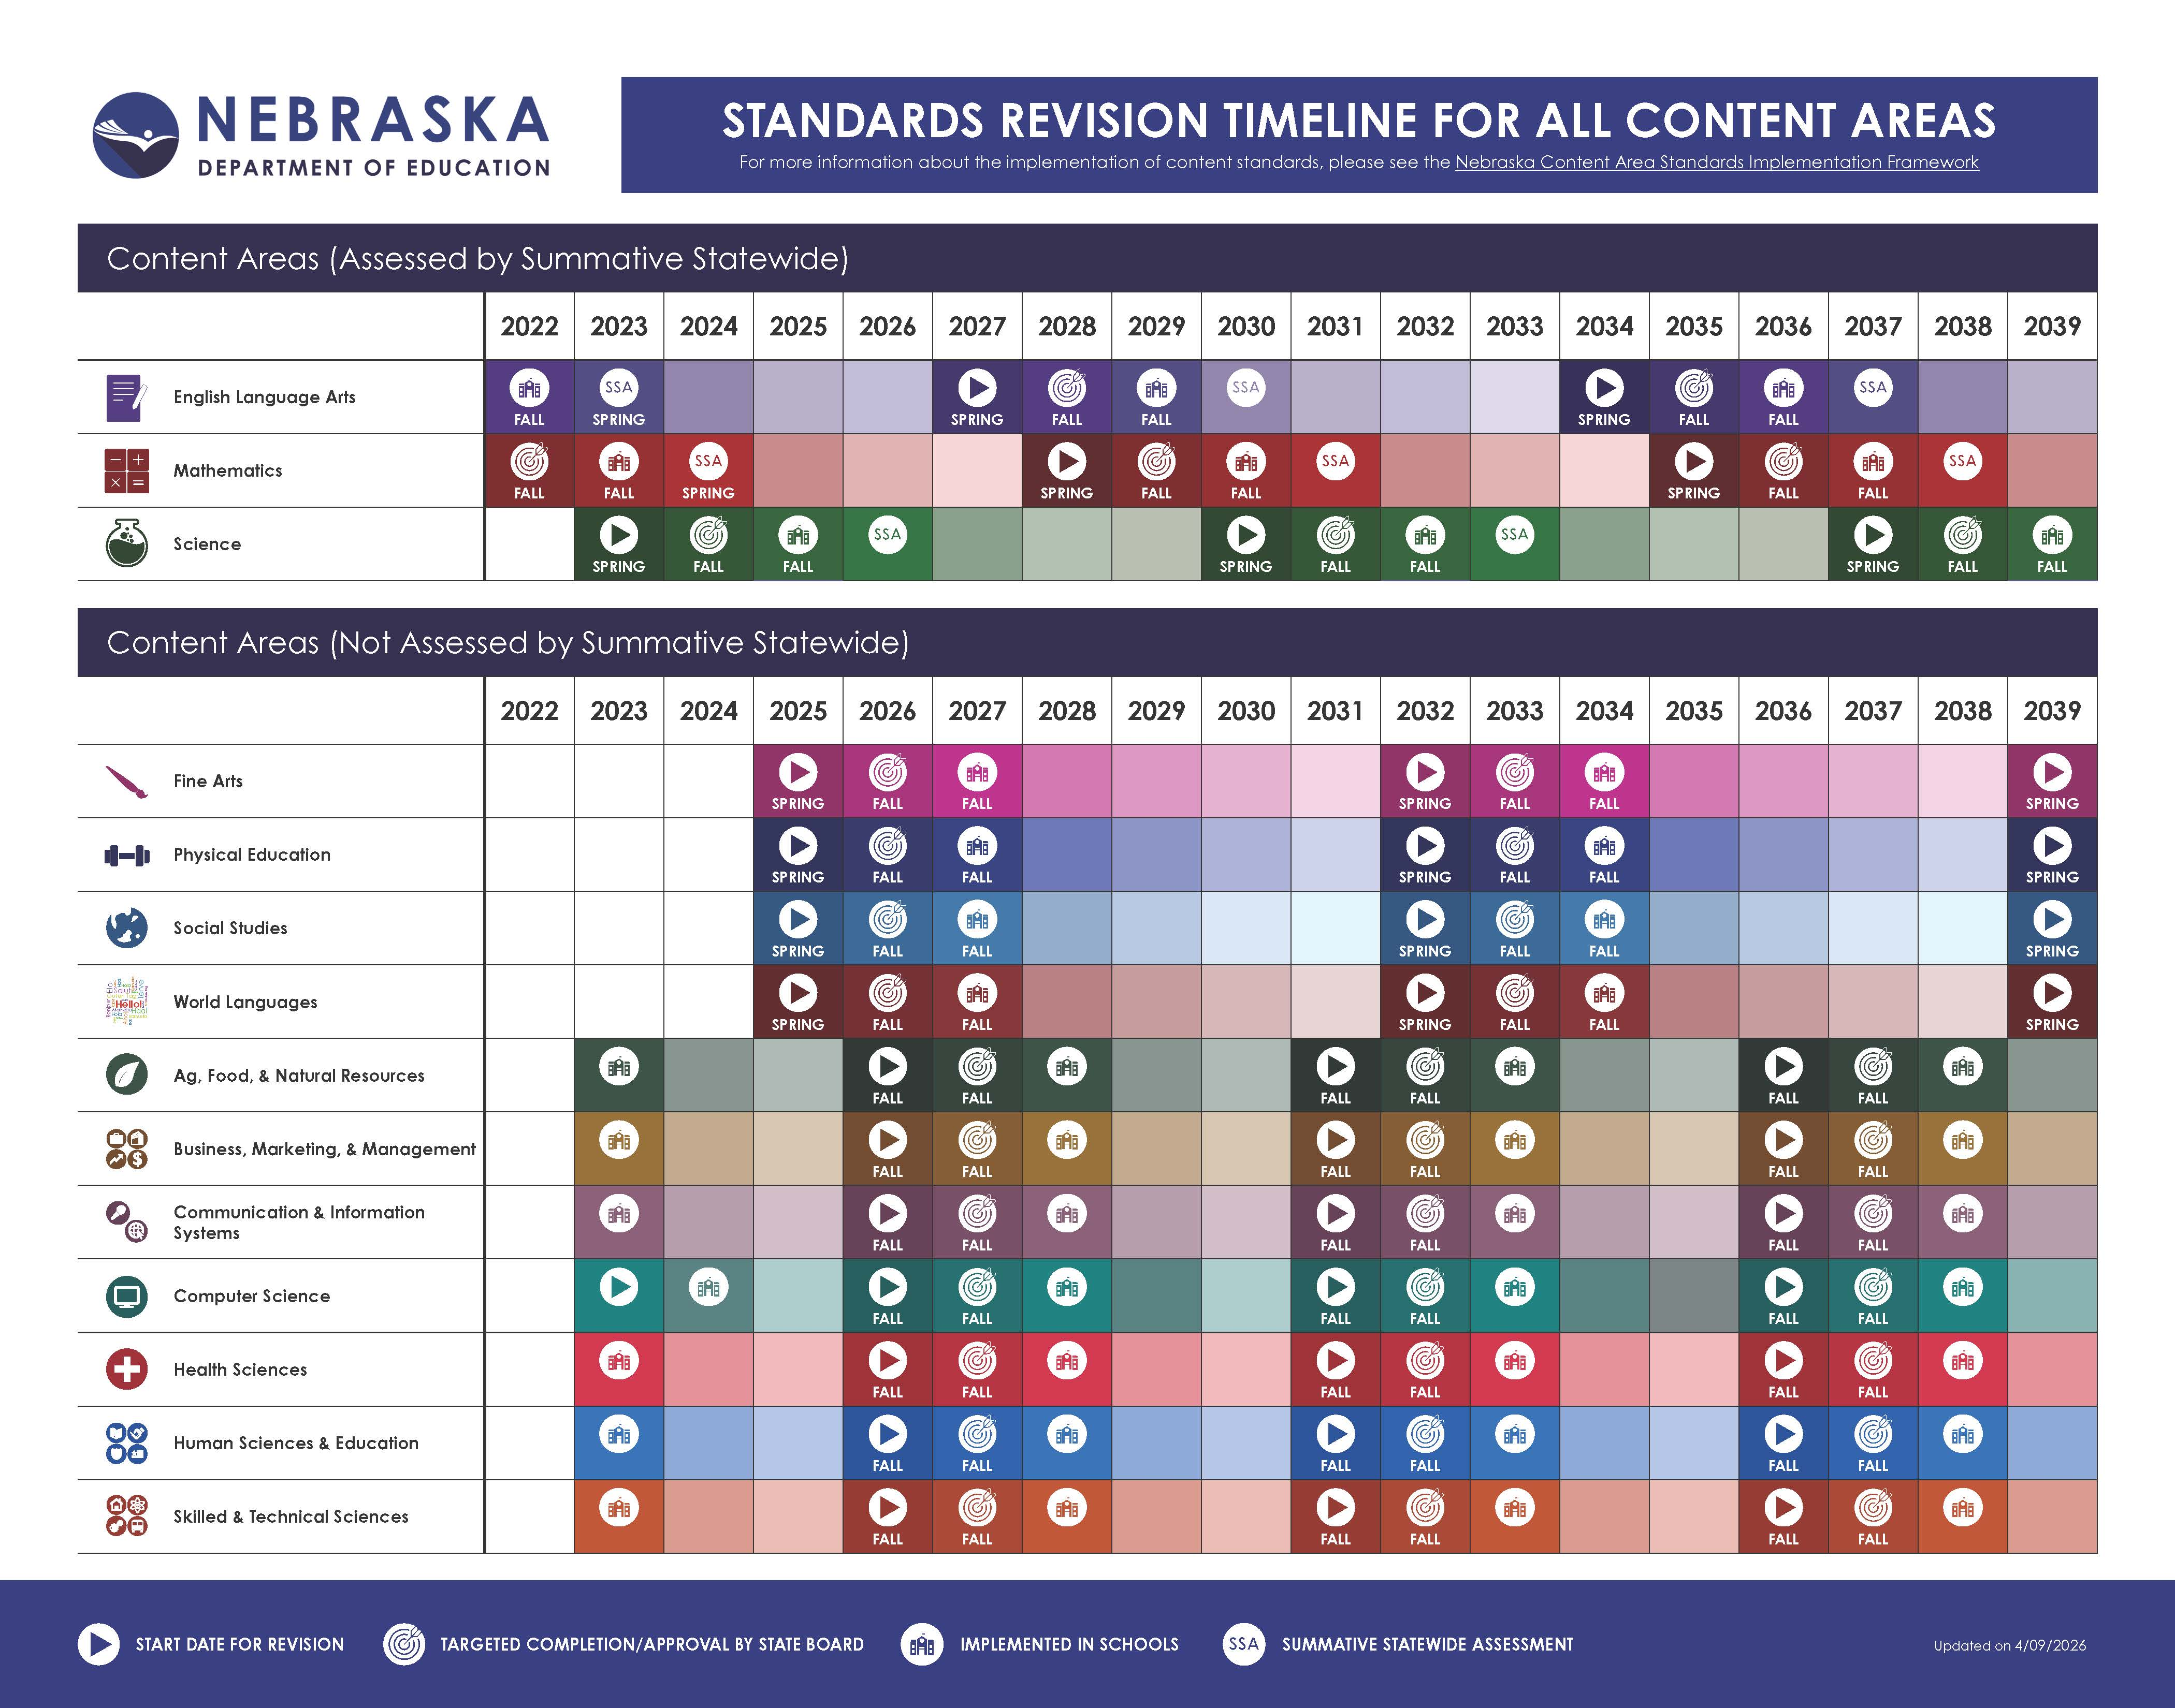
Nebraska Revision Timeline For All Content Areas
Notes:
CTE State Model Programs of Study and course-based standards are revised on a five-year cycle to remain responsive to the rapid advances and needs of business and industry, help students explore a variety of postsecondary options and corresponding entrance requirements to help identify their next steps, and to align to changes in postsecondary programs.

Slide 5
Program of Study
A program of study is a sequence of at least three (3) semester-long career education courses in a given career cluster that prepares students for postsecondary education and entry into a career area of personal choice.

Slide 6
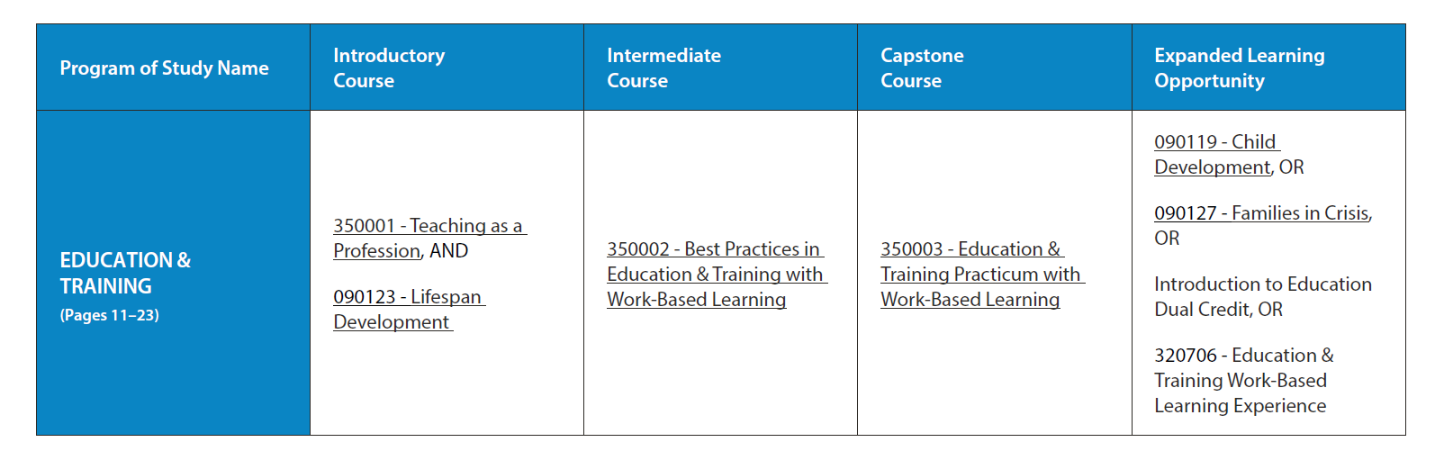
Education & Training Program of Study

Slide 7
Teaching as a Profession
Course Description: This introductory course is designed to introduce students to career opportunities and related skills in the field of education and training. Topics covered include history of education, the philosophy of education, roles of educators, instructional and assessment methods, diversity of cultures and communities, learner development, and professional development.
Teaching Endorsements:
  Family/Consumer Science (0903)
  FCS Occupational (0906)
  Education and Training (2905)
  Other Endorsement (8888)
For courses where there is no specific endorsement required (8888), any teaching endorsement is acceptable so long as the grade level of endorsement is still appropriate for the assignment.

Slide 8
Lifespan Development
Course Description: This introductory course explores the physical, intellectual, emotional, and social development of individuals across the lifespan from conception to death. Topics covered are external impacts on development including family structure and practices, theories of development, social and technological forces, and resources available to individuals and their outcomes.
Teaching Endorsements:
  Family/Consumer Science (0903)
  FCS Occupational (0906)

Slide 9
Best Practices in Education & Training with Work-Based Learning
Course Description: This intermediate course will focus on best practices in education building on concepts from the introductory courses. Topics covered include instructional and assessment methods, differentiated instruction, development of communication skills necessary for educators, and instruction planning. Knowledge and skills will be applied within a structured work-based learning experience, which may take place in a school, community, or business and industry setting. The focus of the hands-on experience will be immersion in an educational setting.
Teaching Endorsements:
  Family/Consumer Science (0903)
  FCS Occupational (0906)
  Education and Training (2905)
  Other Endorsement (8888)

Slide 10
Education & Training Practicum with
Work-Based Learning
Course Description: This capstone course will focus on the thought processes needed in education building on concepts from the introductory and intermediate courses. Topics covered include ethics in education, instructional strategies, equitable learning opportunities, and effective, inclusive communication. Knowledge and skills will be applied within a structured work-based learning experience, which may take place in a school, community, or business and industry setting. The focus of the practicum experience will be on the improvement of instructional strategies.
Teaching Endorsements:
Family/Consumer Science (0903)
FCS Occupational (0906)
Education and Training (2905)
Other Endorsement (8888)

Slide 11
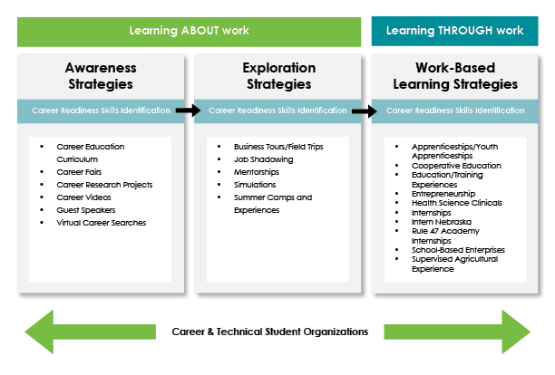
Nebraska Workplace Experiences Continuum

Slide 12
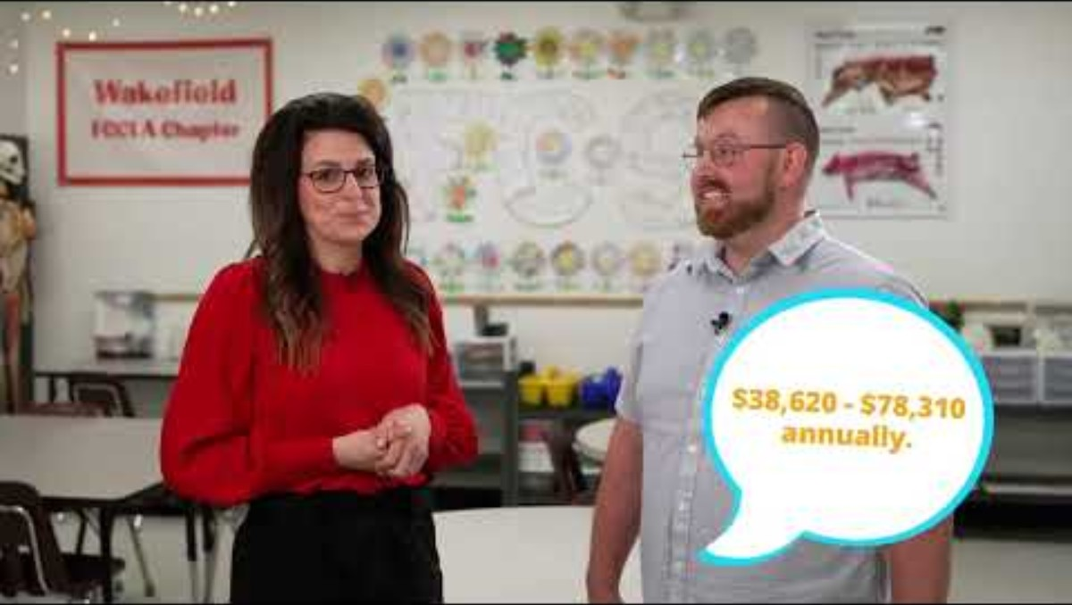
Nebraska Career Tour Videos
Notes:
Phase 1: Awareness Strategy Example

Slide 13


Career & Technical Student Organizations
Notes:
CHELSEY

Slide 14
CTSO Integration → High-Quality CTE
Career & Technical Student Organizations (CTSOs)
Rooted within Education & Training courses
Another way for students to demonstrate skills
Opportunity to connect content with the “real world”
Allows students to grow as leaders
Provides opportunities that wouldn’t be available otherwise
Notes:
CHELSEY

Slide 15
Nebraska Educators Rising
18 unique competitive events
  Competitive Events Alignment Guide
2026-2027
  594 members
  36 chapters
    25 school districts

Slide 16
Nebraska Family, Career, &
Community Leaders of America
15+ unique competitive events aligned to Education & Training
  Skill Demonstration Events Alignment Guide
  STAR Events Alignment Guide
2026-2027
  2,829 members
  92 chapters
    89 school districts

Slide 17
Curriculum Resources

Slide 18
ESU 6 & 9 Grow Your Own Curriculum
Available on OER Commons (Welcome Modules)
Teaching as a Profession
Lifespan Development
Best Practices in Education & Training With Work-Based Learning
Education & Training Practicum With Work-Based Learning
Available on Canvas Commons
Filter by Nebraska Districts, ESU’s & NDE
Video on how to access

Slide 19
Teaching as a Profession:
Module 3.2 Historical Philosophies
Essential Question: How has education in the United States changed over time?
Learning Target: I can explain the various teaching philosophies that have been used throughout history.
State Standard: HSE.HS.35.5.a Describe the history of various teaching philosophies
Directions: In this lesson, activities are organized into categories: Something to Do, Something to Read, Something to Watch, and Something to Listen To. Not every lesson will include all four categories, but for the ones that are present, plan to complete all activities in each category unless options are provided.

Slide 20



Module 3.2 Historical Philosophies
Something to Read: Read about each historical philosophy and explain the meaning in your own words in 3.2 Philosophies Explained.
Something to Watch: Watch How the Inspirational Life of Maria Montessori has Impacted the World.
Something to Do:
Complete the Educational Philosophy Survey by answering all 40 questions, rating each statement on a scale from 1 (strongly disagree) to 5 (strongly agree). Calculate your results manually using the Educational Philosophies Self-Assessment Scoring Guide.

Slide 21
Other Resources
Kansas Center for CTE (FREE!)
  Lifespan Development
  Teaching as a Career, Semester 1
  Teaching as a Career, Semester 2
Goodheart-Willcox
  Lifespan Development, 3rd Edition
  Teaching, 4th Edition
    Teaching, 4th Edition, Workbook Alignment Guide
iCEV
  Human Growth & Development
  Principles of Education & Training
Texas Tech University’s Curriculum Center for Family and Consumer Sciences
  Principles of Education and Training
  Human Growth and Development

Slide 22
Questions?
Miranda Bright
Human Sciences & Education Career Field Specialist
miranda.bright@nebraska.gov
(402) 937-5095
Chelsey Greene
Nebraska FCCLA State Adviser
Nebraska Educators Rising State Advisor
Human Sciences & Education
Career Field Specialist
chelsey.greene@nebraska.gov
(531) 207-3104
Thank You!

