Slide 1





FRAUD AND ILLICIT FINANCE
PRESENTED BY:
SUPERVISORY SPECIAL AGENT GREGORY R. CLARK PHOENIX FIELD OFFICE, TUCSON RESIDENT AGENCY

Slide 2









 |  | IC3 / The Numbers Types of Frauds Prevention Victim – What to Do Now
AGENDA
 |  |  | 2

Slide 3
 |  | The Federal Bureau of Investigation (FBI) is a domestic intelligence and principal federal law enforcement agency – started in 1908. What do we investigate: Terrorism / National Security Counterintelligence Cybercrime Violent Crime / Crimes Against Children Transnational Organized Crime White-Collar Crime / Health Care Fraud Civil Rights / Public Corruption Weapons of Mass Destruction
FEDERAL BUREAU OF INVESTIGATION
 |  |  | 3

Slide 4
 |  | FBI employs approximately 35,000 people throughout the world, around one third of them are Special Agents. FBI has 56 field offices typically located in major metropolitan areas across the U.S. There are about 350 smaller offices located in smaller cities throughout the U.S. Internationally – Legal attaché offices located around the globe that provide connections to around 180 countries, territories, and islands.
FEDERAL BUREAU OF INVESTIGATION
 |  |  | 4

Slide 5




 |  | The Internet Crime Complaint Center (IC3) is a 24/7 hub for reporting crime, run by the FBI. Combined with other data, IC3 allows the FBI to investigate crimes, track trends and threats, and in some instances freeze stolen funds. IC3 shares information throughout FBI field offices and law enforcement partners, strengthening the response both locally and nationally.
INTERNET CRIME COMPLAINT CENTER (IC3)
 |  |  | 5

Slide 6







1,008,597
TOTAL COMPLAINTS $20.8 BILLION |  | 2025 IC3 DATA IC3 BY THE NUMBERS
TOTAL LOSSES
26% INCREASE
OVER 2024 LOSSES
$20,699
AVERAGE LOSS
 |  |  | 6

Slide 7
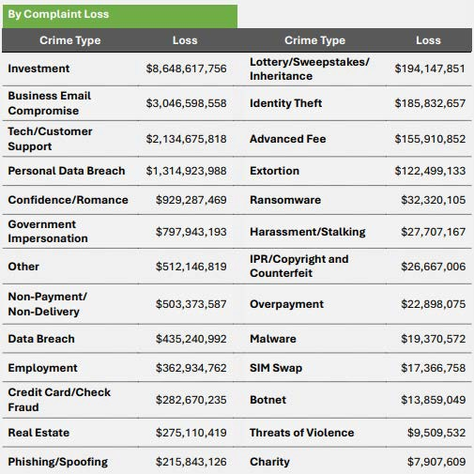
7

Slide 8
2025 TOP STATES BY LOSS ($M)
2025 TOP STATES BY # OF COMPLAINTS

Slide 9
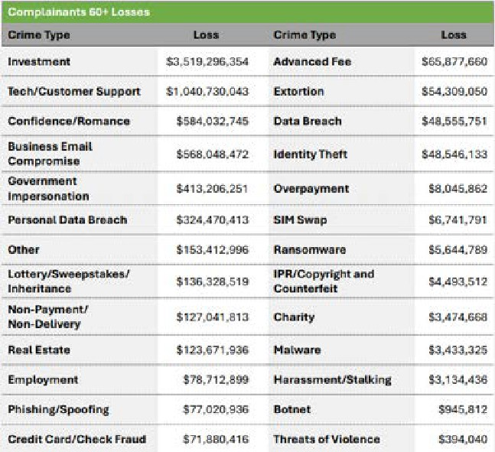
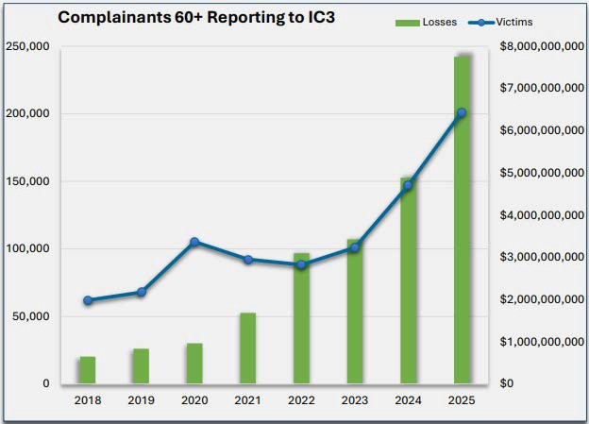
COMPLAINTS FILED BY INDIVIDUALS 60+ 201,266 COMPLAINTS +37% FROM 2024 $7.7 BILLION IN LOSSES +59% FROM 2024 12,444 COMPLAINANTS LOST > $100K
 |  | 9

Slide 10






 |  | Communication may appear to be an organization you trust: Your employer, you bank, or credit card company A governmental organization Social networking site or charity, etc. Communication may come from an unknown individual: “Hi, how are you today…” Communication will generally want you to act, respond, or portray something that creates a sense of urgency: Suspicious activity or unusual login attempts to your account Threatens consequences, or promises big reward Requests you to click a link to the website
HOW DOES IT START? PHISHING (EMAIL) SMISHING (TEXT) VISHING (VOICE)
 |  |  | 10

Slide 11



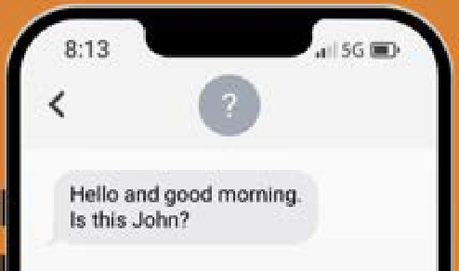
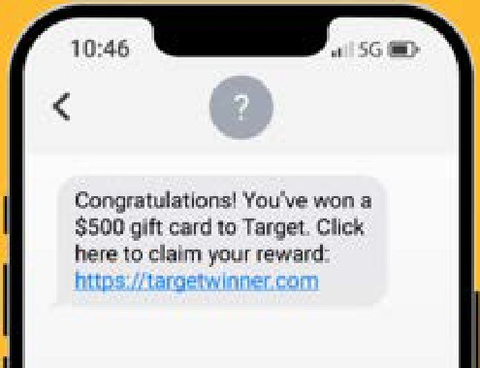
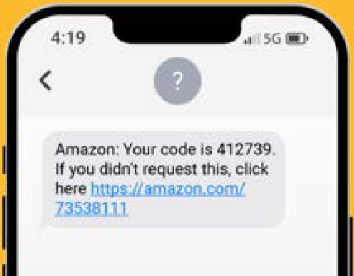

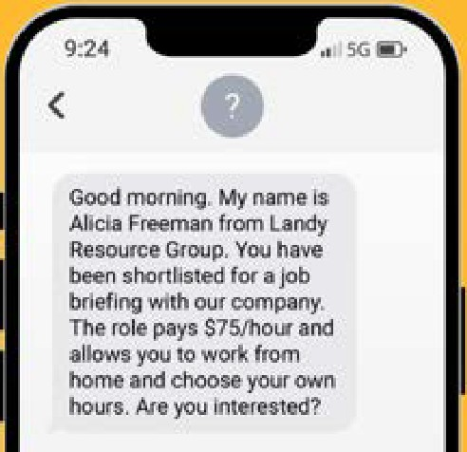


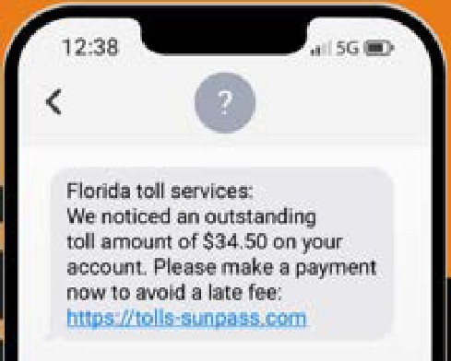

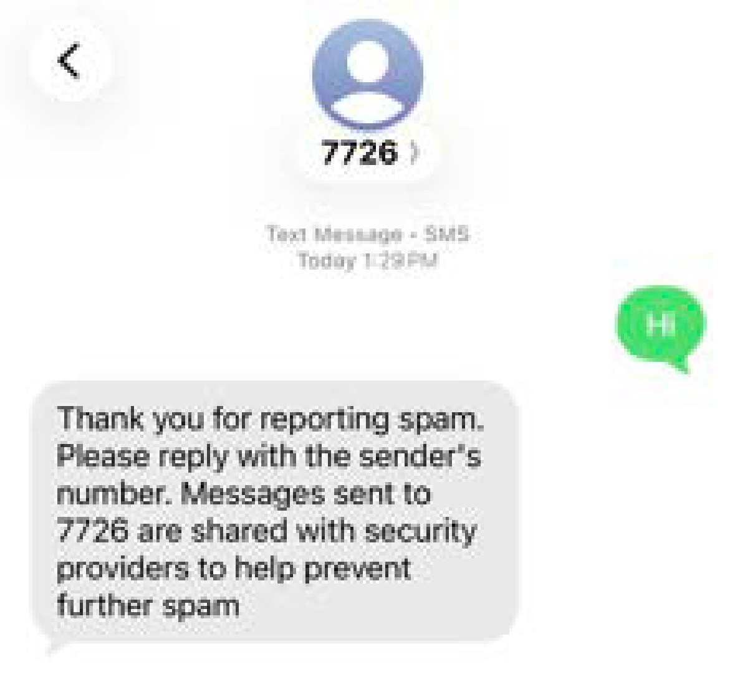
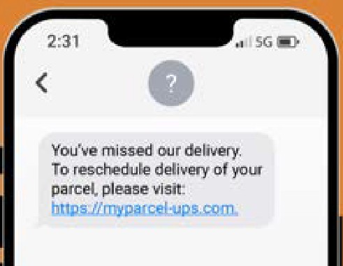
TEXT SCHEMES
Copy the message and forward it to 7726 (SPAM)
DO NOT CALL/CLICK
11

Slide 12



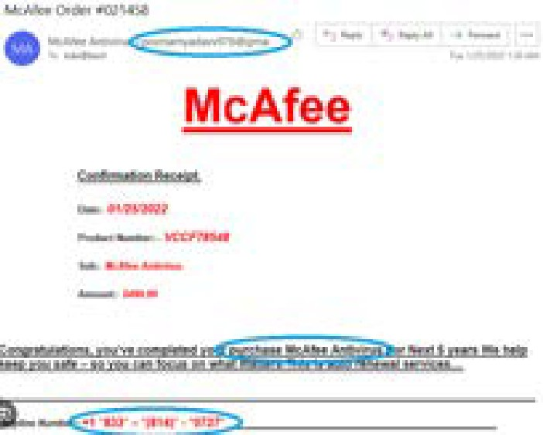
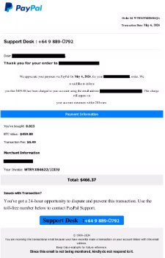
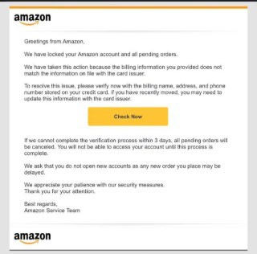




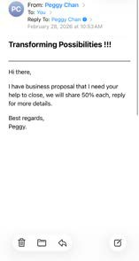
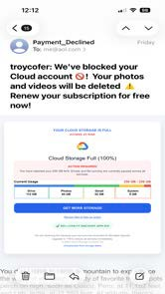
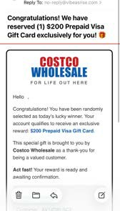
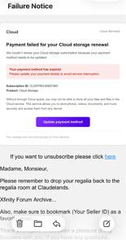
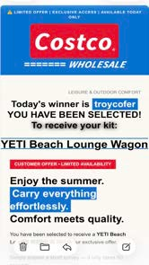

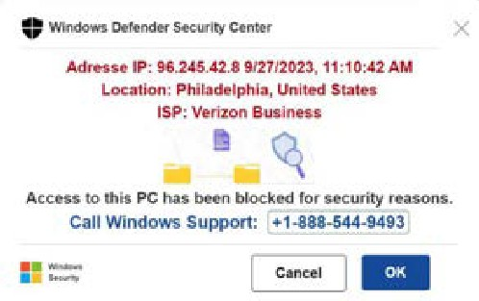
EMAIL SCHEMES
DO NOT CALL/CLICK
12

Slide 13

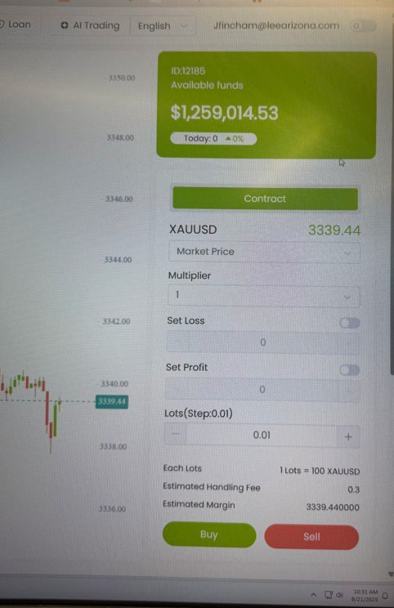

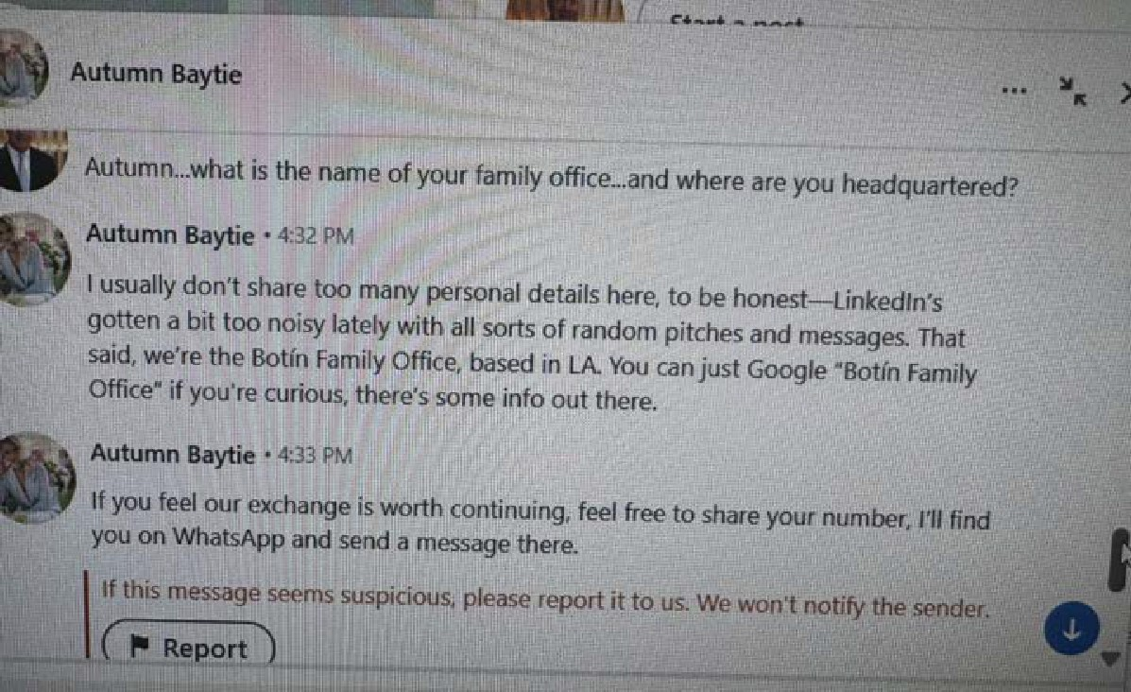

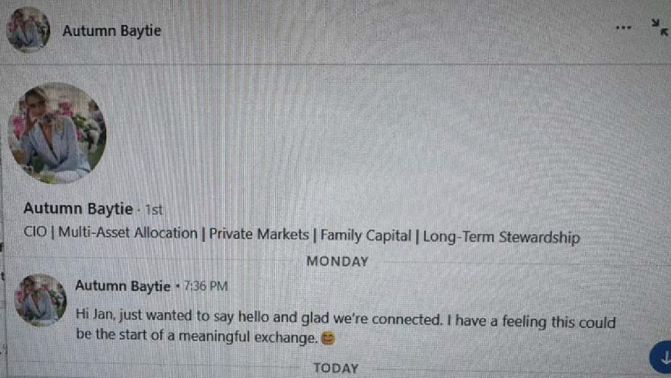

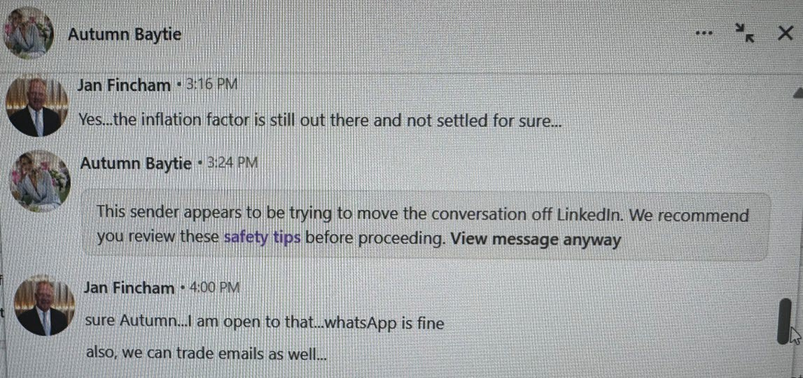


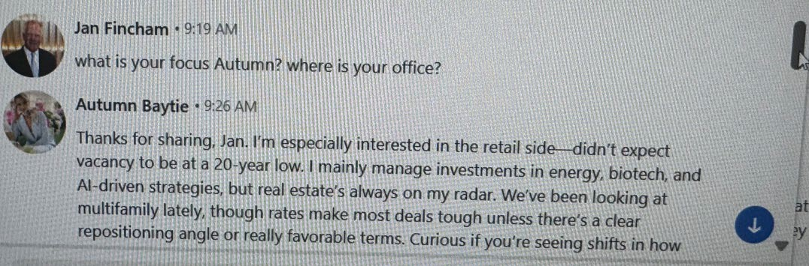
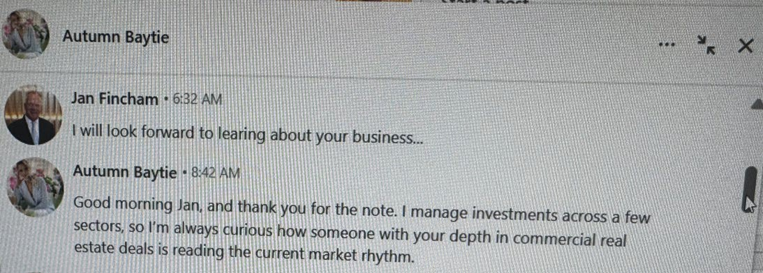

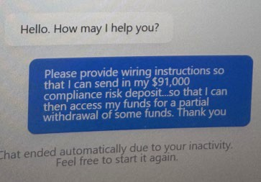
PHASES OF CONFIDENCE SCAMS (PIG BUTCHERING)
CONTACT PITCH BUTCHER
RELATIONSHIP
Bad actor creates an Bad actor builds a identity on social media, relationship with the
Bad actor talks about an investment, typically in cryptocurrency and directs victim to a (fake) website or application. Bad actor encourages victim to send money to
Victim’s “investment” does well – high returns shown on the site.
Victim tries to withdraw money from their account and can not.
Victim needs to pay a tax or fee to get money.
Victim will not get
dating site, networking victim – days, weeks, site, etc. and reaches and months – even
out to a victim. years. Bad actor shares Communication pictures, videos, and
typically moves to an stories of a wonderful life encrypted application. they have.
(fake) site or bank account.
money back.
13

Slide 14
 |  | In a BEC scam – bad actors send an email message that appears to come from a known source making a legitimate request, like in these examples A homebuyer receives a message from their title company with instructions on how to wire down payment. A vendor your company regularly deals with sends an invoice with an updated address. A company CEO asks their assistant to purchase dozens of gift cards to send out as employee rewards.
BUSINESS EMAIL COMPROMISE (BEC)
 |  |  | 14

Slide 15
BAD ACTORS USE SLIGHT CHANGES TO EMAIL ADDRESSES ORIGINAL ALTERED johndoe@firstam.com janedoe@ctt.com johndoe@ptaaz.com janedoe@titleoneaz.com
 |  | 15
johndoe@firsllam.com
joonedoe@ctt.com johmmdoe@ptaaz.com janedoe@titleoneaz.conn

Slide 16

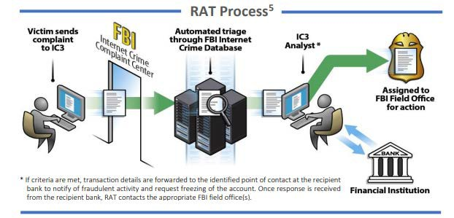
RECOVERY ASSET TEAM
2025 HIGHLIGHTS
$1.2 BILLION ATTEMPTED THEFT
$679 MILLION FROZEN 58% SUCCESS RATE
16

Slide 17


17

Slide 18
 |  | Bad actor attempts to gain access to a victim’s computer by falsely claiming to offer tech support Scammer asks for remote access to the victim’s device “to cleanup” viruses or malware “Fake refund” of service fees: Victim is given an excess refund ($30,000 vs. $300) Victim asked to withdraw cash / mail excess back Bad actor access victims’ bank, retirement, credit accounts to move money into their other account to make it appear they did get an overpayment
TECH SUPPORT FRAUD
 |  |  | 18

Slide 19
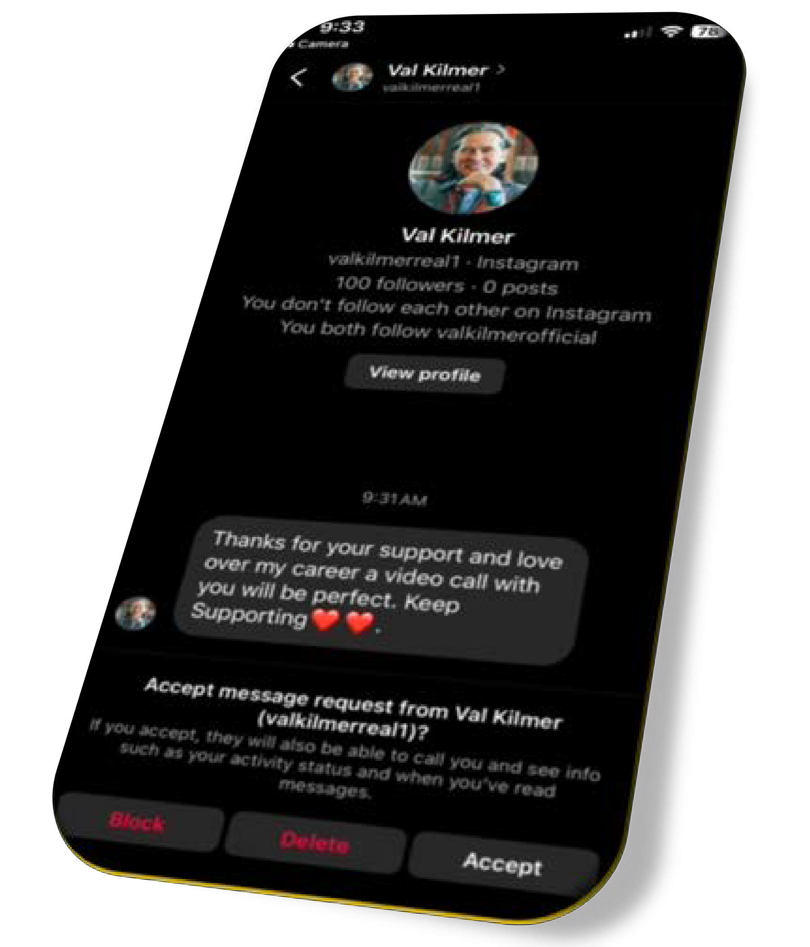

HOW DOES IT HAPPEN Bad actors do research on potential victims Grooming, aka building TRUST Communication may start out on a public application, then move to an encrypted application Will never meet in person, always an excuse Typically, working “overseas”, in the “military”, some type of “contractor”, on an “oil rig”, or have an “investment tip” Need money for hardship, fees, airfare, sick family member, taxes, they were robbed, etc.
 |  | ROMANCE SCAMS
 |  |  | 19

Slide 20
 |  | Voice Over Internet Protocol (VOIP) calls, spoofing location and identity, caller ID gives false sense of legitimacy Urgent situation requiring immediate response Caller may provide badge number to increase sense of legitimacy, even documentation Caller will pressure victims to act to prevent financial losses or legal consequences, fabricating stories about hacking threats, arrests, or links to criminal investigations Victims are instructed to withdraw funds or purchase gold bars for "safekeeping" then: Mail with FedEx/UPS shipping service Meet a “courier” to hand over cash/gold Send virtual currency
GOVERNMENT IMPERSONATION
 |  |  | 20

Slide 21
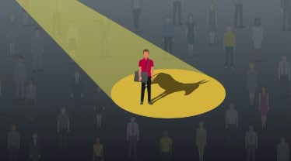


MONEY MULE
A money mule is someone who transfers or moves
illegally acquired money on behalf of someone else.
Bad actors recruit individuals to launder proceeds derived from online frauds, which make it harder for law enforcement to trace
Can be unwitting or unknowing or willing and knowing
Asked to use bank account or open an account in their name to receive money from someone they never met
May keep a portion of the money they transferred
Motivated by trust in the existence of their online relationship

Slide 22
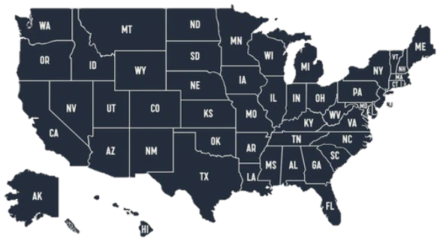






Slide 23



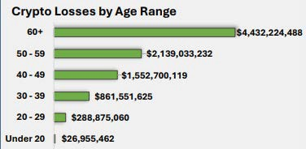
181,565 CONNECTED COMPLAINTS 21% INCREASE OVER 2024 COMPLAINTS $11.4 BILLION CONNECTED LOSSES 22% INCREASE OVER 2024 LOSSES
 |  | CRYPTOCURRENCY NEXUS 2025 IC3 DATA
 |  |  | 23

Slide 24
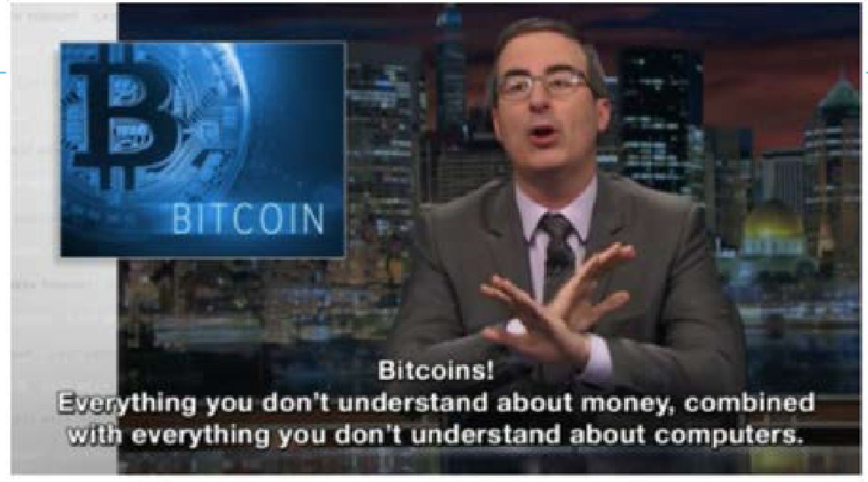
CRYPTOCURRENCY Why Scammers Like Cryptocurrency Public’s lack of knowledge Use fake cryptocurrency platforms Increasing availability of Bitcoin ATMs Ease of transferring money (cold storage) Unsolicited Contact: Receiving unexpected calls, emails, or messages about investments. Promises of High Returns: Scams often involve guaranteed profits with little to no risk. |  | S&P 500's average annual return, about 10% since its launch in 1957 John Oliver
 |  |  | 24

Slide 25
Fraudulent Billing
Medical services not rendered or medically needed appearing on Explanation of Benefits
statement
Providers submitting multiple claims for the same
HEALTH CARE FRAUD
service
In May 2023, AHCCCS announced findings of
▪
Billing for a more expensifvreausedrvbicyestohbanert-hlieving providers across the state.
patient received
AHCCCS suspended more than 300 providers
Services provided by unquªa^{n}lif^{d}ied^{e}/^{s}u^{ti}n^{m}licªe^{te}ns^{s}e^{t}d^{he fraudulent conduct to be}
employees
Medical Equipment Fraud
over $2 Billion. AHCCCS implemented more
than 20 new initiatives to combat fraud, waste, and abuse in their Medicaid program.
Calls offering medical equipment at no cost but requiring your Medicare identification number
Unrequested delivery of braces, diabetic test strips, or topical creams, some from unknown providers
25

Slide 26
 |  | AI is a tool which can be used for legitimate, helpful purposes or for criminal motives AI can manipulate audio and video, it is already being used in frauds AI technology enables the creation of convincing synthetic content, such as social media profiles and personalized conversations, often in mass quantities Indivdiuals have manipulated video and audio similarly for decades, but the widespread availability of AI makes it possible to create high-quality content easily In 2025 IC3 saw nearly $1 Billion in losses with an AI nexus
ARTIFICIAL INTELLIGENCE (AI)
 |  |  | 26

Slide 27
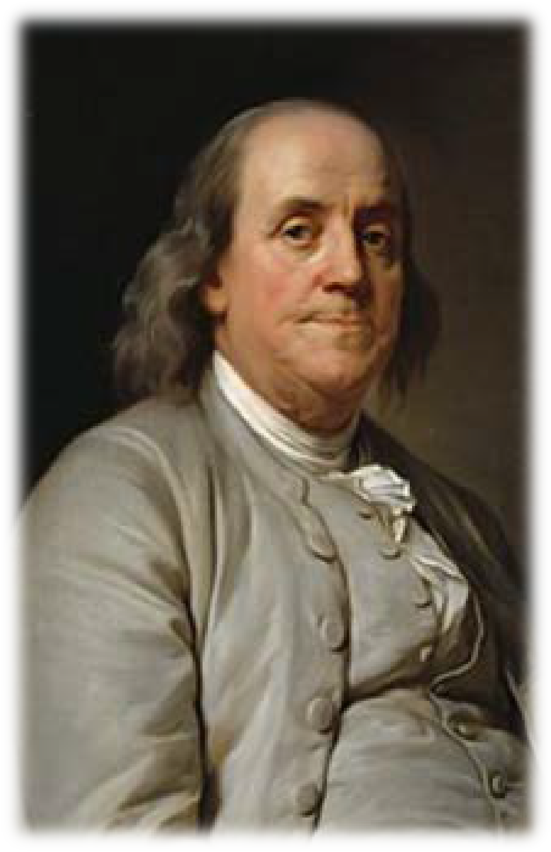

1776
2026
27

Slide 28
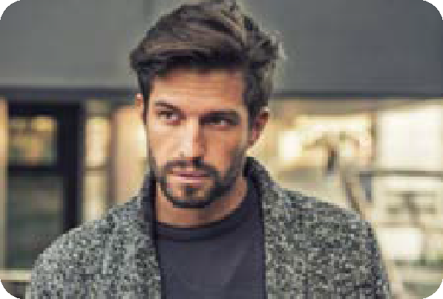
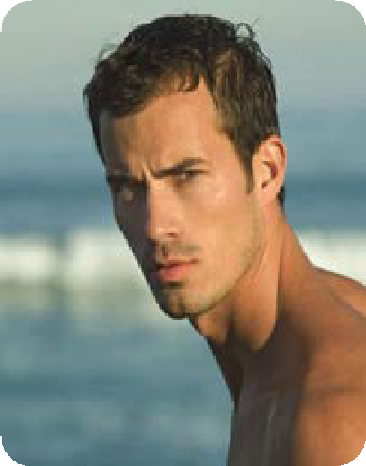






GUSTAVO CARLOS NADIA JENNIFER
 |  | 28

Slide 29






STEP 1 STEP 2 STEP 3
 |  | 29

Slide 30
TIPS TO PROTECT YOURSELF FROM FRAUD Insist on learning full name, address, Be wary of individuals you do not know contact info, get information in writing reaching out to you unsolicited Trust your instincts; If it sounds to good to be ▪ Register with FTC’s “Do Not Call” registry ^{true, it likely is} ▪ Do Not provide computer access, personal Properly dispose of sensitive documents with or financial information through an PII (shred them) unverified phone call or in an email Do Not respond to unsolicited messages that ▪ Never send (or receive) money to/from prompt you act with urgency _{people you do not know} Be cautious when individuals want to move ▪ When sending money, be cautious of new conversations to encrypted applications bank accounts or new instructions Law Enforcement will not ask for money over _{the phone} ▪ Do Not click a hyperlink without hovering over the link to examine the URL
 |  | 30

Slide 31

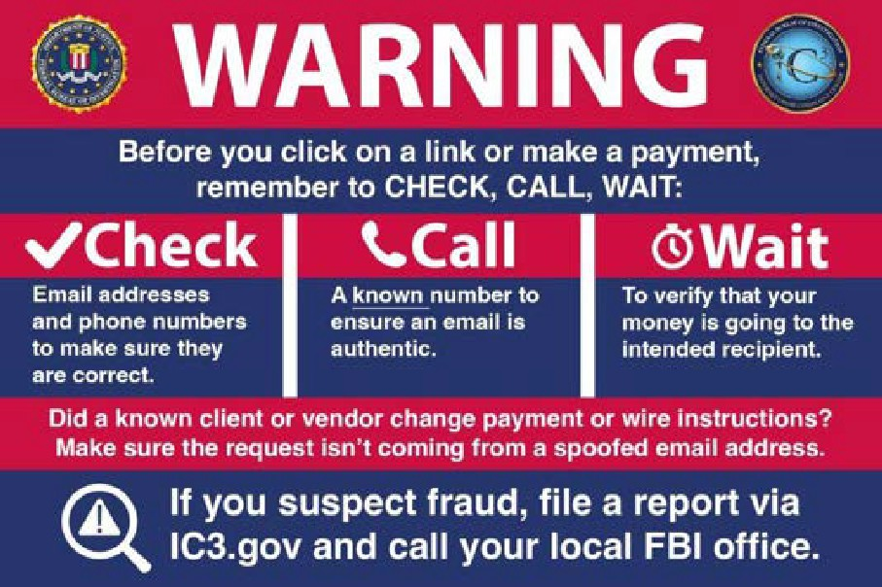
IF YOU OR SOMEONE YOU
KNOW IS VICTIM OF FRAUD:
If in immediate danger call 911
Contact your local law enforcement
Contact your bank, initiate a recall request
Report it to www.ic3.gov
Contact the FBI at 800-CALL-FBI (225-5324)
National Elder Fraud Hotline 833-FRAUD-11
(372-8311)
Block the scammer, stop communication, change passwords, and monitor your credit

Slide 32




QUESTIONS?
SSA GREG CLARK
PHOENIX FIELD OFFICE

