Slide 2


Family Networks:
The Most Overlooked Marketing Engine in Banking
Carie Kelly
SVP, Digital Banking
Claremont Savings Bank
Billie Connally
VP of Partnerships
Paige

Slide 3






The Missing Piece in Your Marketing Strategy
Your Financial Institution
Margaret, 63
Your Customer
Competitor Bank
Sarah, 34
Not a customer
Competitor Bank
David, 31
Not a customer

Slide 4
How Families Choose Their Banks
50%
of Americans learned to manage finances from parents or relatives
46%
of Gen Z (ages 18–27) rely on financial assistance from parents and family
Source: NerdWallet Money Habits Survey, CNBC/Generation Lab Survey

Slide 5
When a Customer Dies…
Accounts
Get Frozen
Family members face immediate access issues.
Beneficiaries
Consolidate
Heirs often move inherited funds to their own bank.
No
preparation
Families are left to navigate death without a clear plan.
Lost
Connections
The next generation has no existing relationship with the institution.

Slide 6


Solving the Planning Gap
The Problem:
Most people lack basic estate planning documents
68% of Americans don't have a will
$49.5B sits unclaimed in state treasuries
Families don't know what they're entitled to or how to access it
The Opportunity:
96% of customers expect estate planning guidance from their bank
Only 25% actually receive it
This gap represents
untapped demand
for support
during critical
moments
Source: NerdWallet Money Habits Survey, CNBC/Generation Lab Survey

Slide 7
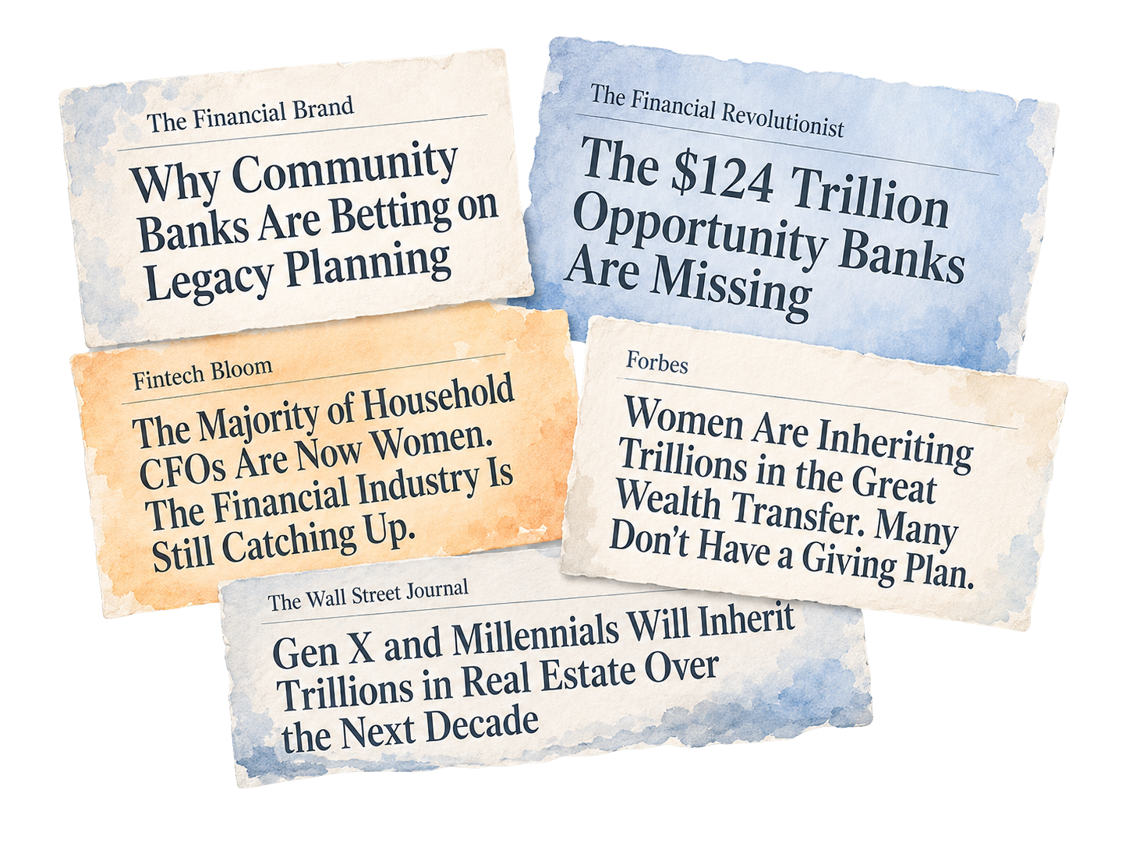
$124T Will Change Hands by 2048

Slide 8
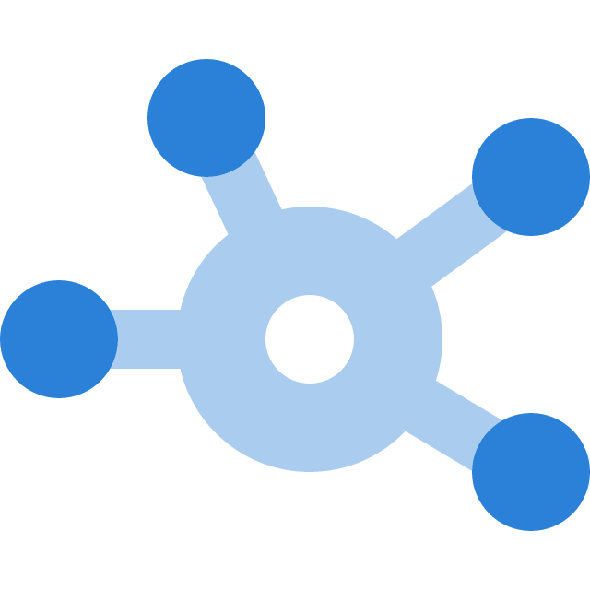

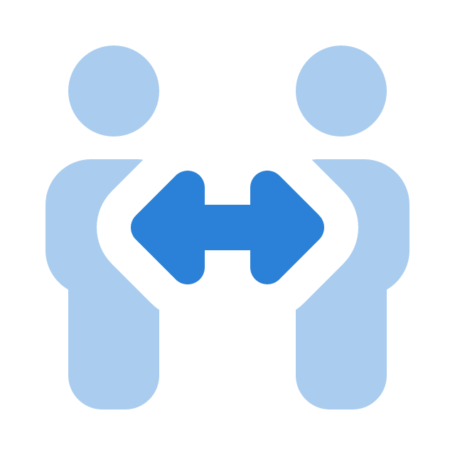
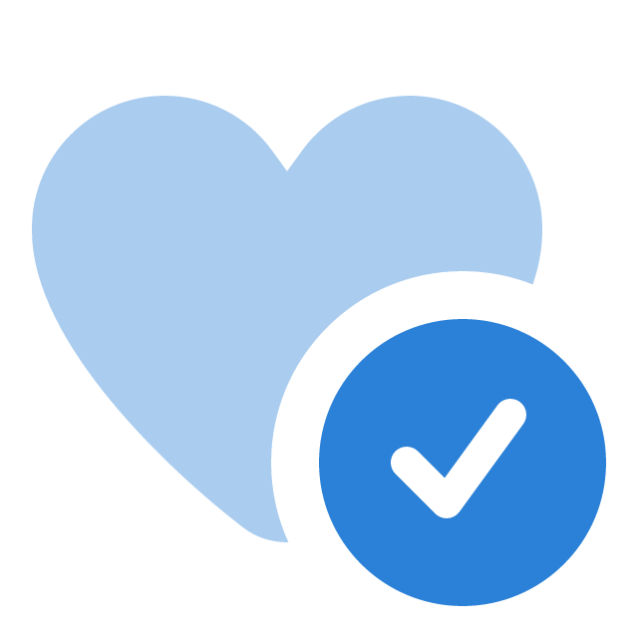
More Than a Product: Why Legacy Planning Is a Marketing Channel
Creates Network Effects
Drives Natural Consolidation
Keeps Customers Connected
Builds Trust

Slide 9

Traditional Marketing vs. Family Networks
Cold leads from ads
High cost per acquisition
No context about customer
Single customer at a time
Transactional relationship
Traditional Marketing:

Slide 10

Traditional Marketing vs. Family Networks
Warm introductions from existing customers
Organic growth through referrals
Pre-vetted through family connection
Network effect brings multiples
Trusted partner in critical moments
Family Network Marketing:

Slide 11


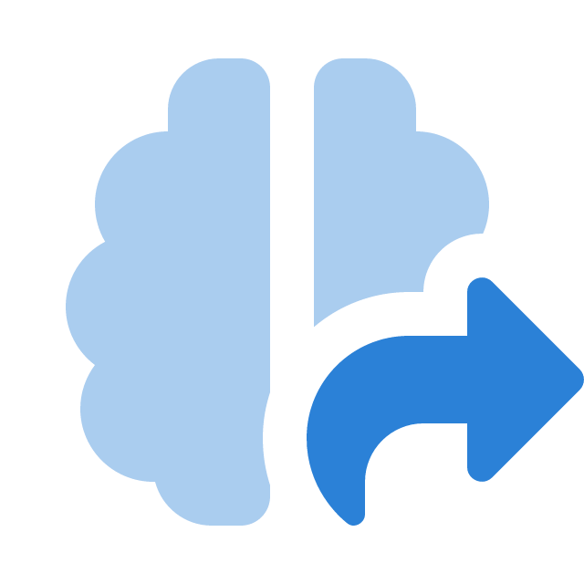


Why This Builds Irreplaceable Trust
You're there during vulnerable moments
You help solve real problems, not just sell products
The switching cost becomes emotional, not just financial
Family stories about your bank get passed down
You become part of their legacy, not just a vendor

Slide 12
Measuring the Marketing Impact
Network Multiplier
How many new relationships does one user generate?
Target: 2–4 new accounts per planning customer.
Why it matters: Shows the viral coefficient of your program.
Conversion Rate
What percentage of family members open accounts?
Target: 30–50% of invited family members convert.
Why it matters: Measures how compelling the value proposition is.
Generational Retention
How many keep their inheritance at your institution?
Target: 60–80% retention (vs. typical 10–20%).
Why it matters: Proves you're capturing wealth transfer, not losing it.
Cost per Acquired Customer
How do family networks compare to traditional CAC?
Target: 50–75% lower than paid advertising.
Why it matters: Demonstrates marketing efficiency and budget impact.
Start with one metric. Add others as your program matures.

Slide 13
Messaging That Works
Don’t Say
Say Instead
Estate planning
Getting organized for your family
When you die
So your family knows where
everything is in the future
End-of-life planning
Legacy planning
Wills and trusts
Securing what you worked to build

Slide 14
Building It Into What You're Already Doing
Same budget. Same touchpoints. One generational layer added.
Community Workshops
"Family Financial Organization"
Not generic financial literacy. Parents bring adult children. You build two relationships at once.
Cross-Sell Programs
"Now that your mortgage is paid off, let's make sure your family knows where everything is."
Meets customers when they're already thinking long-term.
Loyalty & Retention
"You've earned this. Let us help you make sure your family is taken care of."
Legacy planning tools as a perk for top-tier customers. Their family network becomes part of your retention strategy.
Relationship Banking
Customer Acquisition
"Let's make sure your family is part of this conversation."
Brings spouses and adult children into the relationship naturally.
"We help you plan for your family's future."
Stands out when competitors are leading with rates.

Slide 15

Customer Story
The Network Effect in Action

Slide 16

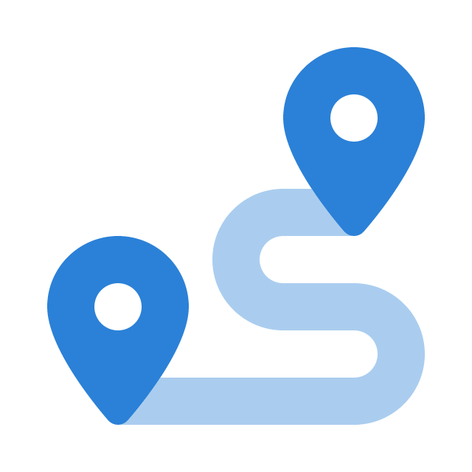

Customer Story
From Safe Deposit Boxes to Digital Access
Documents locked in one location
Expensive and often isolated to one generation
Beneficiaries often live out of state
The Issue
Start conversations early
Encourage digital document storage
Enable secure sharing with family
Our Approach
Easier access when it matters
Supports intergenerational financial awareness
Strengthens ongoing relationships with dispersed families
Positions the bank as a modern, forward-thinking advisor
Impact

Slide 17

Customer Story
Wills & Document Storage
The Gap
Many customers don’t have a will
Documents can be hard to find
Our Role
Normalize hard conversations
Encourage will creation & updates
Promote secure online storage
Impact
Faster, smoother transitions
Less stress for families

Slide 18
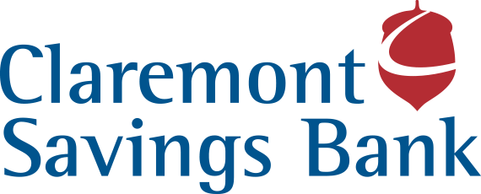

Customer Story
Supporting the Whole Customer
Our Mindset
Beyond banking—life-centered support
What We Do
Lead empathetic conversations
Help families prepare & stay informed
Guide across life transitions
Value
Builds trust across generations
Strengthens long-term relationships
The opportunity isn’t just assets.
It’s earning trust with the next generation.

Slide 19
If You Remember Two Things…
Takeaway 1
Family networks are your most powerful, most overlooked marketing channel.
Legacy planning opens doors to entire family circles, not just individual customers.
Takeaway 2
The $124 trillion wealth transfer is happening now.
Banks that help families plan before the transition will capture relationships with the next generation.
This is about showing up when it matters, not just when it's convenient.

Slide 20
When You Get Back to Your Office
Action 1: Identify your 10 most loyal customers who have adult children.
Test the messaging: "We're rolling out a new tool to help families get organized. Would you be interested in being one of our first testers?"
Action 2: Map your customer journey for key life events (home purchase, retirement, birth, death).
Find the natural moments to offer legacy planning as part of your existing service.
Start small.
Test the network effect.
Measure what happens.

Slide 21
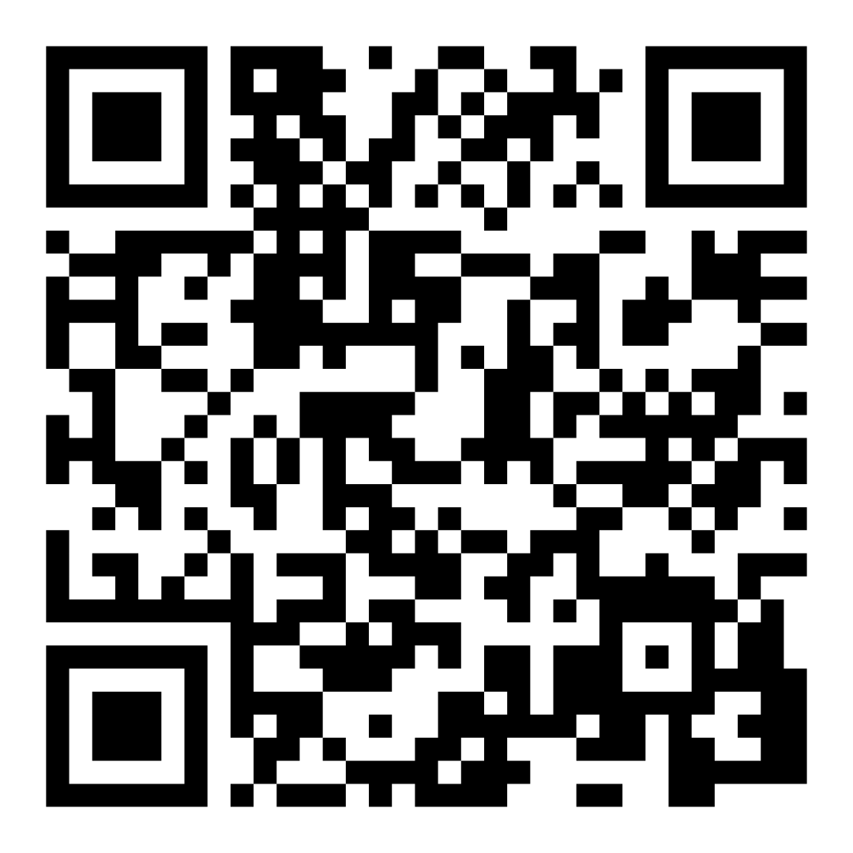
Questions?
Schedule Your
Free Demo
Carie Kelly
SVP, Digital Banking
Claremont Savings Bank
Billie Connally
VP of Partnerships
Paige

