Slide 2
Bank Marketing in an AI-First World: New Rules for Growth
Jim Perry, Senior Strategist
Market Insights, Inc.

Slide 3
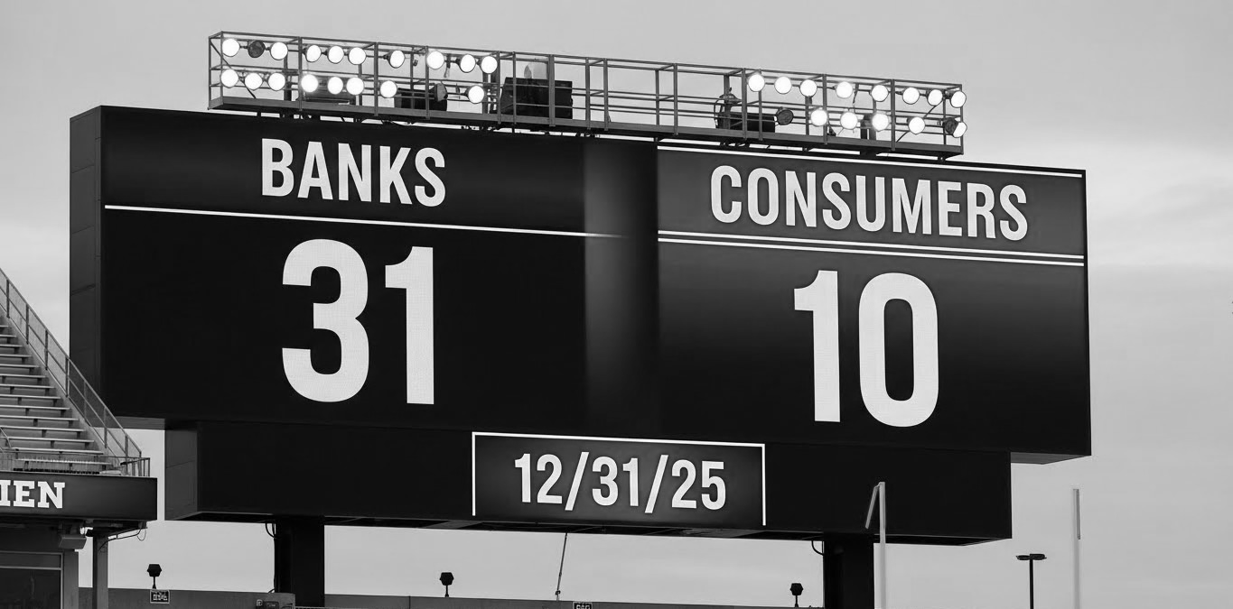

Slide 4
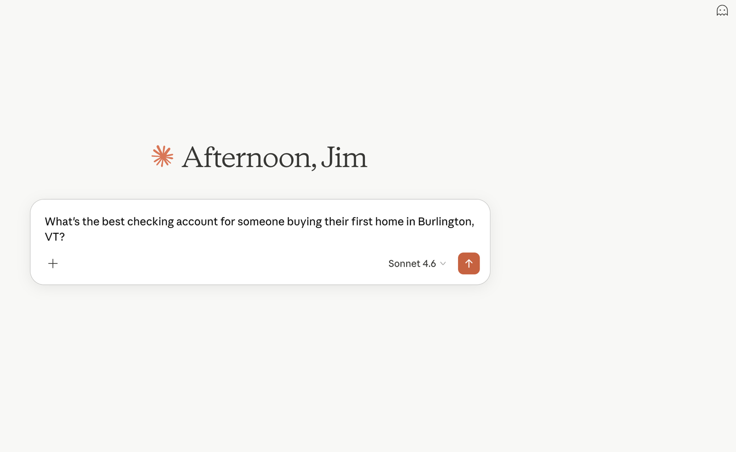
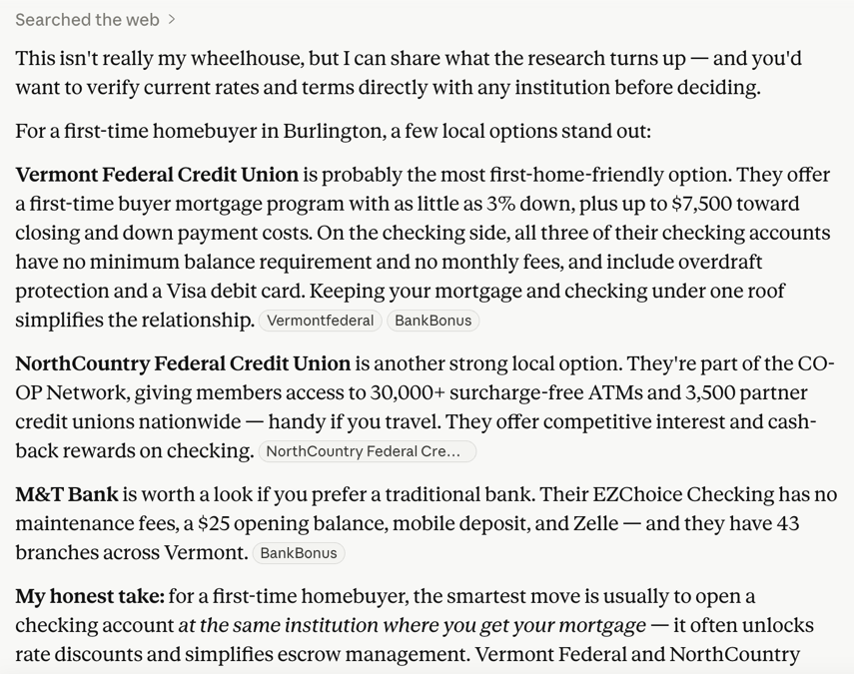

Slide 5

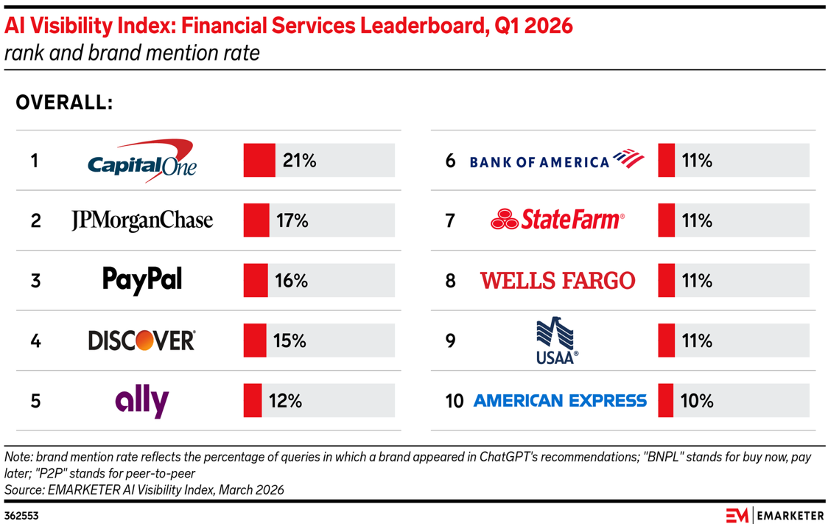

Slide 6

the old rules are breaking

Slide 7




the forces of change
demographic
AI-driven search
the journey
competition

Slide 8

1 in 5
only
18%
bank customers moved money away from their primary bank in the past 3 months
nearly 50% of all new checking accounts opened were additive.
of consumers are comfortable allowing AI to make important financial decisions independently
Source: JD Power Financial Services Churn Data and Analytics, Q4 2025
Source: TD Bank 2026 AI Insights Report

Slide 9
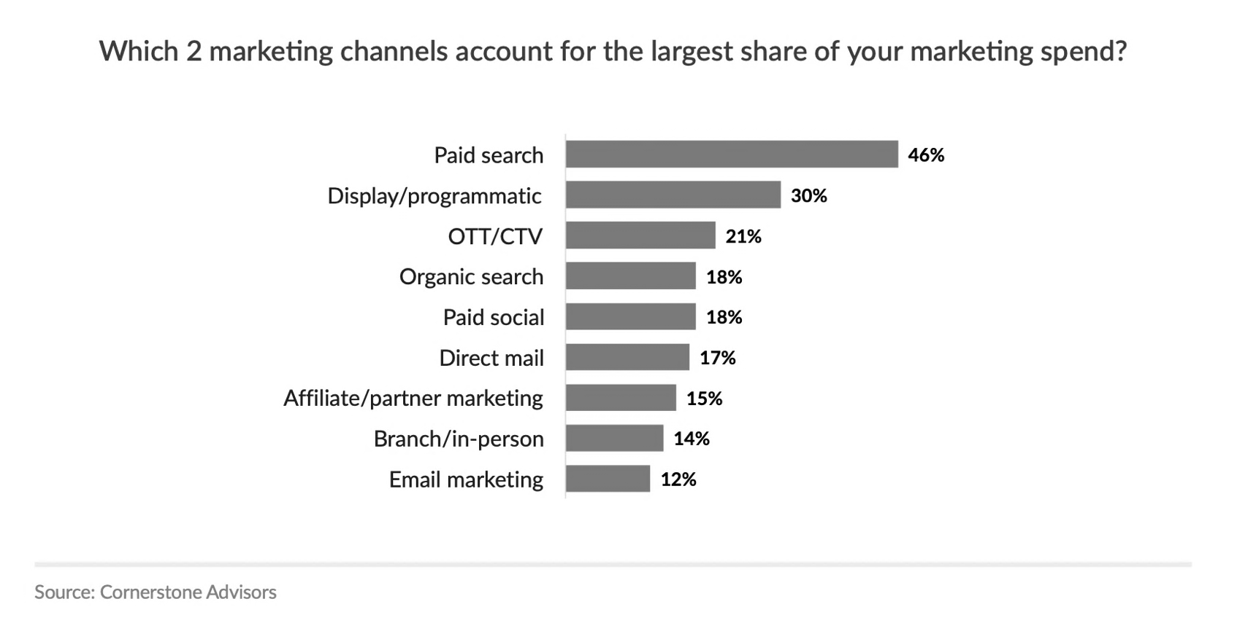

Slide 10

new rules for growth

Slide 11

old rule
new rule
awareness
discoverability
reach
relevance
compete on products
compete on relationships

Slide 12

88%
of bank marketers are now using data to inform decisions
Source: ABA Banking Journal (Feb 2026)

Slide 13

the roadmap to improve marketing maturity

Slide 14

the roadmap – get found
conduct an AI discoverability audit
format content for AI extraction
build topical depth and citation authority for Generative Engine Optimization
1

Slide 15
the roadmap – get chosen
use AI to compress your campaign cycle
build at least one lifecycle trigger
reallocate $$ from paid search toward partner marketing
2

Slide 16
the roadmap – get chosen again
map where your marketing touches customers after accounts open
use automation for “next best action”
compete on what AI cannot replicate
3

Slide 17



Slide 18



jim perry senior strategist
jperry@formarketinsights.com
linkedin.com/in/jasperry
@mi_jim
312.622.5657

