Slide 1
Strategic Social Content For Financial Marketers:
Driving Trust, Engagement & Growth
2026 NEFMA Conference
Notes:
I’m here to help you tell better stories — the ones that actually drive deposits and build trust.

Slide 2
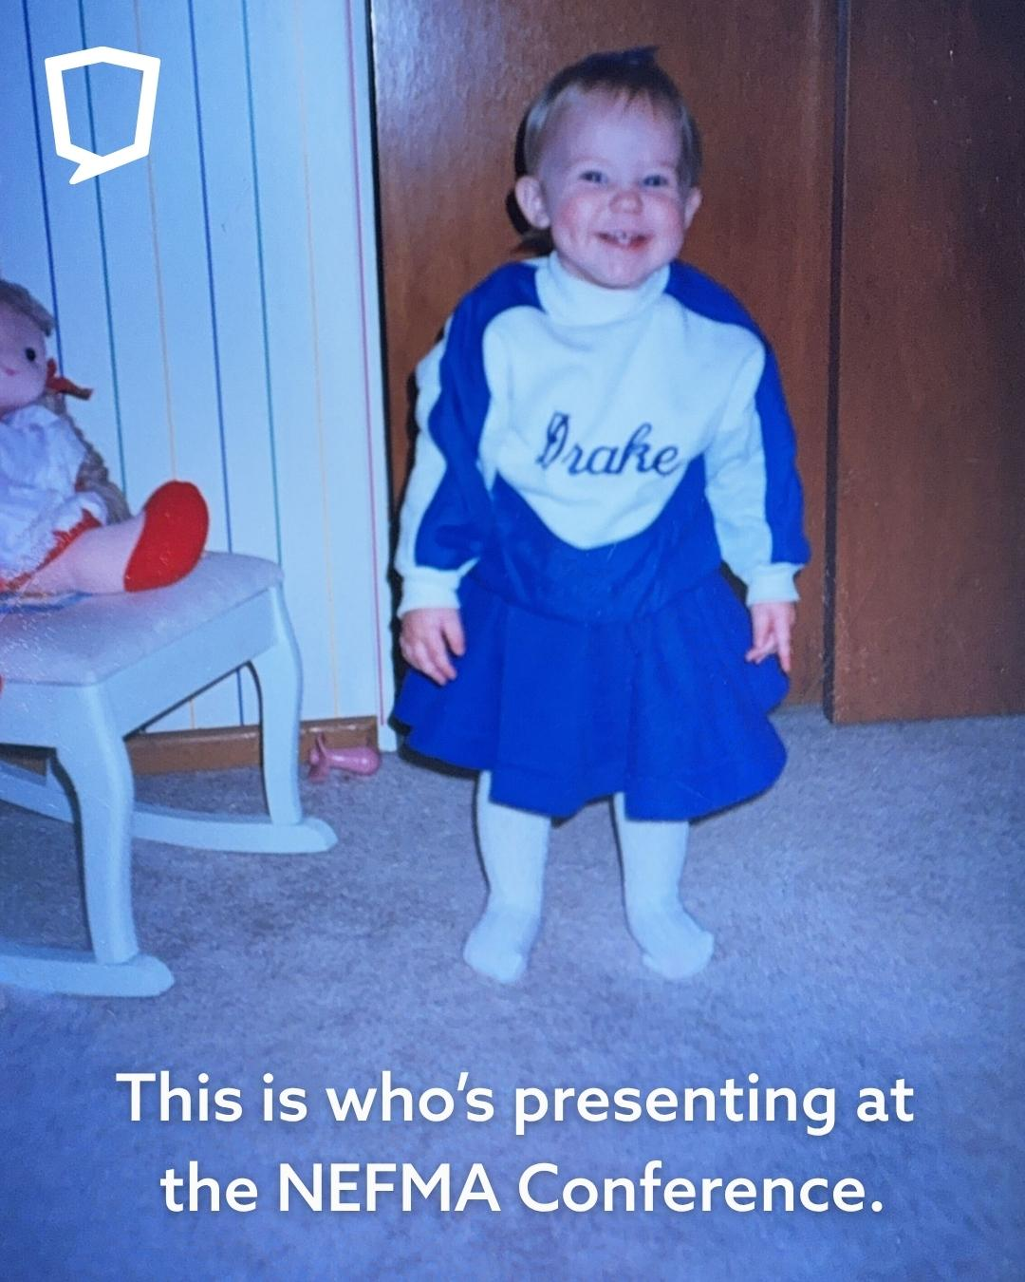
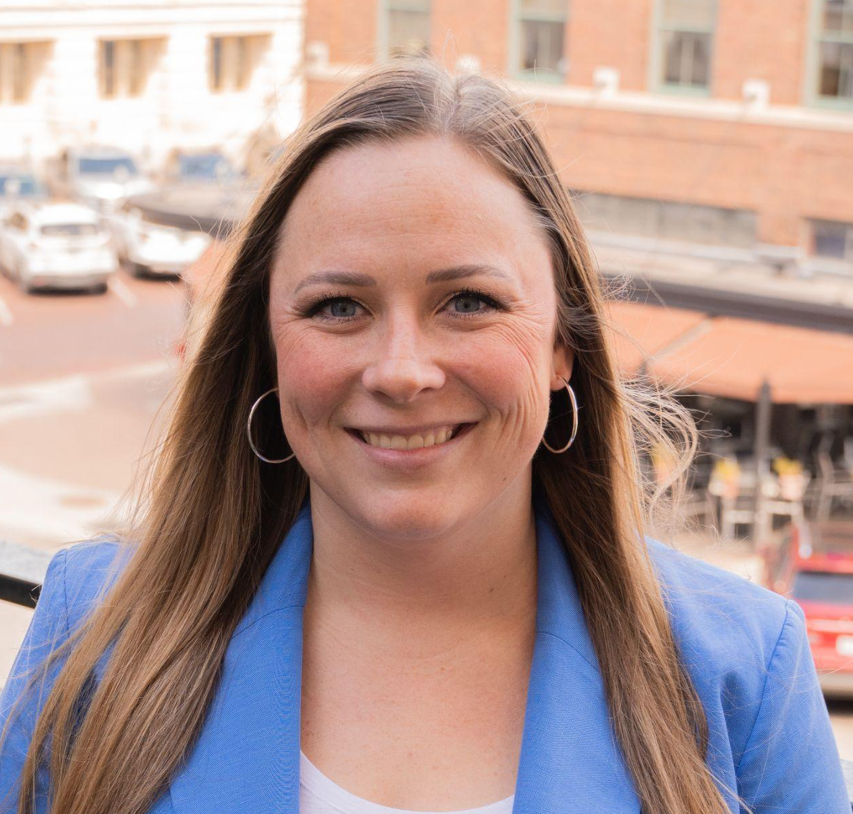
Jordyn Swanson
Client Development Manager
jordyn@socialassurance.com

Slide 3
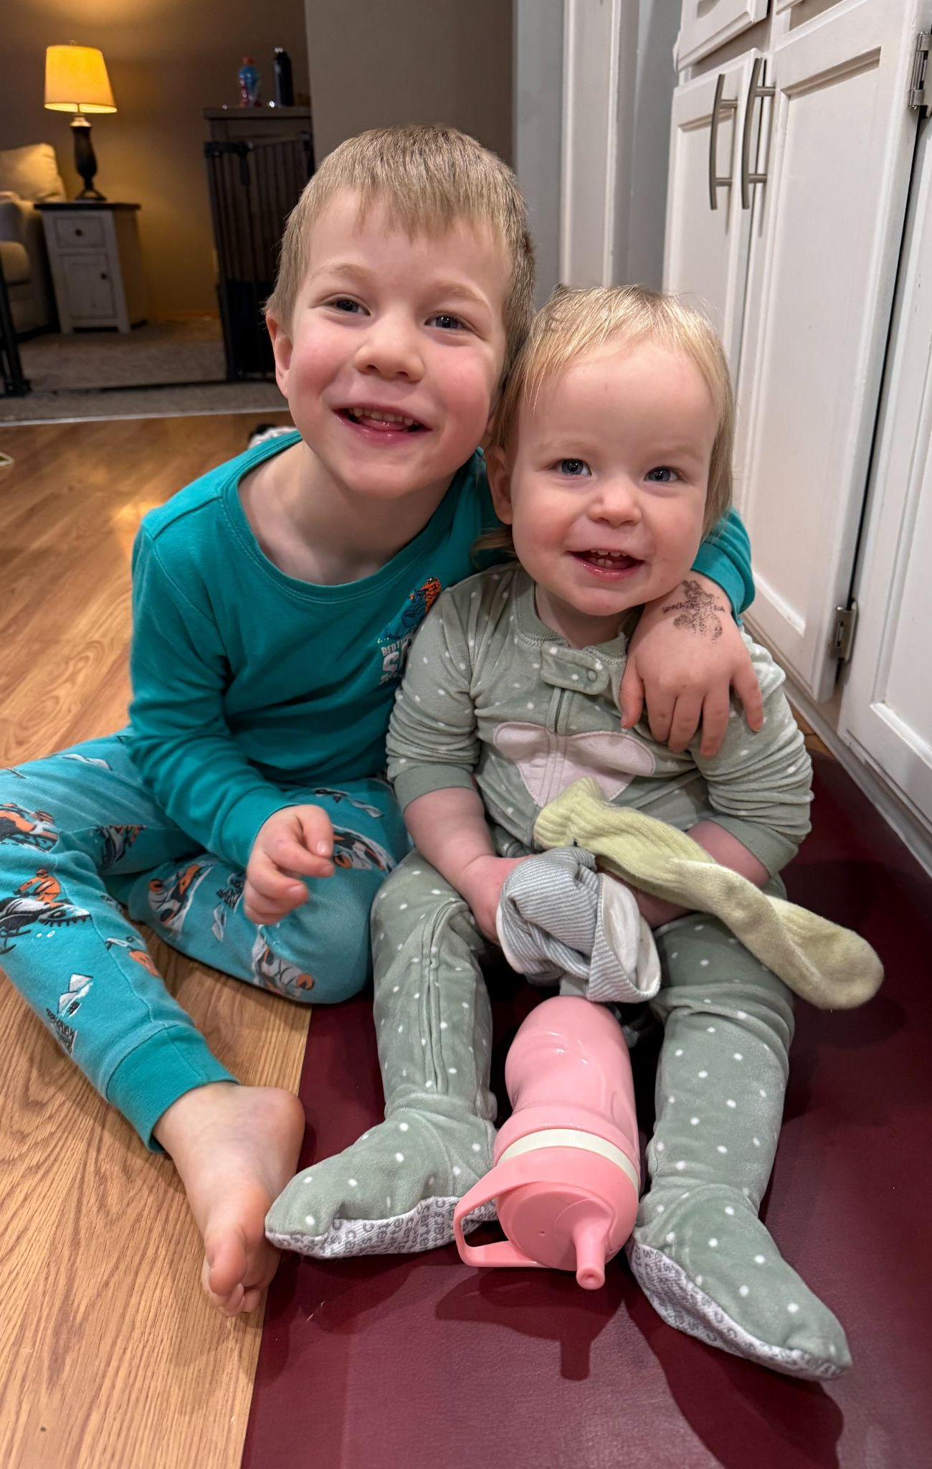
For the Next 25 Minutes…
I’m Your Content Therapist
Mom of two toddlers.
Professional chaos wrangler.
Real moments > perfection.
Notes:
I have two toddlers at home.
So trust me… I understand the feeling of, ‘I don’t have the perfect photo.’
I used to think I needed the perfect photo — perfect lighting, perfect smiles, perfect background.
Then I had toddlers. Now I’m just hoping no one is crying and everyone is wearing pants.
And honestly? That’s how content works too.
It doesn’t have to be perfect.
It just has to be real and strategic.

Slide 4
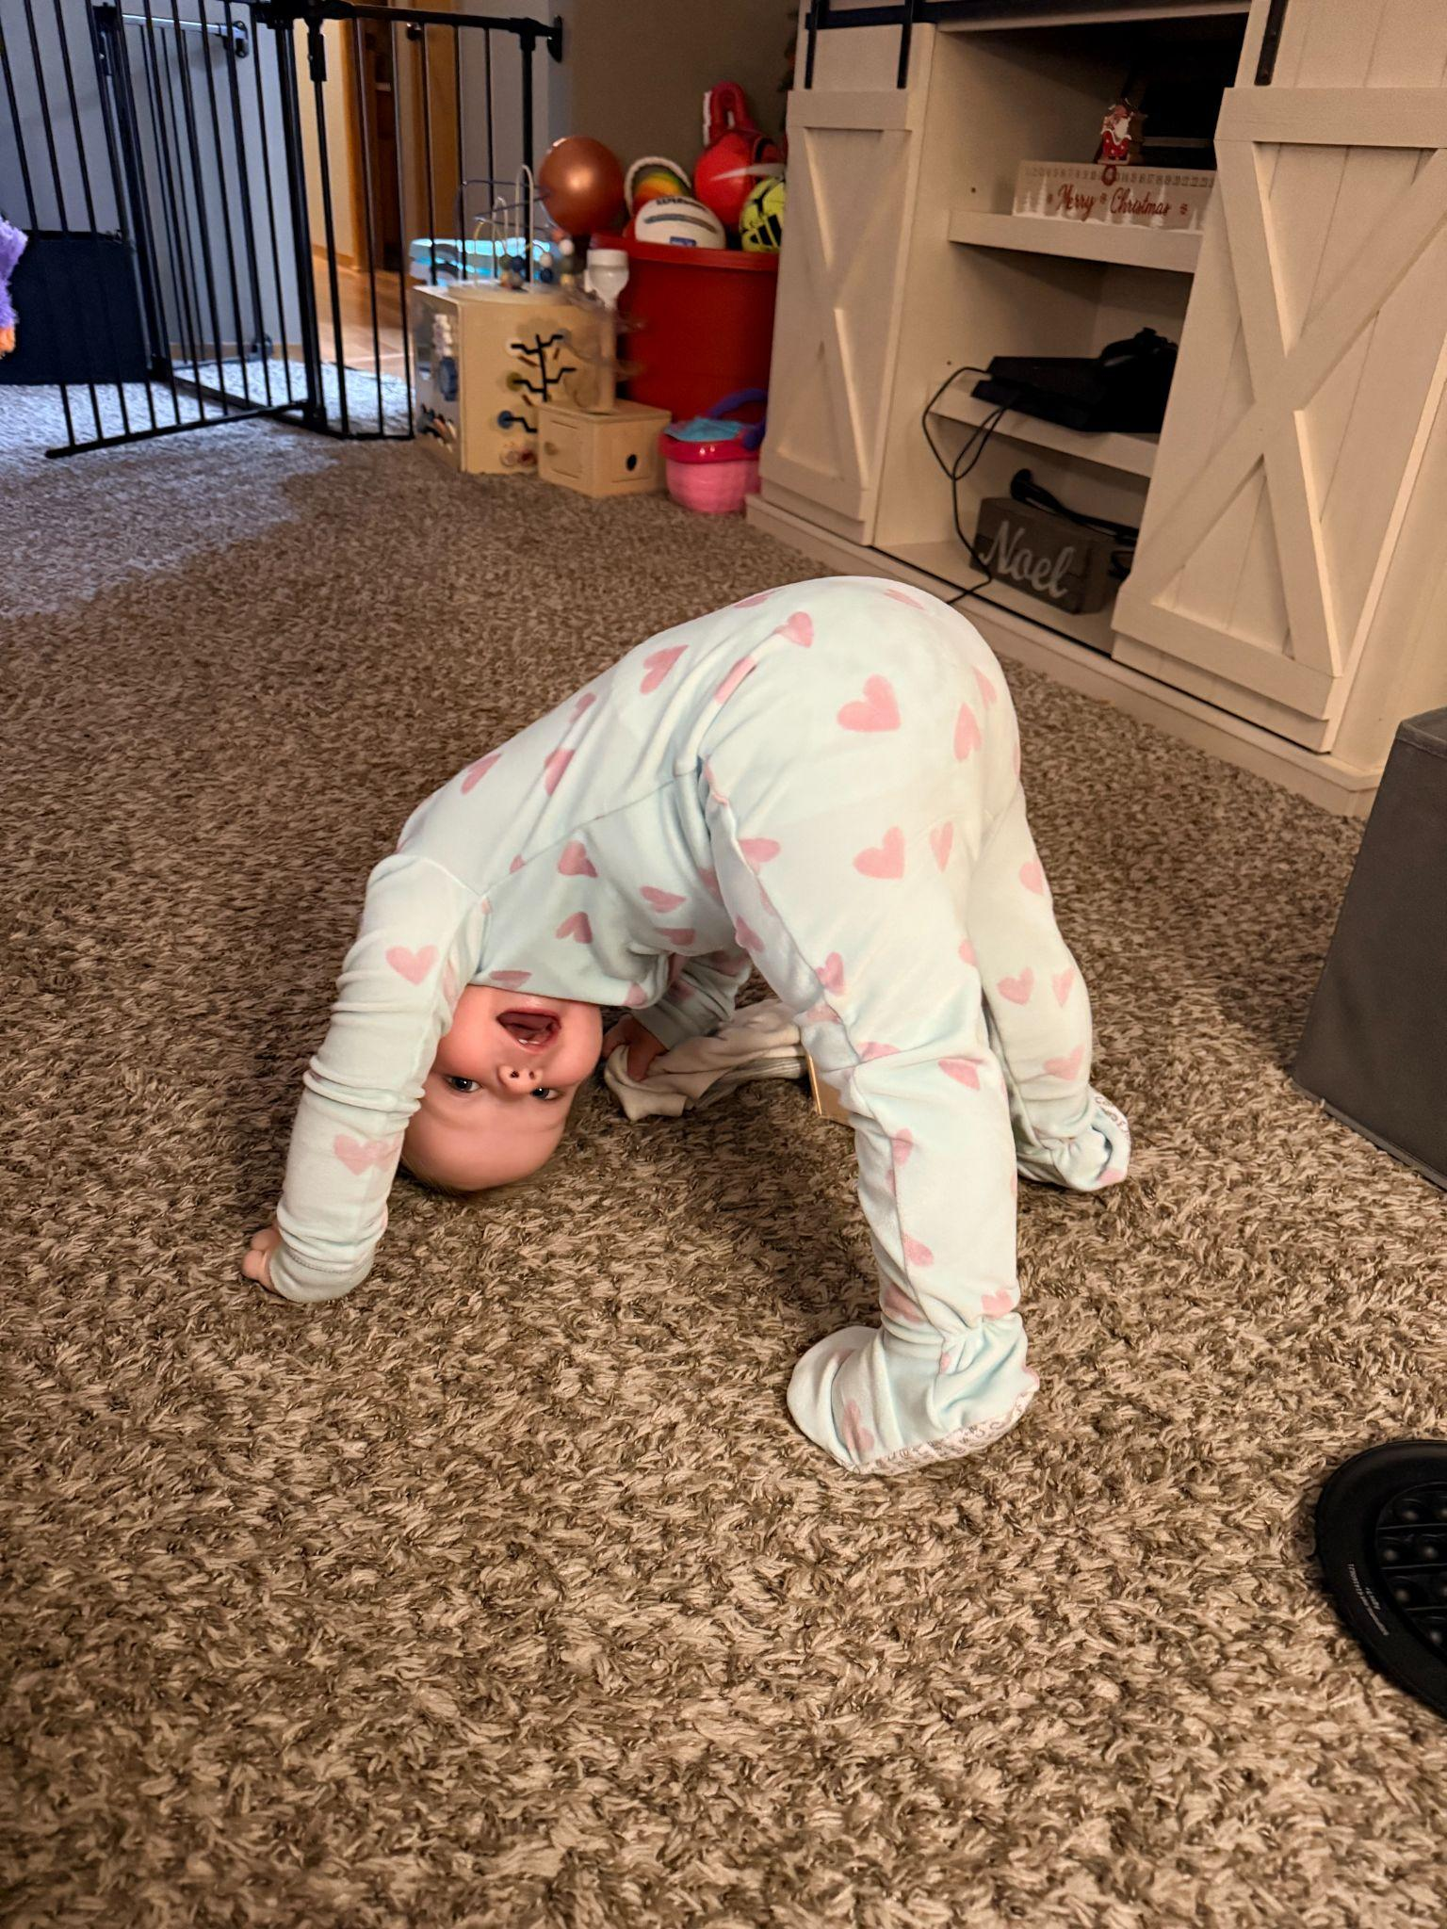
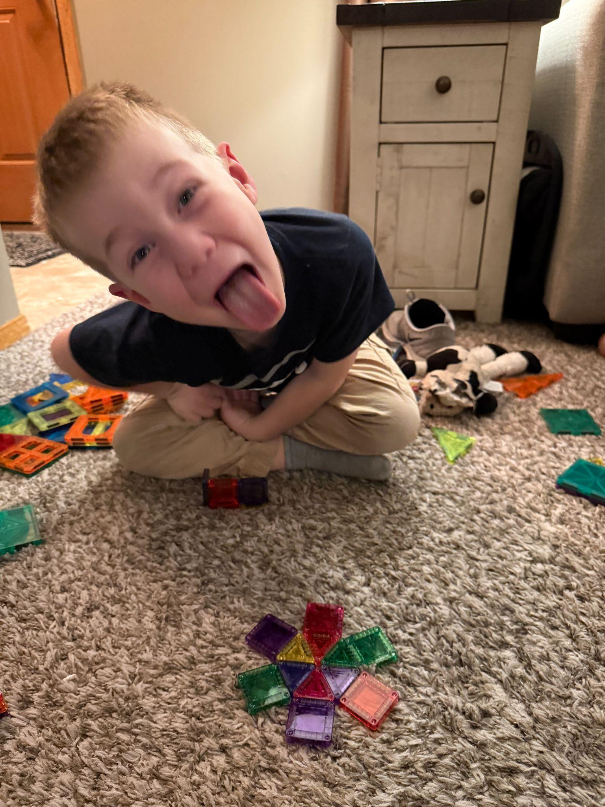
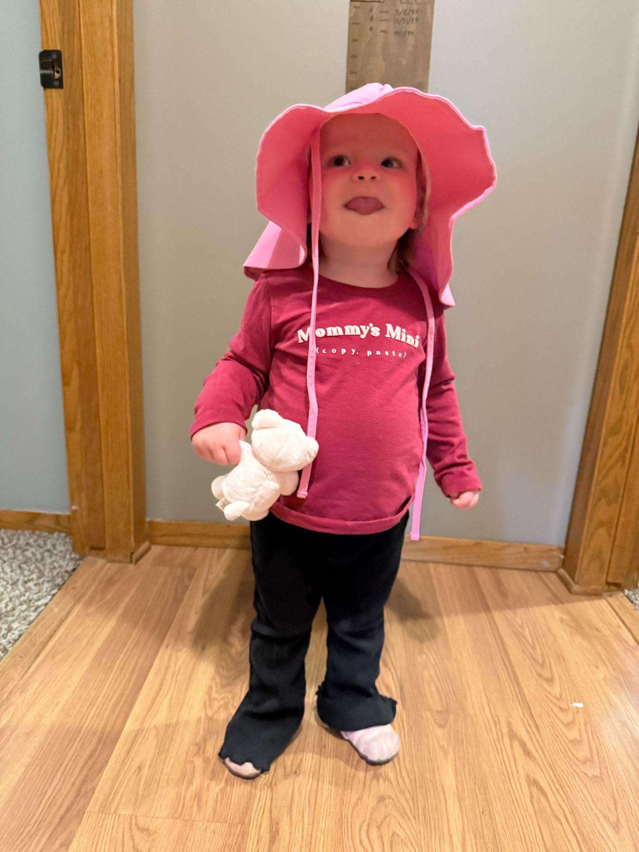


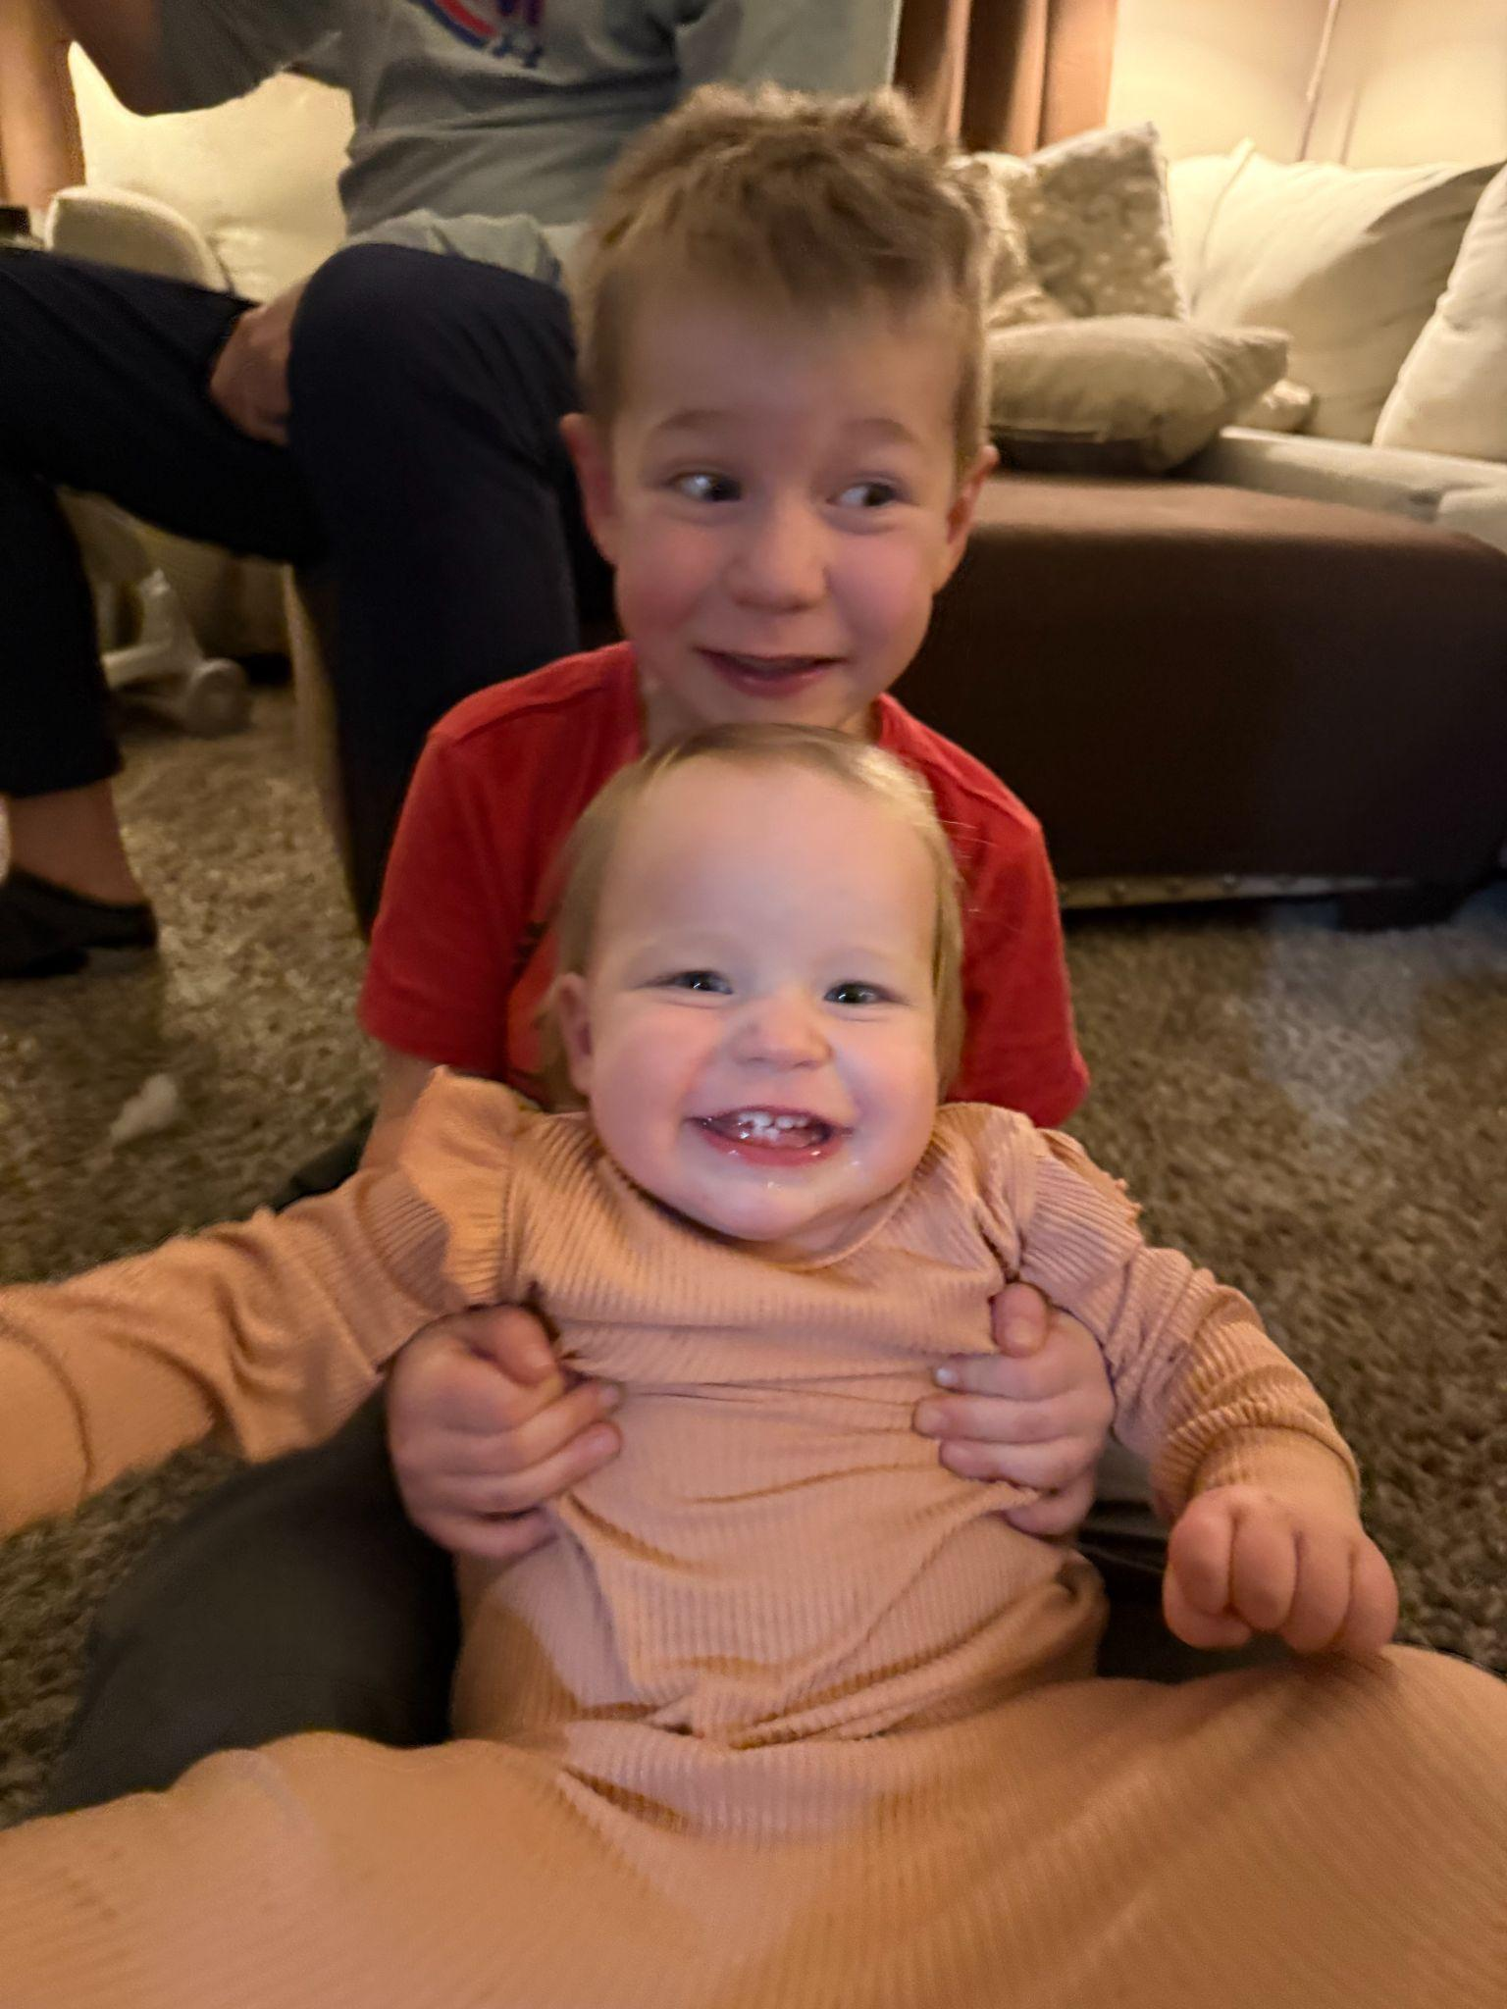
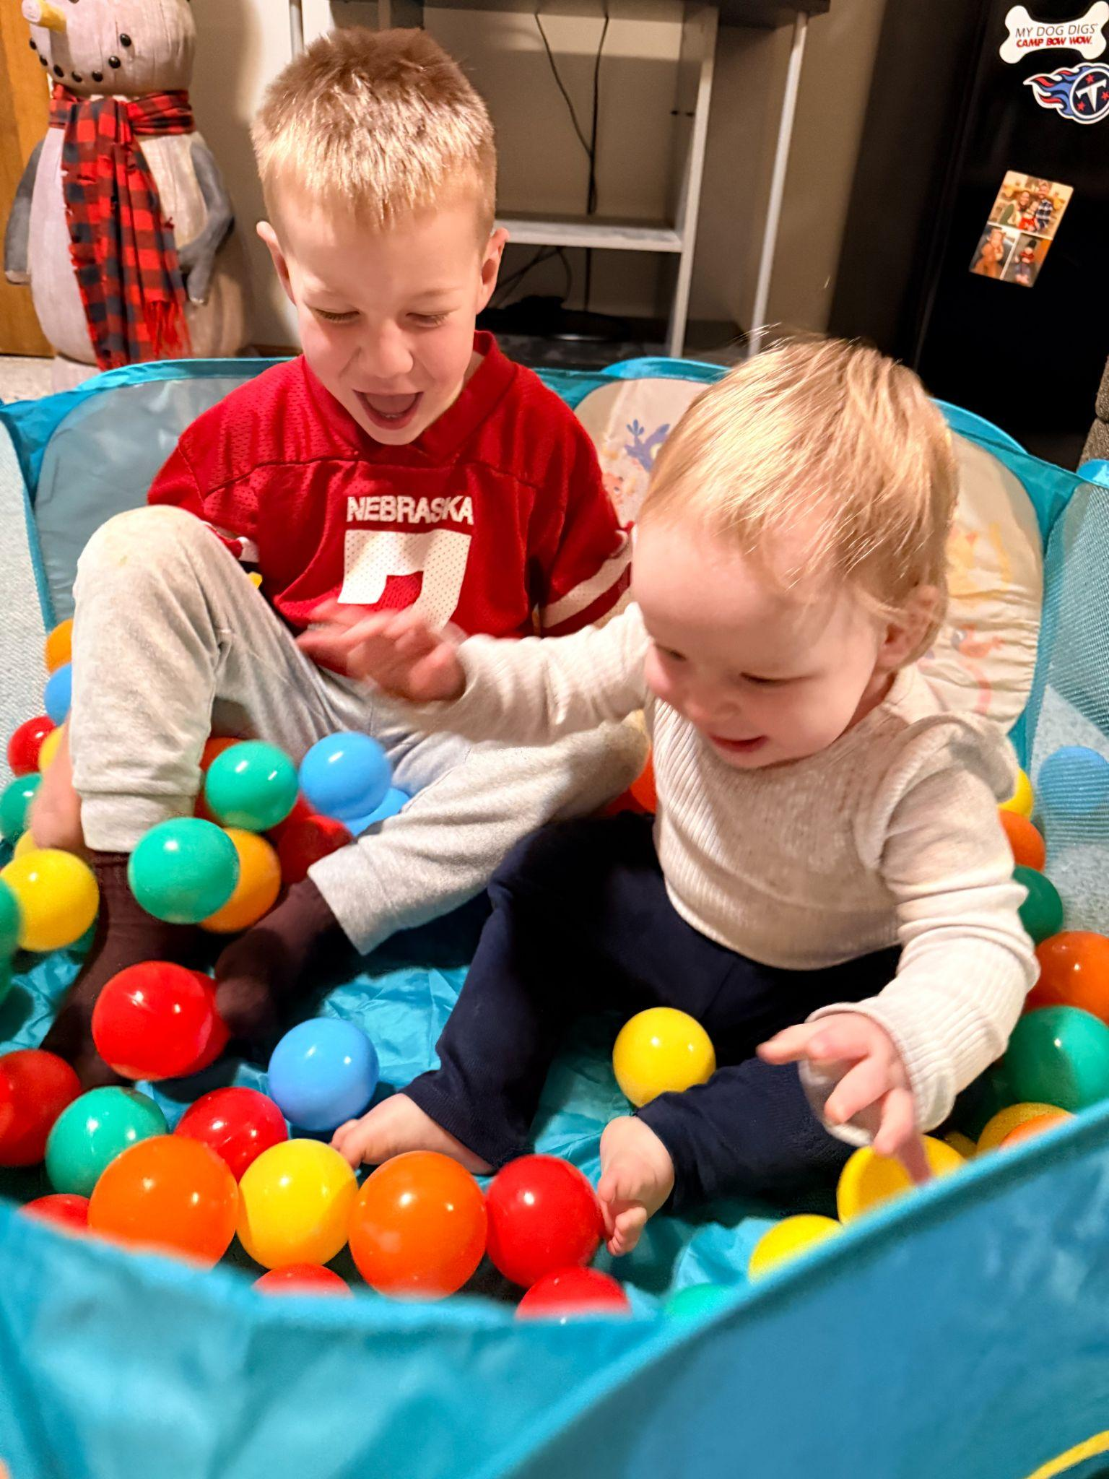
Notes:
At my house, if I waited for the perfect photo, I’d have zero memories.
And in marketing, if we wait for perfect… we miss the moment.

Slide 5
1
What, Exactly,
Is Good Content?
What We’ll
Cover Today
2
Planning
& Sourcing Content
3
Tying Content
to Business Objectives
Notes:
By the end of today, I want you thinking differently about what you already have access to — and how powerful it can be.

Slide 6

1.
What, Exactly,
Is Good Content?
Notes:
Strategic. Human. Relatable. Community.

Slide 7
82% of consumers say they want a brand’s values
to align with their own (up from 63% in 2019).
Edelman Trust Barometer, 2024

Slide 8
68% of consumers said they were more loyal to financial institutions that support local initiatives and charitable causes.
Accenture Banking Consumer Study, 2024

Slide 9

Human connection is more important than ever.

Slide 10
The relatable, authentic, human elements of the work you do are HUGE differentiators.

Slide 11
But, you have to talk about them.
Notes:
We have values. We are giving back and deeply involved in our communities. We need to talk about it in our content! We need to SHOW our impact and our values. It is crucial to customer retention and acquisition.

Slide 12

Good content is compliant, but also:
Human | Real people, real stories.
Strategic | Aligned to business goals.
Valuable | Educational or meaningful.
Visual | Strong photos > graphics.
Emotional | Makes people feel something.
Action-Oriented | Moves someone to respond, click, ask, or engage.
Share-Worthy | Compelling: people want to share with their network.

Slide 13
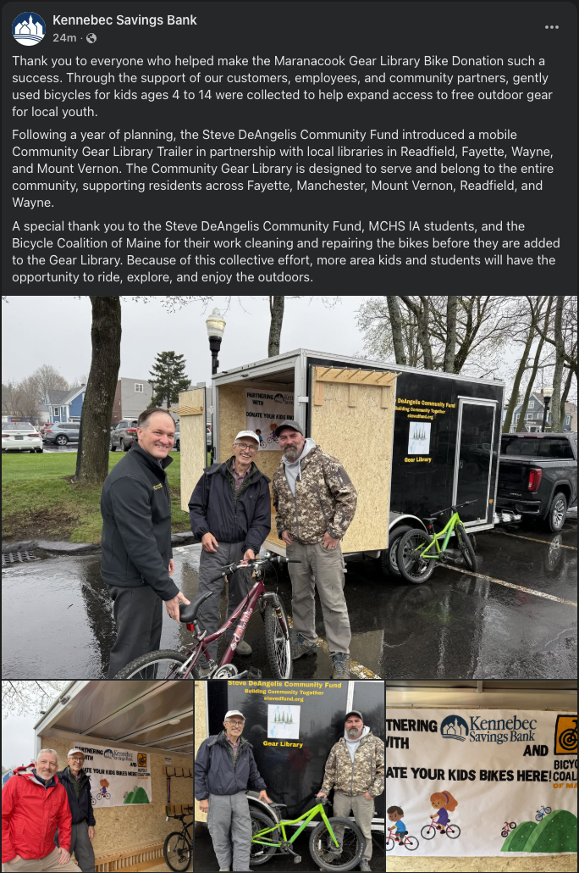
Don’t tell people, show them!
Showing looks like: ✅
Story about impact + specific humans + why it matters.
Notes:
Saying ‘we care about our community’ doesn’t land nearly as well as showing it through specific actions.
It’s not about showing off. We can do this AND be humble by putting the cause and community first. It’s not about us, it’s about supporting the community in a way that’s genuine, authentic, and that makes a difference.

Slide 14
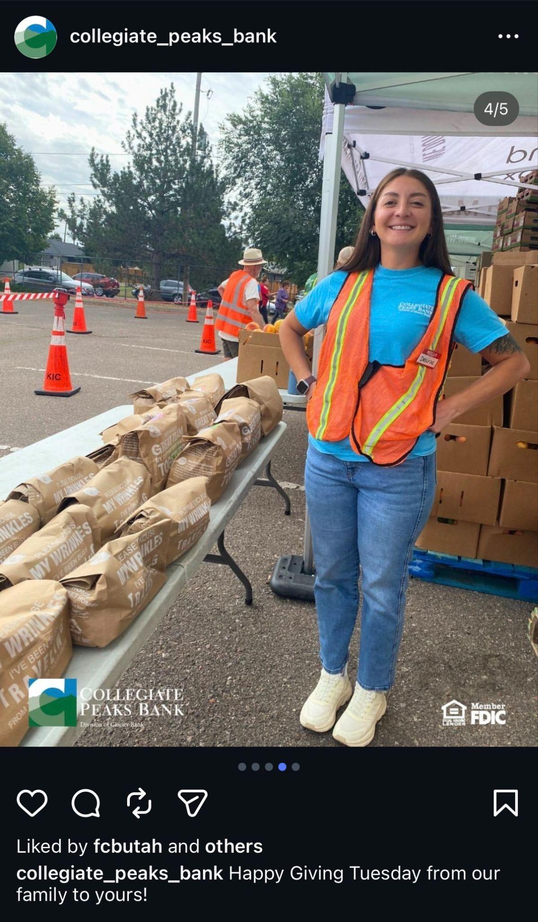
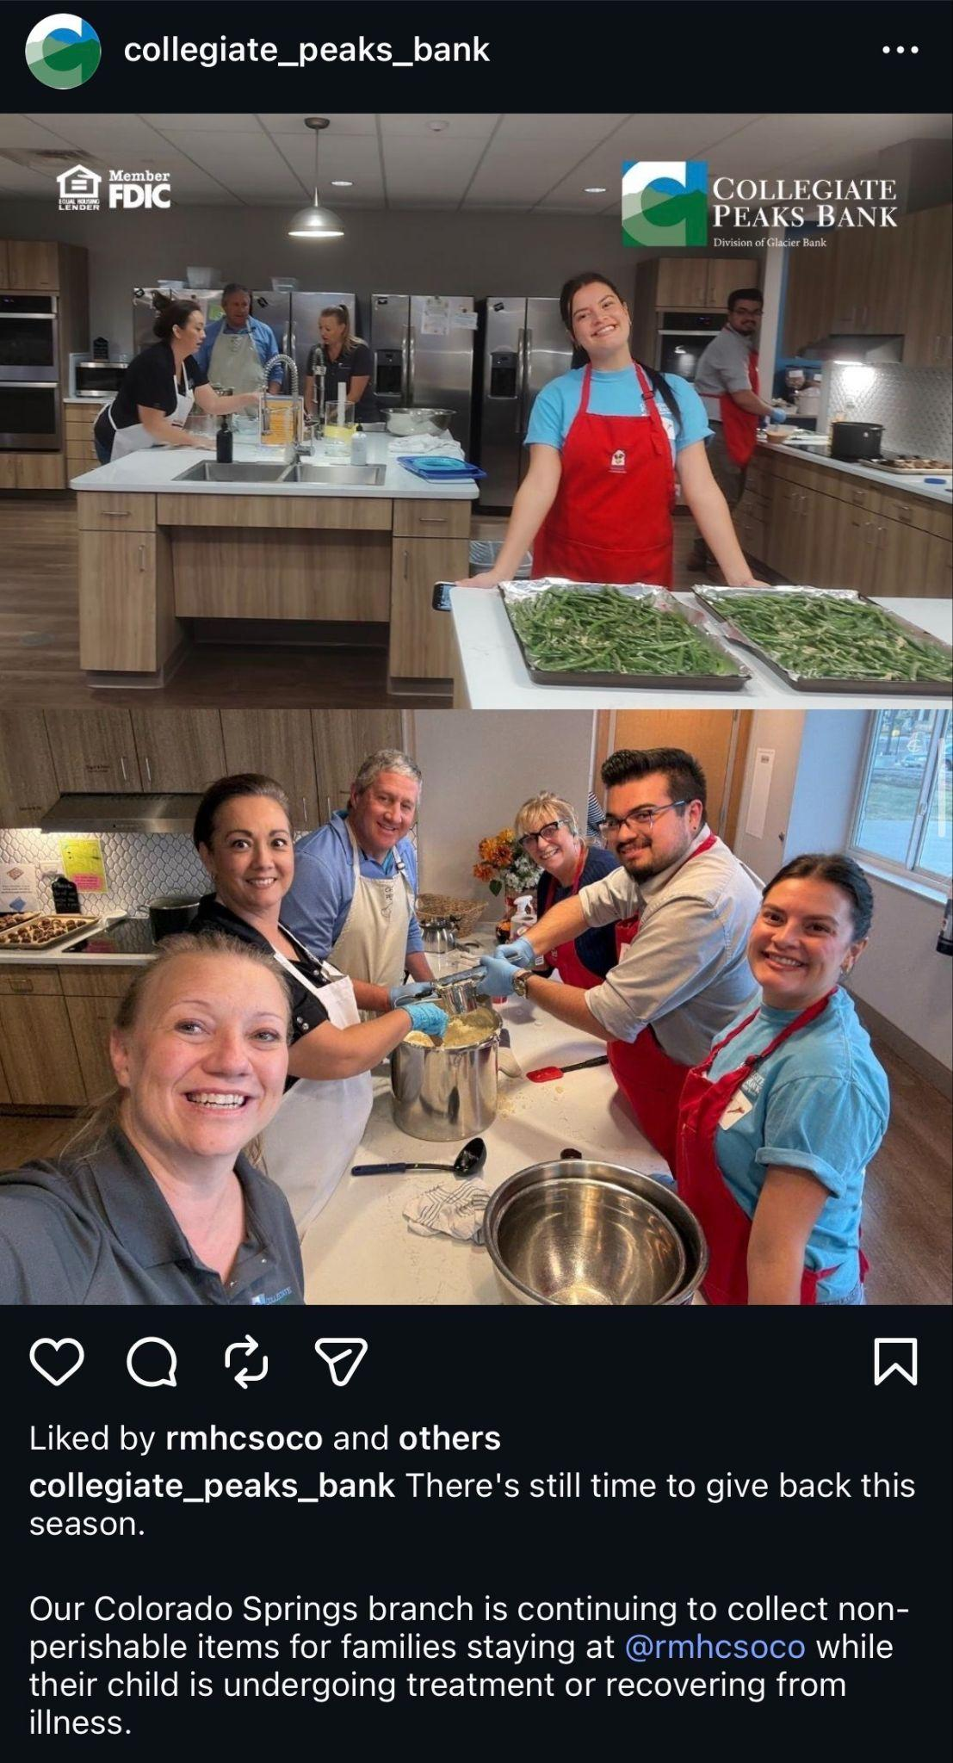
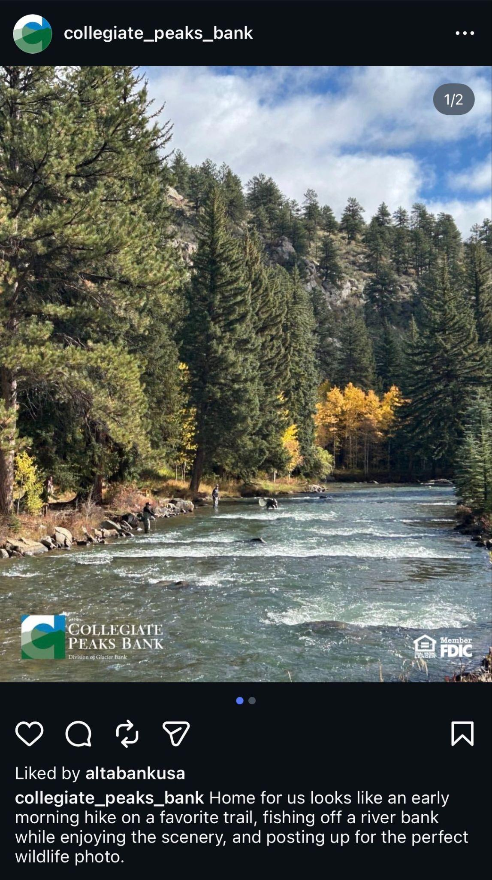
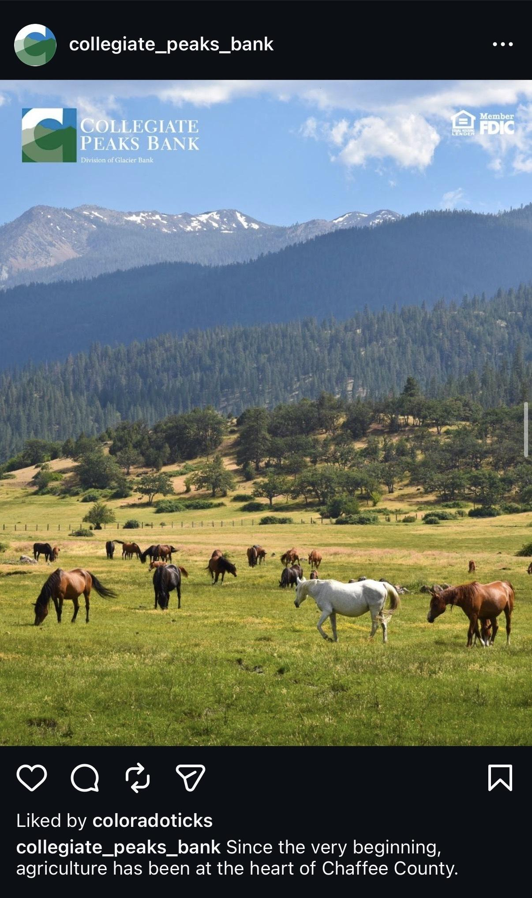
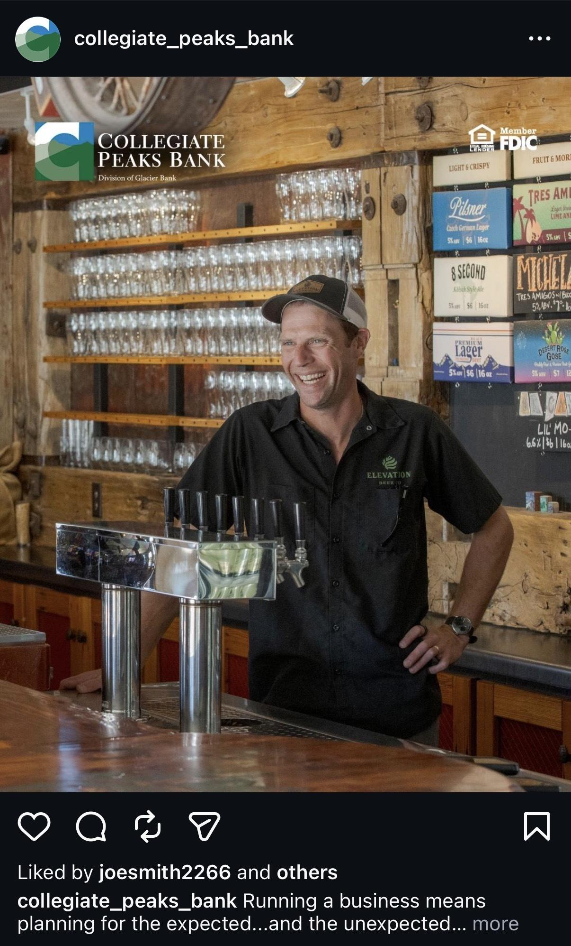
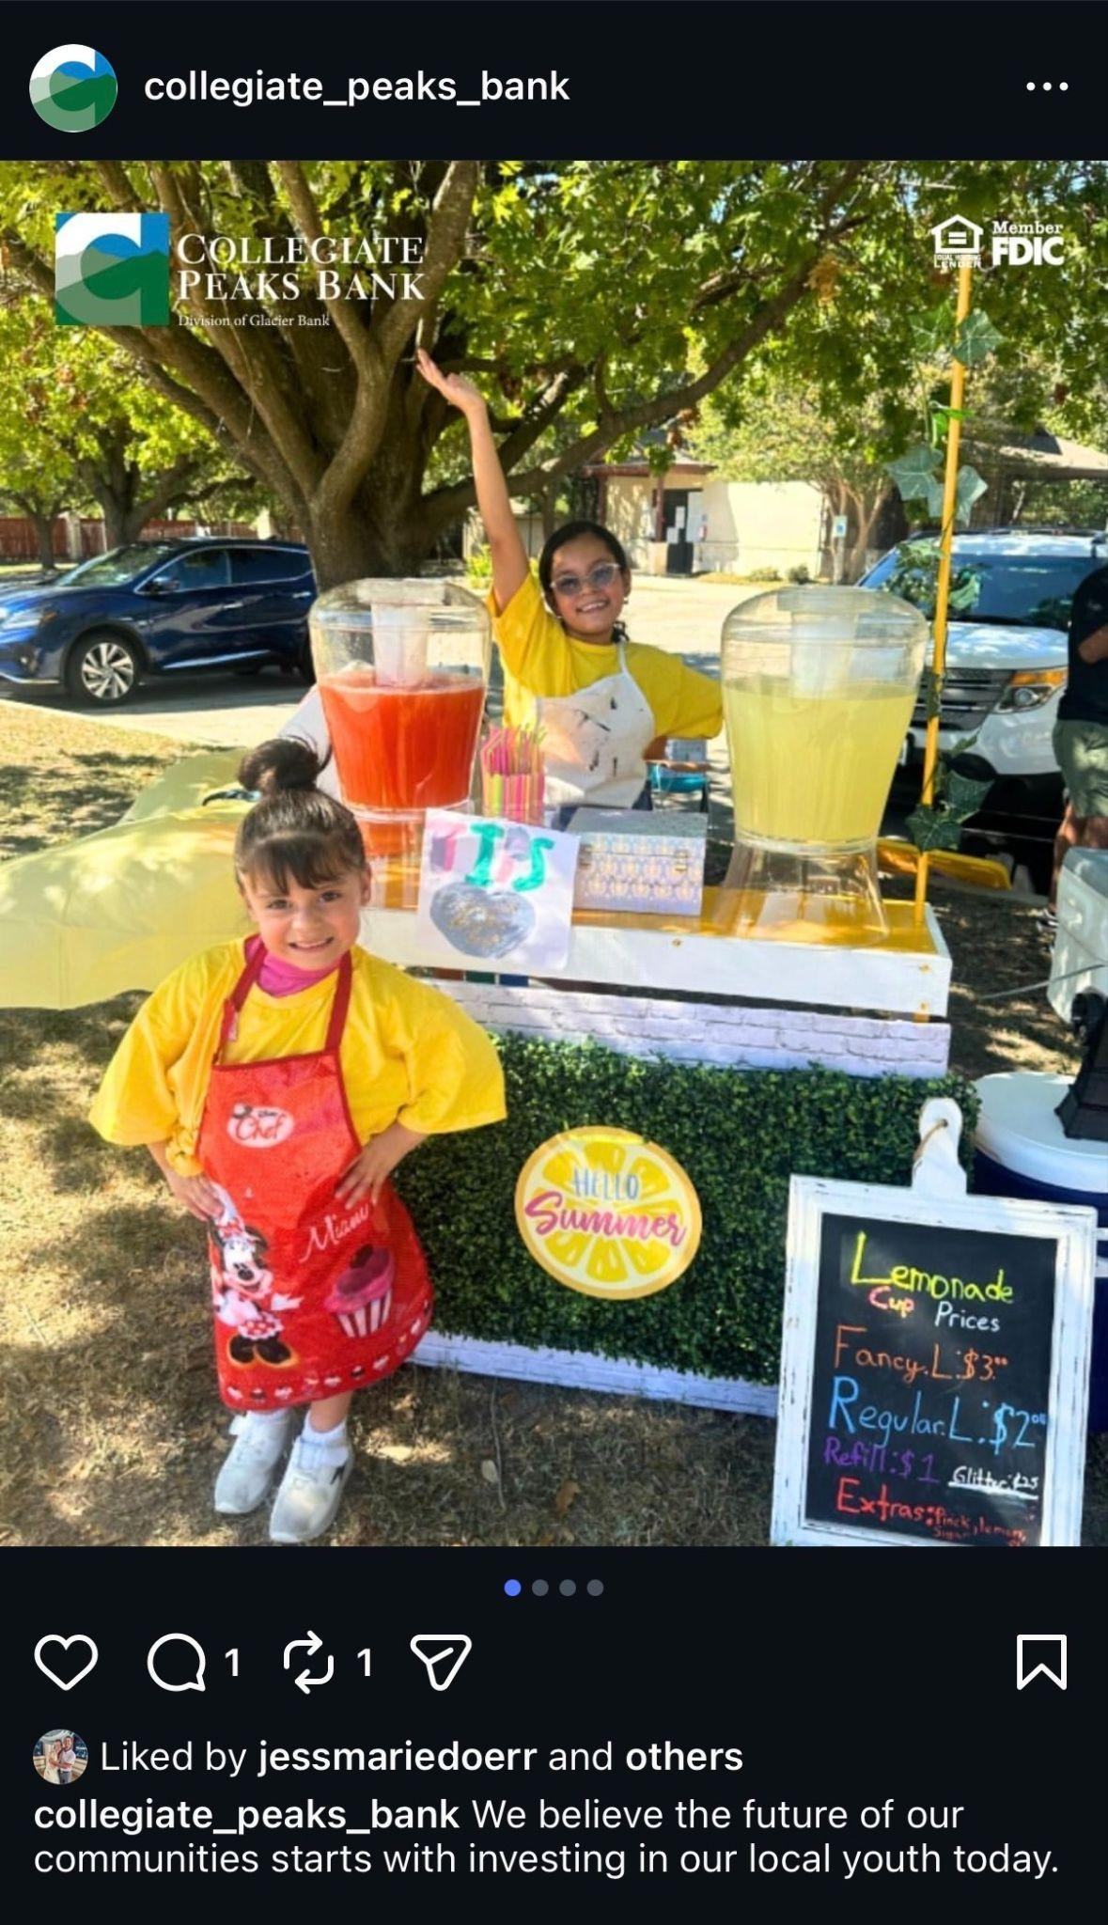
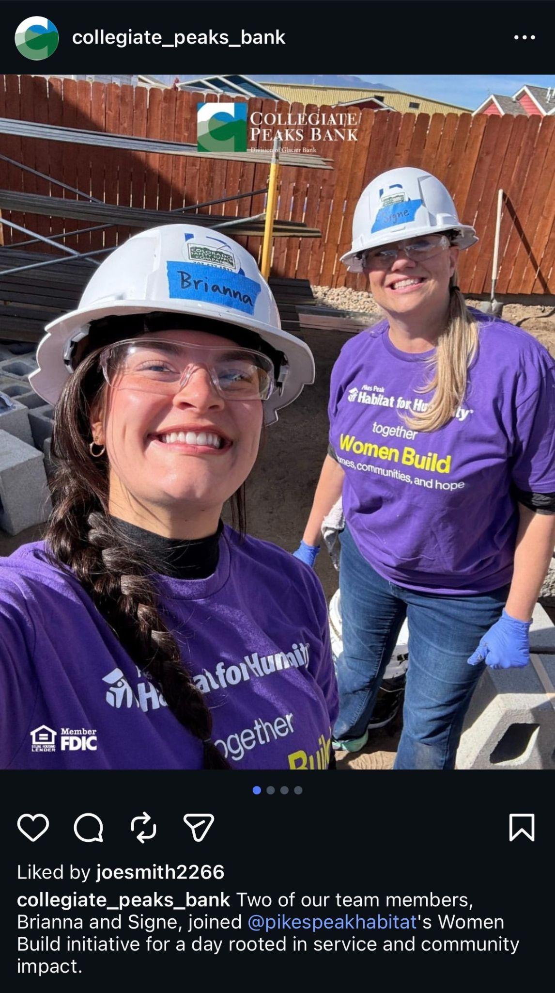
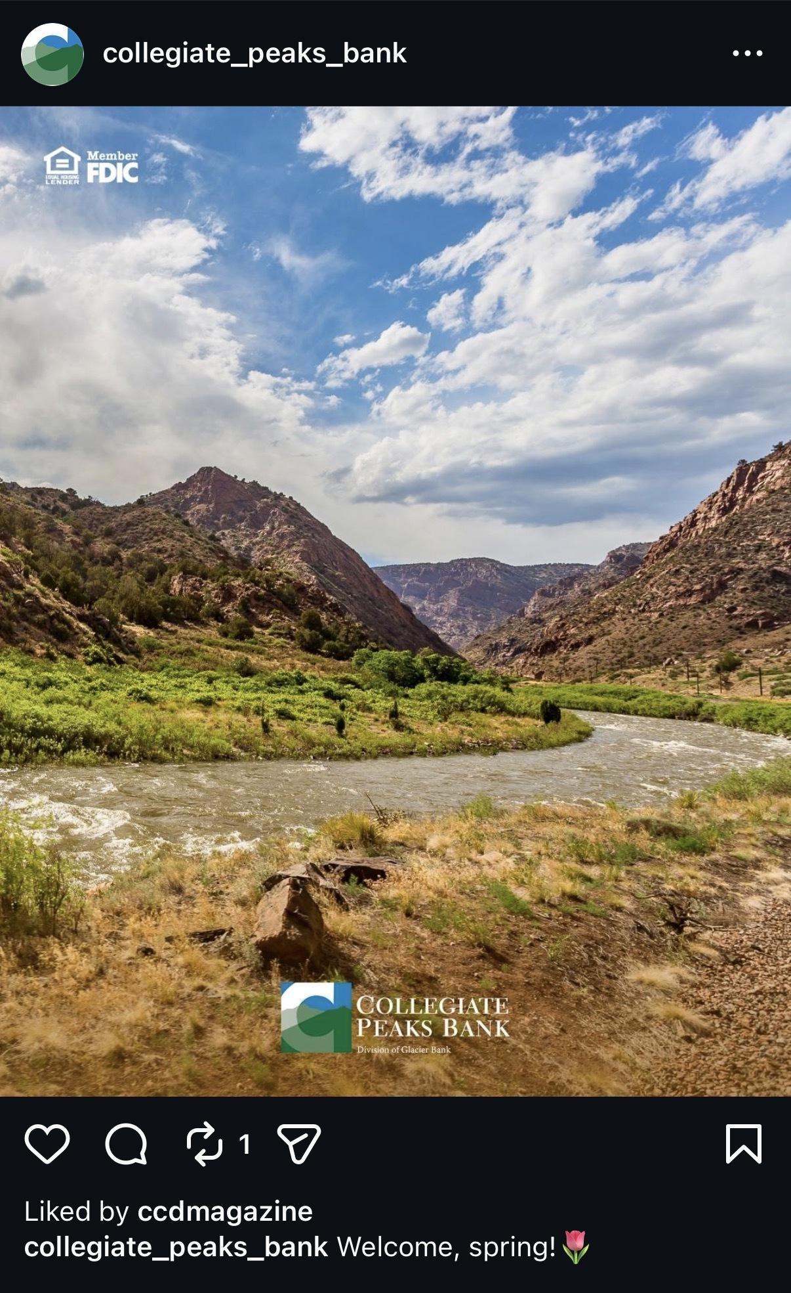
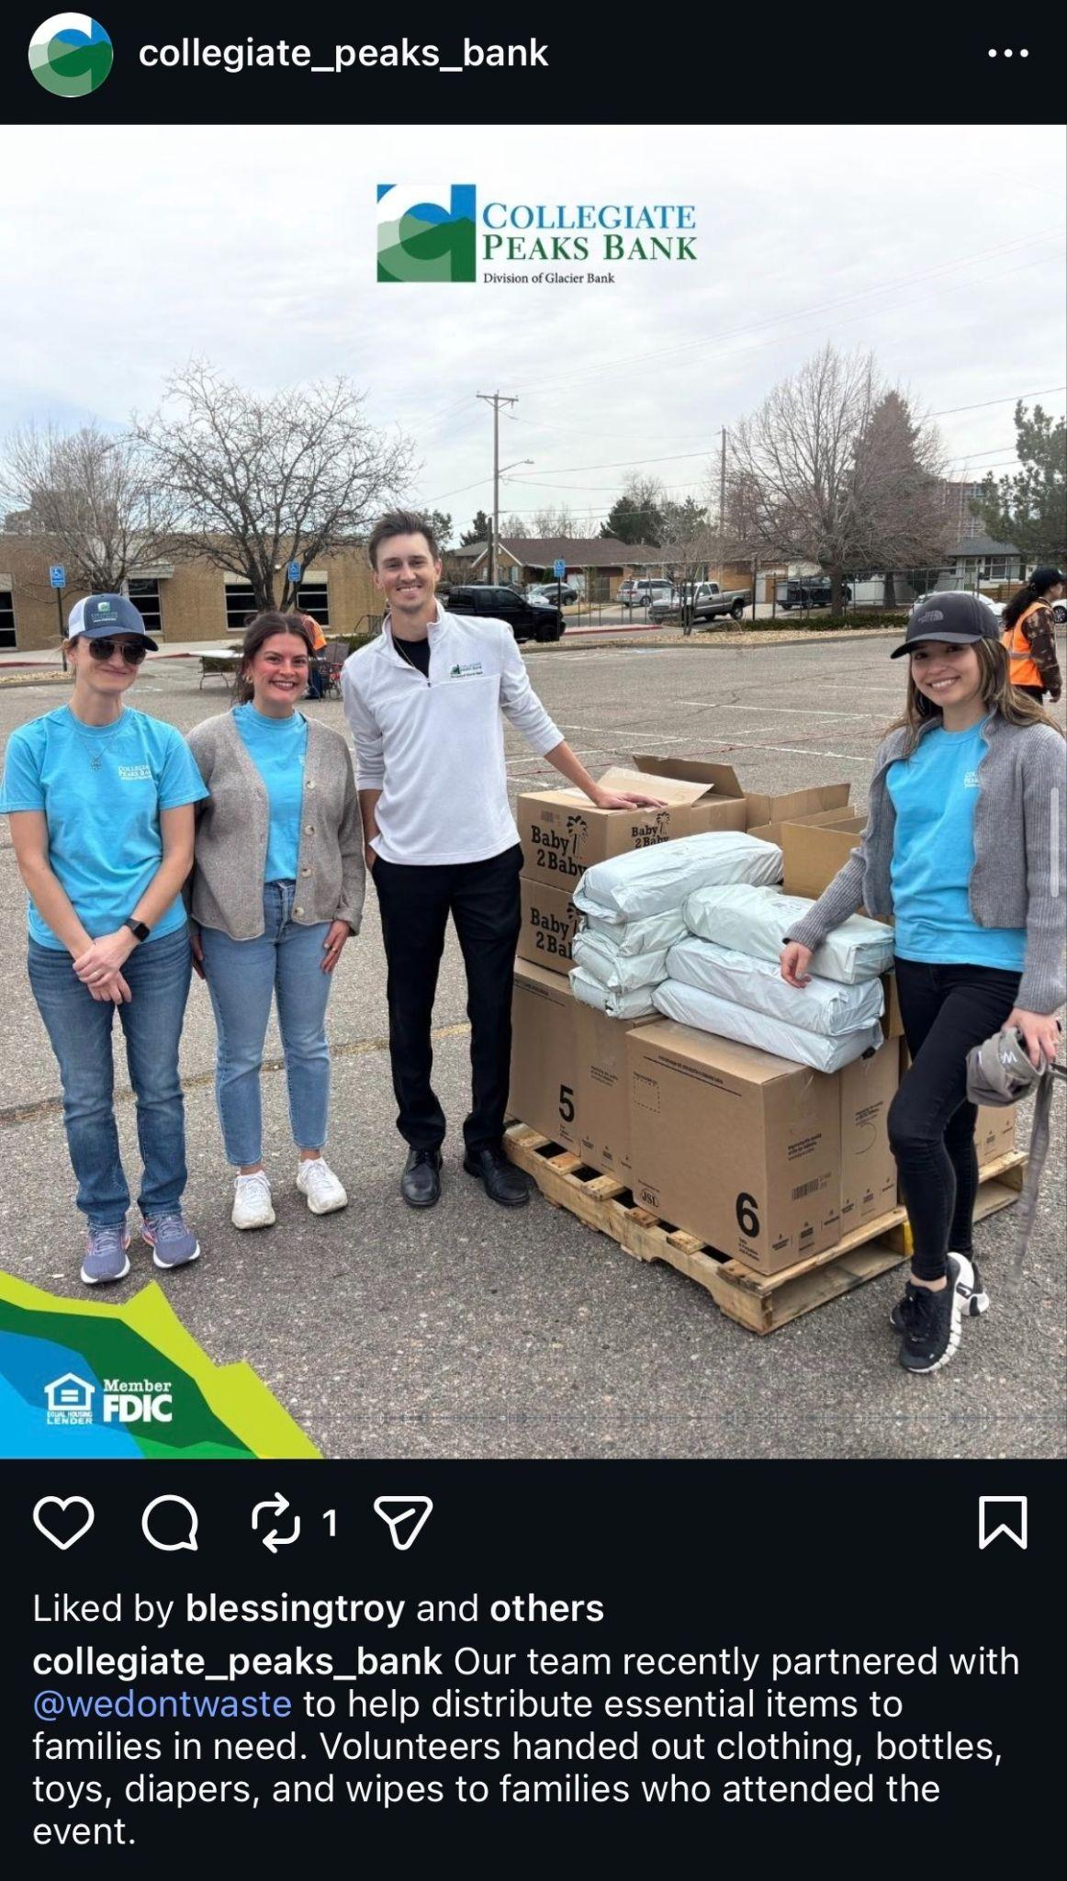
Visuals Matter
Stop the scroll
Real photos > polished graphics
Makes content memorable
Continually builds trust
Notes:
How many of you wish you had better photos from last month’s events? How many of you have had to post a stock photo or graphic because you didn’t have a photo from the event?
We live in a visual-first world. Social, TV, digital, even billboards — all of them lean on images to stop the scroll. That’s why authentic photos of your people and community are so much more powerful than polished stock photos. When people see themselves in your stories, they pay attention.

Slide 15
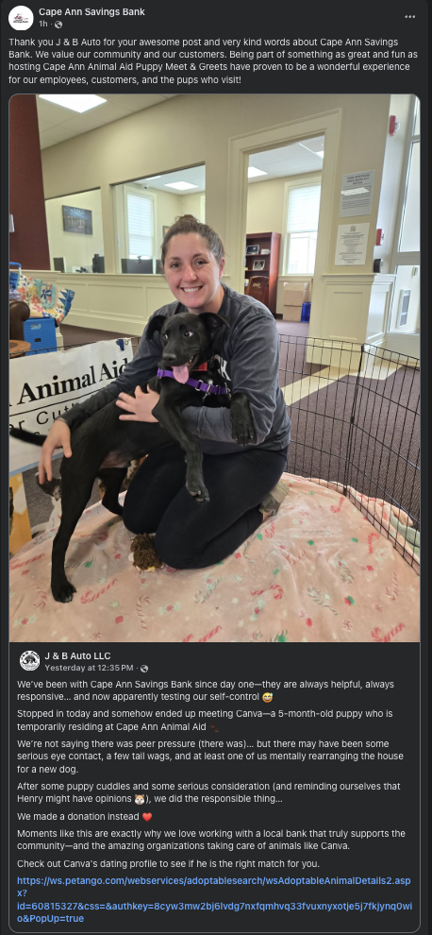
The best content isn’t the content you create from scratch.
Notes:
Re-sharing partner posts. Being tagged in sponsorships. Customers talking about you.
If someone else is telling your story, amplify it!

Slide 16

Actionable Tip
Before posting, ask:
Who is this for?
Why would they care?
What’s the “why”?
Is there a human angle?
Would I stop scrolling?
Does this support a business goal?

Slide 17
2.
Planning
& Sourcing Content
Notes:
How to Get Great Content Without Doing It All Yourself

Slide 18


Why Content Feels Hard
Stories live in silos across the organization
Every department thinks they’re the priority
“Can you post this real quick?”
You’re chasing content instead of planning it
You have to prove the ROI

Slide 19
AI Can Help You Scale
Use AI to streamline–not to create the story.
Drafting captions from raw notes
Repurposing content (blog → email → posts)
Brainstorming content ideas
Generating content requests & photo prompts
Notes:
In today’s society, it’s natural for us to turn to AI for help. And there’s times when that is ok. Reference the list. So, use it for some of these things. But what I really want you to take away from today, is that you need to look at your role differently, and use what you already have at your disposal.
AI can polish the story, but your people are living it.
AI is incredible at helping you move faster… but it has never attended a community event, sat across from a borrower, or seen the impact your bank makes locally.
If you use AI to generate your content, it will feel generic.
If you use AI to refine your content, it becomes powerful.
AI doesn’t create trust.
Your people do.

Slide 20

Rethink your Role
It’s not about planning, creating, and thinking up every single piece of social media content.
It’s about sourcing and curating content from people across the organization–polishing it into effective, strategic, on-brand content.

Slide 21
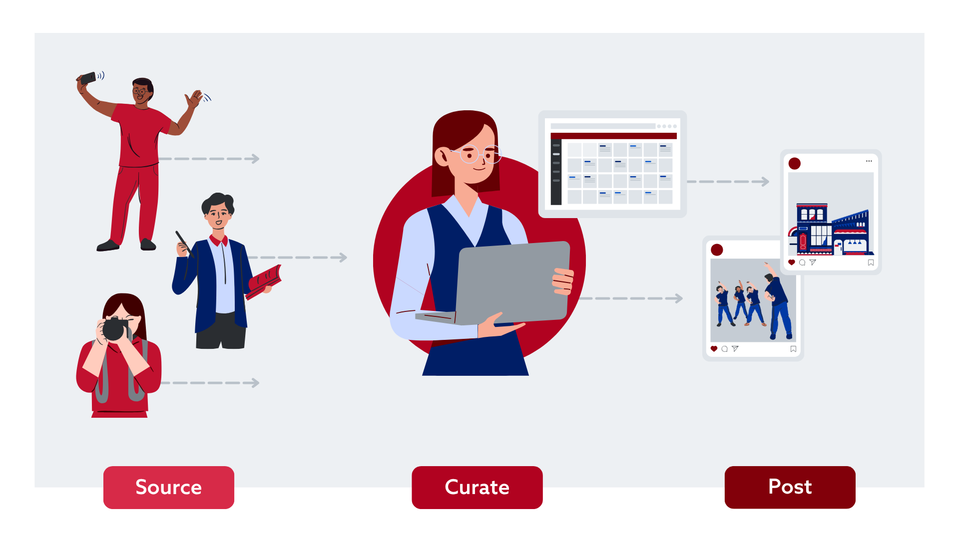
Notes:
JESS
Sourcing (photos, details, notes) → Curator (strategic, on-brand, values-aligned, thinking big picture, photo edits) → Smart, strategic socials (engaging, balanced, human, people/employees are proud and engaged)
You can’t just roll out there and say “hey people send me stuff.” You need to plan, you need to coach and guide them on what to capture.
You need impactful moments. Train people to see these moments and capture them!
Let’s take a picture of our teammates working on the structure, doing the thing. Not just a staged team photo in front the the Habitat Humanity sign.

Slide 22


Sources of Content
Your People | Community Involvement
Customer stories | Volunteerism
Employee spotlights | Board service
Event attendance | Sponsorships & donations
Branch happenings | Scholarships
History & leadership | Community events
Lender involvement | Financial literacy

Slide 23
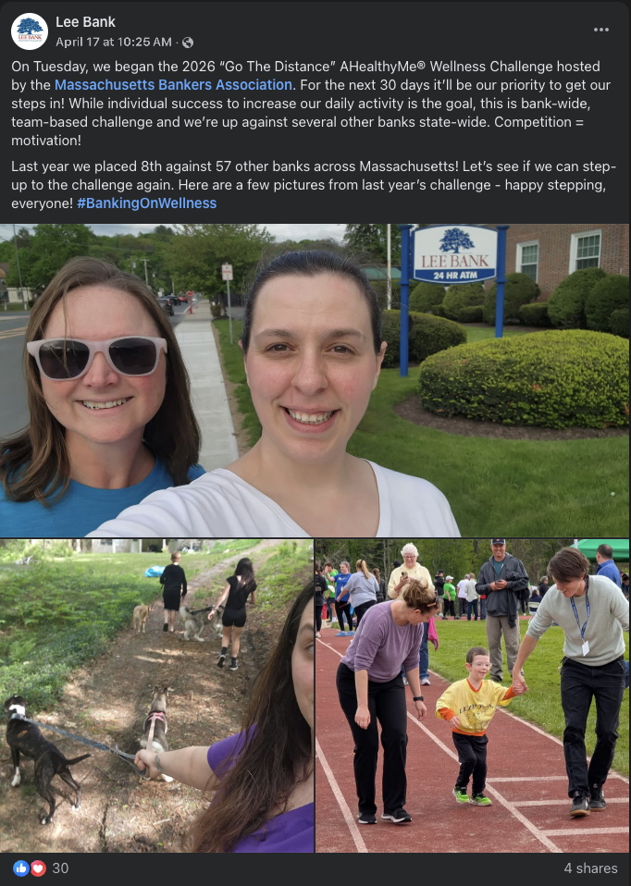
Start with Relationships
Identify content champions/liaisons
Stay in touch consistently
Build rapport before you need something
Notes:
This is about building relationships inside your institution. Get in with your branches, talk to your lenders, stay close to team members who are connected to the community. When they see you as a partner, they’ll share more stories with you.
When they see content they’ve collected creating impact on social, they’ll want to share it and give you more.

Slide 24

How to Actually Get Content from Others
Clear and specific requests;
share the vision with them
Coaching and guidance builds rapport and confidence
Streamlined process for submitting materials

Slide 25

Keep Content Flowing
Use their content
Be gracious
Celebrate them!
Notes:
People are far more likely to keep contributing if they know their content is valued and visible. Give them credit when their photos or stories make it online. Even a small shout-out at a staff meeting builds momentum.

Slide 26





Systems & Processes Are Key
→
→
→
→
1.
Task
2.
Photo Upload
3.
Create
4.
Approval
5.
Publish
& Archive

Slide 27
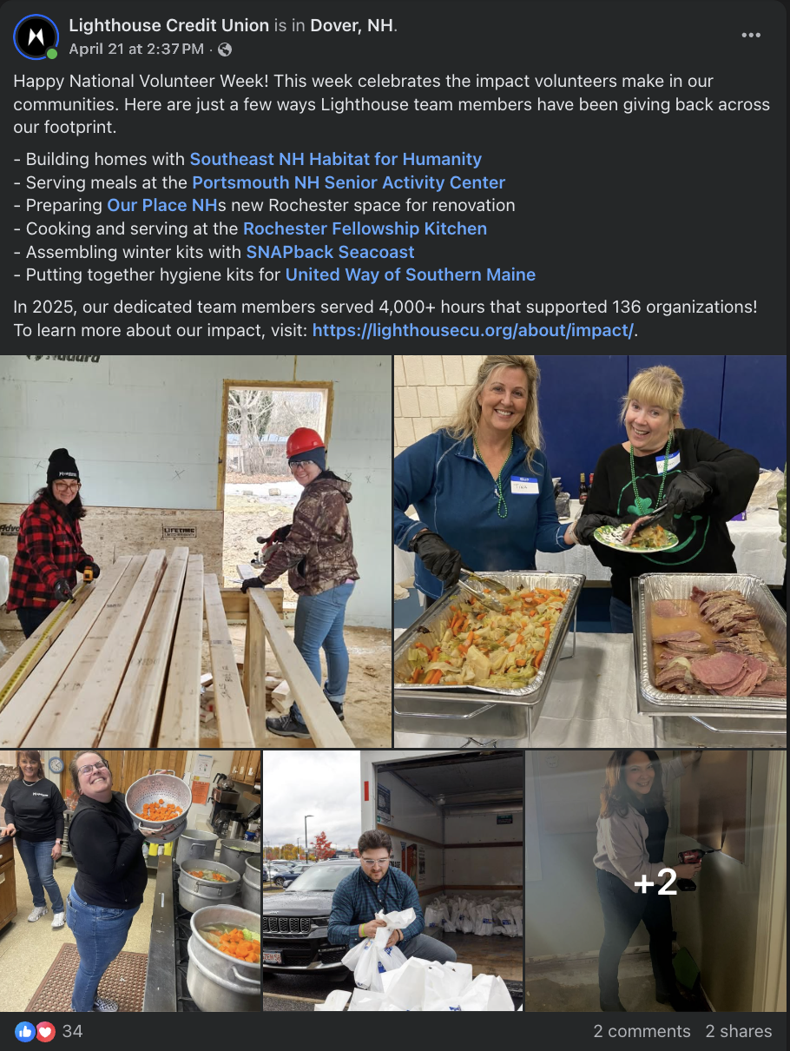
Content from
Give-Back Efforts
Volunteerism
Events
Board service
LMI loans
Donations
Sponsorships
Grants & scholarships
Financial literacy
Notes:
Authentic, human content doesn’t just come from big events—it’s in your day-to-day give-back efforts: volunteer hours, sponsorships, board service, LMI loans, scholarships. If you don’t capture it, those stories are lost opportunities.

Slide 28
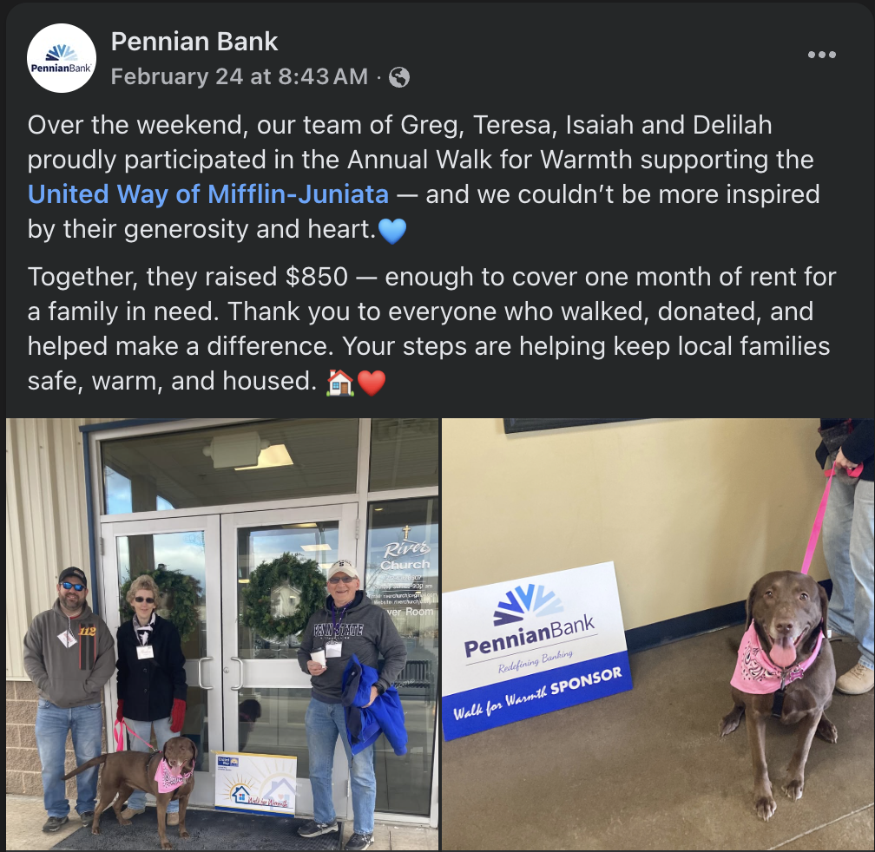
Impact Stories
Are Powerful
In addition to the data, we need context.
  What’s the local need?
  Why did this outreach matter?
Connect cause → action → impact
Notes:
Metrics are only half the story. You also need to explain why the effort mattered. What was the local need? Why was your involvement important? Connect the dots from cause → action → impact. Otherwise, the story stops at ‘we donated $5,000,’ and that’s easy to scroll past.

Slide 29
Actionable Tip
Send 3 emails this week:
Pick 3 employees
Ask one specific question:
“What’s something happening in your world in the next 30 days that we should highlight?”

Slide 30
3.
Tying Content to Business Objectives

Slide 31
Tying Community Content to Business Outcomes
Retail | School supply + winter coat drive
Consumer Accounts | Youth sports sponsorship + fundraising match nights
Commercial | Local employer spotlight + workforce story
Small Business | Buy Local Month: market/vendor features
Mortgage | Habitat for Humanity partnership; Homebuyer readiness night
Autos | Vehicle rehab program
Leasing & Finance | Scholarship program for entrepreneurs
Wealth Management | Local philanthropy + legacy giving series
Treasury Management | Fraud awareness partnership w/ small biz association
Notes:
BTW, this type of content also provides growth.

Slide 32
“Get more deposits.”
Notes:
“If leadership says, ‘Get more deposits’…
what does that actually mean for your content?”
This isn’t a marketing tactic. It’s a business objective.

Slide 33

The Directive-to-Content Framework
Which deposits?
Who’s the target audience?
What builds trust with that audience?
What content supports that journey?

Slide 34
Directive:
Target Audience:
What Builds Trust:
Strategic Content Ideas:
Get more
retail deposits
Young families
First-time savers
Local consumers
Financial education
Community visibility
Relatable life moments
Back-to-school
savings tips
“First account” stories
Youth sports
sponsorship recap
Financial literacy video
Employee spotlight helping a first-time homebuyer
Notes:
If leadership says, ‘Get more retail deposits,’ that doesn’t mean post a checking promo every Tuesday.
It means build trust with the people who open retail accounts.
Retail trust is built through consistency and education

Slide 35
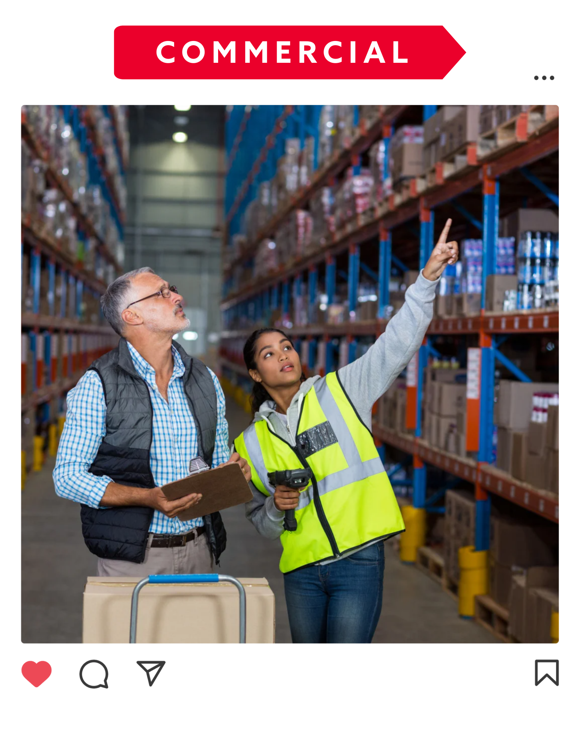
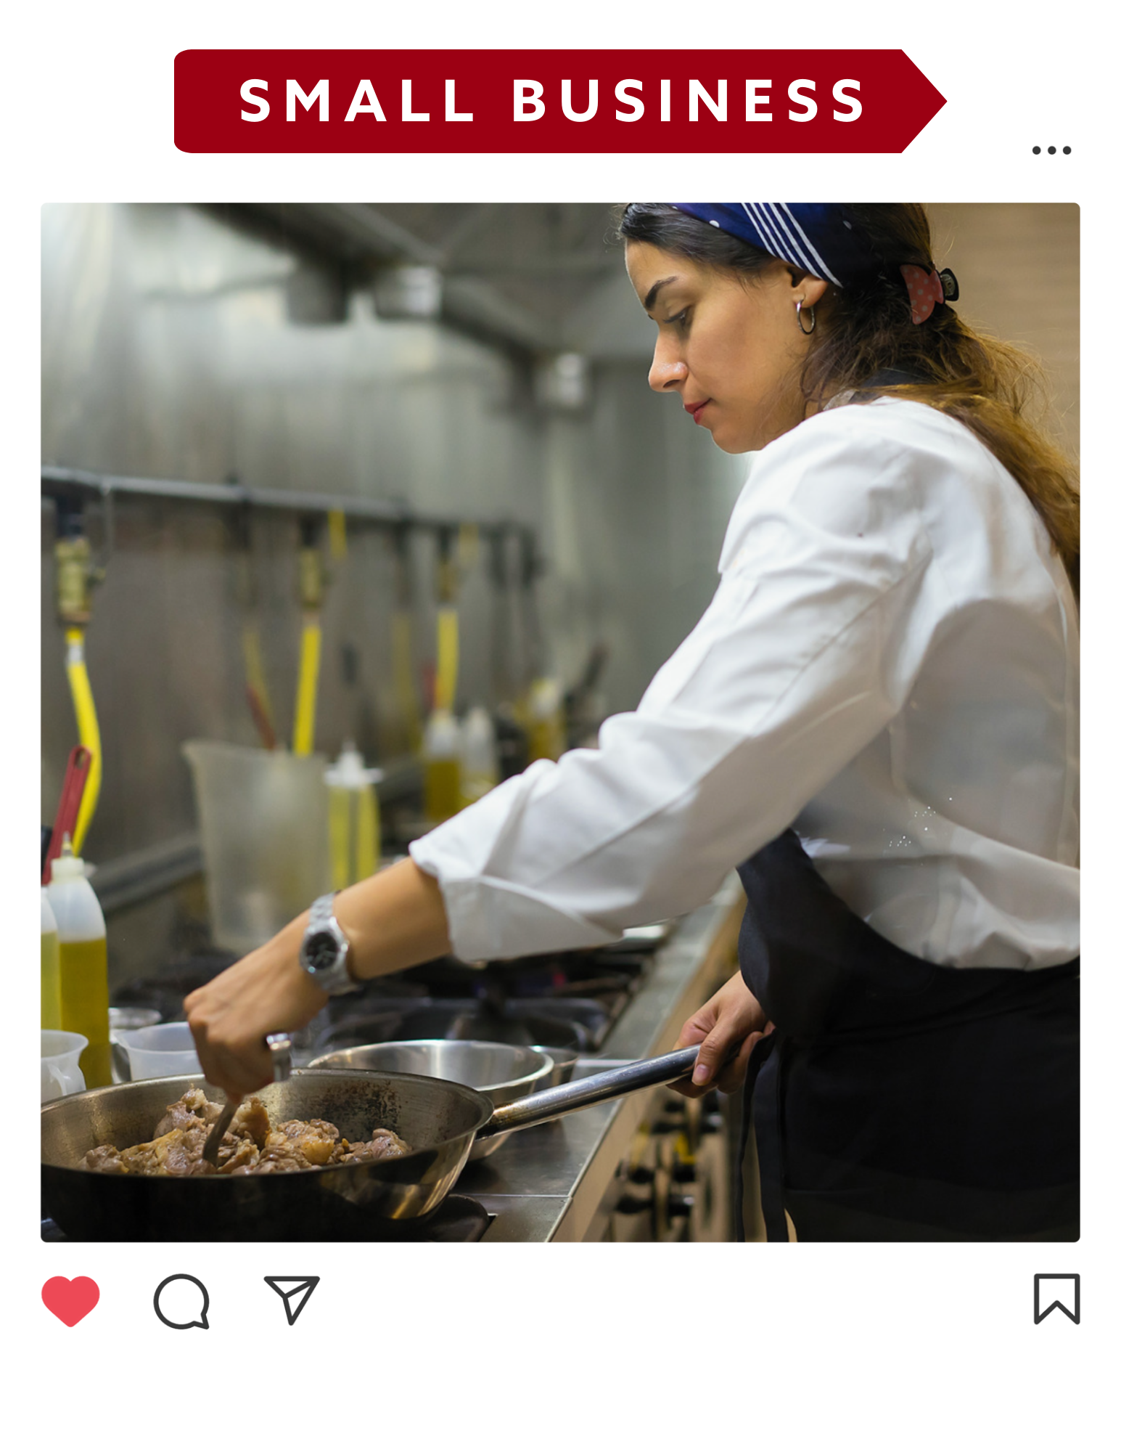
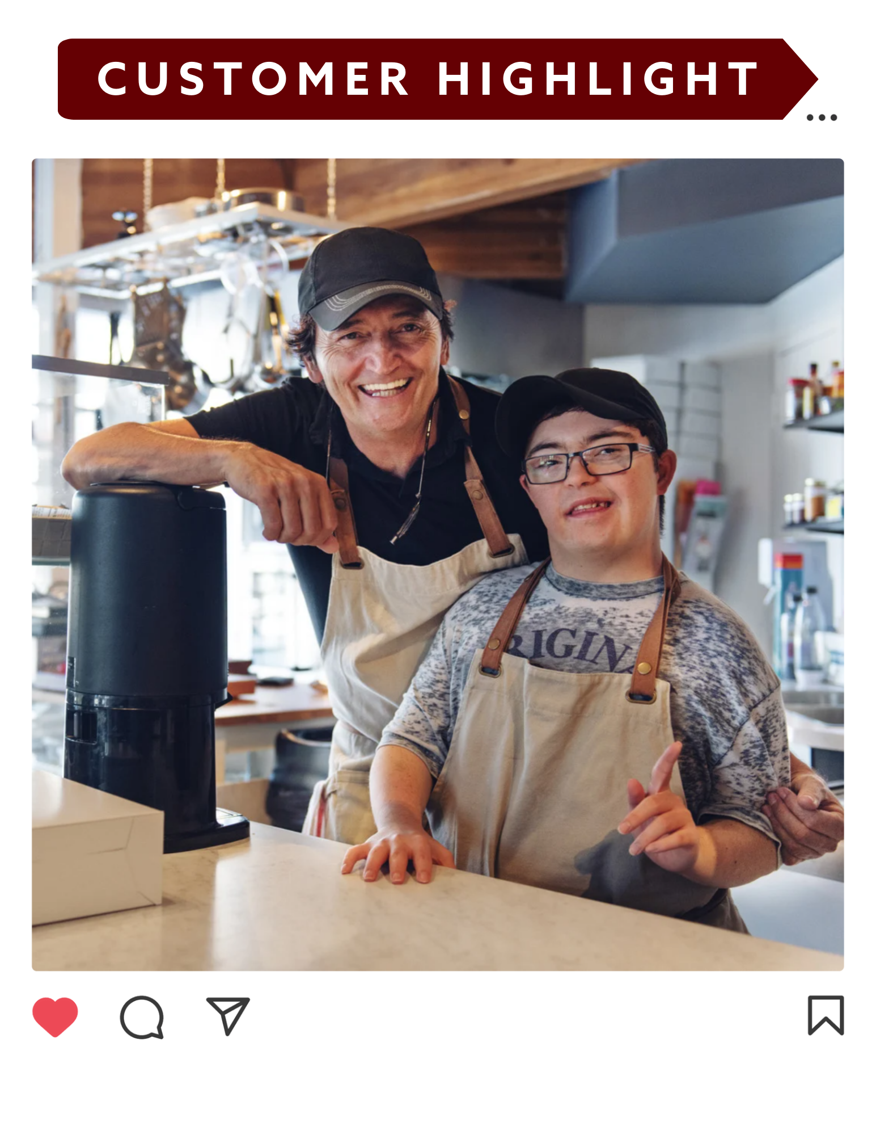
Labels & Proving ROI
Tag content by business line (retail, commercial, mortgage, etc.)
Track engagement by label
Show leadership what is resonating
Connect posts to strategic priorities
Notes:
If you can walk into a leadership meeting and say,
‘Our commercial content drove 38% of LinkedIn engagement last quarter,’
you are no longer just the social media person.

Slide 36
Actionable Tip
Audit your last 20 posts:
Label them.
How many aligned to a business line?
How many supported a growth priority?
What category drove the most traction?

Slide 37
Takeaways
Good content is human.
You don’t have to create everything! Source + curate.
Tie content to a real business goal.
Systems make it sustainable.

Slide 38



Resources
1
2
3
Sample Photo/Video List for Helping Your Team Capture Great Visuals
Content Request Templates: Asking for Photos & Context
Practical Content Ideas for Different
Business Lines

Slide 39

Connect on LinkedIn:
Jordyn Swanson
Client Growth & Relationship Manager
jordyn@socialassurance.com

