Slide 1

Traditional Cyber Defenses are
Being Bypassed Every Day
How To Defend Accordingly
Andy Boell
K-12 Cybersecurity Advisor

Slide 2

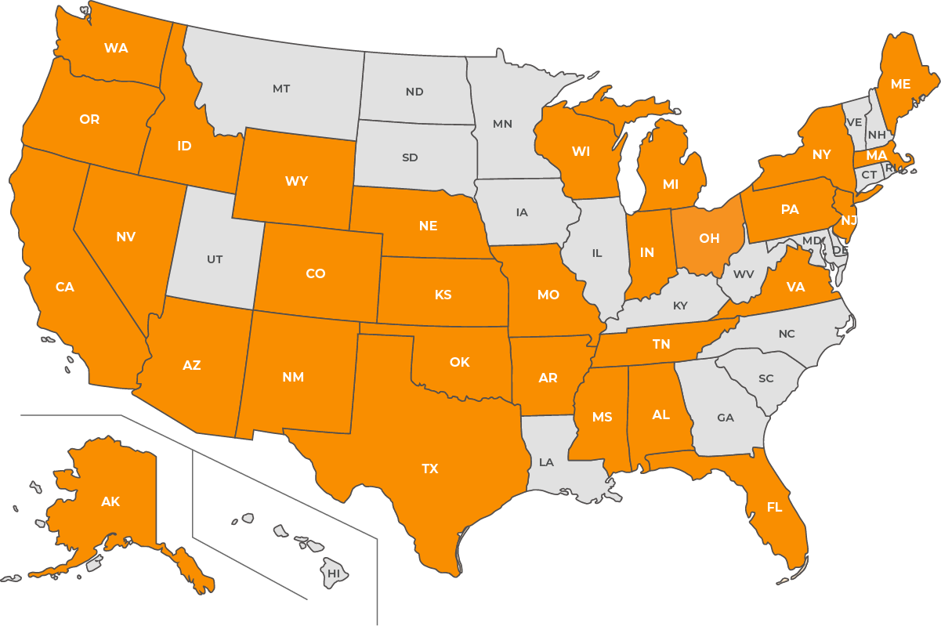
About Me
Why Lumu
Former Cybersecurity Director for Nebraska Cybersecurity Network for Education
20+ years in education
MS in Information Assurance and Computer Security & MS in Secondary Teaching
Certifications: A+, Security+, CC, CISSP and CCP*
6 kids, wife and dog
Cybersecurity Consultant, Midwest Cyber, LLC (www.midwestcyber.net)
Notes:
Before we dive in, I want to give you a quick sense of who we are and where we’re making an impact.
On the right, you can see a map highlighting the states where Lumu is already working closely with schools and districts. The darker orange shows where we’re engaged at a state level, helping entire education systems strengthen their cybersecurity posture. The lighter orange represents districts that are already active Lumu customers using our platform to detect, contain, and respond to threats in real time.
This footprint continues to grow every month, and what’s exciting is how we’re helping both large and small districts achieve the same level of visibility and control—without adding complexity or strain to their IT teams.
So whether it’s statewide education departments or individual districts, Lumu is already embedded in the K-12 community, helping protect classrooms across the country.

Slide 3



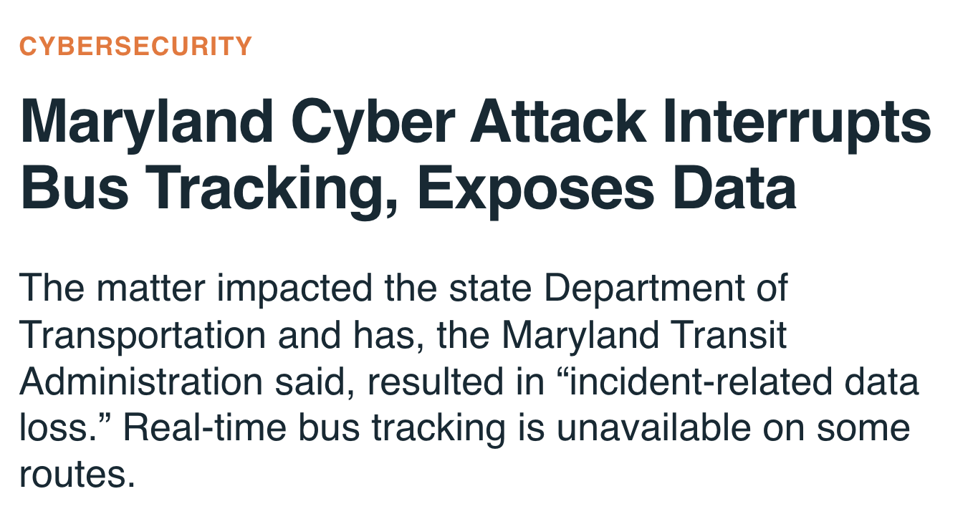
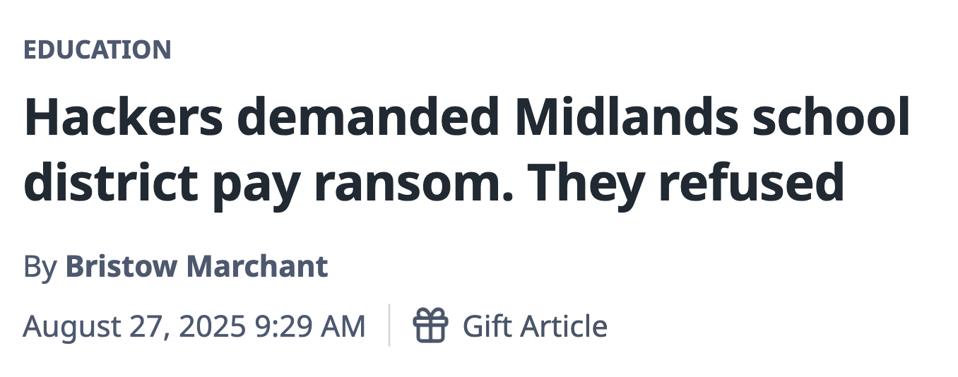
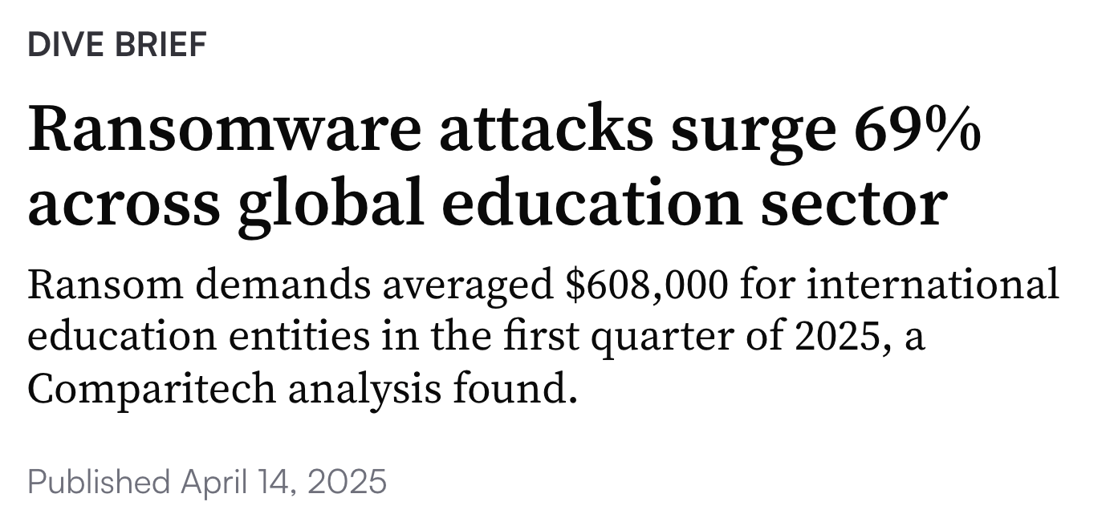
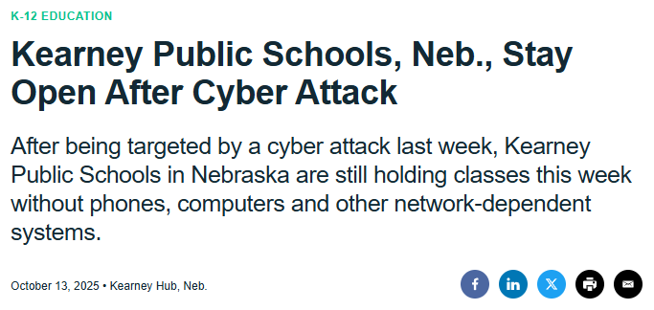
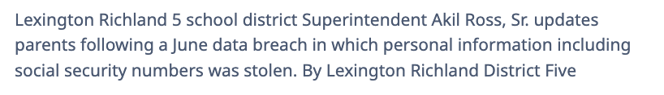

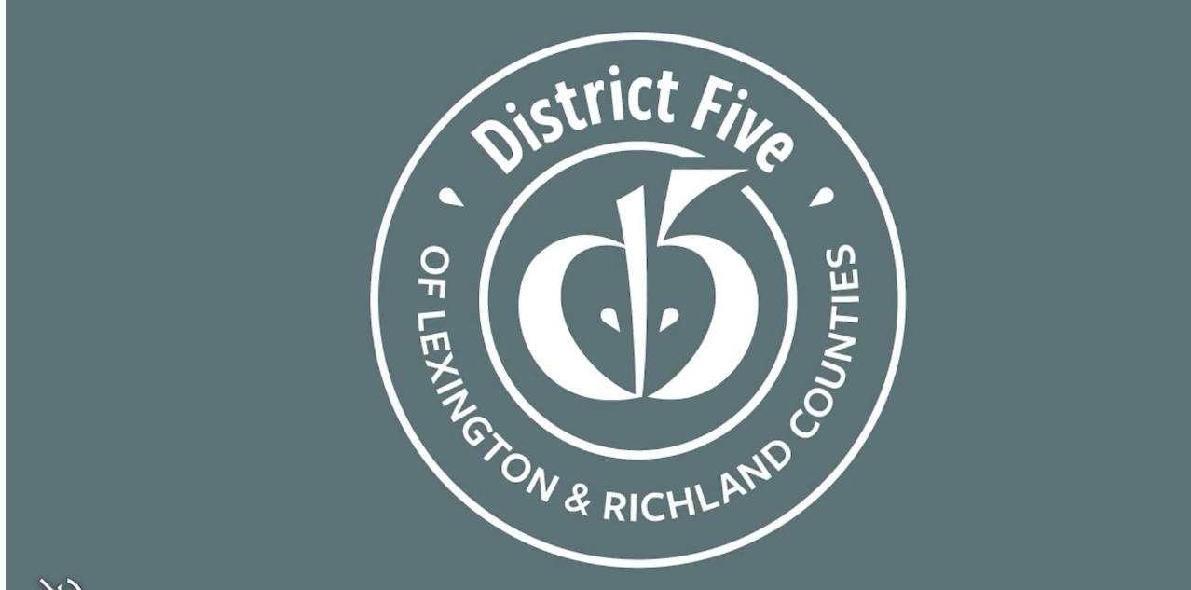
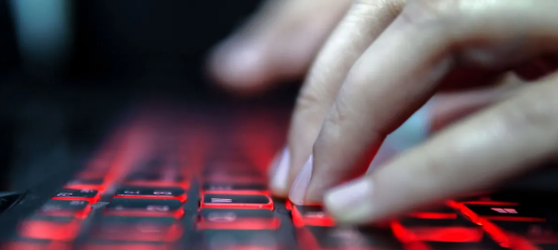

K-12 Cyber Threats Are on the Rise
Notes:
1 - Kearney Public Schools - experienced a cyber attack. Disrupted network connectivity, but school remained in session.
2 - Maryland Transit Administration - ransomware attack with data exfiltration of PII. Attackers are demanded a 30 Bitcoin payment.
3 - Lexington Richland 5 - a ransomware attack that originated from a phishing email.
4 - 2025 Q1 Stats - education ransomware attacked increased by 69%. Ransoms averaged $608,000. This is a reflection of how cyber attacks are targeting schools.
Transition statement: Part of the bigger problem, educational institutions are being targeted, why?

Slide 4

Why Are Schools Being Targeted?
1
Vast networks with large attack surface
Perceived ability and willingness to pay ransoms
Limited staff and budget
Schools ‘under the radar’ of large cybersecurity firms
Student data is valuable for identity theft
2
3
4
5
Notes:
What makes education a particularly big target for criminals?
Schools have become a growing target for cyberattacks, and it’s not hard to see why.
Most school districts manage vast networks with hundreds or even thousands of devices, creating a large attack surface that’s hard to secure. Attackers also know that when operations are disrupted, schools feel pressure to pay ransoms quickly just to get back to teaching.
On top of that, limited staff and tight budgets make it difficult to maintain strong defenses. Many schools also fly under the radar of large cybersecurity vendors, meaning they don’t always get the same level of protection or attention as big enterprises.
And perhaps most concerning, student data is incredibly valuable for identity theft. It can be used to open credit accounts or build false identities, and because students are young, it often goes undetected for years.
That combination makes schools a prime target, which is why strengthening their defenses has never been more important.
Transition statement: We know why schools are being targeted but how?

Slide 5

How Do Cybercriminals Get In?
“
The biggest threats these days are engineering people to click on things that they shouldn’t. You have foreign states like North Korea and Russia trying to extract information or wealth."
Matt Powers
Information Systems Director
Harding Academy
Notes:
So now that we understand why schools are being targeted, the next question is—how are attackers actually getting in?”
As Matt Powers from Harding Academy explains, one of the biggest threats today isn’t a technical flaw—it’s human behavior. Cybercriminals are constantly engineering people to click on things they shouldn’t. Whether it’s a fake email, a malicious link, or a file that looks like it came from a trusted source, social engineering remains the number one way schools are compromised.
And it’s not just random hackers anymore. We’re seeing organized groups and even state-backed actors exploiting those same tactics to extract sensitive data or financial information.
This is a reminder that even the best technology can’t fully protect a district if people aren’t aware and equipped to spot these tricks. That’s why cybersecurity in schools has to focus just as much on people and process as it does on tools.
Transition statement: Let’s take an even deeper look into the top threat types that are impacting schools.

Slide 6
Top Threats Impacting Schools

Slide 7
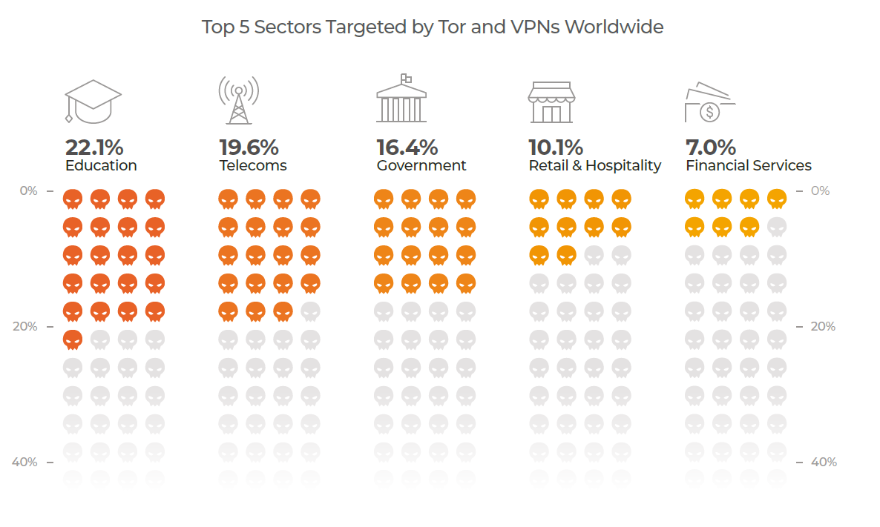
Many School Breaches Are Anonymous
Notes:
Data from 2026 Compromise Report
Attackers use anonymization services to establish covert communication channels, mask their true location, and exfiltrate data.
While not intrinsically malicious, services like Tor and private VPNs pose a critical visibility challenge, blinding administrators to potential threats.
In a normal work environment there is not often a legitimate need for anonymizers, so we can assume that a high percentage were malicious.
This widespread use of legitimate, encrypted tools to hide malicious activity is a key reason why traditional, signature-based defenses are failing.

Slide 8
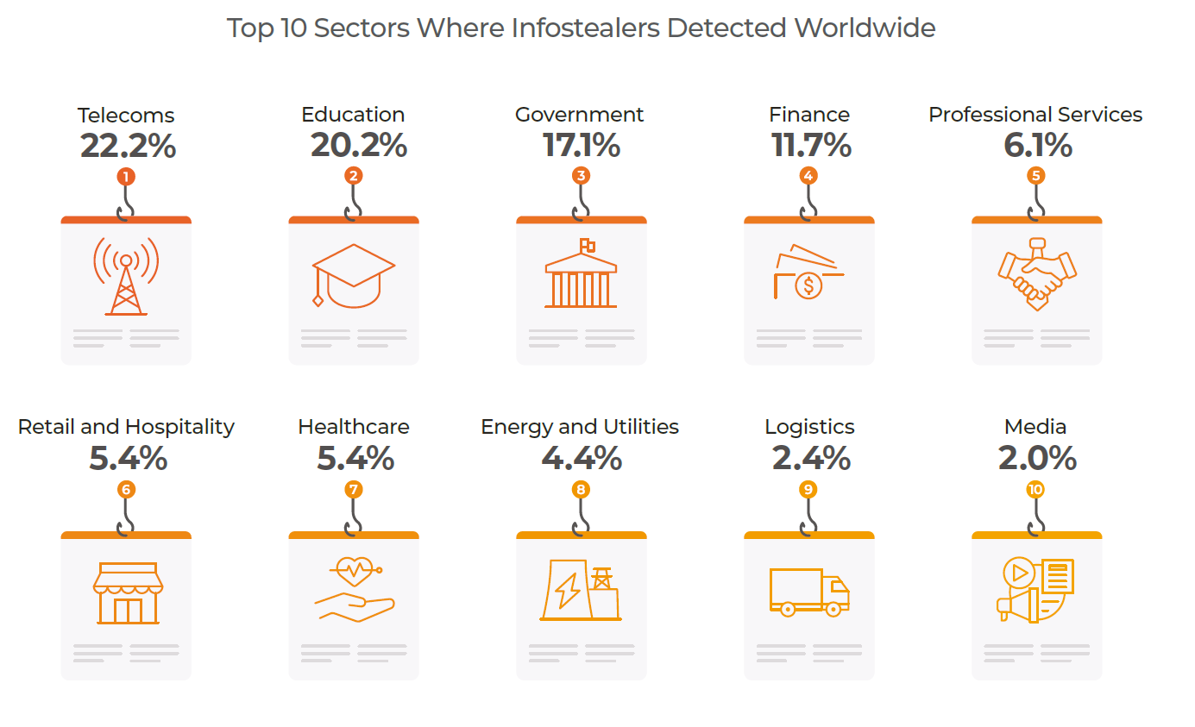
Infostealers Target Schools And Students
Infostealers by Sector
Notes:
Data from 2026 Compromise Report
Infostealers are spyware designed to steal sensitive information. This includes logins, bank details, and personal data, which is then often sold on the dark web. Attackers buy that data to speed to break into a network and proceed directly to their main objective.
The information that infostealers gather is used in many attacks, such as ransomware and stealing from cryptocurrency wallets. It can also increase the impact of attacks, as it gives defenders less time to respond.
Infostealers work quietly and often avoid detection by Firewalls, EDRs, by running only in the computer’s memory, as well as other techniques.
By avoiding initial detection, infostealers can explore a system more deeply. They can gather things like detailed system info, private user data, and internal network details. This provides a strong foothold for further attacks.
Transition statement: Infostealers is a problem but the bigger problem is the ultimate goal here, which is ransomware.

Slide 9
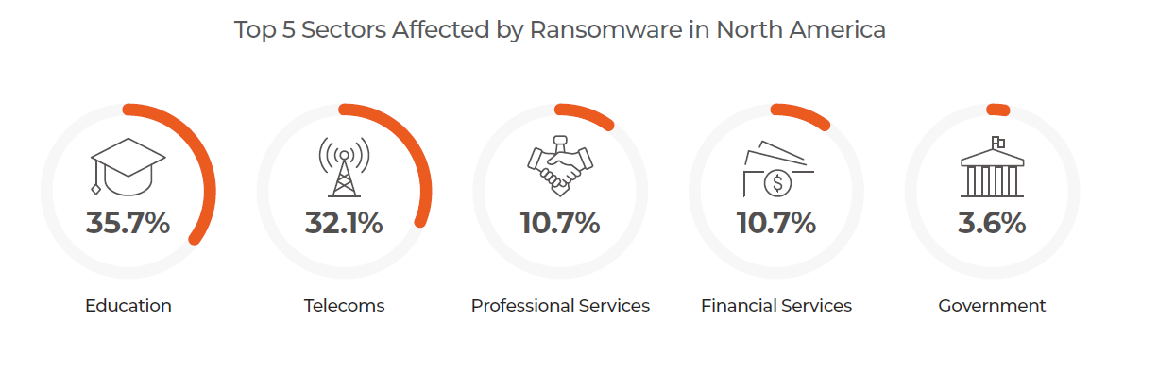
Ransomware Gangs Are Targeting K-12
Sectors Most Affected by Ransomware
Notes:
Data from 2026 Compromise Report
Lumu has consistently observed that Education is the top sector hit by ransomware.
Ransomware gangs tend to target sectors where they can cause maximum disruption.
The impact on students’ education and a schools’ reputation increases the probability of a ransom payment and often allows attackers to demand higher amounts.
An attack may start with a single deceptive email. The user downloads a dropper that delivers an infostealer.
The data that is extracted from your network is sold on the dark web.
A criminal buys the access credentials and delivers ransomware.
The successful attack locks you out of your system and demands a ransom be paid or the data will be deleted or released
Transition statement: Now let’s zoom in a little further an understand how some of the more technical threat types are targeting schools.

Slide 10
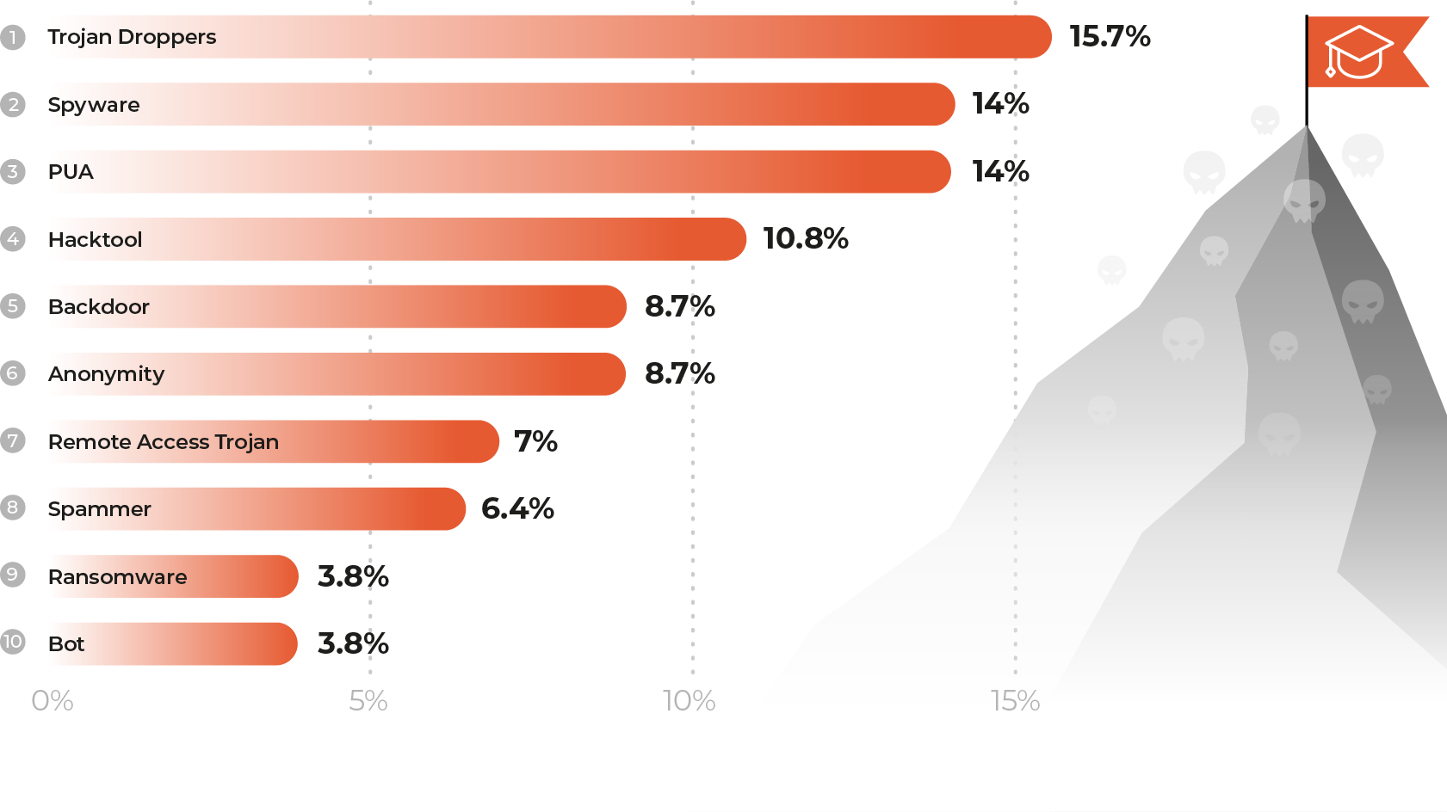
Threat Types Targeting Schools
Top 10 Threat Types Affecting the Education Sector in the USA
Notes:
Data from 2026 Compromise Report
Trojan droppers are the most common, accounting for over 15% of detections. These are pieces of malware designed to deliver other malicious payloads — think of them as the delivery trucks of cyberattacks. Once they’re inside a school’s environment, they can quietly install ransomware, backdoors, or credential stealers without triggering obvious alarms.
Next, we have spyware, which makes up about 14% of the threats. Spyware is all about monitoring users — collecting data like credentials, browsing activity, or even student information. In an education setting, this can lead to serious privacy concerns and data breaches.
The third is PUAs, or potentially unwanted applications, also around 14%. These aren’t always outright malicious, but they often introduce risk — browser extensions, free tools, or utilities that students or staff might install can open the door to tracking, ads, or vulnerabilities that attackers later exploit.
Together, these top three categories show that the biggest risks for schools today aren’t just big headline-grabbing ransomware events — they’re the everyday stealthy threats that quietly slip into student and staff devices, gathering information or laying the groundwork for bigger attacks.
Transition statement: So now that we know the top threats impacting schools, how are they actually getting in and taking control?

Slide 11

Attackers Are Exploiting Modern School Environments and Technologies
Smart classrooms
Big networks
Remote devices
Internet of Things
Use of new technologies
Evasion of existing defenses (Firewalls, EDRs)
Notes:
When we think about how attackers are getting into schools today, it’s rarely through a single, dramatic breach. It’s through the everyday technologies that make modern education possible.
Smart classrooms, remote devices, big networks, and all the IoT and cloud systems that connect students and staff. These are amazing tools, but each one expands the attack surface. Attackers know that as districts modernize, there’s often limited visibility across all those connections.
What’s most important to realize is that many of these attacks never have to ‘break through’ the firewall at all. They simply go around it. Whether through a compromised Chromebook at home, a cloud app that isn’t monitored by perimeter defenses, or a phishing link that creates an outbound connection, they’re already operating beyond what the firewall can see.
This shift is critical. Firewalls and EDRs still matter, but attackers have evolved. They’re exploiting the new ways schools connect and collaborate and that means our visibility and defenses have to evolve too.
Transition statement: Evasion of existing tools is a big issue because attackers will do what they have to do to take control.

Slide 12
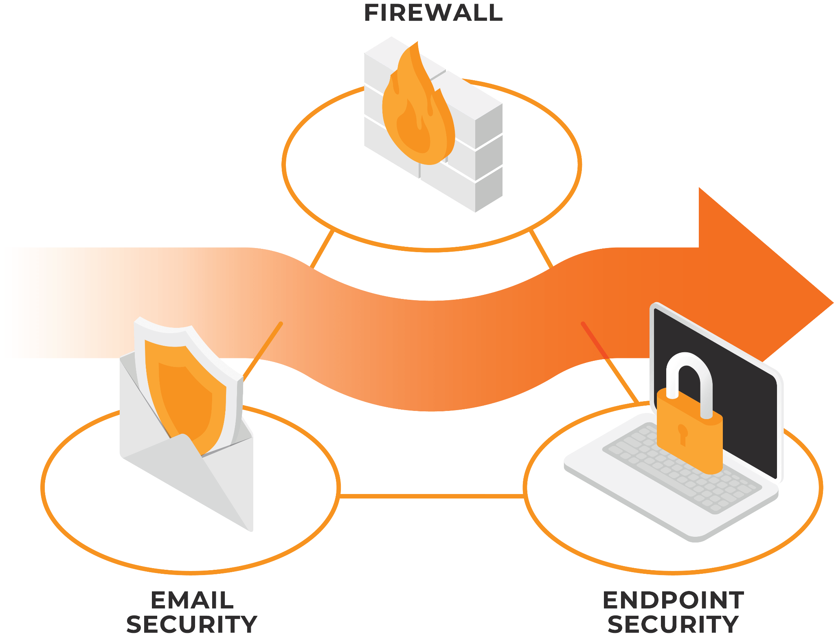







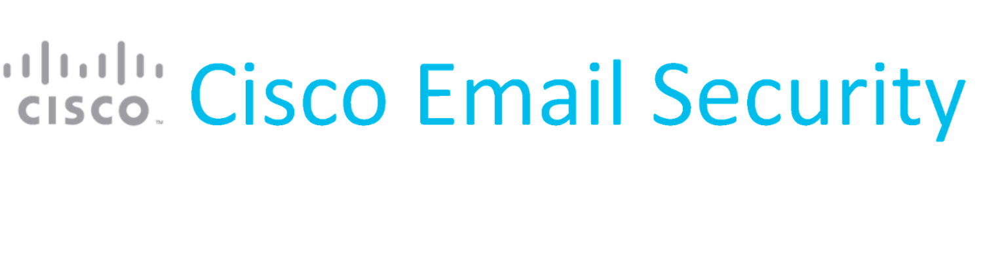
Attackers Know How to Evade Your Cyberstack
CVE-2024-24919
CVE-2024-22394
CVE-2023-20198
CVE-2024-21762
CVE-2024-3400
Advanced Phishing Techniques
EDR Bypass Kits
Frameless BITB
Awesome EDR Bypass
CVE-2024-21410
CVE-2023-2868
Defense Evasion Techniques
VOIDGATE
DV_NEW
CVE-2022-20798
Notes:
Even with the right tools in place such as email security, endpoint protection, and a firewall, attackers continue to find ways to move through or around them.
The firewall is still seen as the main line of defense, but attackers no longer need to break it. They take advantage of the traffic it’s designed to trust, like outbound connections, cloud applications, and remote users, to quietly operate inside the environment.
Even leading vendors such as Cisco, Palo Alto, Fortinet, and Check Point have experienced recent vulnerabilities. These are well-managed systems, yet a single new CVE or missed configuration can create an opportunity for attackers.
When combined with advanced phishing and endpoint bypass kits, adversaries can move laterally across the stack, slipping past one layer while the others remain unaware.
This is why visibility beyond the Firewall EDR and email is essential. Perimeter defenses alone cannot stop threats that use trusted channels. The challenge today is not only preventing attacks at the edge but detecting them once they are already inside.
Transition statement: It’s not just my word for it, you see it in the news every day.

Slide 13


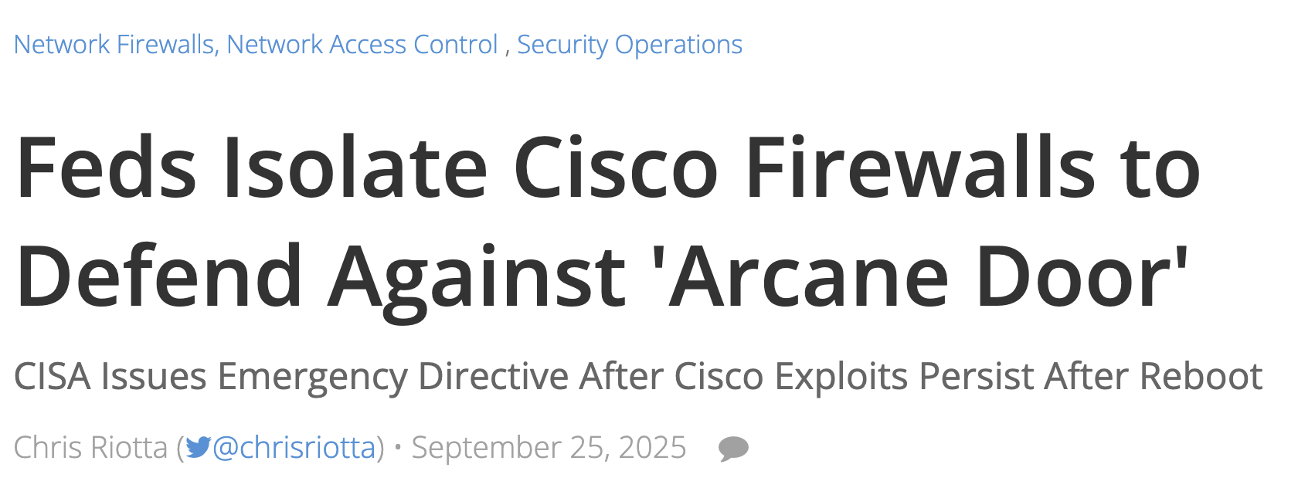
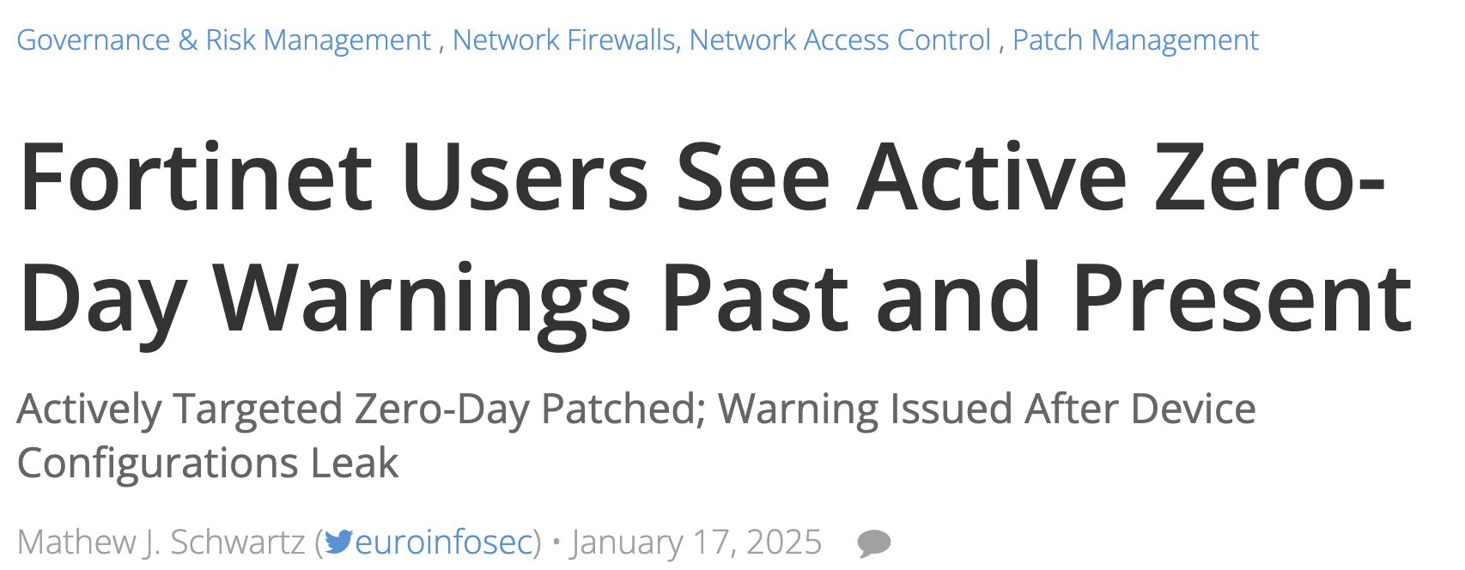
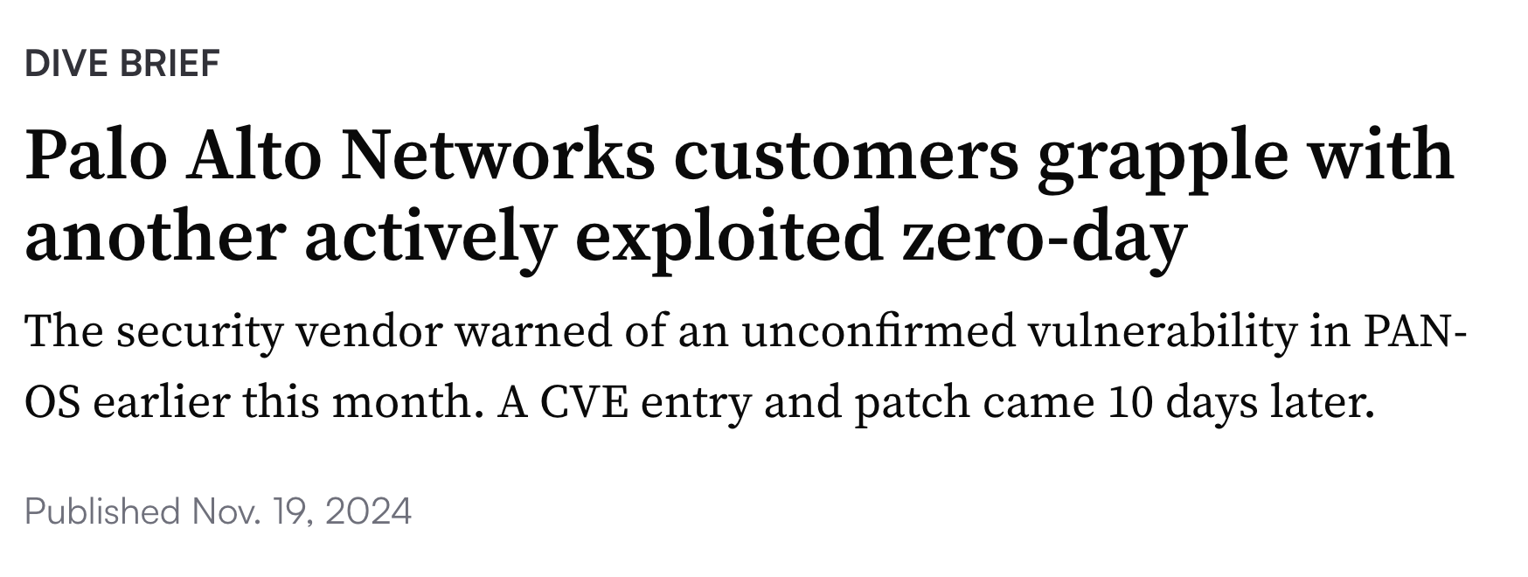

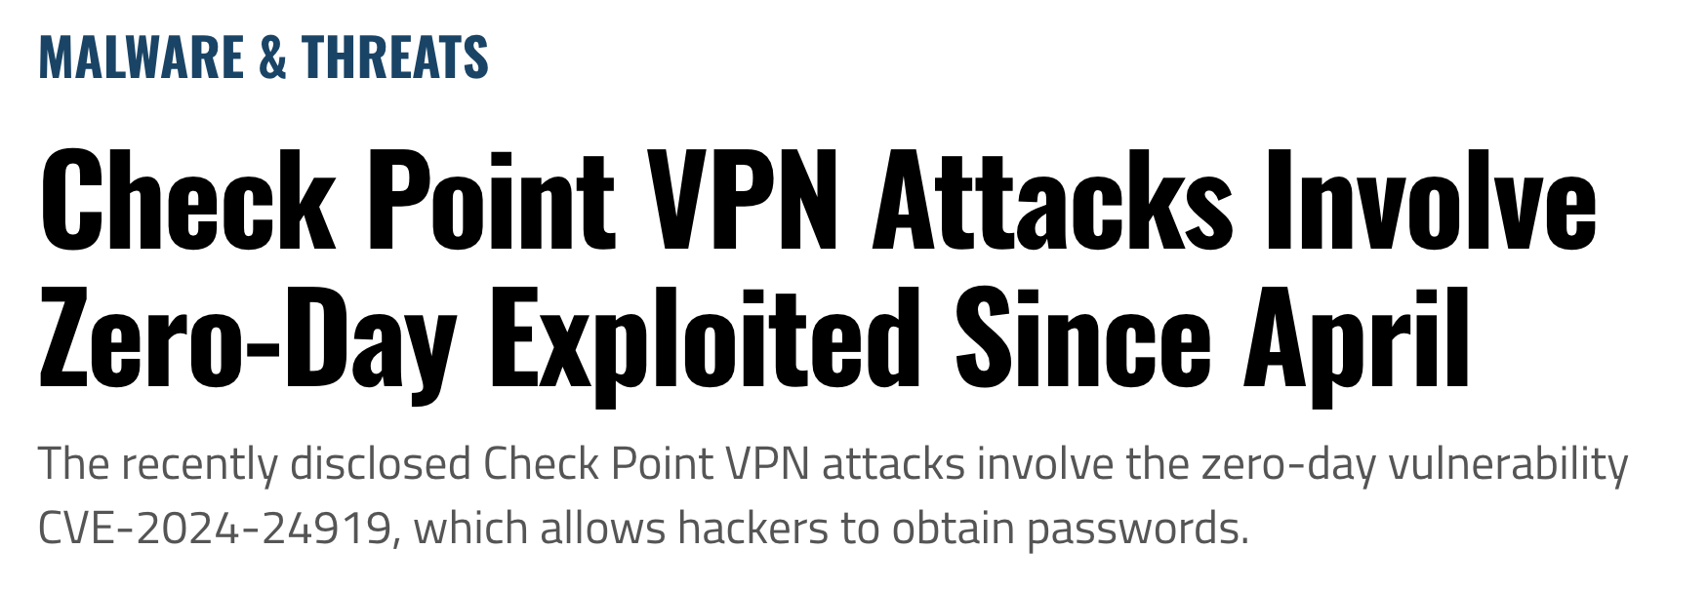
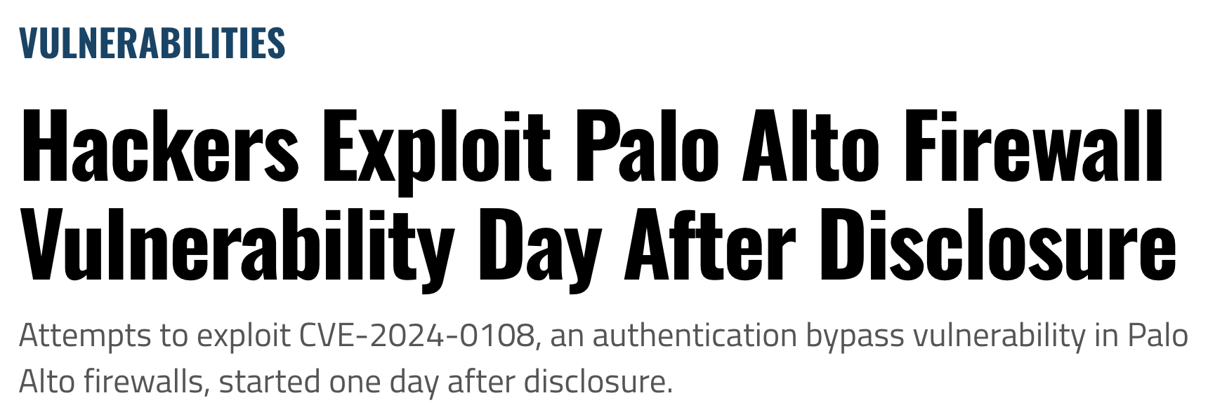
Firewall Vulnerabilities - In the News
Notes:
If this feels theoretical, it’s not. These are headlines from just the last few months showing how frequently firewalls are being exploited.
Cisco, Fortinet, Palo Alto Networks, Check Point — all major players — have faced zero-day vulnerabilities that were actively exploited, in some cases within hours of public disclosure.
The firewall was built to be the gatekeeper, but attackers are now finding and weaponizing weaknesses in that gate faster than ever. They don’t need weeks or months to prepare; they act immediately, knowing that patch cycles in schools and public institutions take time.
The takeaway is simple: relying on the firewall as the single point of control is no longer enough. When attackers can use trusted channels or unpatched vulnerabilities to walk right past it, visibility into what happens after that point becomes essential. That’s the only way to know when your ‘trusted traffic’ has turned against you.
Feds Isolate Cisco Firewalls to Defend Against 'Arcane Door'
This headline captures the severity of the state-sponsored 'ArcaneDoor' campaign and the official U.S. government response, highlighting the critical nature of the threat.
Fortinet Users See Active Zero-Day Warnings Past and Present
This title effectively communicates the unique dual crisis Fortinet faced: a new, actively exploited zero-day vulnerability and a simultaneous data leak from a past breach, illustrating the long-term risks of security debt.
Palo Alto Networks customers grapple with another actively exploited zero-day
This headline speaks to the relentless pressure on a major vendor and its customers, covering the widespread 'Operation Lunar Peek' campaign that involved a chain of vulnerabilities.
Check Point VPN Attacks Involve Zero-Day Exploited Since April
This is a compelling story because it highlights the significant danger of zero-days that are exploited for an extended period before they are publicly discovered and disclosed.
The Fact that it is a VPN expands the story to other cybersecurity tools
Hackers Exploit Palo Alto Firewall Vulnerability Day After Disclosure
This headline illustrates the timeline between vulnerability disclosure and mass exploitation, a key trend for security teams to understand.
Transition statement: There are many ways attackers do this, here’s a look at some of the ways the firewall itself is bypassed.

Slide 14
Firewalls Can Be Bypassed
Some Common Techniques:
Payload Encoding and Obfuscation
Tunneling and Encryption
Source Port Manipulation
IP Fragmentation
HTTP Parameter Pollution (HPP)
Decoy Scanning
Notes:
Payload Encoding and Obfuscation: This technique alters the representation of a malicious payload to make it difficult for a Web Application Firewall (WAF) to recognize. Attackers use methods like Hex, Base64, or URL encoding to disguise malicious patterns, which may not be correctly decoded and inspected by the firewall. Attackers can also use polymorphic code, which changes its structure to avoid signature-based detection.
Tunneling and Encryption: Attackers can hide malicious traffic by encapsulating it within a legitimate, encrypted protocol. By using protocols that are typically allowed through firewalls, such as DNS, SSH, or VPNs, they can create a tunnel to bypass content filters and security inspections. For example, DNS tunneling exploits the DNS protocol to send non-DNS traffic over port 53, which is almost always open.
Source Port Manipulation: Firewalls are sometimes configured to trust traffic that originates from well-known, essential ports, such as port 53 (DNS) or port 80 (HTTP). Attackers can manipulate the source port of their packets to mimic legitimate services, tricking the firewall into allowing the malicious traffic to pass through its filters.
IP Fragmentation: An attacker can break up a malicious payload into multiple, smaller IP packets. A firewall that fails to properly reassemble and inspect these fragmented packets may allow them to pass through individually. Once they reach the target server, the packets are reassembled, delivering the full malicious payload.
HTTP Parameter Pollution (HPP): This method involves sending multiple HTTP parameters with the same name in a single request. Some firewalls may only inspect the first parameter, allowing a malicious value in a subsequent, duplicate parameter to be processed by the server.
Decoy Scanning: To hide the true source of an attack or scan, an attacker can spoof packets from multiple, random IP addresses known as decoys. The target's firewall or Intrusion Detection System (IDS) sees traffic from many different sources, making it difficult to identify the actual attacker's IP address.
Transition statement: firewalls are necessary, but they only solve a part of the problem, same goes for EDRs.

Slide 15
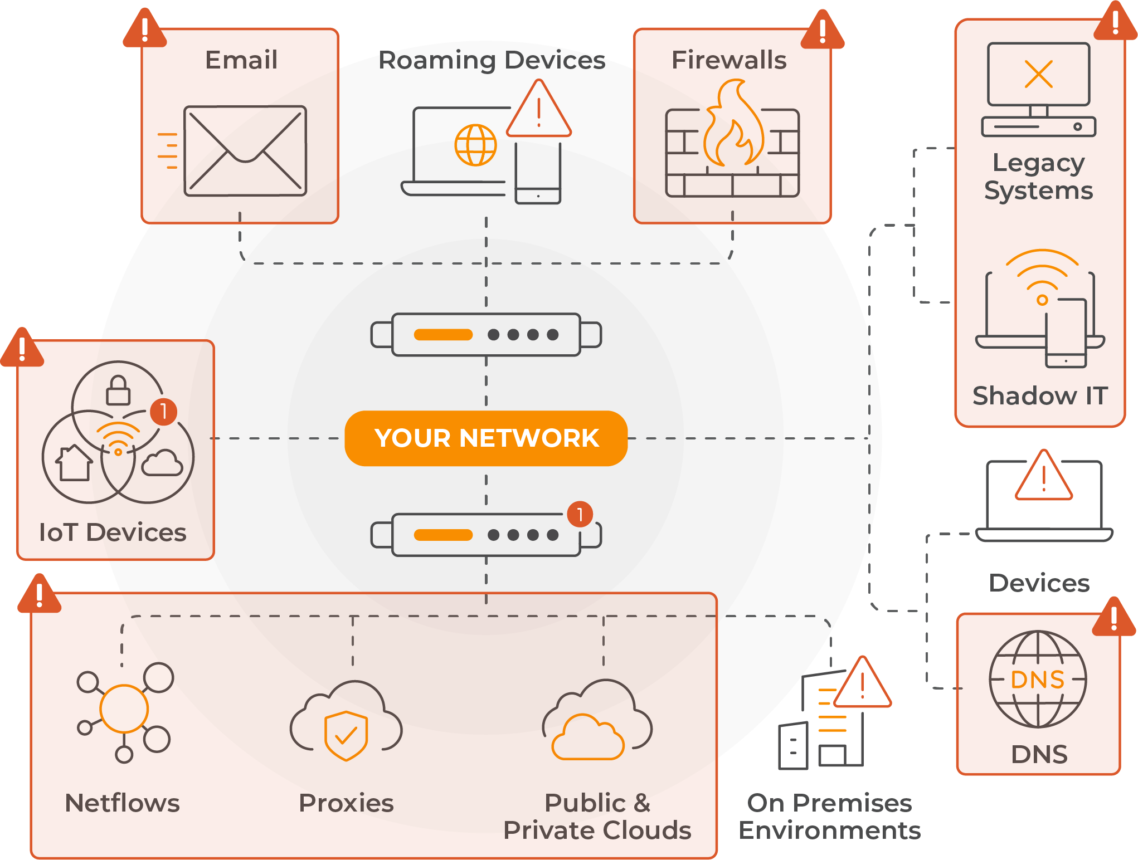
Attackers are Sidestepping Defenses
Limitations of the EDR
Notes:
Even with strong endpoint protection, attackers are finding ways around it. The reality is that not everything in a school environment is covered by an EDR.
Think about all the systems that make up a typical district like email platforms, IoT devices, student tablets, classroom smart boards, even legacy servers and personal devices. Many of these either can’t run an endpoint agent or fall outside of IT’s direct control.
Add to that roaming laptops, guest networks, and cloud applications, and suddenly you’ve got gaps attackers can slip through. They use these blind spots to move quietly across the network, often without triggering traditional security tools.
So while EDR is valuable, it only tells part of the story. To really understand what’s happening, you need visibility across the entire network, because that’s where attackers eventually have to go, no matter how they get in.
Transition statement: Now that we understand why this is all happening, what attackers are doing, and how they are doing it, let’s explore some practical solutions.

Slide 16
How Schools Can Respond
6 Ways To Win Against Cybercriminals

Slide 17

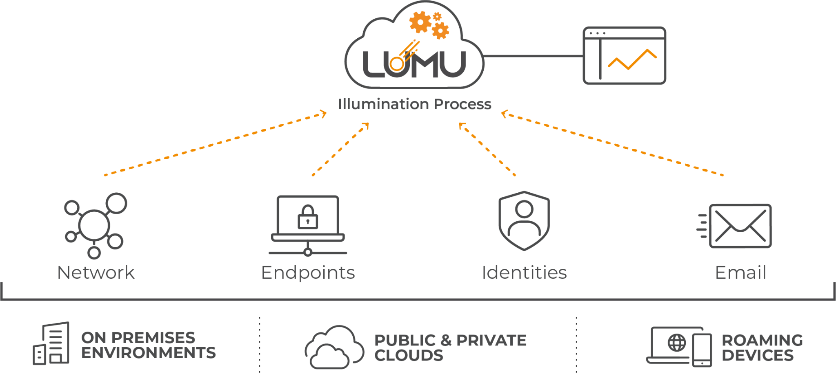
Evolve Visibility to Cover All Environments
STEP 1
Notes:
Attacks have evolved. They no longer live in one place or trigger one control. They span network traffic, endpoints, identities, email, and cloud services often at the same time. What has to change is visibility.
Instead of treating these as separate domains, Lumu brings them together through a single pane of glass. Network signals, endpoint activity, identity behavior, and email telemetry all feed into one place, where they can be correlated in real time.
The key point is that this works everywhere the business operates. On-premises environments, public and private clouds, and roaming devices are all covered without changing how the organization works.
By unifying visibility across these signals, Lumu makes attack behavior visible as it unfolds not after the fact and not tool by tool.
This is how you move from reacting to alerts to understanding compromise as a continuous state.

Slide 18





Analyze Your Emails & Spam
STEP 2
+1000
+1000
Notes:
The Untapped Potential of Analyzing Email and Spam for Cybersecurity
Tie-in: Phishing remains one of the key attack vectors as we saw earlier
Key Point 1: Traditional email security often stops at quarantining spam, creating a false sense of security. Attackers are motivated and persistent, leveraging the high ROI of cheap spam campaigns.
Key Point 2: Your spambox & email isn't just junk; it's a goldmine of threat intelligence. It reveals who's being targeted in your organization, how, and to what extent.
Key Point 3: With remote work becoming more common, perimeter-based controls are less effective. Email is just one attack vector, but it’s a critical one.
Takeaway: Don't just quarantine spam — analyze it. Turn what seems like noise into actionable insights. Make your spambox an asset, not an afterthought, in your cybersecurity strategy.
Transition statement: How can we really maximize the value of email data?

Slide 19
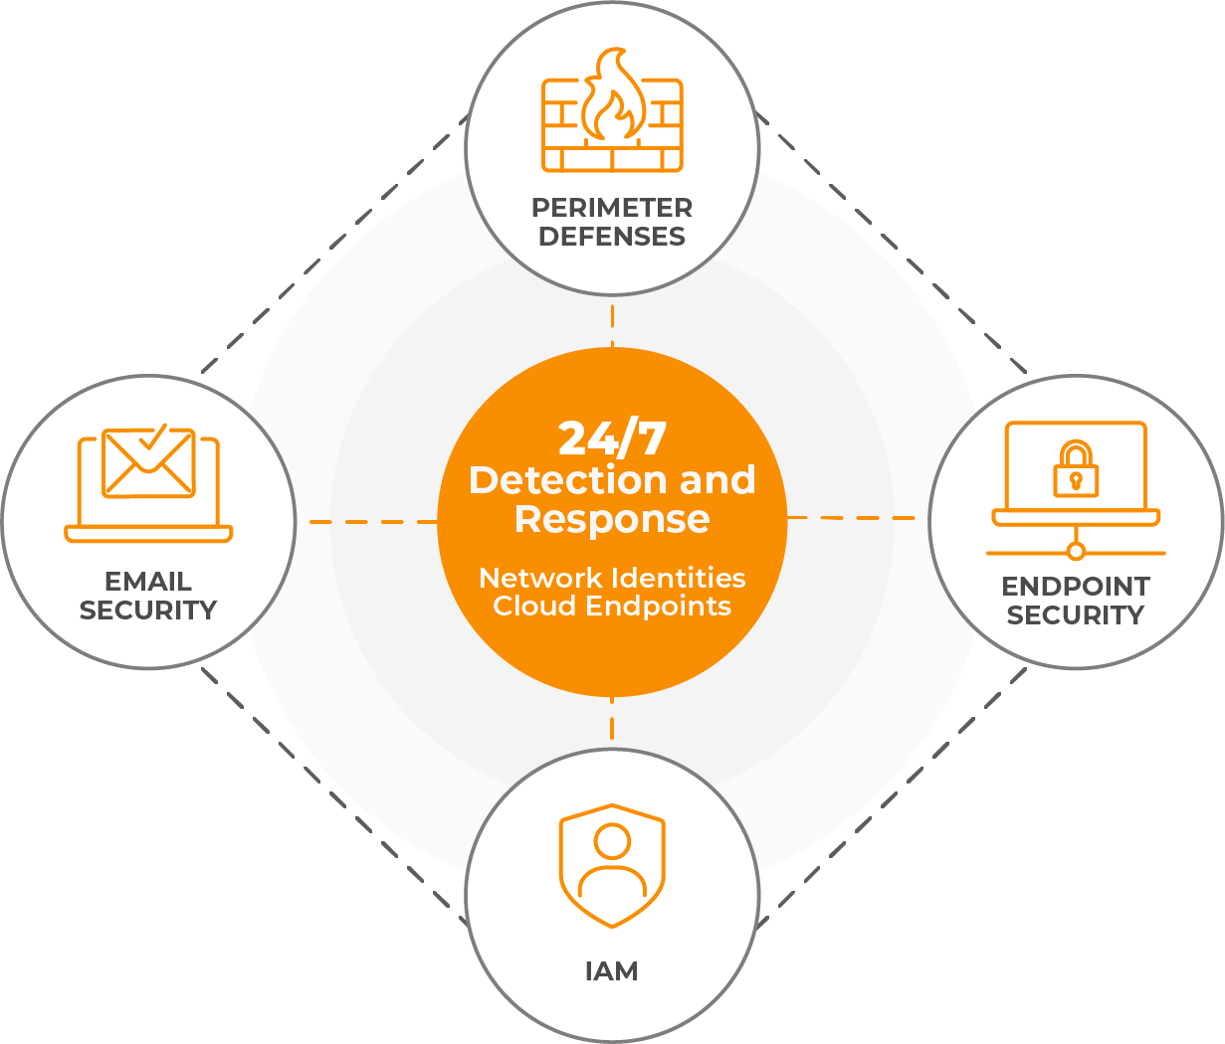
Remove the Silos
Across Network, Endpoint, Identity, and Cloud
STEP 3
Notes:
At the center is 24/7 detection and response, driven by visibility across network, identities, cloud, and endpoints
Instead of operating in silos, controls reinforce each other through a shared understanding of compromise
Network visibility provides the foundation, revealing adversary activity that other controls may miss
Endpoint and perimeter defenses receive confirmed intelligence to contain and block threats in real time
Email security contributes early signals that help identify initial access and lateral movement
Identity systems are continuously observed to understand how access is being used, not just how it’s granted
The key is that response is coordinated, not isolated. Actions in one layer inform and strengthen the others

Slide 20
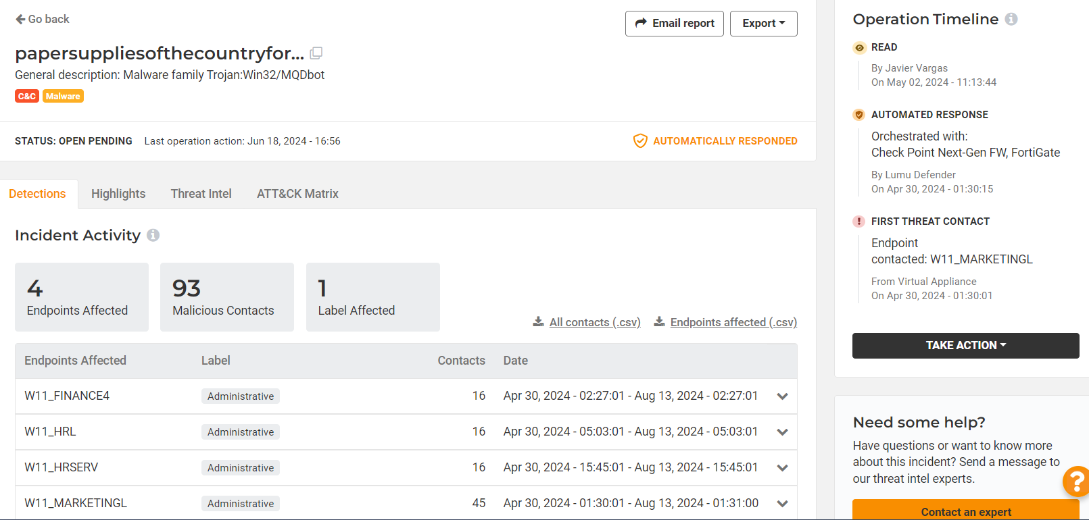
Automate Threat Response
to Block In Real-Time
STEP 4
3
Incident not seen by cybersecurity operator until Monday April 29th (32 hrs later).
By Jim Edwards
On April 29, 2024 - 09:41:18
2
Threat blocked within 3 seconds of initial contact.
Orchestrated with:
Check Point Next-Gen FW, FortiGate
By Lumu Defender
On April 28, 2024 - 01:31:03
Endpoint contacted:W11_MARKETINGL
By Lumu Defender
On April 28, 2024 - 01:31:00
1
Threat initially detected on the network at 1:31am April 28th (Sunday).
Notes:
Here’s a great example of why automating threat response matters so much in schools.
At 1:31 a.m. on a Sunday, a malicious connection hit the network. No one was at work, but the system detected it instantly and automatically blocked the threat within three seconds.
Without automation, that same threat wouldn’t have been noticed until Monday morning, more than 30 hours later. In that time, attackers could have spread across the network or stolen sensitive information.
The takeaway is that schools can’t rely on someone being at a keyboard every hour of the day. Automation ensures threats are stopped in real time, protecting your environment even when no one is watching.
Transition statement: Now that your tools are working optimally, it’s time to talk prioritization and planning.

Slide 21

Prioritize The Biggest Risks
STEP 5
Staff Accounts
Directory Services
Student Data
HR, Financials, Payroll
Network
High Risk
Email and Collaboration Tools
Endpoints and Devices
Online Learning Platforms
Medium Risk
Guest and Student Wi-fi Networks
Classroom Smart Boards
Non-critical Systems & Equipment
Low Risk
Notes:
When every system feels critical, it can be tough to know where to focus your limited resources. This framework helps schools prioritize what truly matters most.
Start with your high-risk areas such as staff accounts, directory services, and student data. If any of these are compromised, it can disrupt the entire district. These should get the most attention and protection.
Next, focus on your medium-risk areas like email, collaboration tools, and online learning platforms. They’re heavily used and often targeted by phishing or account misuse, so they still require strong monitoring and quick detection.
Finally, low-risk assets like guest Wi-Fi or classroom smart boards are still important, but they don’t carry the same level of impact if compromised.
The goal isn’t to ignore lower risks but to make sure you’re spending time and effort where it counts most so your security team can work smarter, not harder.
Transition statement: With priorities aligned, you can now focus on what you will do in case of an incident.

Slide 22





Create a Simple Cyber Incident Playbook
STEP 6
1
2
3
4
5
Define What Happened
Identify Who or What is Involved
Determine Scope and Priority
Decide on Next Steps
Document and Review
Notes:
When something suspicious happens, it’s easy for panic to set in. That’s why every school should have a simple incident playbook. It doesn’t need to be complicated, just a clear plan everyone can follow.
First, define what happened. Is it a phishing email, a lost device, or strange network activity? Write it down clearly.
Second, identify who or what is involved. Which students, staff, or systems might be affected?
Third, determine the scope and priority. Is this an isolated issue or something that could spread or impact learning?
Next, decide on next steps. Who needs to take action, and what should happen right away to contain it?
Finally, document and review. Once it’s handled, take a few minutes to note what worked, what didn’t, and how to respond faster next time.
A simple plan like this helps everyone stay calm, focused, and ready to protect the school community.
https://lumu.io/wp-content/uploads/2023/03/lumu-ransomware-response-playbook.pdf

Slide 23
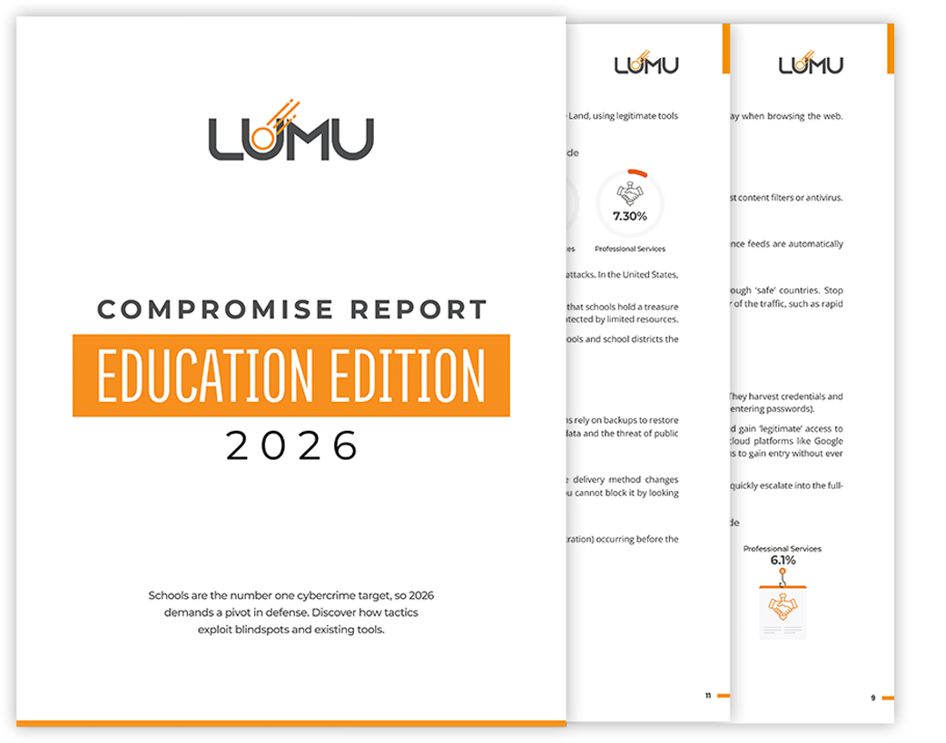

The Lumu Report on Cybersecurity for
EDUCATION 2026
Schools are now the primary objective for cybercrime in the USA. Attackers are taking advantage of the chaos of student traffic to get into your network.
Download your free copy to learn:
Stealth tactics
Emerging threats
Faster Defense

Slide 24
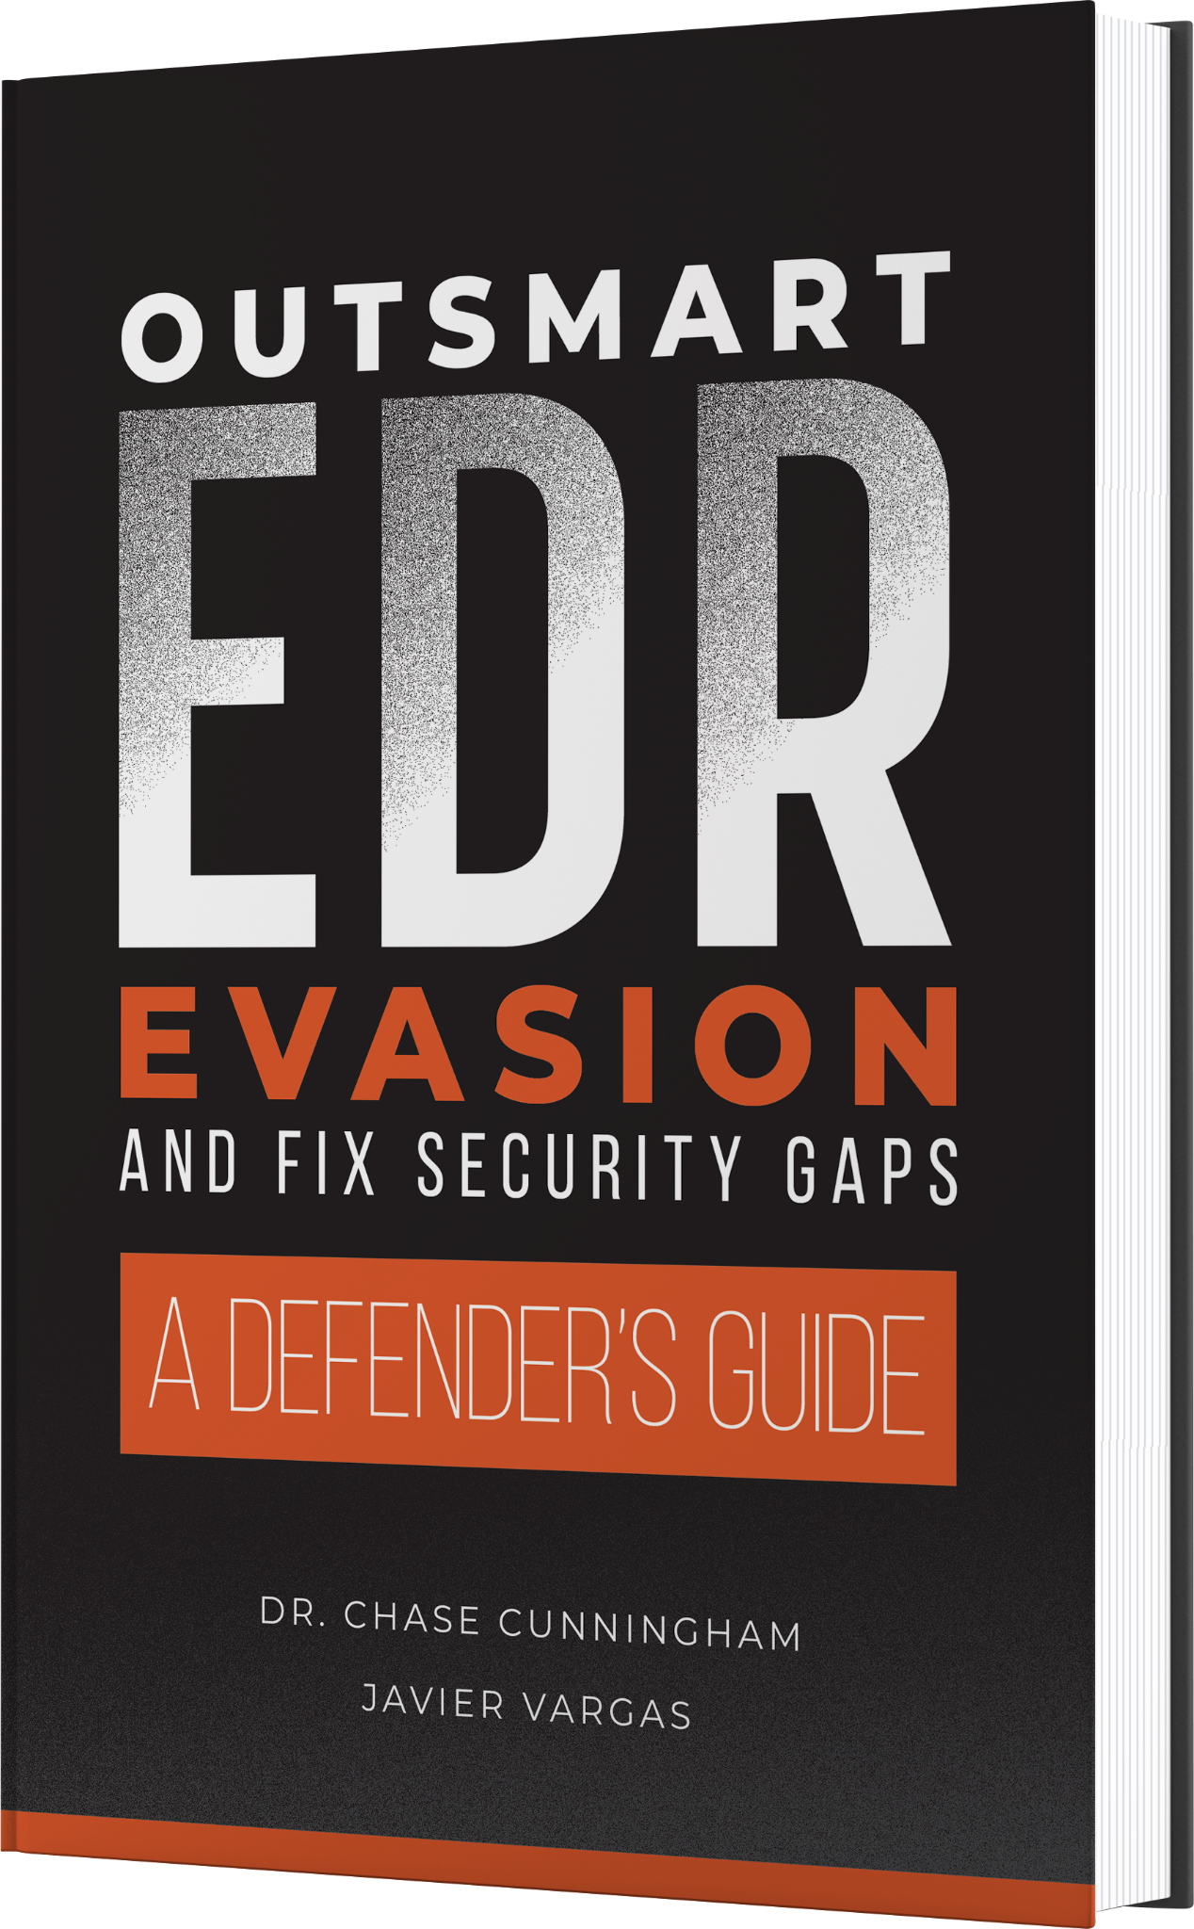

Outsmart EDR Evasion and Fix Security Gaps:
A Defender’s Guide
Notes:
Here is a technical book written by a couple of smart guys affiliated with Lumu. In this book, they identify some of the ways attackers are able to evade EDR with more technical details than I can go into today. Plus, the book also acts like a guide to help you defend against these evasion attacks.

