Slide 1
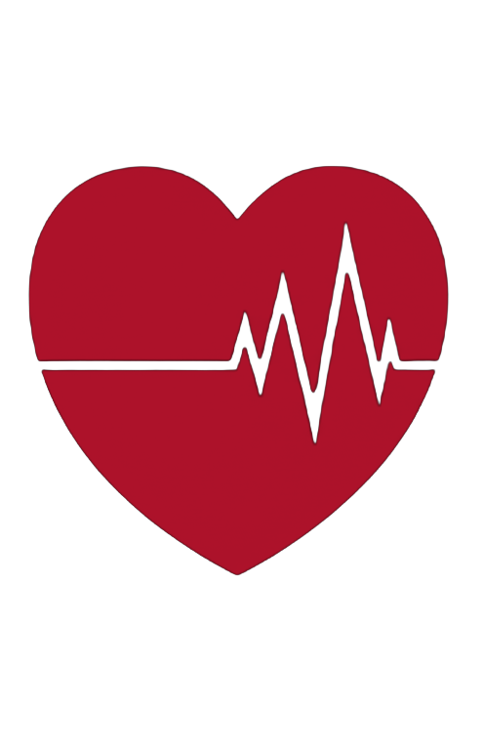
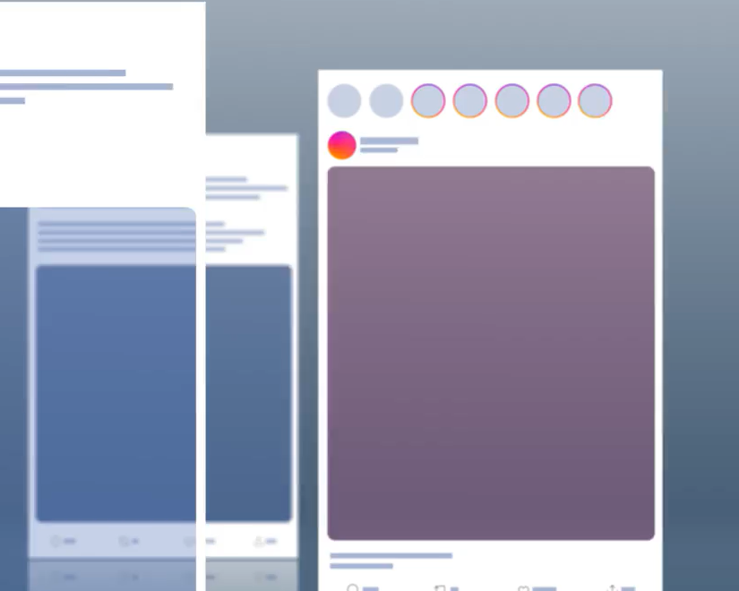
Reimagining STEM for the TikTok Generation
uBEATS 3.0:
How UNMC & UNO Are Transforming Digital STEM Education
Tim Krayer, MSEd
E-Learning Technologist
UNMC Department of Interactive E-Learning
Notes:
Purpose Set tone, establish credibility without flexing, and preview the session.
Anchor line
“Today is about how we design learning for students as they are—not as we wish they were.”
Talking points
Brief intro: who you are and the role you play now
This is not a sit-and-get; it’s practical and classroom-aware
uBEATS partnership is context, not prestige
Transition:
“Let’s start with who we’re actually teaching today.”

Slide 2
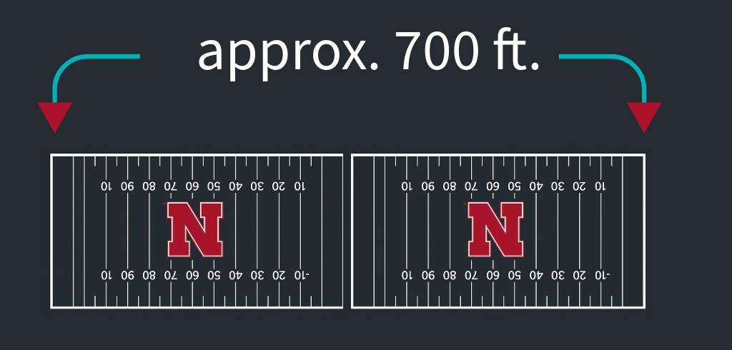
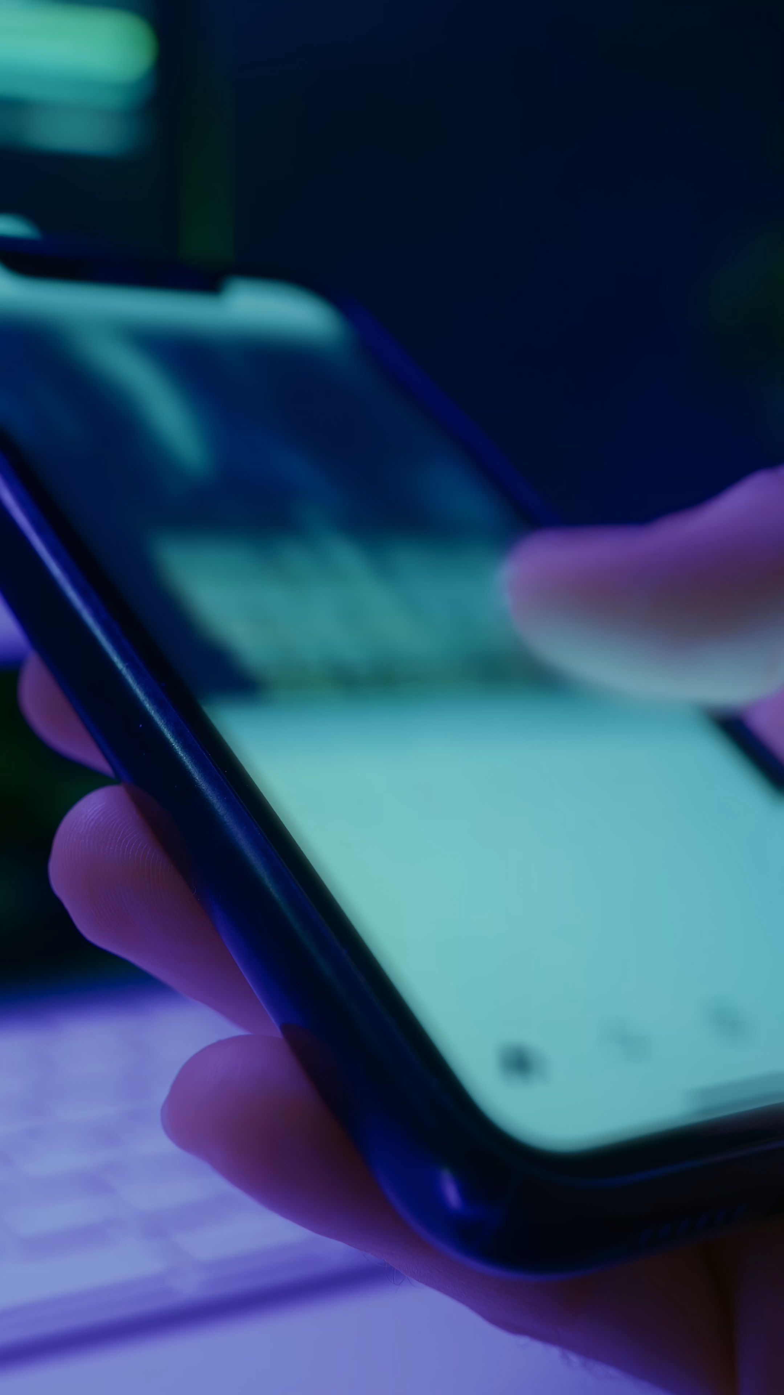
The Reality of Teaching the TikTok Generation
And we ask them to slow down…
…and listen…
…for 45 minutes.
Notes:
Purpose Create shared recognition without blaming students.
Anchor line
“This is the environment our students are growing up in—and we ask them to slow down.”
Talking points
Students consume information continuously, visually, and fast
Emphasize: this isn’t a criticism of students
The environment has changed faster than classrooms have
Light citation mention (Pew) for credibility, not argument
Screen‑time data source: Pew Research Center, “Teens, Social Media and Mental Health” (2025) [pewresearch.org]

Slide 3
So, What Does Learning Compete With?
Traditional
Classroom Reality
Time-bound
Content-heavy
One pace for everyone
Students’ Reality
Micro, visual, fast
Intuitive, app-like experiences
Constant scroll
Notes:
Purpose Reframe the challenge as attention + environment, not motivation.
Anchor line
“This isn’t students versus teachers—it’s learning competing with everything else for attention.”
Talking points
Walk the audience left → right visually
If teaching grades 6–12, you’re teaching the most visual learners in history
The problem isn’t effort—it’s comparison
Promise:
“Today I’ll show you a tool built for this reality.”

Slide 4
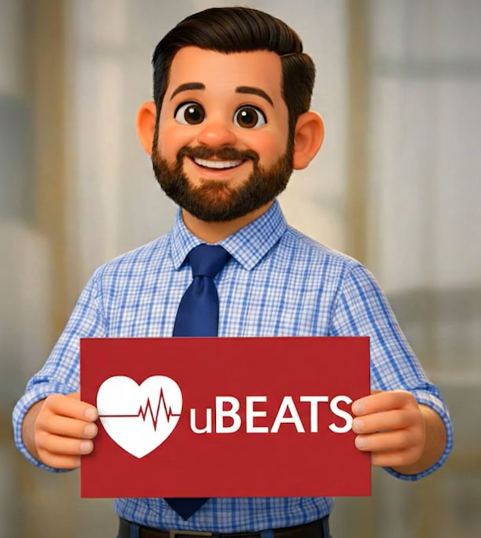
Why This Matters to Me
I design learning experiences at UNMC that help teachers compete with how students actually learn today.
Notes:
Purpose Humanize yourself and establish empathy.
Anchor line
“I’ve lived this problem from multiple sides.”
Talking points
Classroom → coaching → design lens
You’re solving a problem you’ve personally experienced
Emphasize: you respect classroom constraints
5 minutes total

Slide 5
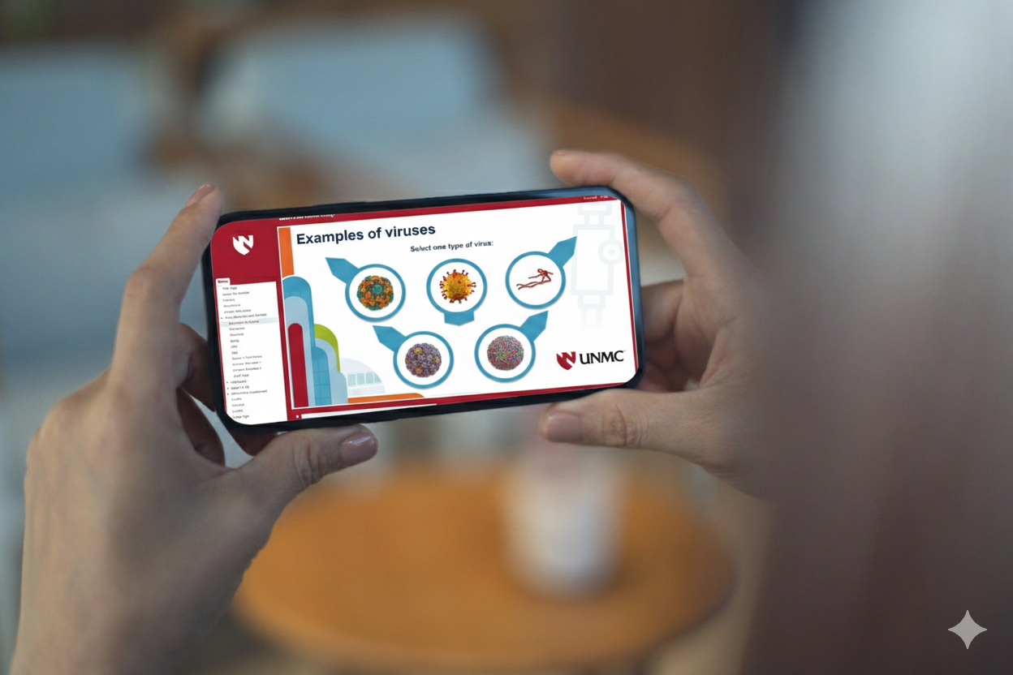
The TikTok Generation Learns Visually
Boosts Retention
Students retain more with short, visual content
Drives Engagement
Short-form content matches how students consume information
Flexible
by Design
Modular lessons that adapt to real classroom needs
💡
⚡
📚
Notes:
Slide 5 – The TikTok Generation Learns Visually
Purpose Legitimize visual learning as effective, not trendy.
Anchor line
“Short and visual doesn’t mean shallow—it means intentional.”
Talking points
Visual boosts retention
Short content aligns with consumption habits
Flexibility is the real superpower for teachers
Bridge to uBEATS naturally

Slide 6
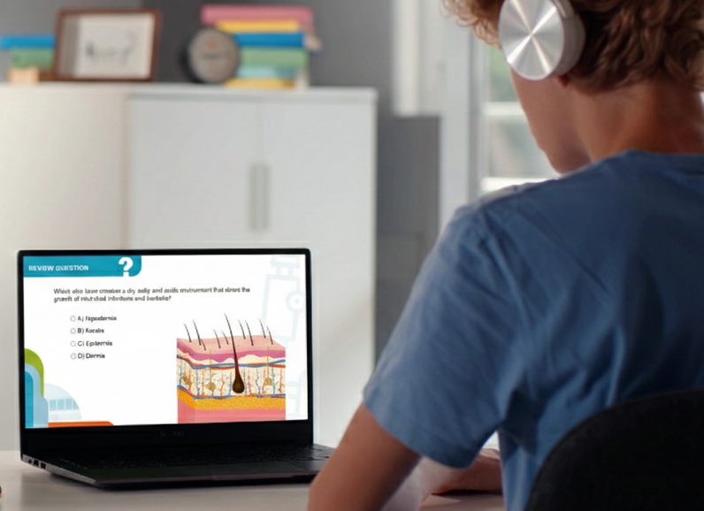
What is uBEATS?
uBEATS helps teachers engage today’s fast-paced, visual learners through short, interactive STEM content.
🆓 Free
🌐 Online
📍 Nebraska-Built
🧪 For Grades 6-12
⚡ Bite-Sized STEM Learning
🎬 Science Made Visual
Notes:
Purpose Define uBEATS clearly and quickly.
Anchor line
“uBEATS is short, visual STEM learning designed for real classrooms.”
Talking points
Free, online, Nebraska-built
Grades 6–12 focus
This is the what—the how comes next
12 minutes total

Slide 7
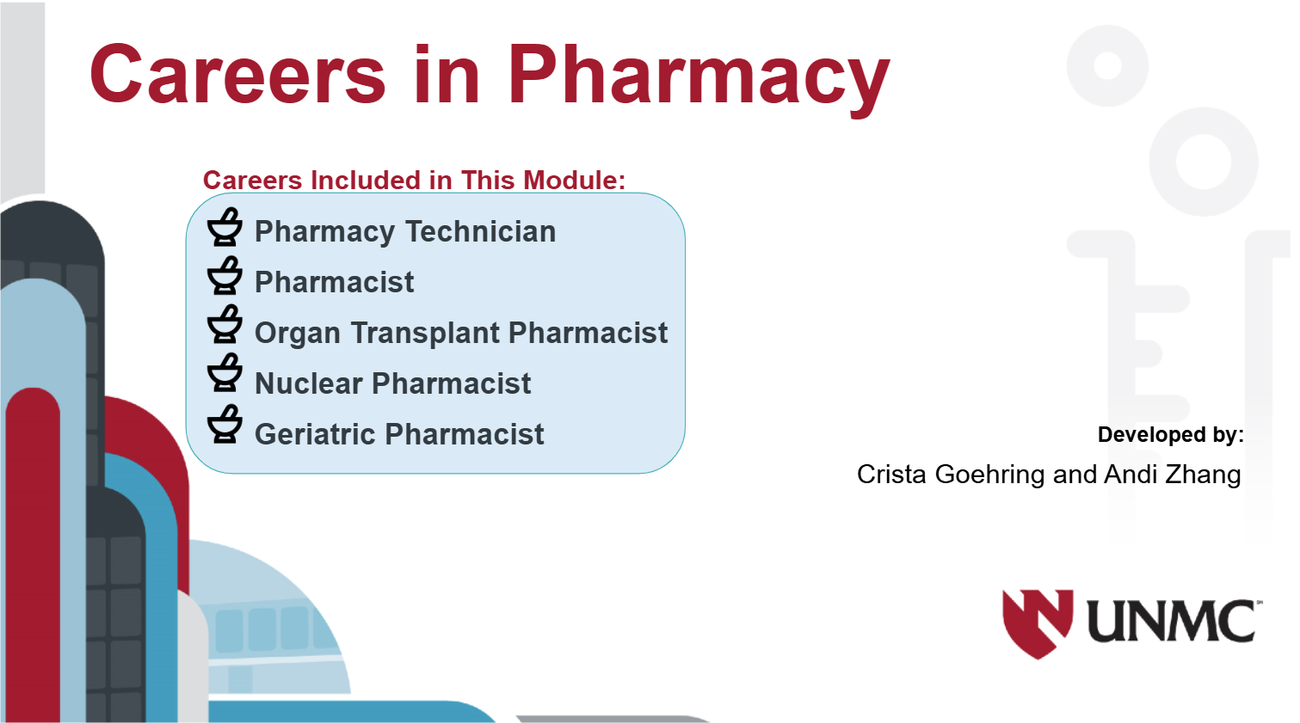
Enter uBEATS 3.0
Faster. Simpler. More Visual. More Engaging.
Our next phase of growth in digital STEM learning
Notes:
Purpose Build anticipation and signal improvement.
Anchor line
“Everything about 3.0 is about speed, simplicity, and visual clarity.”
Talking points
New phase of growth
Designed based on how teachers actually use it
Don’t overtalk—these slides do the emotional work
Reinforce: demo is coming

Slide 8
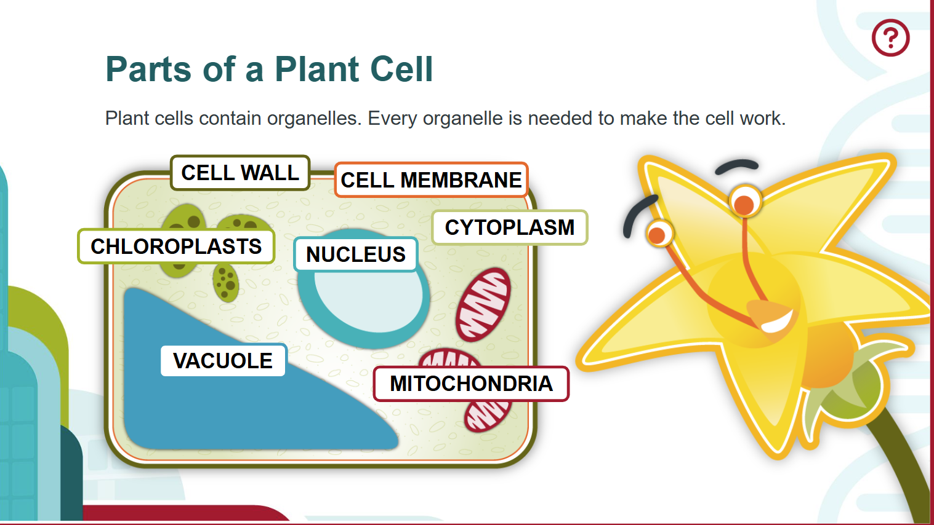
Enter uBEATS 3.0
Faster. Simpler. More Visual. More Engaging.
Our next phase of growth in digital STEM learning
Notes:
“I’ll show you what this looks like in practice in just a minute.”

Slide 9
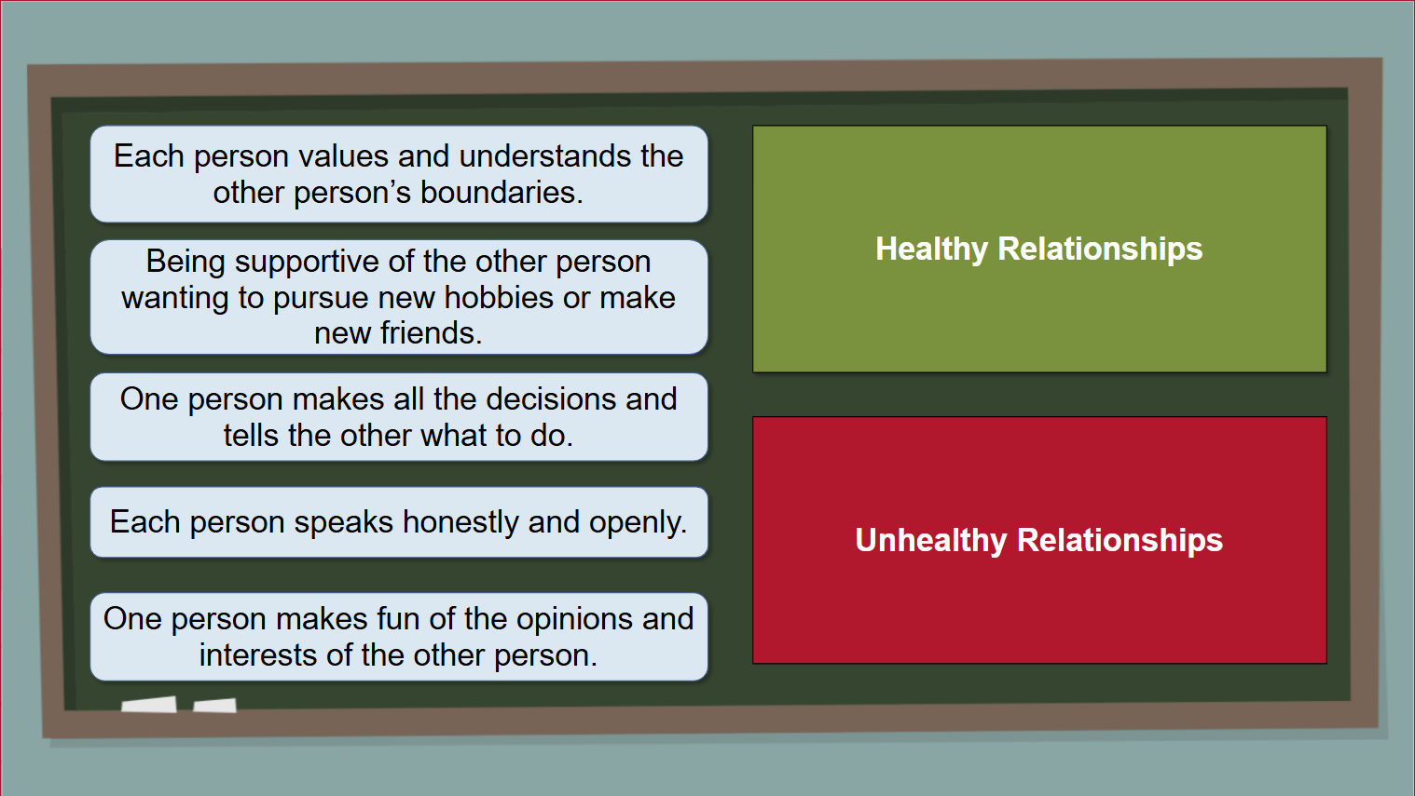
Enter uBEATS 3.0
Faster. Simpler. More Visual. More Engaging.
Our next phase of growth in digital STEM learning
Notes:
“I’ll show you what this looks like in practice in just a minute.”

Slide 10
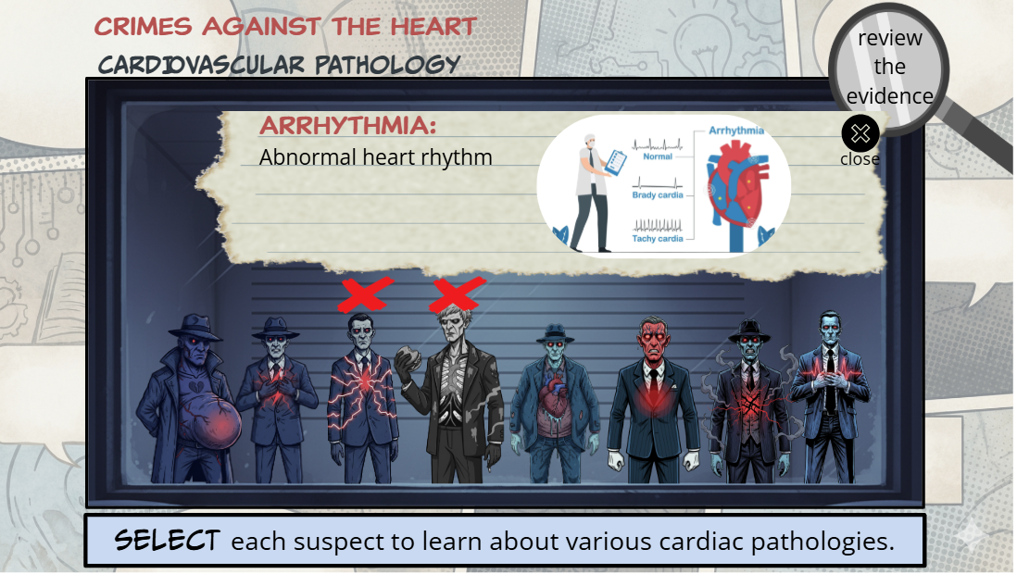
Enter uBEATS 3.0
Faster. Simpler. More Visual. More Engaging.
Our next phase of growth in digital STEM learning
Notes:
“I’ll show you what this looks like in practice in just a minute.”

Slide 11
Enter uBEATS 3.0
Faster. Simpler. More Visual. More Engaging.
Our next phase of growth in digital STEM learning
Notes:
“I’ll show you what this looks like in practice in just a minute.”

Slide 12
What’s New in uBEATS 3.0
Open Access Website
No logins. No barriers.
Simpler Access & Sharing for Teachers
Teachers share links instantly
Microcredential Badges
Digital badges in 9 preset pathways
🔓
🔗
🏆
Improved Navigation for Faster Use
Find modules faster
Mobile-Friendly by Design
Use anywhere, any device
Expanding Content Library
New modules added regularly
🧭
📱
📚
Notes:
Purpose Show concrete improvements that remove friction.
Anchor line
“We removed barriers everywhere we could.”
Talking points
No logins, easier sharing
Mobile-first by design
Microcredential badges
Faster navigation and expanding library

Slide 13


Impact and Reach
Nebraska Impact
39,784
students enrolled
≈ 17% of NE grades 6-12
National
Reach
143,578
students enrolled
All 50 states!
Sustained Growth in Engagement
Module completion over time
Notes:
Purpose Provide proof without bragging.
Anchor line
“This isn’t theoretical—it’s already happening.”
Talking points
National reach + Nebraska impact
Emphasize purposeful use over raw numbers
Growth reflects classroom integration
Expect continued climb
18 minutes total

Slide 14
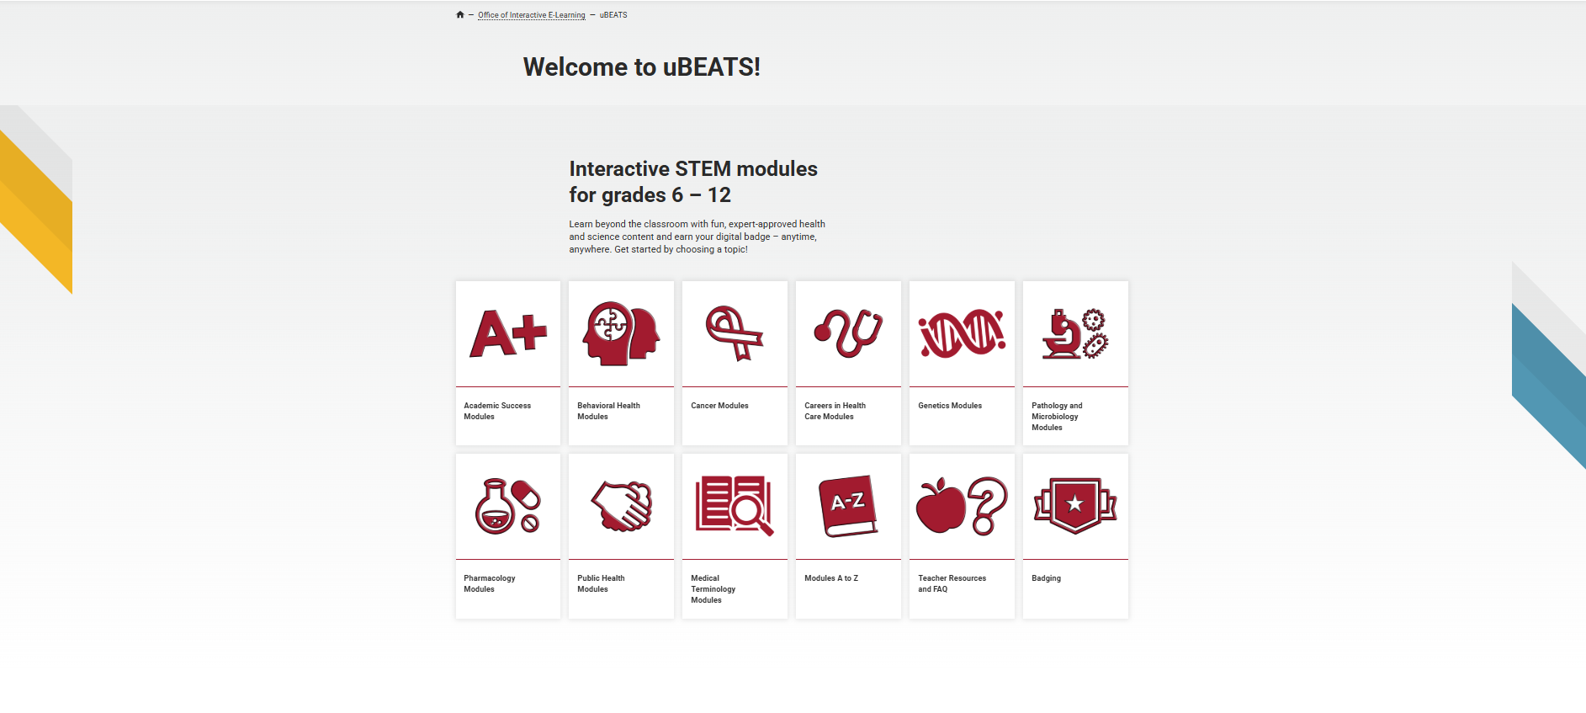
Let’s Take a Look
A quick tour of how uBEATS 3.0 works
Notes:
Purpose Shift from telling to showing.
Anchor line
“Let me make this concrete.”
Talking points
What teachers see first
No setup, no onboarding
How quickly modules fit into lessons
This is the student experience
21 minutes total

Slide 15
How Teachers Use uBEATS
Bell Ringers /
Lesson Launches
Activate prior knowledge
Building Key Vocabulary
Strengthen science terminology
Background Knowledge Builder
Prep students for deeper learning
⏱️
🔤
📚
Station /
Small Groups
Supports differentiation
Independent Learning / Choice Time
Extend or explore topics
LMS Integration
Share modules easily
🔄
⭐
💻
Notes:
Purpose Position uBEATS as flexible, not disruptive.
Anchor line
“Teachers aren’t redesigning their day—they’re enhancing moments.”
Talking points
Bell ringers, vocab, stations
Choice and differentiation
LMS-friendly
Emphasize adaptability
26 minutes total

Slide 16




Standards and Endorsements
NGSS Alignment
Aligned to Next Generation Science Standards performance expectations. Supports grades 6-12 life science & health science.
Nebraska Science Standards
Built for Nebraska classrooms. Reviewed for alignment to Nebraska Science Standards.
Nebraska Department of Education
Verified by NDE. Externally reviewed for quality and accuracy.
NCHSE Endorsement
Validated for Health Science Career Pathways.
Developed by UNO & UNMC faculty and reviewed by educators and science experts.
Notes:
Purpose Remove credibility concerns.
Anchor line
“This is built for classrooms—and vetted for quality.”
Talking points
NGSS + Nebraska standards alignment
NDE review
Health science endorsement (NCHSE= National Consortium for Health Science Education)
Helps ensure students are college- and career‑ready for healthcare pathways
Developed by educators, reviewed by experts
29 Minutes Total

Slide 17
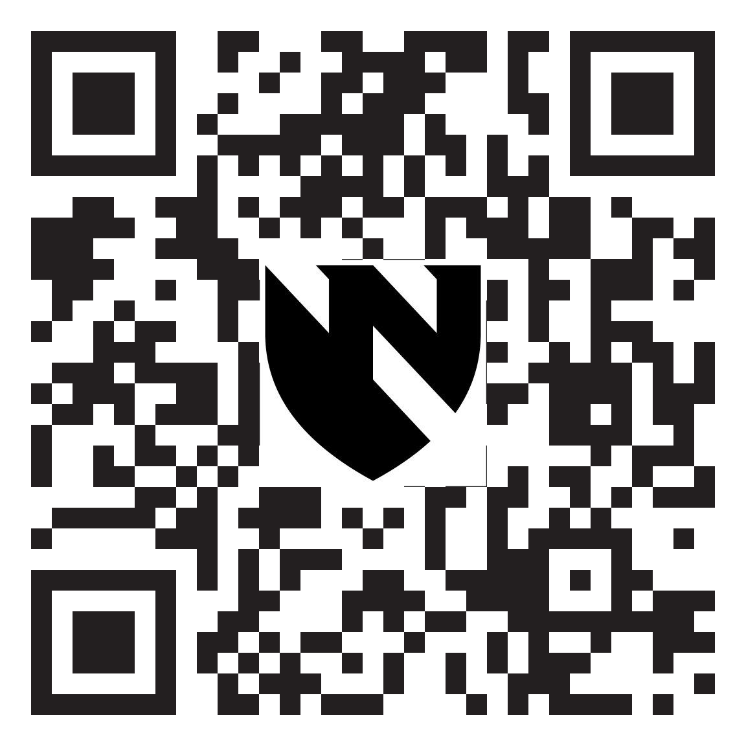
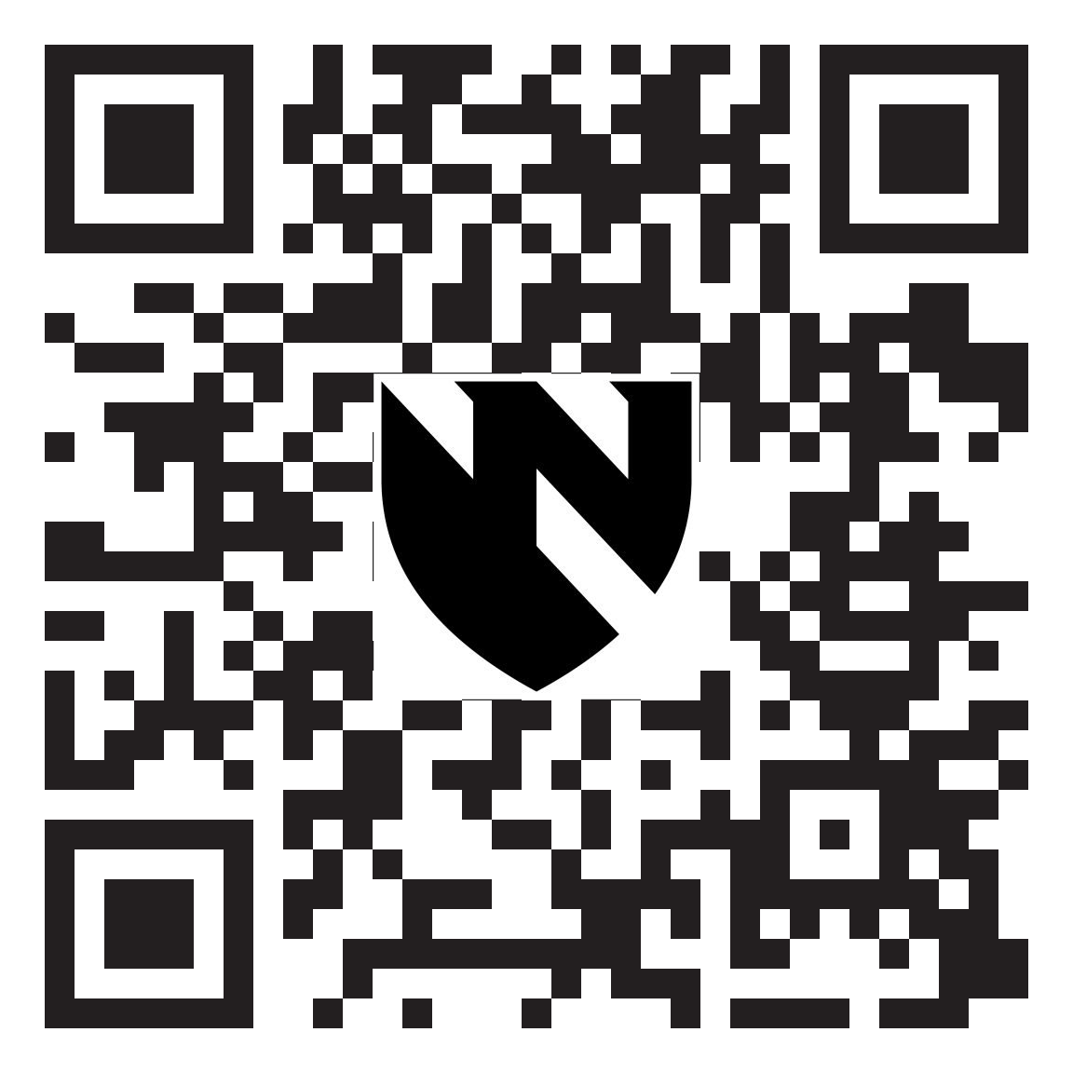
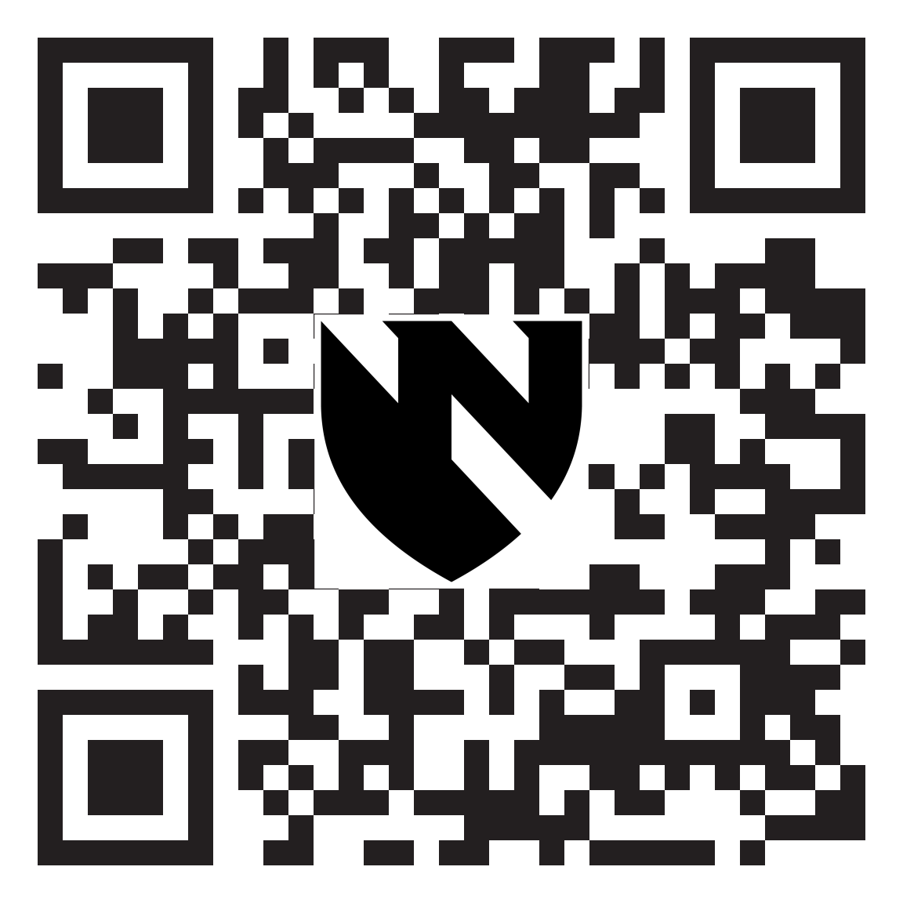
Try uBEATS Yourself
Take 3 minutes to explore on your own
Try a Module
go.unmc.edu/ubeatsexamples
Explore Our Website
unmc.edu/ubeats
Register Now
go.unmc.edu/ubeats-signup
🎬
🌐
🔐
Notes:
Purpose Convert interest into action.
Anchor line
“Experience it the way your students would.”
Talking points
Different ways to engage—no wrong choice
Give clear time expectation (2–3 minutes)
Set expectation that you’ll bring them back
34 minutes total

Slide 18

Thank You
For championing STEM learning in Nebraska.
Any questions?
Contact us
tkrayer@unmc.edu
ubeats@unmc.edu
Explore our website
unmc.edu/ubeats
Register
go.unmc.edu/ubeats-signup
Notes:
Purpose Close with openness and clarity.
Anchor line
“Thank you for championing STEM learning in Nebraska.”
Talking points
Invite questions
Point to contact info
Encourage follow-up after session
42 minutes total

Slide 19
Closing Slide [do not remove]

Slide 20
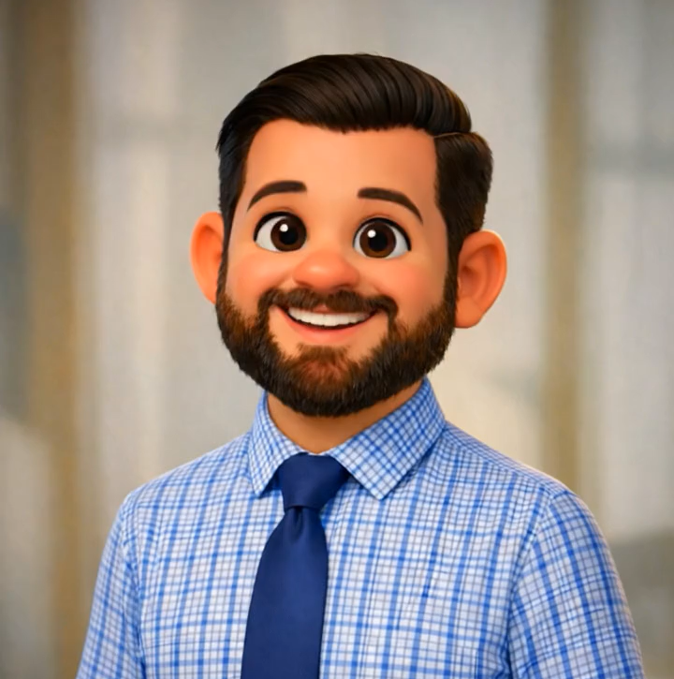


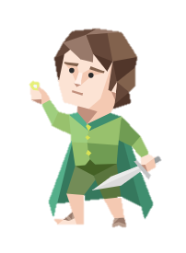

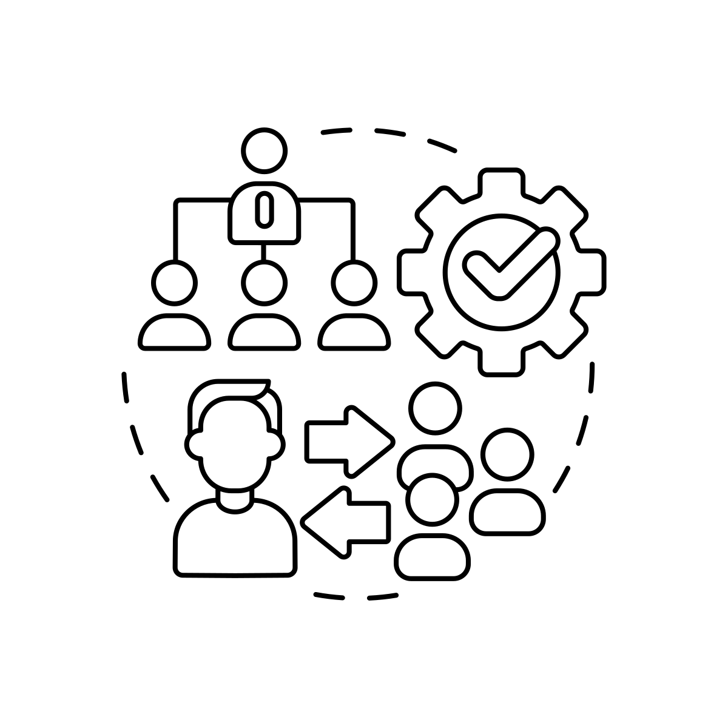


Hi! I’m Tim.
2010
2025
Rochester, NY
Born & Raised
Taught 3 years
Ralston, NE
Special Ed.
Elementary Classroom
Ralston, NE
Instructional Technology Coach
Omaha, NE
UNMC
Multimedia Technologist
INFP
2024
Notes:
“INFPs are empathetic, imaginative idealists who are guided by strong personal values and a deep desire to create meaningful, authentic connections.”

