Slide 1


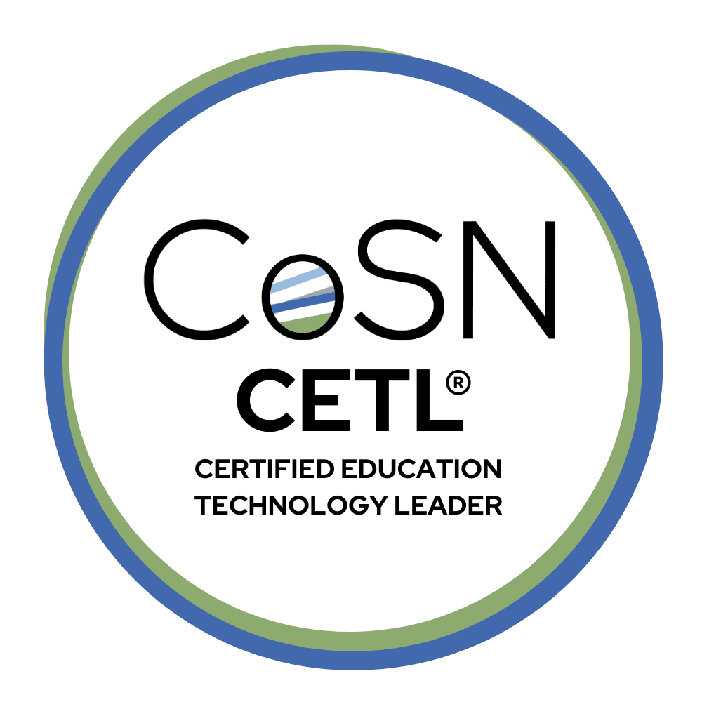

CETL Everything You Need to Know CoSN's Certified Education Technology Leader (CETL®) Certification Program
Notes:
Good afternoon everyone, and thank you for joining us today. My name is Yenny Caceres, and I serve as the Director of Certification at CoSN.
Today we’ll be talking about the Certified Education Technology Leader, or CETL®, certification program, what it is, why it matters, and how education technology leaders can get started on the path to earning the credential.
We’re really excited to have you here and to spend some time walking through the program and answering your questions.

Slide 2

Presenters
Notes:
Before we begin, I’d like to introduce our presenters for today.
Joining me is Robin Gunter, who currently serves as Chair of the Certification Governance Committee and is also a CETL credential holder.
Robin will later share her personal experience pursuing the CETL certification and how it has supported her leadership journey.
My role today will be to walk through the structure of the certification program, including eligibility requirements, the exam process, preparation resources, and recertification.

Slide 3

Agenda
What is the CETL Certification?
Why certification matters for EdTech leaders
Eligibility requirements and application process
CETL exam overview
How to prepare for the exam
Maintaining the credential through recertification
Upcoming CETL program updates
Q&A
Notes:
Here’s a quick overview of what we’ll cover today.
We’ll begin with an overview of what the CETL certification is and why certification matters for education technology leaders.
We’ll then review the eligibility requirements and application process, followed by an overview of the exam itself and how candidates can prepare.
We’ll also talk about maintaining the credential through recertification, share some updates to the CETL program, and then hear directly from Robin about her experience as a CETL.
Finally, we’ll wrap up with questions and answers.

Slide 4
Learning Objectives
By the end of this session, participants will be able to:
• Understand the purpose and value of the CETL certification for K-12 EdTech leaders
• Review current eligibility requirements and exam structure
• Learn about preparing for the CETL exam and available study resources
• Understand recertification requirements and maintaining the credential
• Learn about upcoming updates to the CETL certification program
Notes:
By the end of today’s session, participants should have a clear understanding of:
The purpose and value of the CETL certification for K–12 education technology leaders
The eligibility requirements and exam structure
Resources available to help prepare for the exam
How to maintain the credential through recertification
And some upcoming updates to the CETL certification program.

Slide 5

What is a CETL?
Certified Educational Technology Leader
Credential earned by qualified applicants who pass the CETL Examination
Created to certify K-12 education technology leaders who demonstrate expertise in:
Strategic leadership and vision
Digital learning environments
Data-informed decision making
Technology infrastructure and support
Managing technology resources and teams
Based on a Delineation of Practice that outlines tasks performed by EdTech Leaders
Resulted in the Framework of Essential Skills document and the Detailed Content Outline that the exam is based upon
Not just for CTOs!
Notes:
So what exactly is a CETL?
The Certified Education Technology Leader credential is awarded to qualified applicants who successfully pass the CETL examination.
The certification was created specifically to recognize K–12 education technology leaders who demonstrate expertise across several key leadership areas, including:
Strategic leadership and vision
Digital learning environments
Data-informed decision making
Technology infrastructure and support
Managing technology resources and teams
The exam itself is based on a Delineation of Practice or also known as a Job Analysis, which identifies the key tasks and responsibilities performed by education technology leaders.
This research led to the development of two foundational documents:
the Framework of Essential Skills
and the Detailed Content Outline
These documents define the knowledge and competencies that the CETL exam measures.
And importantly, this certification is not just for CTOs. It’s designed for a broad range of professionals working in education technology leadership roles.

Slide 6
Value of Certification
Shows the public and employers that you have met high national standards for education, training, and experience.
Enhances your professional reputation, credibility, and provides you with a sense of personal accomplishment.
Demonstrates your commitment to continued professional development and skills expansion.
Increases your opportunities for career advancement and increased earnings.
Provides opportunities for you to contribute to advocacy efforts for the education technology profession.
Provides networking opportunities with other professionals in the industry.
Notes:
There are several reasons why professionals choose to pursue certification.
First, certification demonstrates to employers and the public that you have met nationally recognized standards for education, training, and experience.
It also helps enhance professional credibility and reputation within the field.
Many CETLs tell us that earning the credential gives them a strong sense of personal accomplishment and professional validation.
Certification can also support career advancement opportunities, help expand professional networks, and provide opportunities to contribute to advocacy and leadership efforts within the education technology profession.

Slide 7
Certification Governance Committee (CGC)
Responsible for the oversight, development, and governance of the CETL certification program.
Comprised of 15 CETLs in good standing, appointed by either the CoSN Board of Directors or by the CGC.
The CGC has full autonomy over all core credentialing decisions and all important aspects of CoSN’s credentialing programs and activities.
This includes: strategic oversight of the CETL program; definition of eligibility criteria; exam scope and content; recertification criteria and process, the development, administration, and scoring of assessment instruments; granting of certification; marketing and promotion; and ethics and professionalism, including complaints.
Provides reports and updates to the CoSN Board of Directors as needed
Current CGC Chair- Robin Gunter, CETL
Notes:
The CETL certification program is overseen by the Certification Governance Committee, or CGC.
This committee is made up of 15 CETL credential holders in good standing, and they are responsible for the strategic oversight and governance of the certification program.
Importantly, the CGC operates with full autonomy over core credentialing decisions, including things like:
eligibility criteria
exam content and scope
recertification requirements
exam development and scoring
and ethical standards
The CGC also provides updates to the CoSN Board of Directors as needed.
Currently, the Chair of the CGC is Robin Gunter, who will be speaking shortly.

Slide 8
CGC Subcommittees
CETL Ambassadors
Support outreach and engagement by fostering networking among CETLs and promoting the value of the certification.
Exam Development SubCommittees
Volunteer subject matter experts support exam development through Job Analysis, Item Writing and Review, and Form Review activities to ensure the exam reflects current practice in K-12 education technology leadership.
Nominating SubCommittee
Manages the nomination and selection process for members of the Certification Governance Committee (CGC).
Notes:
In addition to the main committee, several subcommittees support the work of the CETL program.
These include:
The CETL Ambassadors, who help promote the certification and foster engagement within the CETL community.
The Exam Development Subcommittee, made up of volunteer subject matter experts who support activities such as job analysis studies, item writing, and exam form review.
And the Nominating Subcommittee, which manages the process of selecting new members for the Certification Governance Committee.

Slide 9
Eligibility Requirements (Effective as of June 2025):
Pathway 1
Bachelor’s degree plus four years of education technology experience
Pathway 2
Associate degree plus seven years of education technology experience
Pathway 3
Ten years of education technology experience
No College degree required
Notes:
To apply for the CETL certification, candidates must meet one of three eligibility pathways.
The first pathway is a bachelor’s degree plus four years of education technology experience.
The second pathway is an associate degree plus seven years of experience.
And the third pathway is ten years of education technology experience, which does not require a college degree.
These pathways allow professionals with different educational backgrounds and experience levels to pursue the credential.

Slide 10
Application Process:
Agree to the CoSN Code of Conduct and Terms of Confidentiality
10% of all applications are randomly audited
Supporting documentation is required (e.g., unofficial transcripts, certificates of completion, resume)
7-10 business day processing time for applications
Three possible outcomes of application:
Eligible- Authorization to Test (ATT) notice is sent to applicant; 6 months to test
Ineligible
Selected for Audit
Application is available at www.cosn.org.
Notes:
The application process is fairly straightforward.
Applicants begin by submitting an application and agreeing to the CoSN Code of Conduct and confidentiality policies.
Approximately 10% of applications are randomly selected for audit, which means supporting documentation may be required, such as transcripts, certificates, or a resume.
Applications are typically processed within 7 to 10 business days.
Once reviewed, applicants will receive one of three outcomes:
Eligible and issued an Authorization to Test
Ineligible based on requirements
Or selected for audit
Candidates who are approved have six months to schedule and take the exam.

Slide 11
Exam Details
100 multiple-choice questions (closed book)
Two hours to complete the exam
Year-round testing offered through Pearson VUE
Test center locations can be found at www.pearsonvue.com
Hundreds of testing locations across the US
International testing is also available
Remote proctoring option
Test in a secure environment of your choosing
Exam Fees: $489 Member; $829 Non-Member; $339 Exam Retake (Member & Non-Member)
Notes:
The CETL exam consists of 100 multiple-choice questions, and it is a closed-book exam.
Candidates have two hours to complete the test.
The exam is offered year-round through Pearson VUE, which provides testing centers across the United States and internationally.
Candidates also have the option to take the exam through remote proctoring, which allows them to test from a secure environment of their choosing.
Exam fees are:
$489 for CoSN members
$829 for non-members
and $339 for exam retakes.

Slide 12
Exam Preparation Tips
Review Essential Documents
CETL Candidate Handbook
Framework of Essentials Skills Document
Detailed Content Outline
CoSN Resources/Products
Foundations Course- self study or facilitated
CoSN Knowledge Center
Self-Assessment Tool
CETL Practice Exam
Form or Join a Study Cohort
State Chapters- 32 Chapters so far
Co-Workers/Peers
Identify a Mentor
Notes:
For those preparing for the exam, we recommend starting with several key documents:
The CETL Candidate Handbook
The Framework of Essential Skills
And the Detailed Content Outline
CoSN also offers several preparation resources, including:
The CETL Foundations Course
Resources within the CoSN Knowledge Center
A self-assessment tool
and a practice exam
Many candidates also find it helpful to form study groups or cohorts, either through CoSN state chapters or with colleagues and peers.
Finally, identifying a mentor who already holds the CETL credential can also be extremely valuable.

Slide 13
What to Expect as a CETL®?
Official Certificate and lapel pin
Use of the CETL Designation after your names
Listed in online CETL Directory- Must opt in to the directory
CoSN and LinkedIn CETL Communities
Notification letter to superintendent and/or supervisor
Digital badge issued through Credly to share in email and social media
CETL Exclusive Events at the CoSN Annual Conference
Opportunities to get involved with the CETL certification program
CGC Member
Item Writer
CETL Ambassador Committee
Notes:
Once you earn the CETL credential, you receive several benefits.
These include an official certificate and lapel pin, the ability to use the CETL designation after your name, and listing in the online CETL directory if you choose to opt in.
You’ll also receive a digital badge through Credly, which can be shared on LinkedIn or in email signatures.
CETLs also have opportunities to engage with the community through exclusive events at the CoSN Annual Conference, as well as volunteer opportunities within the certification program.

Slide 14
Recertification
The CETL credential is valid for three years from the date of certification.
Two options for recertification:
Complete 60 hours of Continuing Education Activities (CEAs)
(Conferences, professional activities, and structured CE)
OR
Retake and pass the then-current CETL® examination
All CEA activities must be tied to the Framework of Essential Skills document and can include:
Continuing Education
E-Learning / Online Courses
Industry-Related Certification
Teaching / Instruction
Professional Membership
Published Works
Volunteer / Leadership Work
Recertification demonstrates continued competence in the field.
Notes:
The CETL credential is valid for three years.
To maintain certification, professionals have two options.
They can either complete 60 hours of continuing education activities, or they may choose to retake and pass the current version of the CETL exam.
Continuing education activities must align with the Framework of Essential Skills and can include things like conferences, training programs, teaching, professional leadership, publications, and volunteer work.
Recertification helps ensure that credential holders remain current and competent in this rapidly evolving field.

Slide 15

CoSN Annual Conference
CETL Summit
CETL Networking Happy Hour
CETL Session
CETL Info Booth – located in The Hive
Notes:
I also want to highlight a few opportunities for CETLs to connect with the community during the CoSN Annual Conference.
Each year we host several CETL-focused activities including the CETL Summit, which brings together education technology leaders for deeper conversations around leadership and innovation in K–12.
We also organize a CETL Networking Happy Hour, which is a great opportunity for credential holders to connect and build relationships with peers from across the country.
There is also typically a CETL-focused session during the conference, as well as an information booth located in The Hive, where attendees can learn more about the certification program, eligibility requirements, and preparation resources.
So if you’re planning to attend the conference, we definitely encourage you to stop by and connect with the CETL community.

Slide 16

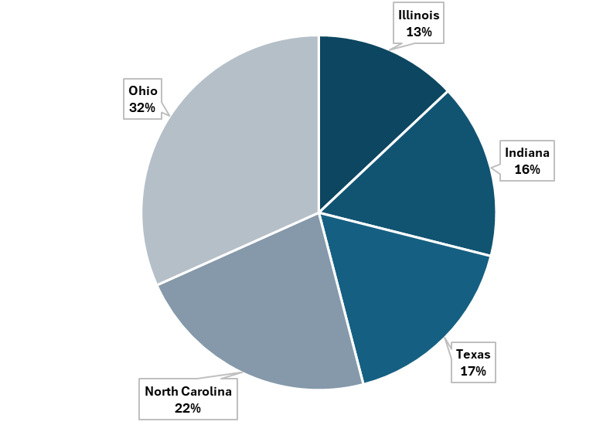
Top 5 States for CETLs (as of 4/1/2026)
Ohio - 152
North Carolina- 109
Texas- 84
Indiana- 77
Illinois- 61
Total of 923 CETLs Nationwide
Notes:
This slide highlights the top five states with the highest number of CETL credential holders as of April 1, 2026.
Currently, Ohio leads with 152 CETLs, followed by North Carolina with 109.
Texas comes in next with 84, followed by Indiana with 77, and Illinois with 61.
These numbers continue to grow each year as more education technology leaders pursue the certification.
We’re also seeing increasing interest from professionals across many other states, which reflects the growing recognition of the CETL credential nationwide.

Slide 17
Upcoming CETL Program Updates
A new CETL exam is scheduled for release in early Summer 2026
The updated exam reflects current leadership practices in K-12 education technology
Supporting documentation is now required during both the initial application and recertification processes
Certification expiration dates will move to the end of the month in which certification was earned
These updates help strengthen the rigor, transparency, and integrity of the CETL certification program.
Notes:
I also want to share a few important upcoming updates to the CETL program.
A new CETL exam is scheduled to be released in early Summer 2026.
This updated exam will reflect current leadership practices in K–12 education technology.
We’ve also strengthened documentation requirements during both the initial application and recertification process.
And certification expiration dates will now move to the end of the month in which the certification was earned.
These updates help ensure the rigor, transparency, and integrity of the CETL certification program

Slide 18


A CETL
Leader’s Perspective
Notes:
At this point, you’ve heard about the structure of the CETL certification program.
I’d now like to shift perspectives and hear directly from someone who has earned the credential.
Robin Gunter currently serves as Chair of the Certification Governance Committee and has been a CETL for several years.
Robin, I’d love to invite you to share your experience and your journey with the CETL certification.
Robin’s CETL Journey
Why I decided to pursue the CETL® certification
How the certification has supported my leadership role
Advice for professionals considering the CETL

Slide 19
How to Get Started
Review the CETL Candidate Handbook
Confirm you meet eligibility requirements
Submit your CETL application
Schedule your exam through Pearson VUE
Prepare using CoSN study resources
Connect with other CETLs or study cohorts for support
Notes:
So if you’re interested in pursuing the CETL certification, here are the key steps to get started.
First, we recommend reviewing the CETL Candidate Handbook, which provides a detailed overview of eligibility requirements, the exam structure, and policies.
Next, confirm that you meet one of the eligibility pathways based on your education and professional experience.
Once you’re ready, you can submit your CETL application through the CoSN website.
After your application is approved, you’ll receive an Authorization to Test, which allows you to schedule your exam through Pearson VUE.
From there, we encourage candidates to prepare using the available CoSN study resources, and many professionals also find it helpful to connect with other CETLs or study cohorts for additional support and guidance.

Slide 20


Thank you!
Questions?
Contact us: certification@cosn.org
Notes:
Thank you again for joining us today.
We’ll now open the floor for questions.
If you have questions, please feel free to enter them into the chat or Q&A box.
And if any questions come up after the session, you can always reach us at certification@cosn.org.

