Slide 1
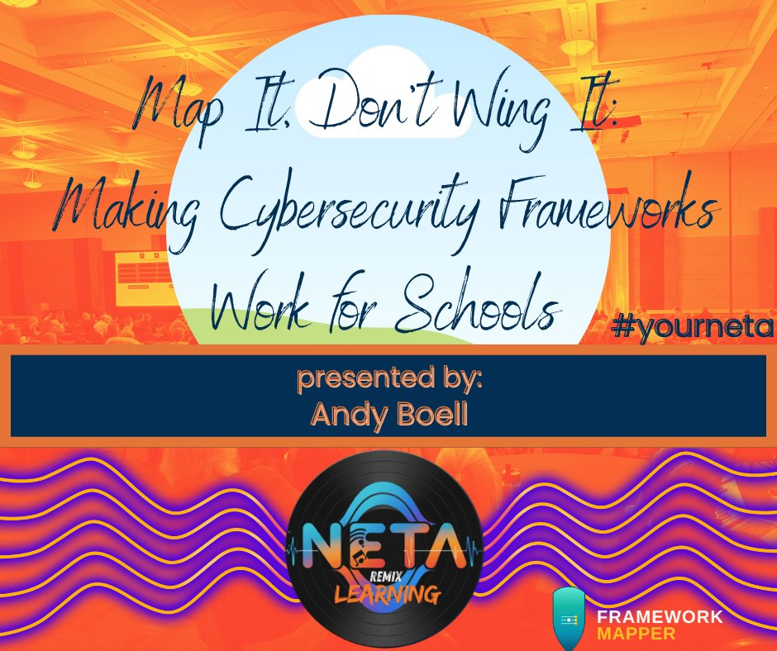
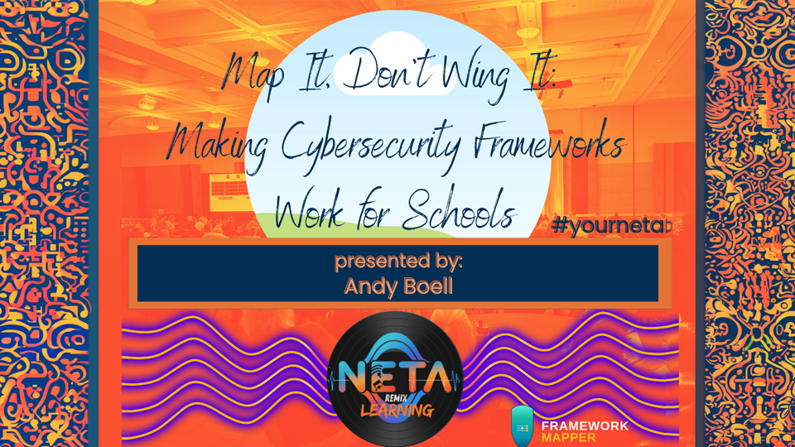

Slide 2
WHY THIS MATTERS
The K-12 Threat Landscape
#1
$3.65M
77%
Most-targeted sector
for ransomware attacks
Average cost of a
K-12 data breach
Of top attacks blocked
by CIS IG1 safeguards
Source: MS-ISAC
Source: IBM 2025
Source: CIS CDM v2.0
frameworkmapper.com

Slide 3


WHAT IS A CYBERSECURITY FRAMEWORK?
A structured set of best practices that helps your district manage and reduce cybersecurity risk.
Think of it as a blueprint — not a product you install, but a systematic approach to protecting your systems, data, and people.
It's a journey, not a destination
Start where you are, improve over time
frameworkmapper.com

Slide 4
NEBRASKA IS TAKING ACTION
LB937
K-12 Education Cybersecurity Act
Districts will be required to adopt a cybersecurity framework and policy
Annual cybersecurity readiness assessments will be mandatory for funding eligibility
The specific framework and assessment details are still being determined
You don't have to wait. Start understanding where you stand today.
frameworkmapper.com

Slide 5
KNOW YOUR FRAMEWORKS
START HERE
RECOMMENDED
K-12 SPECIFIC
CIS Controls v8.1
NIST CSF v2.0
Cybersecurity
Rubric 2.0
18 controls, 153 safeguards. IG1 gives you 56 essential safeguards — the ideal starting point for any district.
6 core functions: Govern, Identify, Protect, Detect, Respond, Recover. The common language of cybersecurity.
Purpose-built for K-12. Aligned with MS-ISAC resources and designed for district self-assessment.
Your foundation for cyber hygiene
How you talk about security to leadership
Built specifically for schools like yours
frameworkmapper.com

Slide 6
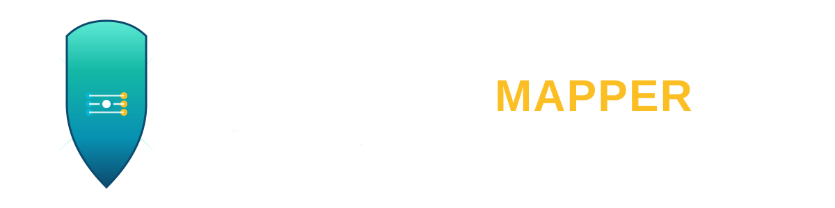



INTRODUCING
Cybersecurity Made Simple
7 Frameworks
450+ Security Tools
CIS Controls, NIST CSF, NIST 800-53, 800-171, CMMC, HIPAA, GovRAMP
Mapped to safeguards, filtered by cost, vertical, and K-12 relevance
24 Industry Verticals
Built for Non-Experts
Tailored prioritization for K-12, churches, SMBs, defense contractors, and more
Explainable recommendations, guided assessments, no jargon required
frameworkmapper.com

Slide 7
FIND YOUR WAY — THREE STEPS
Where Are You On Your Journey?
1
Know Your Gaps
Use the free Coverage Aggregator to see which safeguards your current tools already cover.
2
Close the Gaps
ToolMapper shows 450+ security products filtered by cost, vertical, and K-12 relevance.
3
Plan Your Journey
Run a framework assessment to get actionable, prioritized recommendations for improvement.
frameworkmapper.com

Slide 8
GET STARTED IN 5 STEPS
1
Create a Free Account
Sign up at frameworkmapper.com
2
Select Your Current Tools
See which CIS Safeguards you already cover
3
Build a Wish List
See how new tools change your coverage before you buy
4
Review Your Gap Analysis
Clear, visual picture of where your district stands
5
Complete an Assessment
Get a prioritized roadmap built for your constraints
frameworkmapper.com

Slide 9



LIVE DEMO
frameworkmapper.com
Select Tools
Coverage
Aggregator
ToolMapper
▼
Create Account
Gap Analysis
Assessment
frameworkmapper.com

Slide 10
CREATE A FREE ACCOUNT
TO SAVE YOUR PROGRESS
frameworkmapper.com
Andy Boell | Midwest Cyber, LLC | CISSP, CCP, CETL
Cybersecurity Made Simple • 7 Frameworks • 450+ Security Tools • 24 Industry Verticals
A Viosoph, LLC Product | viosoph.com

