Slide 1
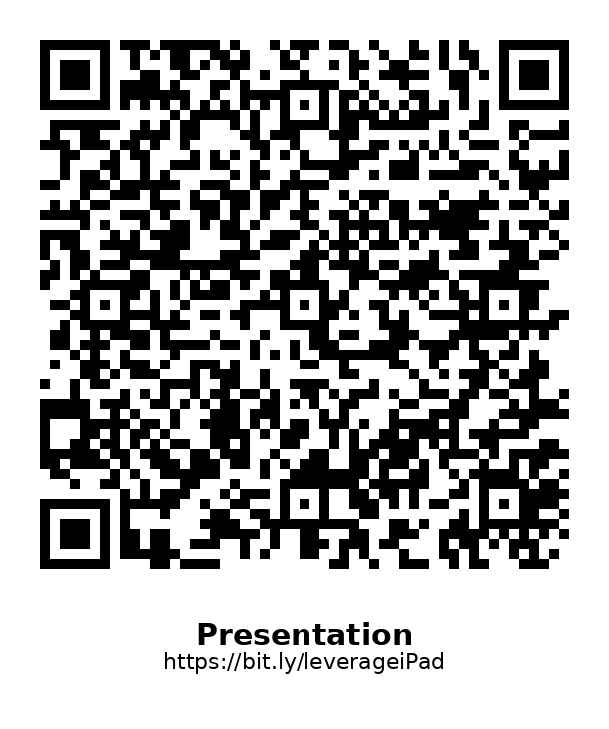
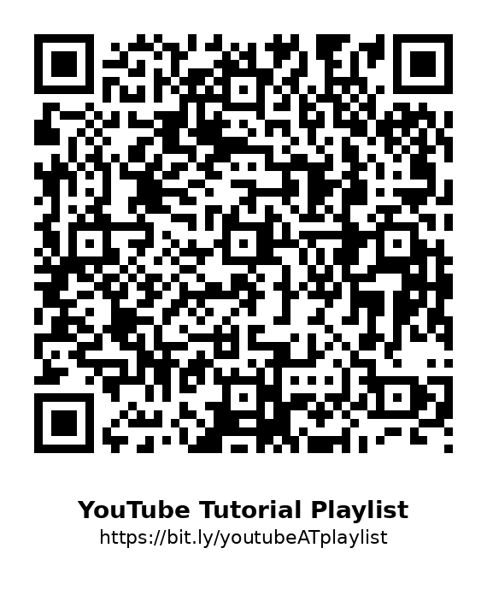
Leveraging iPad Functionality to Increase Access for Students
Colleen Collins
Special Education
Assistive Technology Specialist
Omaha public schools
Notes:
Talk a bit about how AT doesn’t hold students back and is needed to let kids know they can do hard things
If you do open slides, please mute your device. All the underlines are links to video tutorials. Otherwise, you can access the tutorials via the QR codes (which can also be clicked as links) on the handout

Slide 2
About Me
Twenty-two years in special education
Ten years as Assistive Technology Specialist for OPS
Lover of iPads; owner of Androids

Slide 3
Guiding beliefs:
Everyone is doing their best at any given moment.
We all want the best for our students.
We only know what we know.
When we know better, we do better.
Notes:
Ask me questions. If you know other tools or ways to do this, please share.

Slide 4
Assistive Technology:
As defined in IDEA: Assistive technology device means any item, piece of equipment, or product system, whether acquired commercially off the shelf, modified, or customized, that is used to increase, maintain, or improve the functional capabilities of a child with a disability. The term does not include a medical device that is surgically implanted, or the replacement of such device.​
Notes:
IDEA = individuals with disabilities education act

Slide 5
Instructional tech vs assistive tech
Instructional Tech: tools and resources used to facilitate learning. Goal is to make learning more engaging, efficient, and accessible to all students. ​
Assistive Tech: A compensatory strategy. Allows a student to perform functions they otherwise wouldn’t be able to do. May be used in conjunction with instructional tech.​
Notes:
It’s not instructional tech

Slide 6

A Brief OPS assistive tech timeline:
2015–2020
Expert model of Assistive Technology
2020
COVID…
Fall 2020-present
Capacity-building model of Assistive Technology

Slide 7
Accessibility categories:
Apple’s terms:
Vision
Physical & Motor
Hearing
Speech
General
Instructional Terms:
Reading
Writing
Executive Functioning
Accessing

Slide 8
Features that Support Reading:
Speech Controller: when activated, will read aloud the whole screen or a section that is tapped.
Hold to Speak Predictions: when active, hold each word in the prediction line to hear it read aloud.
Speak Selection: any text that can be highlighted can be read aloud. More precise than Speech Controller.
Display & Text Size: Adjust how text looks on the iPad. May not affect things within an app.
Live Text: built into the camera and other apps. It will read aloud text when used in conjunction with Speech Controller or Speak Selection.

Slide 9
Features that Support Writing:
Mic: Dictation/text to speech. Must be enabled in apps.
Text Replacement: Type a shorthand phrase or abbreviation that will generate longer text. Great tool for things that need to be repeatedly typed.
Voice Memos: record verbal answers to turn in or convert to text using the transcription feature. Copy/paste into other documents as needed. Videos from the camera app could also work.
Keyboard Features: Features generally on, but that can be helpful include predictive text and show predictions inline.
Camera: Take photos of notes to alleviate copying.
Lowercase Keyboard: students who struggle with reversals may find typing on a keyboard will all uppercase letters easier to use.

Slide 10
Features that Support Executive Functioning:
LXX5565M9H
Guided Access: locks a student into an app and restricts access within an app.
Timers/Alarms: self-monitor their time
Reminders app: use as virtual agenda. When set as a widget, app doesn’t need to be opened to see to-do list.
Background Sounds: play soothing white-noise sounds while working on the iPad or while the iPad is closed.

Slide 11
Features that Support Access:
Assistive Touch: perform multi-finger gestures with the touch of a button.
Mouse/Keyboards: Connect a mouse to the iPad
Vocal Shortcuts: iPad performs an action when you speak a word, phrase, or other sound.
Voice Control: Use your voice with commands to control your iPad.
Sticky/Slow Keys: possible options for students who have extremity differences, have tremors, etc.
Switch Control: Using a switch interface, control the iPad with switches

Slide 12

App: Snap Type Pro2
Take a picture of a worksheet:
Read aloud text
Type on worksheet
Draw feature

Slide 13

App: Notability
Take a picture of a worksheet:
Type on worksheet
Draw feature
Take Notes

Slide 14
What’s Next?
Secondary: direct-to-student training on these tools and the equivalent in their phones for life after school.
Elementary: introduce these solutions sooner
Notes:
George c we hold our kids back based on what we don’t know, not them.

Slide 15
Questions?
Contact info: colleen.collins@ops.org

