Slide 1


Slide 2
WORKSHOP AGENDA
0:00-0:05 Introductions & Housekeeping
0:05-0:20 What is an IEP
0:20-0:35 Communicating & Partnering with Families
0:35-0:50 Scenarios
0:50-1:20 Supporting Students in Jewish Settings
1:20-1:30 Closing & Takeaways

Slide 3
HOUSEKEEPING
Introductions
Legal Statement
Divide into groups of four. For the participants online, all can be one group.
There will be built in breaks for questions and comments from the online participants
All handouts are on Sched

Slide 4
WHAT IS AN IEP

Slide 5
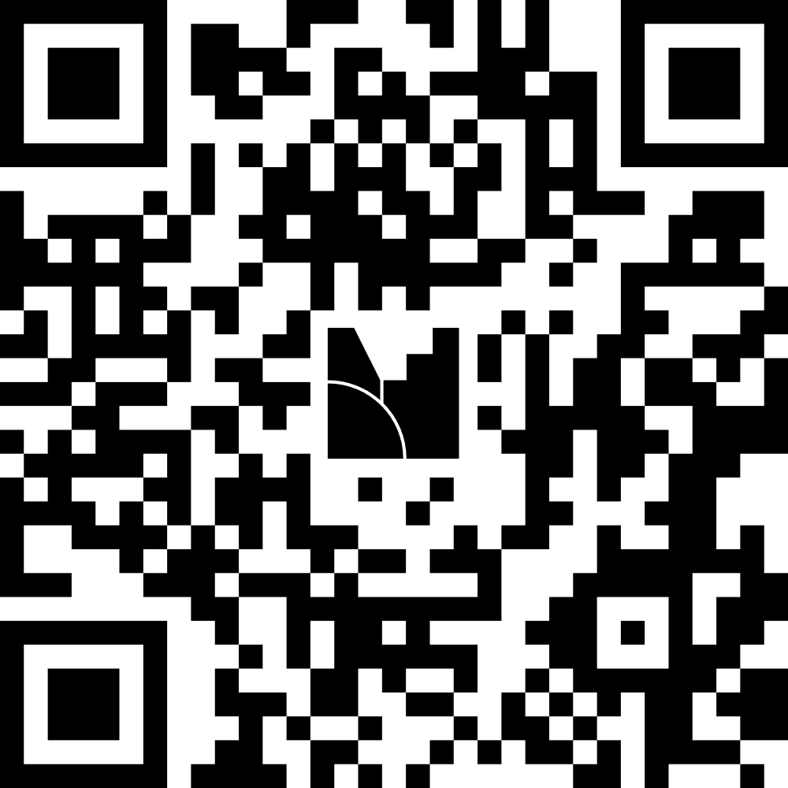
Please take a minute to answer the survey questions
(don’t forget to hit next question, there are two).

Slide 6
WHAT IS AN IEP
A written legal document
It describes the special education services for students who qualify for them
Details how the child is functioning
Acts as a way to measure goals and progress
Reviewed annually

Slide 7
KEY MILESTONES IN IEP HISTORY
1975: Education for All Handicapped Children Act (EHA, or Public Law 94-142). Mandated public schools develop an IEP for every qualifying child to guarantee access to education in the least restrictive environment (LRE).
1990: The EHA renamed the Individuals with Disabilities Education Act (IDEA). This update added autism and traumatic brain injury as recognized disability categories and required post-secondary transition planning.
1997: Amended for greater access to the general education curriculum and to formalize conflict-resolution strategies like mediation for parents.
2004: Congress enacted the Individuals with Disabilities Education Improvement Act, raising standards for special education teachers and requiring the use of research-based interventions in IEPs.

Slide 8
REPORTS AND EVIDENCE THE CREATOR OF AN IEP USES
Comprehensive Evaluations: Individual cognitive, academic, and psychological testing are used to determine eligibility and pinpoint specific strengths and weaknesses.
Classroom Assessments: Standardized test scores, daily assignments, and grading trends help measure academic achievement.
Functional Performance: Documentation of how the student handles daily living, communication, and motor skills in the school environment.
Teacher and Provider Input: Observations and reports from general education teachers, special educators, and specialists (e.g., speech therapists, occupational therapists).
Parent and Student Input: Your direct concerns, insights regarding how your child functions at home, and goals for the future.
Medical or Outside Reports: Any relevant physical, mental, or sensory evaluations provided by the family.

Slide 9
Who is at an IEP meeting?
Special Education Administrator
Special Education Teacher
Mainstream Teacher
Specials Teacher(s)
Specialists (Speech Pathologist, Occupational Therapist, Psychologist)
Parents
Outside Evaluators
Advocate/Lawyer

Slide 10
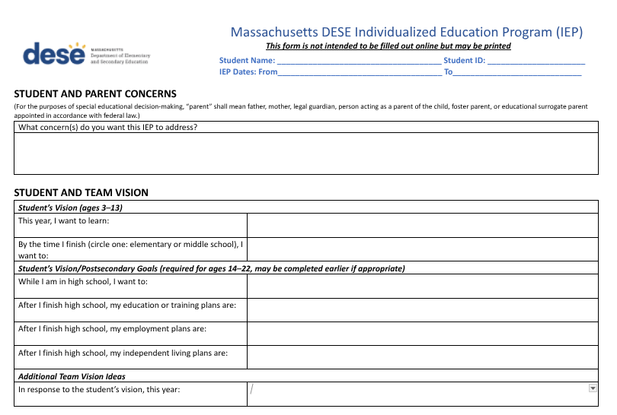

Slide 11
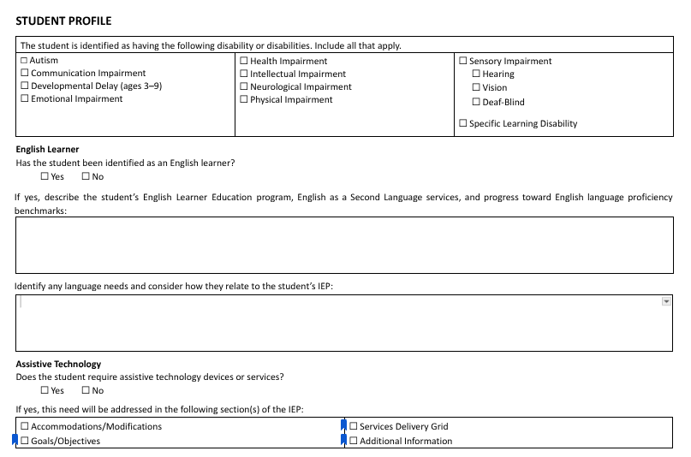

Slide 12
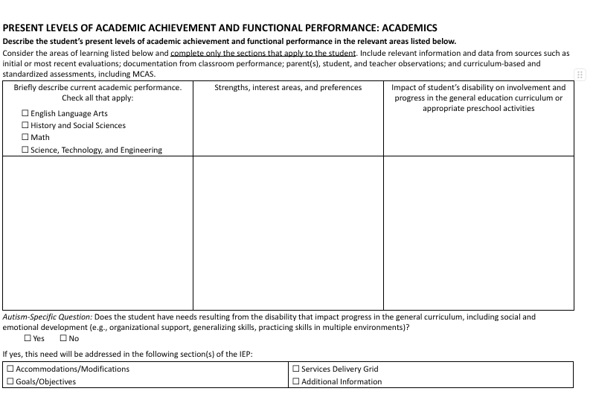

Slide 13
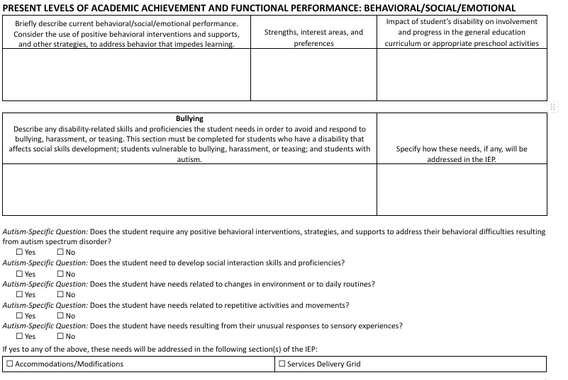

Slide 14
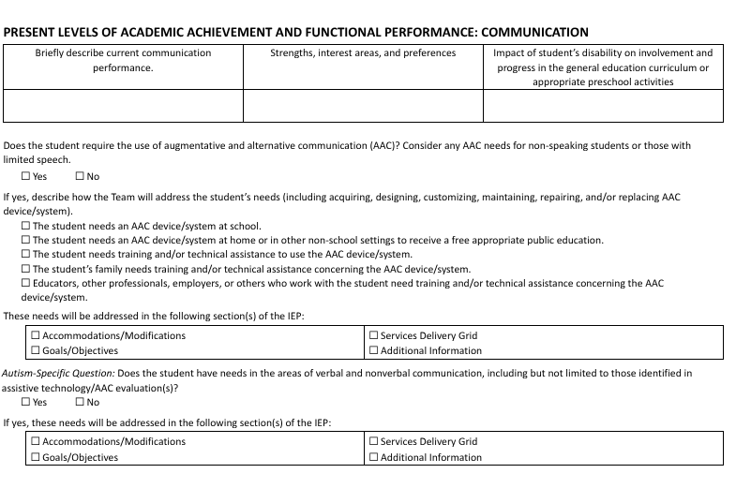

Slide 15
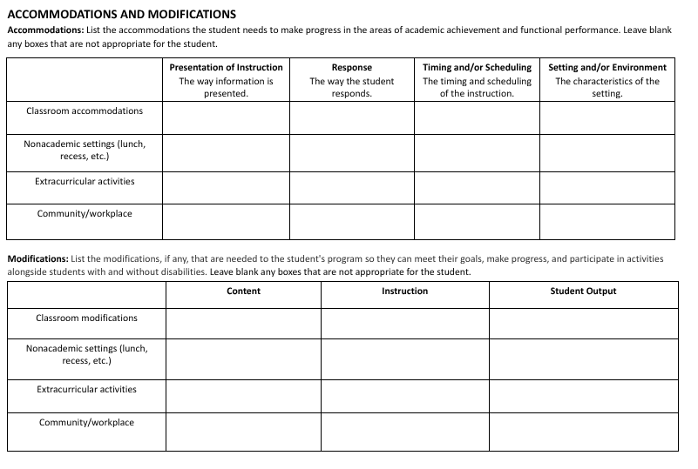

Slide 16
Communicating & Partnering with Families

Slide 17


Slide 18
CONFIDENTIALITY MATTERS
IEPs contain private information
Only share IEPS with appropriate stakeholders (parents, teachers, administrators
Keep documentation locked
Ask permission before speaking about a student

Slide 19
PARENT-SCHOOL MEETING SCENARIOS

Slide 20
Debrief:
How did collaborative did everyone work?
What were some of the challenges to creating the JEAP?
What happened?
What were some things that went well?
In a real IEP meeting, what do you see would be some of the obstacles?
What are some ways we can make our meetings feel different than IEP meetings?

Slide 21
Supporting Students in Jewish Settings

Slide 22
WHEN CREATING GOALS KEEP IT S.M.A.R.T.
Specific
Measurable
Achievable
Relevant
Time-Bound

Slide 23
SAMPLE READING GOAL:
By the end of the semester, the student will identify and name all Hebrew letters with 90 percent accuracy in three out of four trials.

Slide 24
SAMPLE BEHAVIOR GOAL:
By the end of the term, when presented with a non-preferred independent task, the student will use a Hafsakah (break) card to request a 3-minute pause rather than engaging in work refusal, in 4 out of 5 opportunities across two consecutive weeks.

Slide 25
Look at list of accommodations

Slide 26
REFLECTION QUESTION
What is one way I can help every student feel seen, supported, and capable in our community?

Slide 27
Closing & Takeaways

