Slide 1
The Tefilah Reboot Project
Welcome! Please take a seat and enjoy the music until we are ready to begin. Feel free to sing along!
אַשְׁרֵי יוֹשְׁבֵי בֵיתֶךָ, עוֹד יְהַלְלוּךָ סֶּלָה. | Ashrei yosh'vei veitekha, od y'hal'lukha sela.
Happy are those who dwell in Your house;
they will sing your praises forever!

Slide 2
Happy/fortunate
Dwell
Your house
אַשְׁרֵי
יוֹשְׁבֵי
בֵיתֶךָ

Slide 3
בֵיתֶךָ

Slide 4
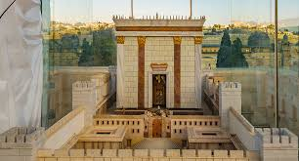
בֵיתֶךָ

Slide 5
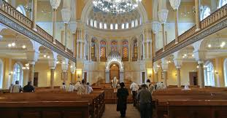
בֵיתֶךָ

Slide 6
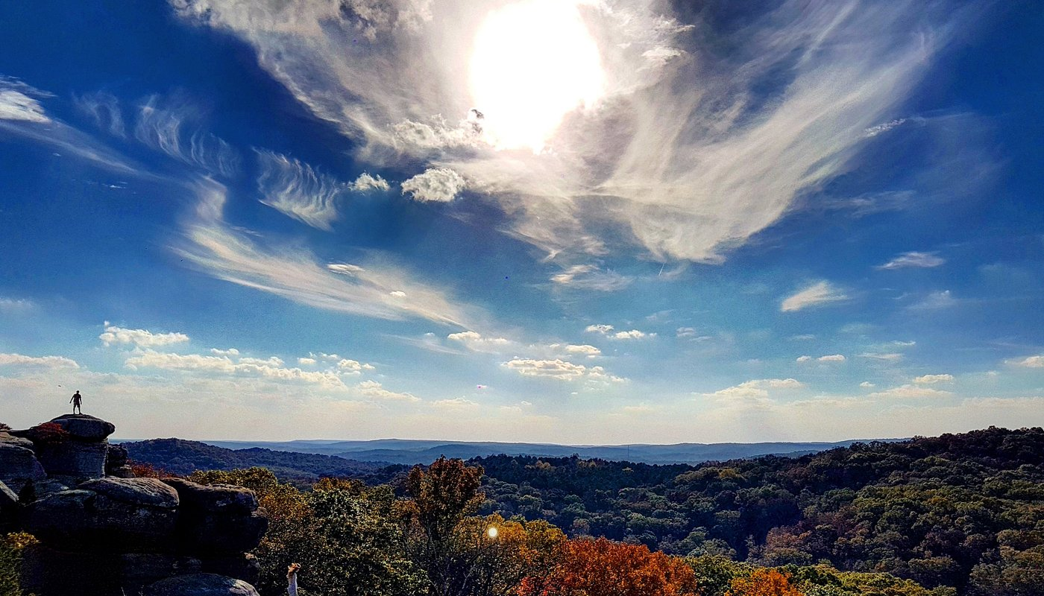
בֵיתֶךָ

Slide 7
Planning for success
Rethinking the roles of faculty/staff and student leaders in a positive Tefilah environment
Rabbi Joshua Cahan

Slide 8
Why invest in Tefilah?

Slide 9
Why invest in Tefilah?
(my answers)
Tefilah is where we have the chance to nurture kids emotionally & spiritually, and infuse joy and love into their experience of Judaism and of learning.
It can shape how they feel about their whole school/camp experience, and make Judaism feel essential to their journey.

Slide 10
Am I/Can I be a Tefilah Educator?

Slide 11
Am I/Can I be a Tefilah Educator?
Good Tefilah doesn’t rely on a Pied Piper
A Tefilah educator isa facilitator, not an expert
You’re not clergy - you don’t need to be a spiritual guide.
Just know yourself: Find some authentic, positive connection you have to prayer or ritual so you can be genuine in helping kids find theirs

Slide 12
What does great tefilah look like?

Slide 13
What does great tefilah look like?
Positive energy and interactions btw faculty & students
Kids channel their teen energy into joy and connectedness
Connecting Tefilah to awareness, meaning, intentionality

Slide 14
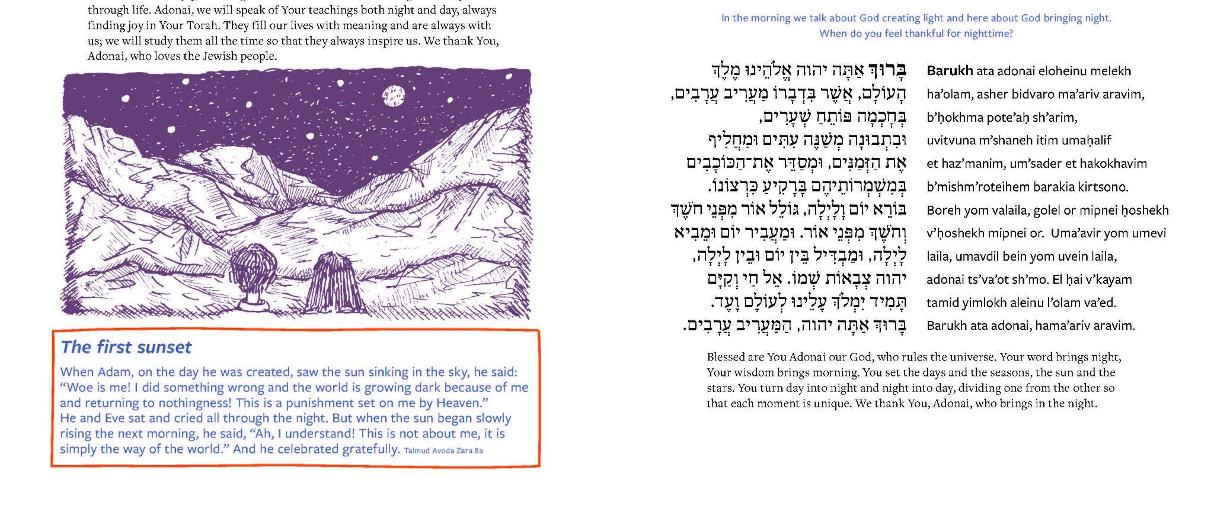

Slide 15


Kabbalat Shabbat
Sh’ma & its Blessings​
  Bar’chu
  Ma’ariv Aravim
  Sh’ma
  V'ahavta
  Mi Chamocha
  V’shamru
Amidah​
Conclusion​
Roll into dark​
Roll into light​
Night becomes day​
Day turns to night​
Borei yom valailah, ​
goleil or mipnei choshech v'choshech mipnei or. ​
בּוֹרֵא יוֹם וָלָיְלָה,
גּוֹלֵל אוֹר מִפְּנֵי חֹשֶׁךְ וְחֹשֶׁךְ מִפְּנֵי אוֹר.
You are Creator of day and night, rolling light away from darkness and darkness from light.
Notes:
Photo by Brett Lubarsky

Slide 16
Keys to transformation
Energy
  Greeting; smiling; singing; FUN
Empowering kids
  Assigning roles; modeling for peers; teaching tunes; skills for leading
Creativity
  Build toward full service; meanings & connections that can be distilled; spend time on melodies and ideas that can become part of regular service; find ways to mix it up; educational goals and long-term arc
Connection
  Prioritize personal meaning with overall theme or a few key phrases; don’t try to learn/practice a whole prayer to start; sharing w each other

Slide 17

Reboot
Staff Roles
In an ideal world, what would staff’s primary roles be?
Think about what you do DURING Tefilah & BEFORE.
Students' Roles
What is students’ role now? What could it be?
Consider roles of the most active students/leaders and of less engaged students.

Slide 18
Obstacles
Students’ attitudes & assumptions & our own
Weak skills - students’ and ours
Too focused on behavior/order
No space for creativity OR Not enough structure

