Slide 1


504 Process Highlights
for Case Managers
Nisha Green-Jones
Coordinator of Section 504

Slide 2

Resources
The 504 Team
The 504 Process with VAIEP Walkthrough
  504 Meeting Invitation
  504 Referral
  504 Evaluation Notice
  504 Eligibility/Re-Evaluation
  504 Plan
  504 MDR
  504 Procedural Safeguards
Agenda

Slide 3

Resources
Section 504 of the Rehabilitation Act: Law and Practice (HCPS training video)
Section 504 of the Rehabilitation Act: Law and Practice (PowerPoint)
HCPS GUIDELINES AND PROCEDURES FOR SECTION 504 English
Parent and Educator Resource Guide to Section 504 in Public Elementary and Secondary Schools

Slide 4

Resources
The 504 Team
Multidisciplinary team comprised of persons knowledgeable of:
The student
The meaning of evaluation data
The placement options available to eligible students
Each required area of knowledge must be present on all 504 teams
Section 504 Team Meeting Roles & Responsibilities

Slide 5

Resources
The 504 Team
The SSW specialty departments and related service providers are a 504 team’s resource for:
Reviewing and interpreting reports from outside providers
Assisting in determining the need for, and conducting and gathering evaluation data
Consulting and participating on the team to:
  Provide knowledge of the impairment
  Recommend accommodations and supports
In the event a team member is unfamiliar with an impairment within the scope of their department, the 504 team should request that the team member bring the case to the team member’s department for consult and support on the team’s behalf.
School nurse attendance at 504 meetings:
An RN should be invited to all 504 meetings.
An RN must be invited to and included in 504 meetings for students with medical/health needs, especially if accommodations and/or services addressing a student’s medical/health needs are being considered/updated. The RN will ensure that all medical/health necessities are properly addressed.
  Check PowerSchool for health alert:
If your school nurse is an LPN, please provide adequate notice for 504 meetings as the nurse will need to invite an RN to join the meeting as well.

Slide 6
Resources
The 504 Team
Updated Visitor Policy/Regulation Highlights:
Parents or guardians are permitted to invite individuals knowledgeable about their student to 504 meetings
Parents are responsible for communicating with any third party they invite to any such meeting
When releasing and exchanging information with custodial parents and guardians about their child, HCPS staff will communicate with the parent and/or guardian directly and not with non-custodial third parties and/or advocates
  However, nothing in this policy shall prevent HCPS staff from making referrals to; coordinating services and resources with; or communicating directly with licensed medical and mental/behavioral health providers and their designated staff and/or attorneys, and/or community organizations and agencies on behalf of students when authorized by a parent/guardian
Related Documents:
P11-08-001-R: Regulations Pertaining to School Visitors
P11-08-001: School Visitors

Slide 7

Resources
The 504 Team
Divorced Parents/Guardians:
VA is a one-party consent state, so for parents/guardians with joint custody, even if they disagree over the need to evaluate, a 504 team only needs 1 parent/guardian signature to proceed.
Ensure that each parent’s/guardian's concerns are documented in the PWN (prior written notice).

Slide 8

Resources
The 504 Process
504 Meeting Invitation
504 Referral
504 Evaluation Notice
504 Eligibility/Re-Evaluation
504 Plan
504 MDR
504 Procedural Safeguards

Slide 9

504 Meeting Invitation
Complete in its entirety & accurately each time the 504 team will convene
Send to parents/guardians/adult students and follow-up when there is no response
Place all meeting invitations in students’ cumulative files
Complete a standalone prior written notice (PWN) to document discussion if no changes are made to the plan
No response/contact from parents/guardians when attempting to schedule a 504 meeting?
Take reasonable steps to ensure the accuracy of the available contact information.
Make a minimum of 3 attempts to make contact through all available contact methods provided to determine a mutually agreeable meeting date and time.

Slide 10
504 Meeting Invitation
Still no response? Proceed with scheduling a meeting date, time and location based on your school’s meeting scheduling procedures.
Create the meeting invitation and send the invite to the parents/guardians a minimum of 3 times (to include sending through mail) - this provides notice of the team’s intent to meet.
If the meeting date arrives and no response from the parents/guardians has been received, the team will convene as scheduled.
  Document all attempts to contact parents/guardians in the PWN (box 5).
  Send finalized 504 documents home with an offer to review/discuss the information.
  If the 504 meeting was an initial eligibility or initial plan meeting where parent permission is required to proceed, email Nisha to collaborate on next steps.
Document all parent/guardian contacts in VAIEP: Directions for Documenting Parent Contacts Using VAIEP

Slide 11

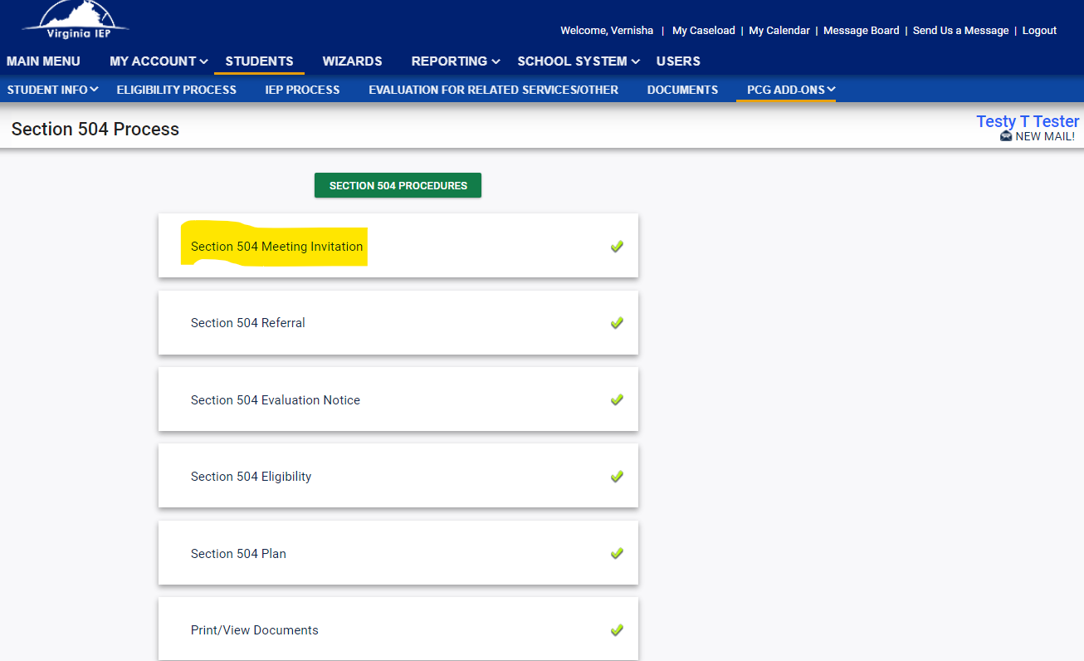
Meeting Invitation

Slide 12

504 Referral
Referral starts the process and meeting must be held within 10 business days of receiving the referral
Anyone can make a referral – can be oral or written made to the administrator or school counselor
Based on review of current student records and data relevant to the reasons for the referral, does the team have knowledge of or suspicion of a disability that may require accommodations and/or services?
If yes, we must evaluate.

Slide 13
504 Referral
Examples of information/events that may cause suspicion of a disability:
Information that student has been hospitalized
Information that student has DSM-V diagnosis
Information that student takes medication
Information that student receives counseling
Information that student has medical impairment
Numerous or increasing disciplinary incidents
Truancy/attendance issues
Indicators of depression or withdrawal
Indicators of attention or behavior problems
Poor or declining grades/assessment results
Poor results/lack of improvement following Intervention Team
504 Team Considerations:
Are there non-disability explanations for the student’s challenges?
Does the student need short-term, targeted instruction to improve a specific skill/area of weakness?
Does the student need a consistent change to teaching/testing that removes a barrier?

Slide 14
504 Referral
Team suspects the student may have a disability that requires accommodations and/or services with no current diagnosis/documentation:
Consider asking for a release to contact the student’s medical provider(s) or other outside provider(s) to obtain information.
Conduct the evaluation using other effective methods of determining the existence of a physical or mental impairment:
  The team is not asked to make a diagnosis but to identify impairments.
  What are “other effective methods?”
    The team can use a combination of methods such as observations, behavior checklists, screenings, rating scales, test scores, grades, and review of other available data to identify the impairment and screen out nondisability causes for the student’s challenges.
What if medical data is required?
  Contact the 504 Coordinator
Is diagnosis/ documentation from parents/guardians needed to initiate a referral?
It is not required that parents/guardians:
  obtain a diagnosis or have documentation of an impairment to make a referral or to have a referral considered
  have a diagnosis/documentation present at the referral meeting for the team to initiate evaluation
If there is suspicion of a disability that requires accommodations and/or services, the district is responsible for evaluating students at no cost to parents/guardians.

Slide 15
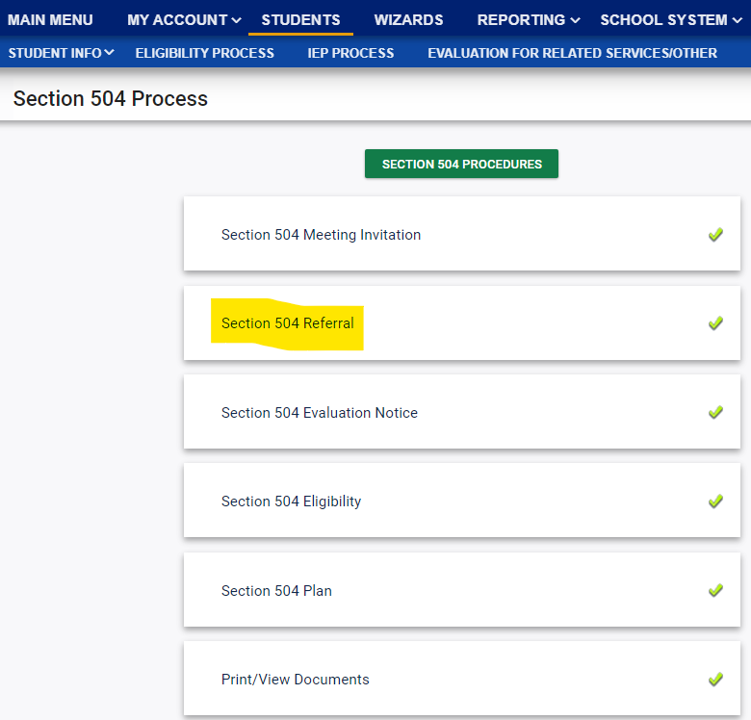
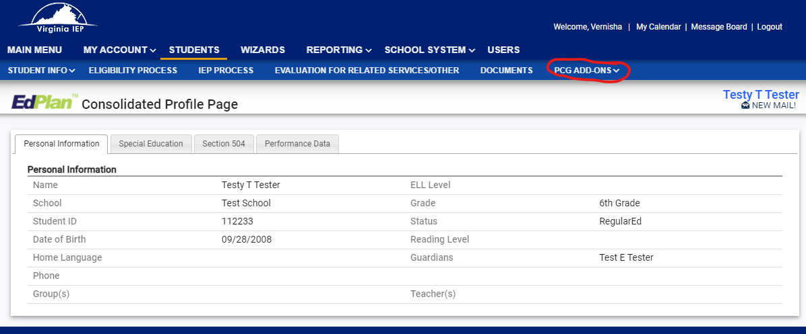
Referral ~ VAIEP
Enter the student’s record in VAIEP
Enter the 504 Process by Selecting PCG Add-Ons
Select 504 Process
4. Select Section 504 Referral to enter the
Referral page

Slide 16
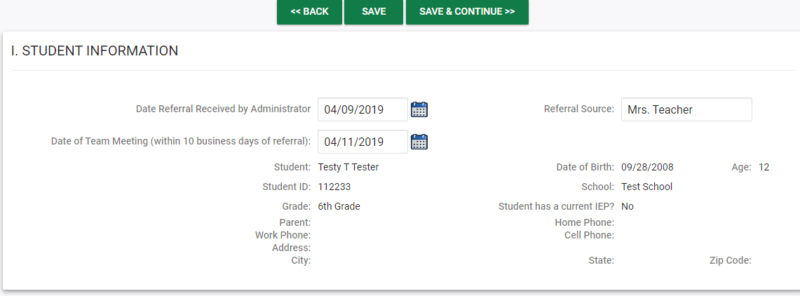
Referral ~ VAIEP
Complete Section I. ~ Student Information:
Make sure that the referral date is accurate
Referral Source: the person who made the referral

Slide 17
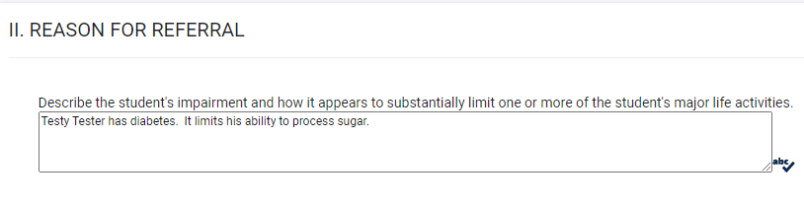
Referral ~ VAIEP
Complete Section II. ~ Reason for Referral
Contact the referral source prior to the meeting and specifically ask for the reason for referral:
  If source reports that the student has an impairment, ask for the areas of concern related to the impairment as related to school
  Communicate this information to team members prior to meeting and have team members bring current information related to the referral to the meeting
Review any reports/medical notes provided by the parents/guardians as well as information from the cumulative file (discipline records, attendance, etc.) and staff input
Document specifically any impairment(s) and how the student is impacted by the impairment(s)

Slide 18
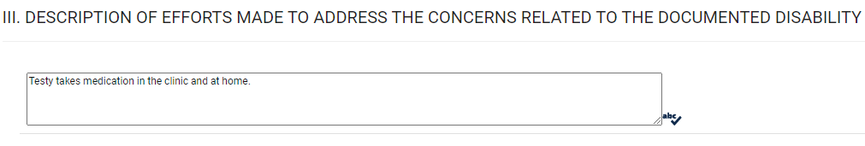
Referral ~ VAIEP
Complete Section III. ~ Description of Efforts Made
Enter efforts that have been made in school and in the home (medication, therapy, school interventions, etc.)
Prompt the team to make a referral decision:
Refer to intervention team
Initiate 504 evaluation process
No action indicated at this time
“Based on review of current student records and data relevant to the reasons for the referral, does the team have knowledge of or suspicion of a disability that requires or is believed to require accommodations and/or services?”
If yes, we must evaluate.

Slide 19
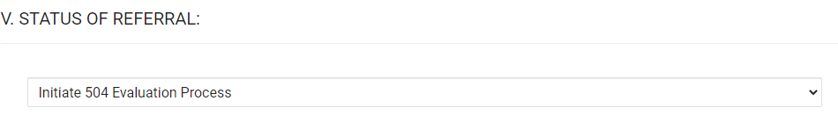
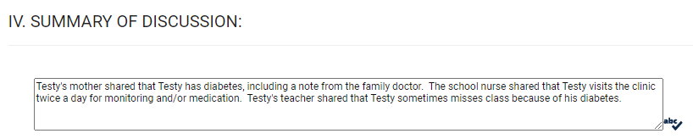
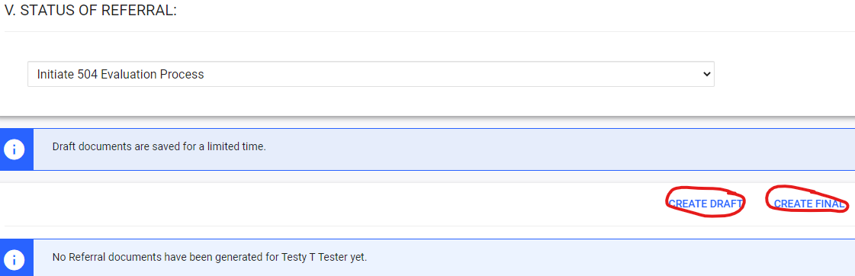
Referral ~ VAIEP
Complete Section V. ~ Status of Referral
Create a draft to check your information and then Create Final document
Complete Section IV. ~ Summary of Discussion
Summarize information that was shared
Document the team’s decision on referral

Slide 20

504 Evaluation
Timeline: 65 business days to complete evaluation and hold eligibility
Complete evaluation & evaluation notice when:
  Initiation of evaluation after 504 referral meeting
  Re-evaluation
  New data is needed
Written parent/guardian consent is required for initial evaluation or evaluation requesting new data
The team determines what information is needed to determine if a student is 504 eligible or continues to be 504 eligible.

Slide 21
504 Evaluation
Written consent not provided?:
  Do not evaluate
  Complete a PWN stating the team decided to proceed to eligibility however the parent/guardian declined consent to evaluate
  This stops the 504 process - consider interventions
How much information do you need?
Enough information to answer the following questions:
  What is the impairment?
  What major life activity or activities are impacted?
  Is there substantial limitation?
  How does the impairment interfere with participation in school programs/activities?
The team must use a variety of sources in the evaluation process
  Medical diagnosis alone is not enough as an evaluation

Slide 22

504 Evaluation
Complete the evaluation notice with team members at the referral meeting
Parent/guardian states they have an upcoming appointment to obtain documentation of disability:
  Account for the possibility that documentation may not be received - What information will the team gather?
Can we accept diagnosis/documentation from other countries? Yes!
Diagnosis/documentation from provider doesn’t discuss disability impact on student:
  Exchange of confidential information - contact the provider for information needed
  Include additional evaluation components to gather the data
Evaluation notice must be completed for re-evaluations

Slide 23
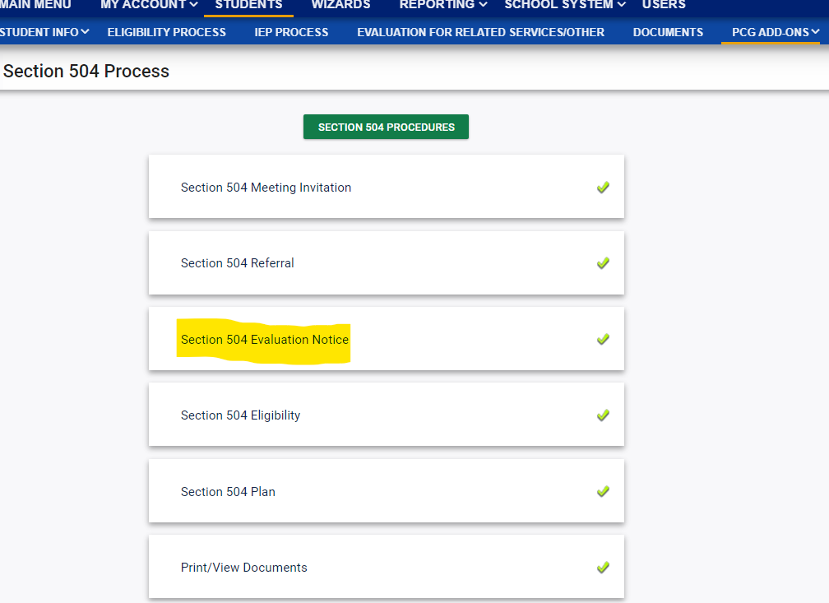
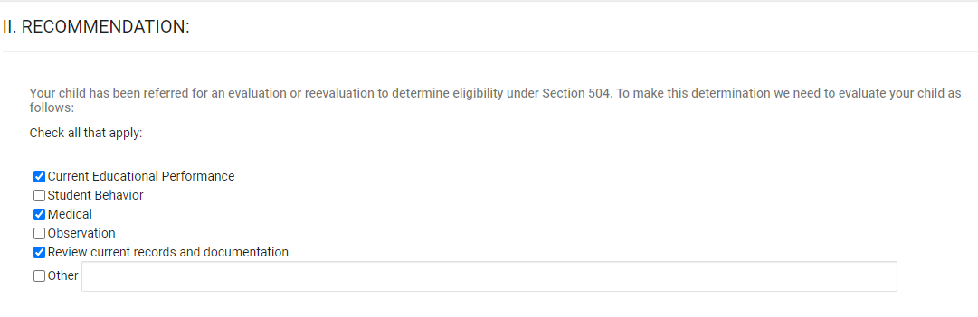
Evaluation
Select Section 504 Evaluation Notice
2. Complete Section II. ~ Here is where you will document the information the team will use to determine eligibility:

Slide 24
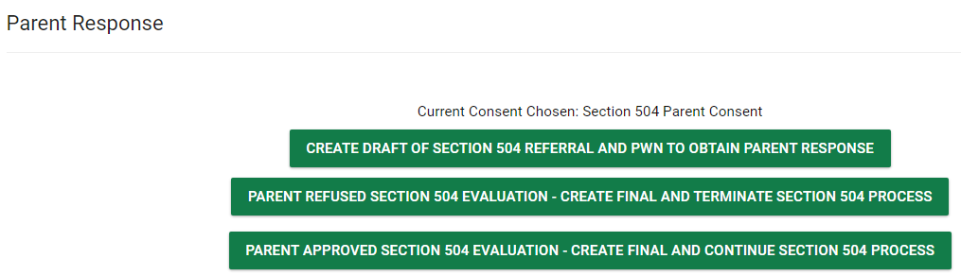
Evaluation
Reviewing Current Records and documentation?
A review of current records and documentation can include:
  Evaluations & information provided by parents/guardians
  Current classroom based, local or state assessments & classroom based observations
  Observations by teachers & related service providers
  Information from student’s cumulative file
Enter the parent’s response to the evaluation notice once the signed document is received

Slide 25
504 Eligibility
Timeline: 65 business days for eligibility determination
Complete eligibility when:
  Initial eligibility
  Re-evaluation
Must have an individual knowledgeable about evaluation data
Information from each evaluation component must be shared
Review and consider all information, including anything provided by parent/ guardian
A student may qualify under Section 504 when there is:
a physical or mental impairment that
substantially limits
one or more major life activities

Slide 26
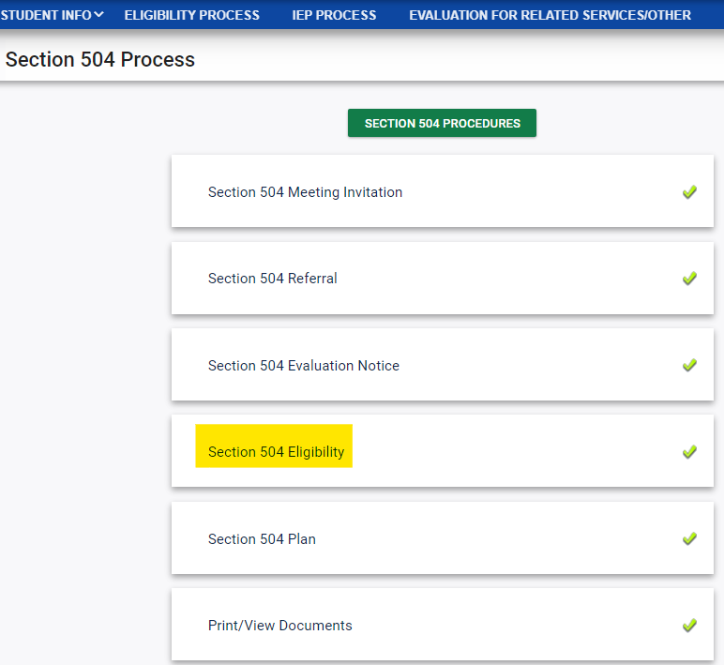
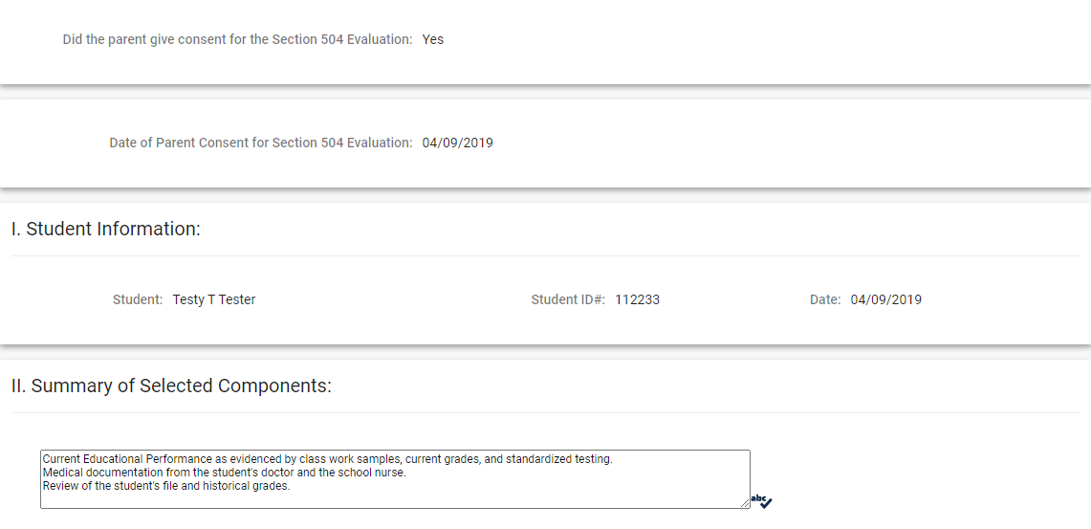
504 Eligibility
Select Section 504 Eligibility
2. Complete Section II of the eligibility page by having the team review each evaluation component that was selected on the evaluation notice and then summarizing the information.

Slide 27
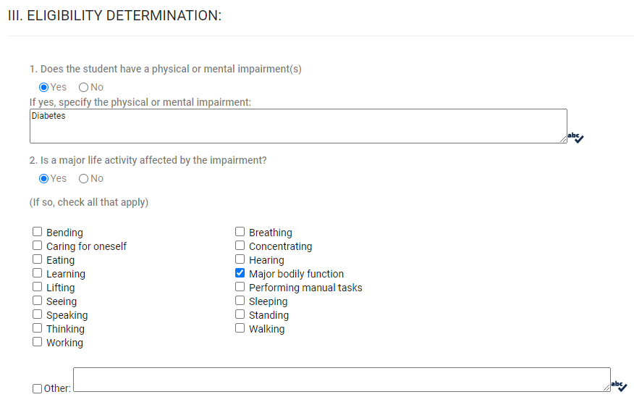
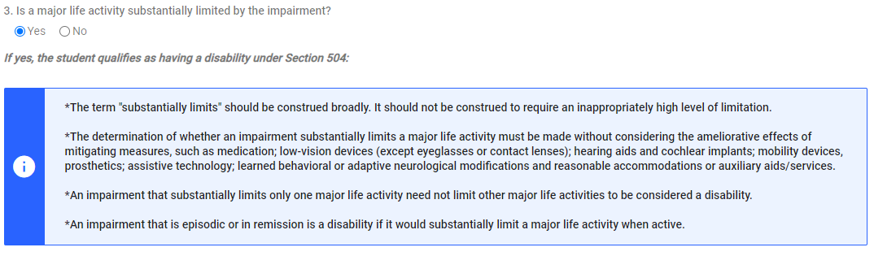
504 Eligibility
Complete section III of the eligibility page by walking the team through each question
and having team members respond ‘Yes’ or ‘No’ and identifying the major life activities impacted.

Slide 28
504 Eligibility
Example summary:
Based on a review of (list the specific evaluation components reviewed), the team has determined that Nisha has (name the impairments). (Describe the student’s specific impacts to the major life activities) Nisha’s concentration is substantially limited as evidenced by challenges with maintaining sustained focus on tasks and frequent attention to environmental distractors. Her learning is substantially limited as she demonstrates frequent challenges with maintaining attention to instruction and completing assignments thoroughly independently. The team determined that Nisha is eligible under Section 504.

Slide 29
504 Plan
Timeline: review annually and as needed
Remember:
  Classroom and school environment
  Extracurricular and nonacademic activities:
    Field trips
    After school activities
    Assemblies
Testing Accommodations:
  504 Team Responsibilities Related to Virginia Assessment Participation
The team determines the accommodations and/or services a student’s requires.

Slide 30
504 Plan
Tip: Remind the team at the beginning of the meeting of the purpose :
“Today we are here to review/develop the 504 plan for ______. As we are discussing accommodations/services let’s all keep in mind that accommodations/services need to address the nature of the disability, the impact of the impairment on the major life activities, and focus on providing access to education.”
504 MEETING
AGENDA POSTER
504 MEETING
GROUND RULES POSTER

Slide 31
504 Plan
Handling Parent/Guardian Accommodation Requests:
Seek clarification regarding parent requests for accommodations
Listen to the answer
Discuss whether or not the request is a reasonable accommodation or whether it will fundamentally alter the program (accommodations shouldn’t provide an
advantage but level the playing field/provide access, so accommodations shouldn’t change learning expectations or alter tests or assignments in any major way)
Rely on data if available (if you don’t have data, assign a team member to collect data and reconvene at a later date with sufficient data)
Discuss and suggest other reasonable accommodations as possibilities

Slide 32
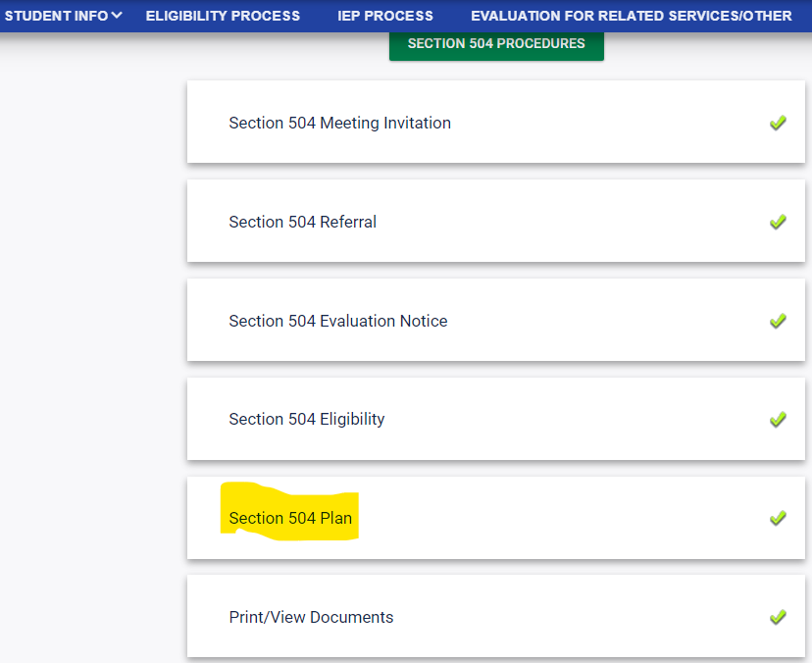
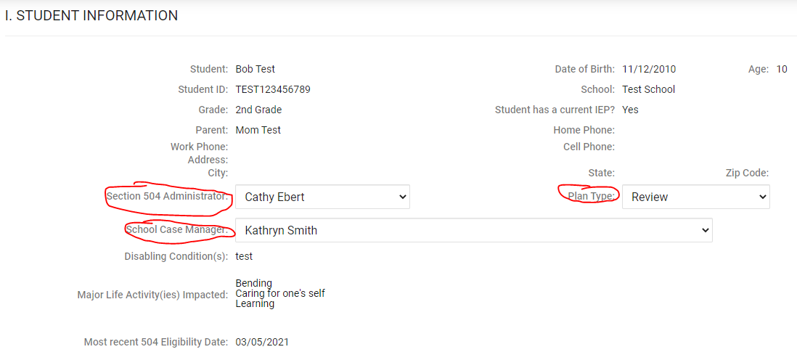
504 Plan
Select Section 504 Plan
2. Complete Section I. ~ Select the administrator attending the meeting, case manager and plan type.

Slide 33
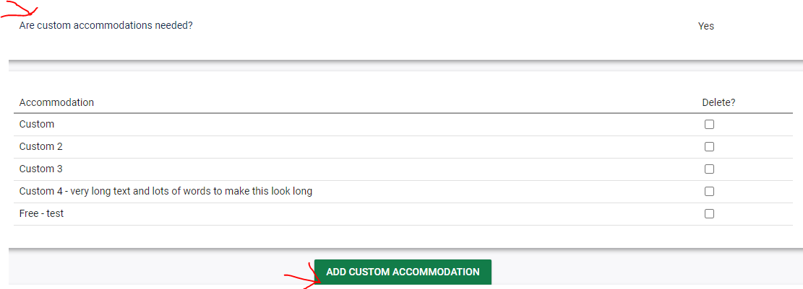
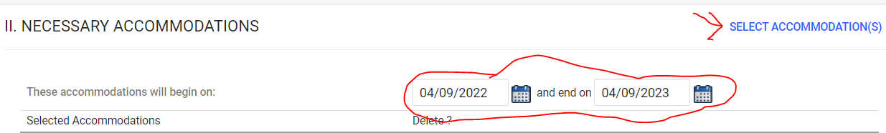
504 Plan
3. Enter plan beginning (date of the meeting) and end (one year later) dates
4. Select accommodations that are already listed in the system or create custom accommodations

Slide 34

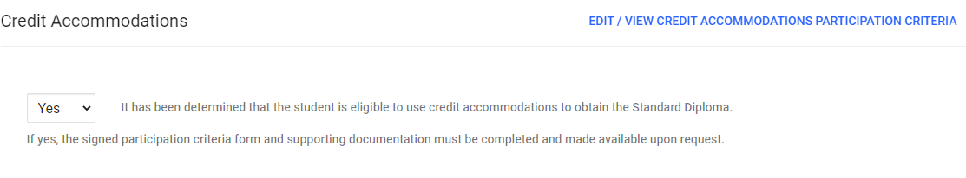
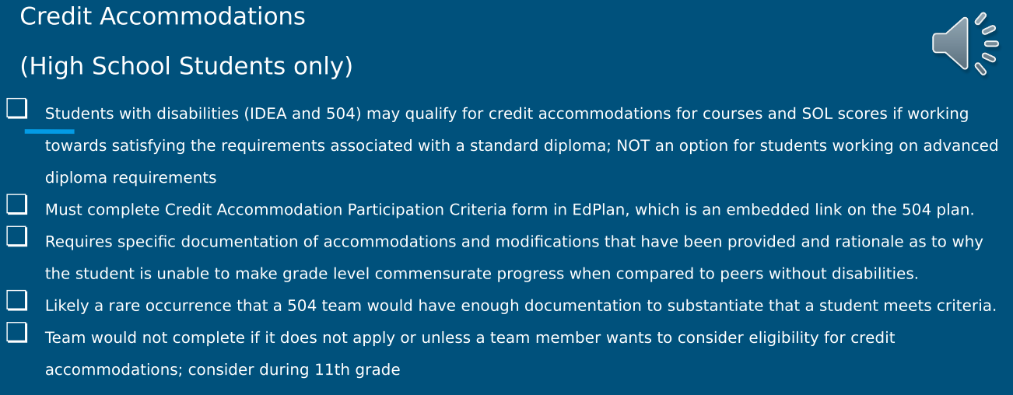
504 Plan
504 Plan
5. Select a response from the drop-down menu - high school students only

Slide 35
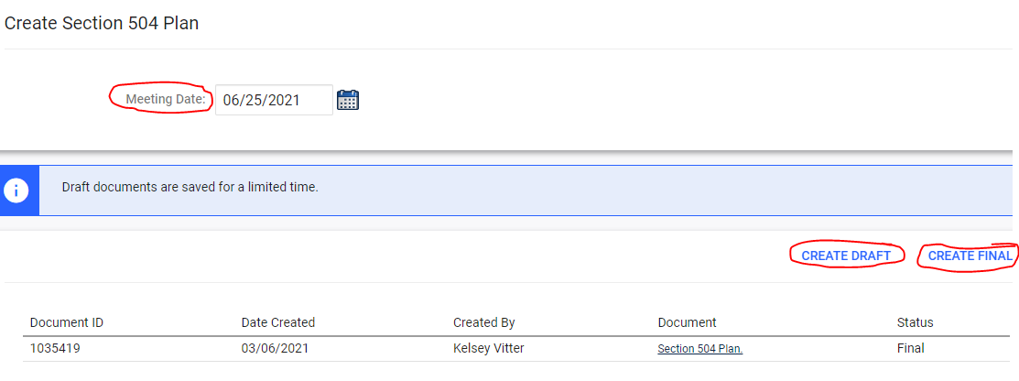
504 Plan
504 Plan
6. Enter the date of the meeting, create a draft for team review, create final when complete

Slide 36
504 Plan
Requests to Terminate 504 Eligibility and Plan
If the entire team feels the student no longer qualifies for a 504:
The team will need to hold a re-evaluation meeting with the appropriate team members:
  Review data
  Determine continued eligibility under Section 504,
  Completing a PWN
*This is done on the eligibility page in VAIEP. So, you’ll need to reach out to the appropriate team members to determine if the team feels this way.
If it is the parents’ decision solely, and we (HCPS) feel that the student does continue to qualify and does need a 504 plan, but the parent no longer wants the student to have a plan or be eligible under Section 504:
  The parent will need to write a statement indicating they no longer want their child to be eligible under Section 504 and wish to terminate any existing 504 plan and discontinue eligibility. It should be signed (wet signature), dated, and retained in the student's cumulative file.
  A standalone 504 PWN should be completed that states that HCPS believes the student is still eligible and requires a 504 plan but has terminated 504 eligibility and plan at parent request.
  Once this information is received by the school, email the written statement to the 504 coordinator for review and termination. If the 504 is for a medical reason, please ensure there is an active health plan for the student on file.

Slide 37
504 MDR
The team determines
if a student’s behavior
is a manifestation of
the impairment.
504 MDR Checklist
504 VAIEP MDR Directions
504 MDR Form Fillable Revised 2023

Slide 38
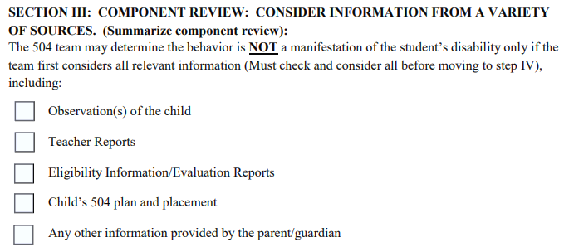
504 MDR
504 Coordinator attendance at MDRs:
  Required when a student is being recommended for expulsion
  Notified and may attend when a student is being suspended to a hearing
Team must include someone qualified to interpret relevant evaluation data
Each of the following must be discussed and documented:

Slide 39
504 Procedural Safeguards
Provide procedural safeguards document at:
  Consent for eligibility
  Initial eligibility determination
  All triennial evaluations
  Initial plan and Annual plan reviews
  Manifestation Determination reviews (MDRs)
  School determines not to evaluate
  School does not find child eligible
  School places student alternatively during discipline because it found behavior not related to disability
Provides an explanation of parent/guardian rights under Section 504.
504 Procedural Safeguards Arabic.pdf
504 Procedural Safeguards Dari.pdf
504 Procedural Safeguards English.r2019.pdf
504 Procedural Safeguards Pashto.pdf
504 Procedural Safeguards Portuguese.pdf
504 Procedural Safeguards Spanish.pdf

Slide 40


Contact Nisha for Questions/Support

Slide 41

Thanks for all you do!!
Nisha Green-Jones
Coordinator of Section 504
Office
804.652.3748
Work Cell
804.291.6694

