Slide 1
ODOT Partnerships for Awesomeness
Chris Cheng
Jenna Berman

Slide 2
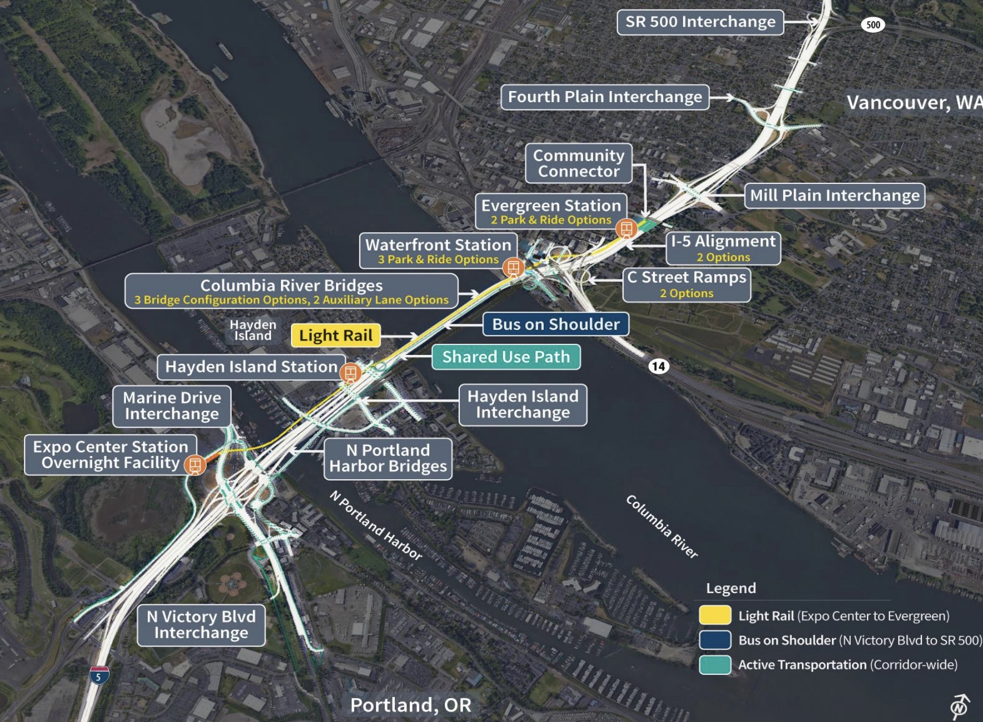
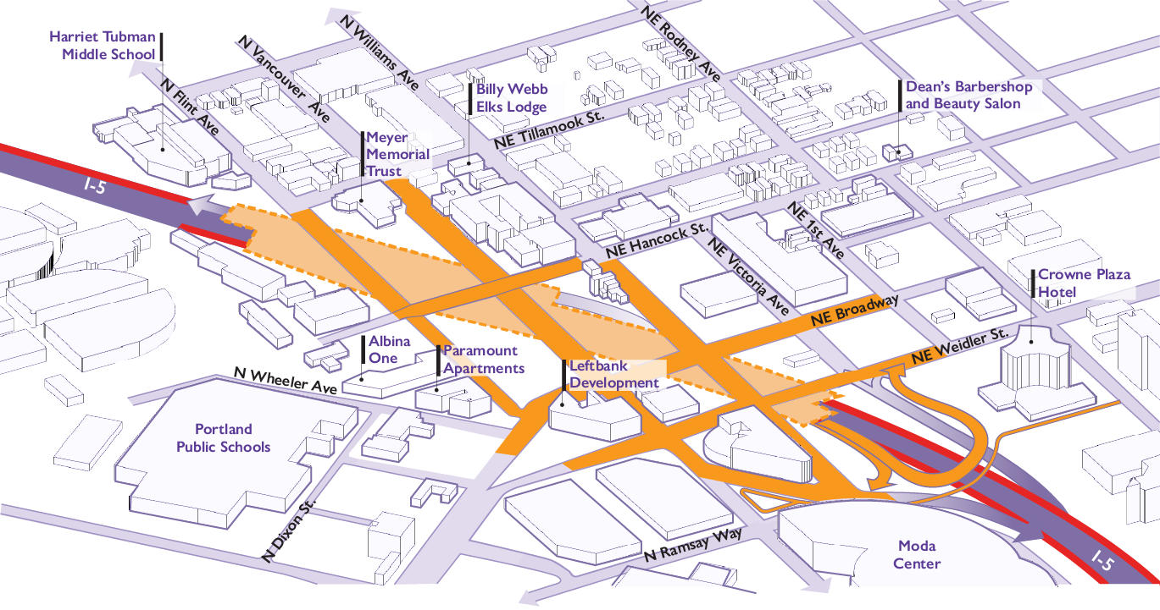
What do you think when you think ODOT?

Slide 3
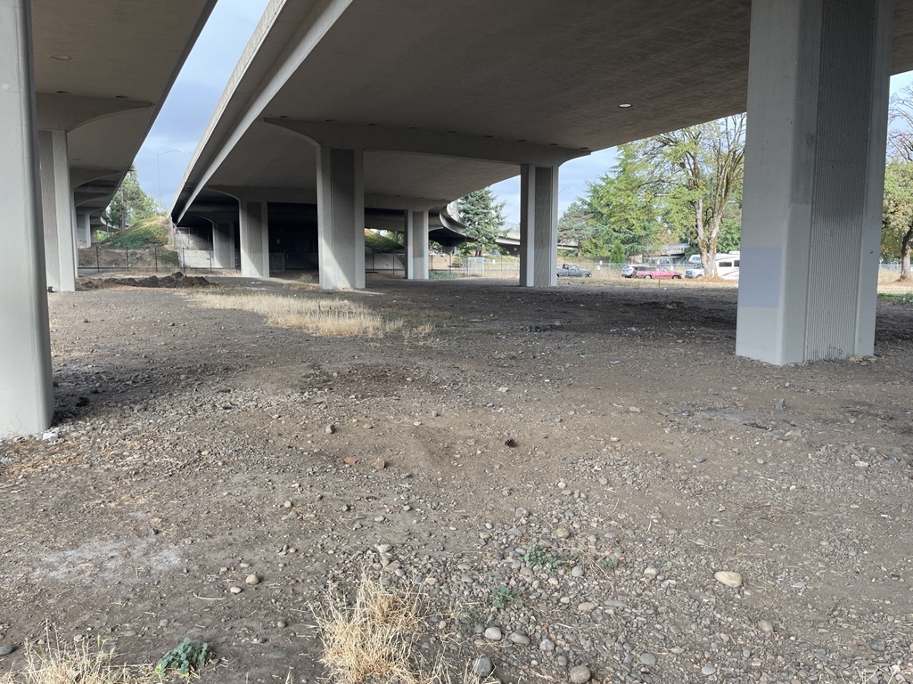
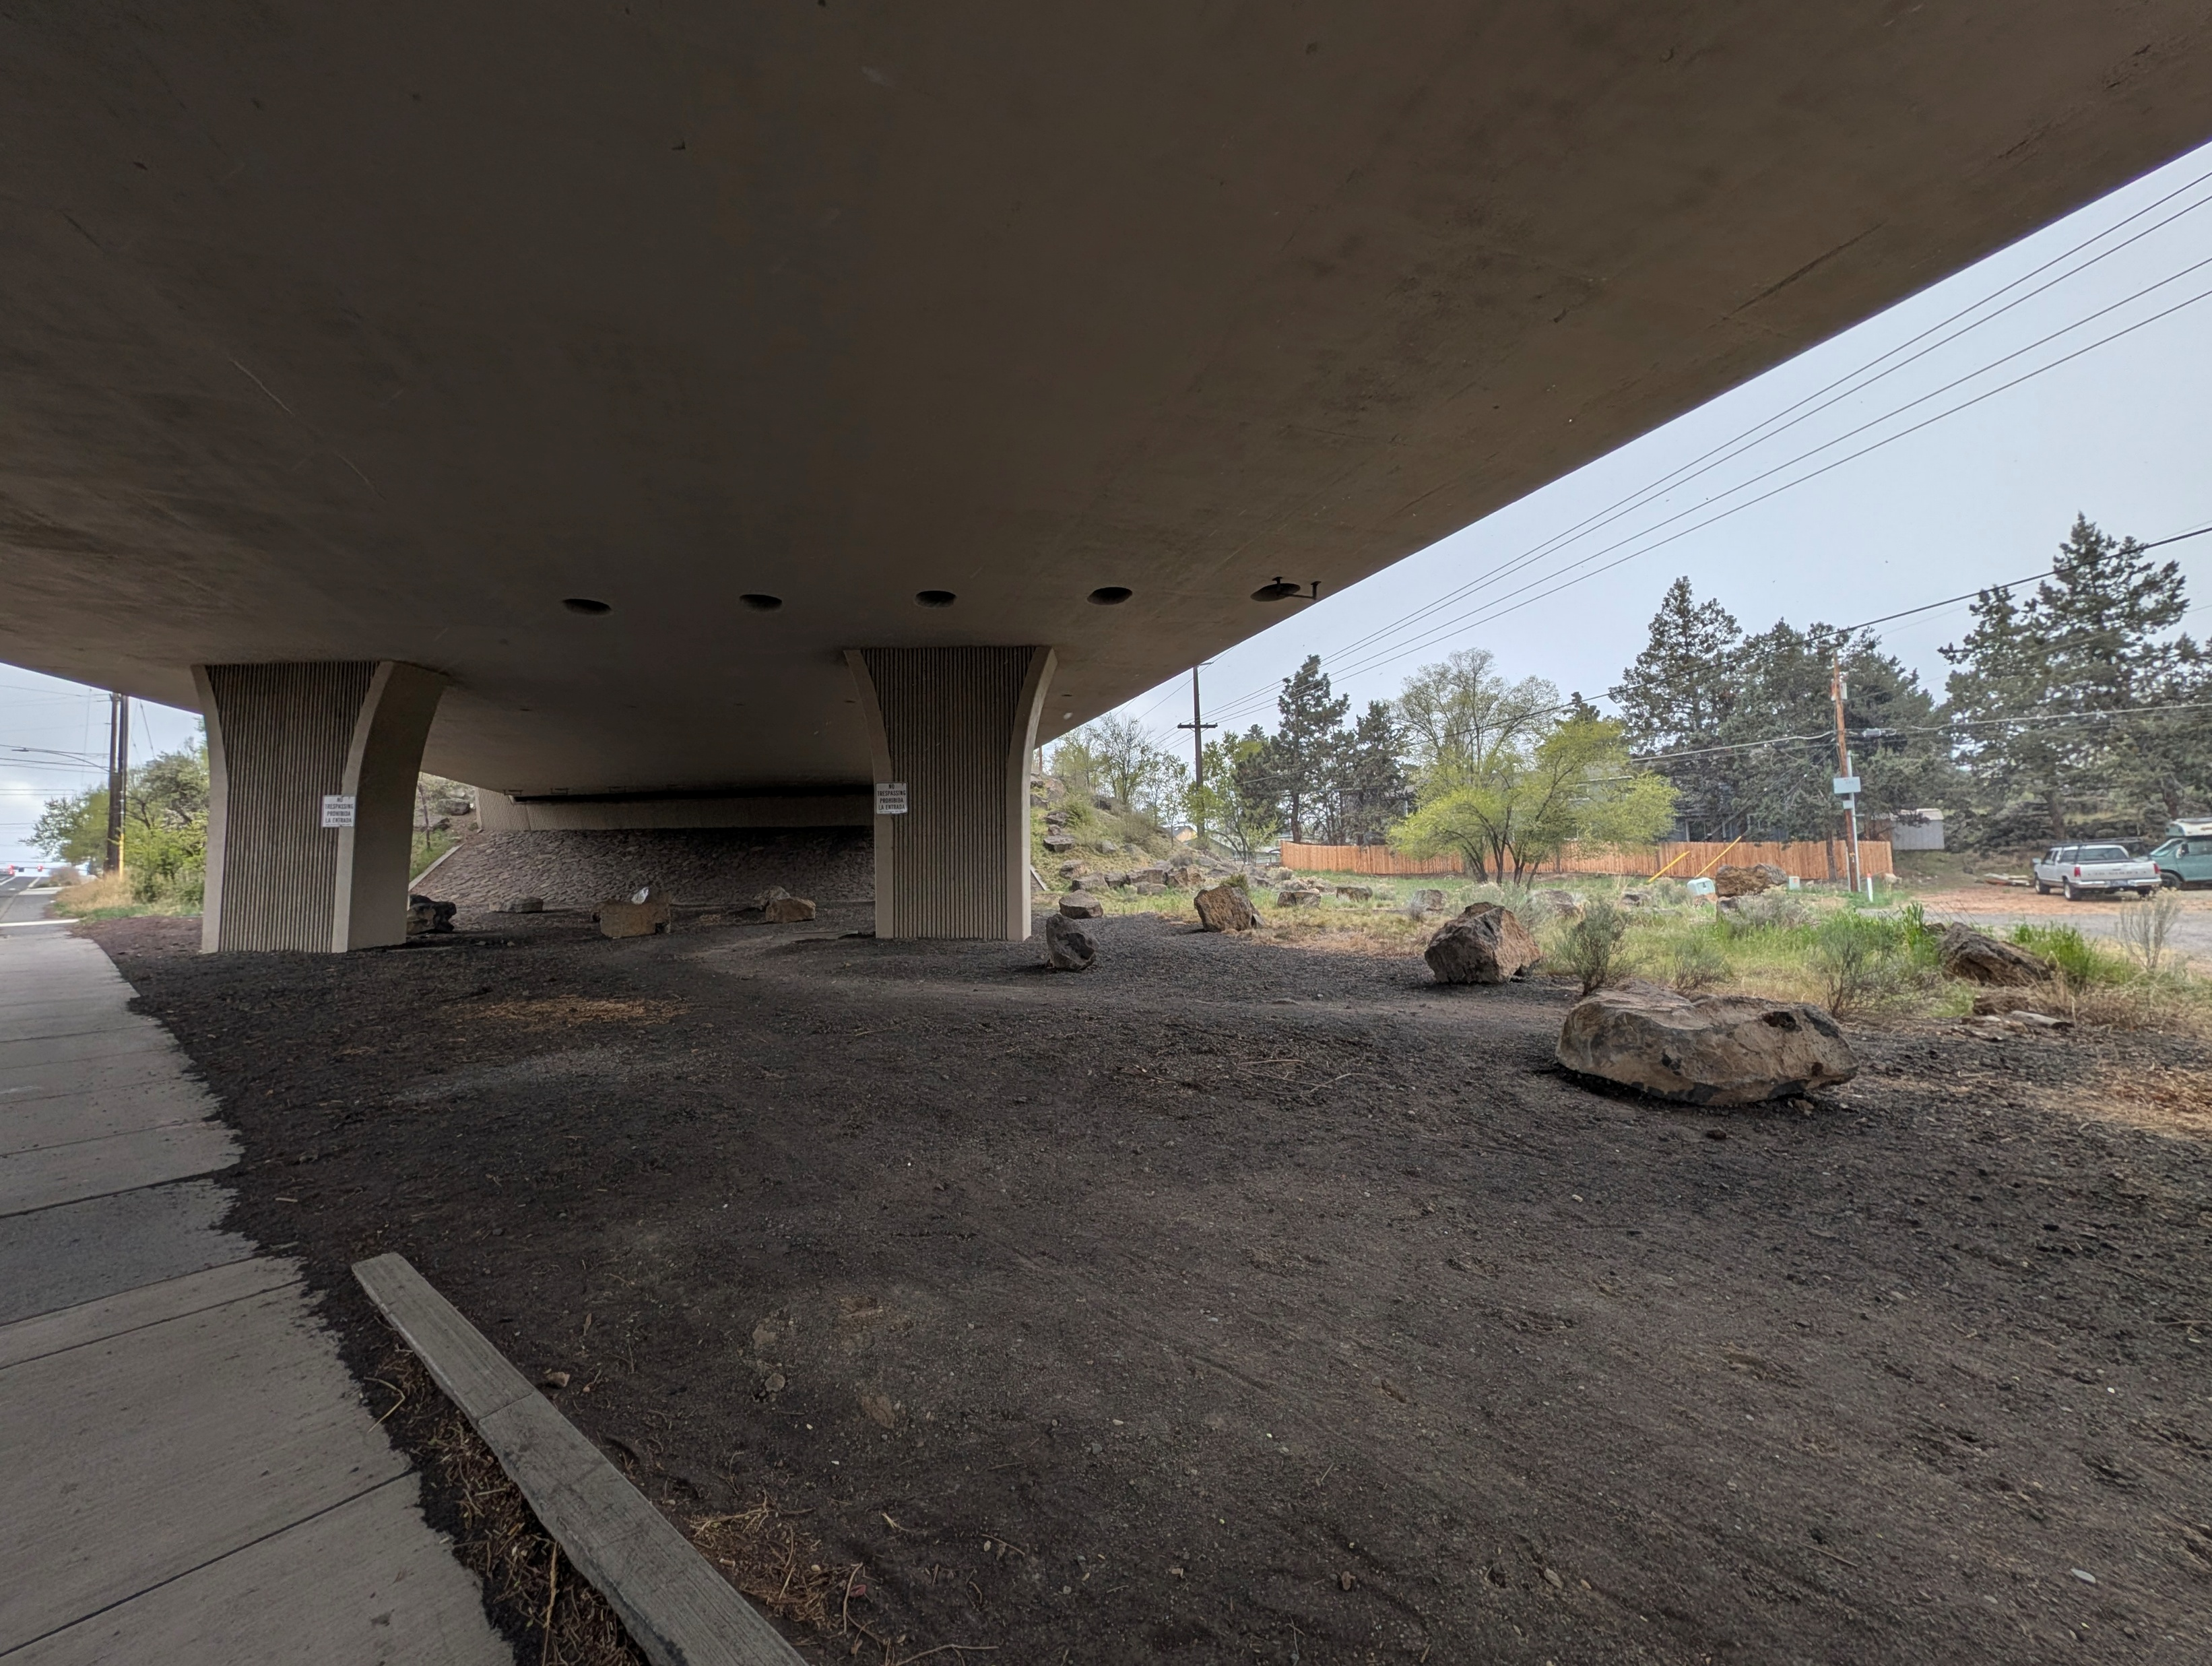
Spaces that should be awesomized
Notes:
What do I see: Underutilized spaces for people:
- not the usual people spaces that we talk about here at OATS and similar spaces that we definitely should be doing like bike lanes, sidewalks, and shared use paths, transit bridges, highway caps, restorative justice for disenfranchised communities that cost millions and billions - we should definitely do that and keep pushing for those.
- Human-sized spaces that have potential to be transformed into community centers and assets

Slide 4

Why put in the effort?
Notes:
You may be asking “chris, what makes you think I’d actually be able to influence ODOT to do anything?”
Everyone, Jenna and I especially, know how difficult it is to work with ODOT
World sucks right now and many of us are just struggling to survive and taking on one big thing, like trying to get ODOT to do something different, might just been too much.
Price of housing, gas, food, everything is crazy and PBOT and ODOT are broke, federal programs for cool stuff are being cut as we spend millions on a war in Iran

Slide 5
Because!
Implementable
Win-Win-Win
Brings community together
Notes:
Do we really need a reason to do awesome things?
Do it for yourself because you want to use it. Do it for the kids! Do it for the community, because we need more things that bring people together rather than divide us apart.
Think about the cool stuff that takes the time someone else

Slide 6
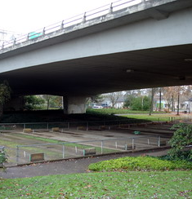
Eugene - Washington Jefferson Park
What’s There?
Basketball court
Horseshoe pit
Skatepark (23,000 square feet)
Public art
Dog park (1.3 acres)
Pump track – new proposal to be included in a Master Plan effort

Slide 7
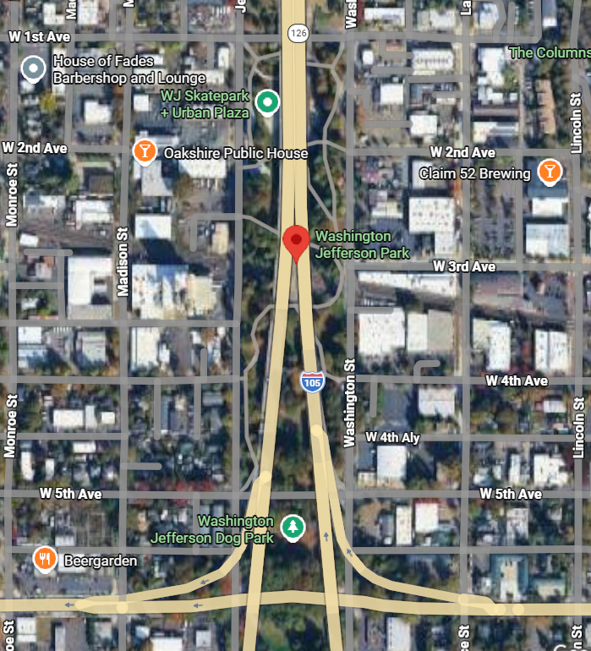
Agreement
Lease agreement established in 1974, updated in 2024.
City maintains all amenities at $0/year.
If city wants to add amenities, they can email ODOT contact for approval (don’t have to change the agreement).

Slide 8
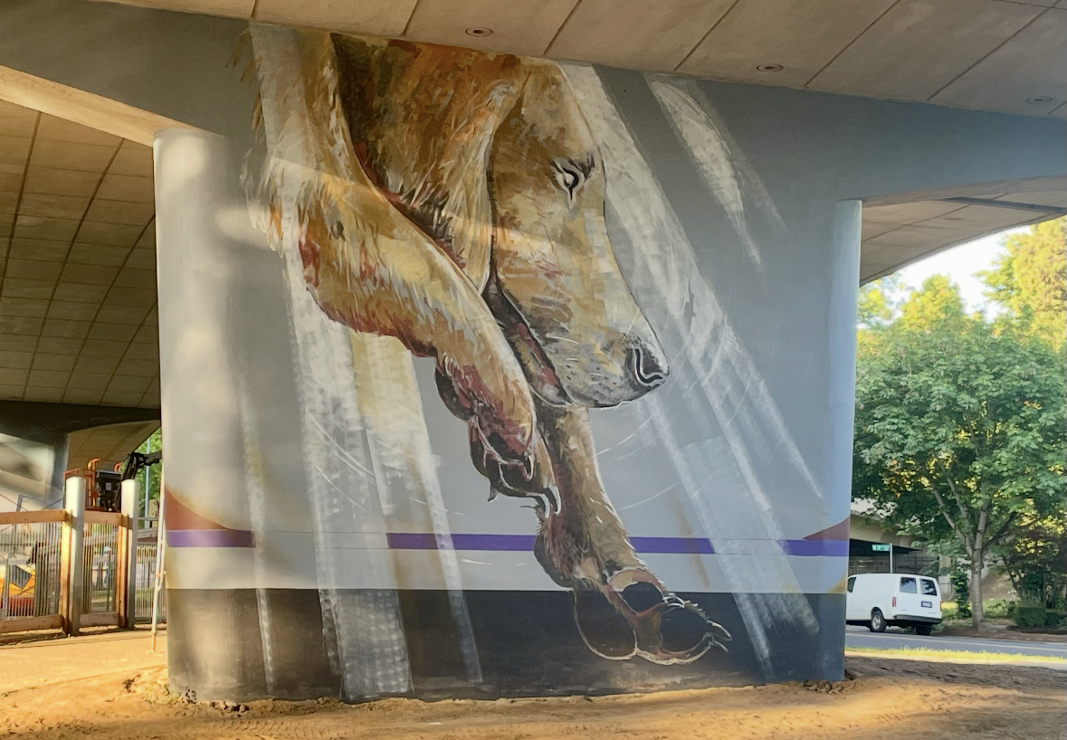

Slide 9
Corvallis Skatepark
What’s There?
Two skate bowls
Dog park
Potential for more!

Slide 10
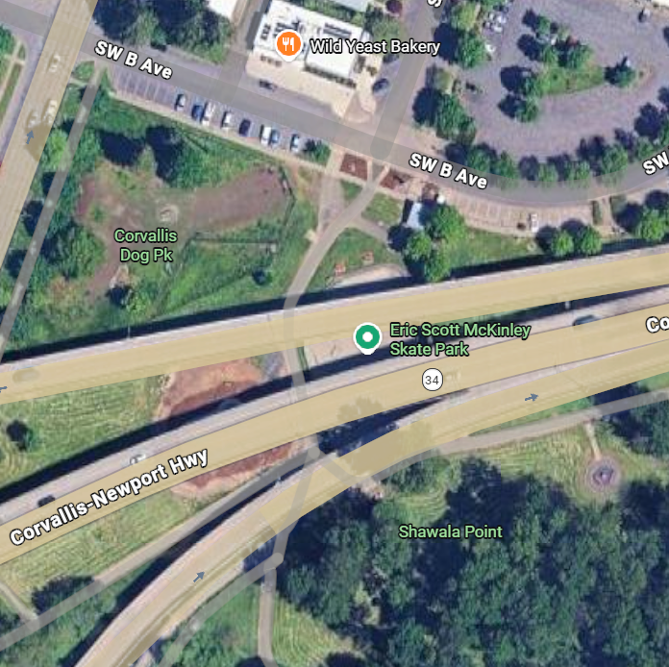
Agreement
Corvallis maintains project and power costs.
Corvallis maintains landscaping.
Development plans reviewed by ODOT.
No commercial advertising/vending.

Slide 11
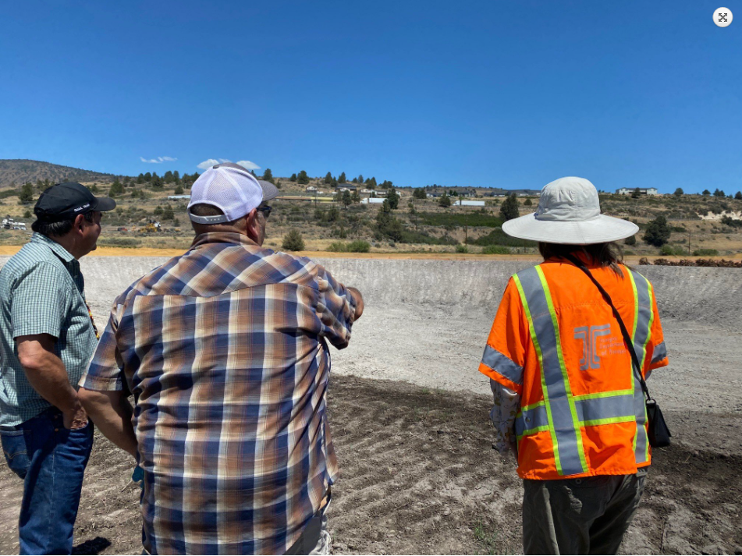
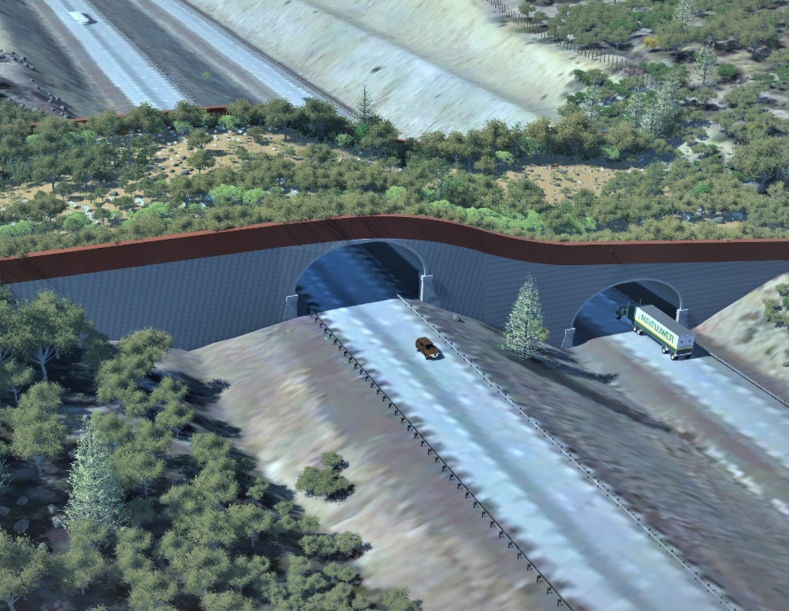
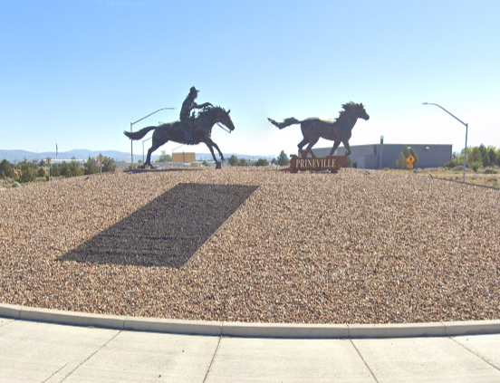
Other Successful Partnerships
Klamath Wetland Banking
Wildlife Crossings and Fencing
Roundabout and Gateway Art
Notes:
Klamath
45 acre wetland restoration and stormwater banking
Partnered with Tribes and Western Federal land to bring sucker rearing pond and habitat to the lake

Slide 12
Awesome People to Work With
City/Park Districts
Funding Partners
User Groups
Non-profits
Transit agencies
Neighborhood Associations
Schools
Notes:
HOW TO CHANGE THE PICTURE
Click on the picture. You’ll notice a new tab appears in the ribbon called “Drawing Tools FORMAT.” Select that.
In the Shapes and Styles, toggle the icon with the paint bucket called SHAPE FILL and choose PICTURE.
Select a picture that fits the image space. Preferably in a portrait orientation.
Select your image, and press open.
Your picture will appear in the shape!

Slide 13
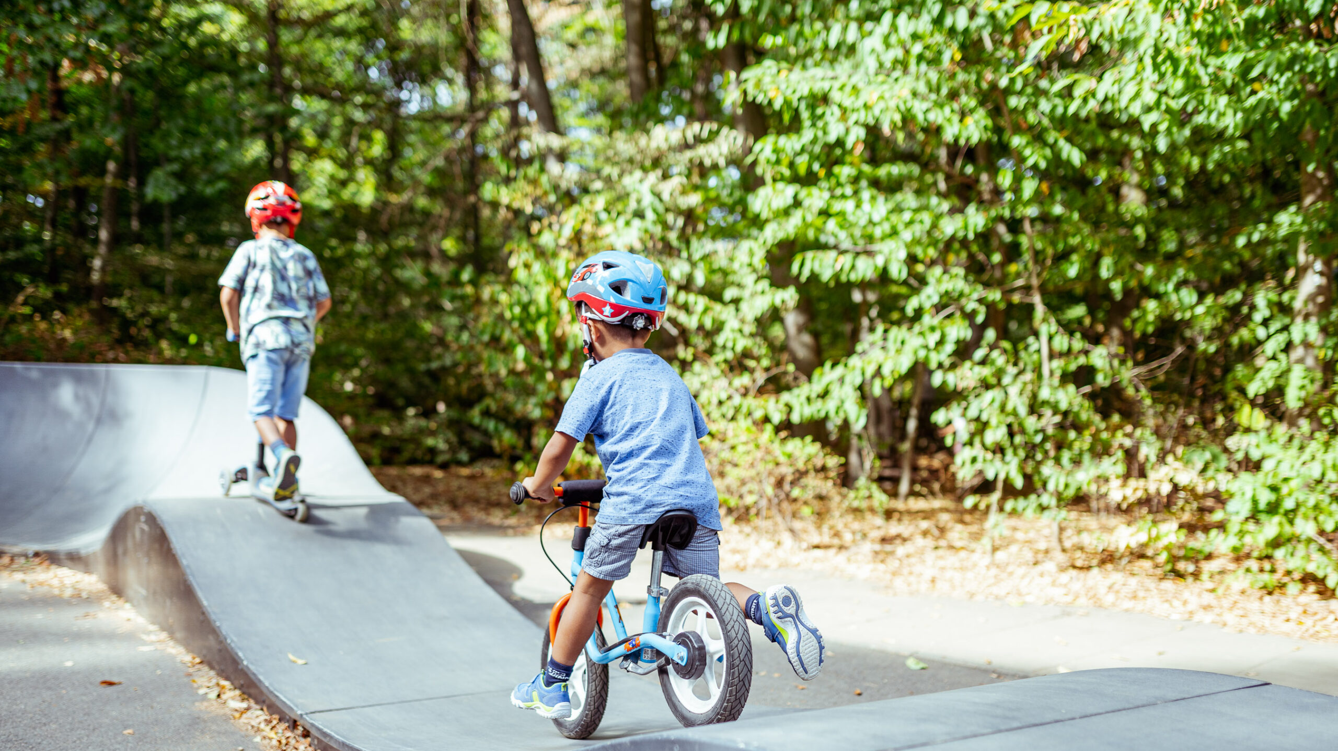
Lessons for Awesomeness
Imagination
Curiosity
Think about the maintenance
Building a coalition
Flexibility
Notes:
HOW TO CHANGE THE PICTURE
Click on the picture. You’ll notice a new tab appears in the ribbon called “Drawing Tools FORMAT.” Select that.
In the Shapes and Styles, toggle the icon with the paint bucket called SHAPE FILL and choose PICTURE.
Select a picture that fits the image space. Preferably in a portrait orientation.
Select your image, and press open.
Your picture will appear in the shape!

Slide 14
Ideas for Awesomizing
Environmental
Placemaking
Trails and Parks
SOMETHING ELSE

Slide 15
Is Salem Next?

Slide 16
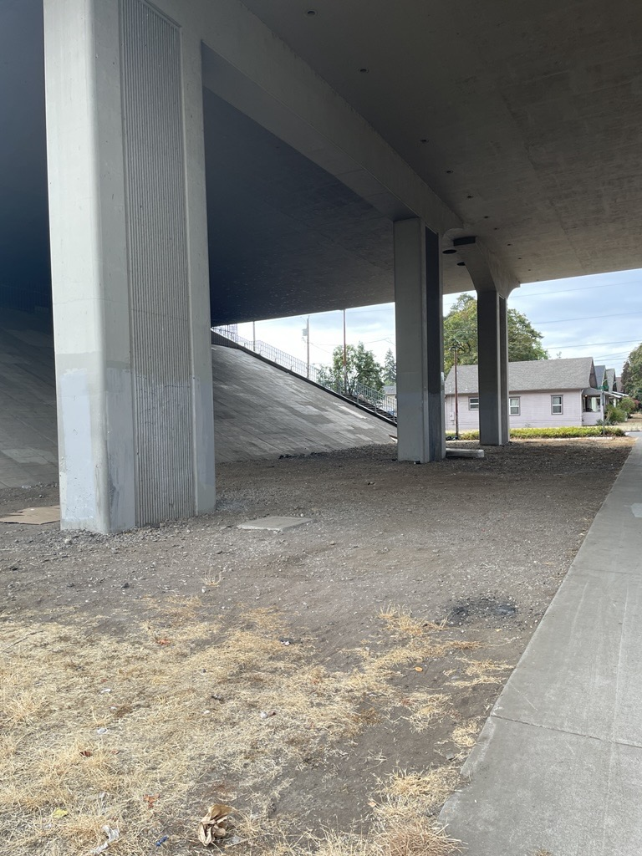
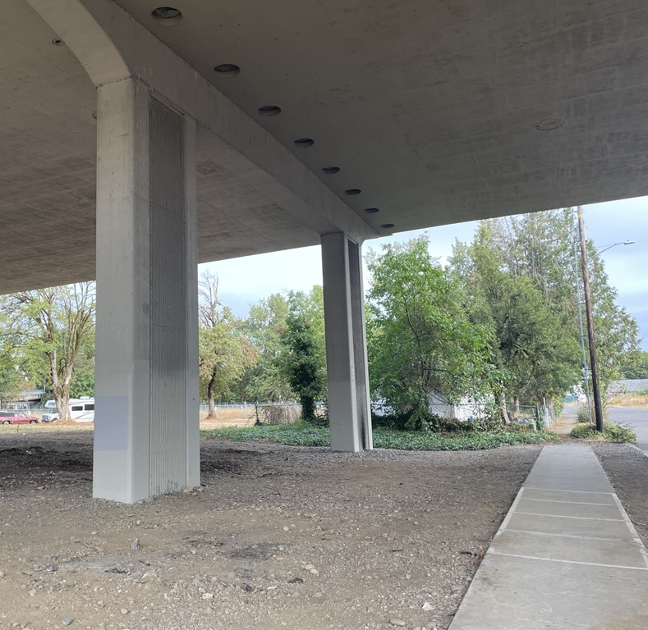
Is Salem Next?

Slide 17
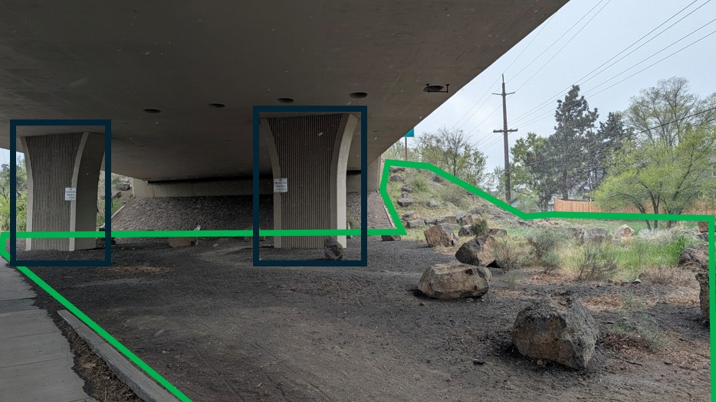
Could this be awesome?

Slide 18
What Do You Want to See Awesomized?

