Slide 1
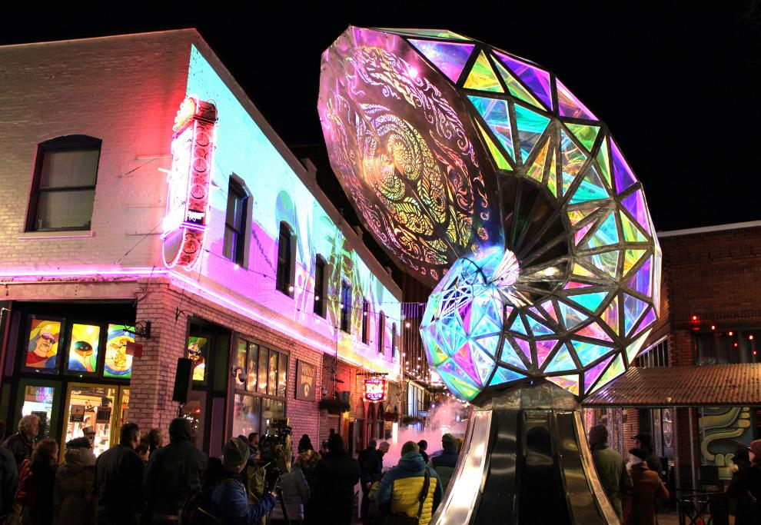
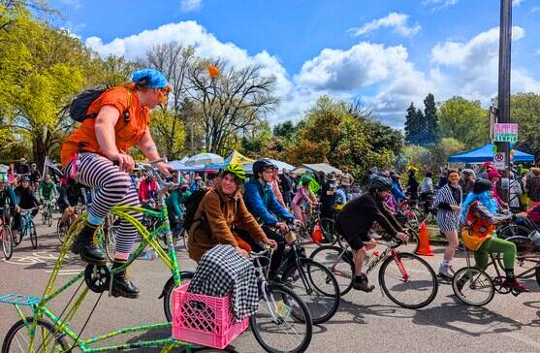
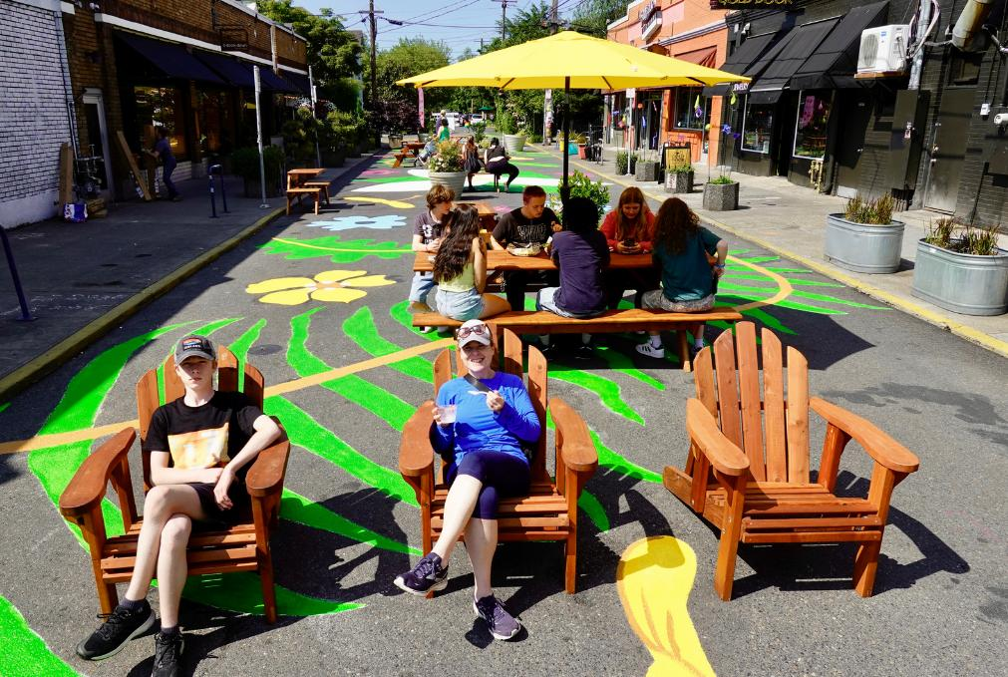
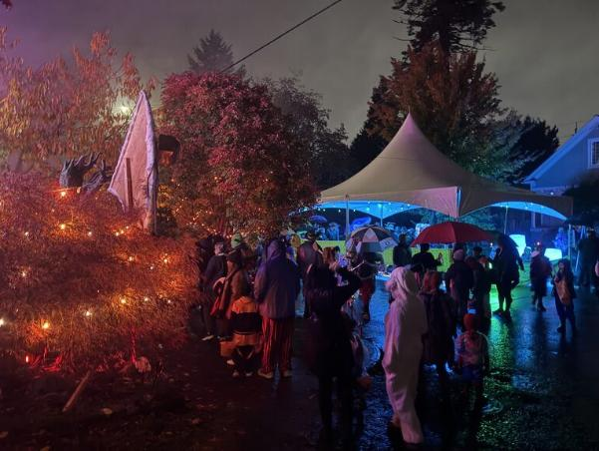
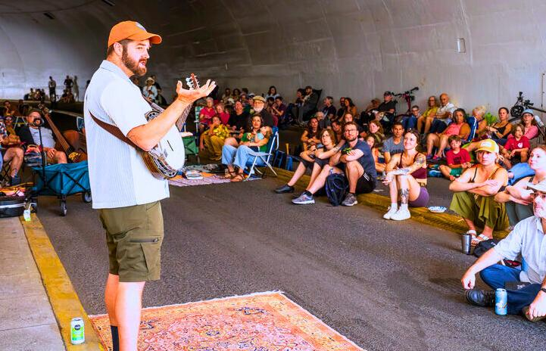
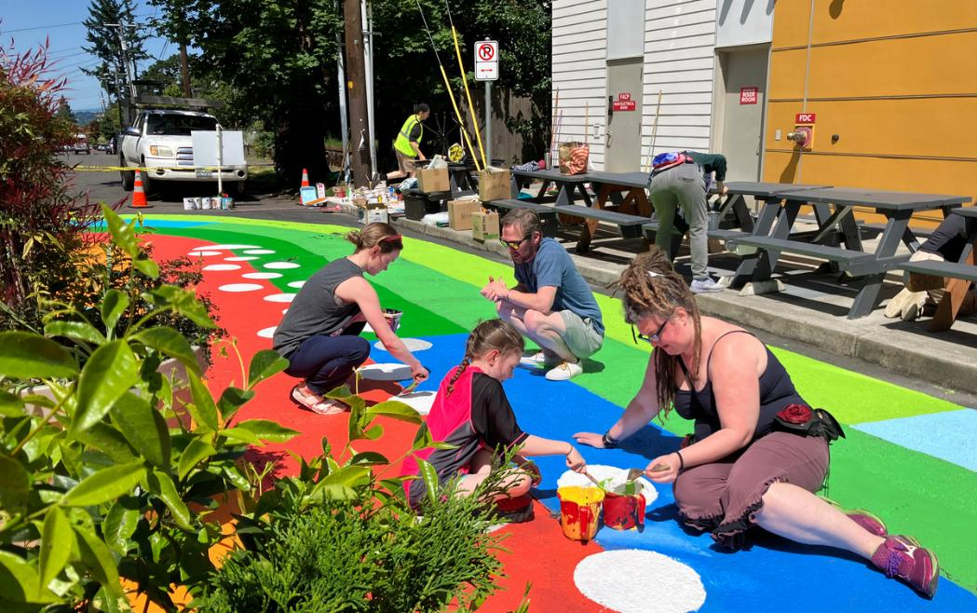
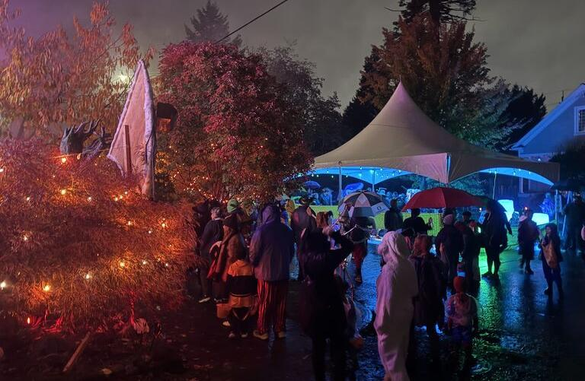
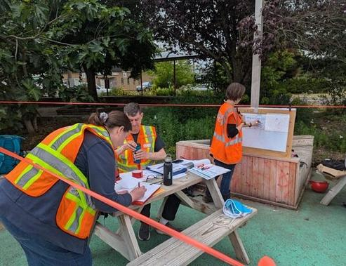


Public Realm & Street Activation

Slide 2
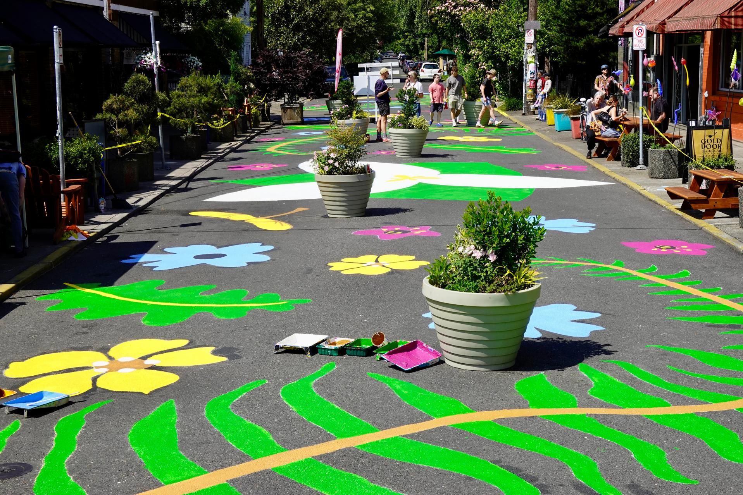
Today’s Agenda
Program Impact Snapshots
Open Call for Plaza Partners
Story Time: Getting to yes
Looking Forward
3

Slide 3
Overview: Public Realm & Street Activation Team
Managing more than 20% of Portland’s land area and our largest public space, PBOT is uniquely positioned to support communities in reimagining city streets as places for connection, responding to the growing demand for people-centered public spaces.
To do this, PBOT’s Public Realm and Street Activation Team (PRSA) oversees programs that partner with community members, organizations, and businesses.
3

Slide 4
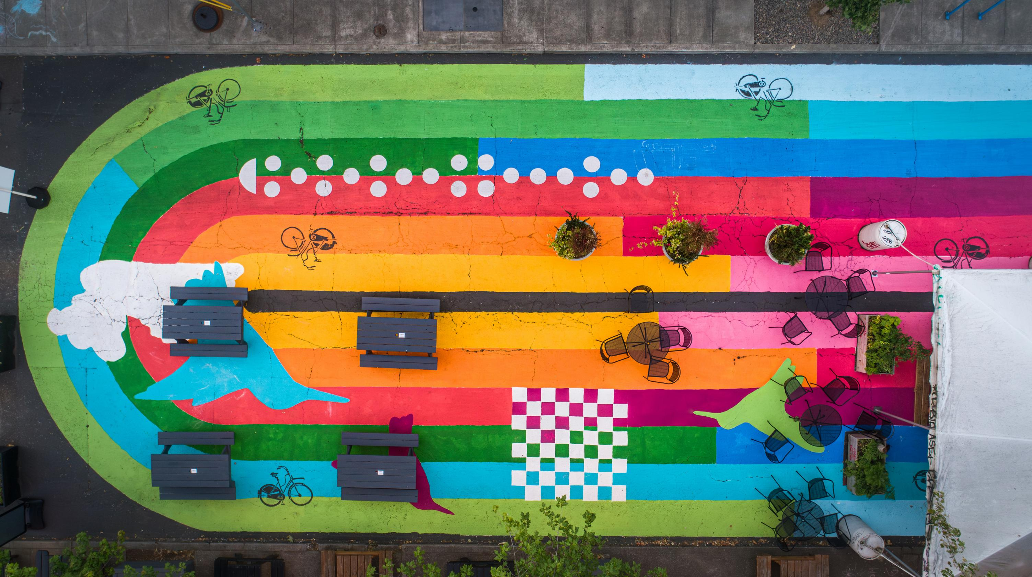
Program Area
2025 Impact Snapshots
5

Slide 5
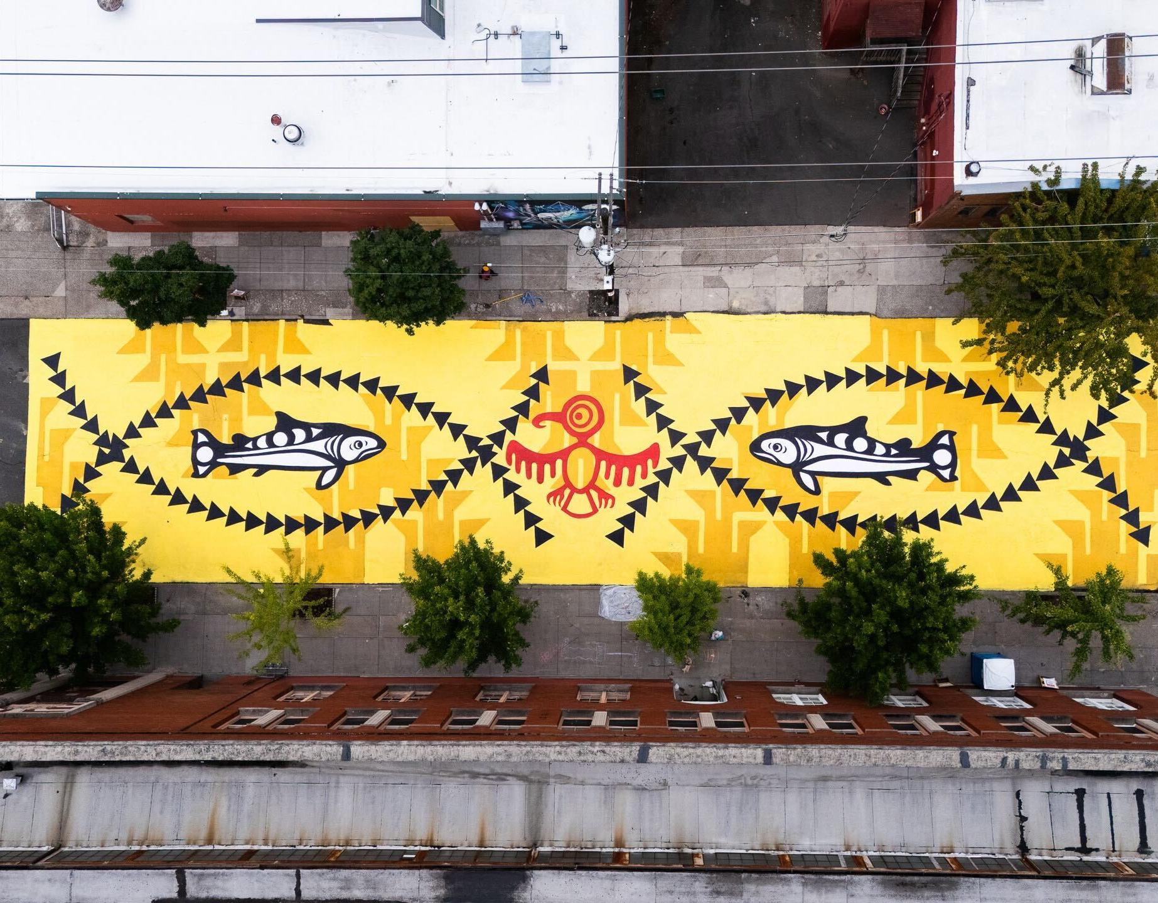
Street Paintings
Record-Breaking Street Paintings:
17 new community-led street paintings
First painting in 1996 now totals around 180
Above: Native American Arts and Culture Foundation @ SE 10th and Belmont
35

Slide 6
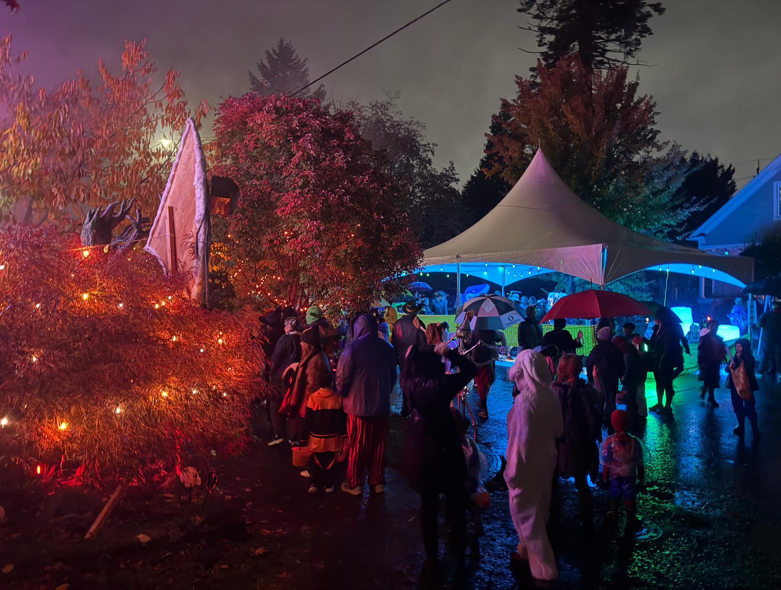
Neighborhood Block Parties Strengthen Local Connections:
881 Block Party permits, an increase from 2024.
Streamlined free and easy permit process
University Park Halloween Block Party
Block Parties
45
Photo courtesy of Conor Wing

Slide 7
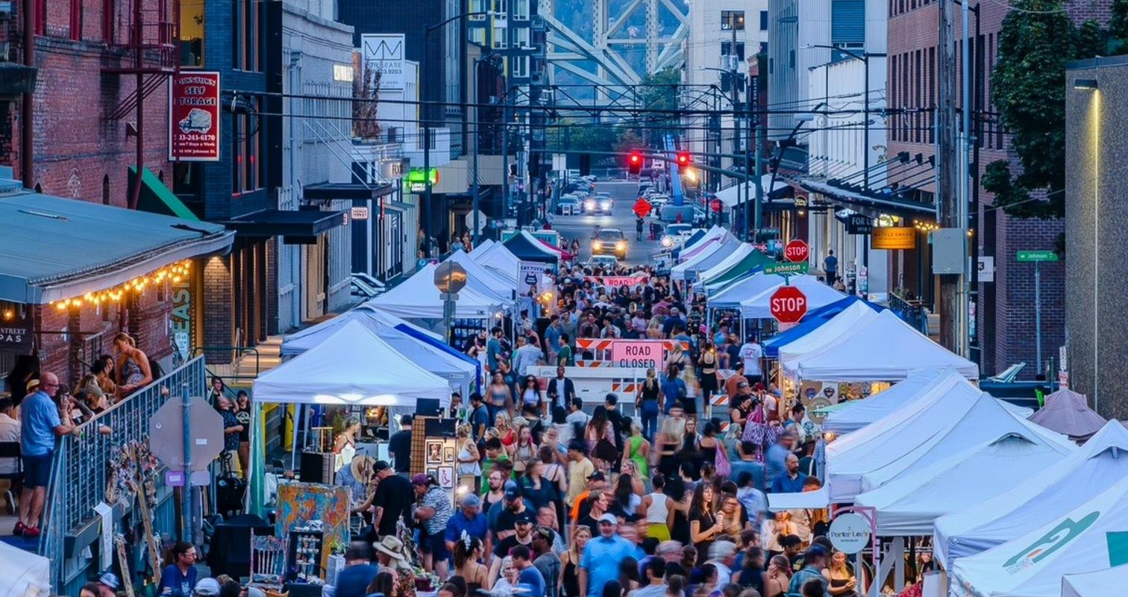
Community Events Reach Over a Million Portlanders:
344 permits and over 600 events
Estimated 1.4 million attendees, exceeding 2024 attendance levels.
First Thursdays in the Pearl
COMMUNITY EVENTS
50

Slide 8
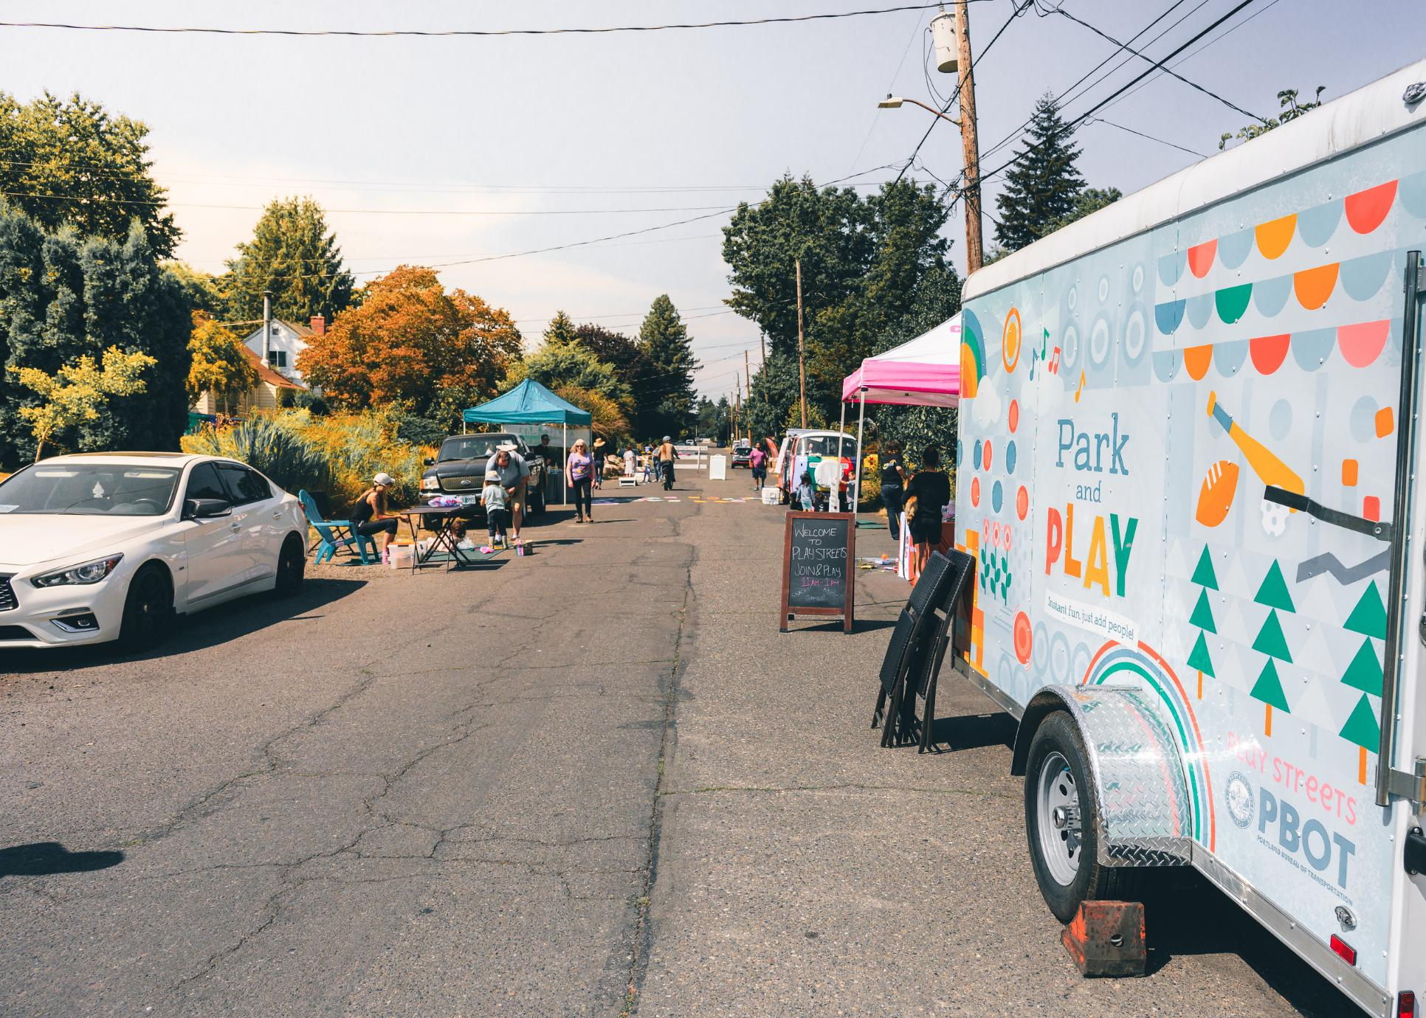
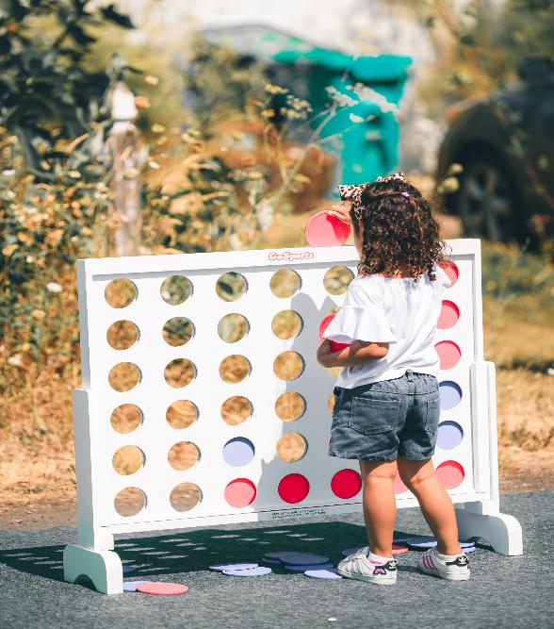
Opportunities for safer recreation:
22 events with 5 non-profits:
Sabin CDC
Pacific Refugee Support Group
Playworks NW
Dream Big City
Sellwood Community House
PBOT Provided trailer
Pacific Refugee Support Group Play Street
Play streets program
Photo courtesy of Jeffrey DeWitt
39

Slide 9
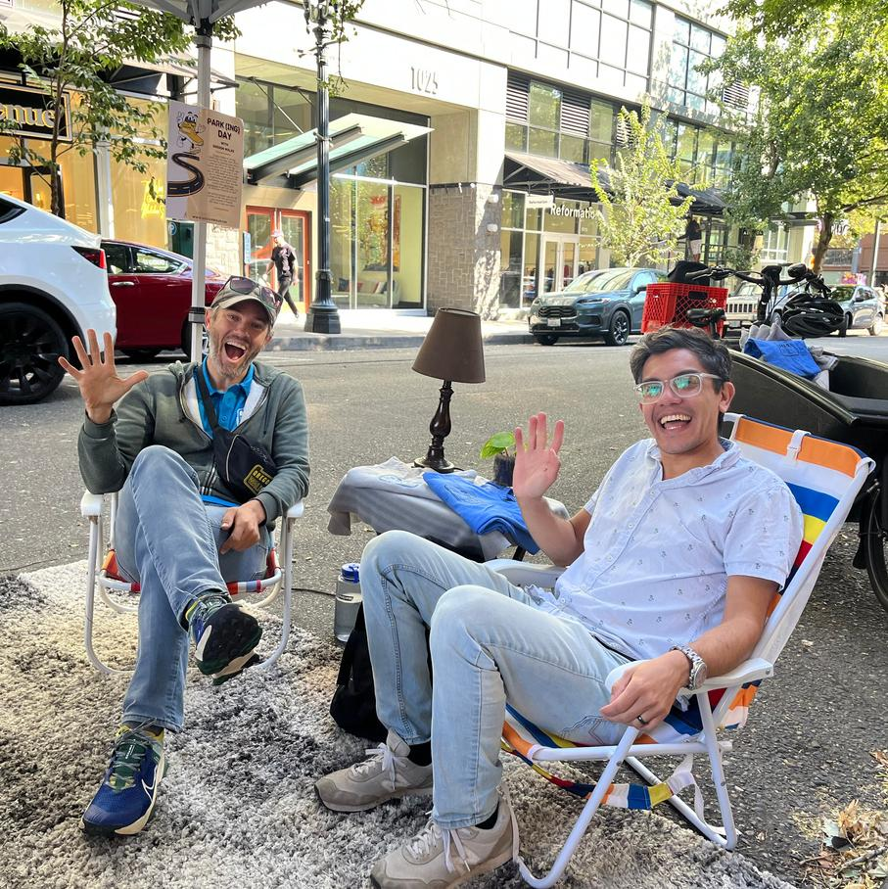
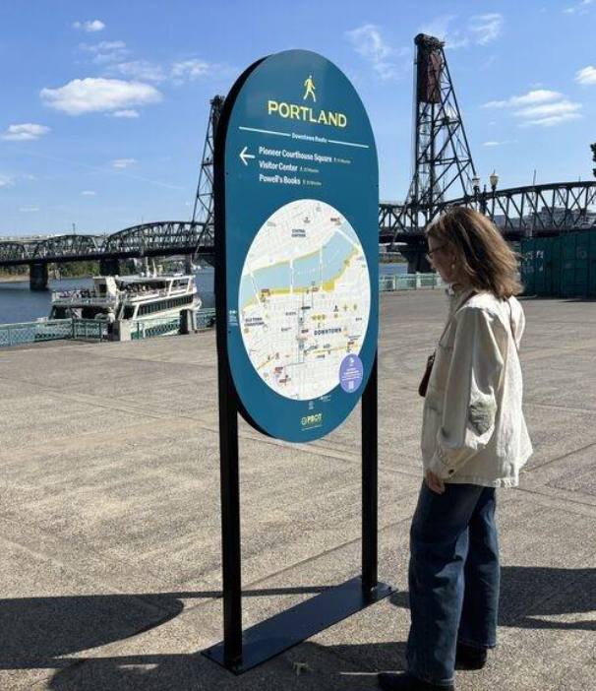
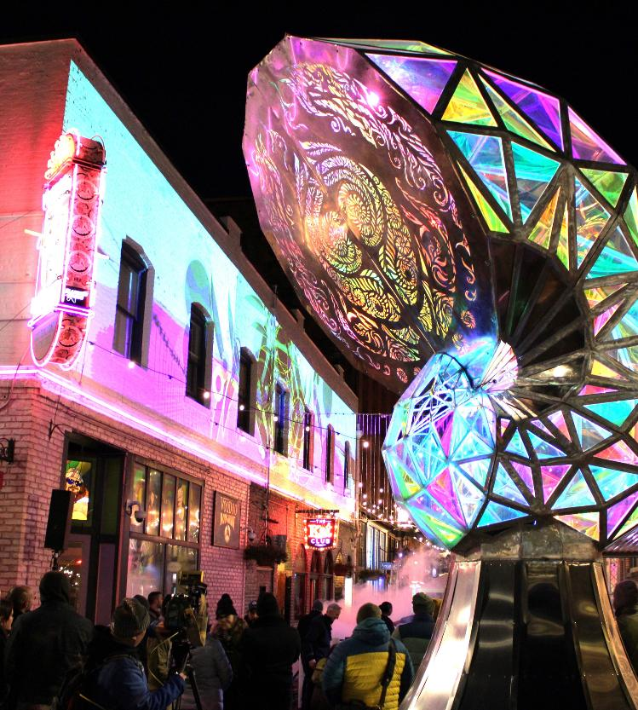
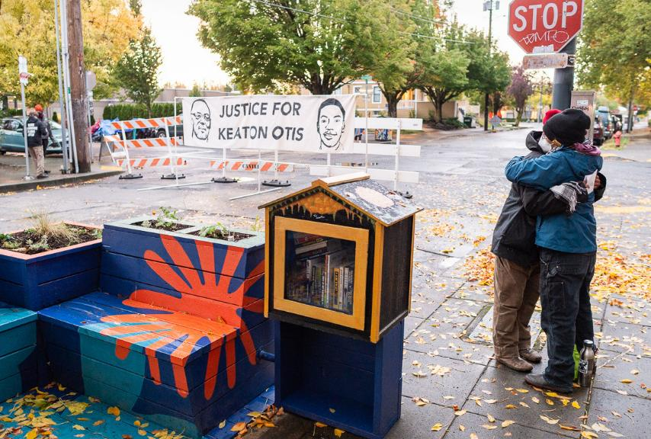
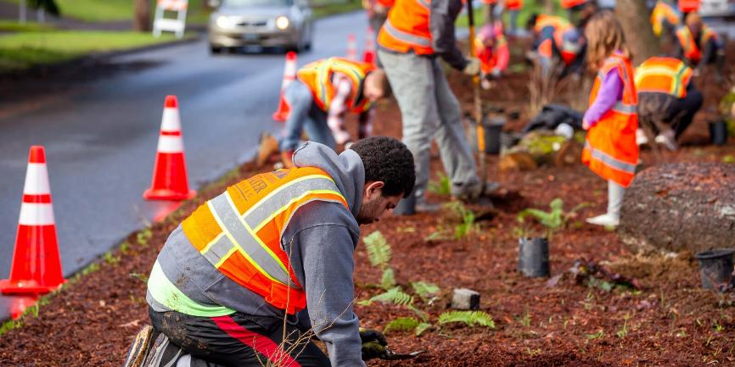
Smaller Programs
Park(ing) Day
Signage and Banners
Art in the Right of Way
Adopt-A-Landscape
Encroachments

Slide 10
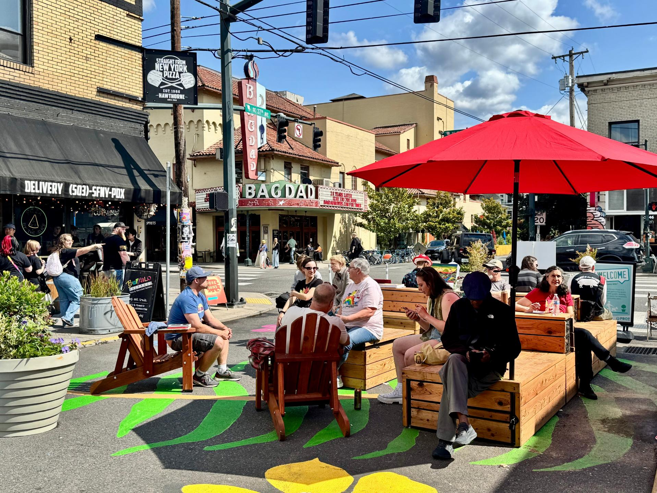
Public Street Plazas

Slide 11
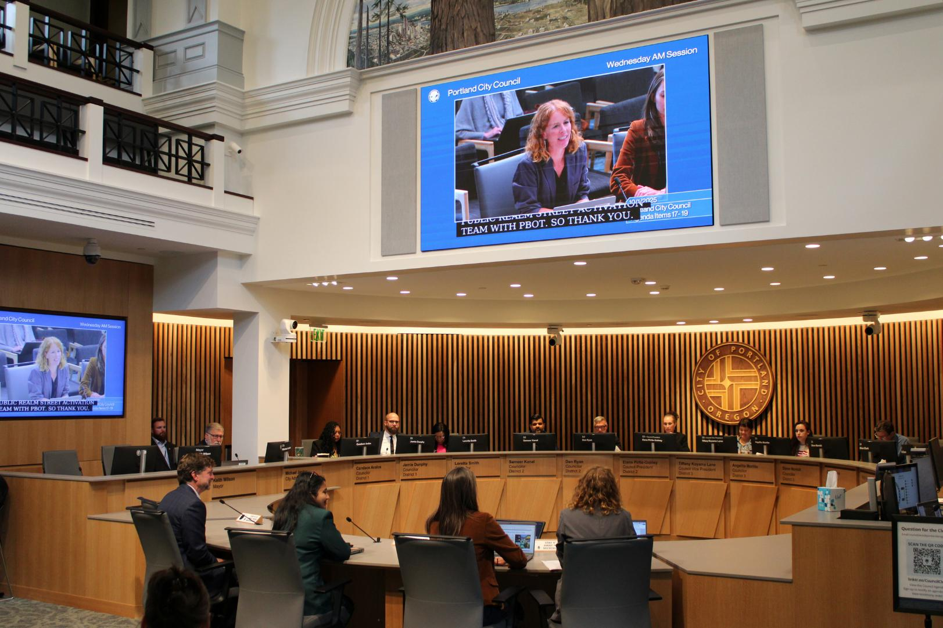
Program
Formalization
"PBOT has a team of people that are amazing. I've worked with probably 8 to 10 people in PBOT, and they've been creative...By voting to adopt the PBOT Public Street Plaza Program, you'll keep Portland at the forefront of creative, community-led public spaces."
-Alex Murrell, Executive Director of Dream Big City
From Covid era Healthy Business program to pilot
October 1st, 2025: the Plaza Program officially transitioned from a pilot to a permanent city program
unanimous vote
10

Slide 12
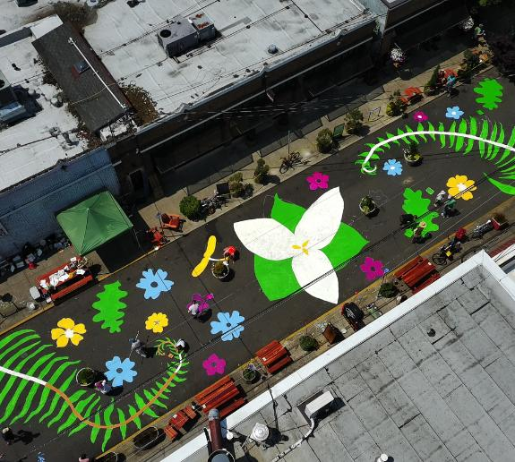
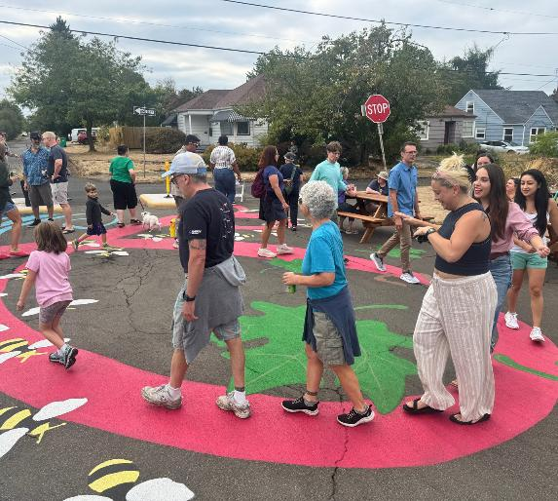
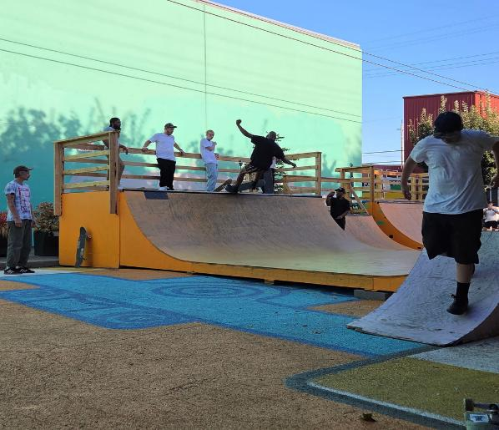
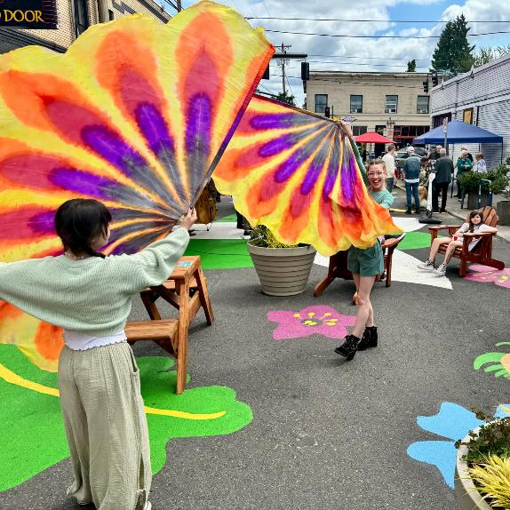
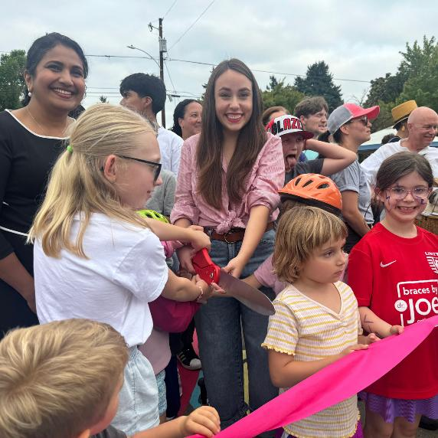
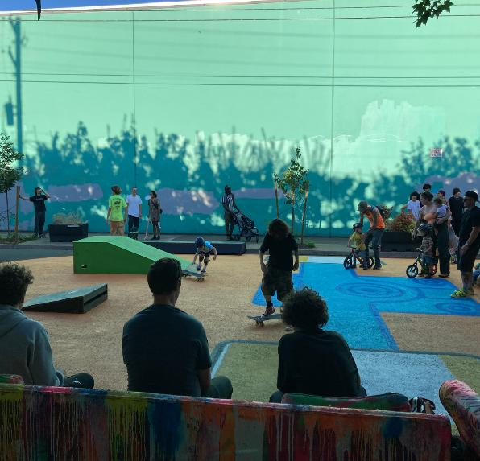
Heart of Hawthorne
SE 37th & Hawthrone
Roseway Plaza
NE 72nd & Mason
Portland Dream Plaza
Se Taylor & 9th
Plaza program continues to Expand: total of 21 active plazas in 2025.
Plazas’ reported benefits: 88% of respondents report substantial community benefits. 91% say plazas contribute to safe and welcoming spaces.
Activation Growth: Over 300 community and partner led events, an increase from 2024

Slide 13
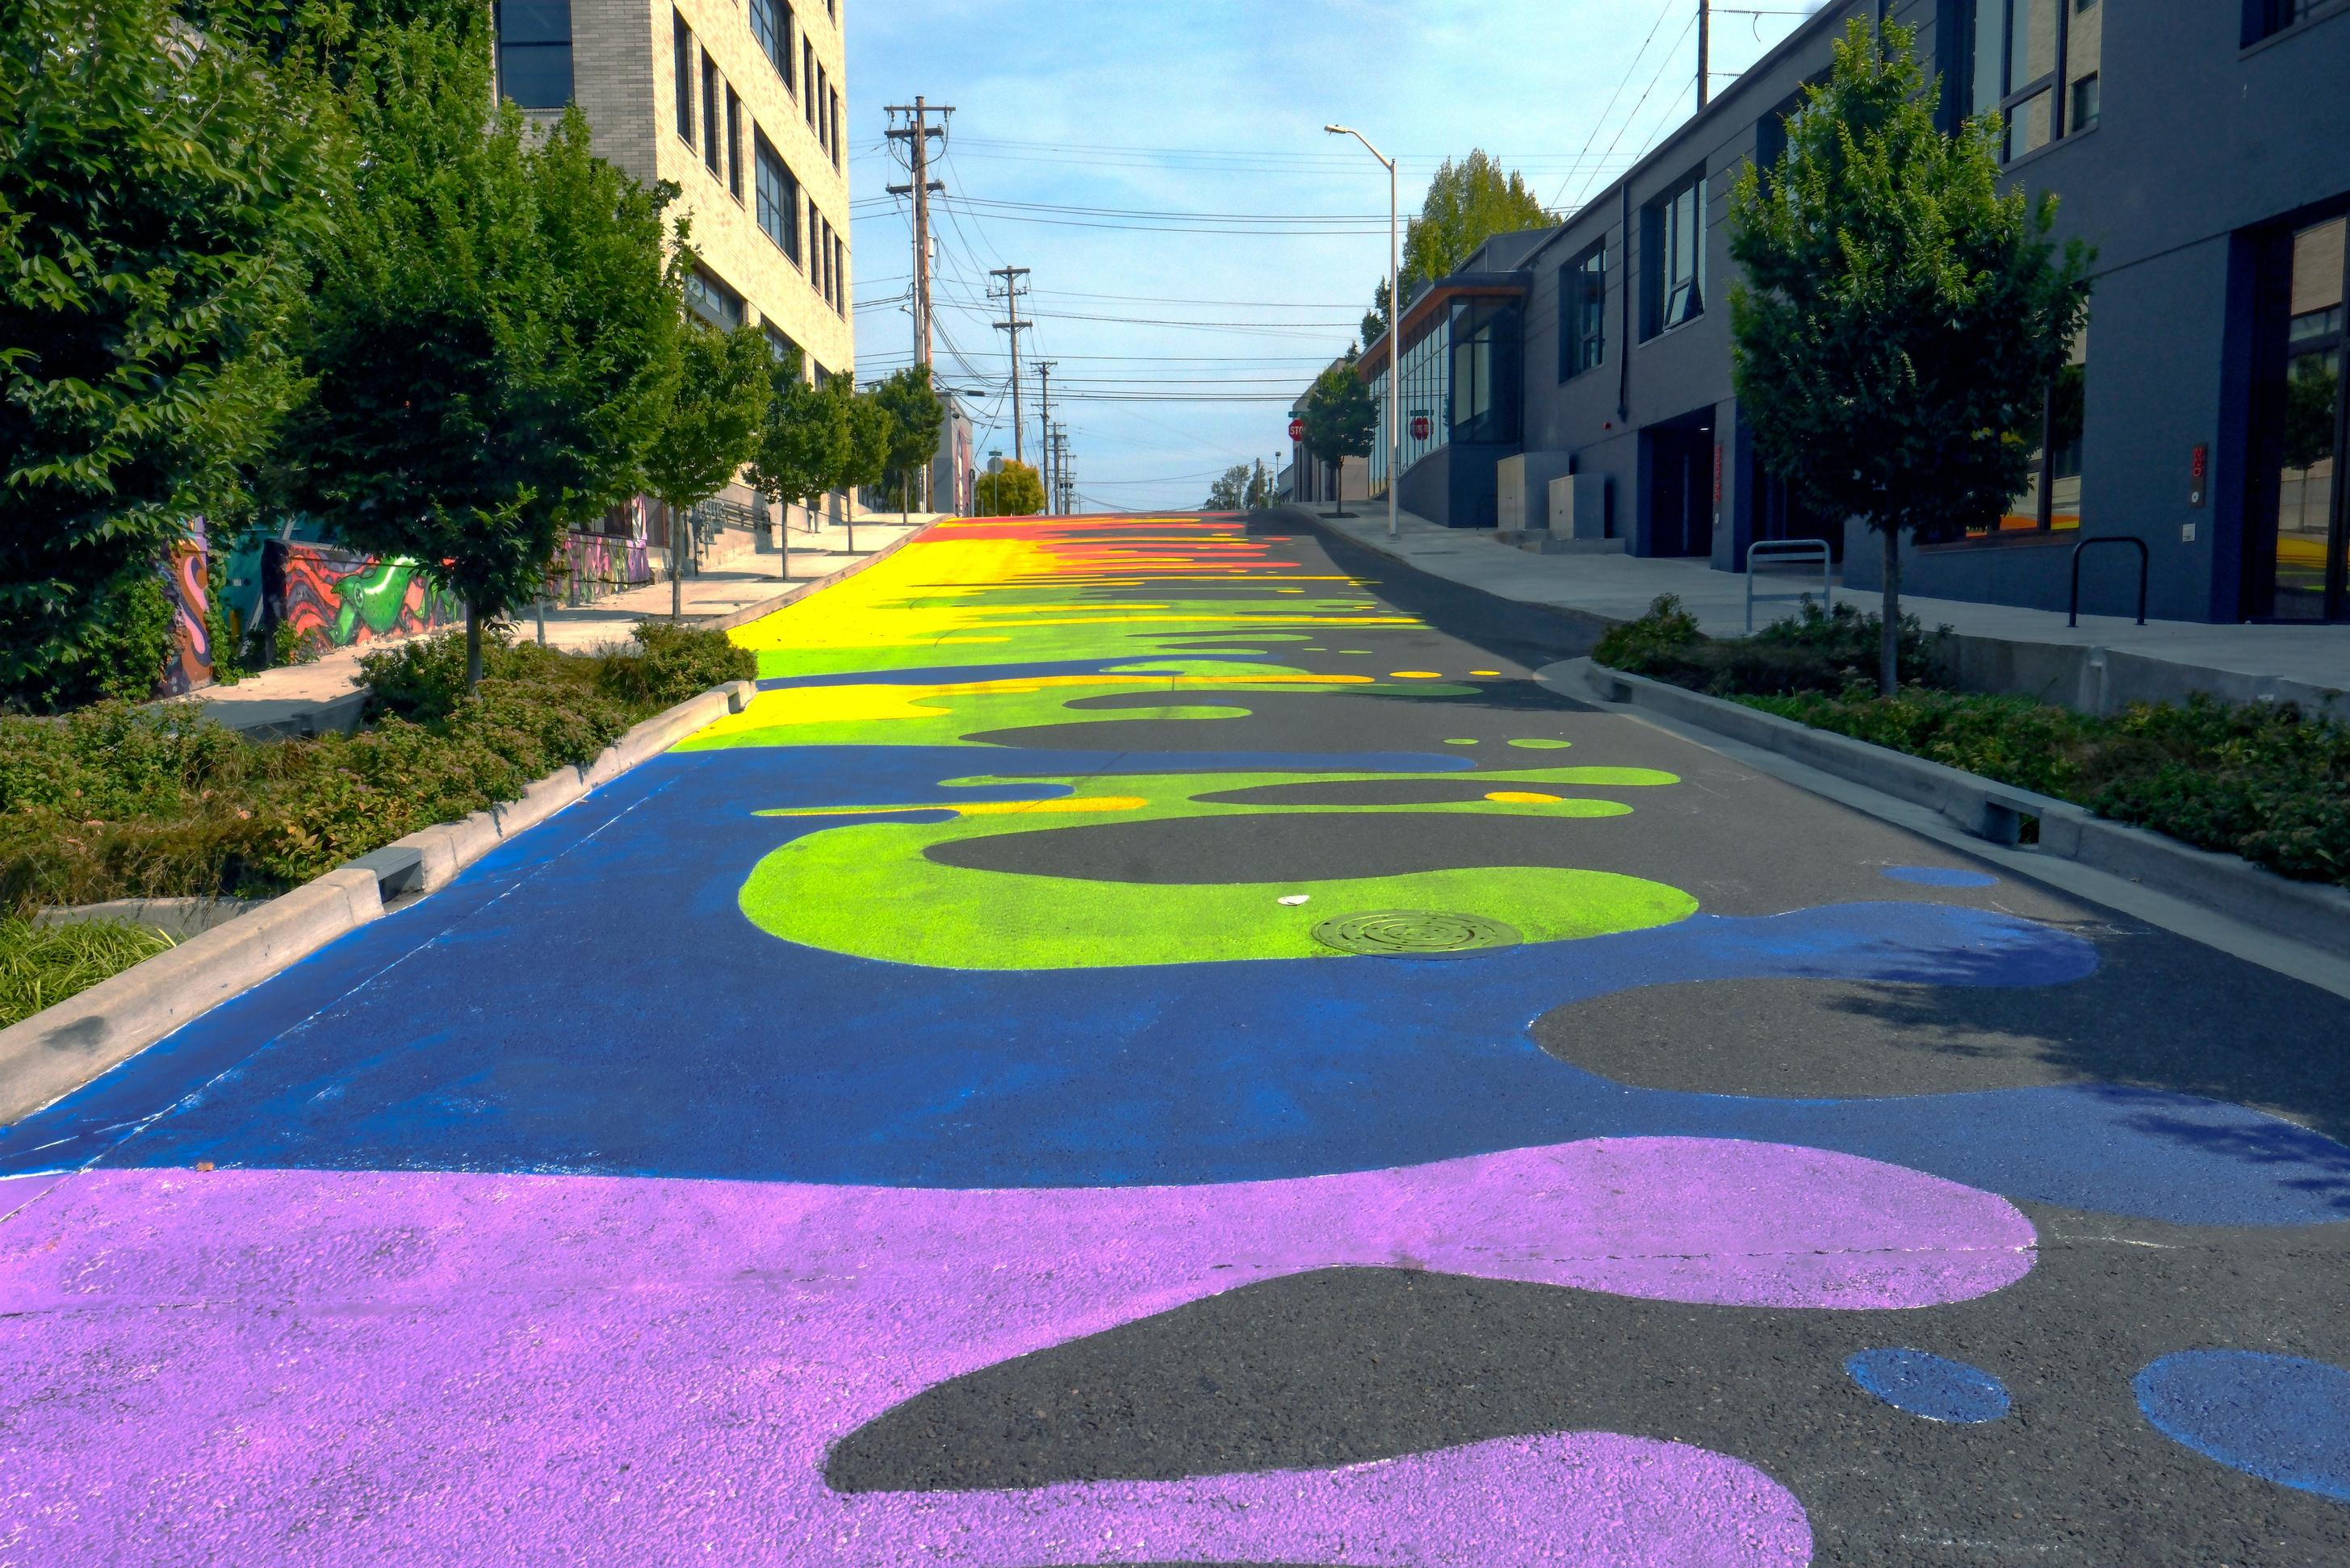
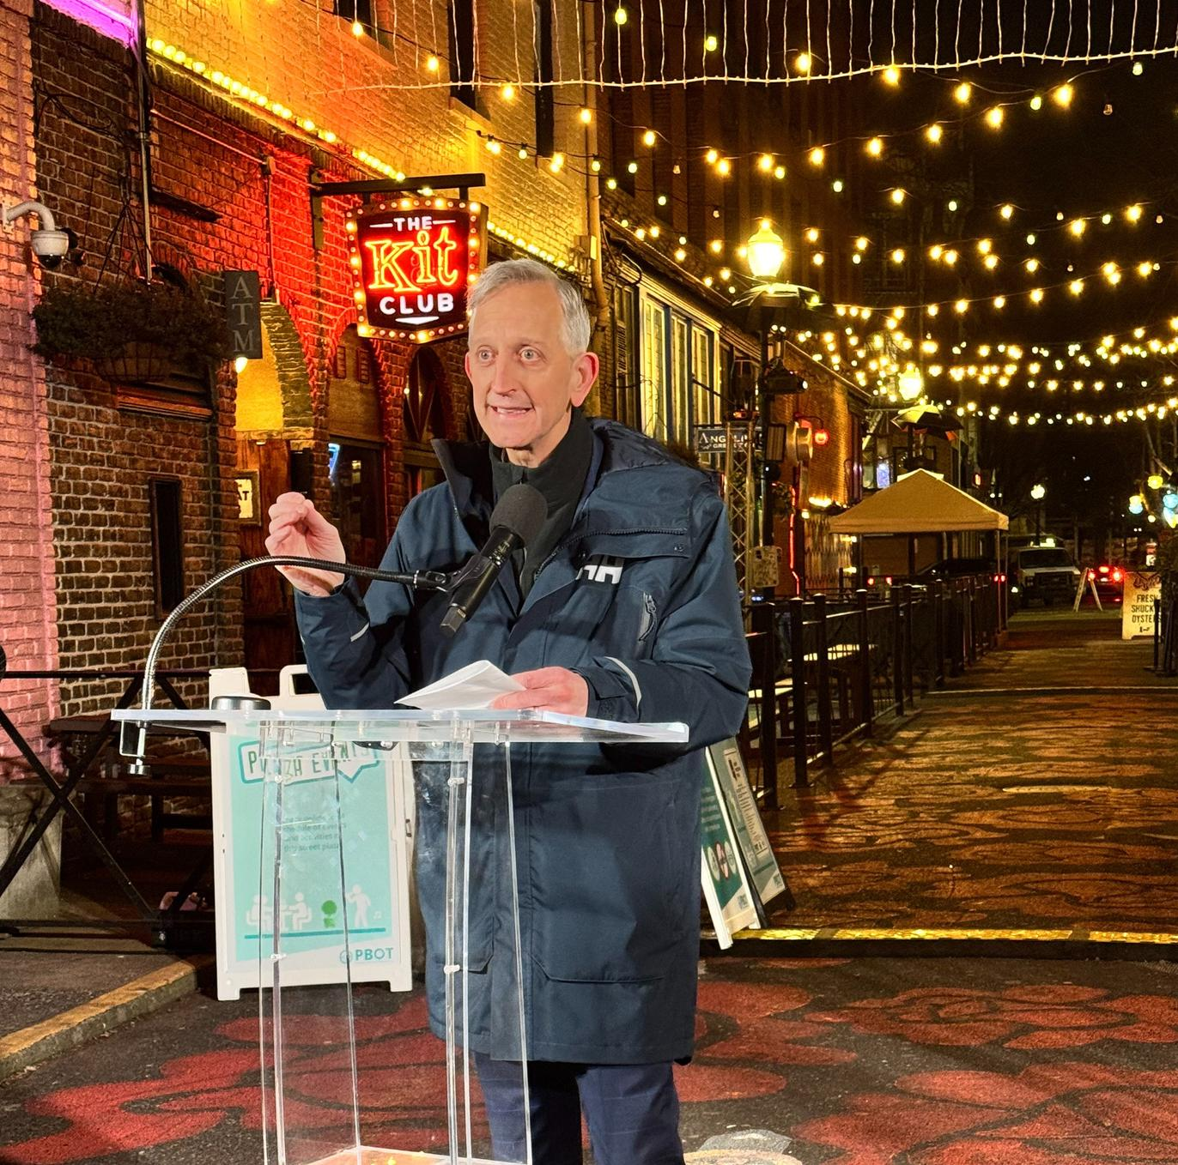
Voices from the Community
“Portland becomes the best version of our city when we fill our street plazas with families, bicycles, farmers' markets, music, and small businesses. From Ankeny Rainbow Road to St. Johns Plaza, this visionary flourishing of public spaces has grown from a dream to a community staple.”
-Mayor Keith Wilson Speaking at Ankeny, February 12, 2025

Slide 14
Plaza Partner Open Call Process
5

Slide 15
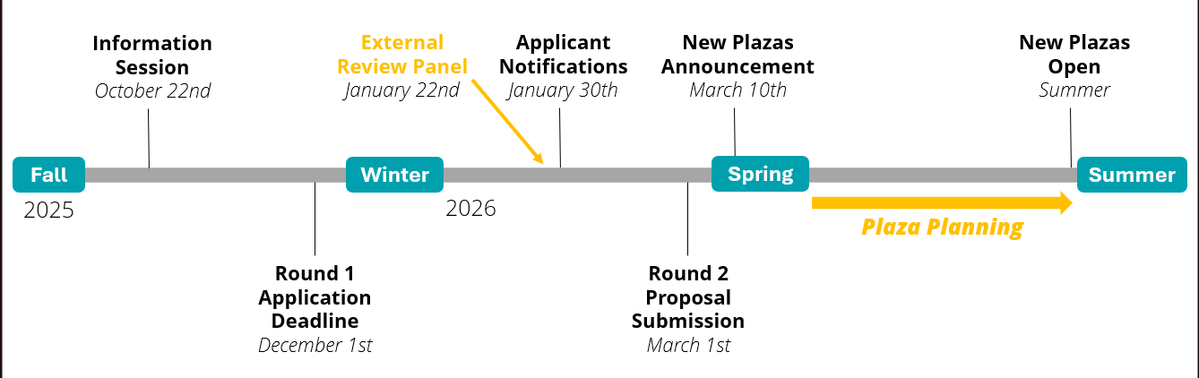
Open Call for Plaza Partners
Fall 2025: First Plaza Partner Open Call
Fairer and more transparent process for creating new plazas
Online application
Virtual information session and focused outreach in District 1
Selected partners will lead a summer-long pilot

Slide 16
Open CalL: Application Stats
17 apps received
Internal red flags check for Viability: timeline, funding, traffic engineers.
3 Apps rejected
6 apps redirected for misc. projects within PRSA
8 apps moved on to External Review Panel.
External review panel provided recommendations:
Office of Arts and Culture
Prosper and Office of Small Business
Safe Blocks
PBOT Equity & Inclusion
4 applications selected for phase II: proposal refinement and plaza planning

Slide 17
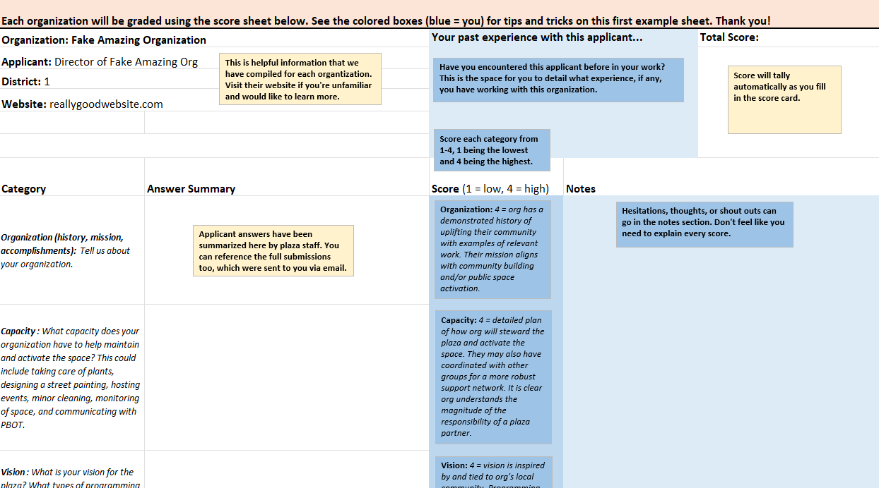
Open CalL: Grading Criteria
Organization (mission, values, history)
Partner capacity
Plaza vision
Engagement/Community Support
Bonus Points
District 1 Bonus
Low-income census tract bonus
Plaza desert (no plaza in 1 mile)

Slide 18
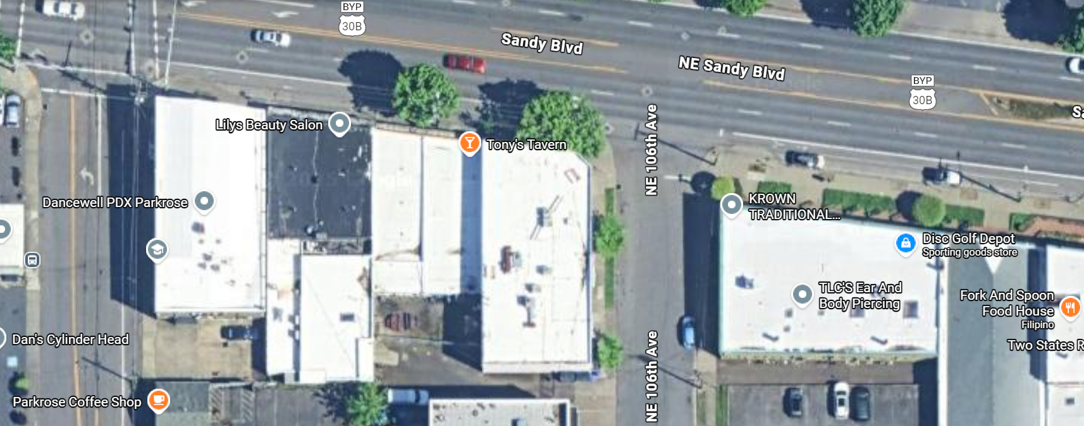
Historic Parkrose – Sandy
District 1 - NE 106th Ave & Sandy Blvd

Slide 19
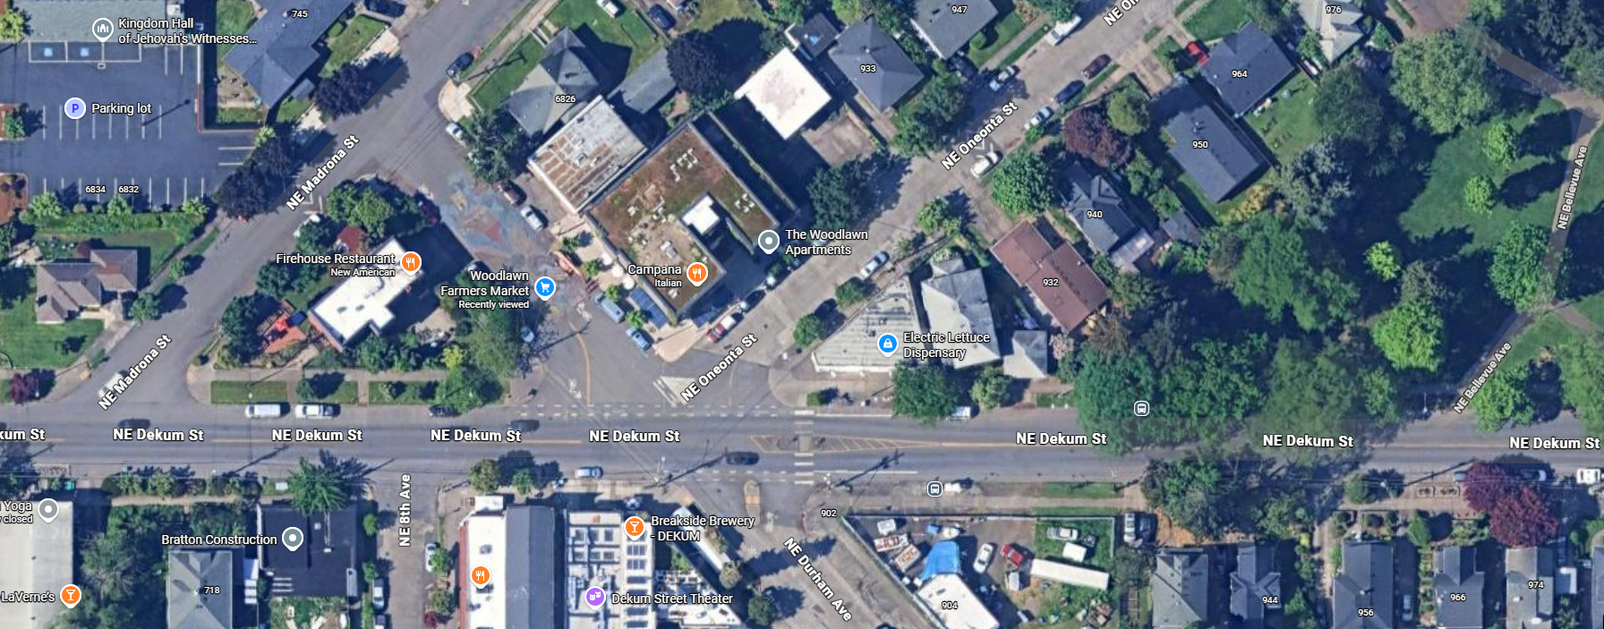
Woodlawn NA – Dekum Triangle
District 2 - NE Durham Ave & NE Dekum St

Slide 20
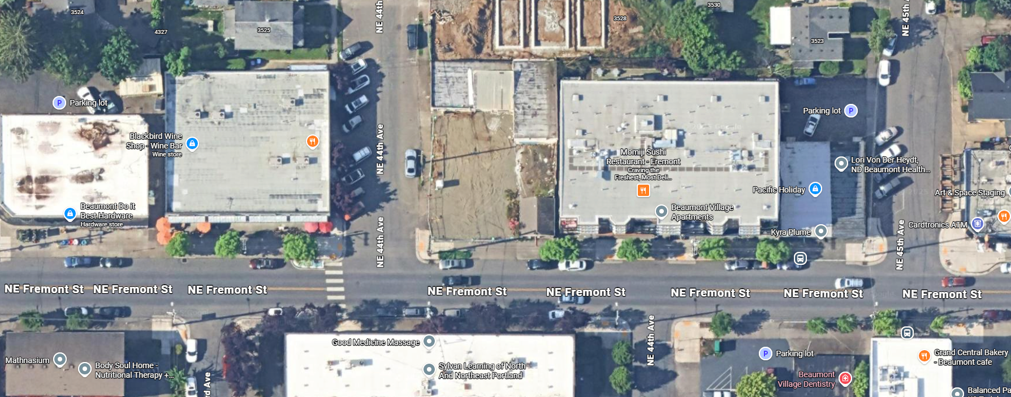
Beaumont Wilshire NA – Fremont
District 2 - NE 44th Ave & NE Fremont St
Food Carts
May 2026

Slide 21
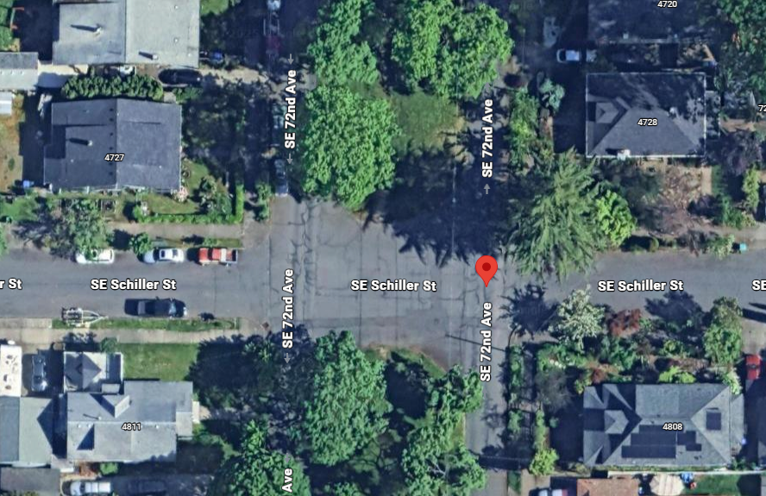
Foster-Powell NA – Parkway
District 3 - SE 72nd and SE Schiller

Slide 22
Storytime!
Getting to Yes
5

Slide 23
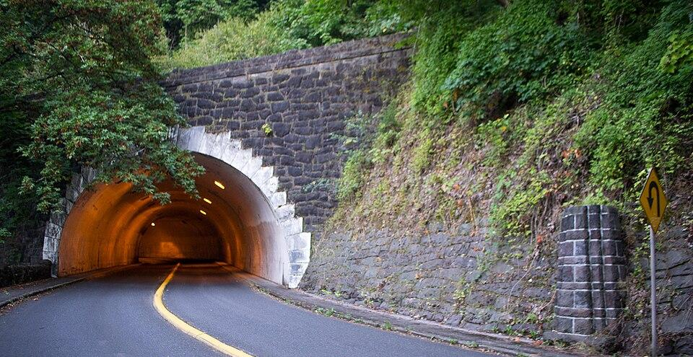

Pushing Bounds so you don’t have to
Proposal: A concert in Rocky Butte Tunnel
Can it be
done?
1939 Key arched barrel tunnel
27’ high x 34’ wide
375’ long
Concrete-lined interior
Path doubles back on itself to negotiate a steep 5% gradient
Within parks property
34
Notes:
This request originally came in through the block party program, but it clearly didn’t meet the standard requirements—things like being on a residential street or having a typical attendance scale.
The proposal involved the Rocky Butte Preservation Society and the Madison South Neighborhood Association, and right away the big question was: who actually has jurisdiction here?
The event site included a road and tunnel running through a park, which made things complicated. Determining ownership ended up being the most time-consuming part of the process—it took about five weeks to get a clear answer. One of the lead parks event coordinators had to escalate it to Parks Property and Real Estate to fully understand the boundaries.
Interestingly, while about 9 out of 10 roads in parks are Parks-owned, this one turned out to be PBOT property. That distinction really mattered, because it changed the permitting pathway entirely. It also highlighted that whenever something is adjacent to park land, there needs to be strong coordination between bureaus.
From there, we moved into feasibility. We worked with traffic engineers to assess whether a closure was even possible. One major issue was that closing the road would force residents into a long detour, so we had to do a deeper dive into traffic impacts.
Initial reactions internally were honestly along the lines of “what is this?”—but that’s pretty typical. We tend to get ambitious or unconventional ideas, and part of our role is figuring out how to make them work safely.
We also needed approval from PBOT Structures to evaluate the tunnel—both for structural integrity and attendee safety. That review came with conditions, including no generators and no amplified sound.
Once those major hurdles were cleared—traffic engineering, Parks coordination, and Structures approval—it became more of a standard process. At that point, we were able to move forward with it as a street closure permit.

Slide 24
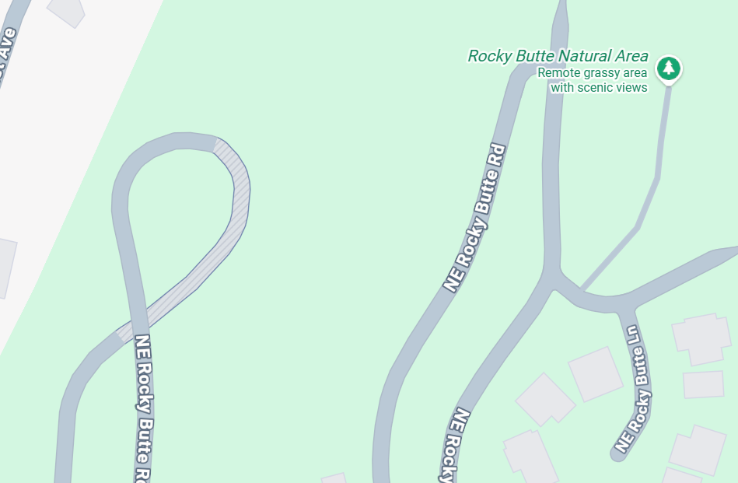
Navigating the Red Tape
Never been done before in Portland
Request didn’t fit block party criteria
Unclear jurisdiction: 5-week process to confirm ownership (PBOT vs PPR)
Required inter- and cross-bureau coordination
Traffic Engineers
Structural review
Notes:
This request originally came in through the block party program, but it clearly didn’t meet the standard requirements—things like being on a residential street or having a typical attendance scale.
The proposal involved the Rocky Butte Preservation Society and the Madison South Neighborhood Association, and right away the big question was: who actually has jurisdiction here?
The event site included a road and tunnel running through a park, which made things complicated. Determining ownership ended up being the most time-consuming part of the process—it took about five weeks to get a clear answer. One of the lead parks event coordinators had to escalate it to Parks Property and Real Estate to fully understand the boundaries.
Interestingly, while about 9 out of 10 roads in parks are Parks-owned, this one turned out to be PBOT property. That distinction really mattered, because it changed the permitting pathway entirely. It also highlighted that whenever something is adjacent to park land, there needs to be strong coordination between bureaus.
From there, we moved into feasibility. We worked with traffic engineers to assess whether a closure was even possible. One major issue was that closing the road would force residents into a long detour, so we had to do a deeper dive into traffic impacts.
Initial reactions internally were honestly along the lines of “what is this?”—but that’s pretty typical. We tend to get ambitious or unconventional ideas, and part of our role is figuring out how to make them work safely.
We also needed approval from PBOT Structures to evaluate the tunnel—both for structural integrity and attendee safety. That review came with conditions, including no generators and no amplified sound.
Once those major hurdles were cleared—traffic engineering, Parks coordination, and Structures approval—it became more of a standard process. At that point, we were able to move forward with it as a street closure permit.

Slide 25
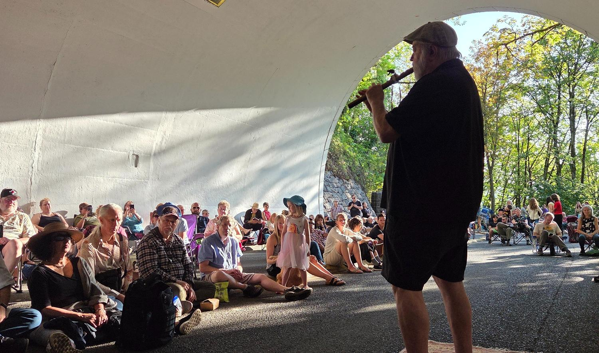
Results
Notes:
Tunnel Download with Sal
Sent to block party request, definitely didn’t fit into our requirements like residential street/attendance
Rocky butte preservation society and Madison s neighborhood association
Needed to know who had the athourity
Road and tunnel that goes through the park
That took the longest to get a solid answer-5 weeks
One of the lead coordinators for parks events had to bring it parks property real estate to understand the boundaries
Established it was pbot property
9/10 times roads are parks property and this happened to not be.
Some kind of coordination needs to happen its when its adjacent to park
Next steps, getting advice from traffic engineers. Was length possible
Closing off section meant that residents would have to do a giant loop
Deep dive into traffic disruption
Geoff
Initial reaction was ugh what the hell. That’s the general jist. We always bring crazy ideas
Had to get consent and approval from pbot structures to see if it was safe for attendees and integrity of the tunnel. and if there were any conditions, for safety of attendees and
No generators, no amplified music
After that generally smooth sailing—business as usual
Green lights for TE, parks, structures
Zone in as street closure
Vista Bridge Sun, Aug 30th
Tons of details still needed
High level: 100 year celebration of vista bridge, food trucks, music, pbot is just doing the bridge includes Washington park, multi venue party
Structures will be involved
Complex because it’s a bridge, weight capacity, trimet component and rerouting, side streets are narrow
How would this impact effect narrow roads with on street parking
Will coordinate with TE again
Major emergency response route
Need layout with food trucks and other aspects, how many, weight of each fully loaded.

Slide 26
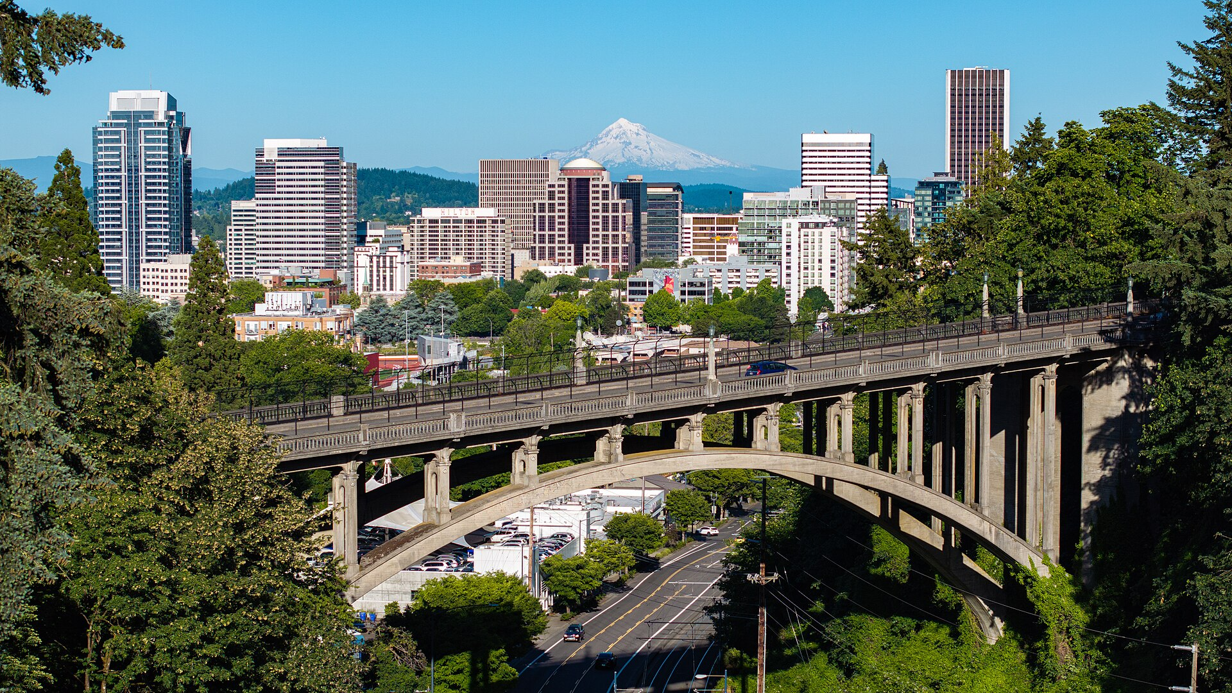

Lofty Pursuits: Vista Bridge Centennial Celebration
Vista Bridge
Total length | 248 ft (76 m)
Height | 120 ft (37 m)
Opened | 1926

Slide 27
Looking Forward
5

Slide 28
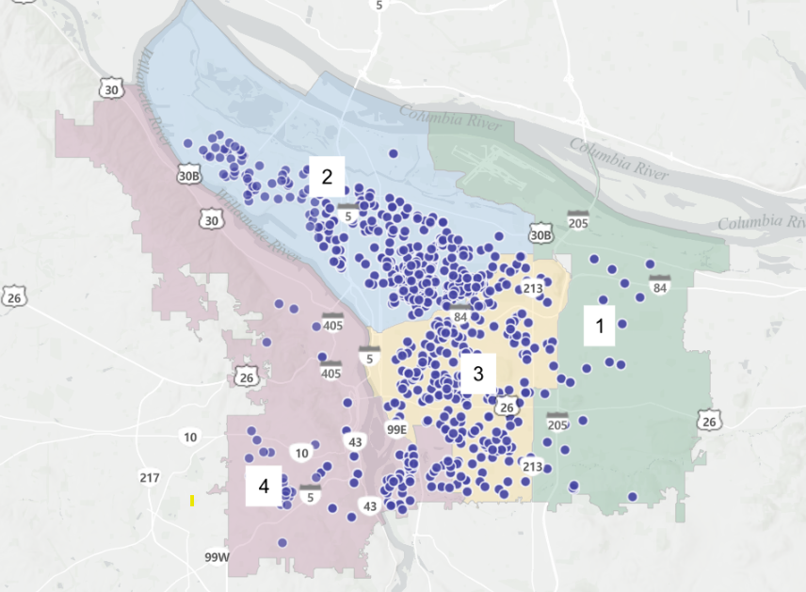
Recognizing Gaps in Service
Unique locations per District*
District 1: 24
District 2: 250
District 3: 250
District 4: 87
District 1 still experiences geographic disparities in block party participation.
Strategies to increase engagement include:
Consulting with the community to identify participation barriers
Conducting focused outreach to raise awareness of the program
Offering translated program materials to improve accessibility
*Note: The number of mapped locations is lower than permits issued, as mapping software displays only unique locations even when multiple events occur at the same site.
47

Slide 29
Looking Forward: 2026 Goals & Initiatives
Increase D1 outreach of PRSA program offerings for all PRSA Programs
Establish a minimum of three new plazas through the Open Call and other strategic projects
Support unselected Open Call applicants via smaller-scale or interim projects
Improve the open call process for 2026
Improve inclusive design of plazas, hold listening sessions with disability advocates and community
Formalize plaza partner agreements to improve clarity and consistency around roles and responsibilities
Continue Plaza Partner Socials and roundtables to build cooperation between partners
Support downtown activation projects
Double Play Streets program partnerships, with a focus on District 1
Launch a “Call for Art” initiative
Find mechanisms for funding, increasing awareness of grants for community partners

Slide 30
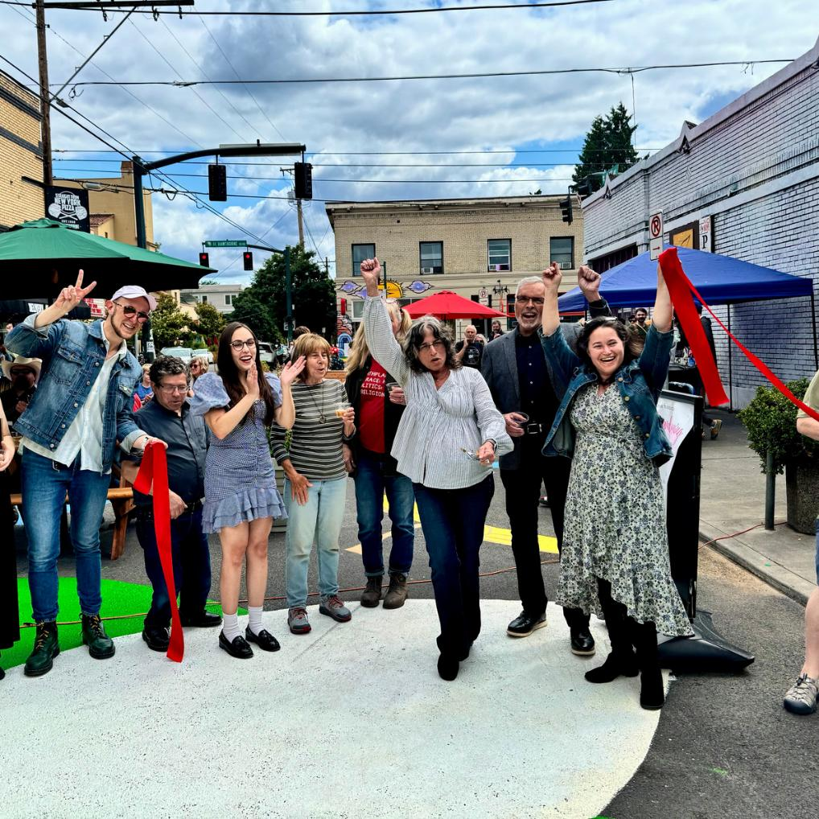
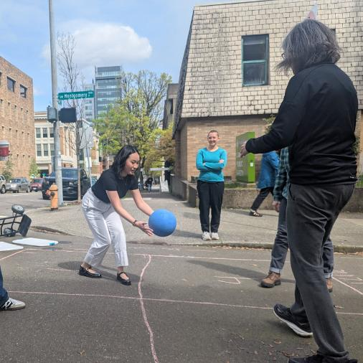
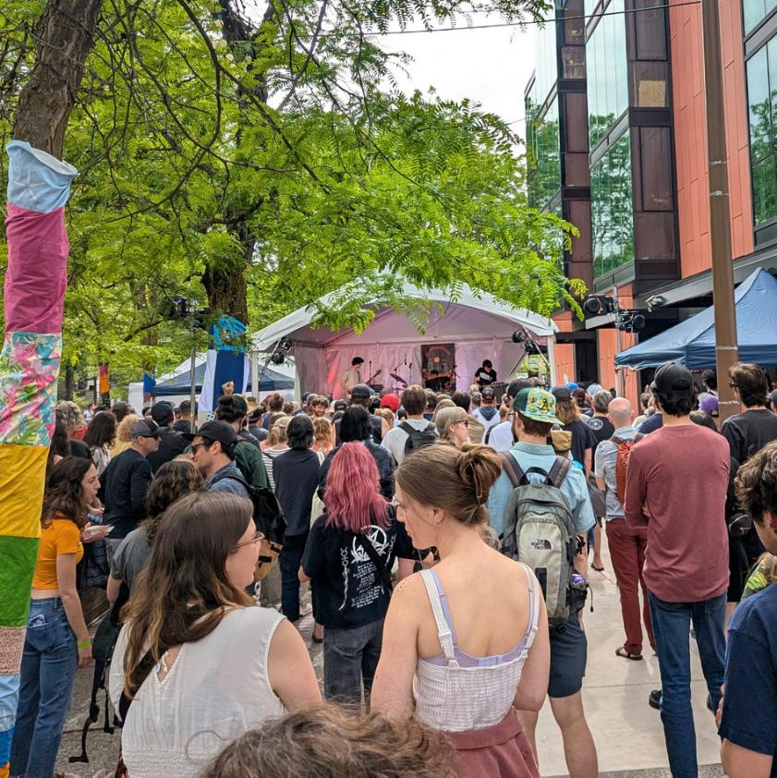
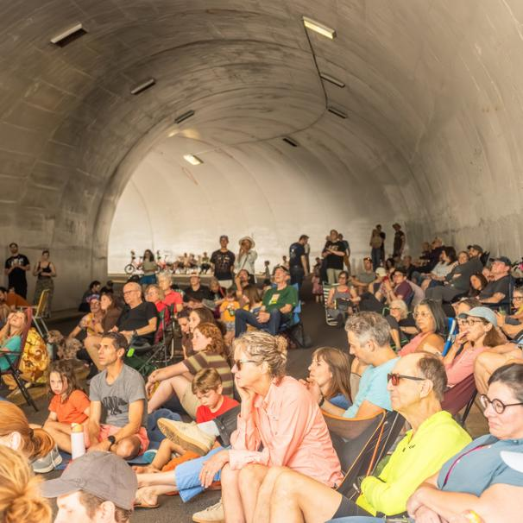
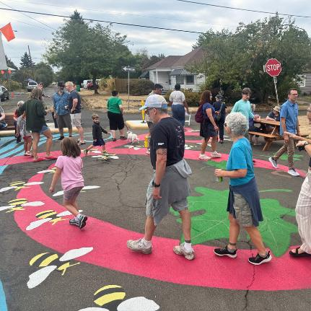
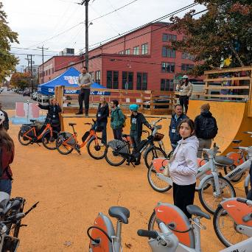
Conclusion
PRSA’s flexible, partnership-based model allows direct response to local needs while lowering barriers to participation in civic life
Activations contribute to broader City goals: encouraging walking and lingering. supporting business, safety, and public health
PRSA remains a cost-effective tool
Work remains. Continued and sustained investments will be critical to maintaining momentum, strengthening partnerships, and ensuring equitable access to activated public spaces.

Slide 31
Discussion
Which programs would be most effective for your community? How can PRSA support?
How can we increase program offerings in underserved areas? What are opportunities and constraints?
How can we improve our open call process?
What other ways could PRSA support Portland placemaking efforts?

Slide 32
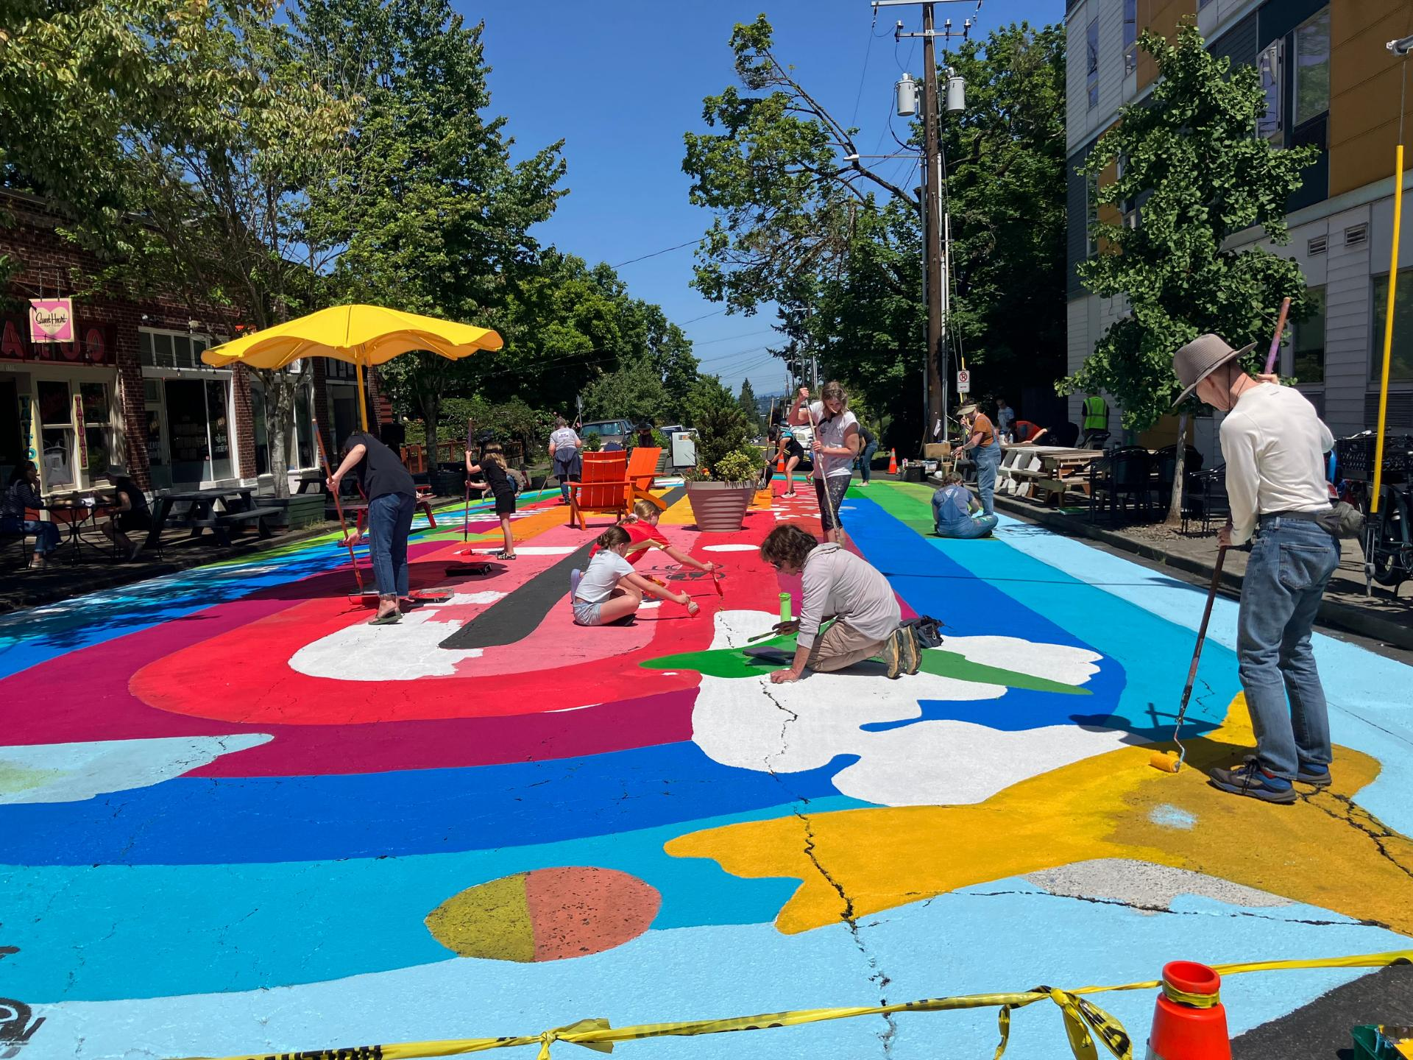
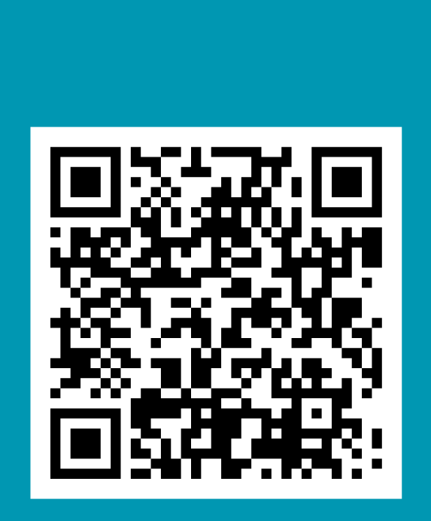
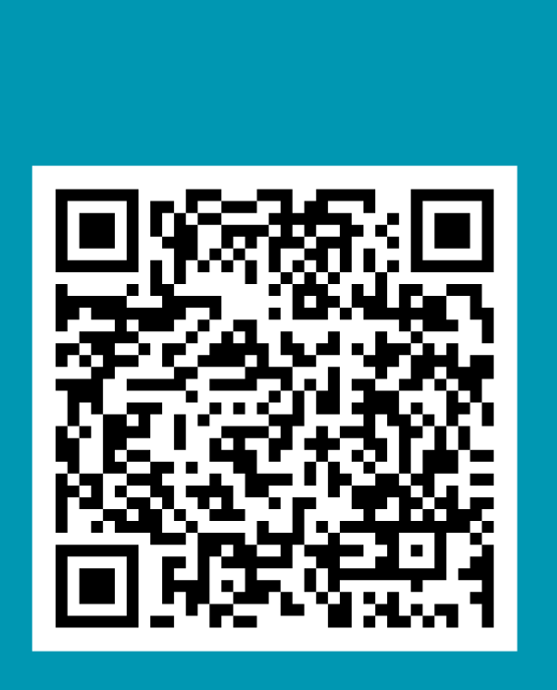


Photo Courtesy of Kepper Petzig
Other
Programs
Plazas
Tyler Smith
Transportation Planner
Tyler.Smith@portlandoregon.gov
Thank you!

