Slide 1
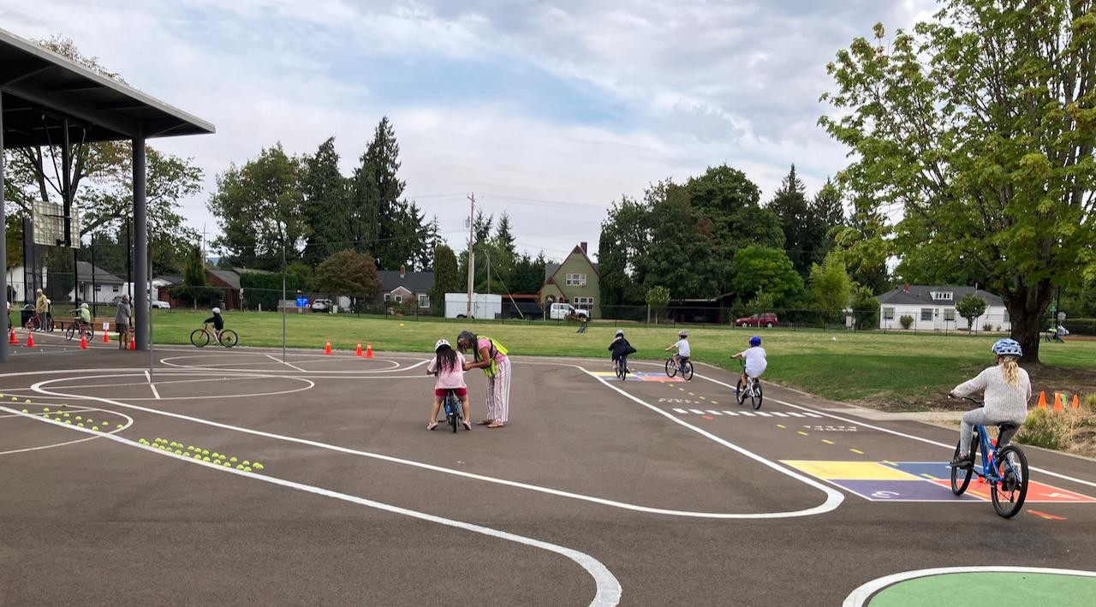

What It Takes to Plant a Traffic Garden: Lessons From Oregon’s 2025 Pilot
04/22/2026
Notes:
Trevor

Slide 2
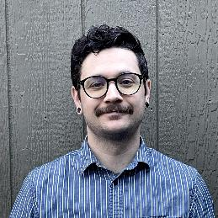
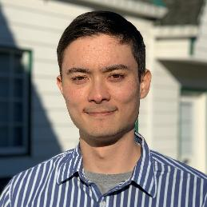
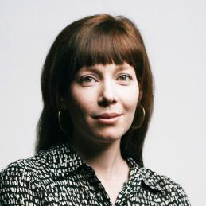
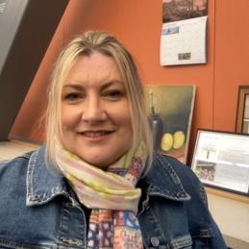
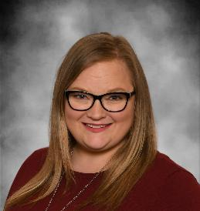
Who we are
Sam Alig, Alta Planning + Design
Amelia Adams, Alta Planning + Design
Kim Patten, Corvallis School District
Trevor Luu, Alta Planning + Design
Amy Lesan, Corvallis School District
Notes:
Trevor

Slide 3
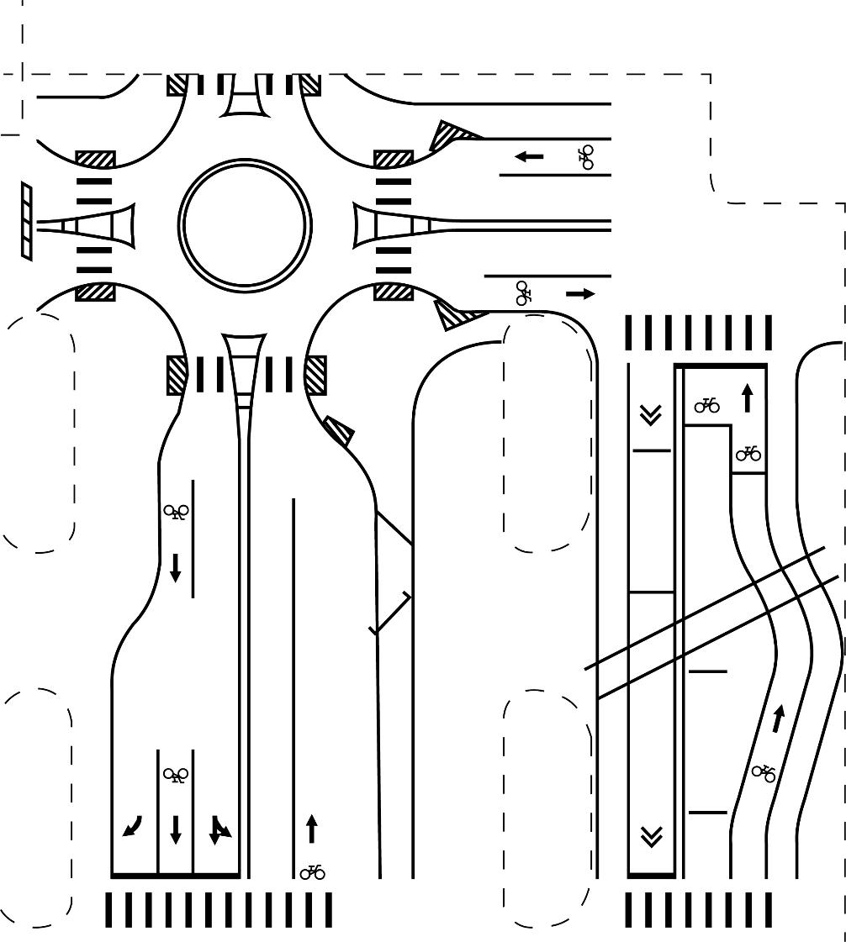

Agenda
Intro + What is a Traffic Garden – 5 min
ODOT Pilot + Development – 3 min
Lincoln ES Design + Install – 3 min
Use After Install – 5 min
Interactive Design Activity – 8 min
Wrap up – 2 minutes
Notes:
Trevor

Slide 4
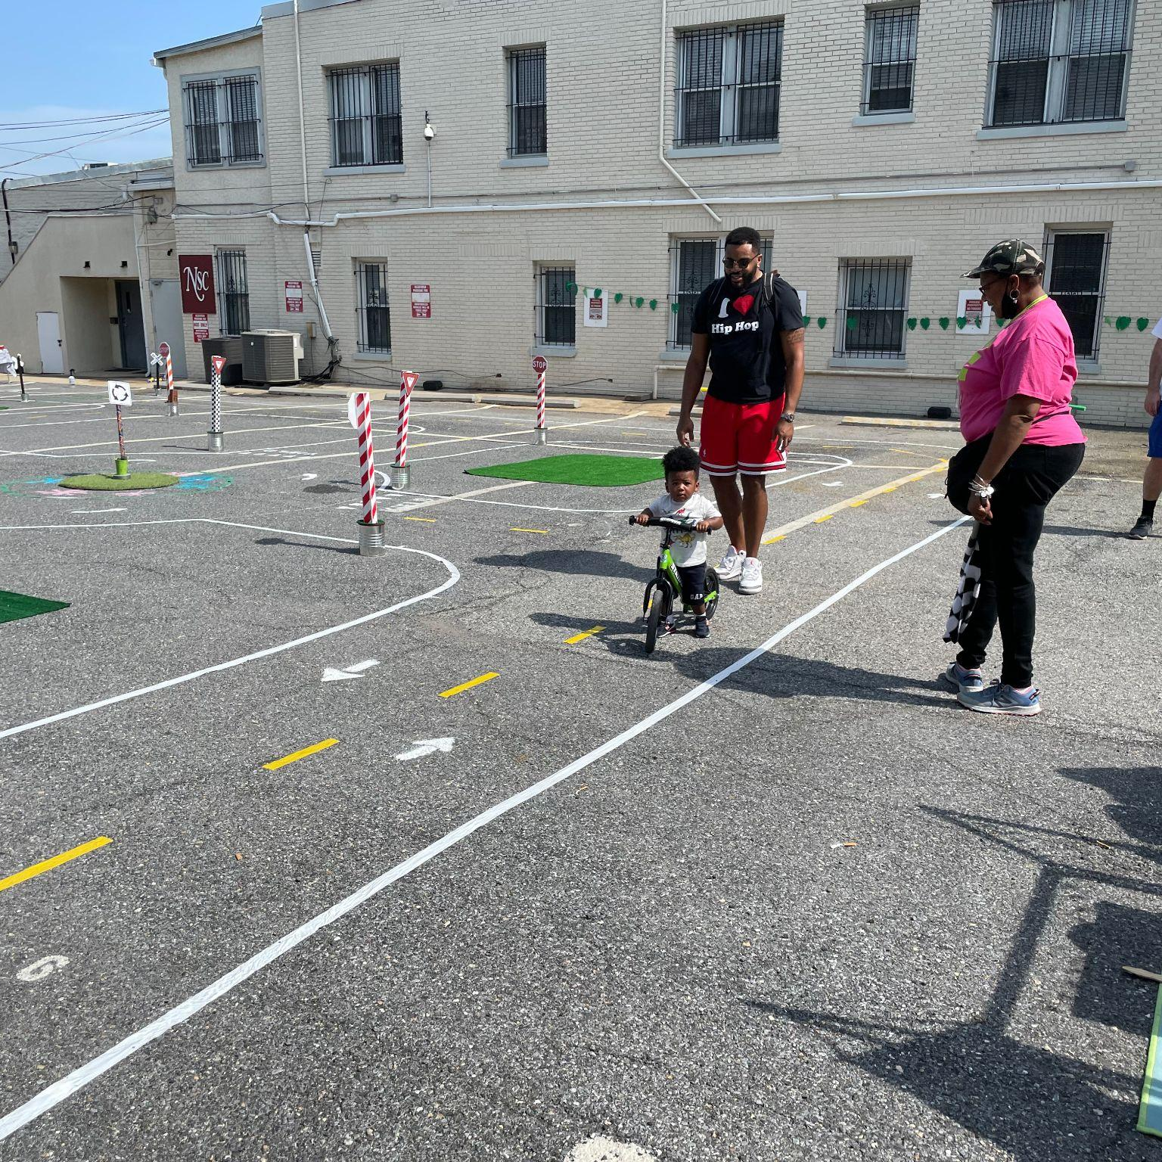
What is a Traffic Garden?
Notes:
Trevor

Slide 5
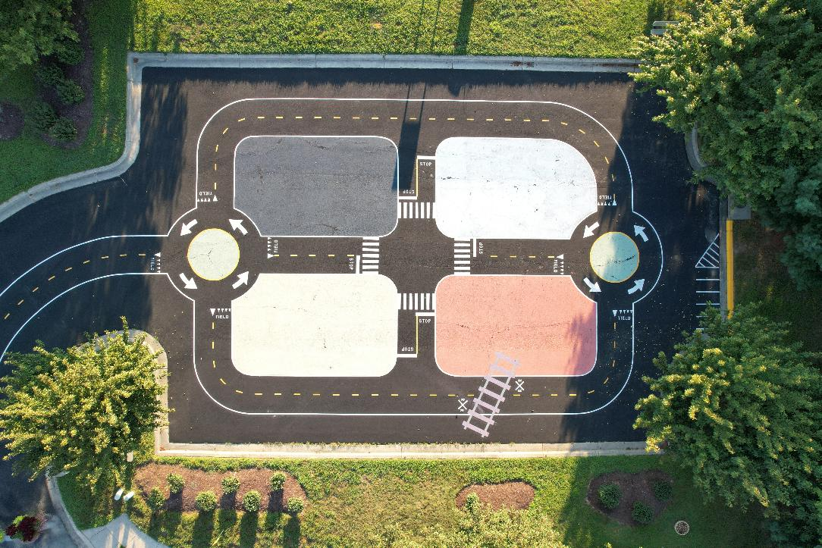
What is a Traffic Garden
A traffic garden is a dedicated vehicle-free space designed for teaching and practicing roadway safety and biking skills, especially for beginners.
Notes:
Trevor

Slide 6
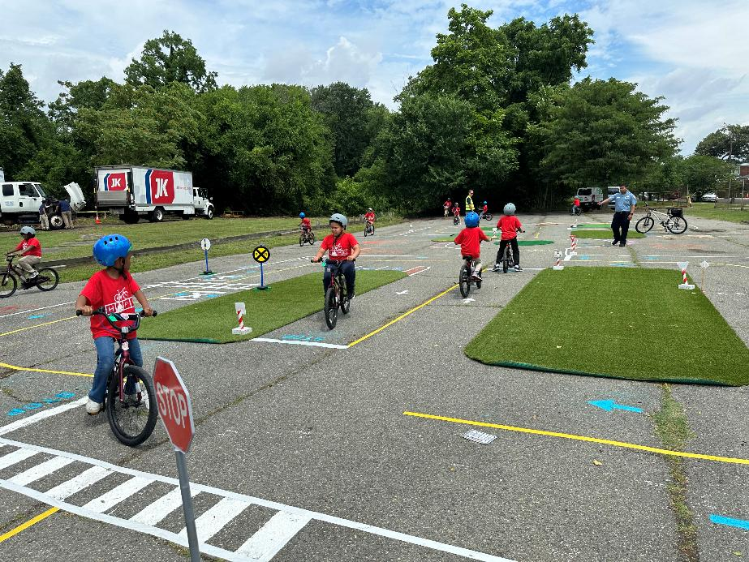
Elements of a traffic garden
Scaled down streets
Signage (yield, stop, RR xing, etc.)
Railroad track
Roundabout
Crosswalks
Bike Lanes
Other decorative features
Notes:
Trevor

Slide 7
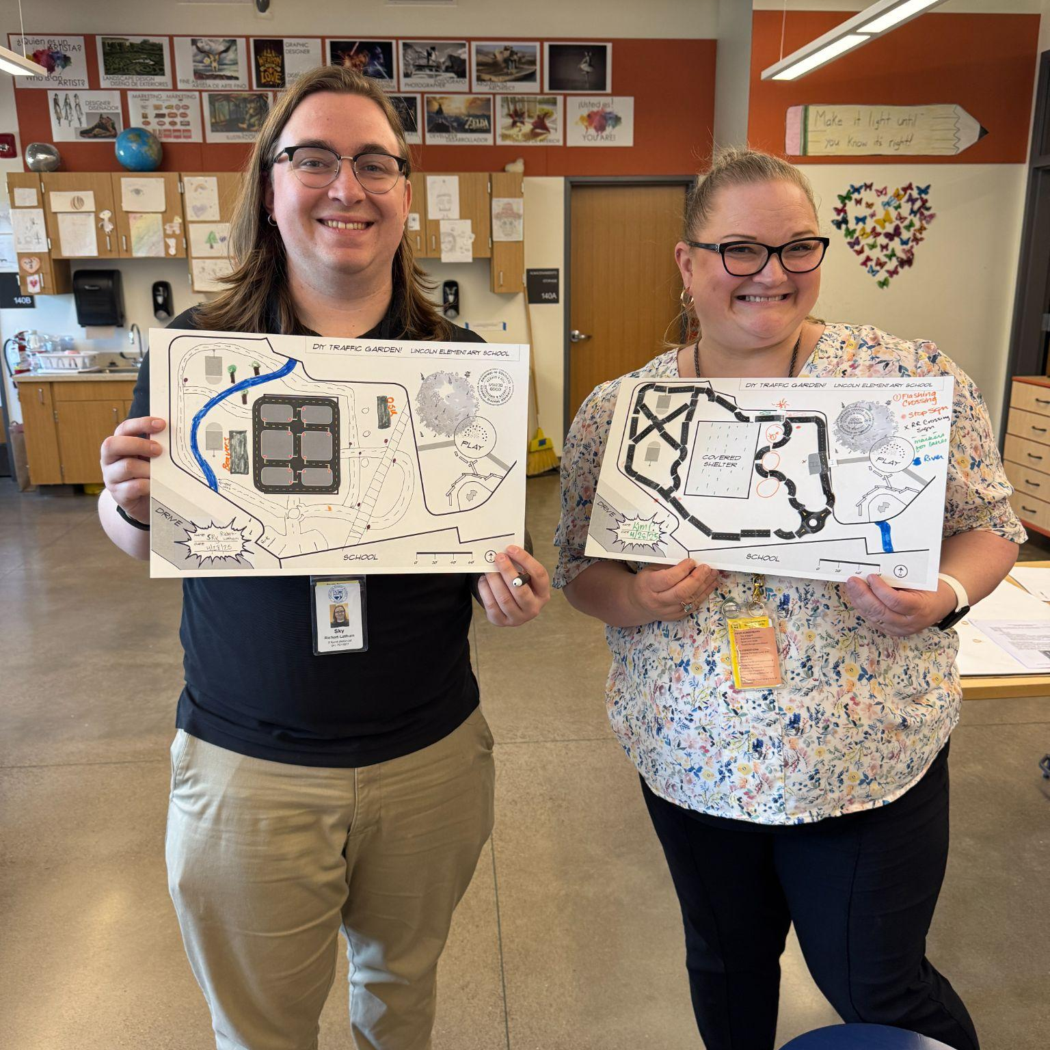
Developing the ODOT Traffic Garden Pilot Program
Notes:
Alta

Slide 8
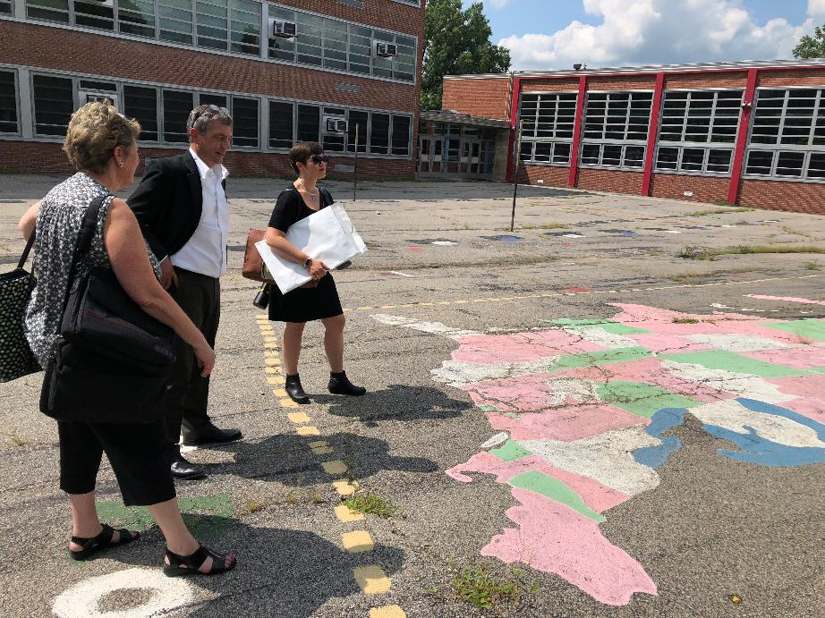
ODOT Pilot Program Purpose
Purpose
The Traffic Garden Pilot Project is designed to explore establishing effective, community-driven traffic gardens across the state of Oregon.
Project objectives
Develop traffic garden typology
Determine site requirements
Establish a vision and set of guidelines for future implementation
Project Scope
Conceptual design-only for permanent traffic garden (2)
Design and installation of surface-applied traffic garden
Notes:
Alta

Slide 9
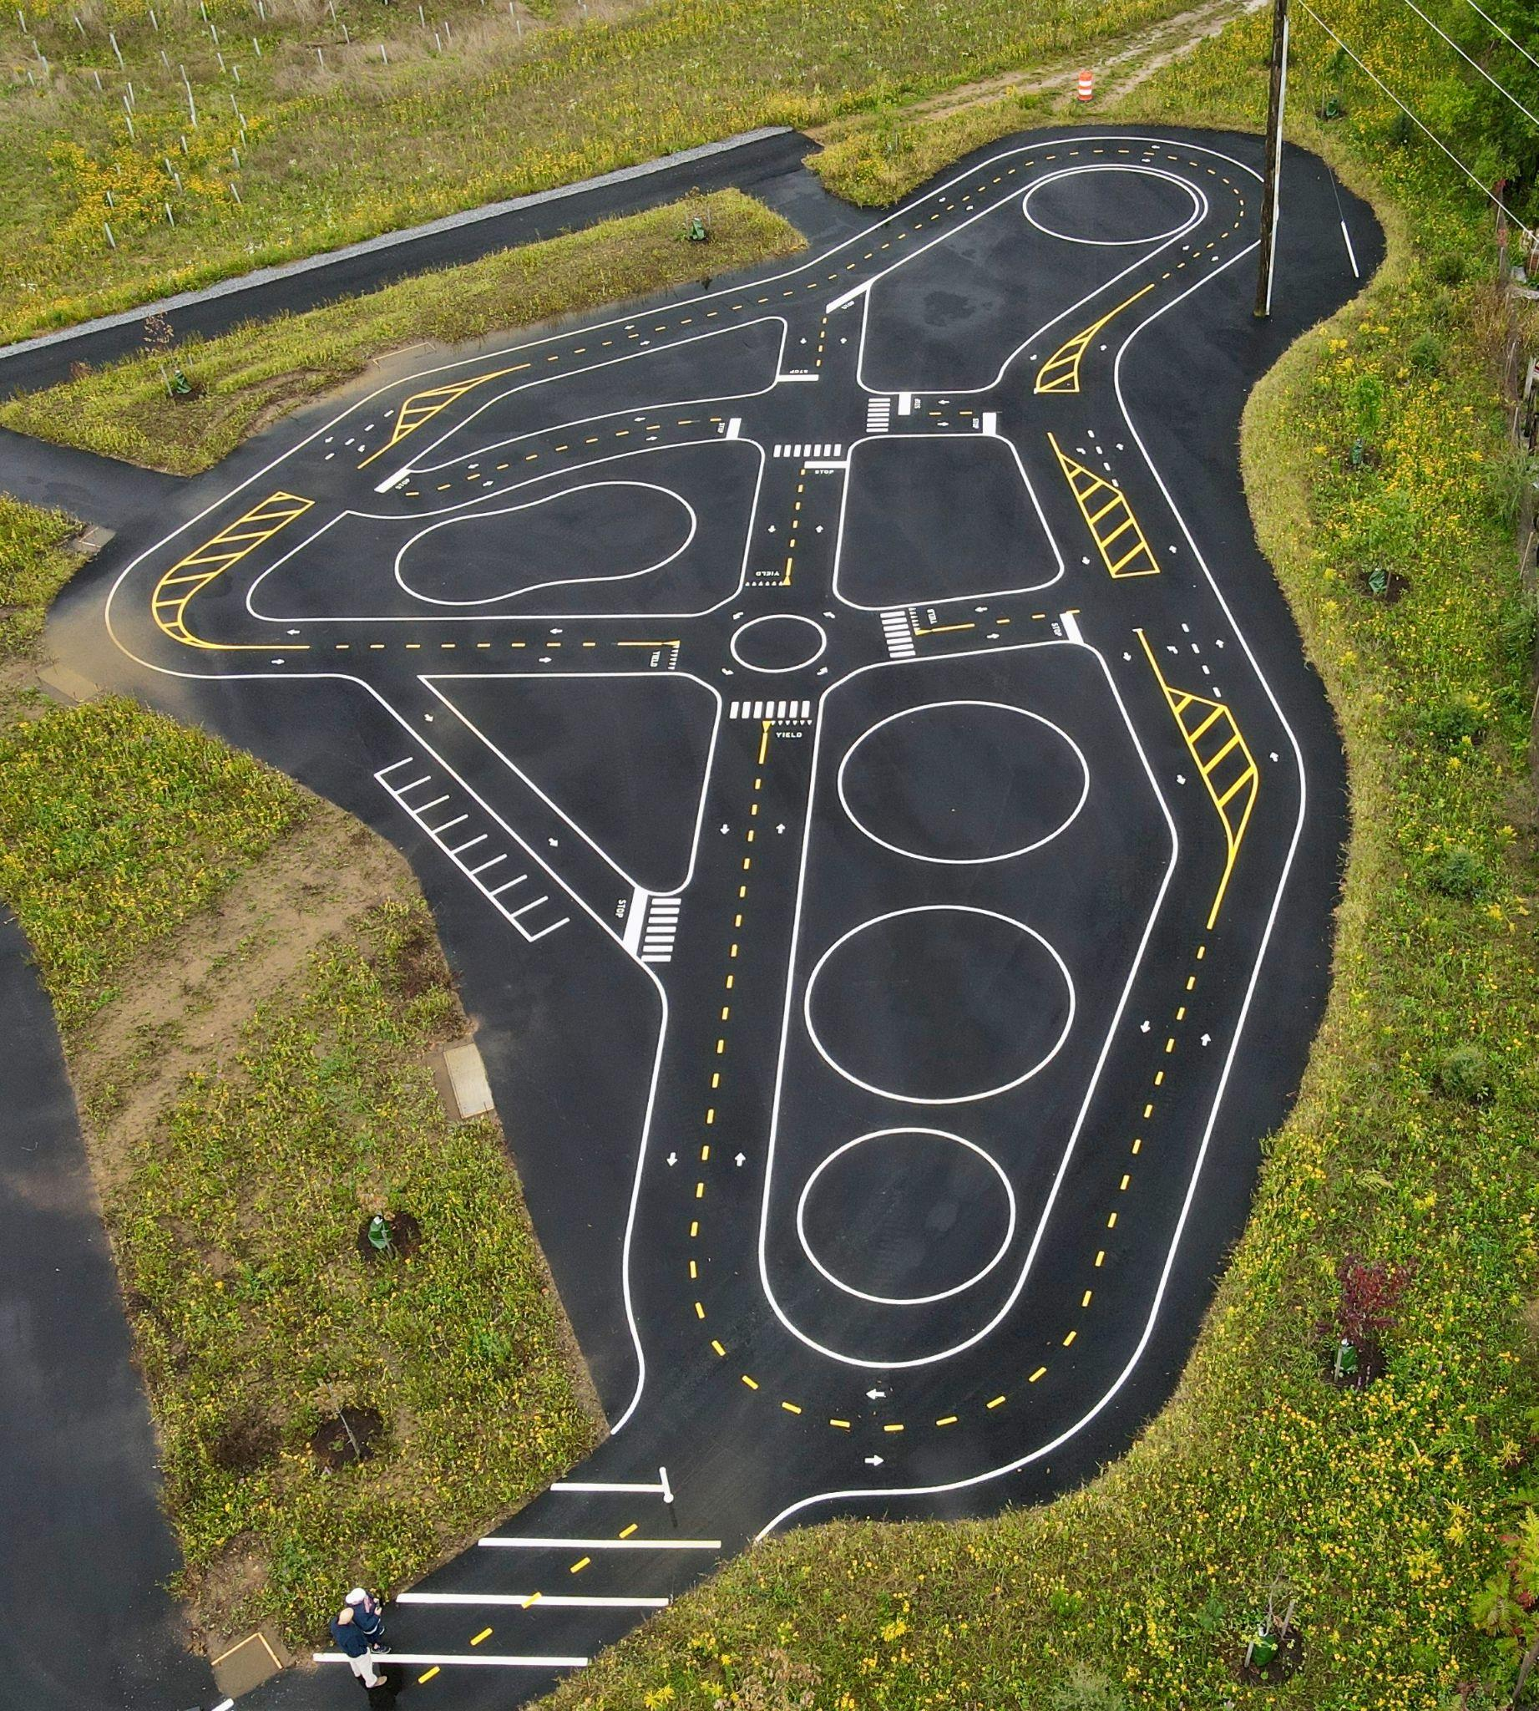
Site Selection
High-quality surface
Level surface
100 sq ft or greater
Existing use and accessibility
Notes:
Alta

Slide 10
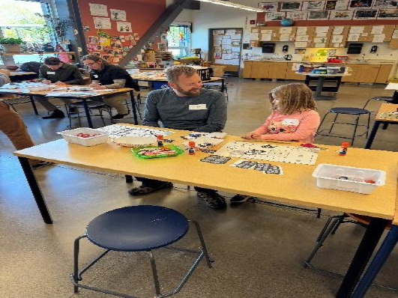
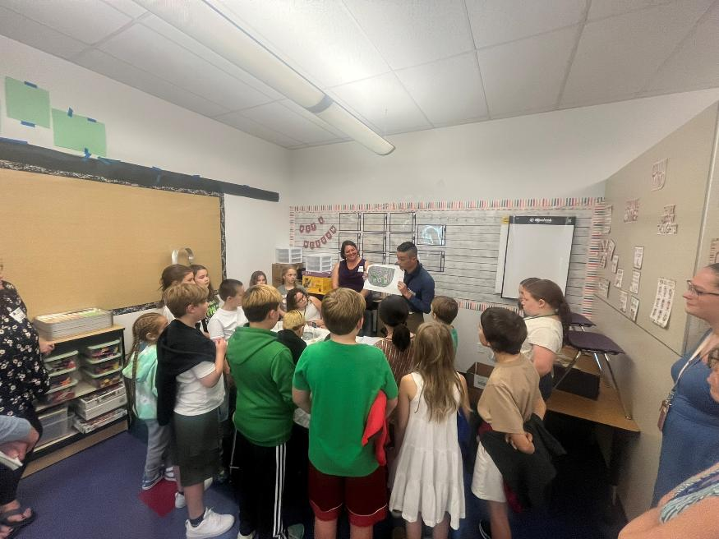
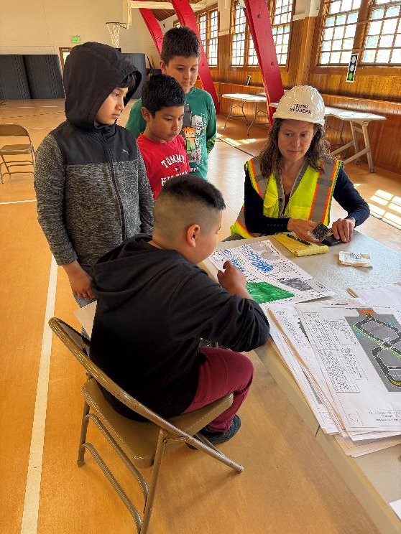
Community-Led Design
Notes:
Alta

Slide 11
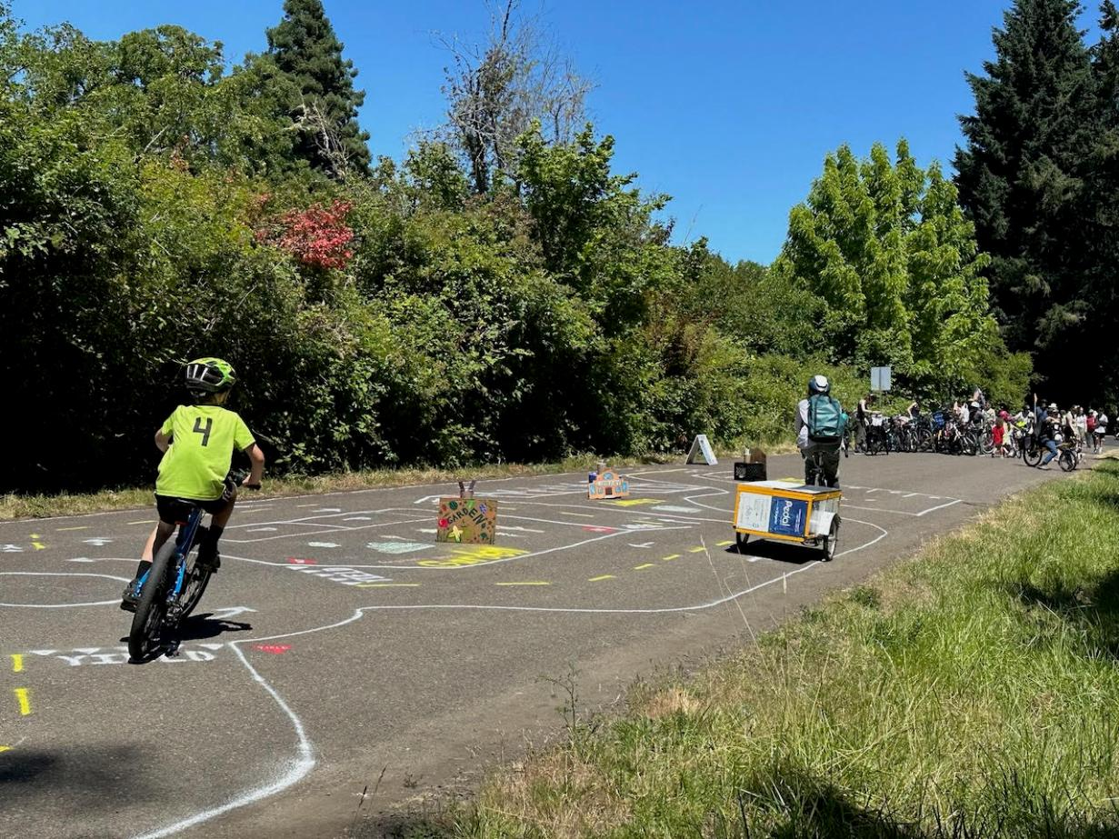
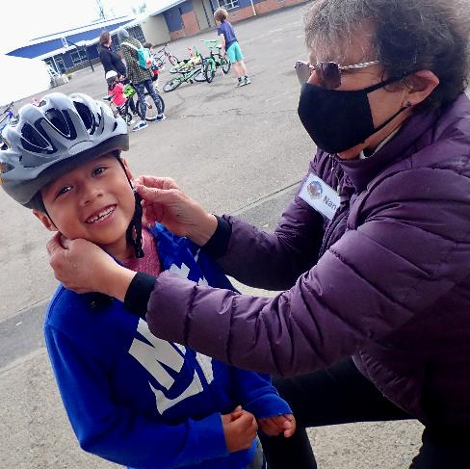
Corvallis School District: Lincoln Elementary School
Traffic Garden Pilot
Notes:
Kim and Amy –
Introduces selves and a little about the community
In Corvallis, we wanted to make sure we had community feedback and buy in (in Corvallis we have a large bike ed program and biking community including mid valley bike club)
At Lincoln got the pilot grant
Planning Meetings with Alta
Scheduled Community Design meeting at Lincoln School
Invited:
families we knew bike commuted to school or were active bike riders
PE Teachers & Bike Ed instructors
Families gave input and made actual designs and then all students go the chance to do the same during the school day
Community: Took the draft to our community – and we had a sample traffic garden at Open Streets Corvallis and continued to get community input & feedback (invited people in by drawing a traffic garden in the street, had the draft for feedback)

Slide 12
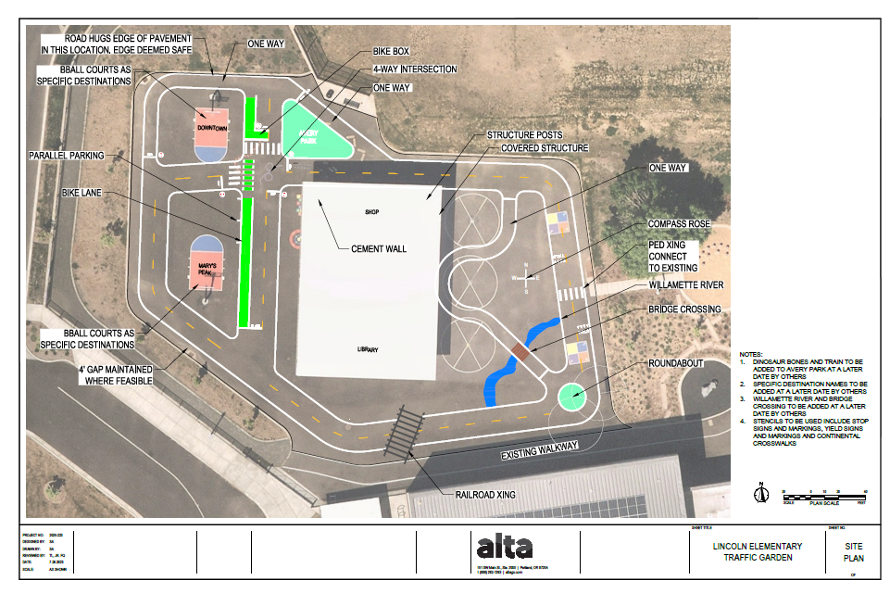
Design Considerations
Notes:
Kim and Amy
Questions we asked included students/families:
Where do you ride your bike
Where do you go in south town (this community)
What features do you/will you encounter (i.e. railroad)
Asked Teachers –
What do you need for this to be a learning environment
Kept in mind things like cue up for instruction (skills practice) and keeping visibility in mind while teaching a full class of students
Landed on key features:
RR
Local Park
Nearby River
Dino bones from another nearby park
Traffic circles
Green bike lanes
Pedestrian crosswalks
Sam
How did you come up with the design, given all the input and knowing the features - what was tricky about it?

Slide 13
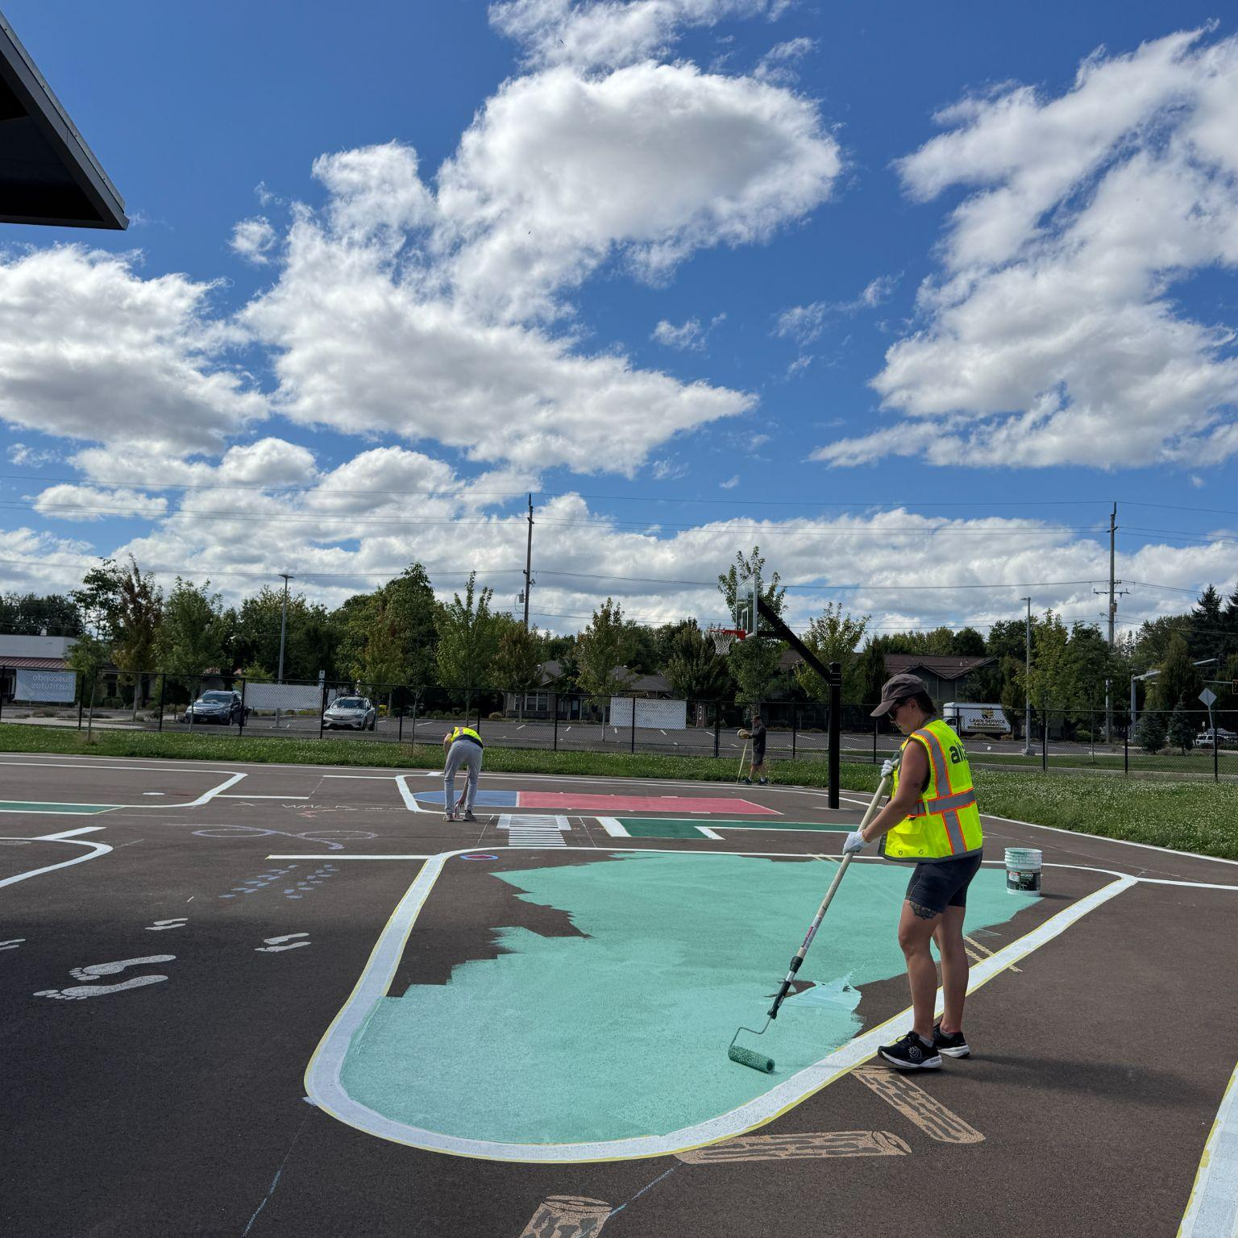
Installing the Traffic Garden
Notes:
Alta

Slide 14
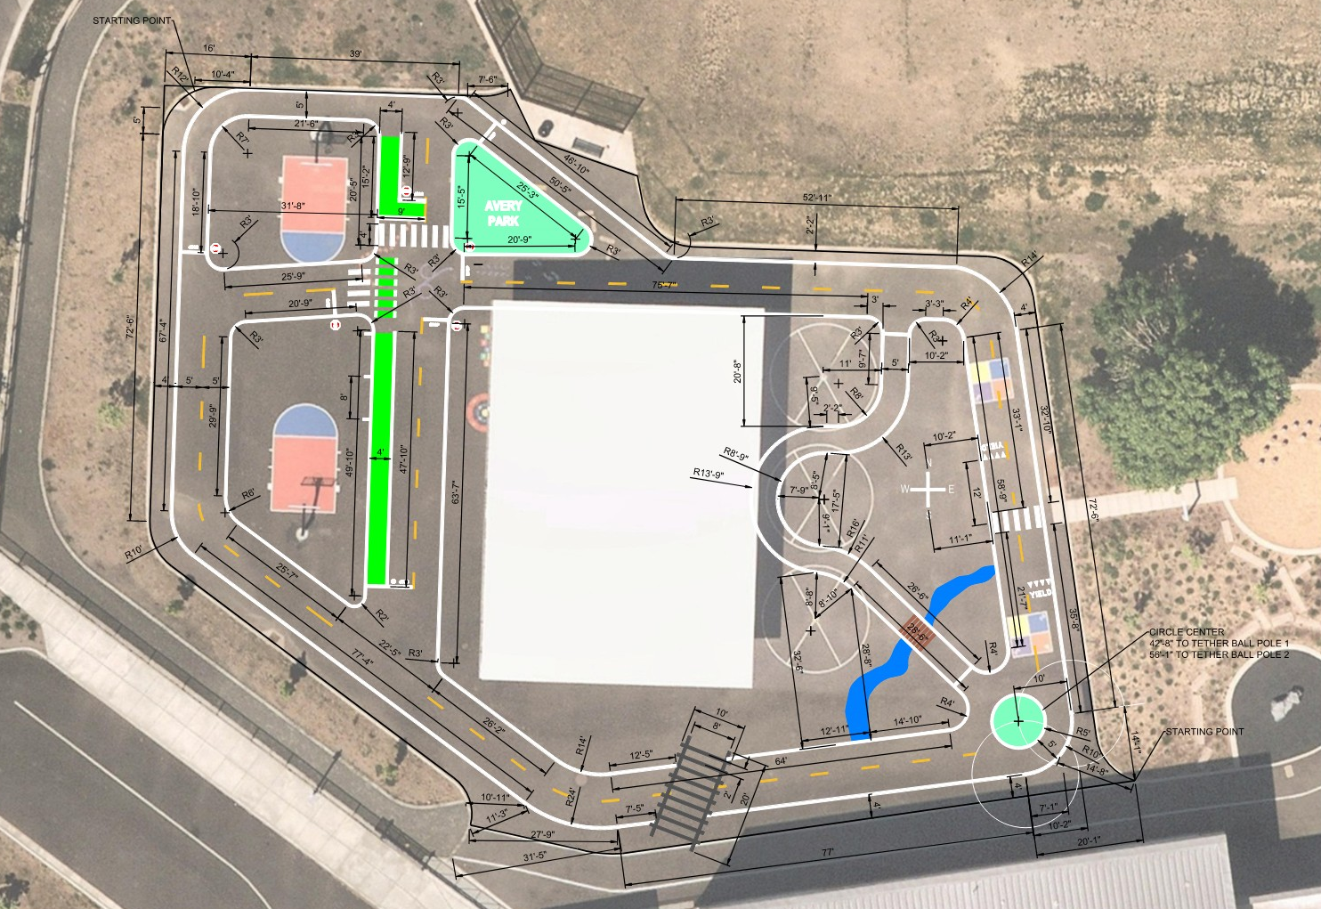
Layout

Slide 15
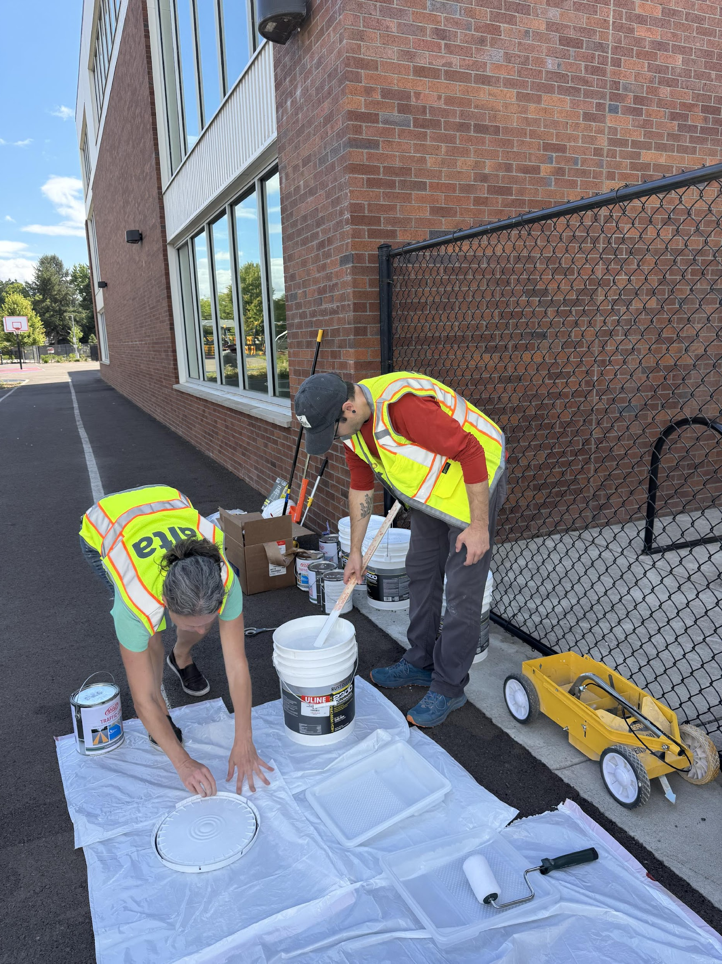
Install: Process and materials
Materials
Measuring tools
Painting supplies and safety gear
Paint and chalk/chalk lines
Specialty equipment
  Striping tool
  Stencils
Notes:
Alta

Slide 16
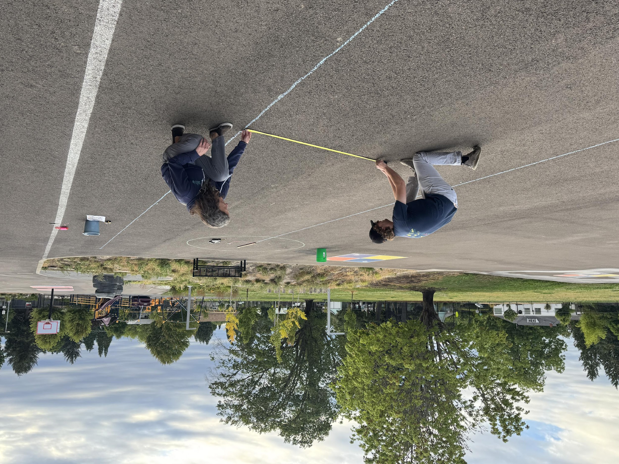
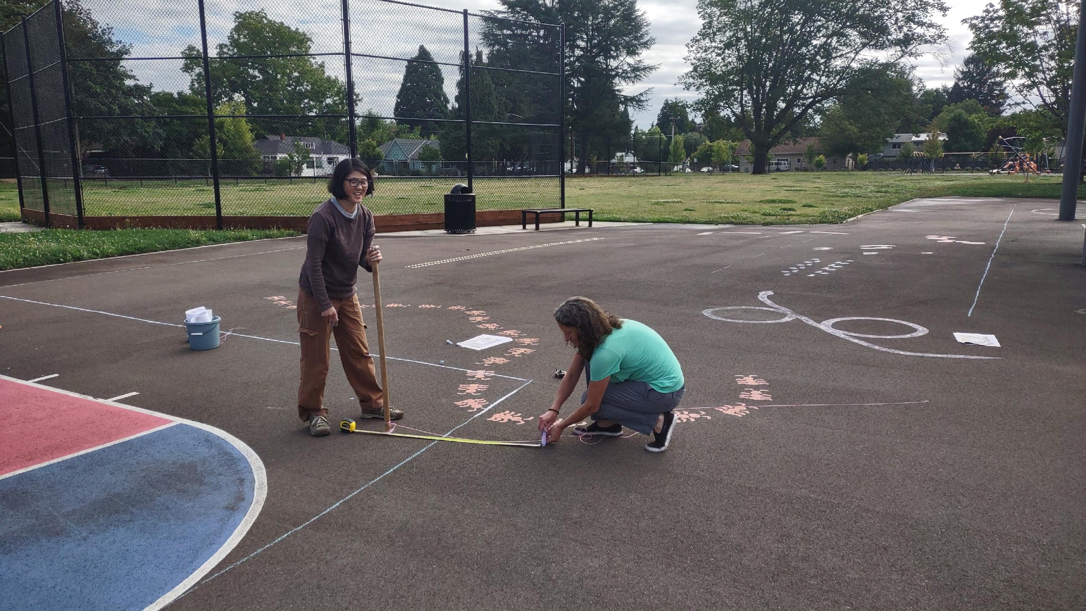
Install: Measuring and marking
Notes:
Alta

Slide 17
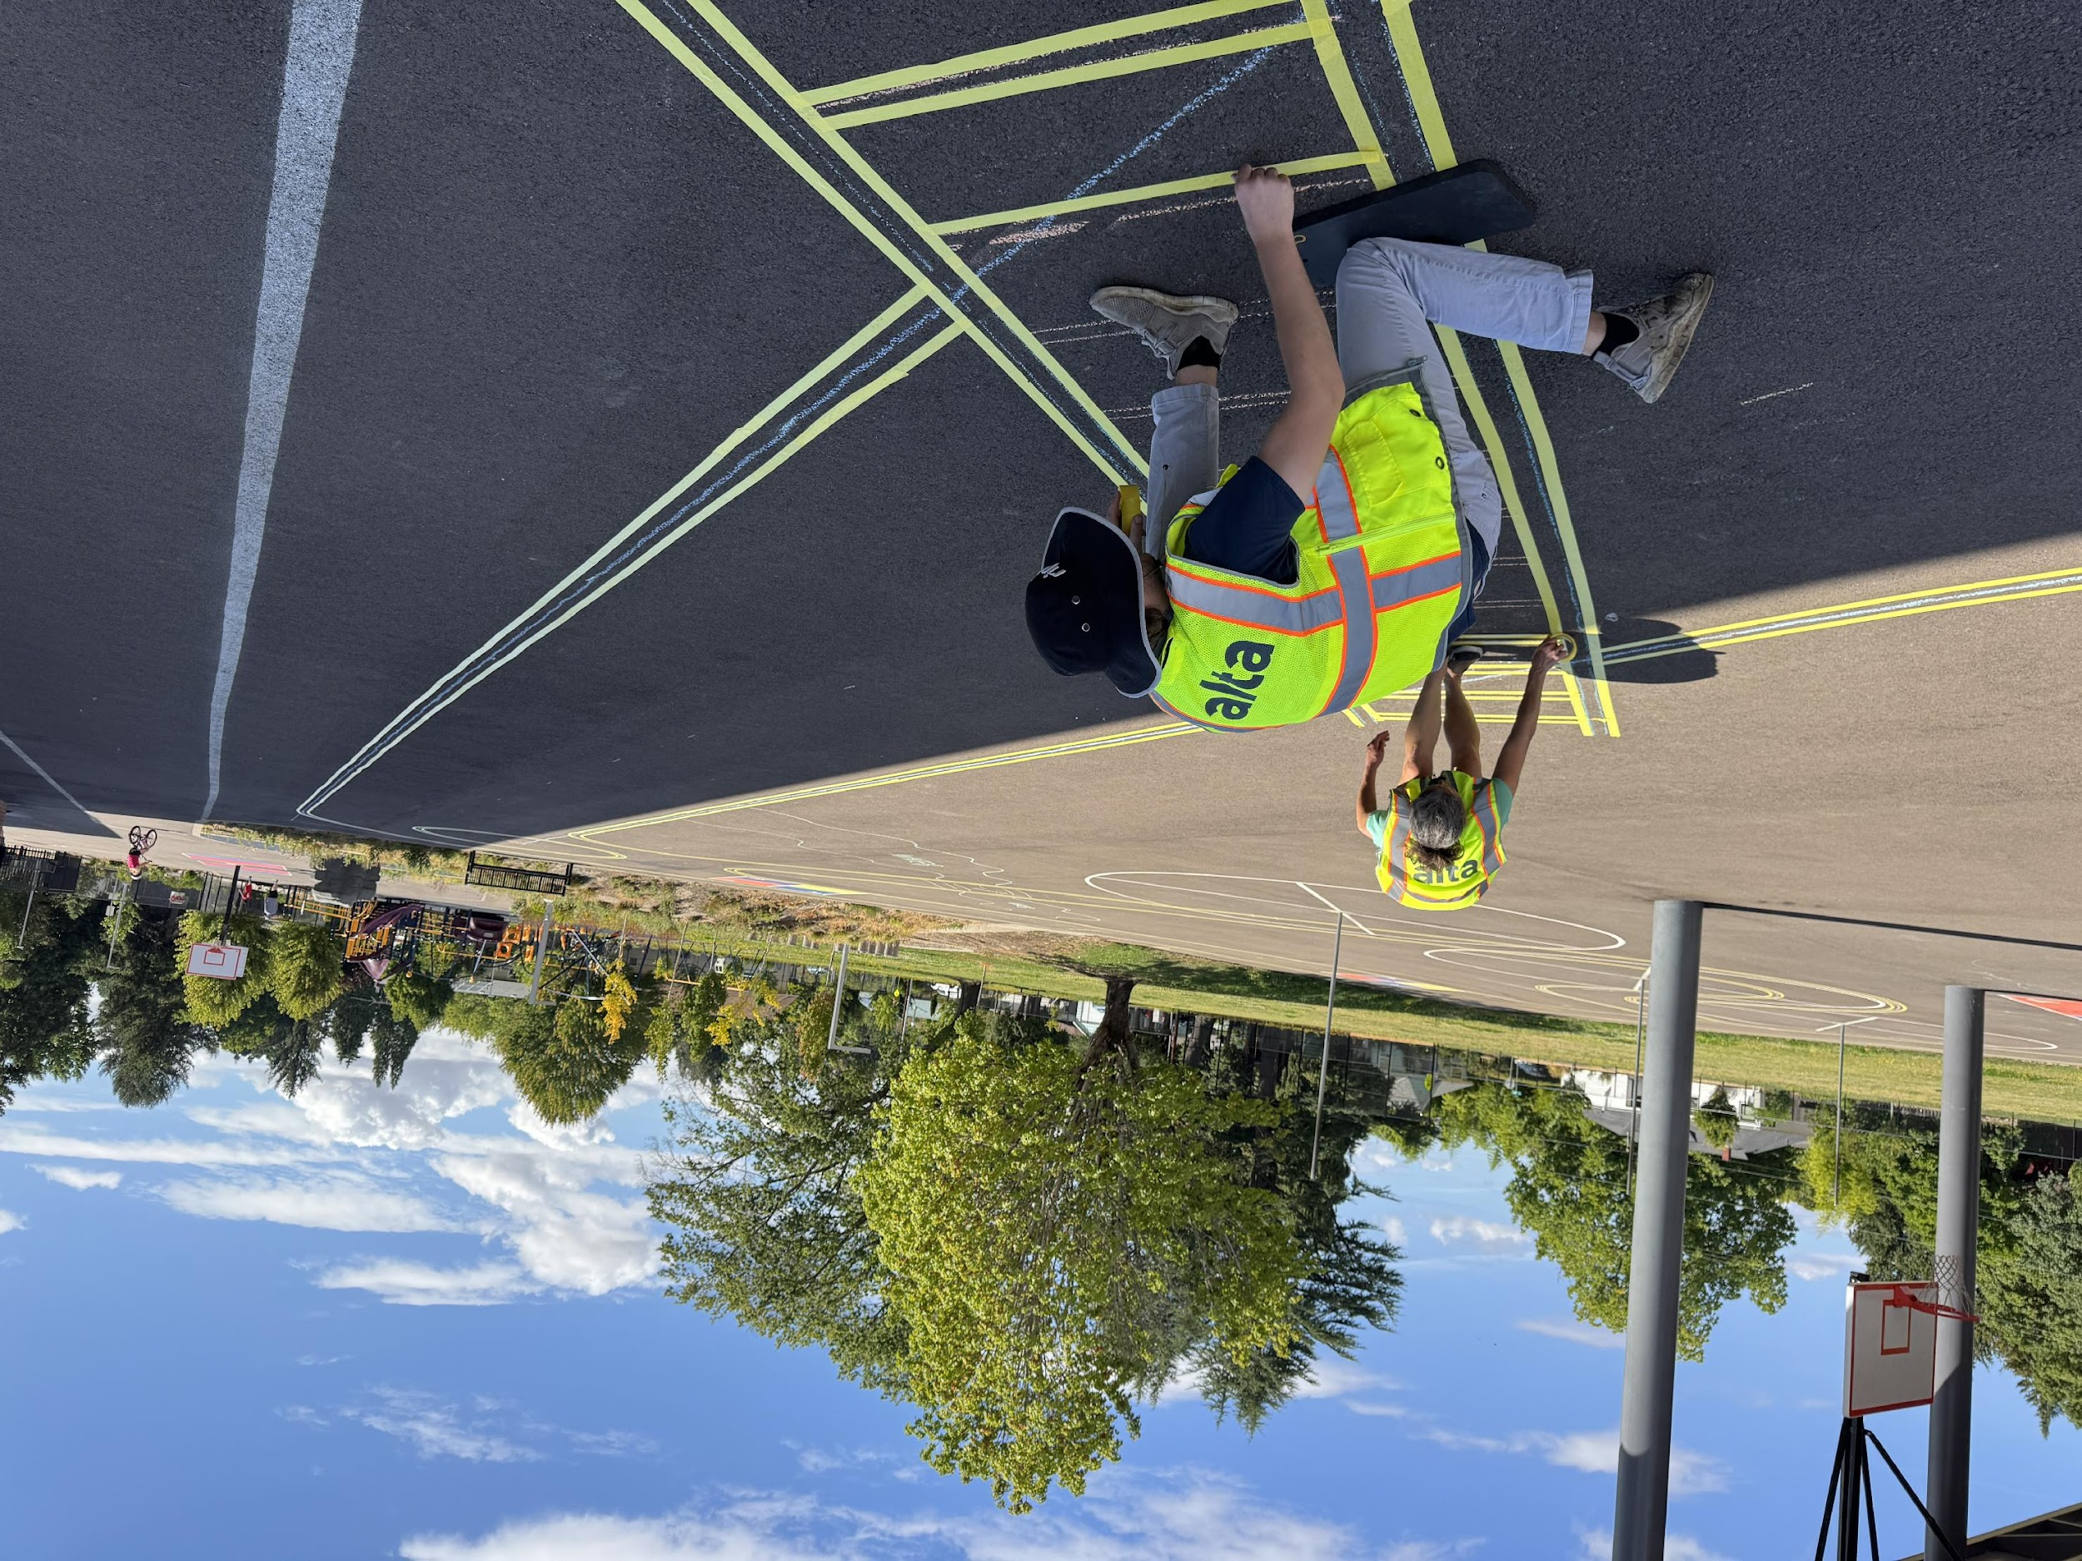
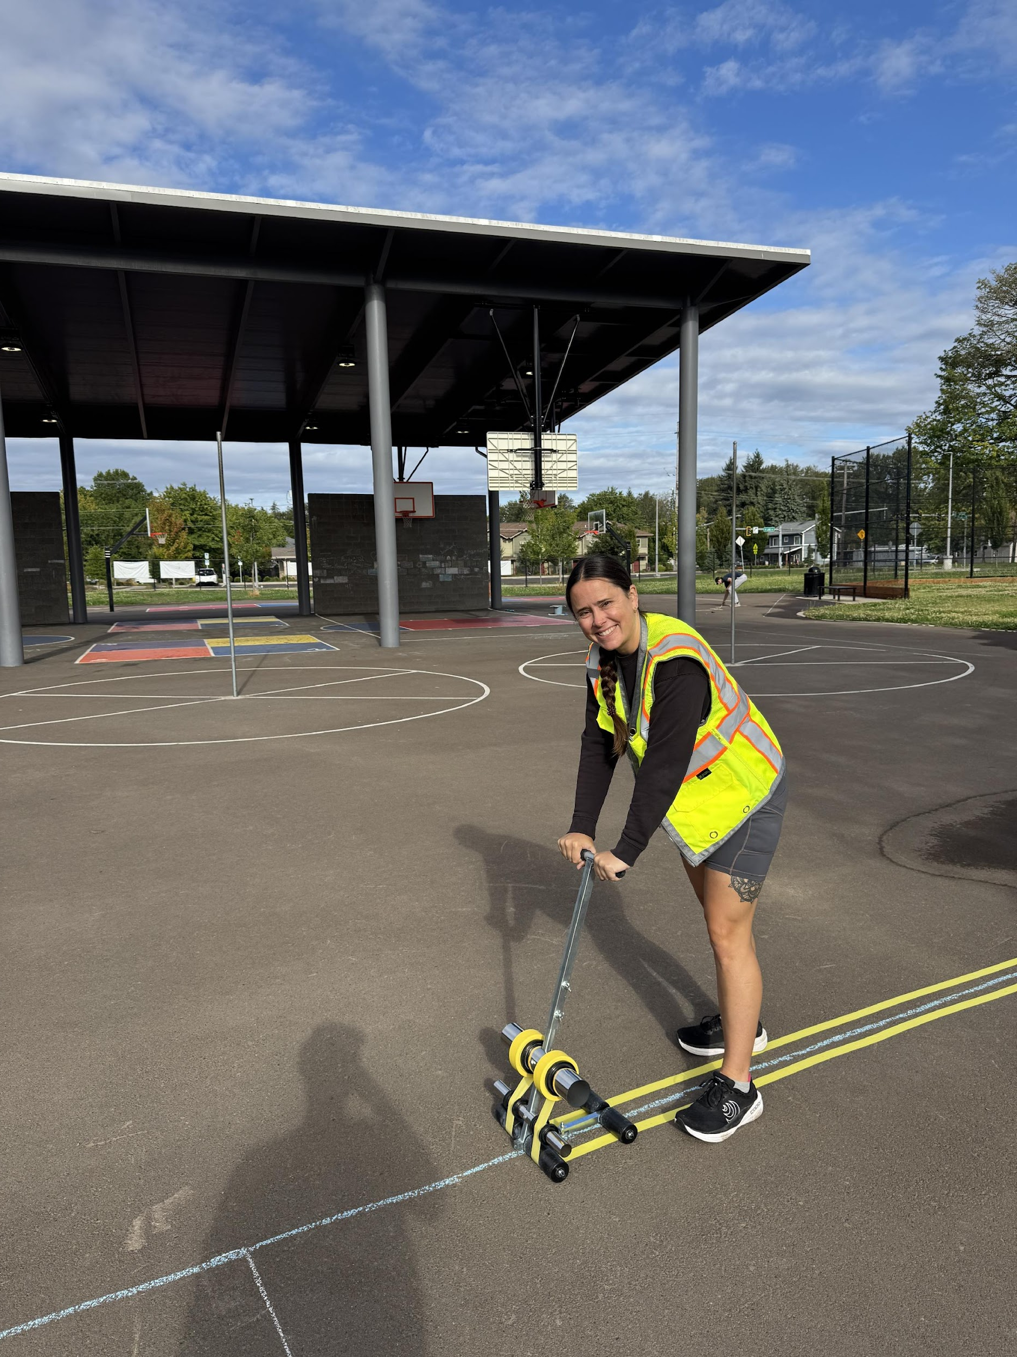
Install: Taping
Notes:
Alta

Slide 18
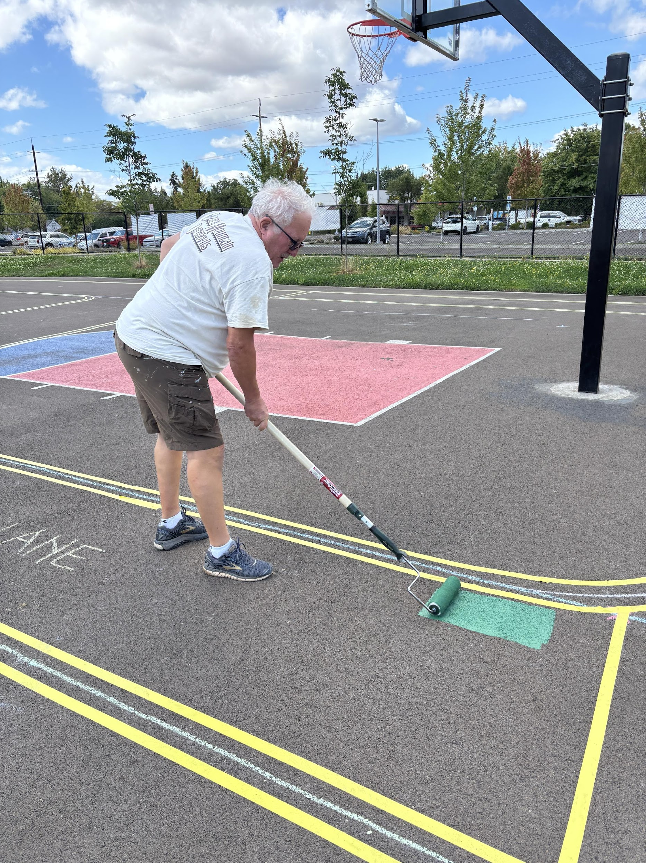
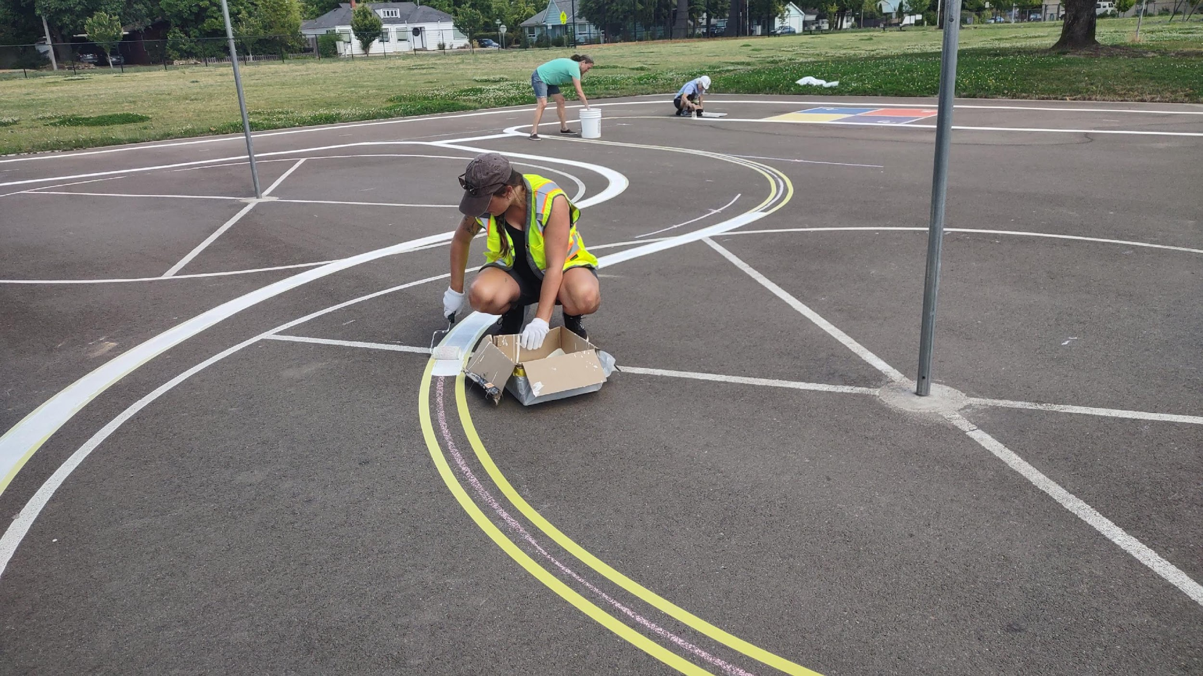
Install: Painting
Notes:
Alta

Slide 19
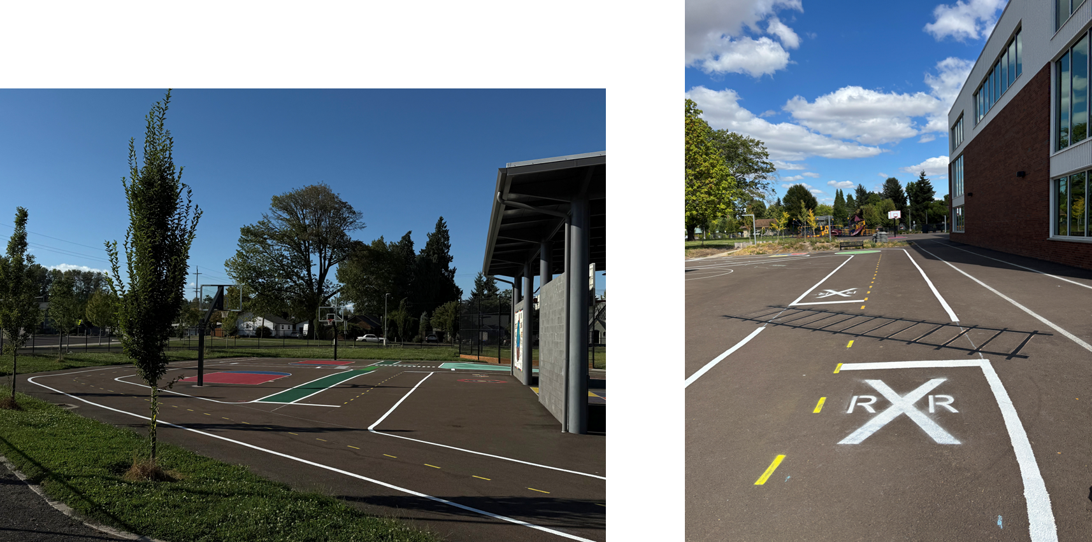
Install: Final Product
Notes:
Alta

Slide 20
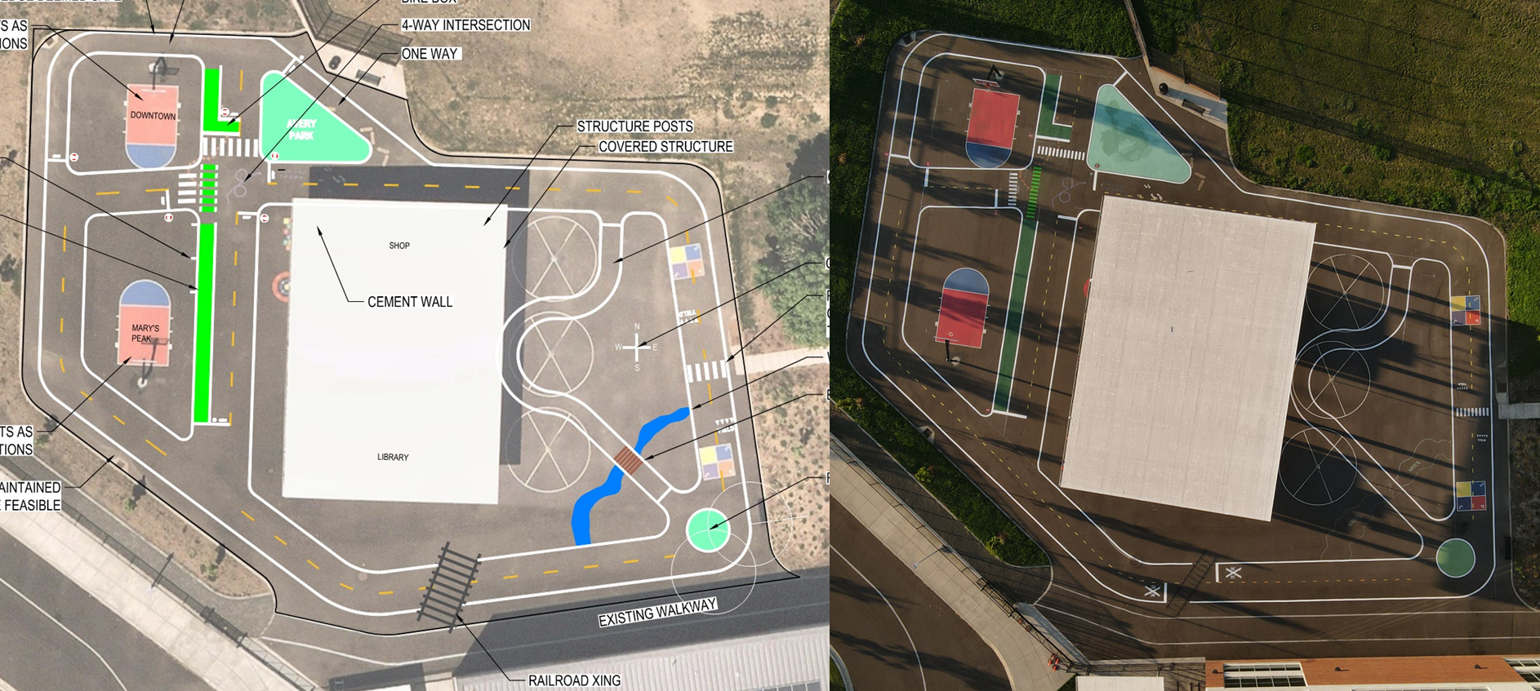
Design
Installation

Slide 21
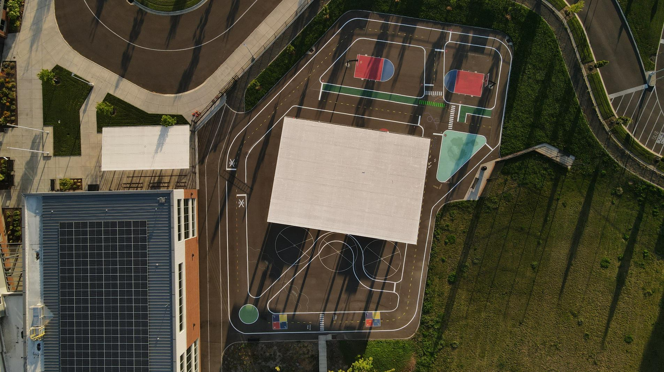
Use of Traffic Garden
Notes:
Kim and Amy
Final Product
White rectangle is covered area
Features: round about, 4 way stop, passing, rr crossing, pedestrian crossing

Slide 22
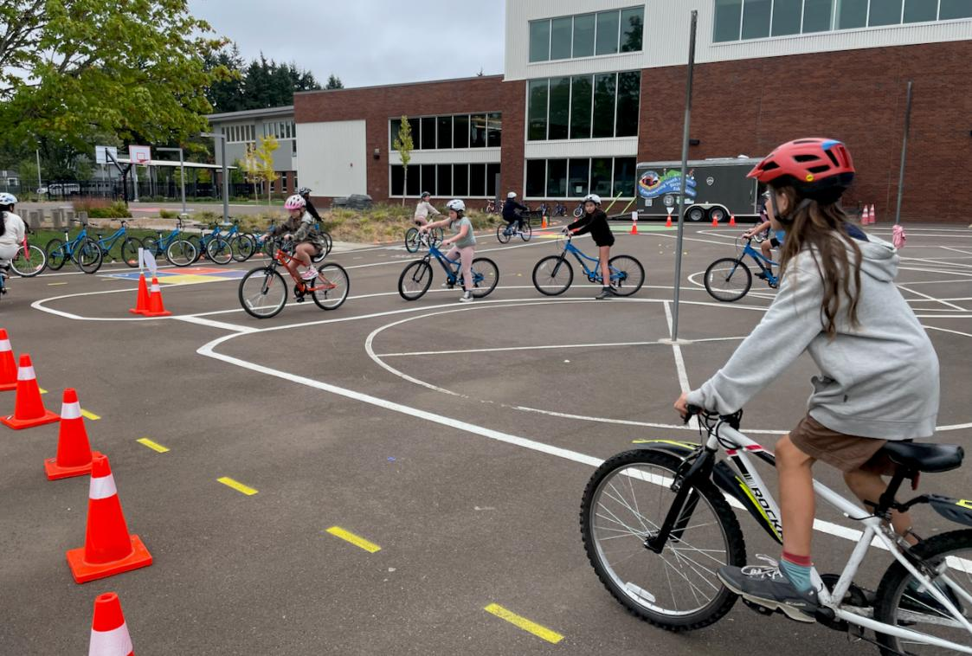
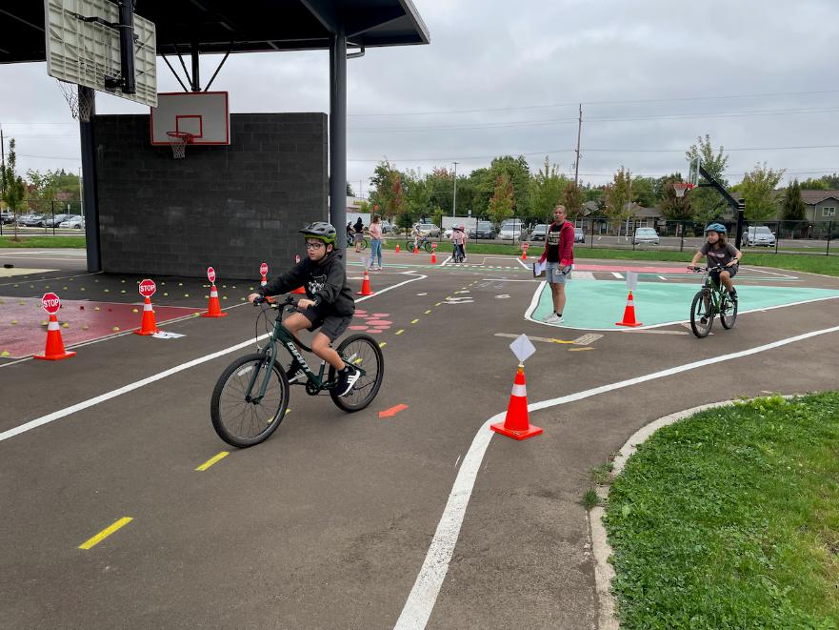
Traffic garden in full bloom!
“I just want you to know that magic is happening here, and over 300 kids will be safer on the streets because of your efforts and cooperation. I have no doubt that K-2 graders will be just as excited when we head out for Pedestrian Safety in a few weeks. Thank you so much! I look forward to seeing how other school locations for Traffic Gardens come together!”
– Armida Guerrero-Gilliam, Safe Routes to School Practitioner
Notes:
Kim & Amy
Use:
for bike education by PE teachers
on weekends and evenings by families
At recess with students playing cars
Next Steps
Strong community engagement directly resulted in donations to install in our of elementary schools

Slide 23
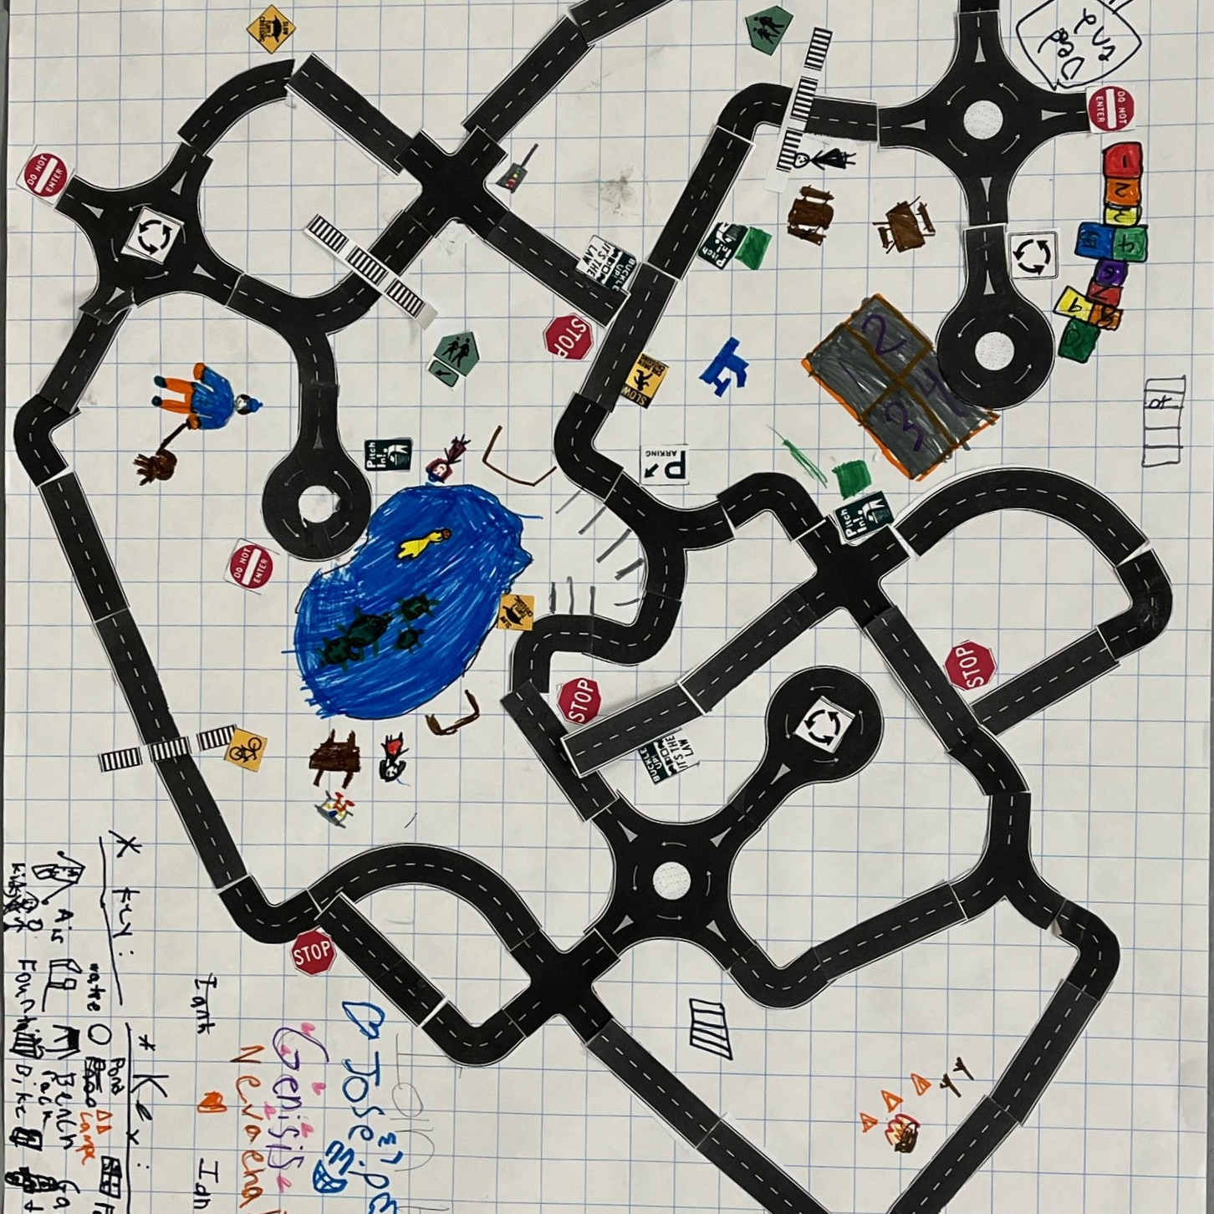
Design Activity
Notes:
ALTA

Slide 24
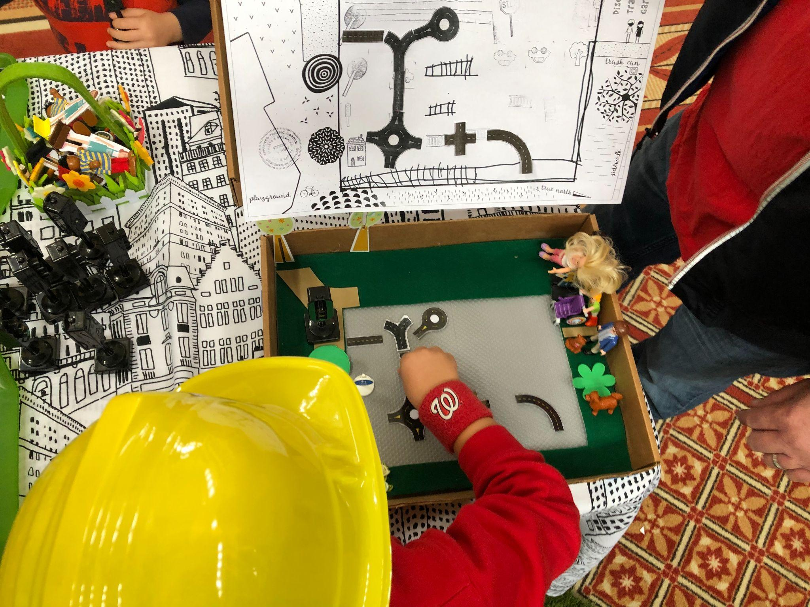
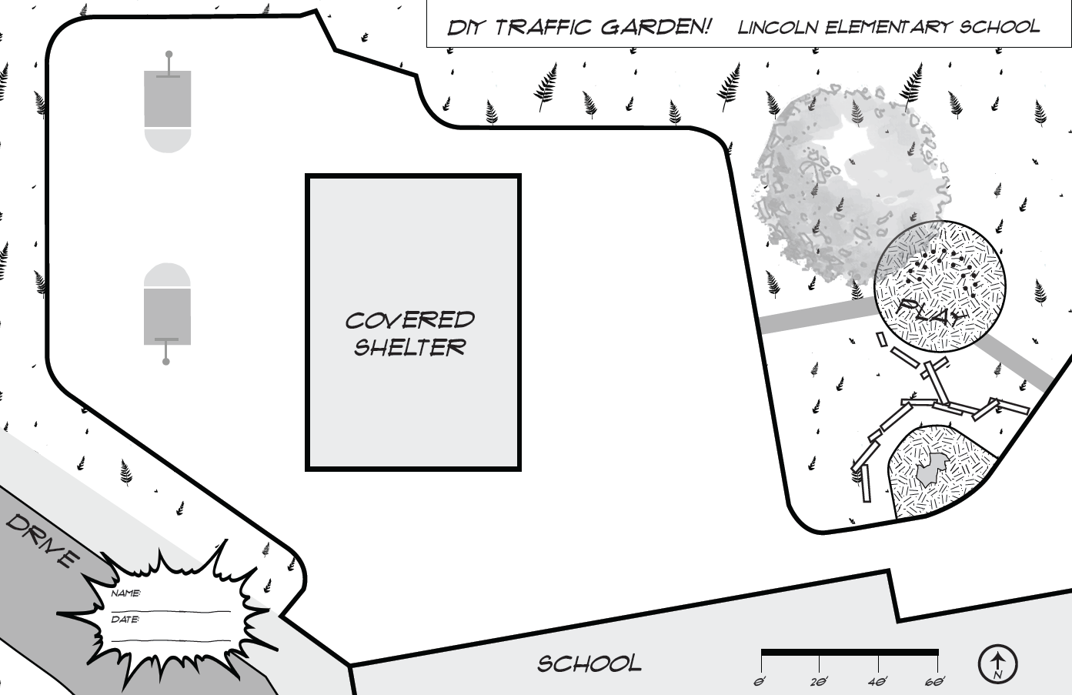
Design your own
traffic garden!
Use the road pieces and canvass to create your own traffic garden!

Slide 25
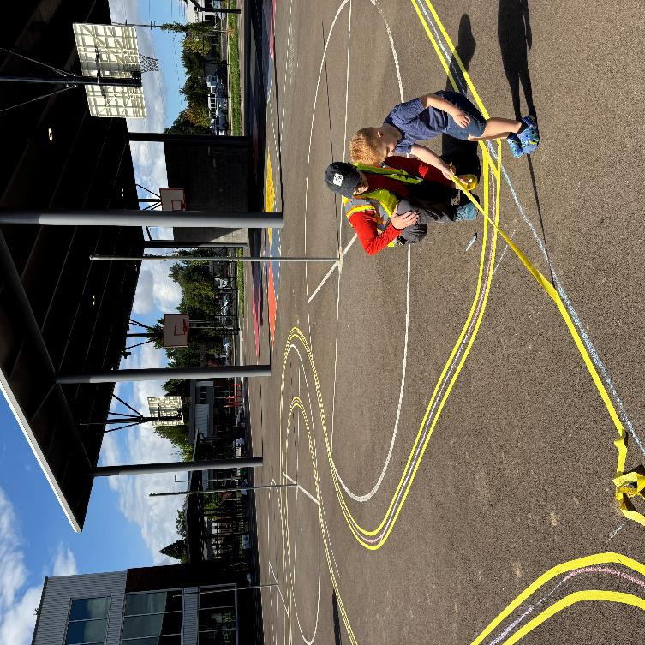
Next Steps – Applications to 2026 Program
Notes:
Alta

Slide 26
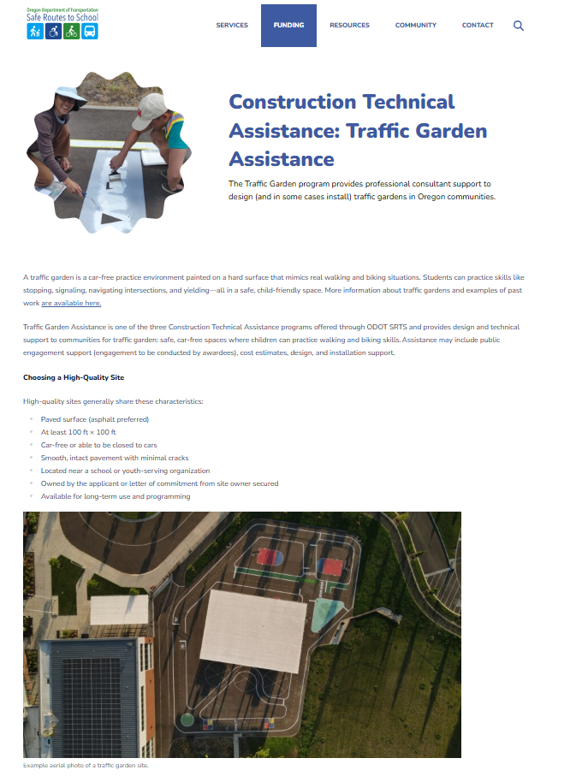
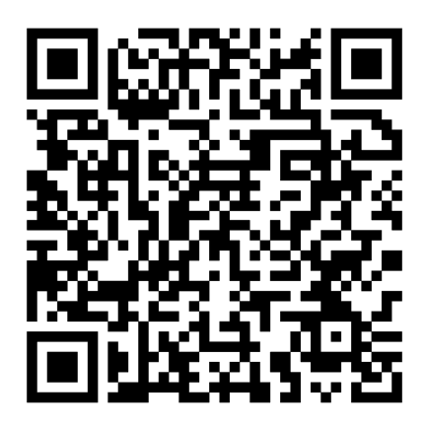
Apply for the ongoing solicitation!

Slide 27
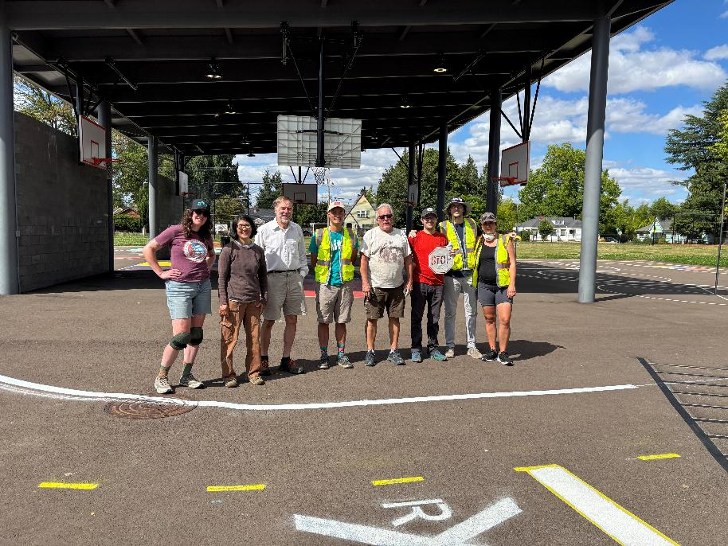
Thank you!

