Slide 1
Before You Let AI Touch Production
Auto-Remediation Readiness
Alok Bhide, Director of Product
Chronosphere (A Palo Alto Networks Company)

Slide 2



Before you can turn on auto-remediation you need..
All the data
All the context
All the (right) guardrails

Slide 3

All the Data
Full Coverage
At Scale

Slide 4

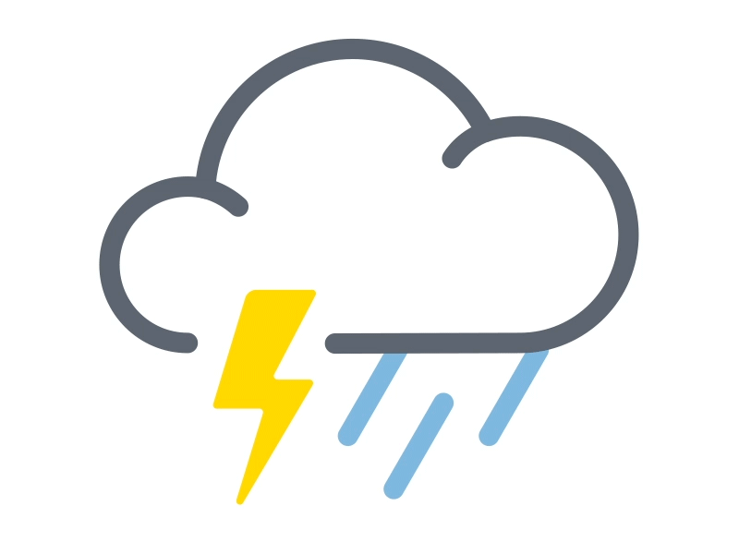
All the Context
Inside Observability
Outside Observability

Slide 5



All the (Right) Guardrails
Repeating Issues
Two-Way Doors
HITL

Slide 6
Auto-remediation Audit
Do you have all the data
  Coverage and scale?
Do you have all the context
  Internal and external?
Do you have the right guardrails?
  Repeatable problems, two-way doors, HITL evaluation?

Slide 7
Thank You

Slide 8
Connecting Your Laptop to Present
If you plan to use speaker notes, please follow the steps below to ensure your laptop is set up correctly. This will allow you to view your notes while the audience sees only your slides.
Before Connecting
Close all unnecessary apps & tabs
Turn off notifications
Disable Night Mode / TrueTone
Don’t enter full-screen presentation mode yet
At the podium
Plug in the HDMI cable
If needed, use your USB-C to HDMI adapter
On Mac, click “Allow” if prompted
USE “EXTENDED DISPLAY” MODE (NOT MIRRORED)
Using MAC
Go to System Settings > Displays
Click the “Arrangement” tab
Make sure “Mirror Displays” is unchecked
Using PC
Press ⊞Win + P, then select “Extend”
Or: Right-click on the Desktop > Display Settings
Under Multiple Displays, select “Extend these displays”

Slide 9
Connecting Your Laptop to Present
When Using PowerPoint
Start slideshow: ⌘Cmd + Enter (Mac) or F5 (PC)
Or: Click Slide Show > Play from Start
If notes show on the wrong screen, click “Swap Displays”
https://www.youtube.com/watch?v=gQ3D4m-5pww
Google Slides
Use Google Chrome as your browser
Click the dropdown next to ‘Slideshow’ > select Presentation Display Options
Check “Presenter View” and “Full Screen”
If prompted, select "Allow"
Choose the external display (may have a strange name like PanasonicXYZ)
Click Start Slideshow
https://www.youtube.com/watch?v=-GT7WCvPcys

